Slide 1
A close look at Apache Aries
An Open Source project for
Enterprise OSGi
Rex Wang
rwonly@apache.org

Slide 2






Who am I ?
王磊 / Rex Wang / rwonly@apache.org
Apache Aries Committer
Apache Geronimo Committer
OSGi Alliance EEG Contributor
Work for IBM Software Group
Graduated from Shanghai Jiao Tong University. Got the Master Degree of Computer Science.

Slide 3
Agenda
OSGi Overview
The OSGi Enterprise Spec
Aries Background
Spec Implementations in Aries
Aries Application Programming Model
Samples and Demo

Slide 4
What is OSGi?
OSGi - Open Services Gateway initiative
  OSGi technology is the dynamic module system for Java™.
  OSGi technology is Universal Middleware.
  OSGi technology provides a service-oriented, component-based environment for developers and offers standardized ways to manage the software lifecycle.
OSGi Alliance
  www.osgi.org

Slide 5
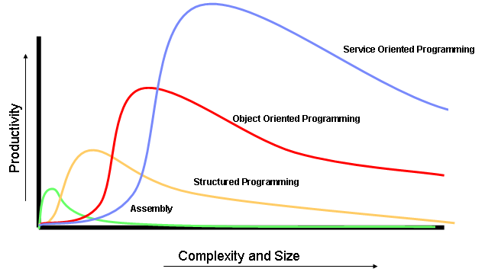
Why OSGi?
The Complexity & Scale of Software requires:
  1. Service Oriented

Slide 6
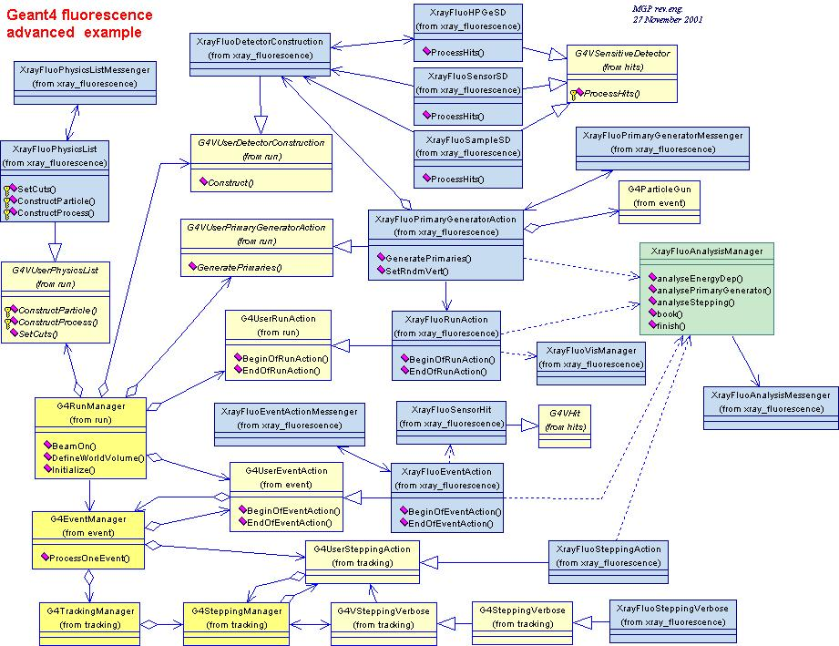
Why OSGi?
  2. Modularity
    Java Platform Modularity
      Classes encapsulate data
      Packages contain classes
      Jars contain packages
    Class visibility:
      private, package private, protected,public
    No “jar scoped” access modifiers.
    No means for a jar to declare its dependencies.
    No versioning.
    Jars have no modularization characteristics
      At runtime there is just a collection of classes on a global classpath

Slide 7
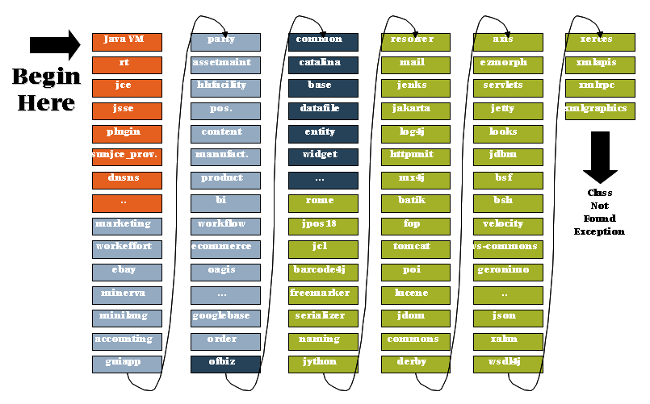
Why OSGi?
    A global, flat classpath to search

Slide 8
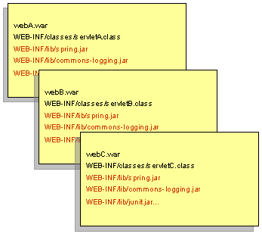
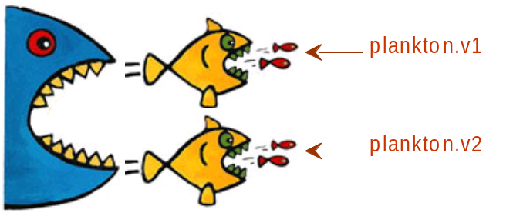
Why OSGi?
  3. Versioning
    Enterprise Apps have isolated classpaths but…
    Across apps - each archive typically contains all the libraries required by the application
      Common libraries/frameworks get installed with each application
      Multiple copies of libraries in memory
    Within apps - 3rd party libraries consume other 3rd party libraries leading to version conflicts

Slide 9

Who use OSGi?
2Wire, Inc.
Alcatel-Lucent
Aplix Corporation
Deutsche Telekom
Ericsson AB
Hitachi, Ltd.
IBM Corporation -> WebSphere 7, Lotus Notes 8, Rational RAD/RSA (Eclipse Based)
LinkedIn
Makewave
Mitsubishi Electric Corporation
NEC Corporation
NTT
Oracle Corporation -> BEA WebLogic, Sun Glassfish 3
Paremus, Ltd.
Progress Software
ProSyst Software GmbH
Qualcomm
Red Hat -> JBoss 5
SAP AG
Siemens AG
Siemens Enterprise Communications
Software AG
Sonatype Inc.
Telcordia Technologies, Inc.
TIBCO Software Inc.
VMWare, Inc. -> Spring DM
Westell Inc.

Slide 10
Agenda
OSGi Overview
The OSGi Enterprise Spec
Aries Background
Spec Implementations in Aries
Aries Application Programming Model

Slide 11
The OSGi Enterprise Spec V4.2
Release date – 22 March 2010
  The product of the OSGi Enterprise Expert Group (EEG)
Brings Enterprise technologies and OSGi together
Using existing Java SE/EE specifications:
  JTA, JPA, JNDI, JMX, WebApps…
  Java EE provides the core enterprise application programming model
Adds Spring-derived component model and dependency injection container – Blueprint Container
Embeded
Desktop
Enterprise

Slide 12
Agenda
OSGi Overview
The OSGi Enterprise Spec
Aries Background
Spec Implementations in Aries
Aries Application Programming Model
Samples and Demo

Slide 13

Aries Background
“Aries” created as a new Apache incubator project in Sep 2009
  Implementations and extensions of enterprise application-focused specifications defined by the OSGi Alliance Enterprise Expert Group (EEG)
    JTA, JMX, JPA, Blueprint, Web, JNDI…
  an assembly format for multi-bundle applications
    EBA – Enterprise Bundle Application
Available to use now
  0.1 version released
Independent of
  OSGi framework provider (Equinox / Felix)
  Integration / server runtime (Geronimo / Servicemix)
43 committers from a broad range of companies
  Ericsson, IBM, JBoss, LinkedIn, Progress, ProSyst, SAP…
    http://incubator.apache.org/aries/people.html

Slide 14
Agenda
OSGi Overview
The OSGi Enterprise Spec
Aries Background
Spec Implementations in Aries
Aries Application Programming Model
Samples and Demo

Slide 15
Aries Implementations
Blueprint container
JPA integration
JTA integration
JMX
JNDI integration
META-INF/services handler
http://svn.apache.org/repos/asf/incubator/aries/trunk/

Slide 16

Aries Blueprint Container
A DI container standardizing established Spring conventions
XML Blueprint definition describes component configuration and scope
  Optionally publish and consume components to/from OSGi service registry.
Simplifies unit test outside either Java EE or OSGi r/t.
The Aries BP container implementation is highly extensible:
  Namespace handlers supported to extend the Blueprint definitions
  Bean interceptors can be registered by handlers
Other Aries components contribute handlers – “jpa” and “jta” handlers.
Some other Aries components are implemented as Blueprint bundles themselves
  e.g. JPA container
Managed beans
publishes
service
consumes
service
OSGI-INF/blueprint/
blueprint.xml
A static assembly and configuration of components (POJOs)‏
Blueprint bundle
Notes:
NamespaceHandlers registered with a property whose value is the target nameapce:
props.put("osgi.service.blueprint.namespace", "http://aries.apache.org/xmlns/transactions/v1.0.0");

Slide 17
Aries JPA Container – Application Managed PUs
Provides support for “Application managed” JPA.
Each persistence bundle has its standard JPA metadata located through the Meta-Persistence bundle header.
JPA Container locates a JPA Provider which can service the PU and registers a Provider-created EntityManagerFactory service for each PU in each persistence bundle
  EMF service lifecyce follows the persistence bundle lifecycle
JPA Provider gets persistence bundle classloader from PUInfo.
Persistence bundle
Managed EntityManagerFactory Registered on behalf of the persistence bundle
Bundle Manifest
…
Meta-Persistence:
OSGI-INF/persistence.xml
Entities
OSGI-INF/
persistence.xml
Registers
EntityManagerFactory
service per PU
Uses
org.apache.aries.jpa.container
Uses
Used to build the EntityManagerFactory
createContainerEMF
(PersistenceUnitInfo)
JPA Provider
javax.persistence.spi.
PersistenceProvider
service

Slide 18
Aries JPA Container – Blueprint Integration
The Aries JPA container context bundle provides a blueprint namespace for dependency injection of managed JPA resources.
Managed persistence units (EntityManagerFactory objects) can be injected with or without a JTA Transaction Services implementation.
Managed persistence contexts (EntityManager objects) are only available with a JTA Transaction Services implementation.
Both managed persistence units and managed persistence contexts behave as per the JPA specification.
Example blueprint with JPA resource injection and container-managed transactions:
<blueprint xmlns="http://www.osgi.org/xmlns/blueprint/v1.0.0"
xmlns:jta="http://aries.apache.org/xmlns/transactions/v1.0.0"
xmlns:jpa="http://aries.apache.org/xmlns/jpa/v1.0.0">
<bean id=“appMgd“ class=“com.acme.AppManaged”>
<jpa:unit property="emf" unitname="myUnit" />
</bean>
<bean id="containerMgd“ class=“com.acme.Container”>
<jpa:context property="em" unitname=“myUnit“/>
<jta:transaction method=“*" value=“Required" />
</bean>
</blueprint>

Slide 19
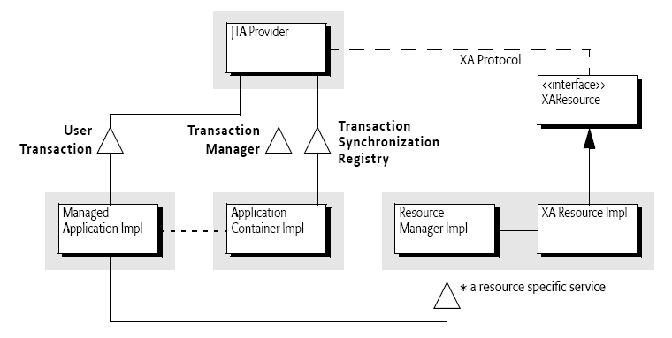
Aries JTA integration
Apache Aries integrates the OSGi Transaction Service Reference Implementation (Apache Geronimo Transaction Manager).
Also: transaction-blueprint bundle registers a “jta” Blueprint namespace handler to provide container-managed transactions for BP components

Slide 20
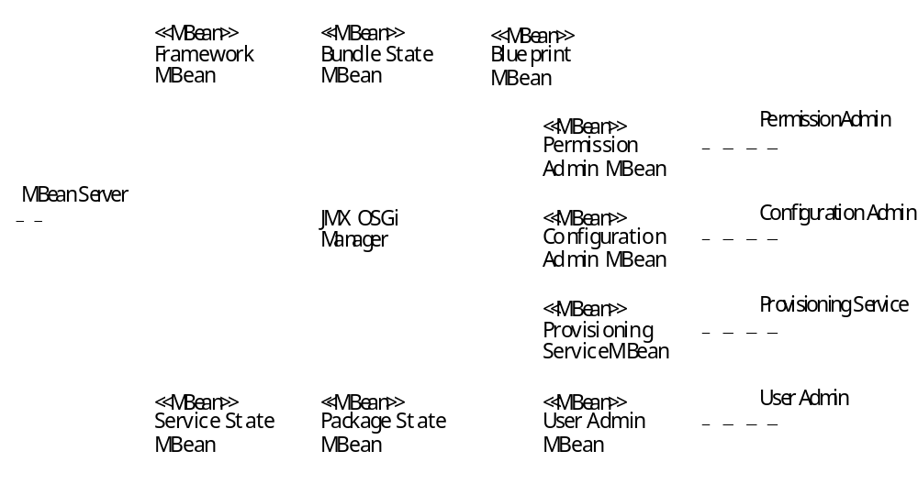
Aries JMX Integration
Implementation of OSGi JMX specification.
Aries JMX bundle automatically registers the JMX MBeans into any javax.management.MBeanServer service in the OSGi Service Registry.
Framework MBeans
Compendium MBeans
Additional Aries MBeans
Notes:
Core MBeans (Required by spec)
FrameworkMBean – Allows the starting/stopping/installing and uninstalling of Bundles. It also allows a restart or a shutdown of the framework. Should be used with care !
BundleStateMBean – Returns information about the bundles in the framework. The information includes the state of the bundle, services a bundle registers, exported packages, fragments, host etc.
ServiceStateMBean – Returns information about services in the OSGi Service Registry. The information includes service properties, the regisitering bundle, bundles that are using the service etc.
PackageStateMBean – Returns information about packages exported from bundles in the system. The information includes which bundle exported the packages, bundles that are importing the package etc.
Compendium MBeans (Optional per spec)
ConfigAdminManagerMBean – Allow access to the OSGi Configuration Administration Service
PermissionManagerMBean – Allow access to the OSGi Permission Manager Service
ProvisioningMBean – Allow access to the OSGi Provisioning Service
UserManagerMBean – Allow access to the OSGi User Management Service
Blueprint MBean – Aries extension
Returns information about the Blueprint containter, component ids and and component definition metadata for a component id.

Slide 21
Aries JNDI integration
Provides JNDI-based access to OSGi Service Registry
<blueprint xmlns=...>
<bean id="bloggingServiceComponent"
class="org.apache.aries.BloggingServiceImpl">
</bean>
<service ref="bloggingServiceComponent"
interface="org.apache.aries.samples.blog.api.BloggingService"/>
...
</blueprint>
registerService
A way for a Web component to access a Blueprint component
OSGi
Service Registry
getService
InitialContext ic = new InitialContext();
BloggingService blog= ic.lookup("osgi:services/"
+ BloggingService.class.getName());
JNDI Context
Notes:
jndi-url bundle registers a JNDI ObjectFactory for “osgi:services” Contexts in the service registry (“OsgiURLContextFactory“)
jndi-core bundle registers an InitialContextFactoryBuilder and ObjectFactoryBuilder with JVM.
The ICFB creates a Context which looks in the SR for an ObjectFactories which can process the URI scheme.
If it delegates to the osgi:services ObjectFactory then this returns the service in the SR.

Slide 22
Aries META-INF/services SPI handler
Common Java SE pattern for loading service provider interfaces: config file in META-INF/services containing class name of provider implementation. For example JPA defines:
META-INF/services/javax.persistence.spi.PersistenceProvider
Aries SPI-Fly project provides a generic solution
Service Provider bundle
org.apache.aries.spifly
Bundle Manifest
…
SPI-Provider:
reads
Registers service with property
spi.provider.url = URL to the associated resource in OSGI-INF/services
OSGI-INF/services
“org.acme.impl.class”
Notes:
Problematic pattern for OSGi where a client import of
META-INF/services gets resolved to one provider.

Slide 23
Agenda
OSGi Overview
The OSGi Enterprise Spec
Aries Background
Spec Implementations in Aries
Aries Application Programming Model
Samples and Demo

Slide 24
Aries Application Assembly and Deploy
The “application” project provides pluggable infrastructure to support deployment of an application consisting of a collection of bundles as a logical unit from an enterprise bundle archive (archive with .eba extn).
  An “Enterprise OSGi Application”.
Constituent bundles may be contained (“by-value”) in the .eba archive or referenced in APPLICATION.MF
Only explicitly declared Services are exposed from the application.
Config by exception - absence of APPLICATION.MF means:
  application content is the set of bundles contained by-value plus any repository-hosted dependencies identified during deployment.
Bundle Repository
Application Manifest
Enumerates constituent bundles
Declares Application “externals”
blog-persistence.jar
json4j.jar
blog.jar
blog.eba
blog-servlet.jar
Notes:
Config by exception - absence of APPLICATION.MF means:
application content is the set of bundles contained by-value plus any repository-hosted dependencies identified during deployment

Slide 25
Aries Application Assembly and Deploy
Pluggable ApplicationResolver
- NoOpResolver
- OBRAriesResolver
Aries Application = createApplication(eba)
org.apache.aries.application.management
Pluggable BundleConverters
- WabConverterService
Manifest-Version: 1.0
Deployment-ManifestVersion: 1.0
Application-Name: Blog Application
Application-SymbolicName: aries.sample.blog
Application-Version: 1.0
Deployed-Content:
aries.sample.blog; version=1.0.0,
aries.sample.blog-api; version=1.0.0,
aries.sample.blog-persistence; version=1.0.0,
aries.sample.blog-servlet; version=1.0.0,
com.ibm.json.java; version=1.0.0
Manifest-Version: 1.0
Application-ManifestVersion: 1.0
Application-Name: Blog Application
Application-SymbolicName: aries.sample.blog
Application-Version: 1.0
Application-Content:
aries.sample.blog; version="[1.0.0,1.1.0)",
aries.sample.blog-api; version="1.0.0",
aries.sample.blog-persistence; version="1.0.0",
aries.sample.blog-servlet; version="[1.0.0,1.0.0]”
Application Manifest (developer/assembler authored artefact)
Enumerates constituent bundles and allowable version ranges
Declares Application “externals”
Deployment Manifest (generated during createApplication)
Transitively closed description of all bundles resolved at specific versions to “freeze-dry” the application.

Slide 26
Agenda
OSGi Overview
The OSGi Enterprise Spec
Aries Background
Spec Implementations in Aries
Aries Application Programming Model
Samples and Demo

Slide 27
Aries Samples
AriesTrader – Apache Geronimo DayTrader Java EE benchmark application converted to OSGi Application using web and blueprint components
  Objective is to demonstrate best practices
  Performance benchmarking
Blog Sample – New application to demonstrate Aries features
The Samples illustrate how to run Aries applications on a standard OSGi f/w (e.g. Equinox) + Aries + dependencies (Derby DB, PaxWeb servlet container).
http://incubator.apache.org/aries/samples.html

Slide 28
Example “Blog” Application Architecture
blog.eba
blog-api
blog-servlet
Web application bundle
JNDI
EM
WEB-INF/
web.xml
Blogging
Service
Blog
Persistence
Service
OSGI-INF/
persistence.xml
OSGI-INF/blueprint/
blueprint.xml
blog
OSGI-INF/blueprint/
blueprint.xml
blog-persistence

Slide 29
Demo
Aries Application programming model has been integrated into WebSphere V7 Feature Pack for OSGi Applications

Slide 30
Current Aries Consumers
Aries components are currently used by:
  Apache Geronimo
  Apache Felix Karaf
  JBossOSGi
  WebSphere Application Server

Slide 31
Futures
There are many new application-centric features that Aries may develop including:
  message-driven blueprint components and services
  declarative role-based security for blueprint components
  annotation-based alternative to XML configuration
  resource-reference metadata and bindings
(Original Proposal: http://wiki.apache.org/incubator/AriesProposal)
Interested in getting involved?
  http://incubator.apache.org/aries/gettinginvolved.html

Slide 32

Q & A

