Slide 1
Continuations And Java
Regis - xu.regis@gmail.com

Slide 2
Agenda
What is Continuations
Why Continuations
Implementations in Java
  Jetty Continuations API
  JavaFlow
  Kilim
  JVM Continuations

Slide 3
What is Continuations
Definition from wikipedia:
  Give a programming language the ability to save the execution state at any point and return to that point at alter point in the program
Basic characteristics:
  Local data (variables, ...) is restored on successive calls.
  Execution of a coroutine is only suspended when it yields, to be resumed when the coroutine is called again.

Slide 4
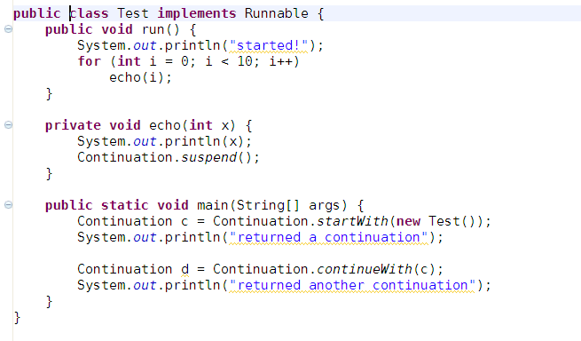
started!
0
returned a continuation
1
returned another continuation

Slide 5
Why Continuations
Thread is heavy and expensive
Writing asynchronous code in the synchronous style
Supporting functional languages
SAX parser
Web servers
  linearize complex interactions
  “back button” problem

Slide 6
Implemented As Library
Jetty 6.0
  For resolving AJAX polling problem
  Event based + retry

Slide 7
Implemented As Library (Cont.)
Instrumentation byte code
  Save current stack frames
    Store local variables
    Save PC
  Restore stack trace
    goto + switch table

Slide 8
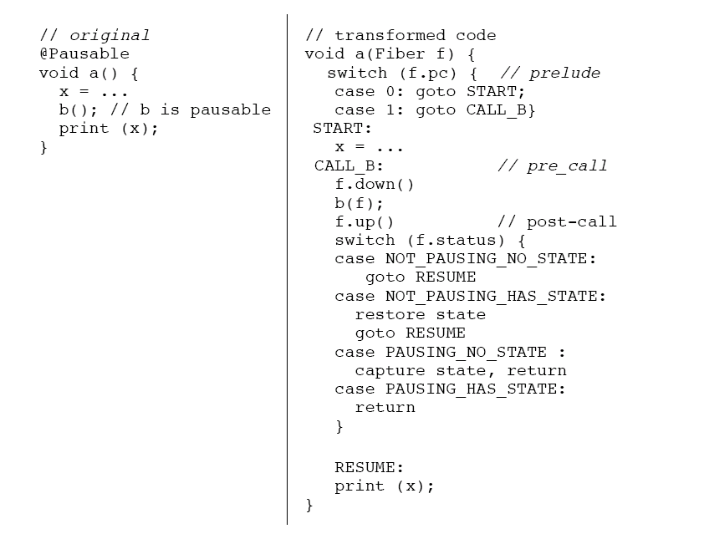
From A Thread of One’s Own

Slide 9
Implemented As Library (Cont.)
Implementations
  JavaFlow
    Asymmetric coroutines: each yield needs to specify which coroutine should come next.
  Kilim
    Symmetric coroutines: a scheduler decides which coroutine should run next after a yield.
    Framework has a thread pool and decide which coroutine run on which thread.
  RIFE/Continuations (WebWork)

Slide 10
Implemented In JVM
Support save and restore stack frames by JVM
No instrumentation needed
APIs is similar with library provided

Slide 11
References
http://wiki.jvmlangsummit.com/JVM_Continuations
http://classparser.blogspot.com/2010/01/coroutines.html
http://lambda-the-ultimate.org/node/1002
http://sourceforge.net/projects/jauvm/
http://commons.apache.org/sandbox/javaflow/
http://rifers.org/wiki/display/RIFECNT/Home
http://www.artima.com/lejava/articles/continuations.html
A Thread of One’s Own
Lazy Continuations for Java Virtual Machines

Slide 12
Question?

