Slide 1

Towards a new world of Java
- Java 7 and Harmony Select
Lv Jing
Apache Harmony PMC

Slide 2






Agenda
Java7 Highlights
Harmony Select Overview
Java Modularization
NIO2 – advanced new io
New GC algorithm

Slide 3
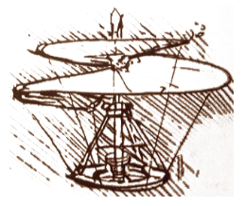
Highlight : VM
JSR 292: VM support for non-Java languages (InvokeDynamic)
  extending the JVM with first-class architectural support for languages other than Java, especially dynamic languages
  can run non-Java languages efficiently, with a performance level comparable to that of Java itself
  Java language itself will not be dynamic
the Da Vinci Machine Project

Slide 4
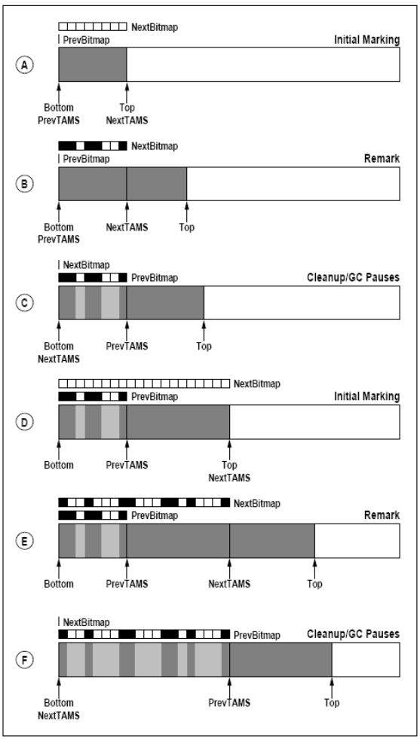
Highlight : VM
Garbage-First GC (G1)
  Idea from the Paper ISMM 2004
  For “server-style” JVM
  Merged into Java6 (hotspot14)
  *Only supported after signing the
  contract with Sun/Oracle?

Slide 5
Highlight : VM
JSR 294: Language and VM support for modular programming
  Tightly bind to Modularization (Project Jigsaw)
Compressed 64-bit object pointers
  Save memory for 64-bit machine
  At cost of performance

Slide 6
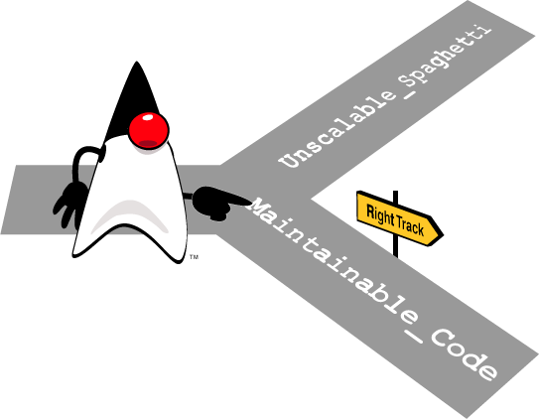
Highlight : Language
JSR 308: Annotations on Java types
  The Java 6 annotation syntax is useful but limited.
    The Type Annotations syntax permits annotations to be written in more places
    Programmers can use type annotations to write more informative types, can detect and prevent more errors.
      e.g: List<@NonNull Object>

Slide 7

Highlight : Language
JSR TBD: Project Lambda (Closure)
  The goal of this Project is to formulate a proposal to add first-class functions, function types, and lambda expressions (informally, "closures") to Java,
  to implement a prototype suitable for inclusion in JDK 7 so as to enable broad experimentation.
  key features:
    A literal syntax, for writing closures, and
    Function types, so that closures are ﬁrst-class citizens in the type system.
    Closure conversion, so that a closure of appropriate type can be used where an object of a single-method interface or abstract class is required, and
    Extension methods, so that closure-oriented bulk-data methods can be retroﬁtted onto existing libraries

Slide 8

Highlight: Core
JSR 203: More new I/O APIs for the Java platform (NIO.2)
  This Project's mission is to produce the implementation of the (New) New I/O APIs being defined by JSR 203 as well as related work in the JDK.
  Improved filesystem interface
  Complete socket-channel functionality
  Support asynchronous I/O

Slide 9
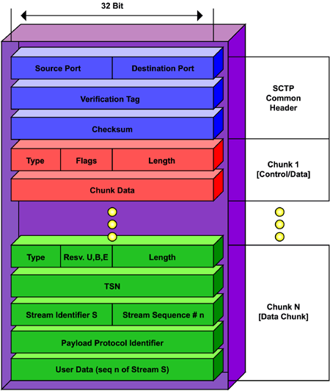
Highlight: Core
SCTP (Stream Control Transmission Protocol)
  The goal of this Project is to develop an API for the Stream Control Transport Protocol (SCTP) and a corresponding OpenJDK prototype.
SDP (Sockets Direct Protocol)
Notes:
SCTP
流控制传输协议（SCTP）是IETF新定义的一个传输层transport layer协议（2000）。RFC 2960详细说明了SCTP，介绍性的文档是RFC 3286。
作为一个传输层协议，SCTP可以理解为和TCP及UDP相类似的。 事实上，它提供的服务有点像TCP——保证可靠、有序传输消息。同时TCP是面向字节的，而SCTP是针对成帧的消息。
SCTP主要的 贡献是对多重联外线路的支持，一个端点可以由多于一个IP地址组成，使得传输可在主机间或网卡间做到透明的网络容错备援。
SCTP最初 是被设计用于在IP上传输电话（SS7），把SS7信令网络的一些可靠特性引入IP。IETF的这方面的工作称为信令传输SIGTRAN。与此期间，也提 出了这个协议的其他一些用途。
SCTP 提供如下服务：
* 确认用户数据的无错误和无复制传输；
* 数据分段以符合发现路径最大传输单元的大小；
* 在多数据流中用户信息的有序发送，带有一个选项，用户信息可以按到达顺序发送；
* 选择性的将多个用户信息绑定到单个 SCTP 包；
* 通过关联的一个终端或两个终端多重宿主支持来为网络故障规定容度。
一、SDP协议介绍
SDP是会话描述协议的缩写，是描述流媒体初始化参数的格式，由IETF作为RFC 4566颁布。流媒体是指在传输过程中看到或听到的内容，SDP包通常包括以下信息：
（1）会话信息
· 会话名和目的。
· 会话活动时间。
由于参与会话的资源是受限制的，因此包括以下附加信息是非常有用的。
· 会话使用的带宽信息。
· 会话负责人的联系信息。
（2）媒体信息
· 媒体类型，例如视频和音频。
· 传输协议，例如RTP/UDP/IP和H.320。
· 媒体格式，例如H.261视频和MPEG视频。
· 多播地址和媒体传输端口（IP多播会话）。
· 用于联系地址的媒体和传输端口的远端地址（IP单播会话）。
SDP描述由许多文本行组成，文本行的格式为<类型>=<值>，<类型>是一个字母，<值>是结构 化的文本串，其格式依<类型>而定。

Slide 10
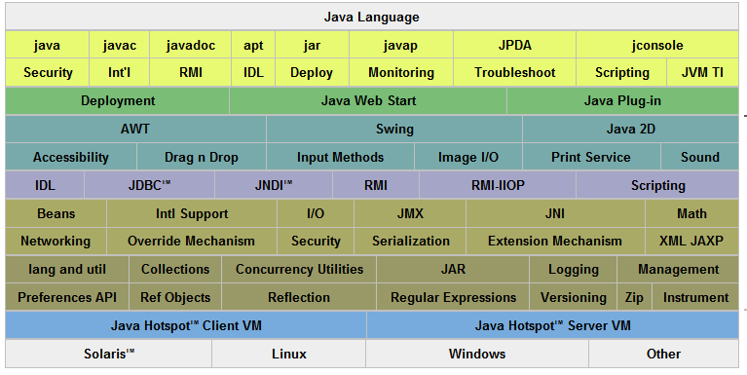
Highlight: Core
Modularization (Project Jigsaw)
  An implementation-specific, simple, low-level module system focused upon the goal of modularizing the JDK, and the application of that system to the JDK itself
  Language and classlib support for JDK
  Focus on future support for modularization

Slide 11
Highlight: Core
Concurrency and collections updates (jsr166y)
Unicode 5.1
Upgrade class-loader architecture
Method to close a URLClassLoader
Elliptic-curve cryptography (ECC)

Slide 12
Highlight : other
Web
  Update the XML stack
client
  XRender pipeline for Java 2D
  Forward-port 6u10 deployment features
  Create new platform APIs for 6u10 graphics features
  Nimbus look-and-feel for Swing
  Swing JLayer component

Slide 13
Introduction to Harmony Project
Apache Harmony is the Java SE project of the Apache Software Foundation.
  created since 2005
  http://harmony.apache.org/
J2SE 5 – milestone 14
J2SE 6 – milestone 2
V.S OpenJDK
  JCK issues

Slide 14












The Harmony Adoption and Community
Sun JDK (Treemap)
(Adoption of innovation
has no borders)
Java ME
Harmony JDK 6
MIWG
OSGi Profiles
IBM JDK (10% of J6)
Harmony Select
IBM JDK (30% of J7)
Galileo plan to include it as supported execution environment

Slide 15
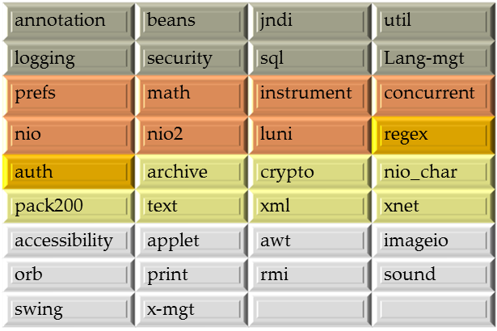
Harmony Select overview
What is Harmony Select
A Componentized Runtime
with sufficient capabilities to run server middleware
Current progress
Applications tested
Geronimo build, tests and samples –pending
Apache Ant unit tests – passed
Apache Maven unit tests – passed
Eclipse – passed
Applications to be tested
Apache Hadoop

Slide 16
Harmony Select Rollout
2009
2010
2011
2012
2013
2014
2015
2016
Community Development: The Open Component Runtime
  Technology evolution, platform development, validation
  Foster Commercial Industry Ecosystem
    Including fit for purpose communities (verticals)
    Industry positioned as “saving Java”
    Innovation into Java community
  Standards Based specifications
    Coordination via IWG or constellation or “dot-org”
  Open Source Adoption
    Eclipse, Apache, Linux distros
  Initial commercial support
    Alpine, Virtuoso, sMash, p8, XS, XTP,
    “Java redefined phase”
Uber scalable Select platform
  exploitation of the IBM processor roadmap, “Power 8”
  heterogeneous (co)processor support - Prism *.*
Component Enterprise Industry
  Fit for purpose “de rigueur”
  De facto delivery model for enterprise components
  Standards efforts expand platforms via component definition
  Open source innovation delivered via components to enterprise platforms – “eTunes”
  Major industry uptake phase
    Products available on Select, not “Java”
    “Primary Enterprise Platform phase”
IBM Deliveries: GA level
  Initial products add Server Profile “right sized” configs
    XS, XTP and Alpine stack, sMash, Datapower appliances
    Notes, Sametime,
  Server Profiles with improved QoS
    Virtualization integration, suspend, restart, mobility
    Large-Heap, Scalability to TB
    NRR
    Real-time
    Security
  Initial Industry uptake
    Industry adopts vision as their own
  Patform innovations
    Multicore performance focused innovations
    Cloud Java evolution
    “Early adoption, platform innovation phase”
We are here
Broad adoption of Select
Enterprise Platform

Slide 17
Futures – What can we do?
Goals
Smaller
Reducing the memory footprint
Decoupling more code
Faster
Tuning to better performance
Leveraging IBM hardware
Smarter
Running on OSGi based framework
Fit for use
Customizing for IBM products
Obstacles
No alternatives
JMX 1.4
JAXB
Security providers
Kerberos
SSL
Not fully tested
Modules not in Java7
Innovations
Fine-grained performance configuration
Multi-core, huge memory scalability
Multi-tenancy
Cluster
JVM hibernate
Realtime
Dynamic language
Functional language
Your thoughts?

Slide 18
Java Modularization
Goal
  An implementation-specific, simple, low-level module system focused upon the goal of modularizing the JDK, and the application of that system to the JDK itself
  Including JSR294，project Jigsaw
History
  OSGi becomes the standard
  Harmony: the first modularized JRE
  JSR277(Java Module System) raised in JCP, but no much progress
  JSR294(Improved Modularity Support in the Java Programming Language) : simplize the plan
  Jigsaw becomes one part of the openjdk (independent to JCP)
  Harmony OSGi fully implemented
  Jigsaw: a new feature in java7?

Slide 19

Different Designs
Harmony design
  Based on OSGi
  OSGi jars
  No language support for modularization
  How to use is a big question
JSR294/Jigsaw
  No compatible with OSGi
  “simple module system”
  simple view modal
  single version
  key word: module
  No “black hole”
Notes:
简单模块系统的提议主要包括如下几点：
简单可视化模型——如果某个模块需要另一个简单模块，那么该模块中的所有内容都将对所依赖的模块可见，并不阻 止大家以跨越模块的方式来分割包。这正是目前的Jigsaw所做的事情，也是大多数不熟悉OSGi表达模型的人们所渴望的东西。它与现在基于Maven的 构建系统以及运行时类路径模型很相像。OSGi必须要更新其规范以为该简单可视化模型提供支持，而这非常类似于bundle上的Require- Bundle（会导出所有的包）。
单版本号模式——单一、共享的版本号模式非常必要。该简单模块系统必须要 定义一种版本号模式，而Jigsaw需要使用该模式，同时OSGi也需要转向它。该版本号模式必须要定义一种自然顺序关系以便可以通过 compareTo()对其进行排序。当前的OSGi定义了一种由4个部分组成的版本号模式并实行自然顺序排序。Sun已经声明OSGi所定义的这种模式 并不满足Jigsaw的需求。我们必须要将这些需求收集起来以设计一种版本号机制及自然排序关系，这样简单模块系统、OSGi以及Jigsaw就能对其进 行共享了。OSGi必须要更新其规范以支持该新的版本号模式。
模块成员——对于简单模块系统来说，编译器必须假定模块成员要符合模块的规格，比如说JAR文件或是目录。在运行时，每个模块都有自己独立的类装载器（关联到特定的模块上）。一个模块所加载的所有类型要由该特定的类装载器加载并成为该模块的成员。
没有“黑洞”—— 我们必须保证规范中没有“黑洞”才能让该提议的价值彰显出来，所谓黑洞，就是一旦没有特定模块系统的辅助就无法理解某些源代码。规范必须要指定简单模块系 统的具体语法和语义，包括版本号、依赖表达式以及模块成员等等。Java语言规范不允许我们定义自己的语言关键字或是操作符。对于module-info 源文件中的模块信息和模块成员规则也要保证这样。
或许最大的胜利就是各方在版本号的表示上达成了一致。OSGi早就定义了major.minor.micro.qualifier格式，它对于所有的Java程序库都 足够了，但唯独Sun是个例外（Sun使用了1.major.minor.micro.qualifier格式）。然而还有一个重大的差别：在OSGi中 空的qualifier代表了最低的版本号，而在大多数Java开发者的潜意识和Jigsaw中，空的qualifier却代表了最高的版本号（换句话 说，在Jigsaw中，1.0.0要大于1.0.0.beta，而OSGi则恰恰相反）。寻找一个共性来解决这个问题（将其作为一个特例）可以看作是模块 系统版本号需求的一个巨大进步，哪怕是再给版本号增加一部分。OSGi的未来版本可能会支持这一点。

Slide 20
Jigsaw works
At the cost of inside-java-modularization
  Language changes
  Classfile changes
  VM changes
  Compiler/javadoc
  Module-file format

Slide 21
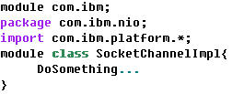
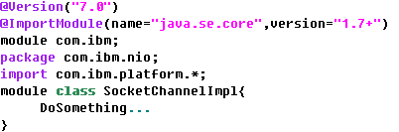
Language changes
New key word: module
Version support with annotation

Slide 22
Other changes
The module-info.class file
  A module compilation unit (module-info.java) is compiled to a ClassFile structure like any other compilation unit.
  Optimized for streamed reading, from beginning to end. Random access should not be required when reading a module ﬁle, though it can be required when writing.
  Content-speciﬁc compression: Pack200+gzip/lzma for classes, bzip2 for native code, etc.
  Independent of any speciﬁc installed-module format or target-ﬁlesystem capability.
Introduce new APIs
  a module system whose core can be implemented directly within the Java virtual machine, since otherwise the central classes of the JDK could not themselves be packaged into meaningful modules.
  java.lang.module
  java.lang.reflect.module

Slide 23
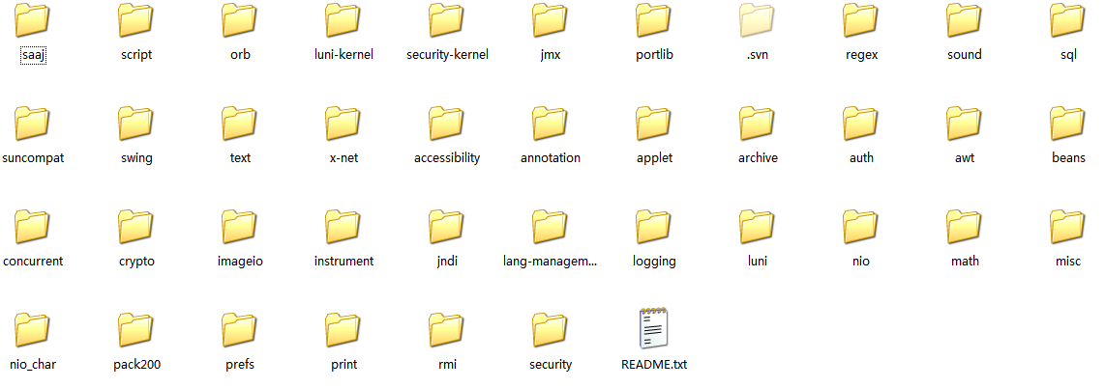
Current status
Working on module class file format
Current version divided classlib into
  jdk.boot, jdk.base, jdk.awt, jdk.swing, and jdk.tools.
Compared to Harmony:

Slide 24
NIO2 – advanced new io
NIO is far from completion
NIO2 – new New IO
  Add new network/io programming model
  Add complete file system support

Slide 25
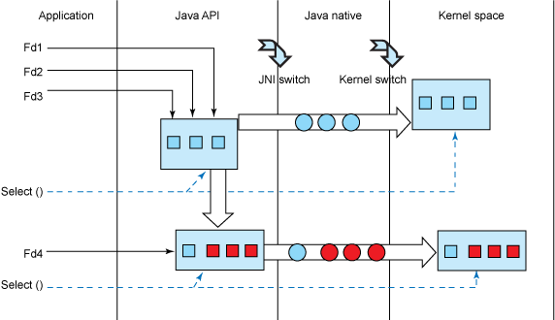
Why use need new model?
Several models
  Blocking (java.net/io)
  block on real operations
  set a timeout before real operations
  Non-blocking (nio)
  try once, return immediately
  select (nio)
  select on sockets, operate afterwards
Disadvantage of select
  Can operation only a limited file descriptors
  2048 by default, can re-compile kernel
  or use multi-process
  Slow when fds increased
C/C++ can do, java cannot!

Slide 26
New model and APIs
SIGIO
  No query, trigger by signal
Asynchronization IO
  Returns immediately, kernel help to make it done
  Can check if operation is done
  Zero-Copy
New networking/io APIs
  Epoll (linux)
  aio (POSIX)
  Overlapped API (windows)
  Pollset (AIX)

Slide 27
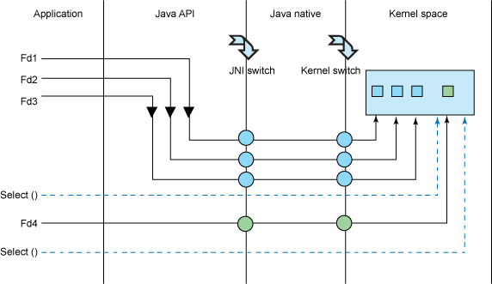
epoll on linux (v2.6)
Advantage of epoll
  Much larger fds to be used ( > 100,000 on 1G mem machine)
  High performance (kernel mmap)
  No performance loss while fds increases
All advantage due to its implementation
much better than poll/select on real apps
file system?

Slide 28
Overlapped API on windows
Windows kernel do the real operation
  Read/write -> getCompletetionPort
2 ways to check
  Signal when it’s done (callback)
  user query
Support both network and file

Slide 29
Posix aio
Follow standard aio model
Support by various of systems
  Linux (slower than epoll)
  AIX (support only file system)
  Zos (support only network system)

Slide 30
Pollset on AIX
AIX does not have aio on socket, nor epoll
Use pollset_poll
+10% throughput in benchmarks

Slide 31
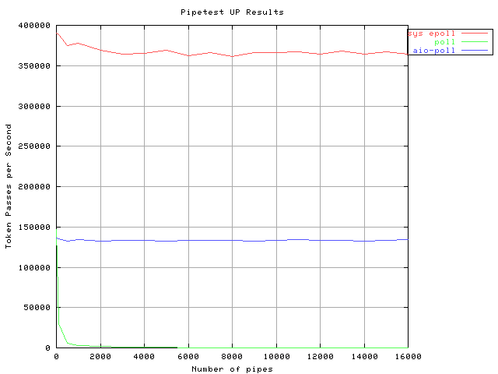
Strategy of implementation
Use faster API?
Customer requirement?
More research required

Slide 32
File system : why need improvement
io/nio lacks:
  No symbolic links
  No simple remove/copy
  Directory search and iterator
  Bad filters
  Limited support for file attribute access

Slide 33
New support for File system
Various of features for different systems
  Keep an eye on file system
File iterator
File Watch service
File type detector
aio

Slide 34
Garbage-First Garbage Collector
G1 is a “server-style” GC and has the following attributes.
  Parallelism and Concurrency.
  Generational.
  Compaction.
  Predictability.
Best fit
  multi-cores
  Big memory
Notes:
Parallelism and Concurrency. G1 takes advantage of the parallelism that exists in hardware today. It uses all available CPUs (cores, hardware threads, etc.) to speed up its “stop-the-world” pauses when an application's Java threads are stopped to enable GC. It also works concurrently with running Java threads to minimize whole-heap operations during stop-the-world pauses.
Generational. Like the other HotSpot GC's, G1 is generational, meaning it treats newly-allocated (aka young) objects and objects that have lived for some time (aka old) differently. It concentrates garbage collection activity on young objects, as they are the ones most likely to be reclaimable, while visiting old objects infrequently. For most Java applications, generational garbage collection has major efficiency advantages over alternative schemes.
Compaction. Unlike CMS, G1 performs heap compaction over time. Compaction eliminates potential fragmentation problems to ensure smooth and consistent long-running operation.
Predictability. G1 is expected to be more predictable than CMS. This is largely due to the elimination of fragmentation issues that can negatively affect stop-the-world pause times in CMS. Additionally, G1 has a pause prediction model that, in many situations, allows it to often meet (or rarely exceed) a pause time target.

Slide 35
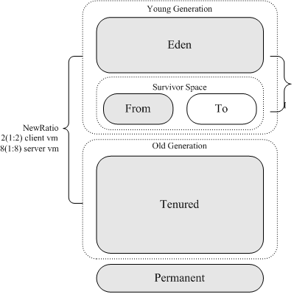
Standard GC
Current normal GC

Slide 36
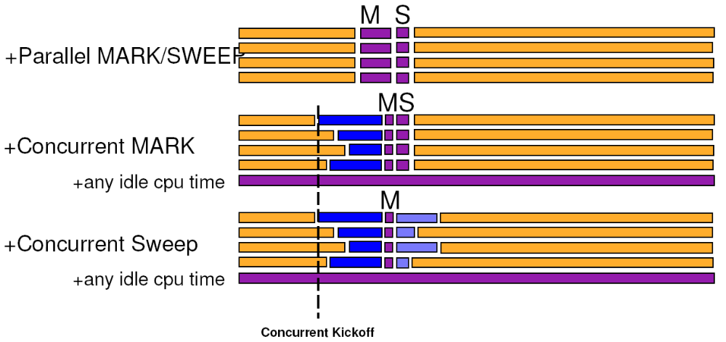
Modern GC
Serial Collector
Parallel Collector
Parallel Compact Collector (ParallelOld)
*Concurent Mark-Sweep(CMS) Collector

Slide 37
New challenging
Multi-core/Multi-thread
VLH
Real time/soft real time
Clouding
…

Slide 38
G1 Design and advantage
Generation
  no physical separation
  single contiguous heap which is split into same-sized regions.
Pauses
  Collection in G1 takes place through evacuation pauses, evacuation pauses are done in parallel, with ALL available CPUs participating
Compact
Predictability
  Compacted heap is easy to malloc
Notes:
In G1, there is no physical separation between the young and old generations. Instead, there is a single contiguous heap which is split into same-sized regions.

Slide 39

Q&A
Http://harmony.apache.org

