Slide 1
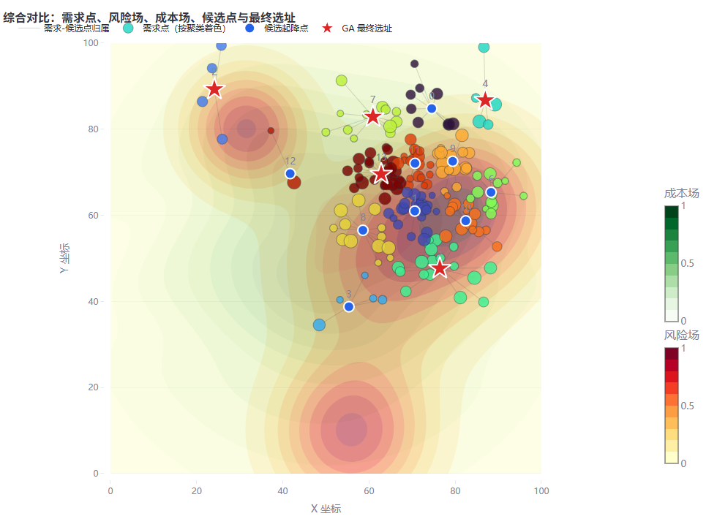
RESEARCH PROTOTYPE
Interactive eVTOL
Vertiport Siting &
Route Planning
A two-dimensional decision-support system integrating demand generation, spatial risk and cost modeling, K-means, genetic algorithms, A*, and RRT*.
Demand → Candidates → Optimized Sites → Routes
System Overview | English Presentation

Slide 2
SYSTEM LOGIC
One continuous workflow links strategic siting to operational routing.
01
02
03
04
05
Urban Scenario
→
Candidate Generation
→
Siting Optimization
→
Route Planning
→
Algorithm Comparison
Generate weighted passenger demand, risk hotspots, and spatial cost fields.
Apply weighted K-means; cluster centers become candidate vertiports.
Use a genetic algorithm to balance coverage, safety, and cost.
Plan routes from selected vertiports to a fixed airport connection point.
Compare A* and RRT* through paths, search behavior, and quantitative metrics.
The same spatial fields and selected sites are reused across modules, preserving consistency between planning stages.

Slide 3
MODULE 1 · SITING
The siting engine makes demand, risk, and cost trade-offs visible.
Demand model
Weighted Gaussian demand clusters approximate heterogeneous urban travel demand.
Candidate sites
Weighted K-means converts dispersed demand points into interpretable candidate locations.
GA objective
F = w₁·coverage − w₂·risk − w₃·cost
Interactive output
Users can change seeds, weights, cluster count, population size, and generations.

Slide 4
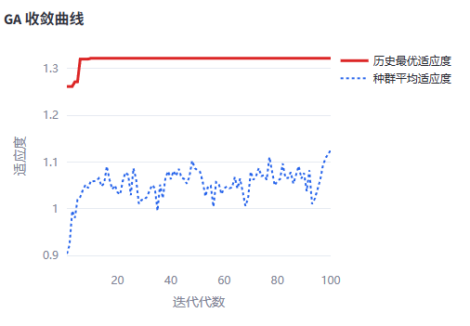
OPTIMIZATION EVIDENCE
The GA exposes convergence instead of presenting a black-box answer.
What the user can inspect
01
Best fitness
Tracks the best solution found across generations.
02
Mean fitness
Shows population-level improvement and stability.
03
Site metrics
Coverage, risk, cost, and single-site score remain exportable.
04
Reproducibility
Random seeds allow repeatable experimental scenarios.
Result: an auditable optimization process suitable for thesis experiments and parameter-sensitivity studies.

Slide 5
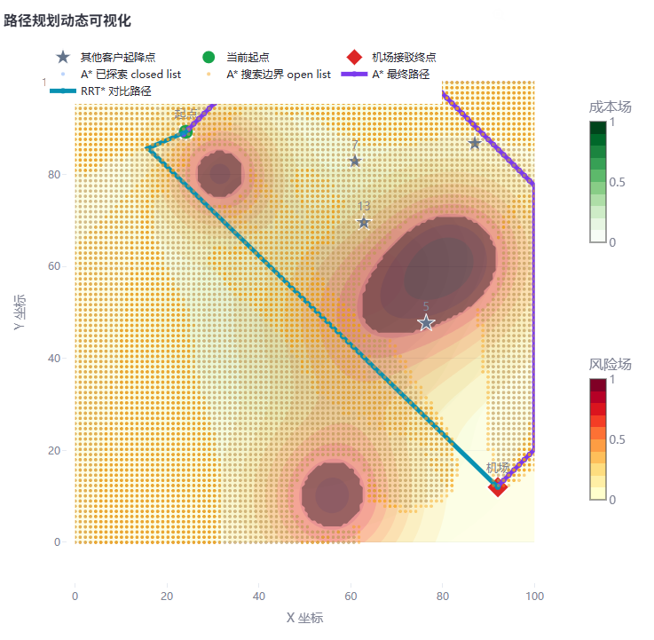
MODULE 2 · ROUTING
Selected vertiports become route origins to a fixed airport connector.
Shared edge-cost model
J = α·distance + β·risk + γ·cost
A*
Grid-based search
Open/closed lists, obstacle inflation, Euclidean or Manhattan heuristic.
RRT*
Continuous-space sampling
Goal bias, collision checking, neighborhood rewiring, optional smoothing.
Risk field
Risk-aware feasibility
High-risk cells become obstacles; remaining fields contribute to route cost.

Slide 6
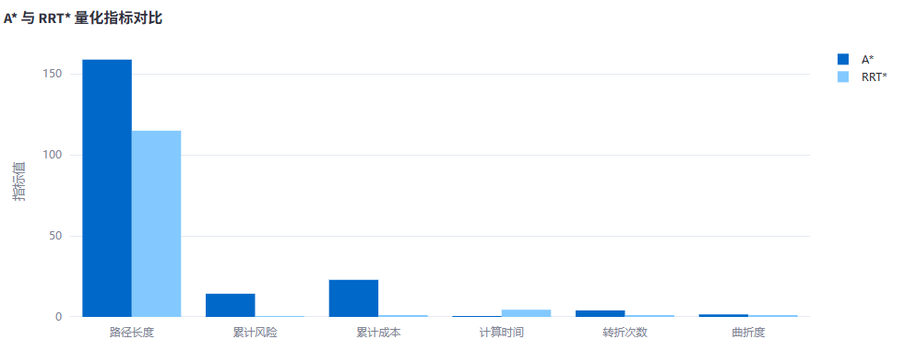
ALGORITHM COMPARISON
A* and RRT* are compared on both solution quality and search effort.
Evaluation dimensions
Path quality
Length, cumulative risk, cumulative cost, average risk
Safety
Minimum obstacle clearance
Performance
Runtime and explored/tree node count
Smoothness
Turn count and tortuosity
The interface automatically summarizes which algorithm is shortest, safest, and fastest under the current parameter set.

Slide 7
RESEARCH VALUE
The system is designed as an experimental platform,
not a one-off visualization.
01
02
03
Interactive experimentation
Transparent methodology
Extensible architecture
Scenario seeds, demand structure, objective weights, and algorithm parameters can be changed without editing code.
Each intermediate stage is visible: fields, demand points, clusters, candidate sites, optimized sites, search trees, and final routes.
The modular Python structure supports real GIS data, multi-objective optimization, capacity constraints, and new planners.
Next step: replace synthetic fields with real urban demand, land-cost, airspace, and infrastructure datasets.

