Slide 1
Realtime multiplayer
Tic Tac Toe game
Isaac Wu
Liren Li
Yang Li

Slide 2
Problem Definition
Problem definition: We need to design and implement a multiplayer Tic Tac Toe game application with the following features:
A user should host a game.
Each game should have a unique game id.
Other user should be able to join the game with the game id.
The game should follow the basic tic tac toe rules.

Slide 3
Requirement Analysis
API for Hosting and Joining game
Unique identifier to find a game
Tic/Toe played reflects on both boards immediately(real-time)
Player always play against another player
Game Rule
Played on a 3x3 board
Each game will only have 2 players
Players take turn to put O/X
The first player to get 3 of her marks in a row wins
If all 9 slots on the board is taken, two players get a draw

Slide 4
Assumptions
People have stable connection during game
People will not rejoin game after leaving
One room will only correspond to one game
People do not care about their past records
Player in the same game do not use the same name
A room must be created before people join it
Host will be starting the game first

Slide 5
Use cases
The actor in the system will be the Player
Host:
Enter Name
Host the game
Play game
Clear board
Joiner:
Enter game
Join game with room id
Play game
Clear board
Share room id
Basic Use Cases
Host Game
Host a game room on the game server
Join Game
Join a hosted game room
Play Game
Play a token on the game
Receive Message
Receive a updated information about the game from the server
Leave Room
Disconnect to the server and clear the board

Slide 6



Architecture
REST API
WebSocket

Slide 7
Classes(categorized by MVC)
Model (Java)
GameStorage: In memory storage for all the game objects within a dictionary, gameId as key
Game: Object containing info of a game: id, players, status, board, steps and winner
GamePlay: Record of where the player play a TicToe
GameStatus(Enum): NEW, STARTING, IN_PROGRESS, FINISHED
Player: Player object containing the name
TicToe(Enum): X and O
View (Qt/C++)
Name Inputs: Widget for inputting name
Room Inputs: Widget for inputting/displaying the roomId
Host and Join buttons: Widget buttons for triggering host/join actions
Board: Widget GridContainer of Buttons for gameplay
Status: Widget for displaying game status
Control (Java)
GameService: The control that implements detail of hosting, joining, gameplay and store information into GameStorage
GameController: The controller handles the Rest request from the client and call corresponding function in GameService and send websocket information to clients.
GameSessionMapper: map the room ids to connected websockets for that room
MyWebSocketHandler: register and delete(with reference count) for room and webSockets.

Slide 8
OO Concepts
Encapsulation
UML design
Aggregation
Association
Composition
Spring/JAVA
GameStorage, GameSessionMapper: Singleton
QT/C++
MainWindow: Aggregation

Slide 9
UML Use case and diagrams

Slide 10
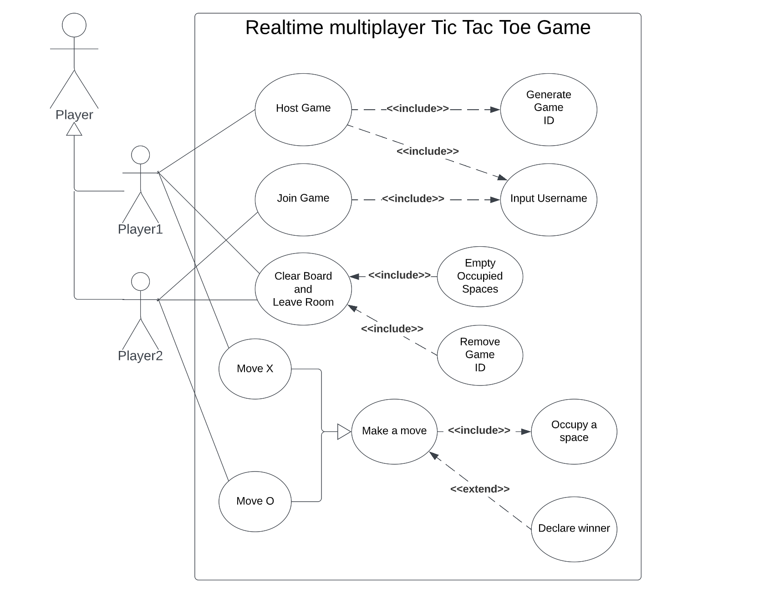
Use
Case Diagram

Slide 11
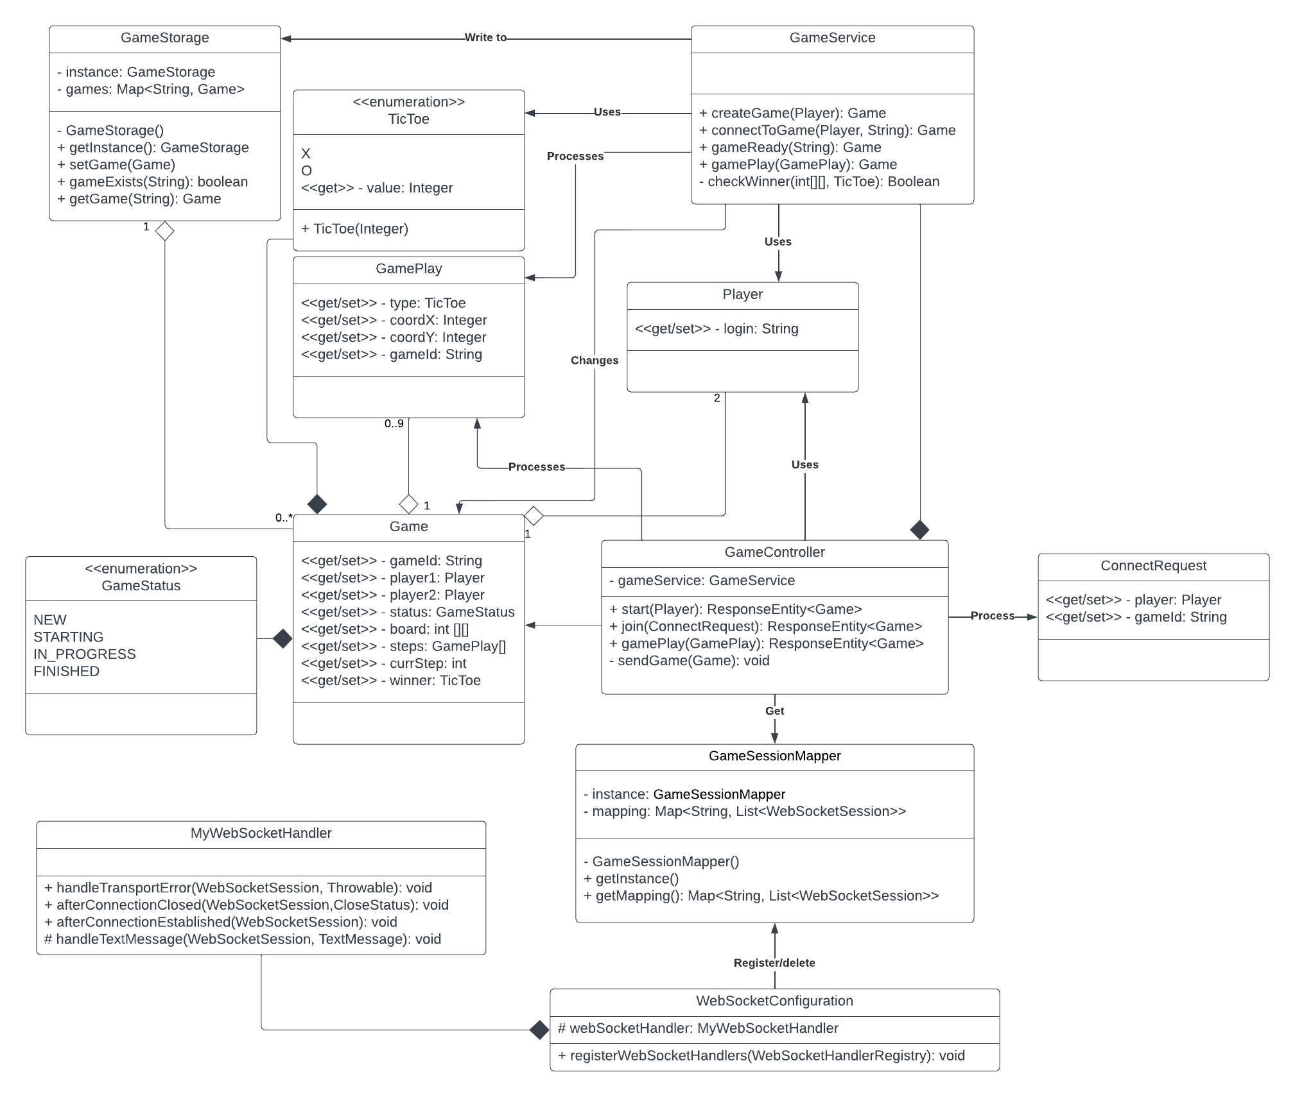
Class Diagram

Slide 12
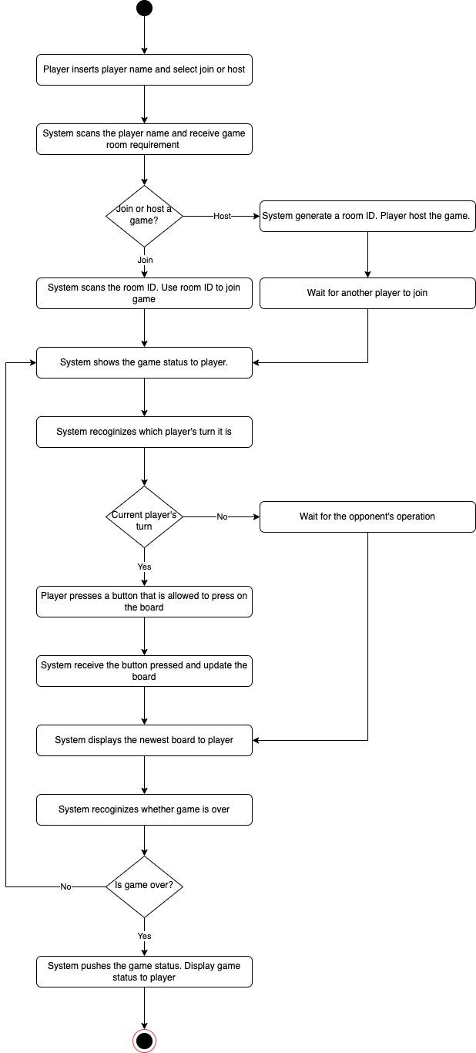

Slide 13
Class Implementation

Slide 14
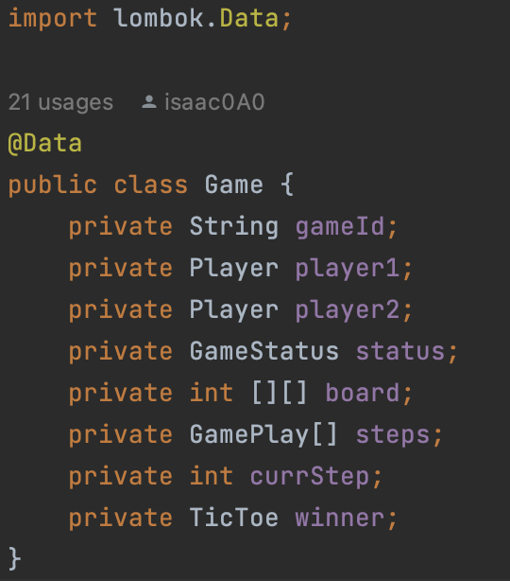
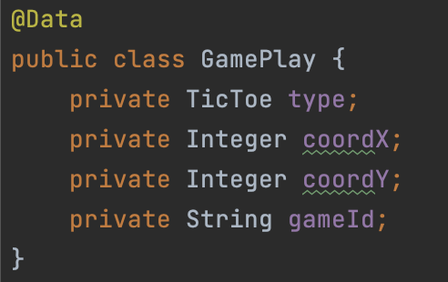
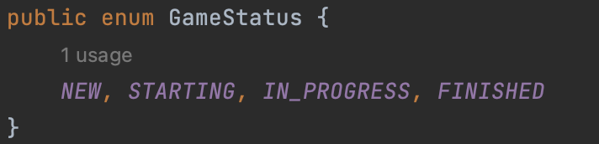
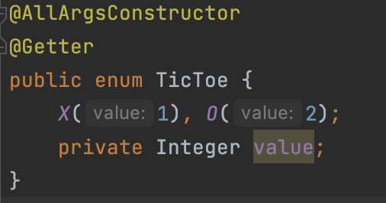
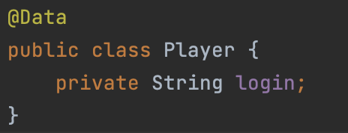

Slide 15
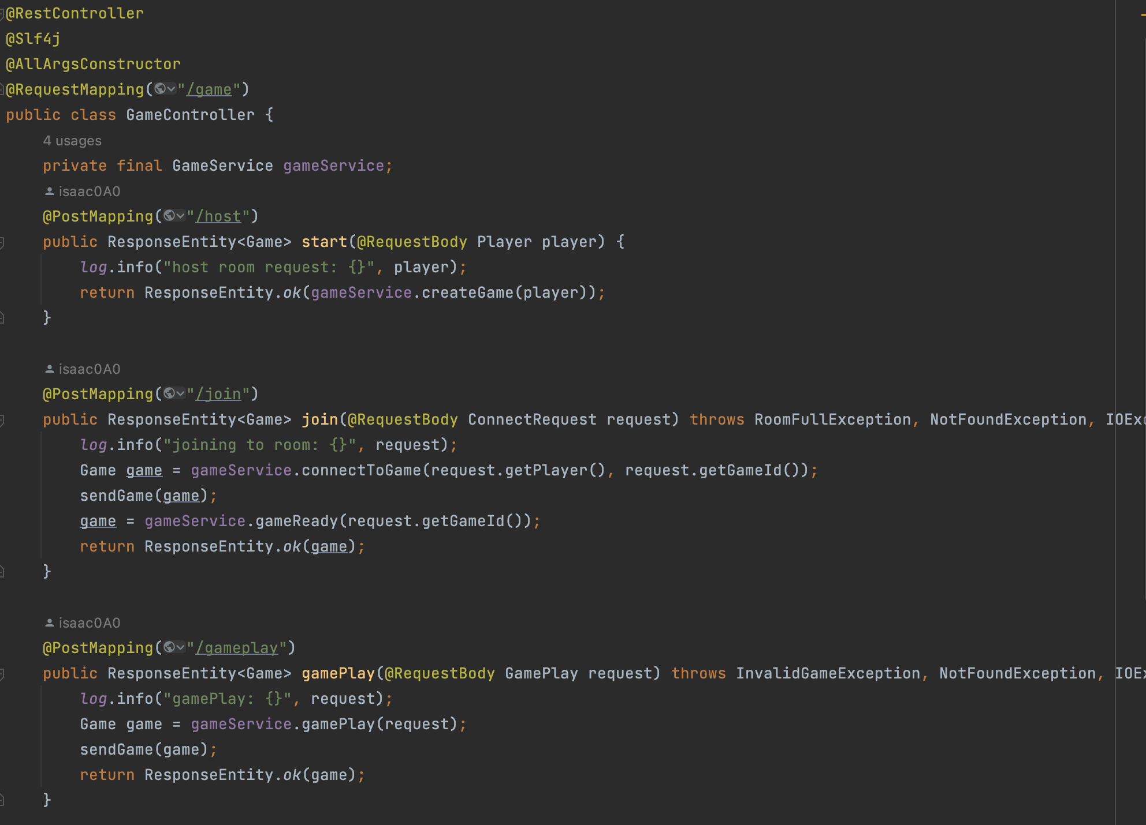

Slide 16
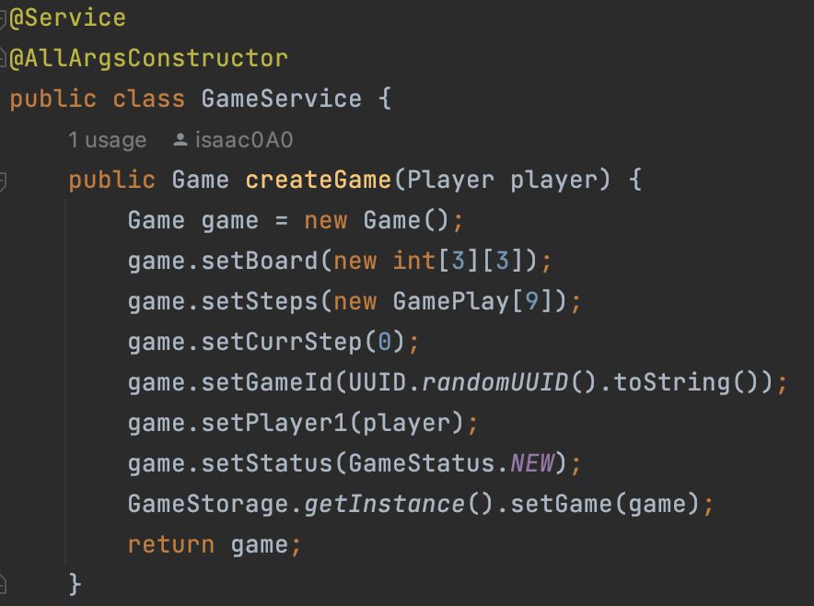
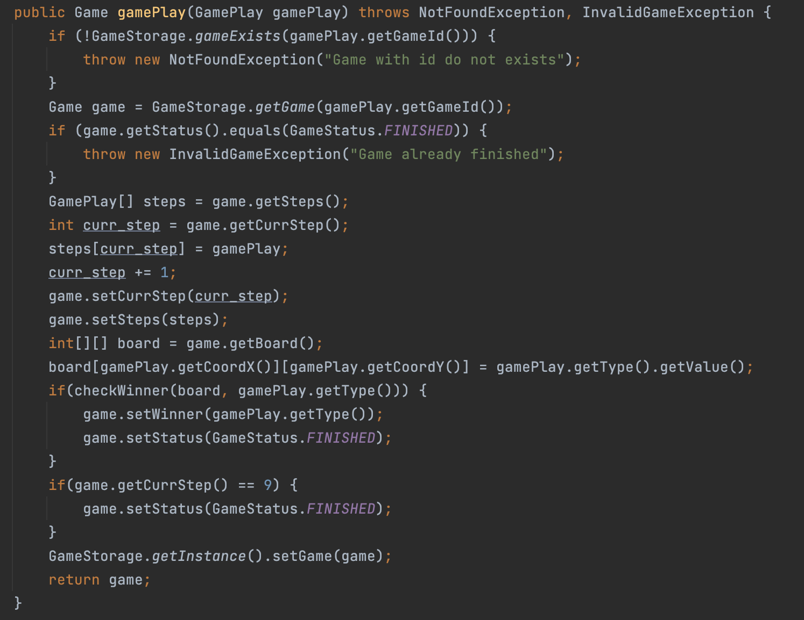
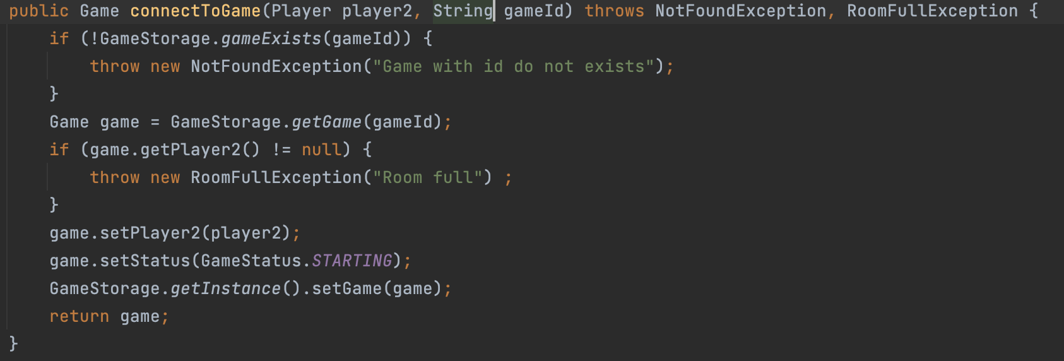

Slide 17
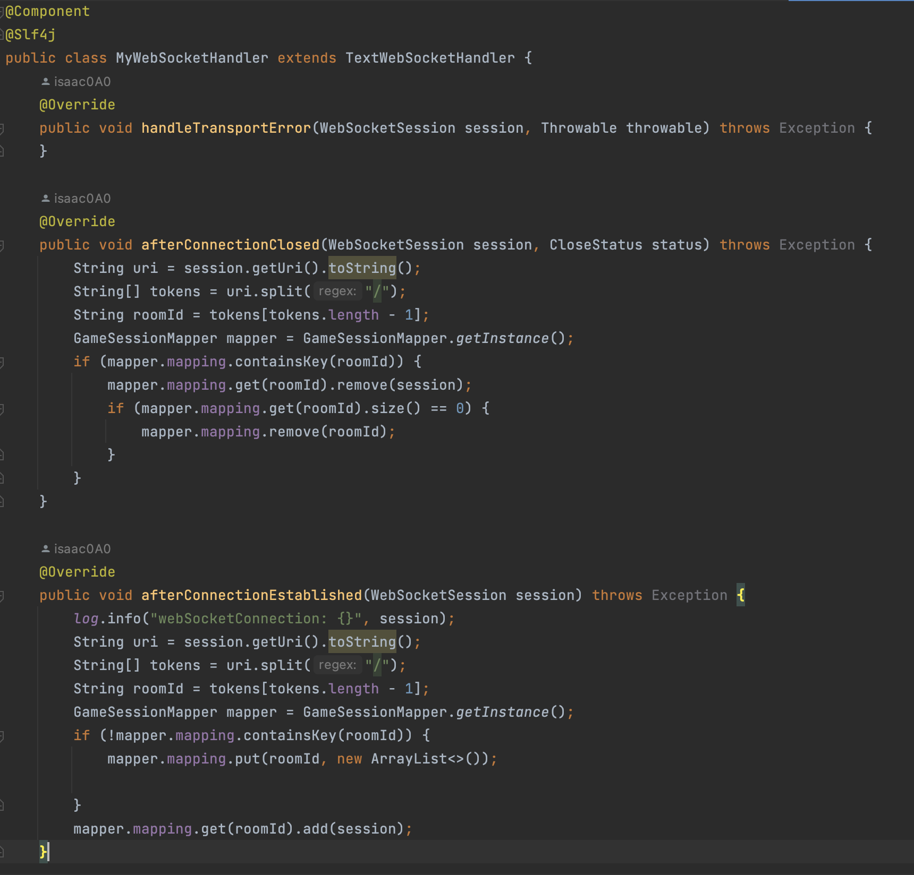

Slide 18
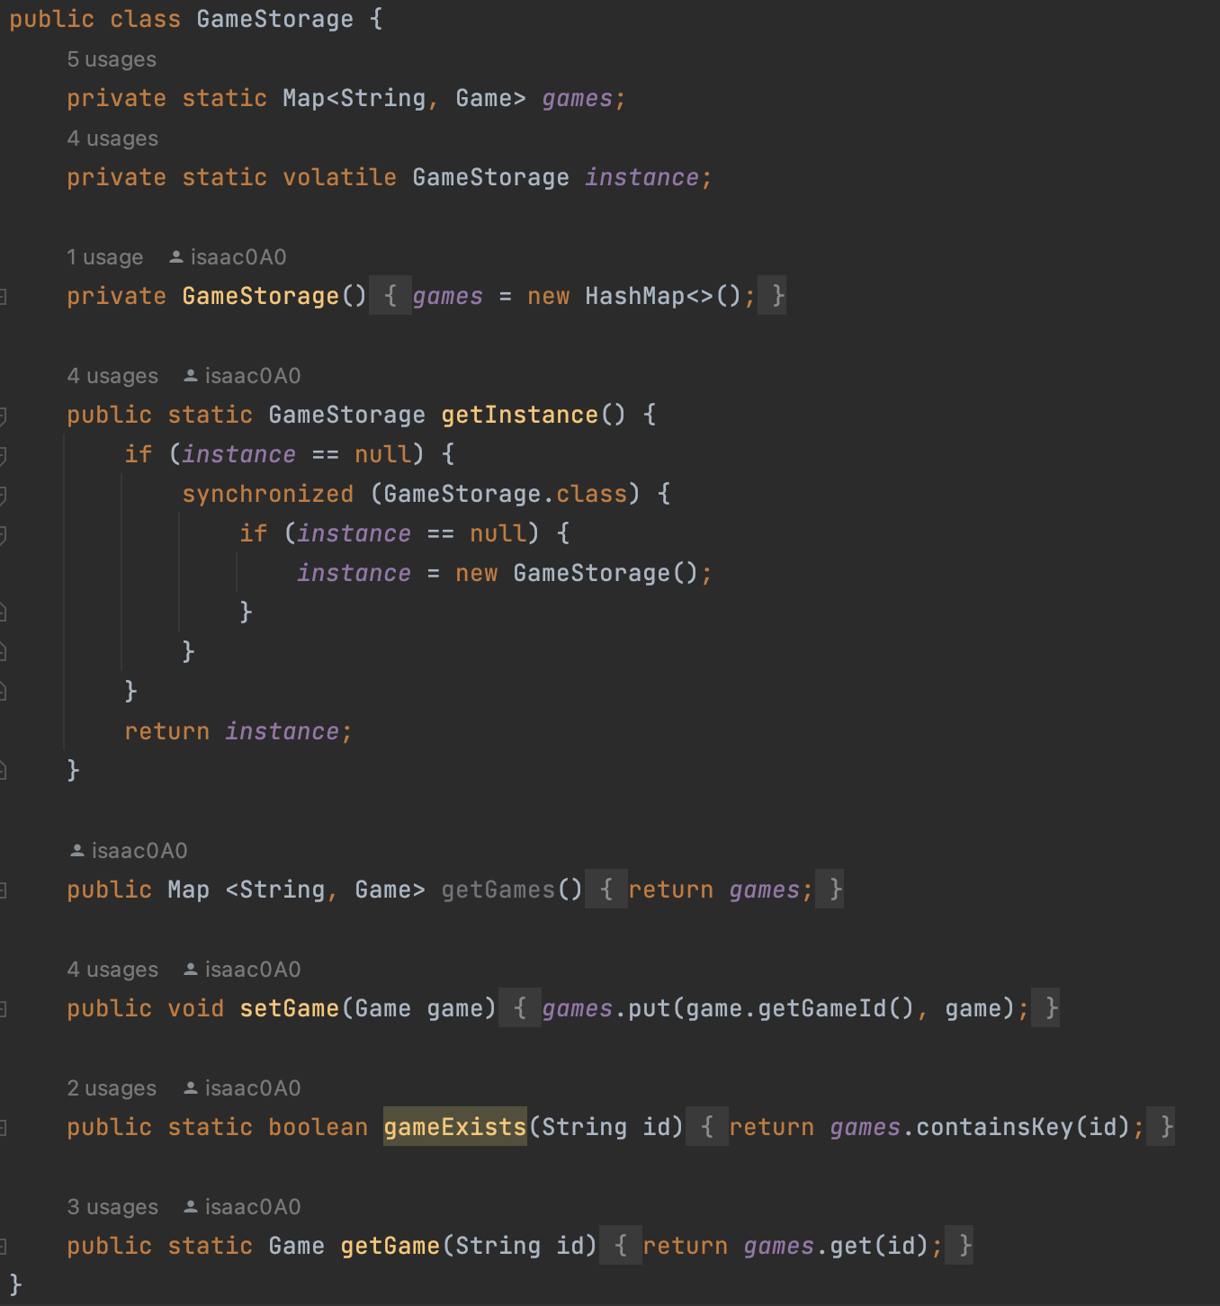

Slide 19
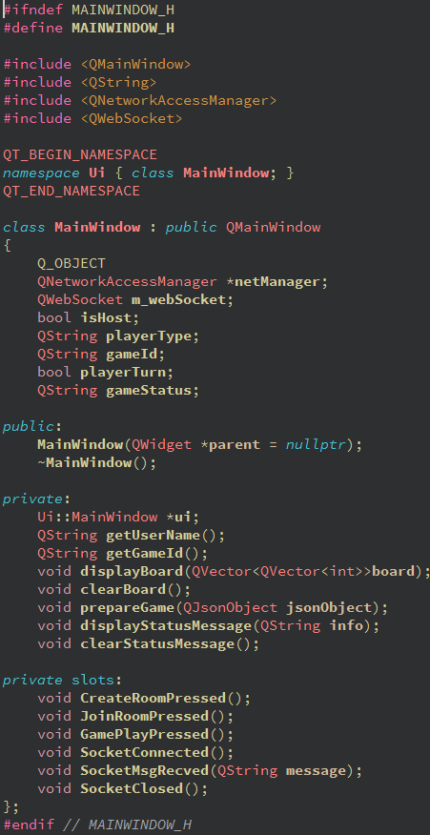
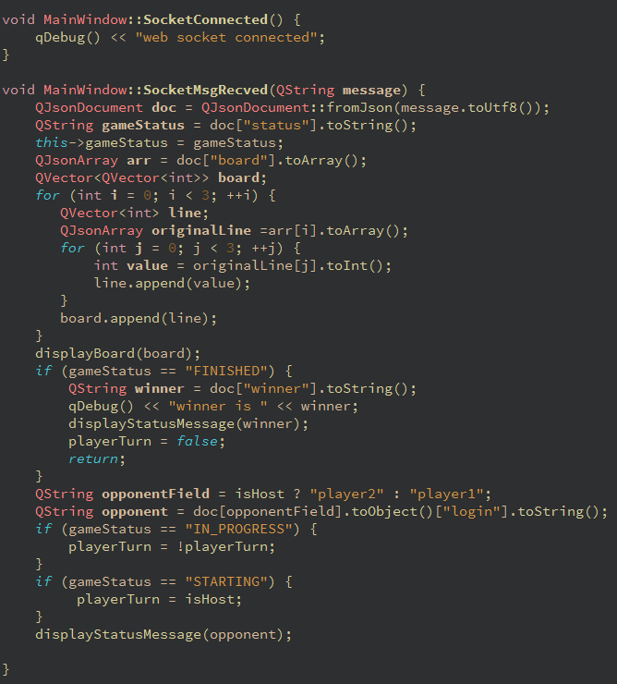

Slide 20
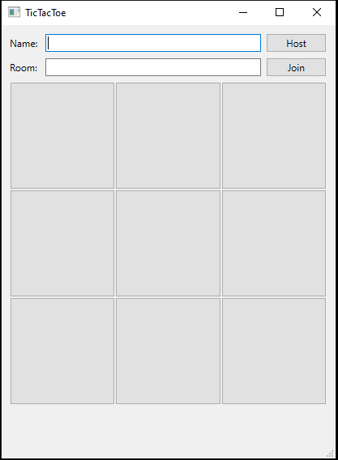
Screen shots
1
3
2
4
1. Name entry
Required for all player
Locked once host/join room
2. Room entry
Set once host game
Required to join a game
3. Button for host a room
4. Button for join/exit a room
Change to clear once game starts
5. Board
5. Game Status Bar
5
6

Slide 21
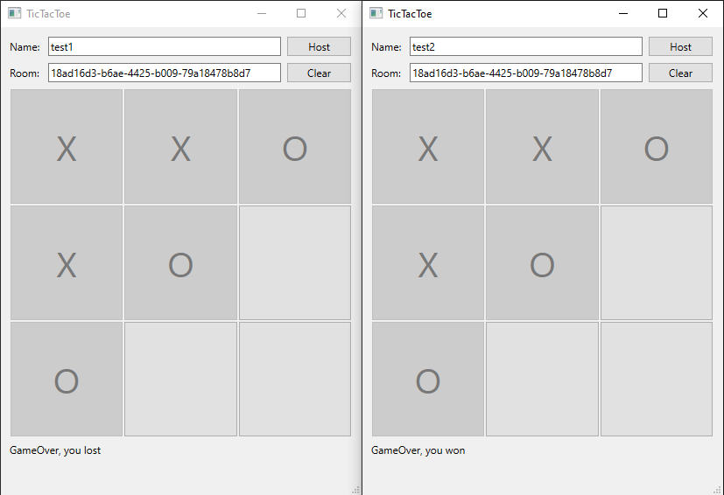
Screen shots(Cont.)

Slide 22
Links
https://github.com/wuyuz99/Realtime-multiplayer-Tic-Tac-Toe-game

