Slide 1
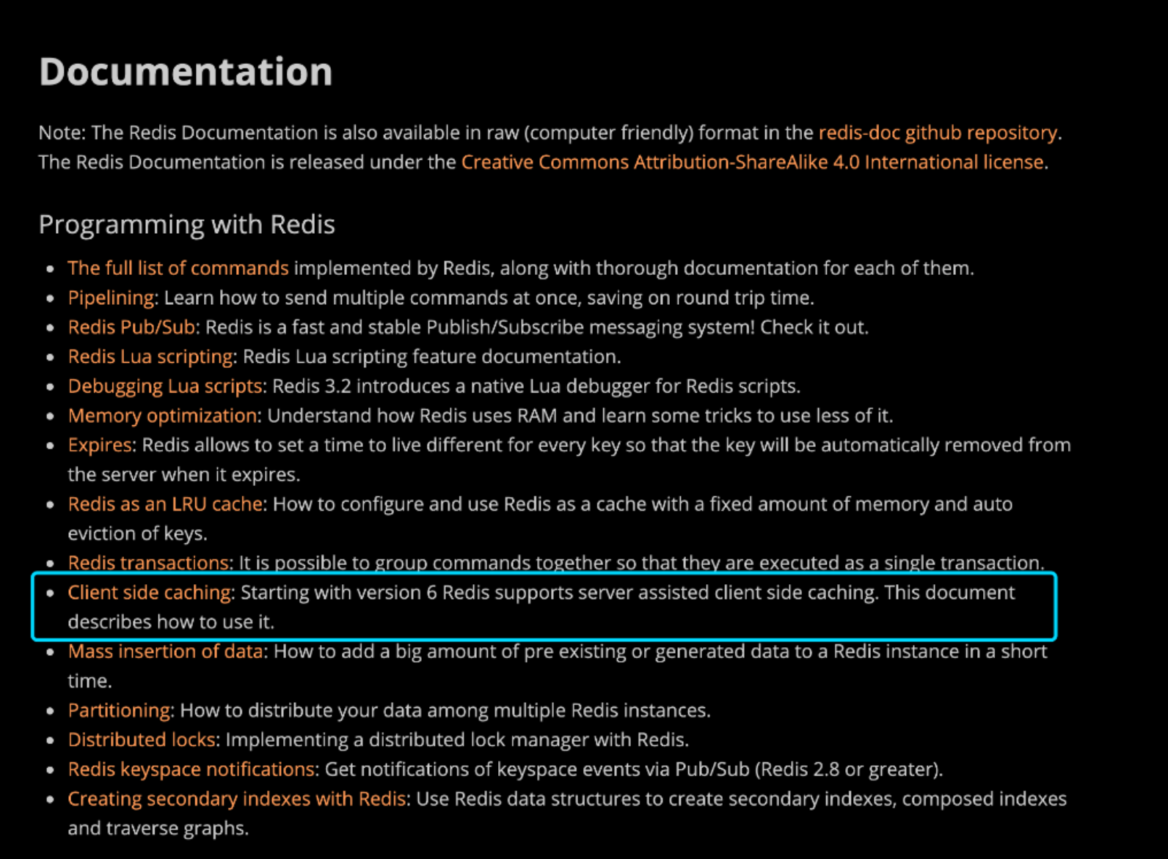

Slide 2
Redis server-assisted client side caching
客户端缓存的好处
1、时延低
2、降低数据库查询并发量

Slide 3
问题
1、过期数据
2、全量过期事件广播带来的压力

Slide 4
The Redis client side caching support is called Tracking, and has two modes
default mode：
broadcasting mode：

Slide 5
default mode：
the server remembers what keys a given client accessed, and send invalidation messages when the same keys are modified. This costs memory in the server side, but sends invalidation messages only for the set of keys that the client could have in memory.

Slide 6
broadcasting mode ：
instead the server does not attempt to remember what keys a given client accessed, so this mode does not cost any memory at all in the server side. Instead clients subscribe to key prefixes such as object: or user:, and will receive a notification message every time a key matching such prefix is touched.

Slide 7
Invalidation Table
single keys namespace
The server does not store anything in the invalidation table. Instead it only uses a different Prefixes Table, where each prefix is associated to a list of clients.

Slide 8
Using the new version of the Redis protocol, RESP3, supported by Redis 6, it is possible to run the data queries and receive the invalidation messages in the same connection.

Slide 9
A very important thing to understand about client side caching used with RESP2, and a Pub/Sub connection in order to read the invalidation messages, is that using Pub/Sub is entirely a trick in order to reuse old client implementations, but actually the message is not really sent a channel and received by all the clients subscribed to it.

Slide 10
We don't want to cache much keys that change continuously.
We don't want to cache much keys that are requested very rarely.
We want to cache keys that are requested often and change at a reasonable rate.

