Slide 1
Conditional Random Fields
Alan Ritter
CSE 5525

Slide 2
Last time we saw MEMMs…

Slide 3
MEMMs: The Label Bias Problem
States with low entropy distributions effectively ignore observations
These are forced to sum to 1 Locally
Q: is that really necessary?

Slide 4
From MEMMs to Conditional Random Fields
Q: how can we make the distribution over tag sequences sum to 1?

Slide 5
From MEMMs to Conditional Random Fields

Slide 6
Gradient ascent
Loop While not converged:
For all features j, compute and add derivatives
: Training set log-likelihood

Slide 7
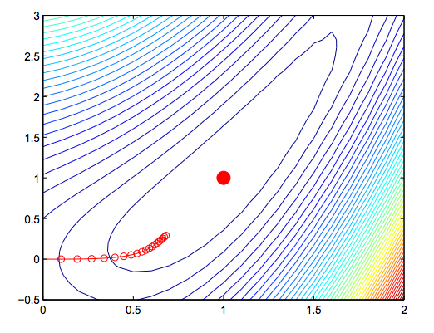
Gradient ascent

Slide 8
Gradient of Log-Linear Models

Slide 9
MAP-based Learning (perceptron)

Slide 10
Conditional Random Field Gradient (log-linear model)

Slide 11
MAP-based learning (perceptron)

