Slide 1
Probabilistic Context Free Grammars
Many slides from Michael Collins

Slide 2
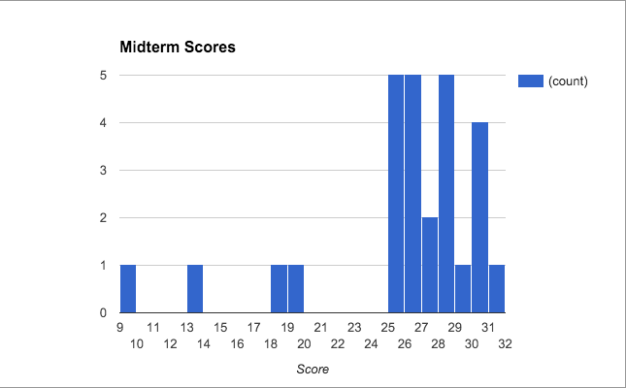

Slide 25
Dependency Parsing

