Slide 1
Introduction to Part of Speech Tagging
Alan Ritter
Many slides adapted from Brendan O’Connor Chris Manning

Slide 2
Where are we going with this?
Text classification: bags of words
Sequence tagging
Parts of Speech
Named Entity Recognition
Other areas: bioinformatics (gene prediction), etc…

Slide 3
What’s a part-of-speech (POS)?
Syntax = how words compose to form larger meaning bearing units
POS = syntactic categories for words
You could substitute words within a class and have a syntactically valid sentence
Gives information how words combine into larger phrases
I saw the dog
I saw the cat
I saw the ___

Slide 4
Parts of Speech is an old idea
Perhaps starting with Aristotle in the West (384–322 BCE), there was the idea of having parts of speech
School grammar: noun, verb, adjective, adverb, preposition, conjunction, pronoun, interjection
Many more fine grained possibilities
https://www.youtube.com/watch?v=ODGA7ssL-6g&index=1&list=PL6795522EAD6CE2F7
Notes:
4

Slide 5
Open class (lexical) words
Nouns
Verbs
Adjectives
old older oldest
Proper
Common
Main
Adverbs
slowly
IBM
Italy
cat / cats
snow
see
registered
Numbers
… more
122,312
one
Closed class (functional)
Modals
Determiners
the some
can
had
Prepositions
to with
Conjunctions
and or
Particles
off up
… more
Pronouns
he its
Interjections
Ow Eh

Slide 6
Open vs. Closed classes
Open vs. Closed classes
Closed:
determiners: a, an, the
pronouns: she, he, I
prepositions: on, under, over, near, by, …
Why “closed”?
Open:
Nouns, Verbs, Adjectives, Adverbs.
Notes:
6
Review J&M 2ed Section 5.1

Slide 7
Many Tagging Standards
Penn Treebank (45 tags) … this is the most common one
Brown corpus (85 tags)
Coarse tagsets
Universal POS tags (Petrov et. al. https://github.com/slavpetrov/universal-pos-tags)
Motivation: cross-linguistic regularities
Notes:
7

Slide 8
What are parts of speech useful for?
Phrase identification (chunking)
Named entity recognition
Information Extraction
Parsing

Slide 9
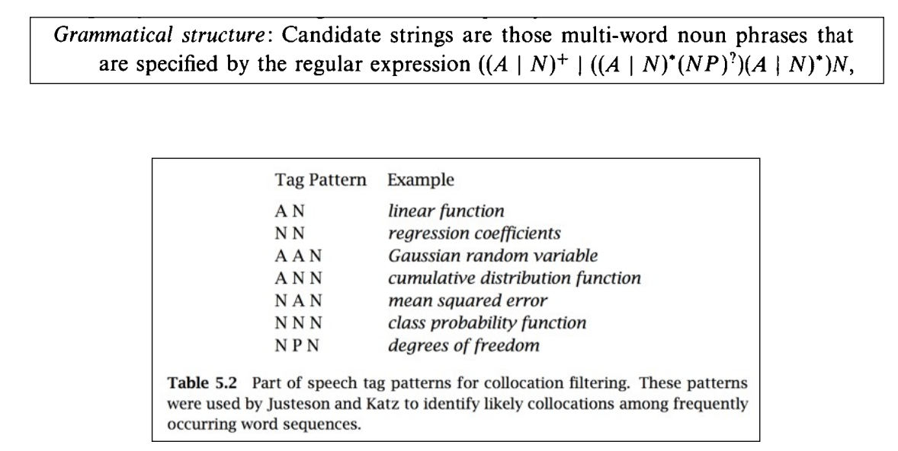
Quick and Dirty Noun Phrase Identification

Slide 10
POS Tagging
Words often have more than one POS: back
The back door = JJ
On my back = NN
Win the voters back = RB
Promised to back the bill = VB
The POS tagging problem is to determine the POS tag for a particular instance of a word.

Slide 11
POS Tagging
Input: Plays well with others
Ambiguity: NNS/VBZ UH/JJ/NN/RB IN NNS
Output: Plays/VBZ well/RB with/IN others/NNS
Uses:
Text-to-speech (how do we pronounce “lead”?)
Can write regexps like (Det) Adj* N+ over the output for phrases, etc.
As input to or to speed up a full parser
If you know the tag, you can back off to it in other tasks
Penn Treebank POS tags

Slide 12
POS tagging performance
How many tags are correct? (Tag accuracy)
About 97% currently
But baseline is already 90%
Baseline is performance of stupidest possible method
Tag every word with its most frequent tag
Tag unknown words as nouns
Partly easy because
Many words are unambiguous
You get points for them (the, a, etc.) and for punctuation marks!

Slide 13
Deciding on the correct part of speech can be difficult even for people
Mrs/NNP Shaefer/NNP never/RB got/VBD around/RP to/TO joining/VBG
All/DT we/PRP gotta/VBN do/VB is/VBZ go/VB around/IN the/DT corner/NN
Chateau/NNP Petrus/NNP costs/VBZ around/RB 250/CD

Slide 14
How difficult is POS tagging?
About 11% of the word types in the Brown corpus are ambiguous with regard to part of speech
But they tend to be very common words. E.g., that
I know that he is honest = IN
Yes, that play was nice = DT
You can’t go that far = RB
40% of the word tokens are ambiguous

Slide 15
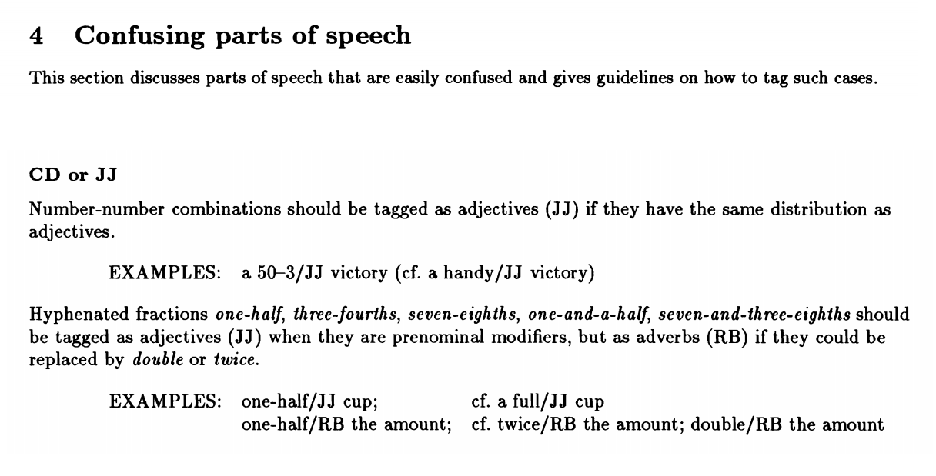
It’s hard for people too!

