Slide 1

PlaqueQuant – Blood Vessel stenosis quantification software
7 Jun 2016

Slide 2
Project Scope
PlaqueQuant is a software with various algorithms, which facilitates user to perform accurate segmentation of blood vessels. Quantitative analysis are performed to help user to quantify blood vessel stenosis
The following steps are used to demonstrate the robustness of the software
Step 1: Loading anatomical images
Step 2: Introduction of the main user interface
Step 3: Segmentation
Step 4: Analysis - 2D and 3D View
Step 5: Report

Slide 3
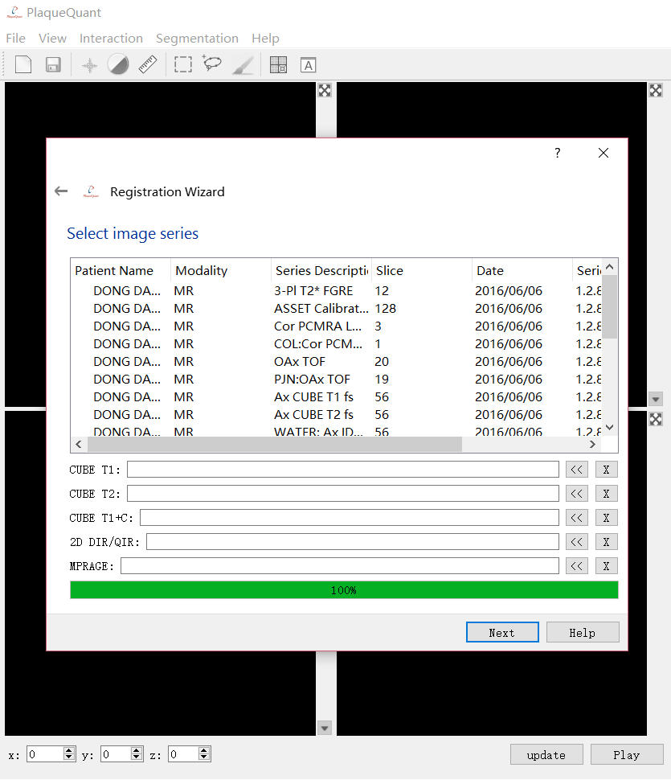
Loading Anatomical Images
User can add anatomical images such as
CUBE T1 image
CUBE T2 image
CUBE T1 + Contrast
2D Double Inversion Recovery (DIR)/Quadruple inversion recovery (QIR)
MPRAGE
Rigid Alignment for the image will be performed in the background

Slide 4
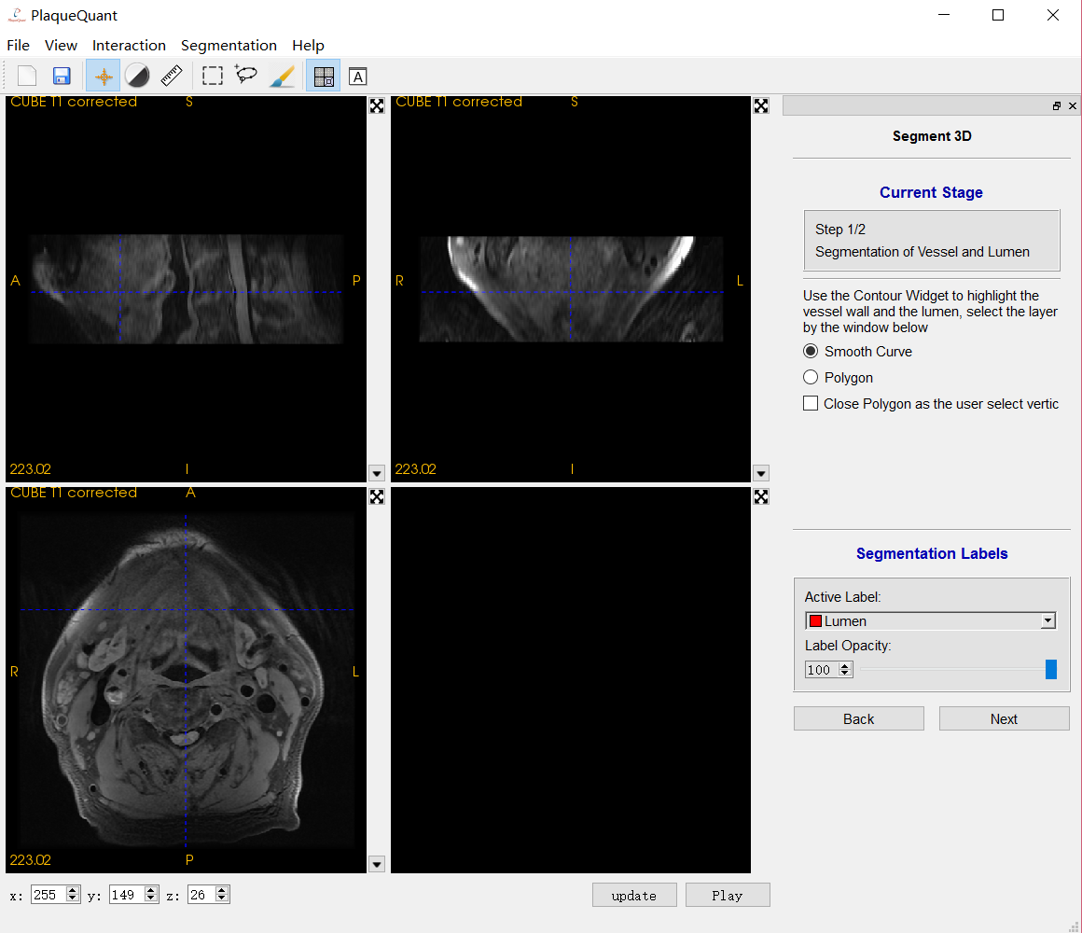

Introduction of the main UI
Segmentation Window
Menu bar
Tool bar
Basic Navigation
Cursor Tools
Contrast Tools
Ruler Tools
Sagittal
Coronal
Axial
3D
Slice
3D View Option

Slide 5
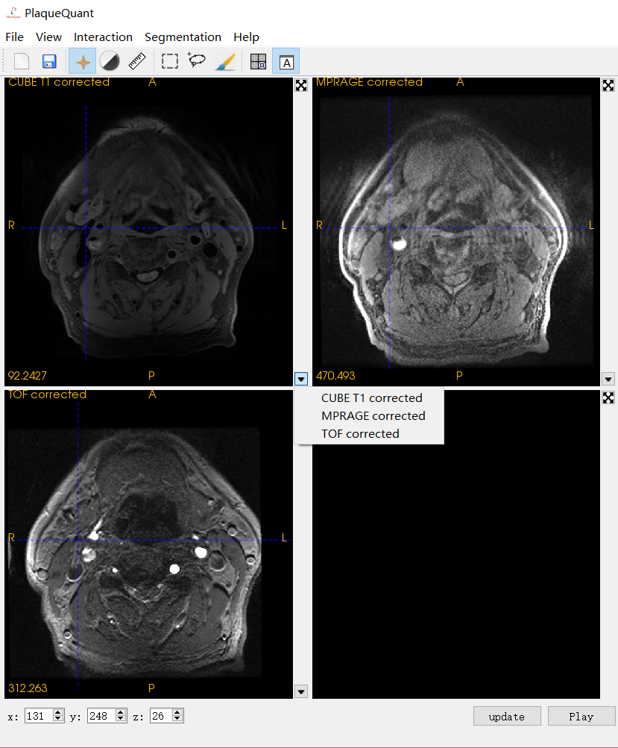
Introduction of the main UI
Switch the View
User can anytime switch from traditional multiple angle view to all axial view, which can display maximum three image data at the same time
User will find it easier to perform segmentation in all axial view
Axial
Axial
Select the display image
Axial

Slide 6
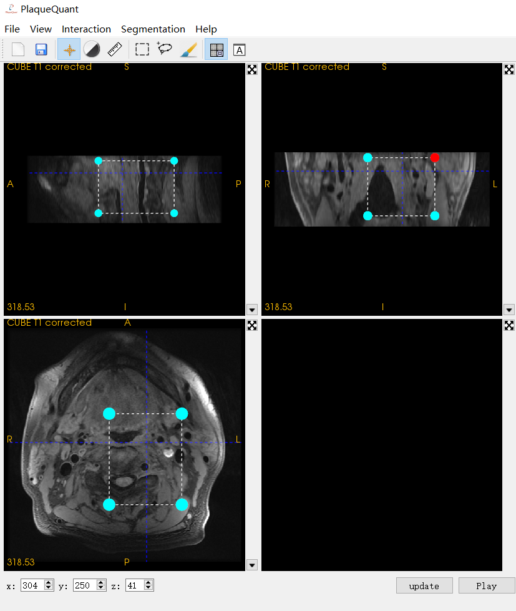
Segmentation
Region of Interest selection tool:
User can define the blood vessel which is of your interest. Subsequent operations are applied to this ROI

Slide 7
Segmentation
In the segmentation stage, we use different tools to segment different parts of the blood vessel
Contour Widget (for Vessel Wall and Lumen)
Brush Widget(for Plaque)

Slide 8
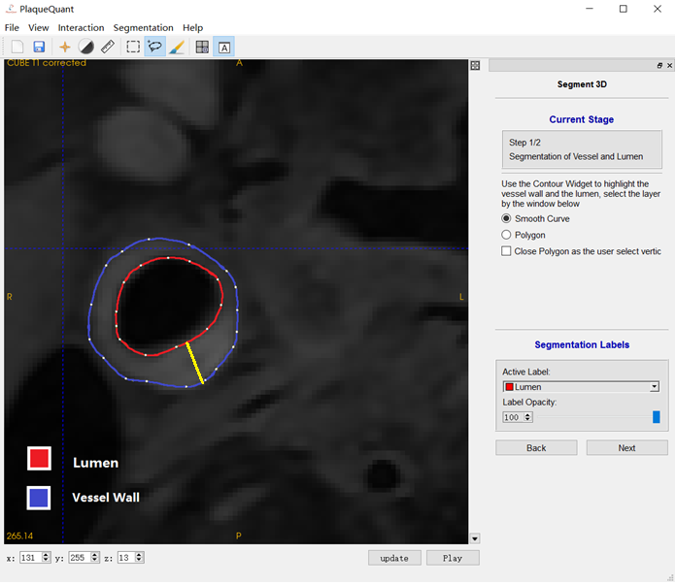
Segmentation
Contour Widget
We use contour widget to select the vessel wall and lumen, layer by layer, highlight the corresponding region
We can also calculated the wall thickness
Maximum wall thickness

Slide 9
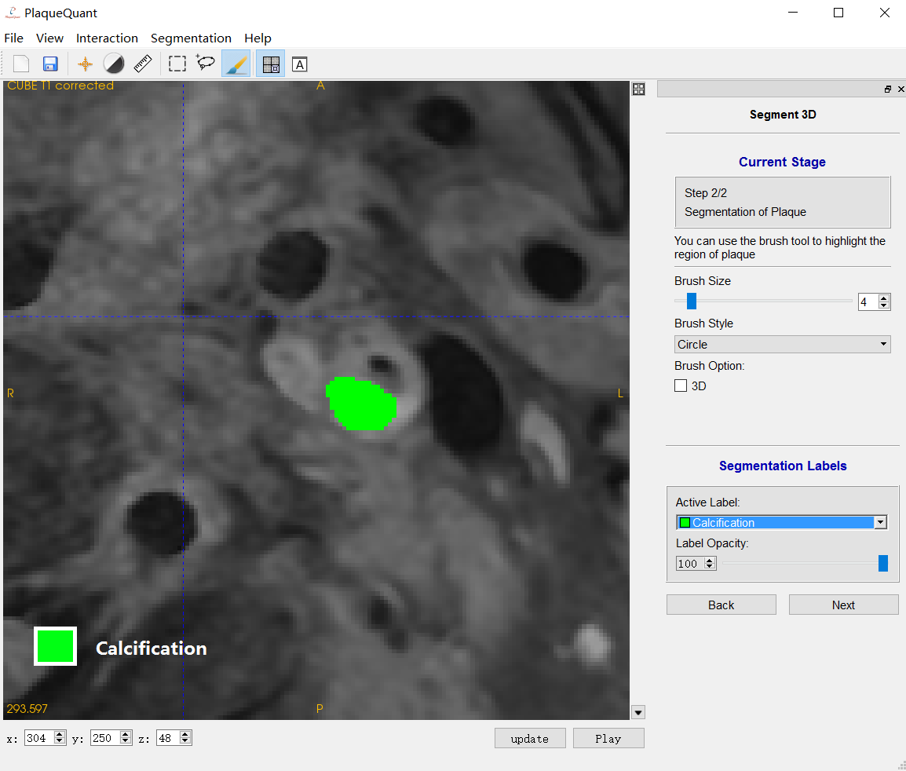
Segmentation
Brush Tool
We can use the brush tool to highlight plaque, such as calcification, hemorrhage, lipid-rich necrotic core, and loose matrix

Slide 10
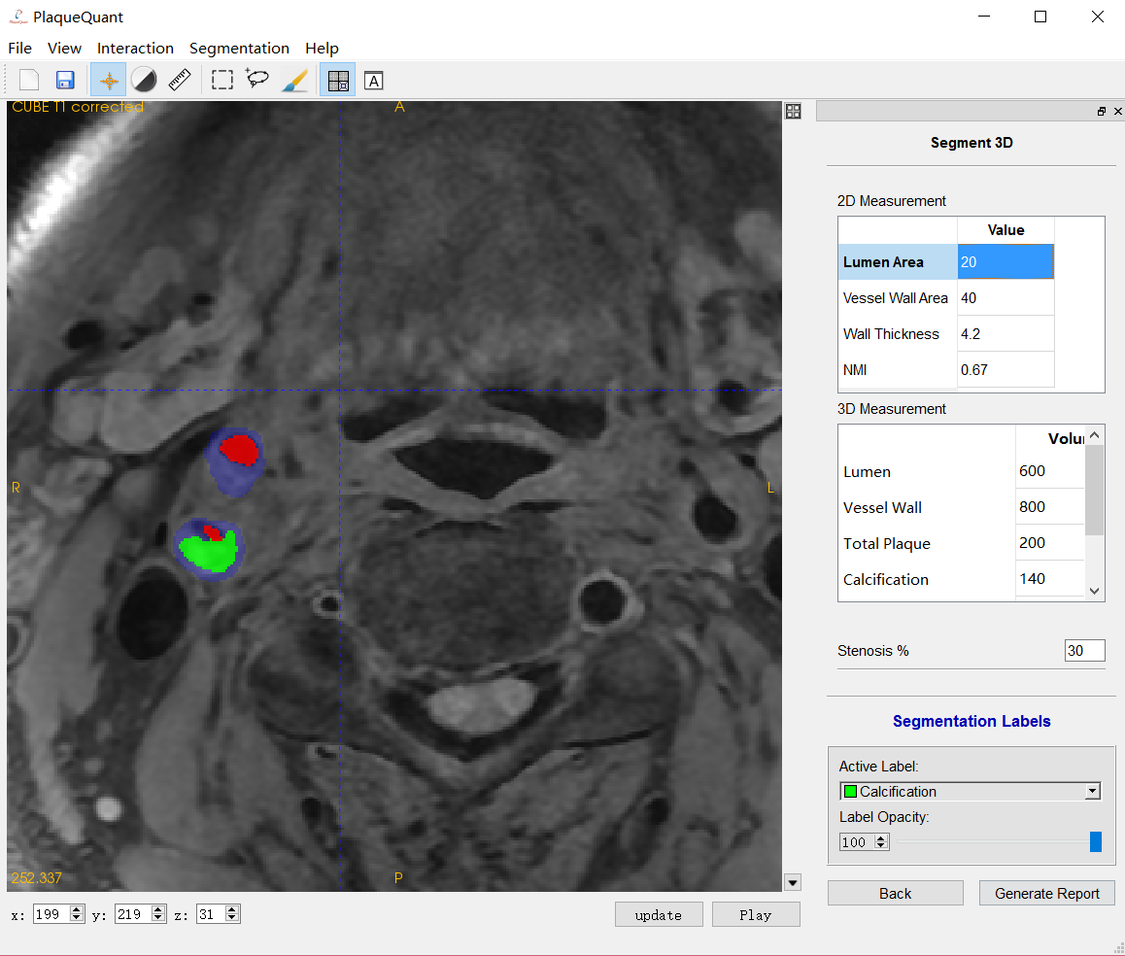
Analysis - 2D results
Measurement and Analysis
Lumen, Vessel Wall, Plaque Area
Maximum Wall Thickness
Normalized Wall Index

Slide 11
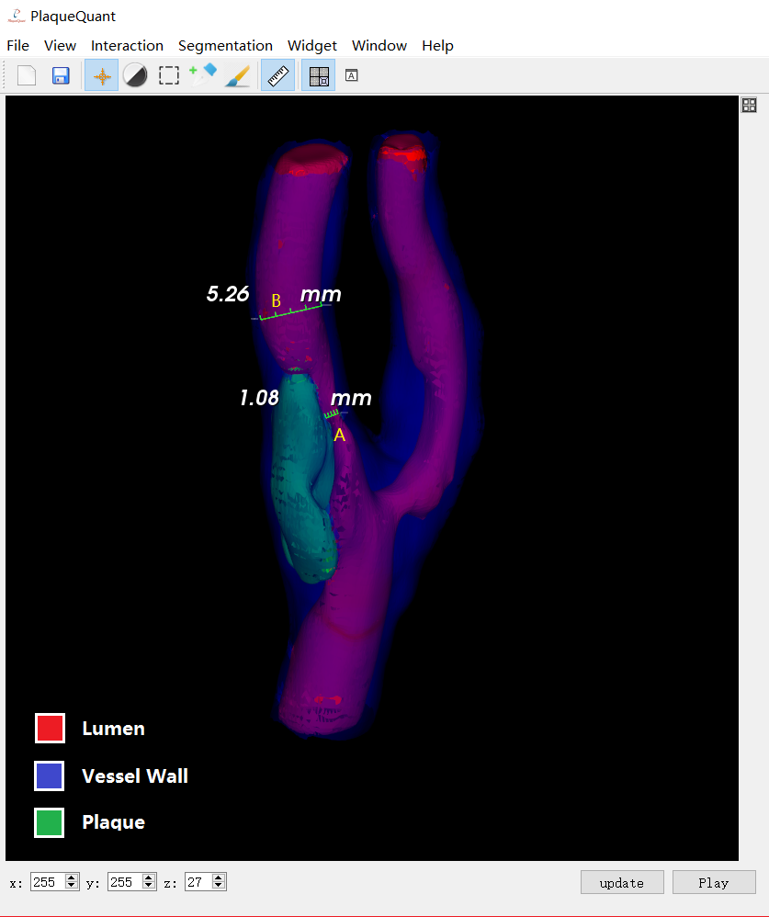
3D measurement of vessel stenosis
After manual segmentation in 2D viewer, 3D model is automatically generated.
Use can use 3D ruler tool to interactively measure stenosis length (A) and reference length (B)
% stenosis

Slide 12
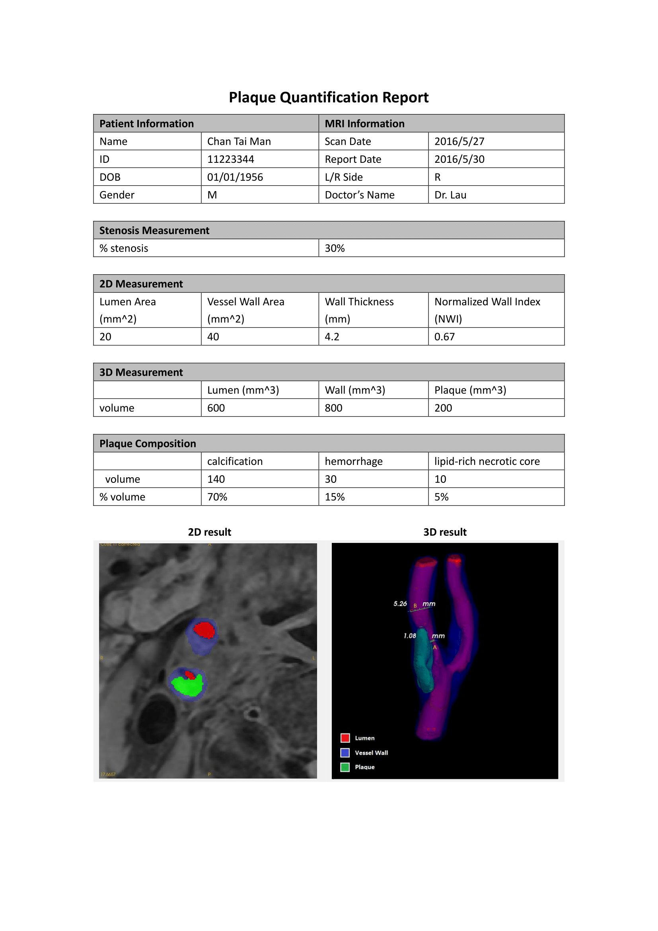
A pdf report is generated on request. 2D, 3D segmentation measurement, images, different statistics such as the maximum wall thickness and % stenosis are included in this report

