Slide 1
Greening A Top-20 Economy: Energy Efficient Timely Transportation of Long-Haul Heavy-Duty Trucks
Lei Deng
2017.09.26

Slide 2
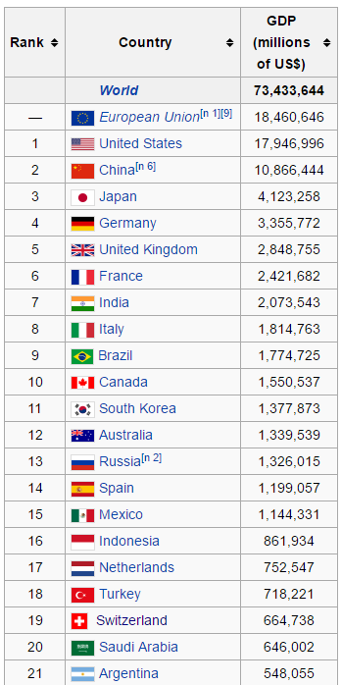
US Trucking Industry: A Top-20 Economy
Freight revenue¹: $726B in 2015 (2.3x HK GDP)
Freight tonnage¹: 10B (70% of all freight), 2015
Number of heavy-duty truck drivers²: 1.8M, 2014
Source 1: ATA American Trucking Trends 2016
Source 2: Bureau of Labor Statistics,
U.S. Department of Labor
GDP Rank 2015, Source: Wikipedia

Slide 3
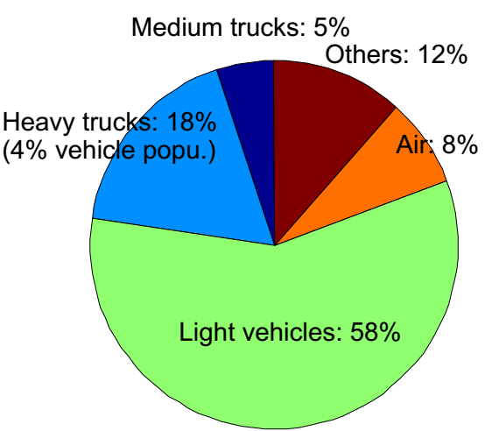
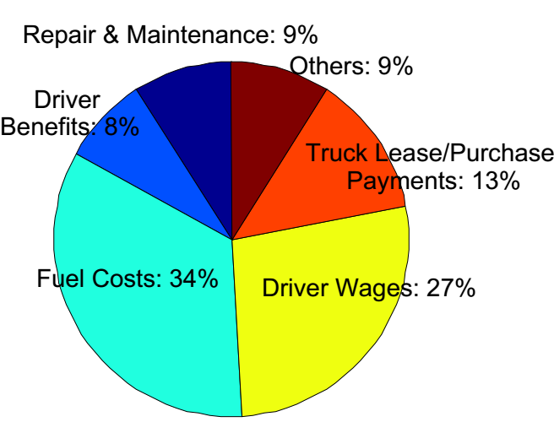
Greening Heavy-Duty Trucks is Relevant
Transportation energy use (US 2013, source: US DOE)
Operational costs of trucking (US 2014, source: American Transportation Research Institute)

Slide 4
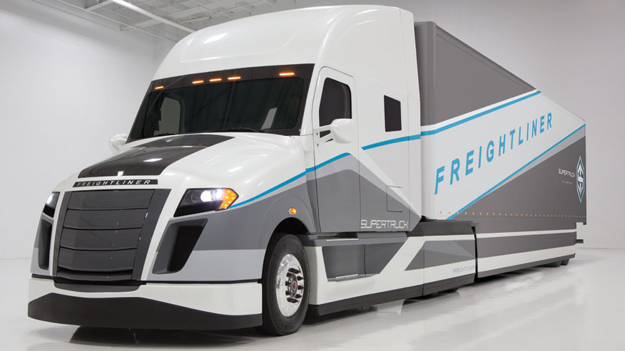
How to Reduce Fuel Consumption?
Fuel-economic truck design
Designs better engines, drivetrains, aerodynamics and tires, etc. Example: SuperTruck
Energy-efficient truck operation
Route planning
Speed planning

Slide 5


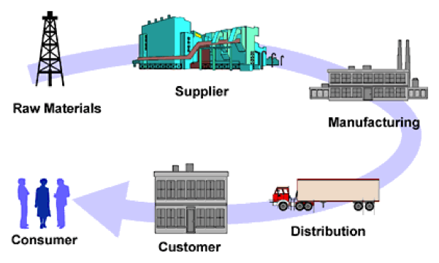
Truck Operation Centers around Timely Transportation
Perishable Food
Amazon SLA
Logistic role in a supply chain
(Source: Internet)
As estimated by US FHWA, unexpected delay can increase freight cost by 50% to 250%

Slide 6
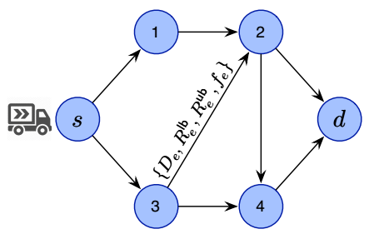
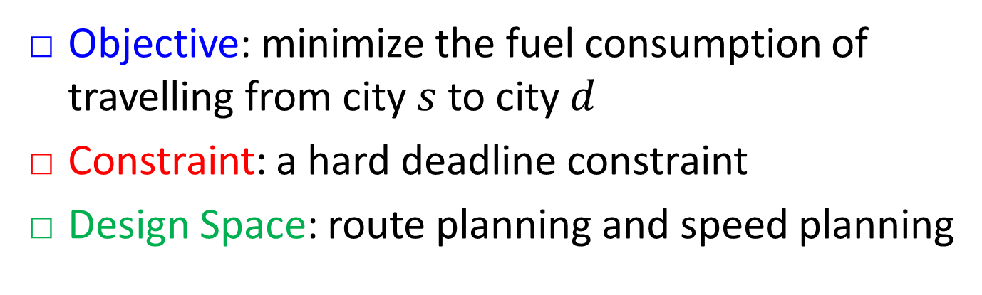
Energy-Efficient Timely Transportation
Objective: minimize the fuel consumption of travelling from city $s$ to city $d$
Constraint: a hard deadline constraint
Design Space: route planning and speed planning

Slide 7
Existing Work on Energy-Efficient Trucking
Paper | Hard Deadline | Route Planning | Speed Planning
[1][2][3] | ✗ | ✓ | ✗
[4] | ✗ | ✗ | ✓
[5] | ✓ | ✗ | ✓
Current Practice | human intelligence
This Work | ✓ | ✓ | ✓
[1] Eva Ericsson, et al, Optimizing route choice for lowest fuel consumption – Potential effects of a new driver support tool, Transportation Research Part C, 2006.
[2] K. Boriboonsomsin, et al, Eco-routing navigation system based on multisource historical and real-time traffic information, IEEE Transactions on Intelligent Transportation Systems, 2012.
[3] G. Scora, et al, Value of eco-friendly route choice for heavy-duty trucks, Research in Transportation Economics, 2015.
[4] E. Hellstrom, et al, Look-ahead control for heavy trucks to minimize trip time and fuel consumption, Control Engineering Practice, 2009.
[5] E. Hellstrom, et al, Design of an efficient algorithm for fuel-optimal look-ahead control, Control Engineering Practice, 2010.

Slide 8



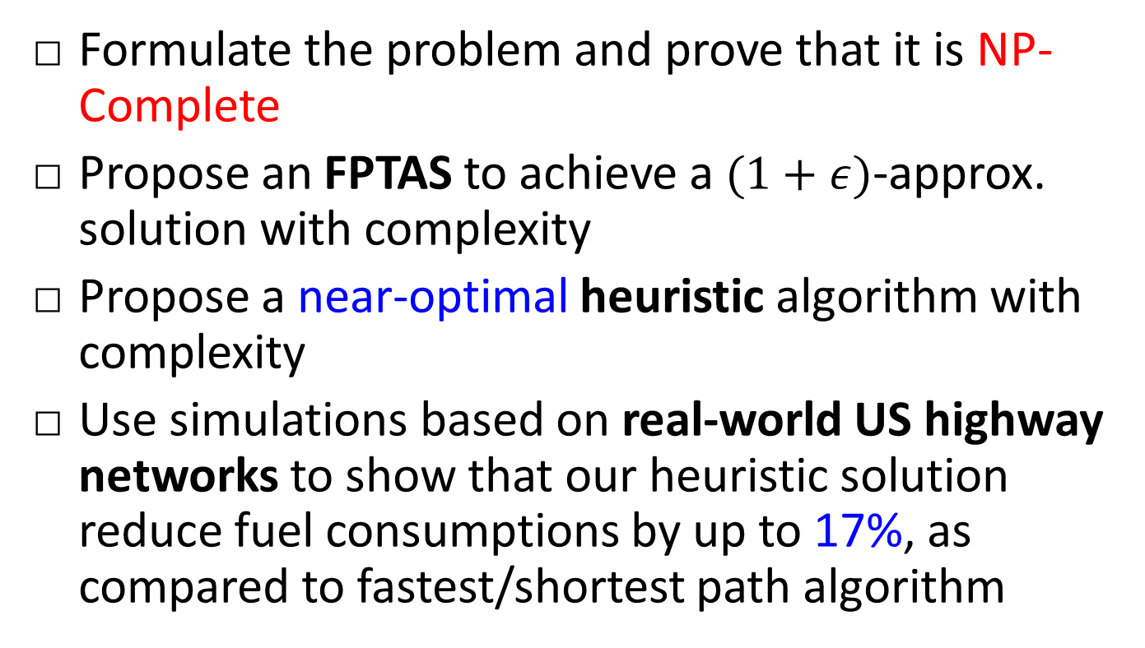
Our Contributions
Formulate the problem and prove that it is NP-Complete
Propose an FPTAS to achieve a $(1+ε)$-approx. solution with complexity
Propose a near-optimal heuristic algorithm with complexity
Use simulations based on real-world US highway networks to show that our heuristic solution reduce fuel consumptions by up to 17%, as compared to fastest/shortest path algorithm
are the number of nodes, edges of the network

Slide 9
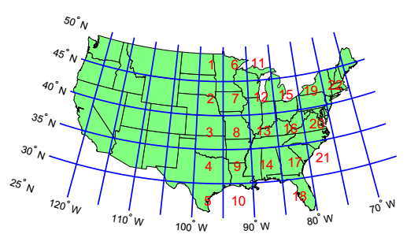
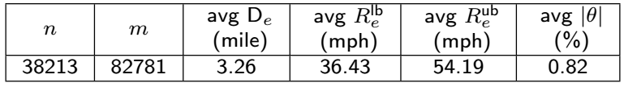
Simulation: Network Statistics

Slide 10
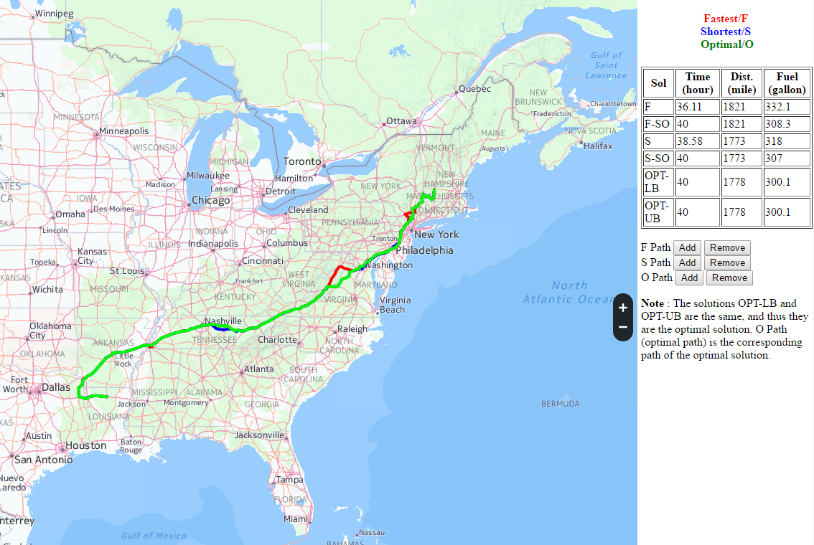
A Solution Example

Slide 11
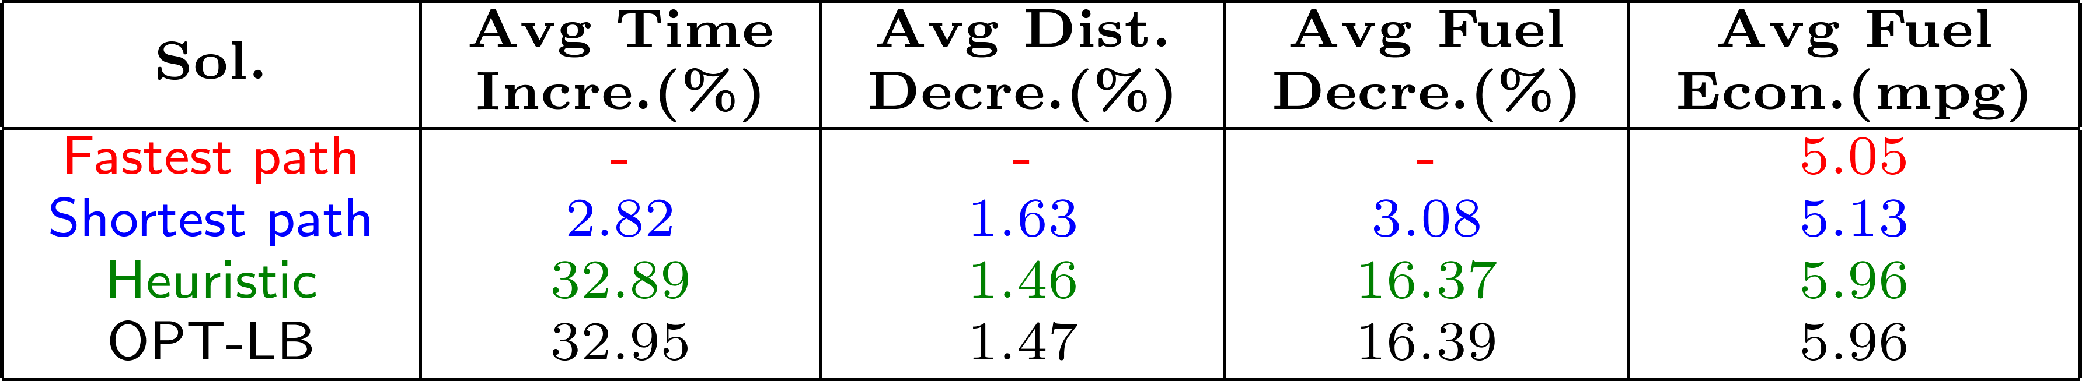
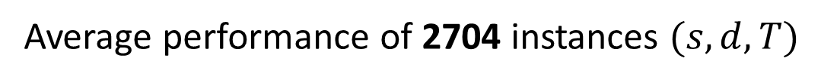
Performance of Our Heuristic Algorithm
Average performance of 2704 instances $(s,d,T)$
Save ~17% fuel as compared to shortest/fastest path algorithms
Enough to power 90% of the transportation sector in New York State
See: Energy consumption estimates by end-use sector, ranked by state, 2013. http://www.eia.gov/state/seds/data.cfm?incfile= /state/seds/sep sum/html/rank use.html&sid=US

Slide 12
Thank You!
Lei Deng
http://personal.ie.cuhk.edu.hk/~dl013/
Lei Deng, Mohammad H. Hajiesmaili, Minghua Chen, and Haibo Zeng, "Energy Efficient Timely Transportation of Long-Haul Heavy-Duty Trucks,”
in Proc. ACM e-Energy, June 2016. (Best Paper Award Candidate)
To appear in IEEE Transactions on Intelligent Transportation Systems.

