Slide 2
Agendar
1.wcreen size
2.window size
3.measuring viewport
4.measuring the <html> element
5.page offset
6.pageX/Y
7.clientX/Y
8.screenX/Y

Slide 3
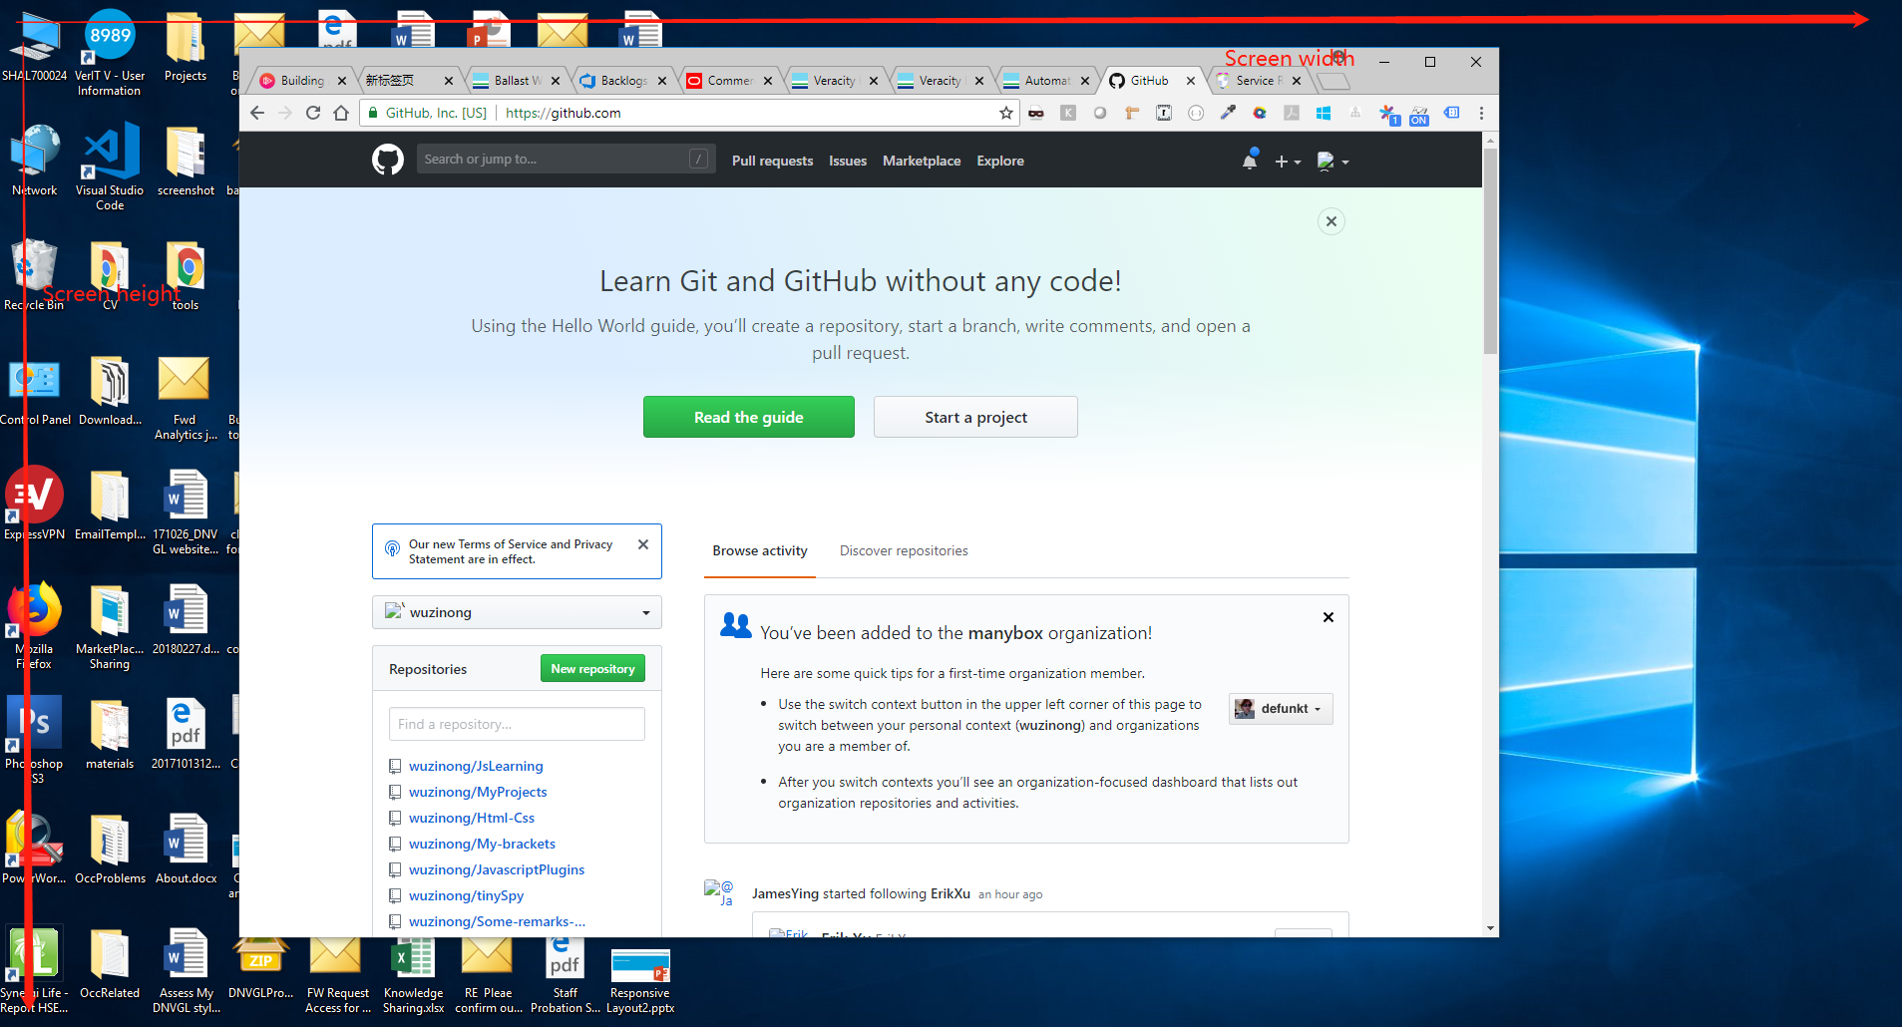
Screen size
screen.width & screen.height
They contain the total width and height of the user’s screen. These dimensions are measured in device pixels because they never change: they’re a feature of the monitor, and not of the browser.

Slide 4
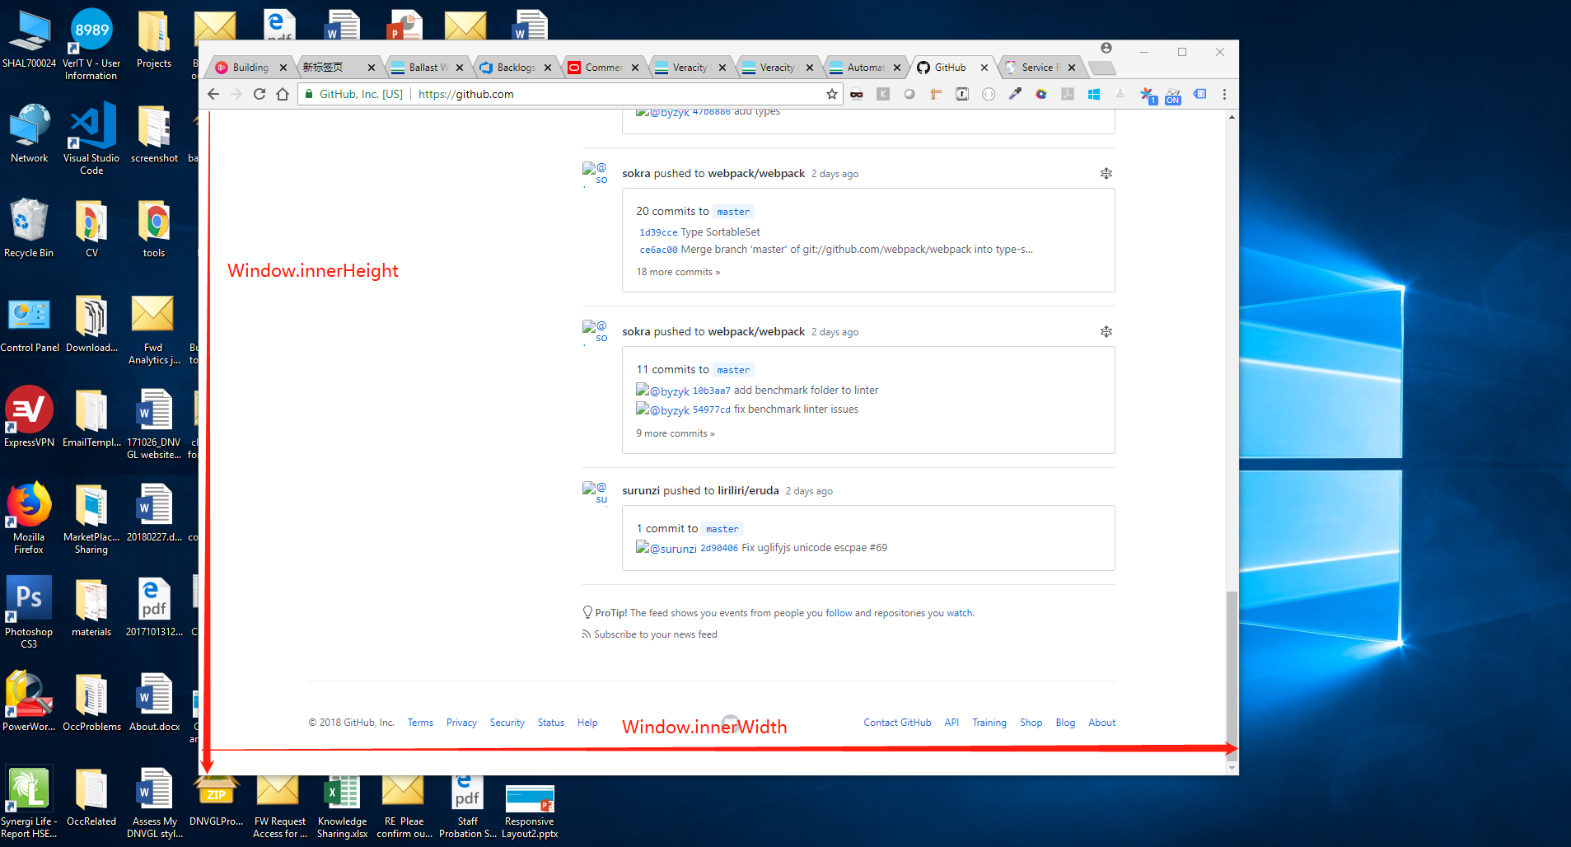
Window size
window.innerWidth & window.innerHeight
the inner width of the window is measured in CSS pixels. You need to know how much of your layout you can squeeze into the browser window, and that amount decreases as the user zooms in. So if the user zooms in you get less available space in the window, and window.innerWidth/Height reflect that by decreasing. Note that the measured widths and heights include the scrollbars

Slide 5
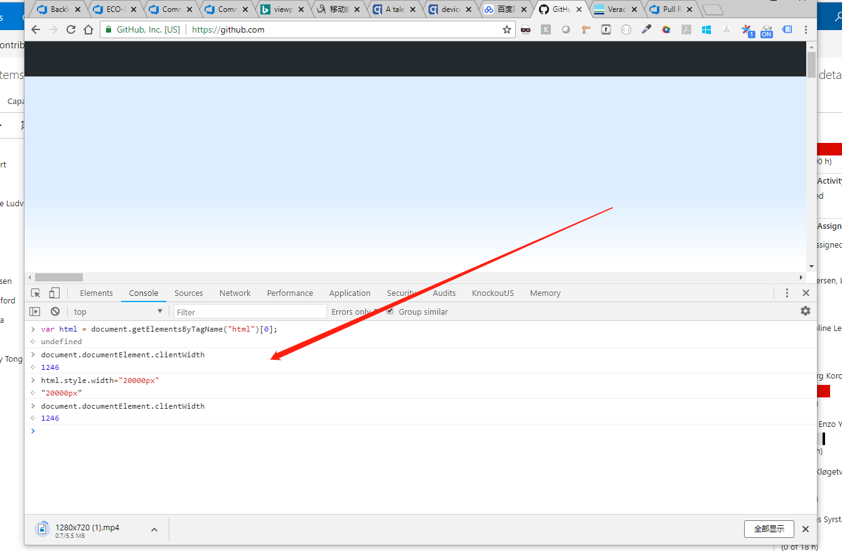
Measuring viewport
document.documentElement.clientWidth & document.documentElement.clientHeight
The width and height of viewport can be found in these 2 attributes.document.documentElement is in fact the <html> element: the root element of any HTML document. ( if you give the <html> element a width.document.documentElement.clientWidth and -Height still gives the dimensions of the viewport, and not of the <html> element. )(Not include the width of scroll bar)

Slide 6
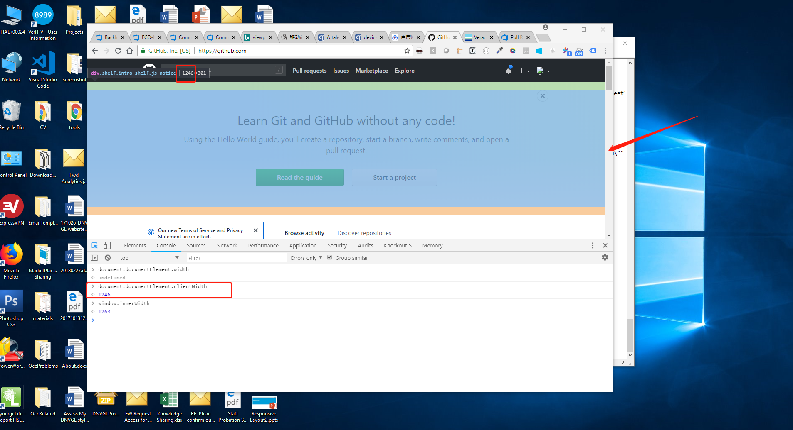
Measuring viewport

Slide 7
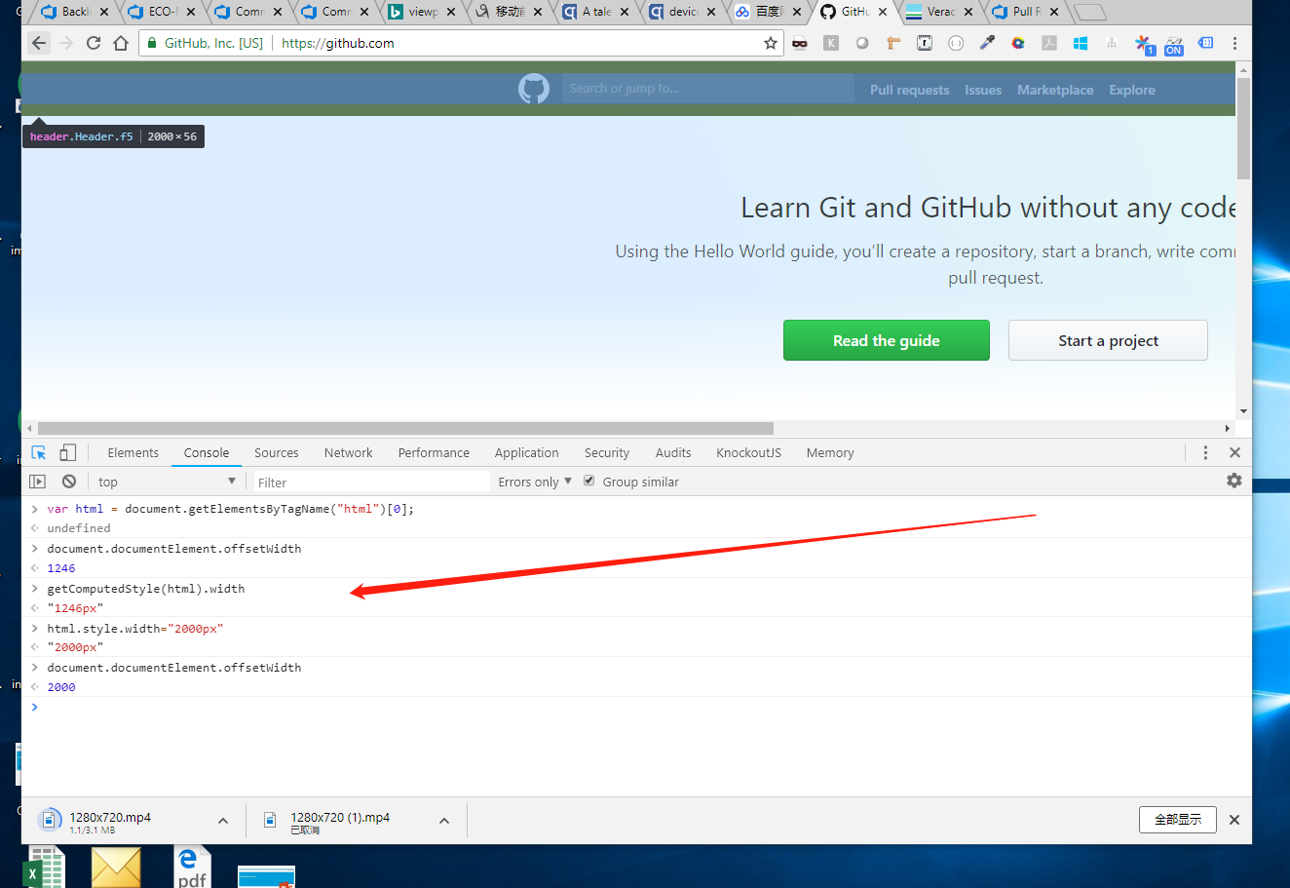
Measuring the <html> element
document.documentElement.offsetWidth & document.documentElement.offsetHeight

Slide 8
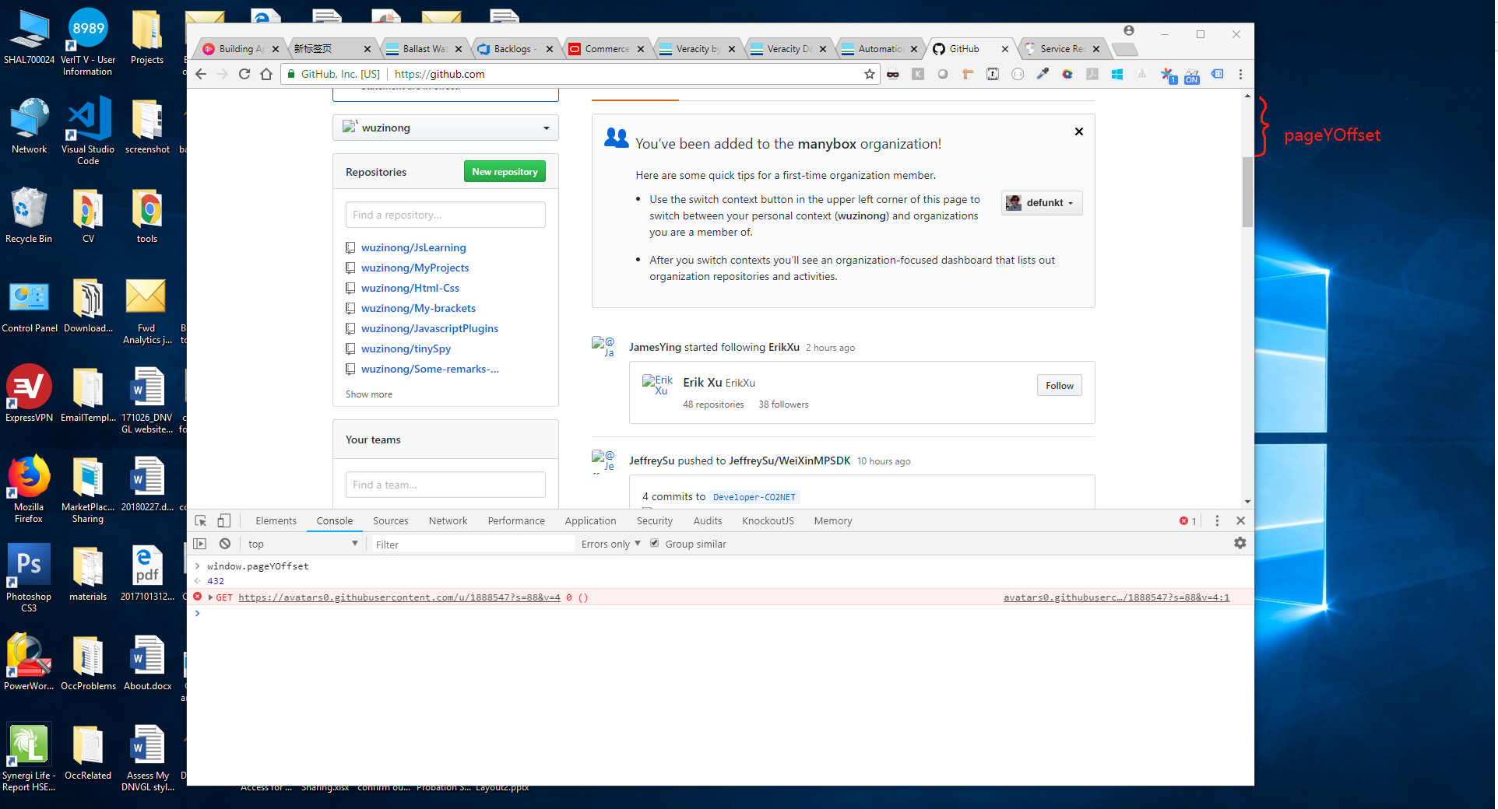
Page offset
window.pageXOffset & window.pageYOffset
contain the horizontal and vertical scrolling offsets of the document. Thus you can find out how much the user has scrolled.

Slide 9
Event coordinates
Then there are the event coordinates. When a mouse event occurs, no less than five property pairs are exposed to give you information about the exact place of the event. For our discussion three of them are important:
1. pageX/Y gives the coordinates relative to the <html> element in CSS pixels.
2. clientX/Y gives the coordinates relative to the viewport in CSS pixels.
3. screenX/Y gives the coordinates relative to the screen in device pixels.
You’ll use pageX/Y 90% of the time; usually you want to know the event position relative to the document. The other 10% of the time you’ll use clientX/Y. You never ever need to know the event coordinates relative to the screen.

Slide 10
References
1. https://www.quirksmode.org/mobile/viewports.html

