Slide 1
Security Demo

Slide 2
What is Web Security
Web security refers to the practice of protecting websites, web applications, and the data transmitted over the internet from unauthorized access, data breaches, and other security threats. It involves implementing measures to ensure the confidentiality, integrity, and availability of web resources, as well as protecting users' privacy and sensitive information.

Slide 3
Scope
Application Security
Network Security
User Authentication and Authorization
Data Protection and Privacy
Secure Configuration and Management
Security Testing and Vulnerability Assessment
Incident Response and Disaster Recovery

Slide 4
Application Security
Application Security: This focuses on securing web applications against various vulnerabilities and attacks. For example secure coding practices, input validation, output encoding, access controls, and proper mechanisms to prevent common threats like cross-site scripting (XSS), SQL injection, cross-site request forgery (CSRF), and more.

Slide 5
Demo
Front End only validation is never enough
Sanitizing/Encoding the contents
CSP
CSRF

Slide 6
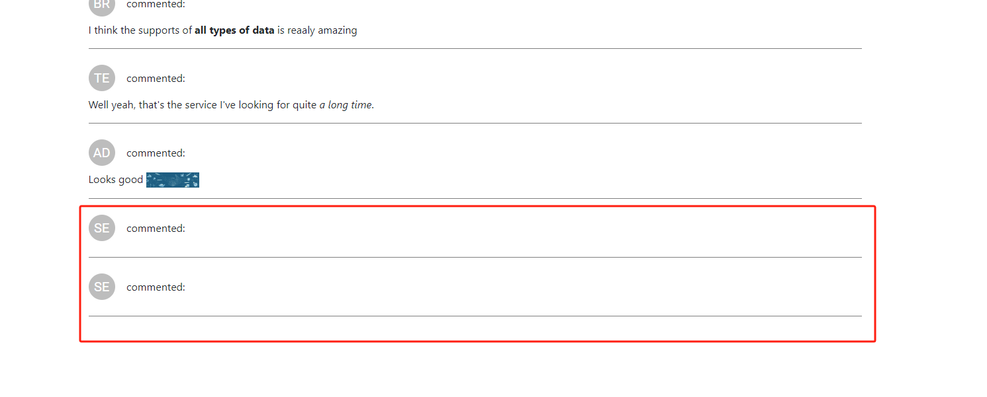
Front End only validation is never enough
Notes:
Use postman to bypass the FE validation
We see the error in the console
Better to add Client/Server side validations

Slide 7
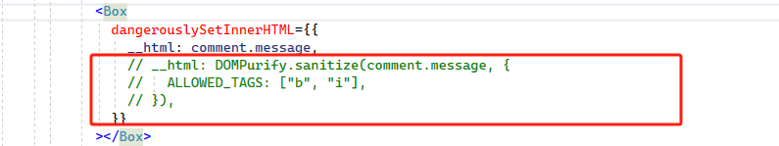
Always Sanitizing/Encoding the contents
Notes:
Try
<img style="width:80px" src="https://fake.com/a.png" onerror="alert('XSS')" />
We need to sanitize the content we use in front end

Slide 8
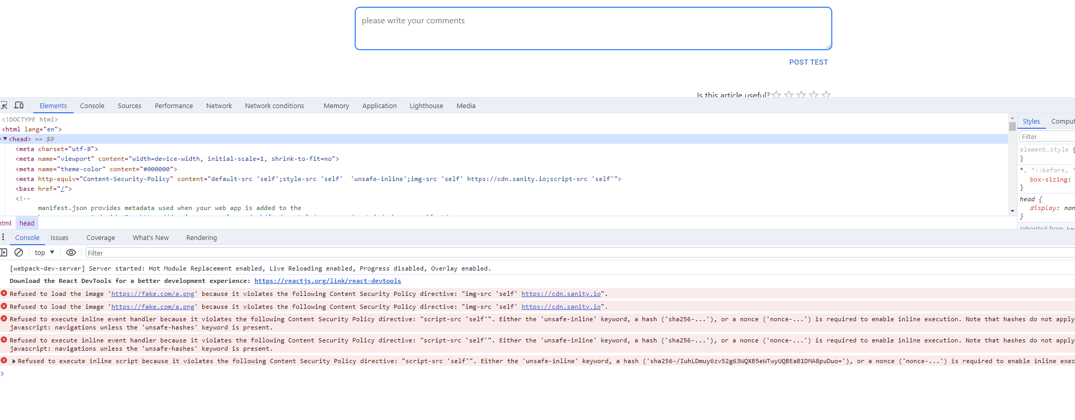
Always set CSP on your website
Notes:
CSP: <img style="width:80px" src="https://fake.com/a.png" onerror="alert('XSS')" /> (csp, remove unsafe-inline for script-src)
Client side validation + POST man
Now if I apply csp the alert will be prevented
<meta http-equiv="Content-Security-Policy" content="default-src 'self';style-src 'self' 'unsafe-inline';img-src 'self' https://cdn.sanity.io;script-src 'self' 'unsafe-inline’”>
Usually I set default-src, style-src, script-src as ‘self’ and add more later if needed
Worth the mention gtm here since it opens the door for injecting 3rd party libraries. Better we put the relevant domains when we need to inject those 3rd party tools

Slide 9
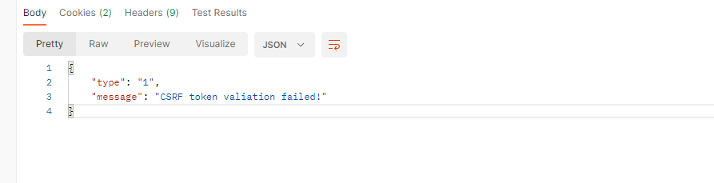
CSRF
Notes:
Normal submit still works
But postman will be blocked
Use:
reCAPTCHA

Slide 10
Thank you

