Slide 1
Introduction
to
SQL Server
Prepared and Presented by : Walter VanderHeide
Present to: InterImage Web Developers
Date: January 21, 2002

Slide 2
What is SQL Server?
Developed by Microsoft, SQL Server is a relational database management system (RDBMS) for distributed client/server computing.
Overview of SQL Server
SQL Server works as a natural extension of Windows NT/2000/9x
Relatively easy to manage through the use of GUIs.
Scales from a laptop to multiprocessor systems.
Data independence (both physical and logical) (Applications are not dependent on
the structure of the stored data)
Query optimization
Data integrity (Date field will not except Feb 30)
Concurrency control (Control how multiple users or apps act at same time on data)
Backup and recovery
Security

Slide 3
SQL Platforms
Server
  Windows 2000
  Windows NT
  Windows 9x
Client
  Windows 2000 Server and Professional
  Windows NT 4.0 Server and Workstation
  Windows 95/98
  Dos, Unix, Apple

Slide 4
SQL Security
Two Level Validation
  Login (SQL or NT)
    Userid
    Password
  Permission Validation
    User
    Group
    Role (I.E. dbcreator)

Slide 5
Login Validation
NT Authentication
  NT login used
  SQL must have NT group or user identified
SQL Authentication
  Separate Userid and Password for SQL
  Could be dual logins
Mixed Mode
  Either NT or SQL login allowed

Slide 6
Permission Validation
Identifies What a User/Group Can Do
  Specific to a Database
  Based on Server Role or Database Role
Server Roles (examples)
Role Permission
Database creators (dbcreator) Create and alter databases
System administrators (sysadmin) Perform any activity
Database Roles
public Maintain all default permissions for users in a database
db_owner Perform any database role activity
db_datareader Read data from any table
db_datawriter Add, change, or delete data from all tables
db_denydatawriter Cannot change data in any table

Slide 7
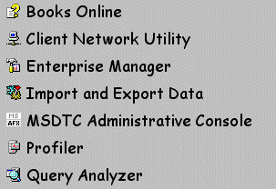
SQL Server Software

Slide 8
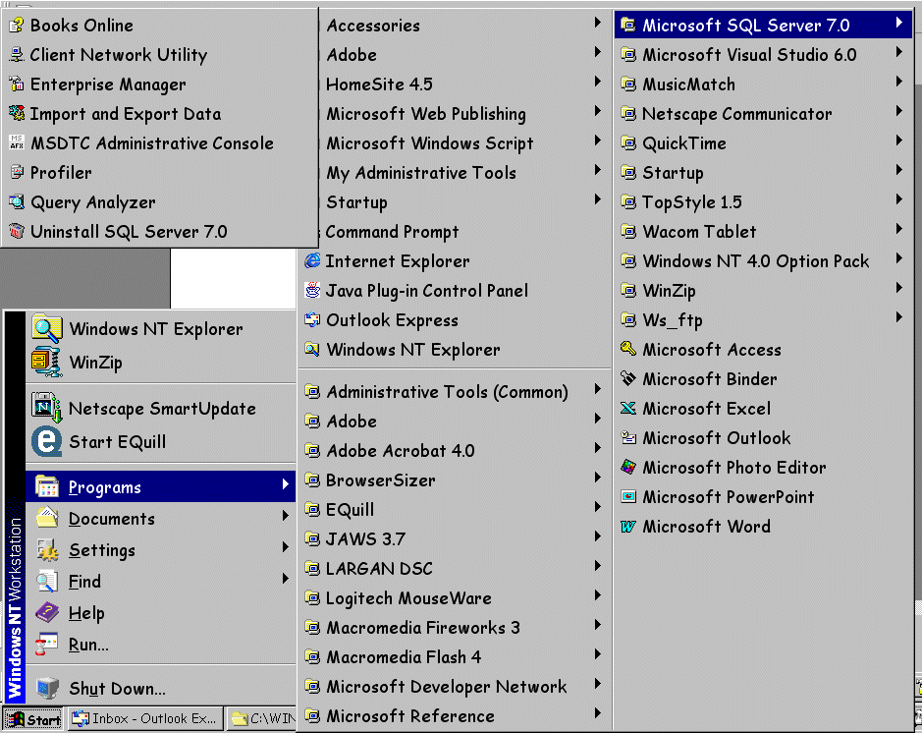
Accessing SQL Server Software
Click the start menu
Go to Programs
SQL Server

Slide 9
Books Online
SQL Manual
Laid Out Like a Manual
  Table of Contents
  Chapters
  Index
Search Capability

Slide 10
Enterprise Manager
GUI for SQL
Manage SQL Server
  Create Databases
  View Database Objects
  View(Change) Database Data
  Import/Export Data
  Backup/Restore Data
  Wizards

Slide 11
Query Analyzer
Enter Transact SQL Commands
Execute Transact SQL Commands
Review Output of Transact SQL Commands
Analyze Execution of Transact SQL Commands

Slide 12
Lab Assignment
Run Books Online
  Search for help on server architecture using the index tab
  Search for help on server architecture using the search tab
  Use the following phrases for the search:
    “server architecture”
    server architecture
    server near architecture
Open Enterprise Manager
  Expand the SQL Server Group to find the names of all DBs on Heavymetal
Launch Query Analyzer from both the start menu and from within Enterprise Mngr
  Select all fields from any table in the Northwinds DB

