Slide 1
Accessing
SQL Server
DataBases
Prepared by : Walter VanderHeide
Date: July 30, 2002

Slide 2

SQL Server Database Access
If you need to access a SQL Server Database, but you don’t have the SQL Server
Client Tools, here are some alternative ways to get at the data
MS Access
Programming Languages
  Visual Basic
  C (any flavor)
  Virtually any language that can use DAO, RDO, ADO, ODBC, OLE DB, etc.
MS Query

Slide 3
Using MS Access
One of the features of MS Access is the reports and forms, that can be used to present
data. This feature is not a part of SQL Server, but can be taken advantage of by opening
SQL Server database in Access.
There are two ways to do this:
1. Use ODBC (Other DataBase Connection) (Works in Access 97 and 2000)
2. Access Project (Introduced with Access 2000)

Slide 4
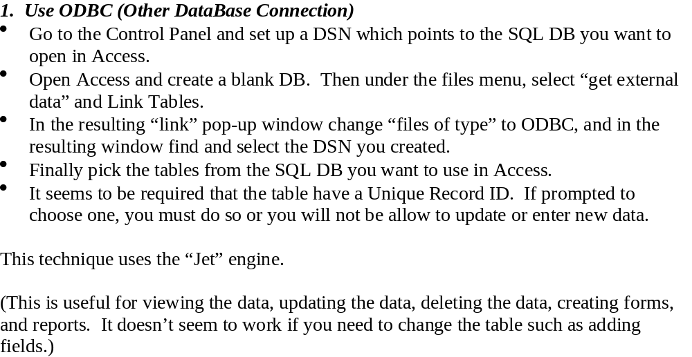
Using MS Access via ODBC

Slide 5
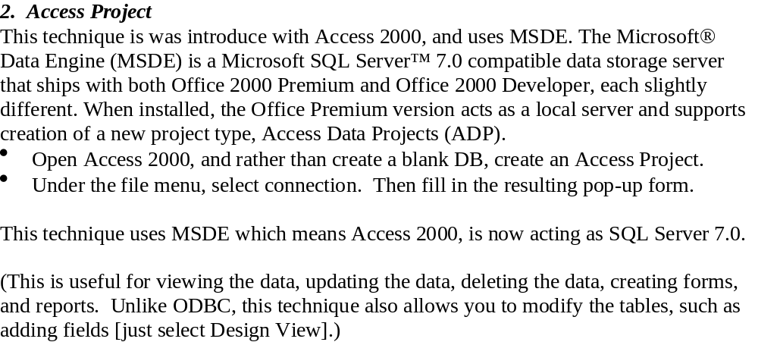
Using MS Access via an Access Project

Slide 6
What is Microsoft Query?
Microsoft Query is to Databases what 'Notepad' is to Word Processing. It's a utility program found on most Windows PCs which these days tends to be forgotten about. To find it look for (Msqry32.exe)
It allows you to connect to a database using ODBC and then carry out SQL queries on the data. It provides quite a bit of help with creating the SQL queries, and displays the results in a spreadsheet format.
For information on using MS Query see http://www.zillion.freeuk.com/odbc/odbc_intro.html#part40

Slide 7
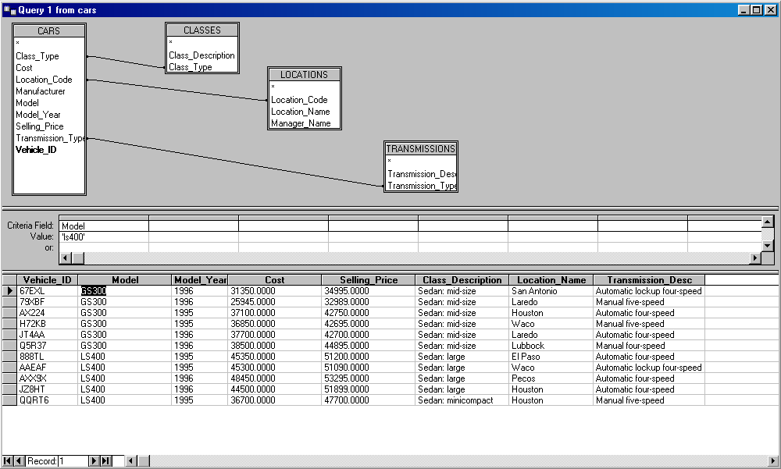
MS Query - Screen Shot

