Slide 1
Maintaining
Databases
and
Tables
Prepared and Presented by : Walter VanderHeide
Present to: InterImage Web Developers
Date: January 21, 2002

Slide 2
Create Database
Define the Name, Owner, Files, Initial Size
Primary File, Secondary File, Log File.
Primary File
  All System Files
  Database Specific Info
  User Objects and Data
  One and Only One Primary File
  .mdf Is File Extension
Secondary File
  User Objects and Data
  Spreads Data Across Physical Disks
  Normally Used for Very Large Databases
  .ndf Is File Extension
  Used to Recover a Database
  Stores Transaction Entered Since Last Database or Log File Backup
  .ldf Is File Extension
Log File

Slide 3
Ways to a Create Database
1. Use SQL Server Enterprise Manager
(Connect to a DB, and right click on DataBases)
2. Use the Create DB wizard
(Under the Enterprise Mngr tools menu)
3. Use Transact-SQL in the Query Analyzer
(see next slides)

Slide 4
Create Database Syntax
CREATE DATABASE database_name
[ON
{ [PRIMARY] (NAME = logical_file_name,
FILENAME = ' os_file_name‘
[, SIZE = size]
[, MAXSIZE = max_size]
[, FILEGROWTH = growth_increment] )
} [, ...n]
]
[LOG ON
{ ( NAME = logical_file_name, FILENAME = ' os_file_name'
[, SIZE = size] )
} [, ...n]
]
[FOR RESTORE]

Slide 5
Database Create Example
CREATE DATABASE employee
ON
PRIMARY ( NAME=employee_data,
FILENAME='c:\mssql7\data\employee.mdf',
SIZE=10MB,
MAXSIZE=15MB,
FILEGROWTH=20%)
LOG ON ( NAME=employee_log,
FILENAME='c:\mssql7\data\employee.ldf',
SIZE=3MB,
MAXSIZE=5MB,
FILEGROWTH=1MB)

Slide 6
Check Database Info
Use Query Analyzer
EXEC sp_helpdb <db name>
  i.e. sp_helpdb northwind
  Use Enterprise Manager
Right Click DB Name and select properties

Slide 7
Delete Database
Eliminates a Database From SQL Server
Once Deleted, It Can Not Be Recovered
Use Query Analyzer
  DROP DATABASE database_name
  i.e. Drop zzzz_test
Use Enterprise Manager
Right Click DB Name and select delete

Slide 8
Lab Assignment 1
1. Use create a database called z_test based on the information in the following table:
File
Name
Initial
Size
File
Growth
Maximum
Size
Database
Sample10.mdf
2Mb
20%
15 Mb
Log
Sample10.ldf
1Mb
1 Mb
5 Mb
2. View the database properties in to verify that the database has been created properly. (In Query Analyzer use sp_helpdb)
3. Delete the Data Base
Do all three steps above once with Query Analyzer and again with Enterprise Manager

Slide 9
Create Tables
Define Name and Contents
Identify Constraints
  Rules for Entering Data
  Tells What Is Allowed
  Tells What Is Not Allowed
Fully Qualified Name
  server.database.owner.table
  Only Table Is Required
(The central concept of the relational data model is the TABLE)

Slide 10
Create Table Syntax
CREATE TABLE table_name
(
{ <column_definition>
| column_name AS computed_column_expression
| <table_constraint>
} [,...n]
)

Slide 11
Column Definition
column_name data_type_size
[ NULL | NOT NULL]
[ DEFAULT constant_expression ]
| [ IDENTITY [(seed, increment ) [NOT FOR REPLICATION] ] ]
[ ROWGUIDCOL ]
[ ...n]

Slide 12
Table Create Example
CREATE TABLE employee
(
emp_no int NOT NULL ,
emp_fname char(20) NOT NULL ,
emp_lname char(20) NOT NULL ,
emp_mi char(1) NULL,
gender char (1) NOT NULL default 'f',
dept_no char(4) NOT NULL
)

Slide 13
Check Table Info
Use Query Analyzer
EXEC sp_help <table name>
  i.e. use northwind
EXEC sp_help employees
  Use Enterprise Manager
Right Click Table Name and select properties

Slide 14
Delete Table
Eliminates a Table From the Database
Once Deleted, It Can Not Be Recovered
Use Query Analyzer
  DROP Table table_name
  i.e. Use zzz_test
  Drop zzzz_table
Use Enterprise Manager
Right Click Table Name and select delete

Slide 15
Lab Assignment 2
(Do this assignment twice once with Query Analyzer and a again
with Enterprise Manager)
Create a table named a_TEST in the Northwind database. Select a name, type and size for each field. View the contents using sp_help. Drop the Table.
Name
Nulls
Identity
Member Number
No
Seed = 2
Increment = 2
Lname
No
No
Fname
No
No
Minitial
Yes
No
Gender
Yes
No
Picture
Yes
No

Slide 16
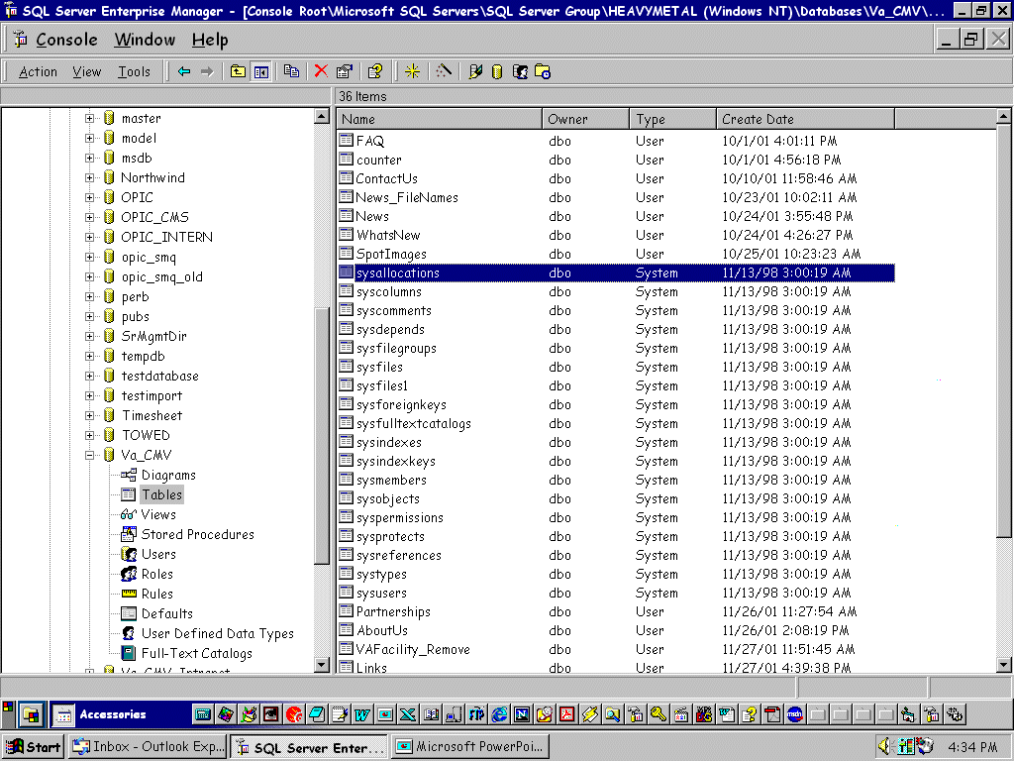
Table Types
User
Tables that are created by a user
System
Table that are used by the SQL Server system.
System tables can be
hidden from view by
right clicking the server name
(i.e. Heavymetal), and selecting
“Edit SQL Server Reg..”.
Uncheck “show system…”

Slide 17
Connecting to a SQL Server Data Base through ASP
Connection String Example
strConn = "Driver={SQL Server}; Server=Heavymetal;”
strConn = strConn & “ Database=Pubs; UID=sa; PWD="
set conn = Server.CreateObject("ADODB.Connection")
conn.Open strConn
DSN Example (Data Source Name)
Set conn = Server.CreateObject("ADODB.Connection")
conn.Open "DSN=MyDSN;UID=Jack;PWD=1234"

