Slide 1
Examining Armed Conflicts in Africa

Slide 2
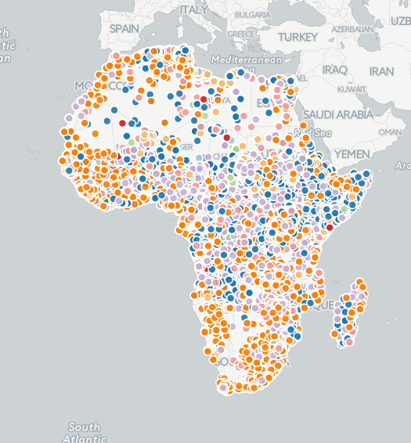
The dataset
http://www.acleddata.com/
Dataset of armed conflict events occurring in the African region from 1997-2015
Approximately 100000 total events occured

Slide 3
Initial Analysis
Fatalities: The mean is 6, with a standard deviation of 98, with a range from 0 to 25000. More than half of events tend to end with no fatalities (67760/1 06700), with 110543 events with 1, 4699 with 2, 2727 with 3. The frequency of fatality counts tend to decrease as the fatality count grows higher.
Event Type: Of the event types, 30% are Battle-No change of territory, 30% are Violence against citizens, 25% are Riots, and the other are miscellaneous
Actors: Of the two categories, Actor 1 and Actor 2, Actor 1 tends to be military group and Actor 2 tends to be civilian groups, which implies that Actor 1 is usually the aggressor
Country: Most events seem to focus in the same countries

Slide 4
Missing values
Missing values
Out of the above columns, the following have significant amount of missing values
ALLY_ACTOR_1 : 88748
ACTOR2: 151 4
ALLY_ACTOR_2: 95024
ADM_LEVEL_2: 100030
ADM_LEVEL_3:: 1002827
NOTES: 10929
SOURCE: 187
FATALITIES: 4478
Interestingly enough, this can tell us a little bit about the data already. There are about 106700 entries in total. The missing values for ALLY_ACTOR1 suggest that the instigators tend not to ally with other groups (75% of the time). We also see that a small, but still significant, portion of the incidents lack an ACTOR2, meaning that violent events were not commited against another political group, and even those that did lacked ALLY_ACTOR2.

Slide 5
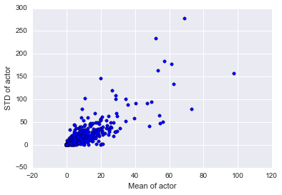
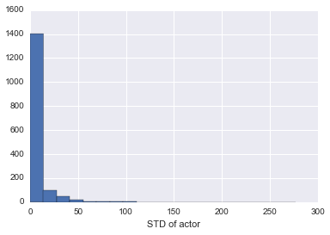
Hypothesis 1: Actors tend to have similar fatality counts across their events
An overwhelming percentage of actors tend to have low standard deviation compared to others. This would imply that our hypothesis that actors tend to have similar fatality counts across events is true, with the caveat that as actors have higher average fatality counts in events they commit, their standard deviation grows. In other words, peaceful groups tend to stay peaceful, but non-peaceful groups tend to vary in their fatality counts (ex different operations)

Slide 6
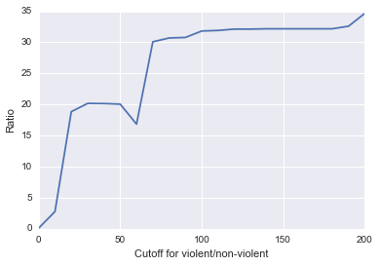
Hypothesis 2: Events where militaristic and non-militaristic group are involved tend to have more fatalities
We divide the events into two groups based on the mean fatality rate of actor 1 being above the cutoff and actor 2 being below (shown in the x axis). Ideally, we want to look at the ratio when the cutoff is close to 0.

Slide 7
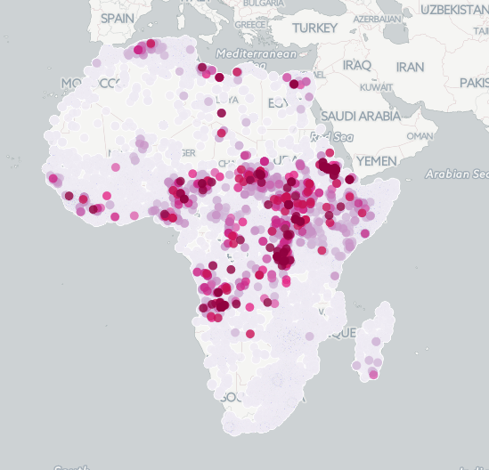
Hypothesis 3: Medium to low casualty events tend to occur in the same area, whereas higher casualty events tend to be more geographically widespread
The opposite is in fact true: lower casualty events tend to be more wide spread geographically, whereas high casualty events tend to be more concentrated.

Slide 8
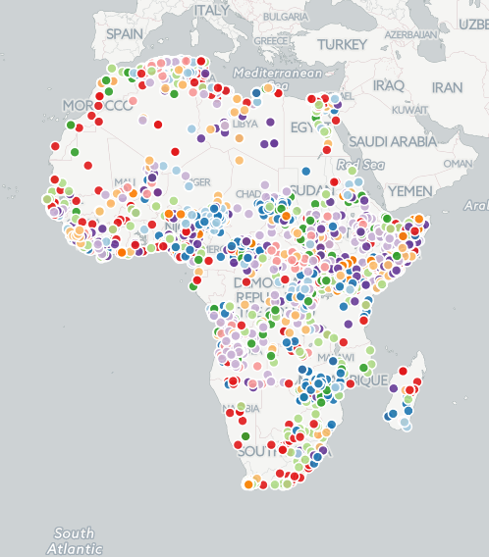
Hypothesis 4: Event with similar causes/actors tend to be clustered geographically
Taking the columns ‘INTERACTION’, ‘ACTOR1’, and ‘EVENT_TYPE’, then converting the categorical variables into binary, and then reducing it into 3 dimensions using SVD, and clustering with kMeans using 10 clusters, results in the clusters below. We can see some semblance of interrelated clusters.
A cluster of note is the red cluster, which seems to stay mainly on the coastline,

