Slide 1
Functional Programming with Scala
By William Van Steen
With help from Dylan Graves, Steve Evers, and Chris Lesinski
Notes:
Bootcamp Welcome -> Personal instruction -> Segue
Add Repo information

Slide 2
Client Requested AWS Migration…
Migrating HR services to AWS.
Employees will appear multiple times in the source
The historical employee data does not need to be moved to AWS
Employee updates will appear in the source and should be on the AWS system within minutes
Only a source dump is possible
This client has LOTS of employees, so performance will be a problem

Slide 3
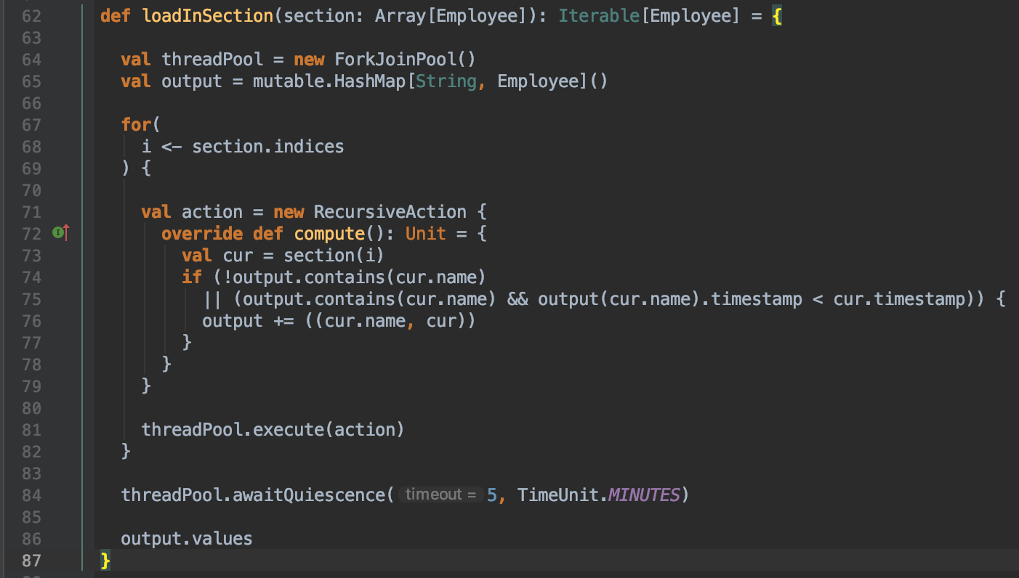

Slide 4
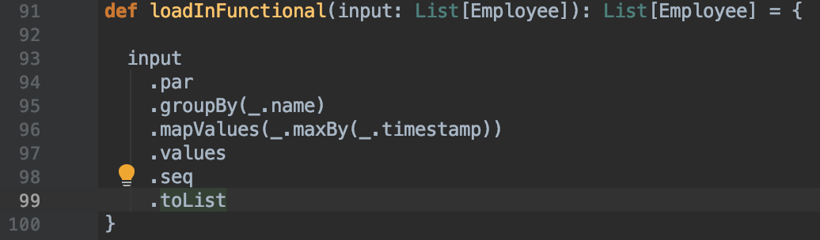

Slide 5
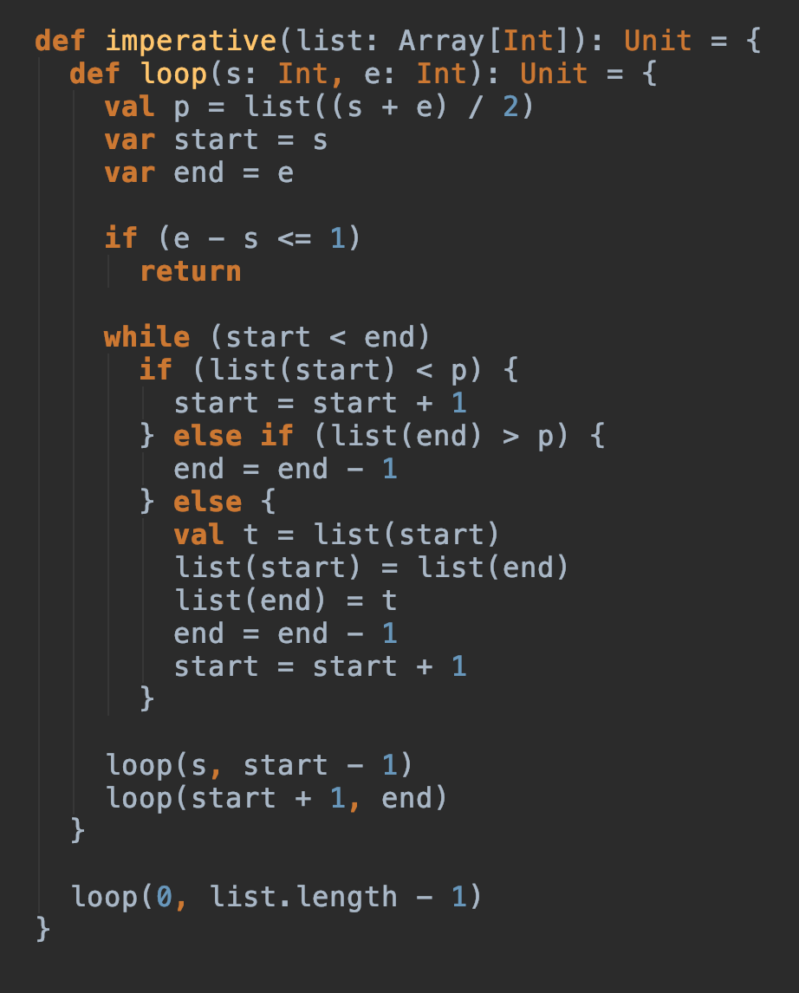
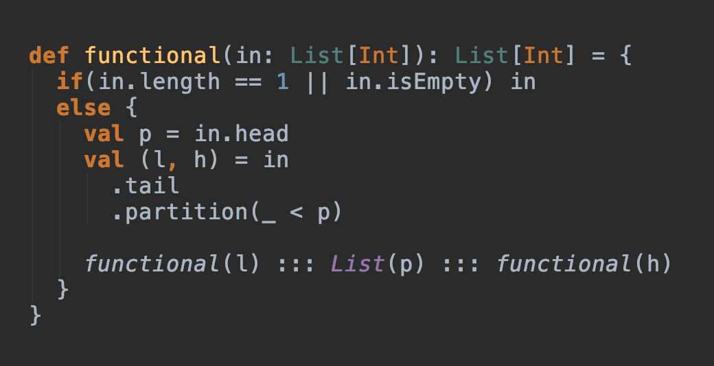
Notes:
Emphasis that the functional won't make sense.

Slide 6
Challenges with Imperative Programs
Distributed programming
State has to be written to disk often in case there is a network issue
Concurrent Programming
Shared State has to be carefully managed and controlled
Difficulty of comprehension
Clear Error States
Notes:
Spark is so great because of immutable collections. They are why it is more performant than Hadoop. Concurrent Programming -> Haxl & Facebook. Ease of comprehension is about making the chunks of a program smaller.
Less detail on facebook

Slide 7
Benefits of Functional Programming
Distributed programming
Map Reduce comes from functional programming research
Concurrent Programming
No shared state: no race-conditions and no need for mutexes
Ease of comprehension
Clear error states
More robust abstractions
Notes:
Spark is so great because of immutable collections. They are why it is more performant than Hadoop. Concurrent Programming -> Haxl & Facebook. Ease of comprehension is about making the chunks of a program smaller.
Less detail on facebook

Slide 8
Downsides of Functional Programing
Performance
Especially predicable performance
Memory usage
Garbage collection
Estimating time complexity
Strangeness

Slide 9
What is Functional Programming?
https://image.slidesharecdn.com/dimitrysolovyov-functionalprogramming-120611062433-phpapp01/95/dimitry-solovyov-the-imminent-threat-of-functional-programming-4-728.jpg?cb=1339396027
Notes:
Ask the question. If they get it agree, state the definition and move on. If they don’t save the definition until after functions.
Setup expectations about how it's simple graphs

Slide 10
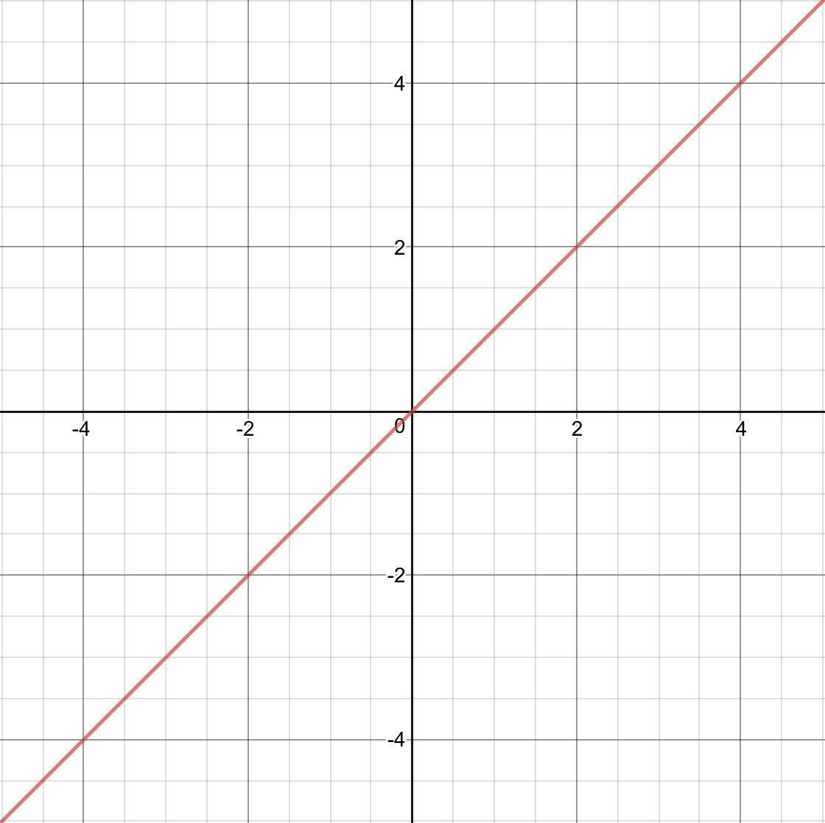
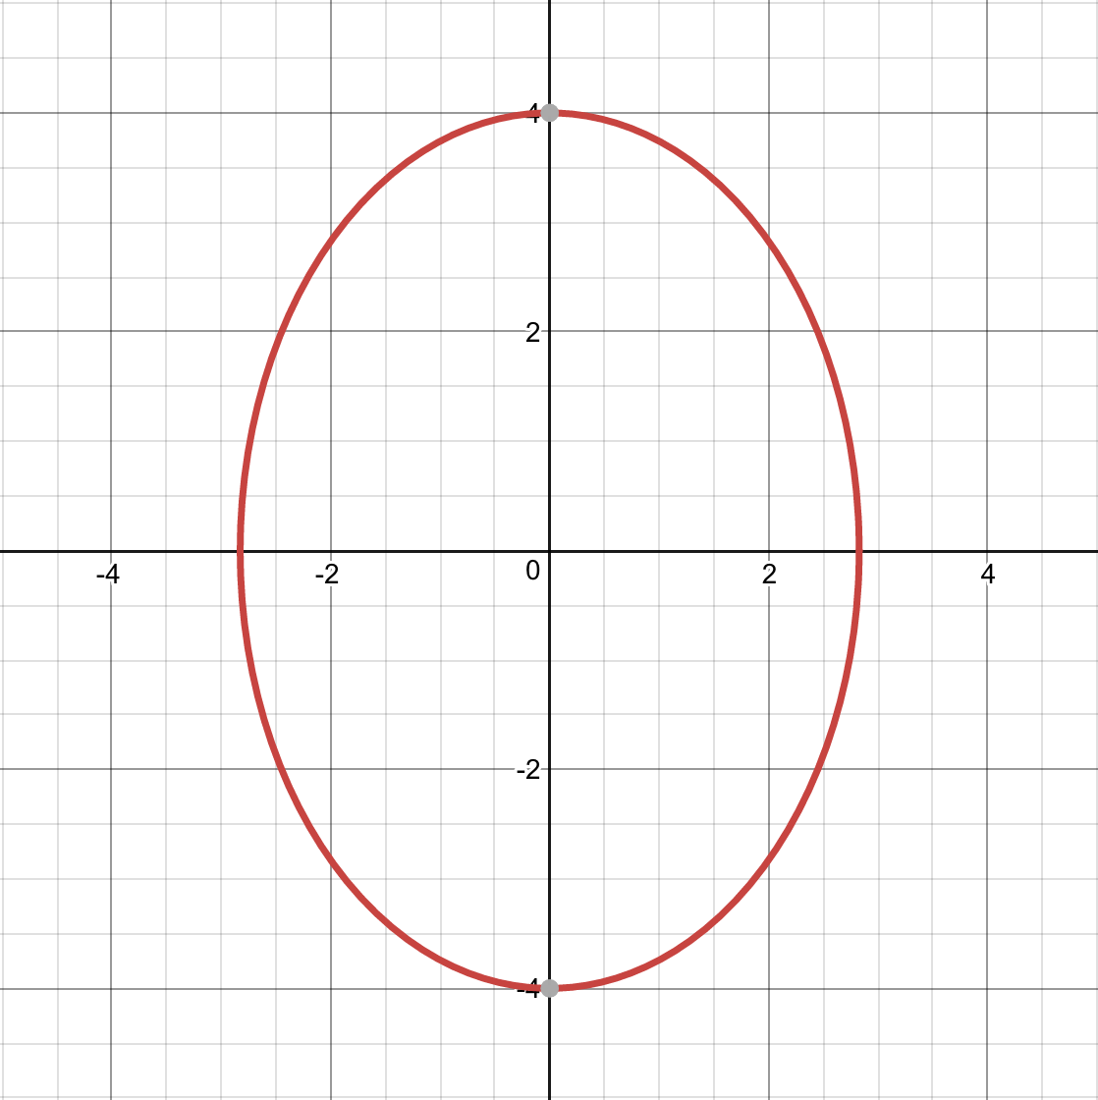
Addition: Functional
1+1 = 2 ALWAYS
DateTime.now(): Not Functional
Notes:
X=Y is a function use a specific example from the graphy. The Ellipse is not a function. Use 0 as the example for why it’s not a function. Move onto the adding and date time as programming examples
Change order to Function -> Programming instead of Math to Programming
Add Array index to the DateTime
In the non functional one give an example of a method with an input

Slide 11
Functional Programing is: Programing using only Mathematical Functions
∴
NO - Programming without mutable state
NO - Programming without variables
NO - Throwing Exceptions
NO - Creating Side Effects
NO - Mutable Collections
Notes:
No Mut state -> no Varibles. No throwing exceptions we’ll cover this more later just trust me for the moment. Performing addition actions which are not part of the return can cause the method to randomly fail for the same input. Collections is going to be something we spend a lot of time on.
Don't enumerate the list. Focus on how people are losing things they are comfortable with.

Slide 12
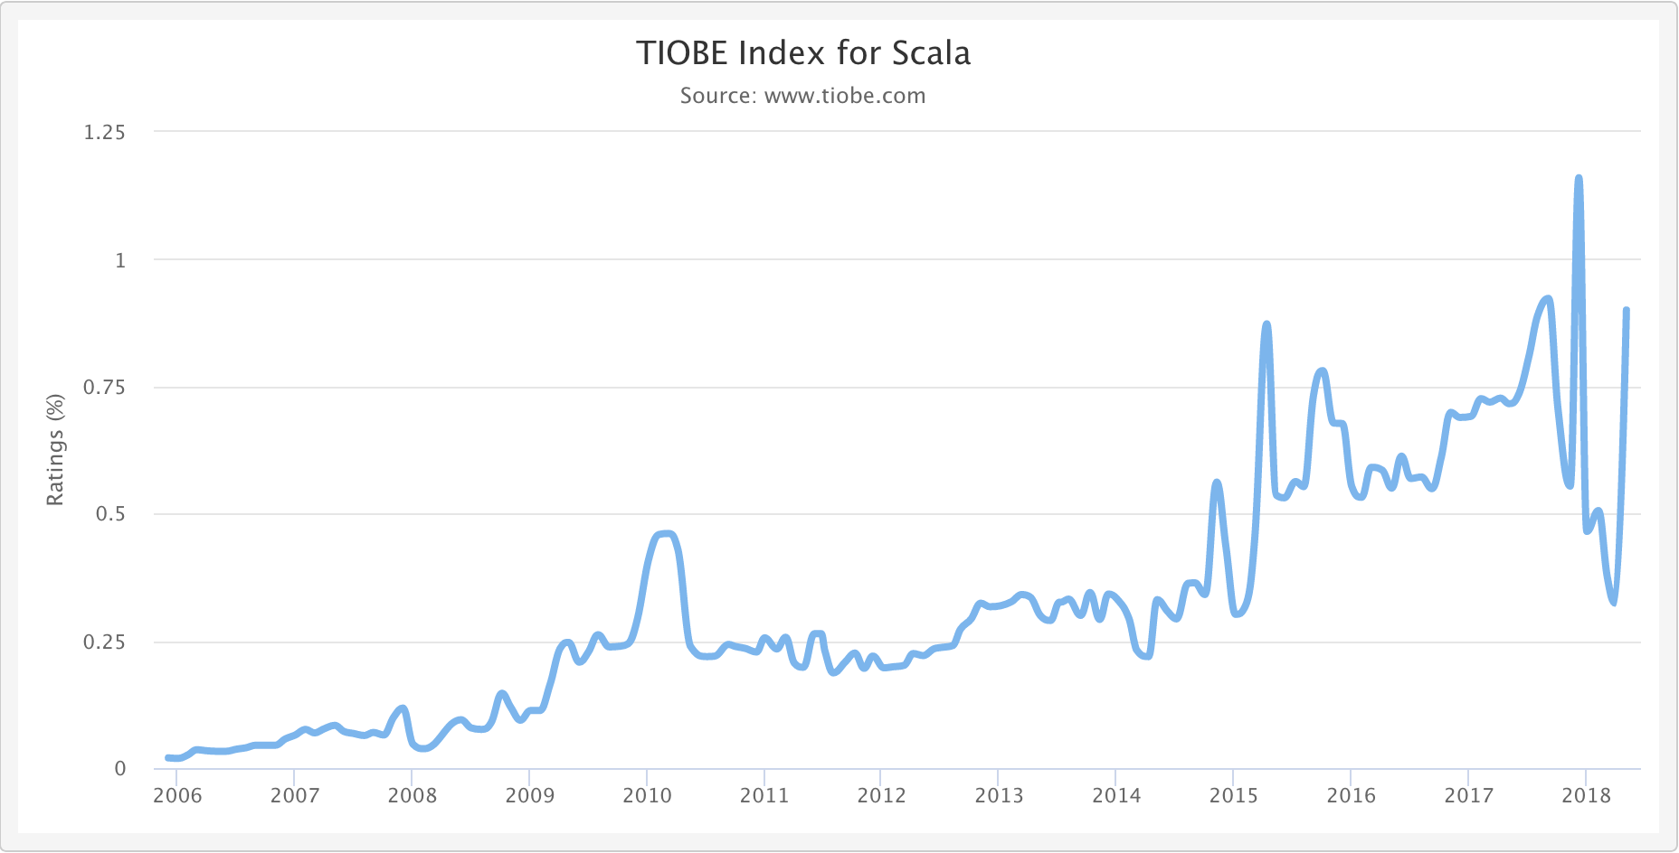
Why Scala?
Most used Functional Programming language*
Use of Scala is on the rise
It runs on the JVM, so the whole Java ecosystem is available
Java programs can be partially ported to Scala
Spark – Distributed Map Reduce Framework
Wide usage in the Big Data space

