Slide 1
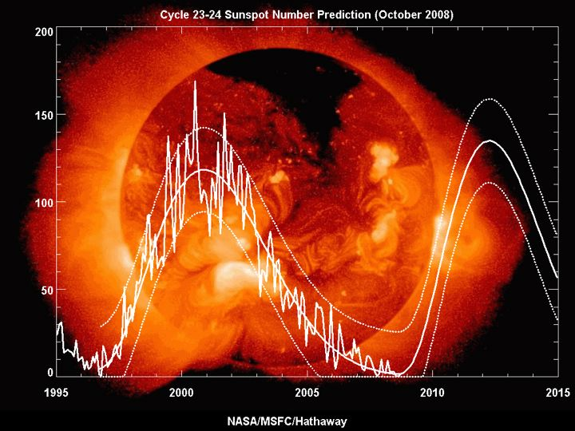

Slide 2
Low Band DXing
There’s life below 14 MHz!
40 meter attributes
  Global coverage
  “Convenient” hours for West Coast DXing
  Minimal TVI concerns
40 meter challenges
  Interference (local & AM broadcast)
  Low Band DXing takes a good antenna

Slide 3
Low Band DX Antennas
The Good, The Bad, and the Ugly

Slide 4
The Half-Square Yagi
A New, High-Performance, Low-Cost Design for Low-Band DXing
Notes:
This is a test

Slide 5
What makes a Good Low Band Antenna?
Common Antenna Myths
Myth #1 Commercially-made antennas are better than homebrew
Myth #2 Directivity and Gain are basically the same thing
Myth #3 A monoband yagi on a 60 foot tower good enough, regardless of the band
Myth #4 Low Band DX antennas gotta be huge

Slide 6
Critical Attributes for an Effective 40 meter DX Antenna
Efficiency
Directivity
Low Angle of Radiation
Gain

Slide 7
Quiz Question #1)
Between what elevation angles do most West Coast 40m openings to Japan occur?
A) 30 to 45 degrees
B) 20 to 30 degrees
C) 3 to 20 degrees
D) 3 to 10 degrees
E) All of the above

Slide 8
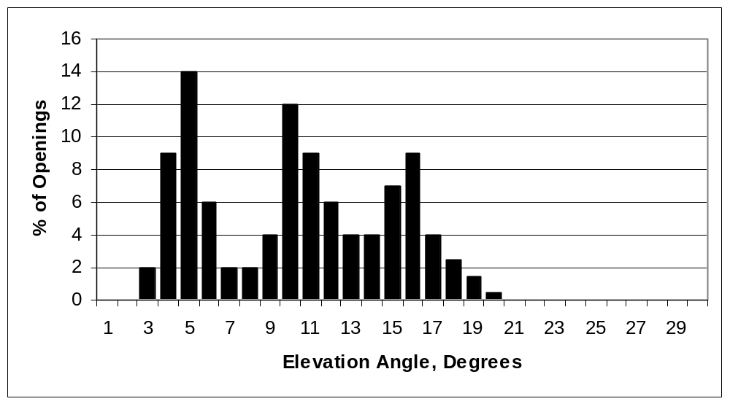
West Coast 40-meter openings to the Far East
(via IONCAP)
If your antenna’s main elevation isn’t between 3 and 20 degrees, you’re toast !

Slide 9
Quiz Question #1)
Between what elevation angles do most West Coast 40m openings to Japan occur?
A) 30 to 45 degrees
B) 20 to 30 degrees
C) 3 to 20 degrees
D) 3 to 10 degrees
E) All of the above

Slide 10
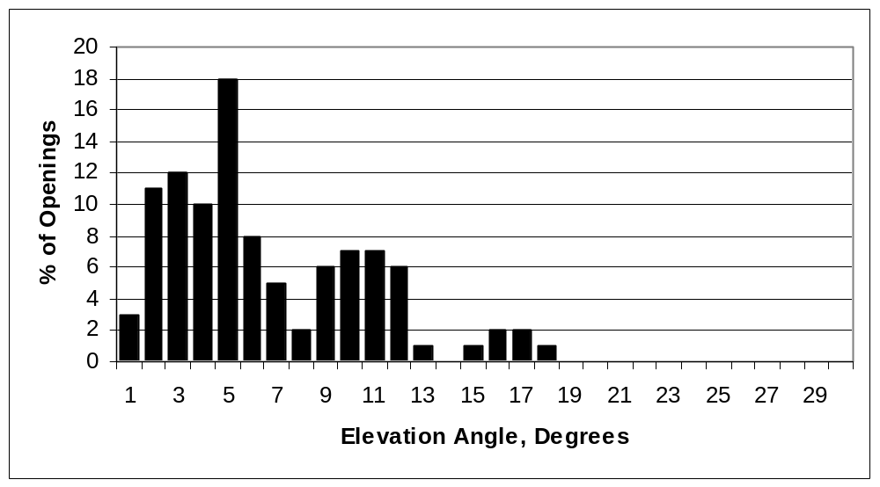
West Coast 40-meter openings to the Europe
Aiming for Europe? Two to 12 degrees is what you want!

Slide 11
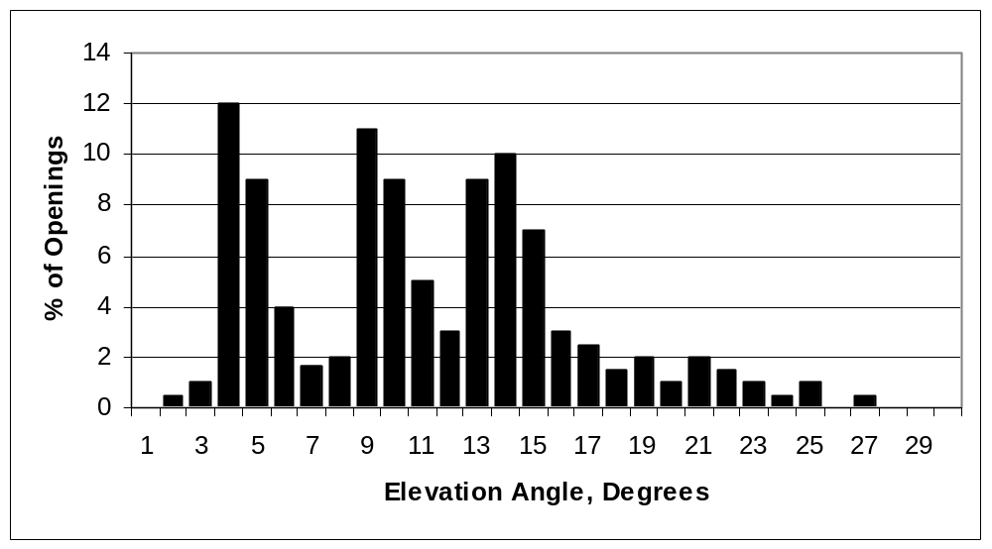
West Coast 80-meter openings to the Japan

Slide 12
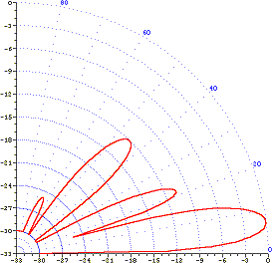
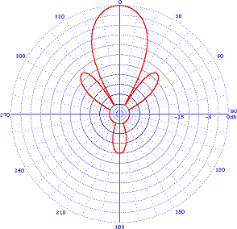
Truly High Performance Low HF Antennas Exist . . .
Elevation Angle of
main beam: 8 degrees
Elevation Angle of
main beam: 8 degrees

Slide 13
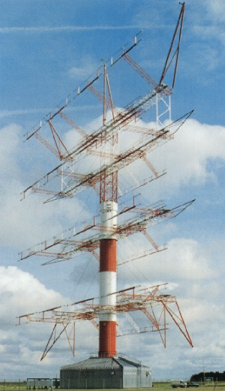
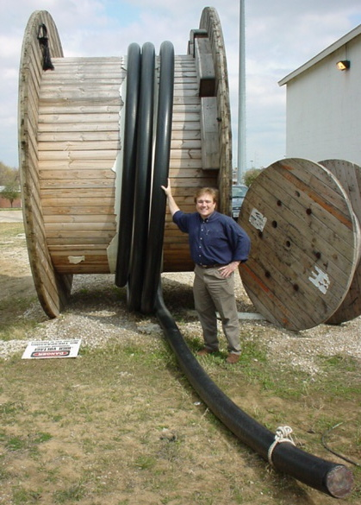
But . . .
They Come At a Price!
A 350 foot tall Rotable Curtain Array for 7 MHz:
$3,000,000

Slide 14
Quiz Question #2)
Which antenna is a better for working 40m DX?
A) Dipole at 45 feet
1/4 λ Vertical & Ground Plane 10 ft above the ground

Slide 15
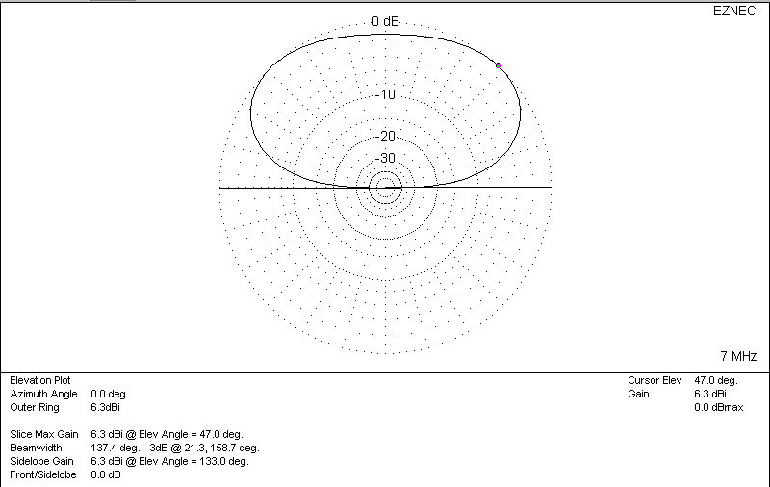
7 MHz Dipole at 45 feet
Via NEC-2 (EZNEC)

Slide 16
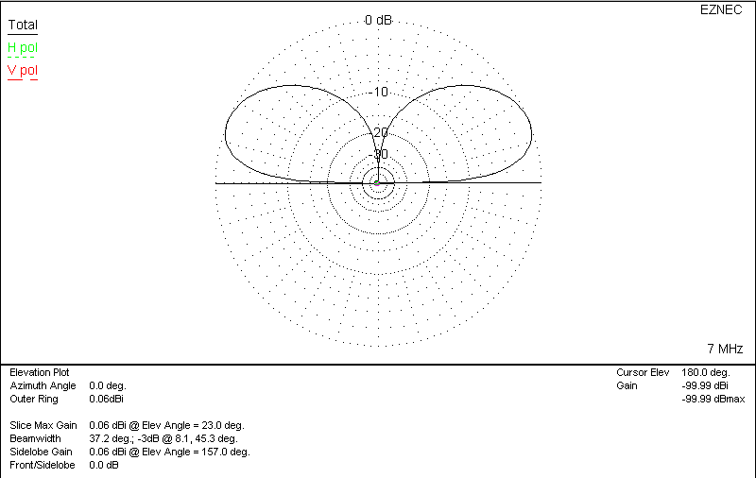
7 MHz Vertical & Ground Plane

Slide 17

Vertical vs Dipole

Slide 18
Quiz Question #2)
Which is better for working 40m DX?
A) Dipole at 45 feet
B) 1/4 λ Vertical & Ground Plane 10 ft above the ground
C) A Tie: Neither is very good

Slide 19
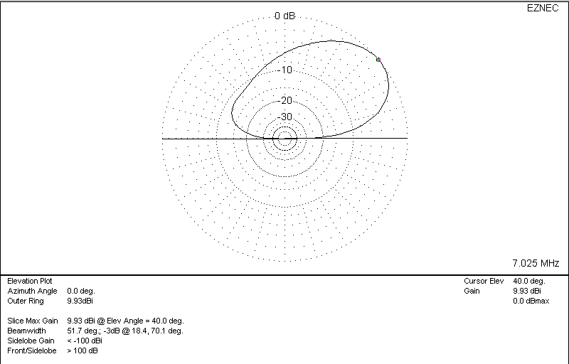
7 MHz 2 element Monoband Yagi at 45 feet

Slide 20
7 MHz 2 element Monoband Yagi at 45 feet
But you need to be concentrated below 20 degrees (and preferably below 12 degrees) to work Low Band DX!

Slide 21
Quiz Question #3)
How high does a 40m dipole need to be for its main beam to be at 15 degrees?
A) 45 feet
B) 60 feet
C) 100 feet
D) 130 feet
E) Higher than 200 feet

Slide 22
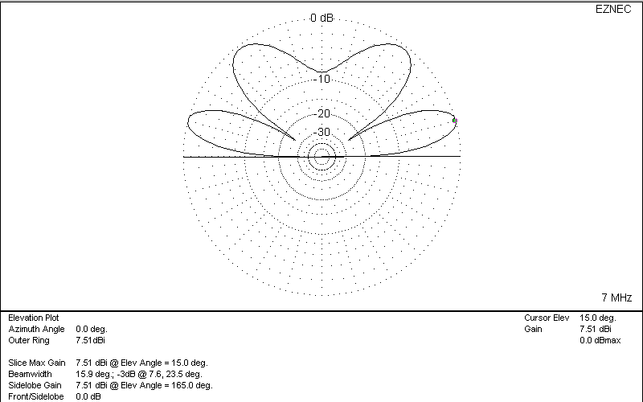
7 MHz Dipole at 130 feet

Slide 23
Quiz Question #4)
How high does a monoband 40m yagi need to be for its main beam to be at 15 degrees?
A) 45 feet
B) 60 feet
C) 100 feet
D) 130 feet
E) Higher than 200 feet

Slide 24
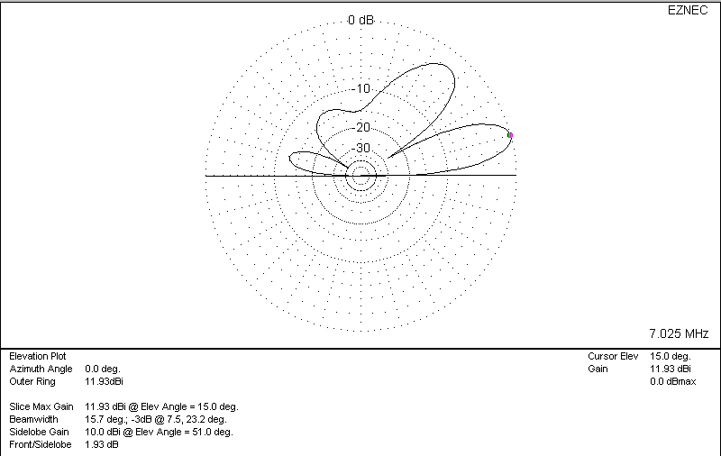
7 MHz 2 element Monoband Yagi at 130 feet

Slide 25
7 MHz 2 element Monoband Yagi at 130 feet
Using horizontal polarization for Low Band DXing
isn’t ideal for the average ham

Slide 26
Current Distributions
1/2 λ Dipole
Feed
Point
Feed
Point
Half Square

Slide 27
The Traditional Half Square
λ / 2
Feed point Detail
Main Beams
Z
RF Choke
Y
λ / 4
λ / 4
X

Slide 28
Advantages of the Traditional Half Square
Low Angle of Radiation
Inexpensive, Simple Construction
Moderate Gain
No Radials, Traps, or Tuning Unit Required
Most of the energy is radiated from up high, not near the base of the antenna

Slide 29
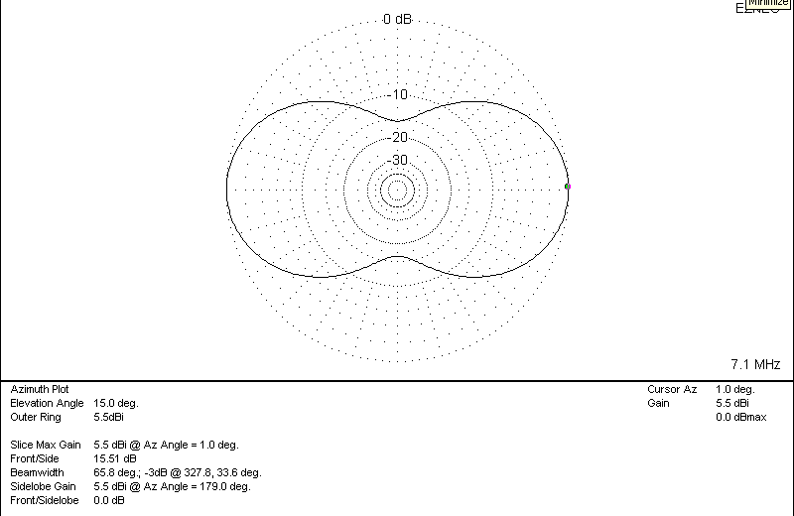
Half Square Azimuth Pattern

Slide 30
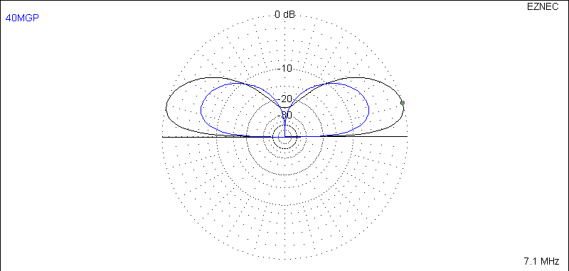
Half Square vs Vertical & Ground Plane
6 dB at 15 degrees
Quarter Wave Vertical &
Elevated Ground Plane
Traditional
Half Square

Slide 31
The Half-Square Yagi
Feed point Detail
Main Beam
Z
RF Choke
Driven Element
Y
Reflector
X

Slide 32
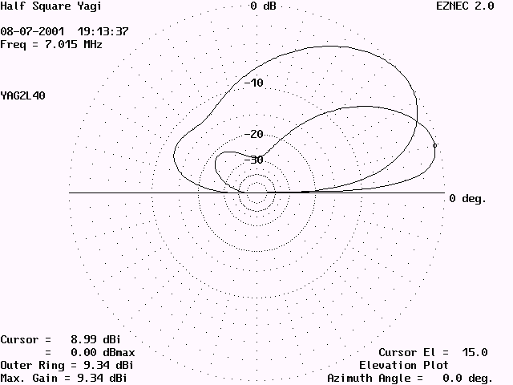
Elevation Patterns for a 2-element Conventional Yagi & Half-Square Yagi with horizontal wires at the same 45-foot height
10 dB better F/B
10 to 15 dB more
low angle gain
Conventional
2 el Yagi @ 45 ft
2 el Half Sq Yagi
over 9 dBi @ 15 degree elevation

Slide 33
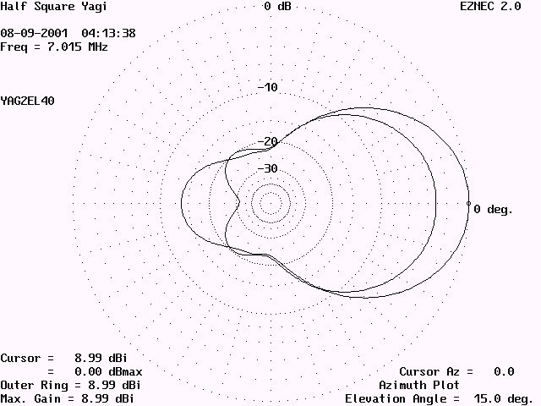
2 el Conventional Yagi vs Half Square Yagi
Half SqYagi
Half SqYagi
Conventional
2 el Yagi @ 45 ft
at 15 degree elevation angle

Slide 34
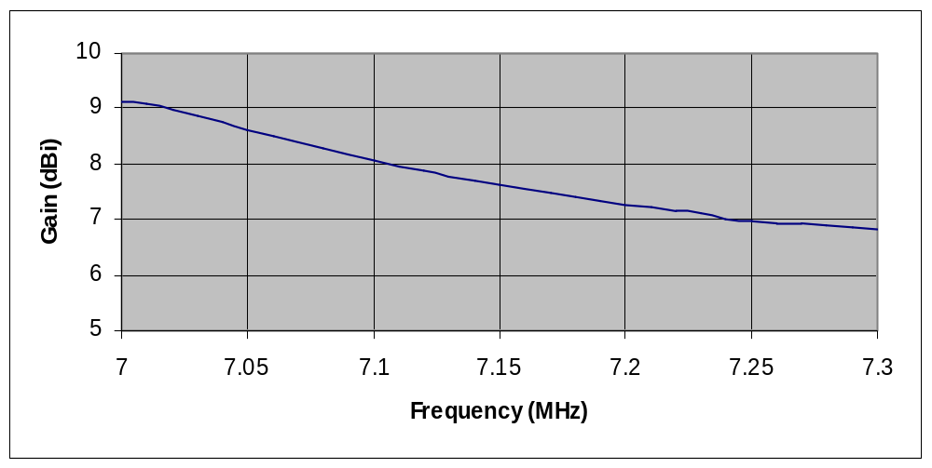
Gain vs Frequency

Slide 35
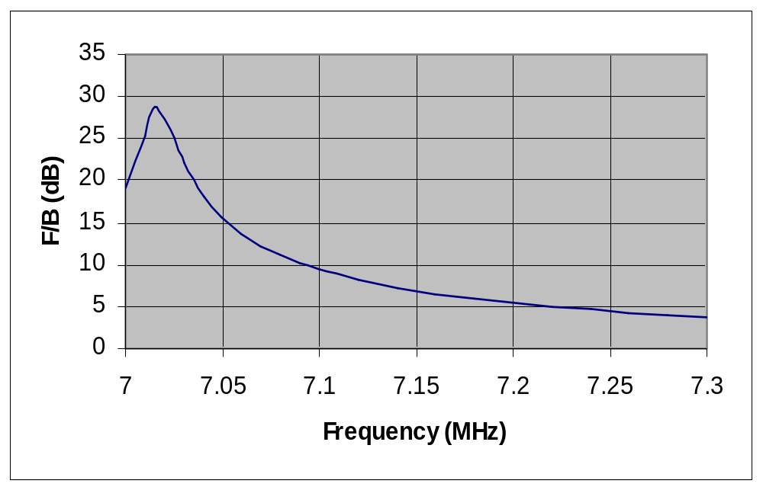
Front-to-Back vs Frequency

Slide 36
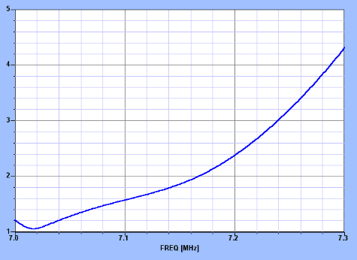
SWR versus Frequency

Slide 37
Dimensions for 7.025 MHz
491.2 / f (70 feet nominal)
Driven Element
Height
Feeding
Pruning
Nearby structures
Reflector
245.6 / f (35’ nominal)
245.6 / f (35’ nominal)
499.7 / f (71’ 3” nominal)
249.9/ f (35’ 8” nominal)
249.9/ f (35’ 8” nominal)
5-10 feet
5-10 feet
5-10 feet
5-10 feet

Slide 38
How the Half Square Yagi Performs
(The Proof is in the Pudding)
Installed for 40 meters in my backyard
Loaded up as predicted
Actual F/B and F/S patterns consistent with model
90 trans-Pacific contacts in the first 30 days

Slide 39
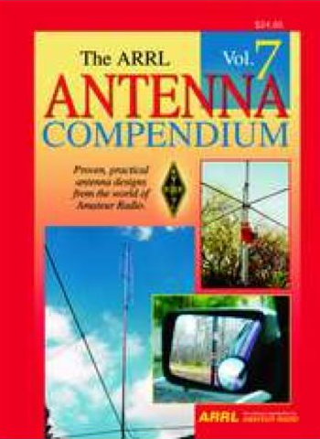
For more details on the Half Square Yagi . . .
Email me:
Jim Peterson, K6EI
k6ei@arrl.net
Or read my article

