Slide 1


testing with

Slide 2

What are the 5 most terrifying words in testing?
Notes:
Why ?
if your app has a bug, you need to resubmit the app to the app store … wait for the review process to complete
So you are at least a few days in trouble

Slide 3
What is Appium?
An open source mobile application UI testing framework
that uses the Selenium JSON-wire protocol to control your app

Slide 4
Appium philosophy
You shouldn't have to recompile your app or modify it in any way in order to automate it
You shouldn’t be locked into a specific language or framework to write and run your tests
A mobile automation framework should be open source

Slide 5

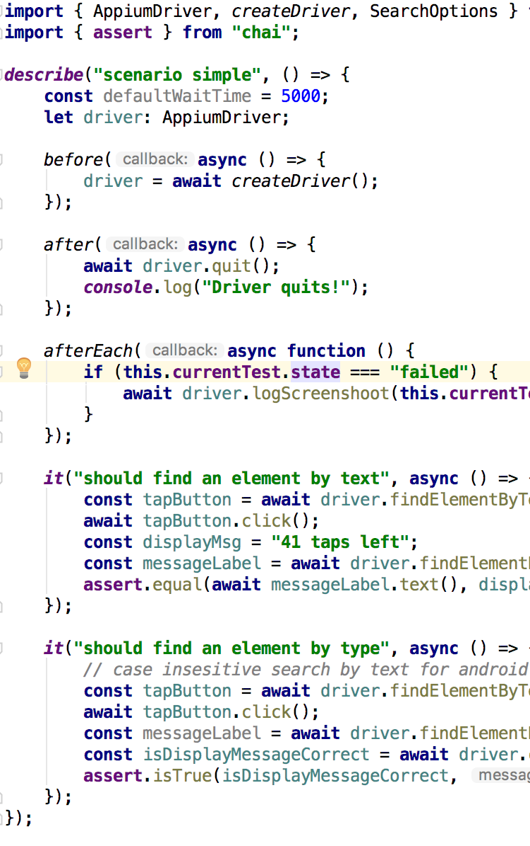

How does it work?
HTTP Request
Appium
Server
API Request
JSON-wire protocol
API Response
HTTP Response

Slide 6
How does it work?
Desired
Capabilities
HTTP Request
Appium
Server
API Request
JSON-wire protocol
API Response
HTTP Response

Slide 7
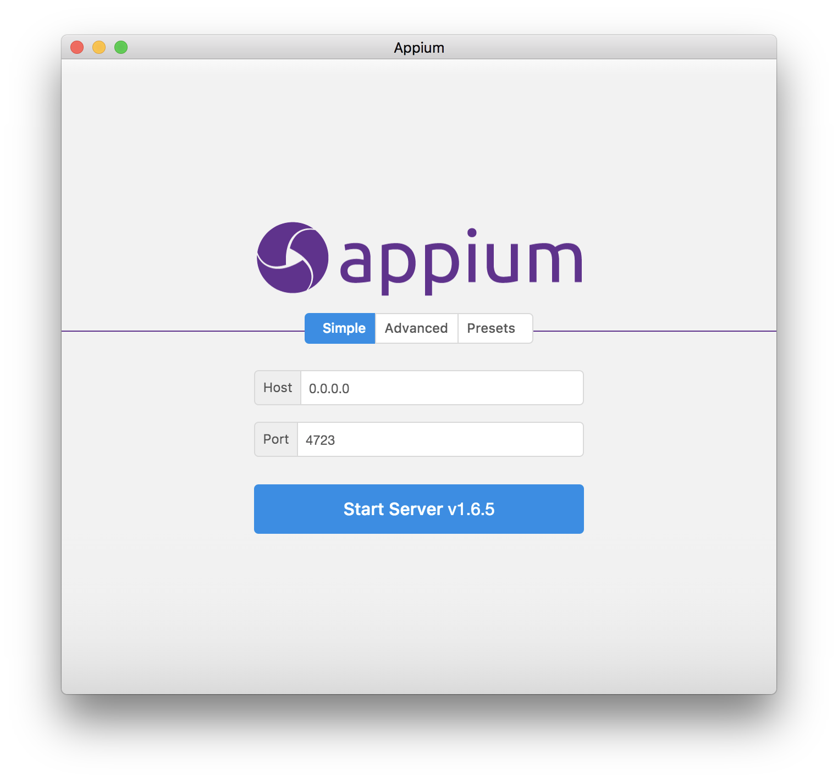
https://github.com/appium/appium-desktop

Slide 8
nativescript-dev-appium
Helper package to make running E2E Appium tests
in NativeScript apps easier
https://github.com/NativeScript/nativescript-dev-appium
Notes:
Improved a lot … over the last months
By default Mocha (runner) with chai (assertions)

Slide 9
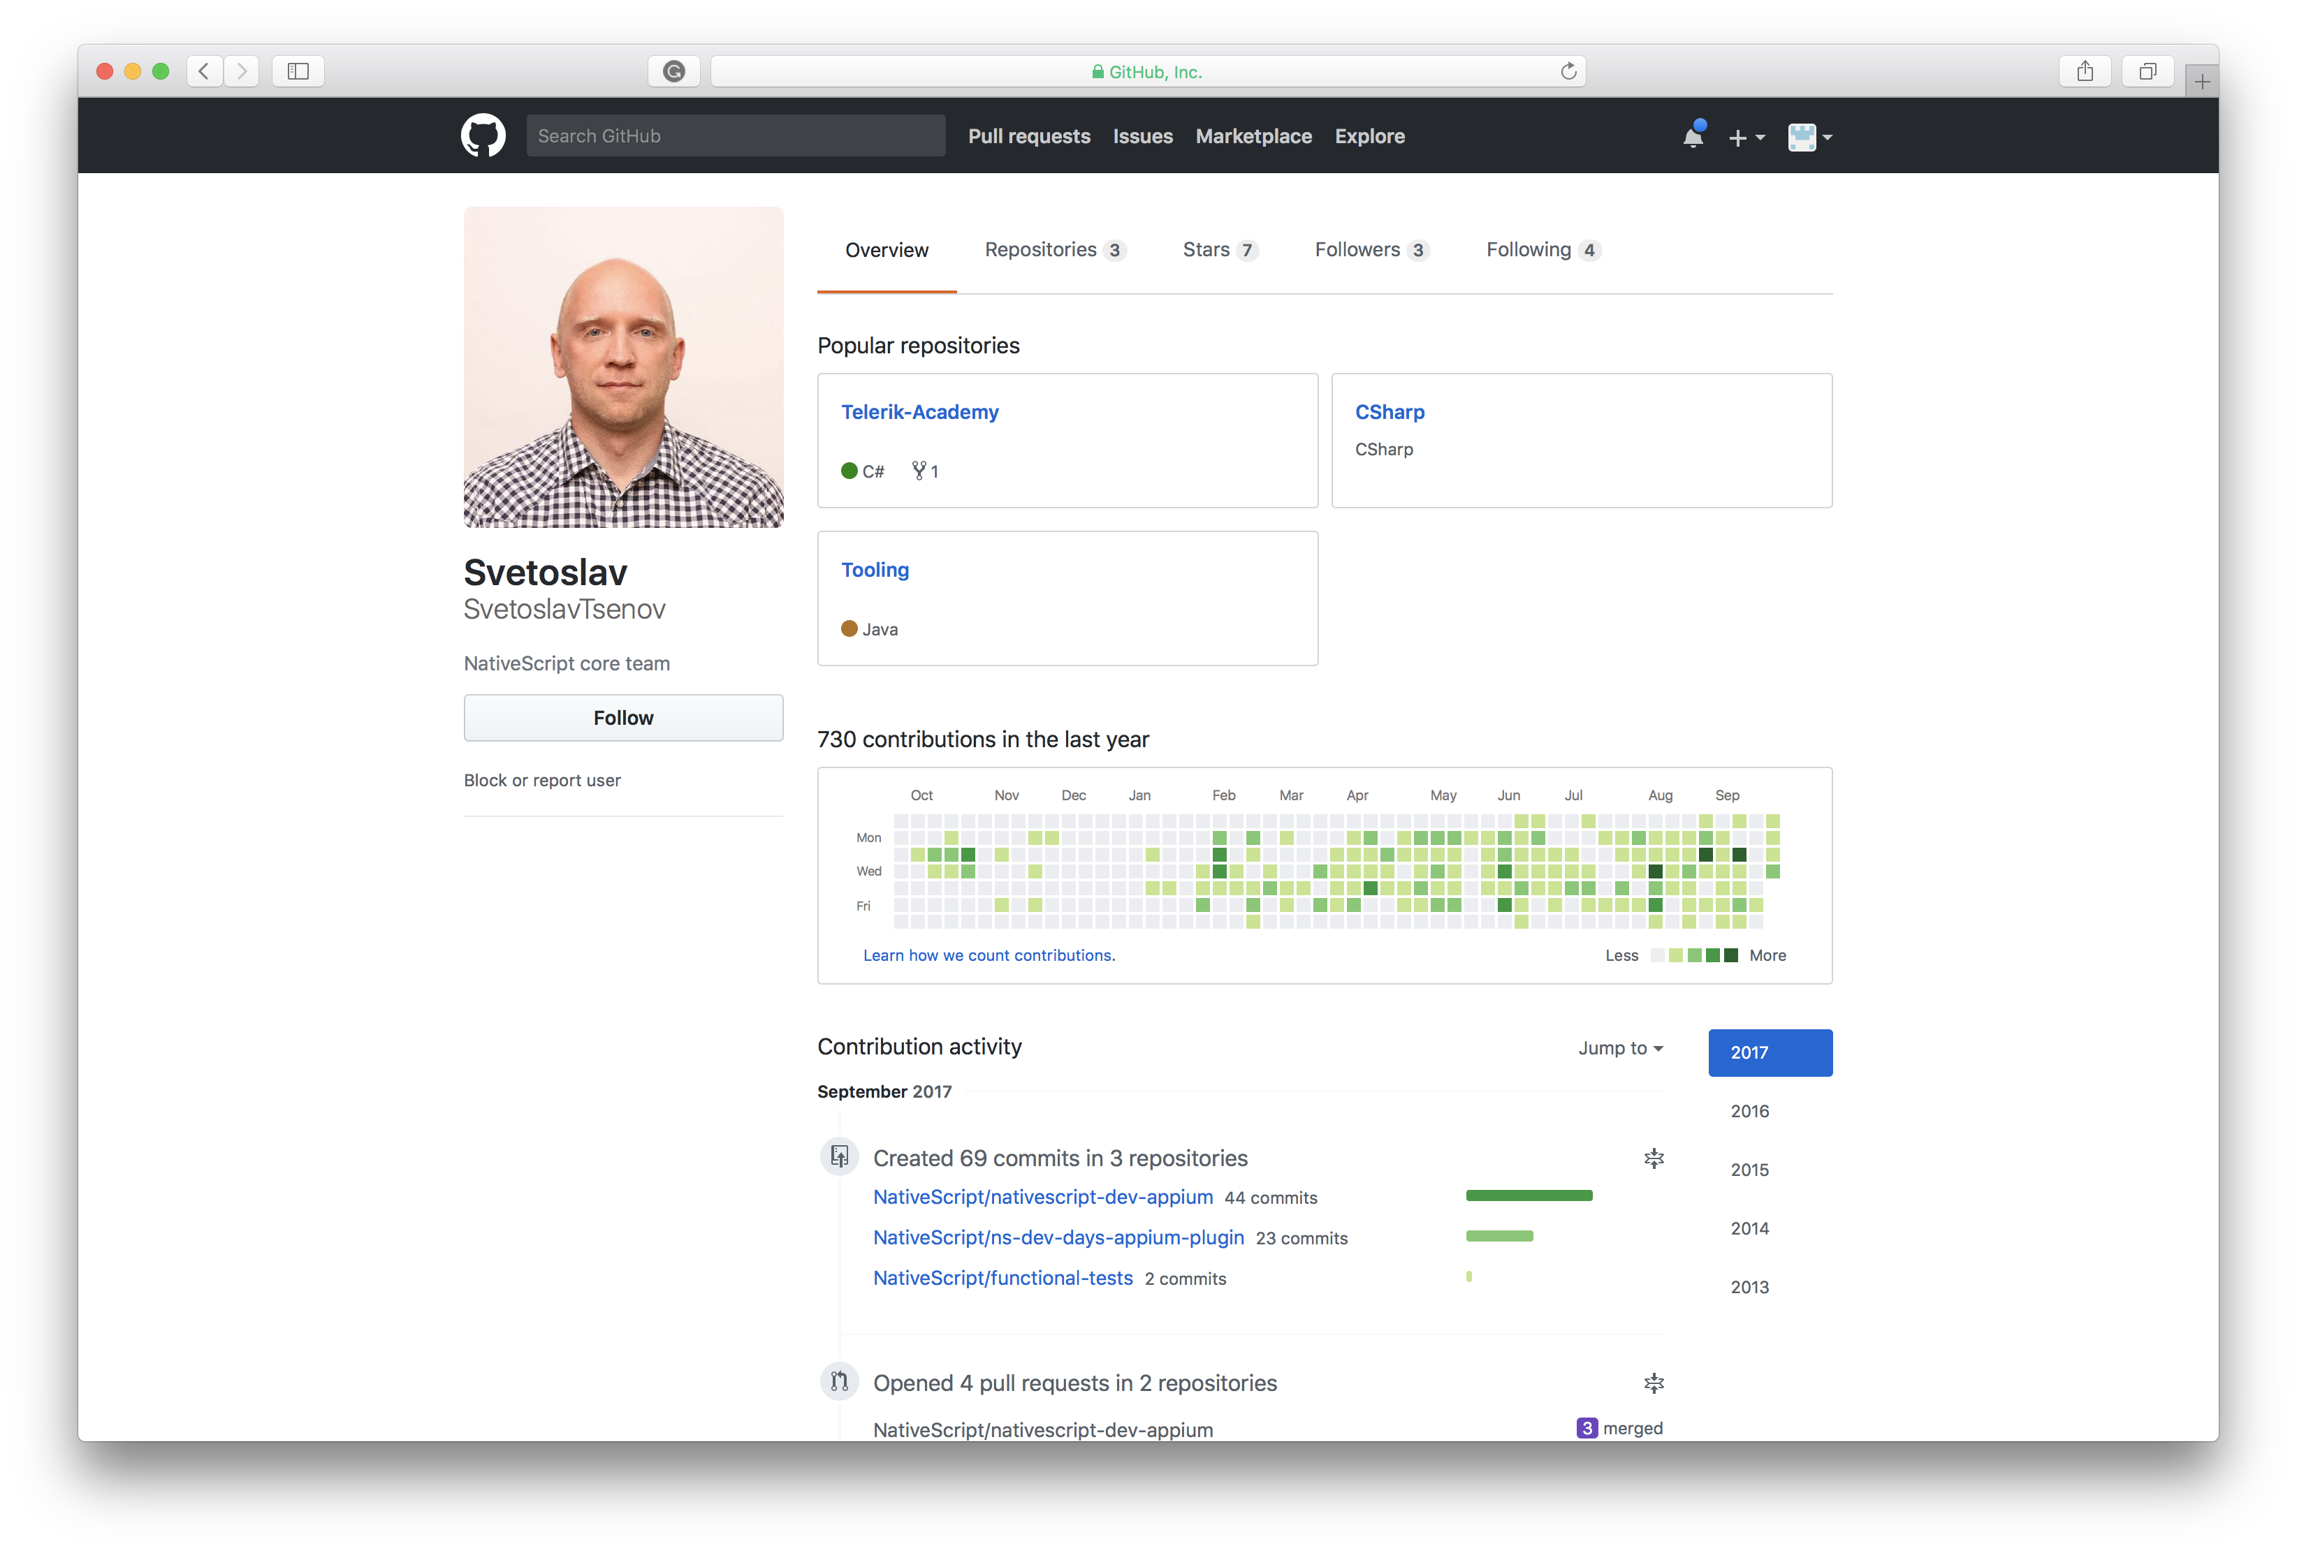
nativescript-dev-appium
Notes:
This guy put in a lot of effort to improve {N} dev appium
Al kind of locators and new convenience functions for scrolling, swiping, etc.
Besides [wd] (originally) now [webdriver.io] as well
Both wd and webdriver.io are accessible from the Appium Driver

Slide 10
nativescript-dev-appium
$ npm install --save-dev appium
or
$ npm install –g appium
$ npm install --save-dev nativescript-dev-appium

Slide 11
nativescript-dev-appium
$ npm run e2e -- --runType android23
Notes:
Start appium server
Launch emulator – defined by run type

Slide 12
Demo setup
$ tns create appium-demo –ng
$ tns platform add ios
$ tns platform add android
$ npm install --save-dev nativescript-dev-appium
$ tns build ios
$ tns build android

Slide 13
Lets do it …
Notes:
You can find the demo code here → https://github.com/wvegteren/NativeScript-testing-with-Appium

Slide 14
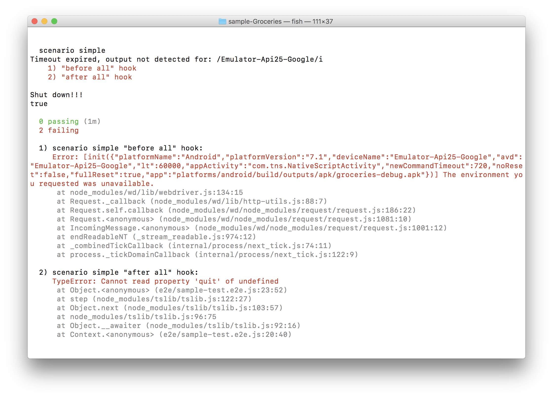
nativescript-dev-appium
Failed to launch emulator check /e2e/config/appium.capabilities.json
Notes:
android list avd

Slide 15
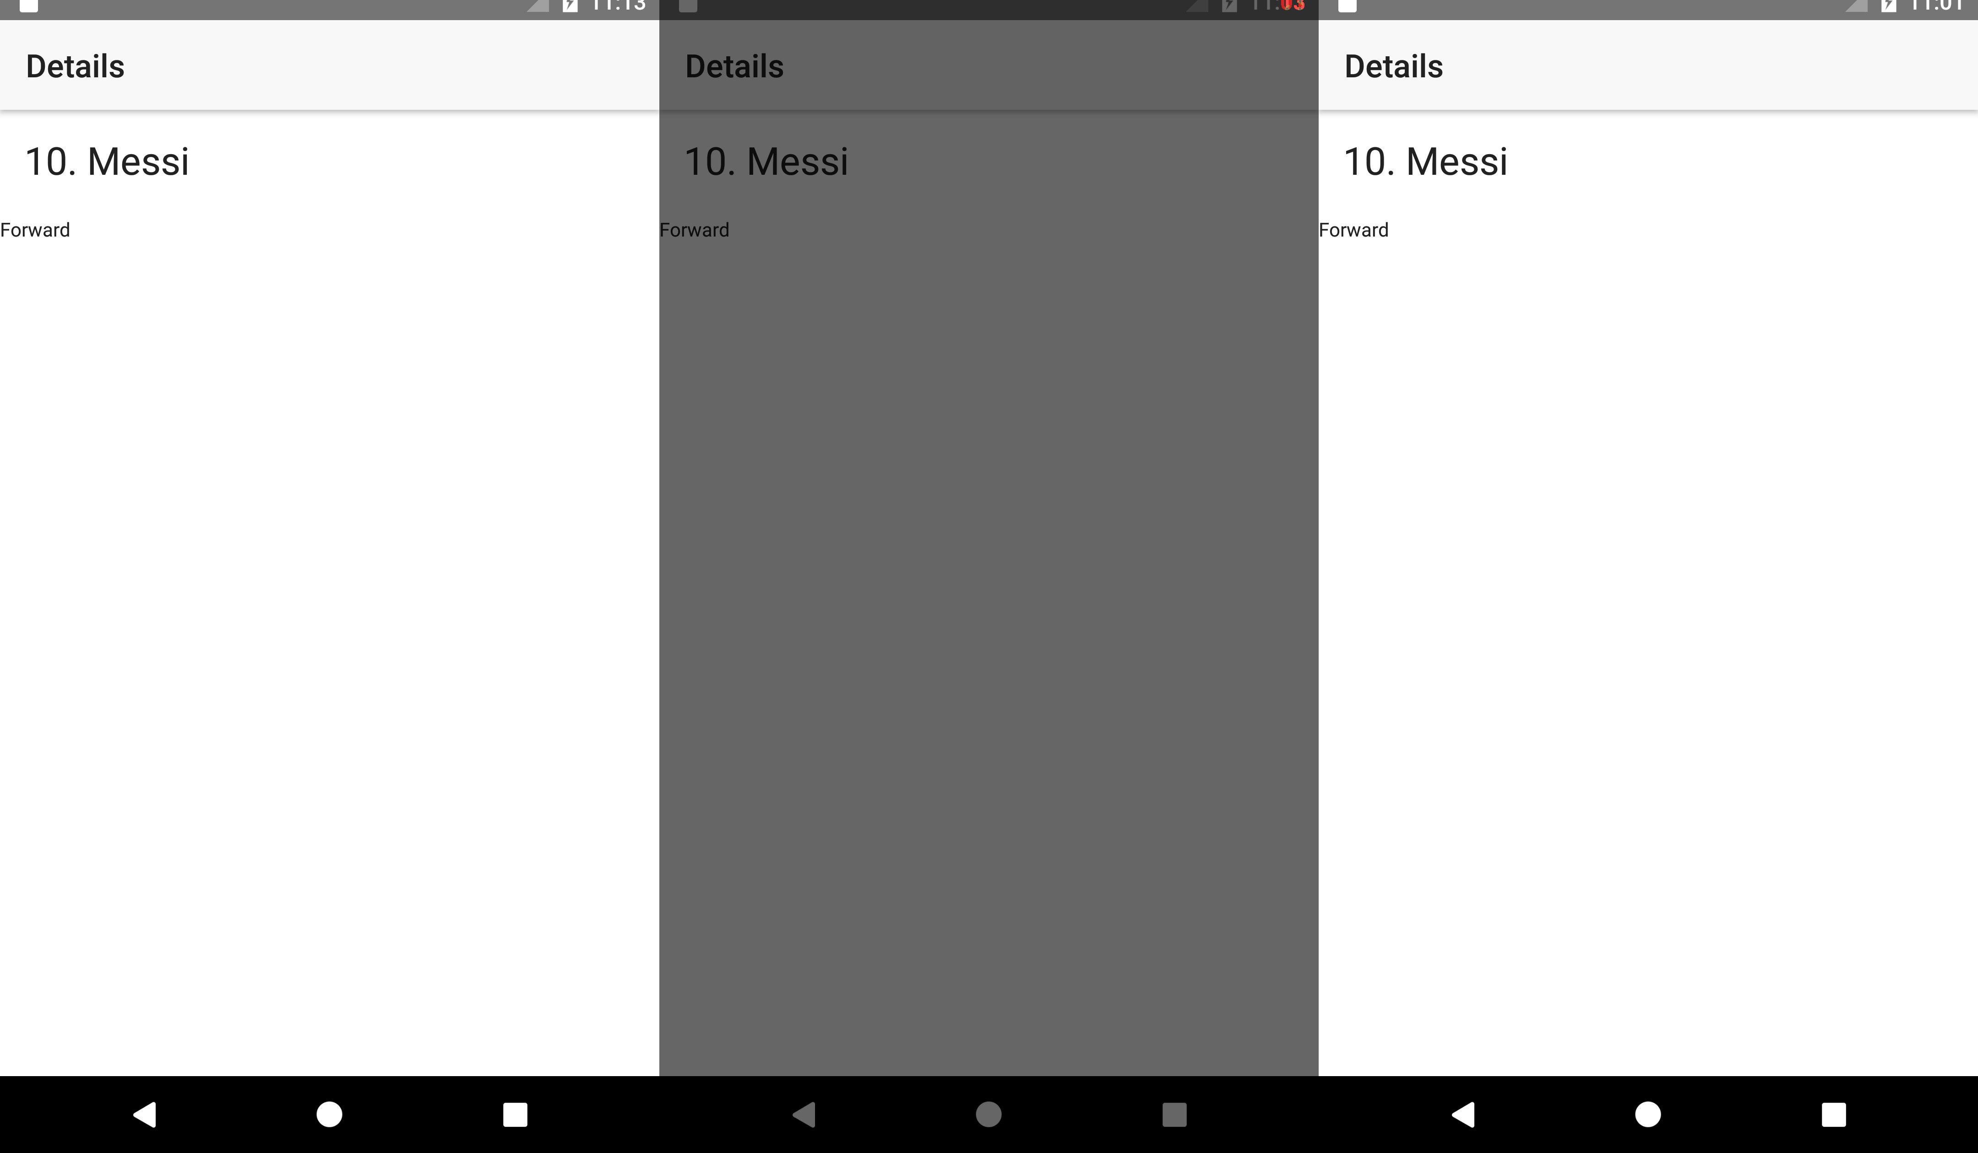
Notes:
Comparing android images – need to be fixed
Workaround set time with:
adb shell date $(date +%m%d%H%M%Y)

Slide 16
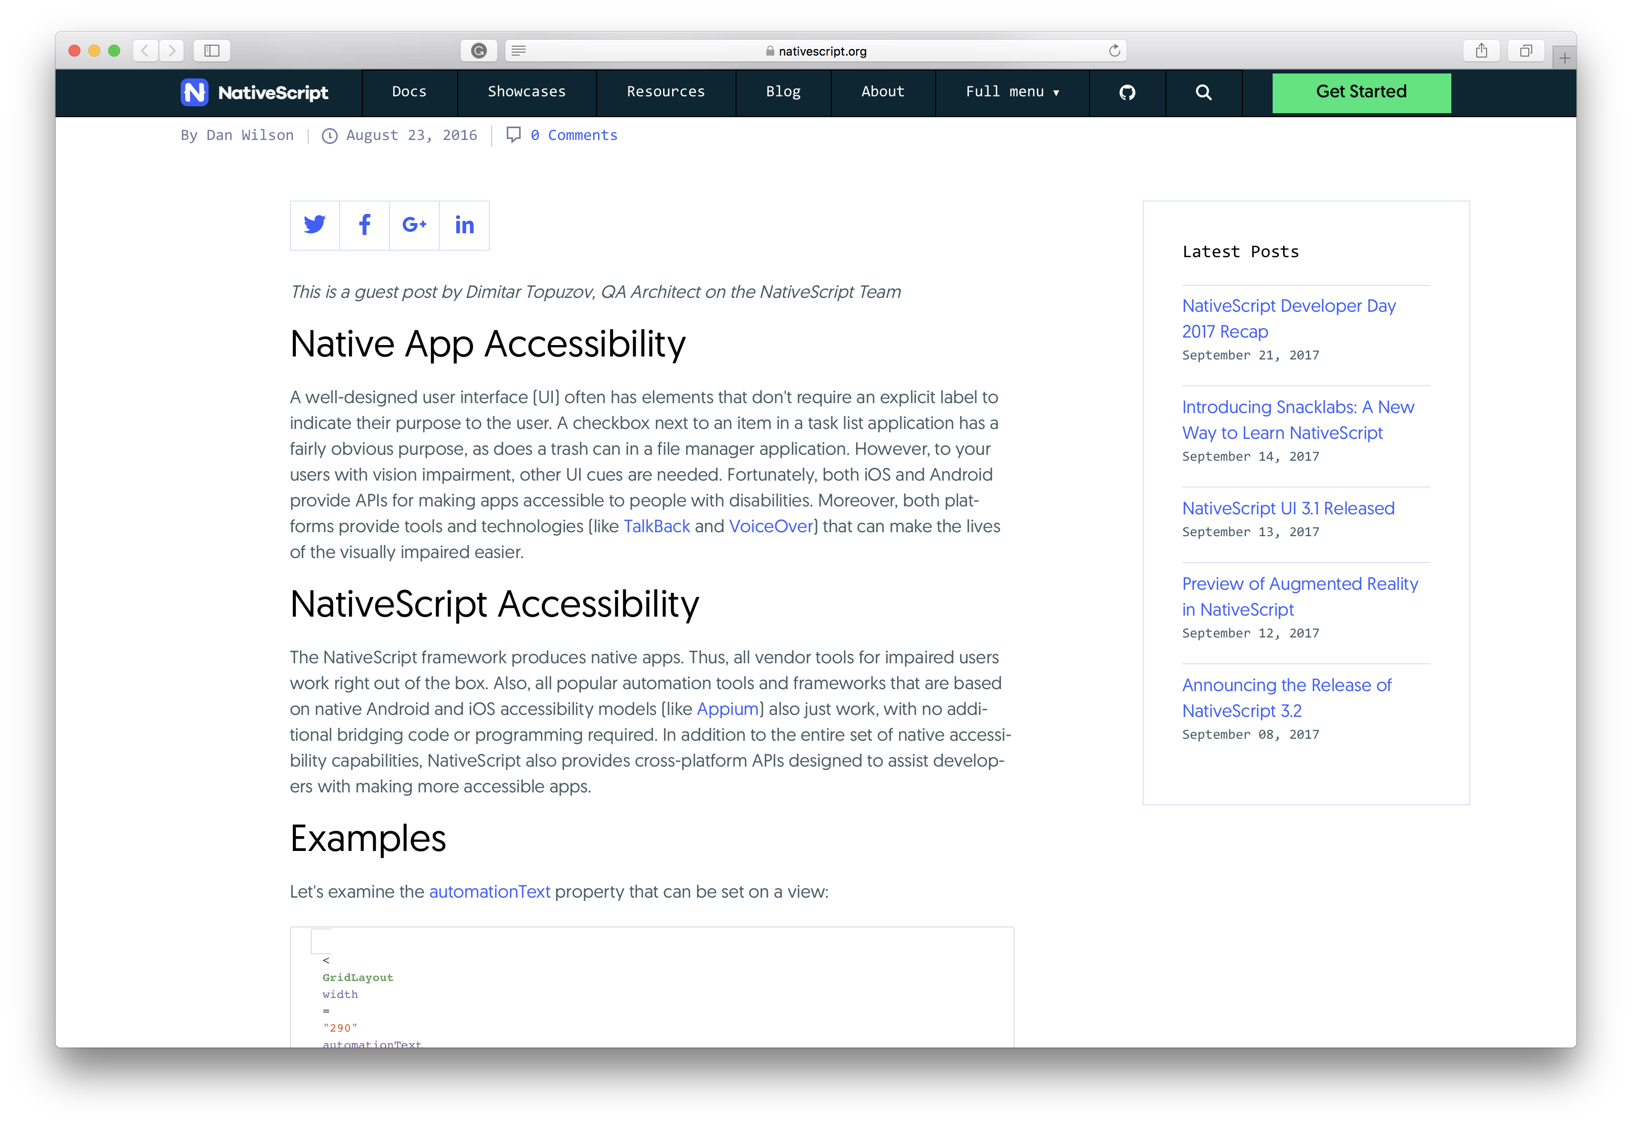

Slide 17
Questions
@wvegteren

