Slide 1

Modern Web Development - 1

Slide 2
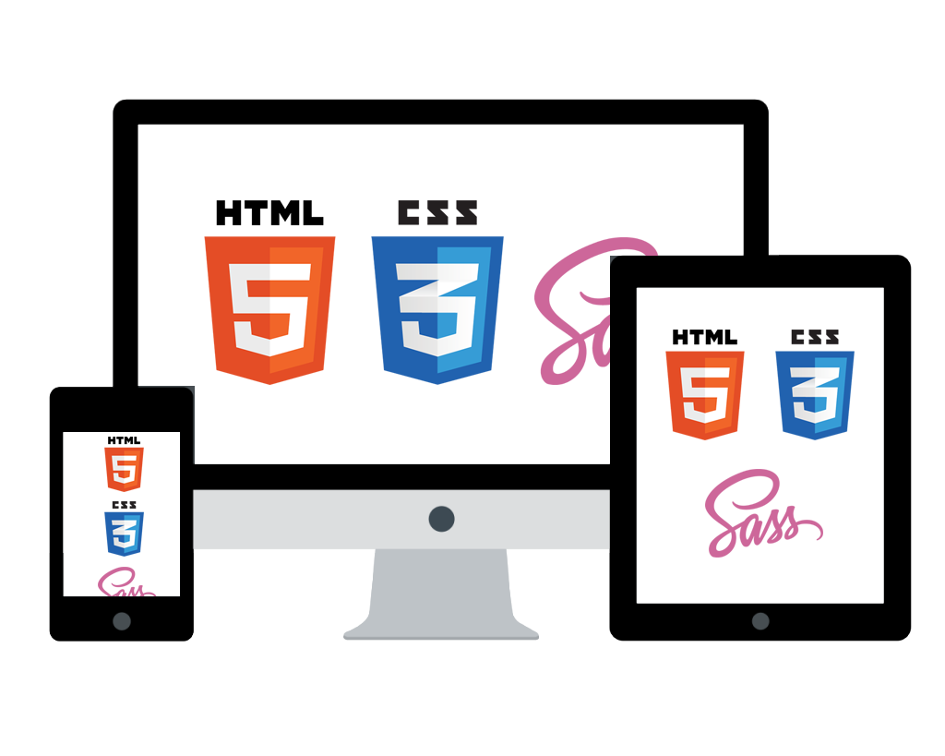



Agenda

Slide 4
HTML 4 - structure
<!DOCTYPE HTML PUBLIC "-//W3C//DTD HTML 4.01 Transitional//EN" "http://www.w3.org/TR/html4/loose.dtd"> <html> <head> <meta http-equiv="Content-Type" content="text/html;charset=UTF-8"> ... </head> <body> ... Content ...
</body> </html>

Slide 5
HTML 5 - structure
<!DOCTYPE HTML>
<html> <head> <meta charset="UTF-8”> ... </head> <body> ... Content ...
</body> </html>

Slide 6
HTML 5 - structure
<!DOCTYPE HTML>
<html> <head>
... </head> <body> ... Content ...
</body> </html>
Notes:
UTF-8 is default character set

Slide 7
HTML 5 - new elements
New semantic elements:
<header>
<footer>
<nav>
<section>
<article>
<aside>
<header>
<nav>
<section>
<aside>
<article>
<article>
<article>
<section>
<section>
<footer>

Slide 8
HTML 5 - new elements
New input types
number
range
email
tel
search
url
… poor browser support:
date
datetime
datetime-local
month
week
time
color
- IST VERBOTEN -

Slide 9
HTML 5 - new elements
New Input Attributes:
placeholder
pattern
autofocus
autocomplete
min / max
height / width
required
contenteditable
list
step

Slide 10
HTML 5 - new elements
<mark>
<figure>
<figcaption>
<meter>
<progress>
<audio>
<video>
<canvas>
<svg>
http://www.w3schools.com/html/html5_new_elements.asp

Slide 11
HTML 5 - new elements
Demo

Slide 12
HTML 5 - removed elements
<frame>
<frameset>
<applet>
<big>
<center>
<font>
No replacement
<object>
CSS

Slide 14
CSS - basics
Selectors:
element
id
class
Notes:
applying a style

Slide 15
CSS - basics
Demo Selectors

Slide 16
CSS - basics
Typography:
absolute = px
relative = em
rem vw, vmin, vmax
(IE 9+)
Notes:
font sizing

Slide 17
CSS - basics
Demo Typography

Slide 18
CSS - basics
Combinators:
descendant
child
adjacent sibling
general sibling
(space)
>
+
~
http://codepen.io/wvegteren/pen/obGJvj

Slide 19
CSS - basics
Display:
block
inline
none
<div> <h1> … <h6> <p> <section> <header> <footer> …
<span> <a> <img> …
http://codepen.io/wvegteren/pen/pgWqwY
Notes:
Layout

Slide 20
CSS - basics
Position:
relative
fixed
absolute
static
positioned relative to its normal position
positioned relative to the viewport so stays in the
same place even if the page is scrolled
positioned relative to the nearest 'positioned' ancestor
folows normal page flow
Notes:
Layout

Slide 21
CSS - basics
Demo Positioning

Slide 22
CSS - basics
Pseudo classes
used to define a special state of an element
can be combined with CSS classes
selector:pseudo-class { property:value; }
a:hover { color: orange; }
Notes:
Layout

Slide 23
CSS - basics
Link
:link
:hover
:active
:visited
Input
:valid
:invalid
:in-range
:out-of-range
:optional
:checked
:disabled
:enabled
:focus
:read-only
:read-write
:required
Sequence
:first-child
:nth-child(n)
:nth-last-child(n)
:last-child
:only-child
:first-of-type
:nth-of-type(n)
:nth-last-of-type(n)
:last-of-type
:only-of-type
:not(selector)
Notes:
Layout

Slide 24
CSS - basics
Pseudo elements
used to style specified parts of an element
::after
::before
::first-letter
::first-line
::selection
selector::pseudo-element { property:value; }
http://www.w3schools.com/css/css_pseudo_elements.asp
Notes:
Layout

Slide 25
CSS - basics
Cascading order:
Inline style
Internal style sheet
External style sheet
Browser default
Notes:
Layout

Slide 26
CSS - basics
Cascading quiz -1:
What is the color of ‘text’ ?
<p class="pclass" id="pid"> <span class="sclass" id="sid">text</span> </p>
HTML
span#sid { color: red; }
#pid span { color: green; }
CSS
Notes:
Layout

Slide 27
CSS - basics
Cascading quiz -2:
What is the color of ‘text’ ?
<p class="pclass" id="pid"> <span class="sclass" id="sid">text</span> </p>
HTML
#pid #sid { color: red; } p.pclass span#sid.sclass { color: green; }
CSS
Notes:
Layout

Slide 28
CSS - basics
Cascading quiz -3:
What is the color of ‘text’ ?
<p class="pclass" id="pid"> <span class="sclass" id="sid">text</span> </p>
HTML
#pid { color: red !important; } span { color: green; }
CSS
Notes:
Layout

Slide 29
CSS - basics
Cascading quiz -4:
What is the color of ‘text’ and the font-size ?
<p class="pclass" id="pid"> <span class="sclass" id="sid">text</span> </p>
HTML
#pid { color: blue; font-size: 10px; } #pid span { color: red !important;} p #sid { color: green; font-size: 150%; }
CSS
font-size = 15px
Notes:
Layout

Slide 30
CSS - basics
Cascading priorities :
id
class
element
 | id | class | element
div | 0 | 0 | 1 | 1
ul li | 0 | 0 | 2 | 2
div.stepview | 0 | 1 | 1 | 11
#navigation | 1 | 0 | 0 | 100
p.pclass span#sid.sclass | 1 | 2 | 2 | 122
If two rules have the same weight, the latter wins the battle.
Notes:
Layout

Slide 31
CSS - basics
!important
(placed after the declaration, before the semicolon)
Will override all previous cascade and give it the highest priority.
If !important is specified more than once for the same element,
they will fall back to the normal cascading rules.
Notes:
Layout

Slide 32
CSS 3 - browsers
CSS-3 is supported by all ‘modern’ browsers.
For some ‘older’ browsers vendor specific styles are available.
Prefixes:
-moz- Mozilla (Firefox)
-webkit- Webkit (Chrome, Safari)
-o- Opera
-ms- Internet Explorer
http://www.w3schools.com/cssref/css3_browsersupport.asp
Notes:
Layout

Slide 33
CSS 3 - border-radius
border-radius: <top-left> <top-right> <bottom-right> <bottom-left>;
border-radius: 5px;
border-radius: 50%;
-moz-border-radius: 5px 20px 5px 20px; -webkit-border-radius: 5px 20px 5px;
border-radius: 10px / 30px; horizontal radius / vertical radius
Notes:
Layout

Slide 34
CSS 3 - gradient
background: linear-gradient(direction/angle, color-stop1, color-stop2, ...);
background: radial-gradient(shape size at position, start-color, ..., last-color);
CSS3 directions:
to right
to bottom
to bottom right
…
-moz- and-webkit- directions:
left
top
135deg
…
http://www.w3schools.com/css/css3_gradients.asp
Notes:
Layout

Slide 35
CSS 3 - shadow
text-shadow: offset-x offset-y blur color;
box-shadow: offset-x offset-y blur color;
color: rgba(128, 128, 128, 0.5);
Notes:
Layout

Slide 36
CSS 3 - transitions
Transitions allow you to change smoothly …
To create a transition effect, you must specify:
the CSS property you want to add an effect to
the duration of the effect
Notes:
Layout

Slide 37
CSS 3 - transitions
transition-timing-function:
ease - low start, then fast and end slowly (default)
linear - same speed from start to end
ease-in - slow start
ease-out - slow end
ease-in-out - slow start and end
cubic-bezier(n,n,n,n) - define your own values
Notes:
Layout

Slide 38
CSS 3 - transform
A transformation lets an element change shape, size and position
(translate, rotate, scale, and skew)
CSS3 supports 2D and 3D transformations.
http://www.w3schools.com/css/css3_2dtransforms.asp
Some nice examples:
http://css3.bradshawenterprises.com/
Notes:
Layout

Slide 39
CSS 3 - animation
How to do CSS animations:
@keyframes - define the stages and styles of the animation
assign the @keyframes to a specific CSS element … and define how it is animated.
Notes:
Layout

Slide 40
HTML 5 + CSS
Define your own tags …
Notes:
Layout

Slide 42

Responsive design
Use CSS and HTML to resize, hide, shrink, enlarge or move the content
to make it look good on any screen

Slide 43
Responsive design
Recipe:
Set viewport
Use media queries
Use a grid-view
Optimize for mobile use

Slide 44
Responsive design
1. Viewport - the user's visible area
<meta name="viewport" content="width=device-width, initial-scale=1" />
<meta name="viewport"
content="width=device-width, minimumscale=1, maximum-scale=1" />
<meta name="viewport"
content="width=device-width, initial-scale=1, user-scalable = no" />

Slide 45
Responsive design
2. Media Queries - react on:
screen size
orientation
resolution

Slide 46
Responsive design
HTML
<link href="phone.css" media="only screen and (max-width: 499px)" > <link href="tablet.css" media="only screen and (min-width: 500px) and (max-width: 1023px) " > <link href="desktop.css" media="only screen and (min-width: 1024px)" >
CSS
@media only screen and (min-device-width: 500px) and (max-width: 1023px) { … }
@media only screen and (orientation: landscape) { … }

Slide 47
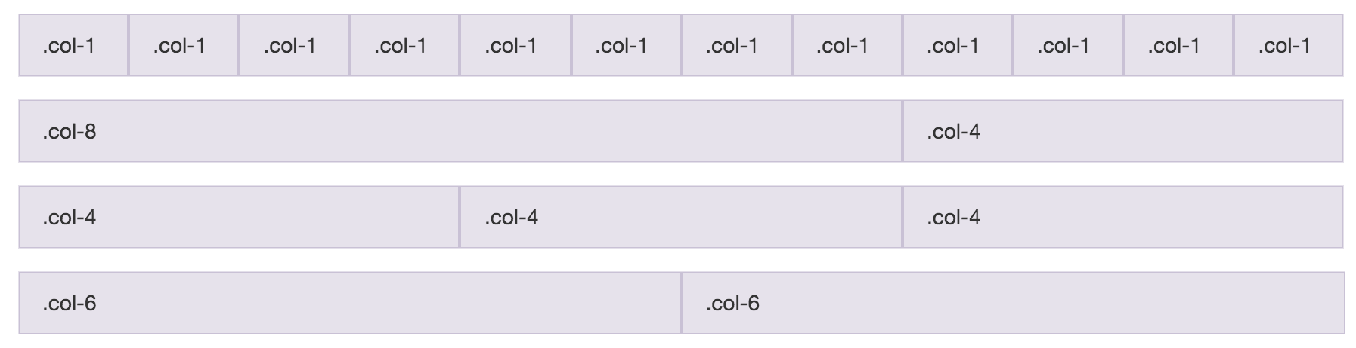
Responsive design
3. Grid-view:

Slide 48

Responsive design
3. Grid-view:

Slide 49
Responsive design
3. Optimize for mobile use:
trigger appropriate keyboard
save bandwidth
home screen icons
full screen browsing

Slide 50
Responsive design
Trigger appropriate keyboard
<input type="email"> <input type="tel"> <input type="number”>
<input type="number" pattern="[0-9]*">
enforces the numeric keyboard on iOS

Slide 51
Responsive design
Home screens icons
<link rel="apple-touch-icon" href="icon.png" >
<link rel="apple-touch-icon-precomposed" href="icon.png" >
<link rel="shortcut icon" sizes="196x196" href="icon-196x196.png">

Slide 52
Responsive design
Full screen browsing
<meta name="apple-mobile-web-app-capable" content="yes"> <meta name="apple-mobile-web-app-status-bar-style" content="black-translucent"> <meta name="mobile-web-app-capable" content="yes">

Slide 54
SASS
SASS is a CSS Pre-Processor and offers:
Variables - ie color scheme
Nesting - follow the structure of your HTML
Partials - Import - separate styles in different files
Mixin - structures for reuse
Extend - share properties from selectors
Math operators - ie to calculate width, etc.
http://sass-lang.com/

Slide 56
Frameworks
Twitter Bootstrap http://getbootstrap.com
Foundation http://foundation.zurb.com
HTML Kickstart http://www.99lime.com/elements
Gumby Framework http://www.gumbyframework.com
Skeleton http://getskeleton.com
W3 css http://www.w3schools.com/w3css
HTML5 boilerplate https://html5boilerplate.com

Slide 57
Frameworks
Font awesome https://fortawesome.github.io/Font-Awesome/
Google Fonts https://www.google.com/fonts

Slide 58
Reference
www.w3schools.com
www.html5rocks.com
www.html5tuts.co.uk
css-tricks.com
Browser Support
caniuse.com

Slide 59
Get inspired
Some inspiration …
http://codepen.io ie. search for Material Design
https://daneden.github.io/animate.css
http://nicolasgallagher.com/pure-css-speech-bubbles/demo

Slide 60
Have fun …

