Slide 1
EY DnA Presentation
Amir Charkhi – Nov 21

Slide 2
Notes
Blue lines represent data from 2010.
For simplicity, linear models have been used.

Slide 3
Workflow
Pre-processing
Exploratory Data Analysis (EDA)
Model Building
Model Validation

Slide 4
pre-processing
- Data cleaning
- Wait time calculation (Arrival to Doctor/Nurse visit)
- Days in hospital calculation
- Categorization of wait_time to 15-minute windows
- Duplicate deletion

Slide 5
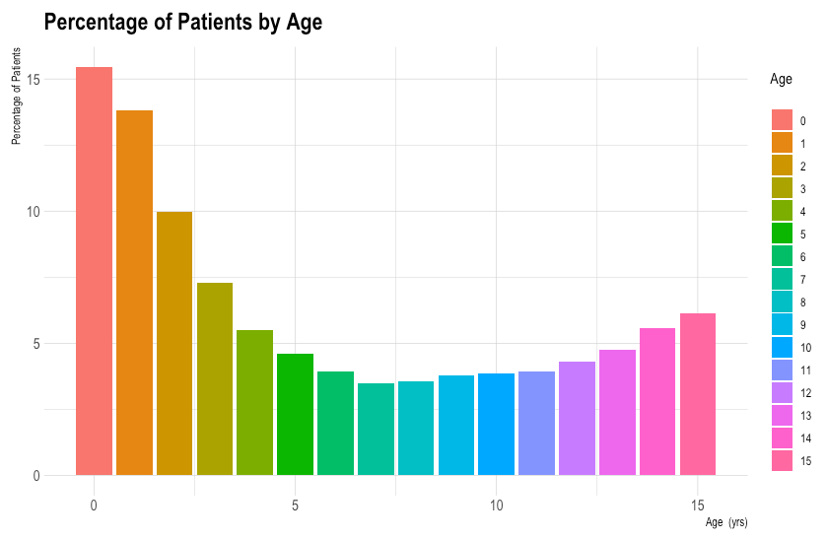
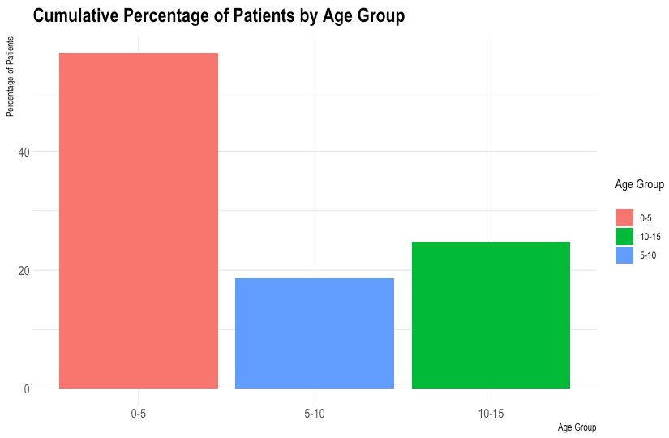
Exploratory Data Analysis
Children under 5 years of age constitute the biggest population in this data, whereas children between the age of 5 and 10 are the minority.

Slide 6
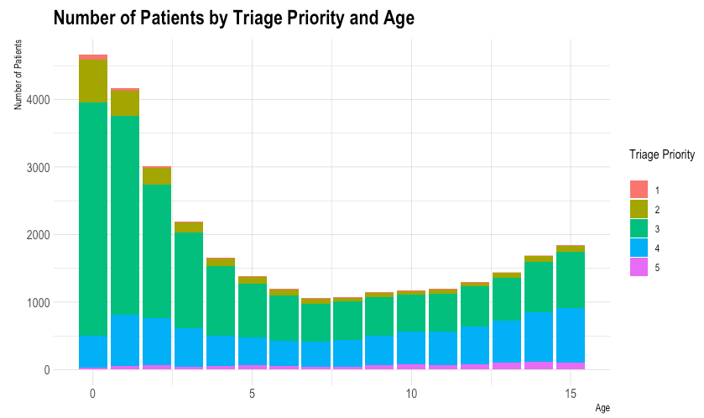
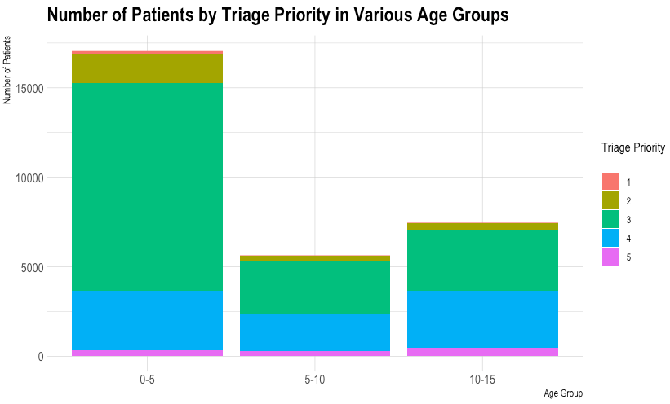
Exploratory Data Analysis
Triage priorities of 3 and 1 have the highest and least number of visitors, respectively.

Slide 7
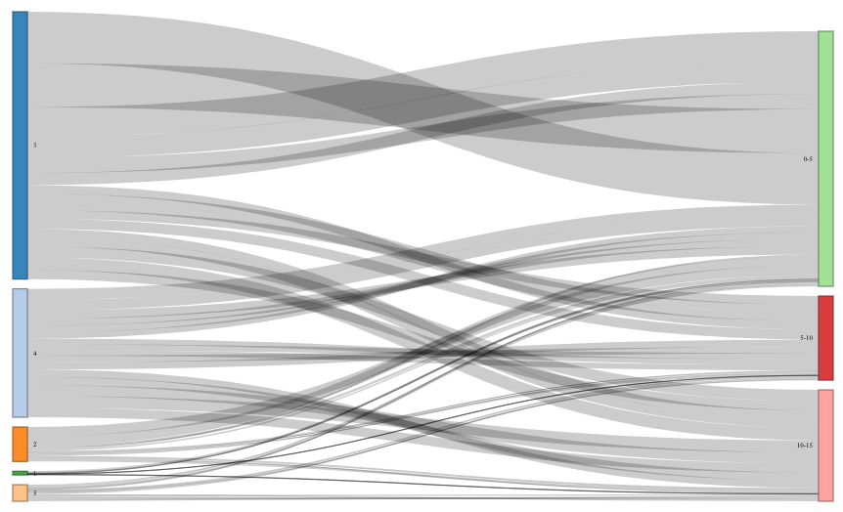
Exploratory Data Analysis: TRIAGE
The spread of patients with various triage priorities seems to have a random distribution and not drastically biased.

Slide 8
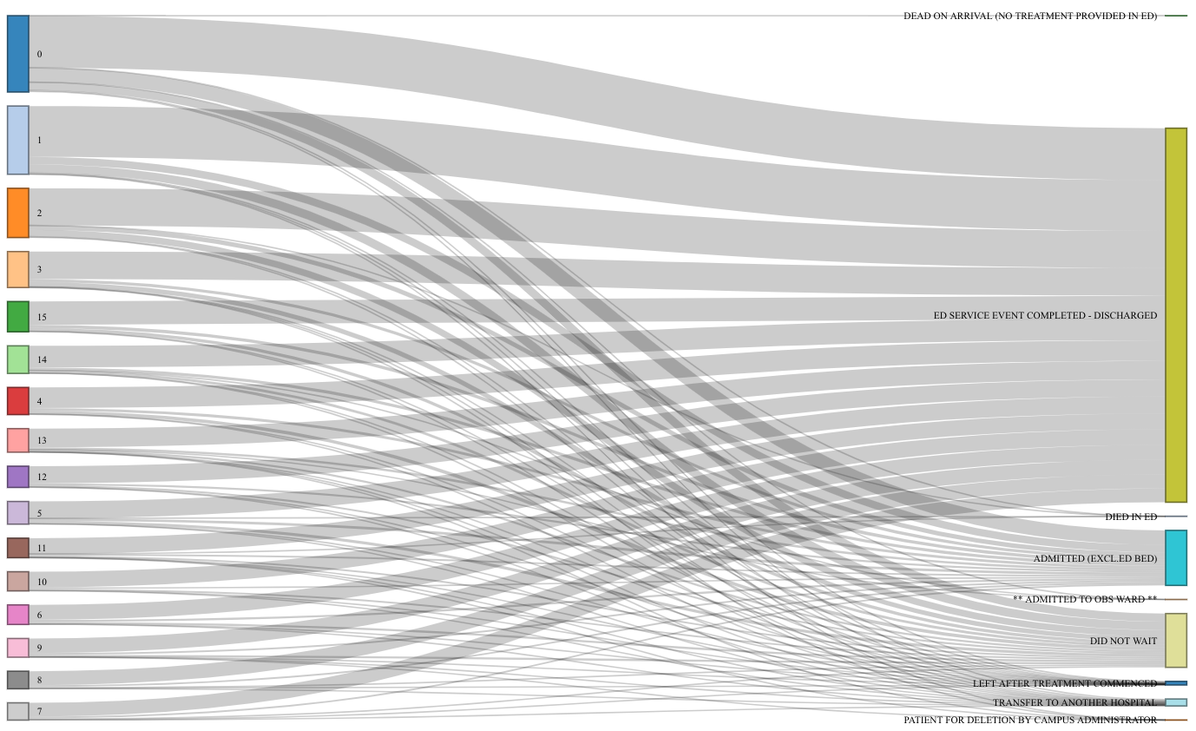
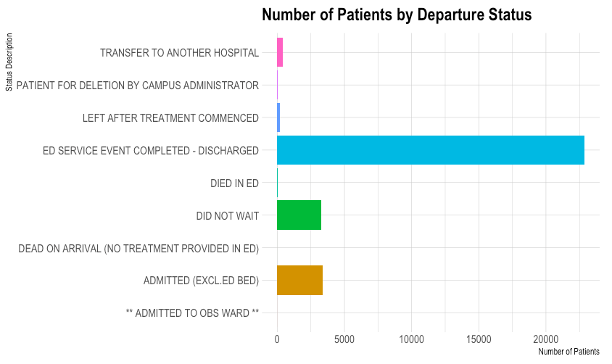
Exploratory Data Analysis: DISCHARGE
A vast majority of patients have been discharged once the service has been completed.

Slide 9
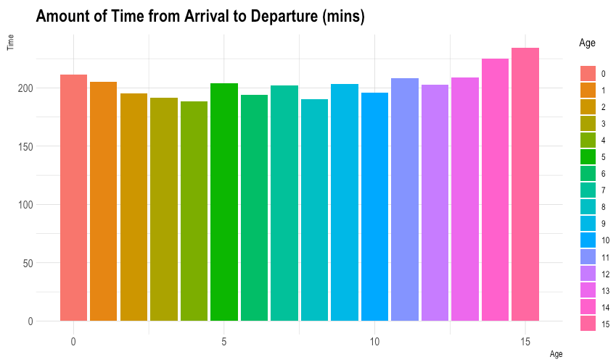
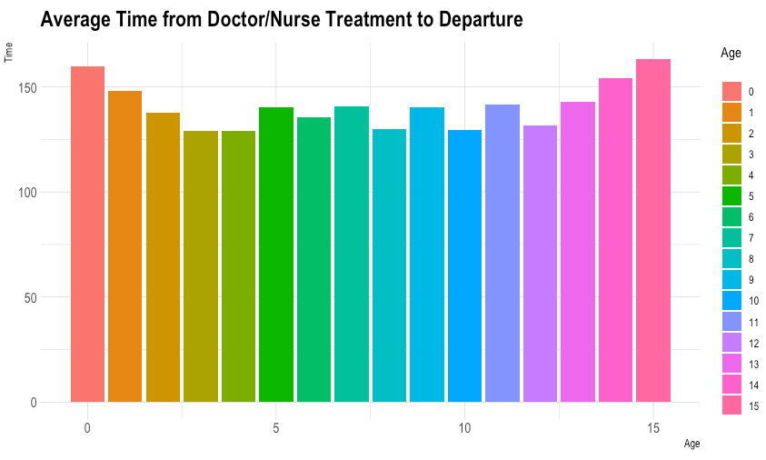
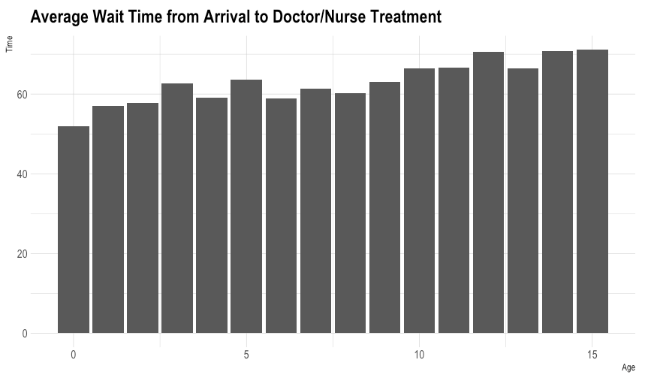
Exploratory Data Analysis: TIME
For the purposes of this exercise, wait time was calculated to represent the time it takes for a patient to be checked by a doctor/nurse from their time of arrival.
- Wait_time increases by age.

Slide 10
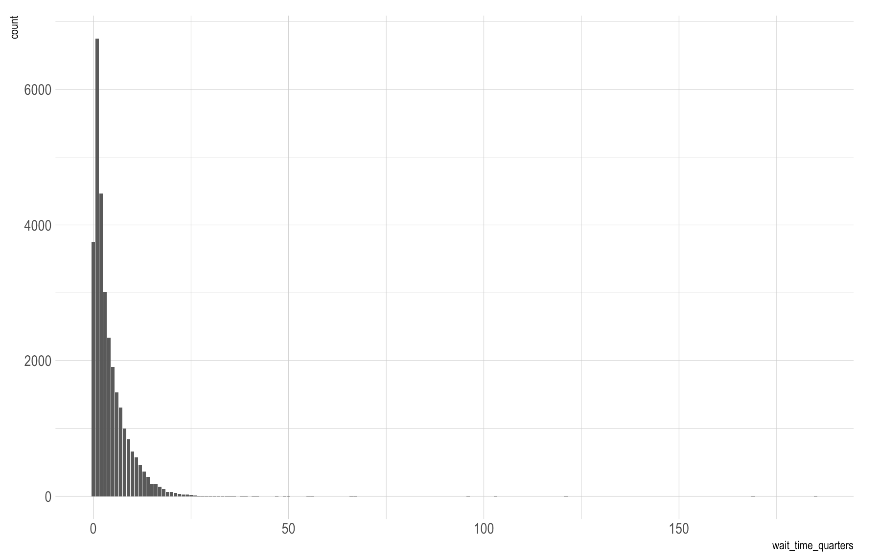
EXPLORATORY DATA ANALYSIS: Density Function
Majority of patients have been attended by a health professional in less than 6 hours. However, there are still patients who had to wait a far longer time to be treated.

Slide 11
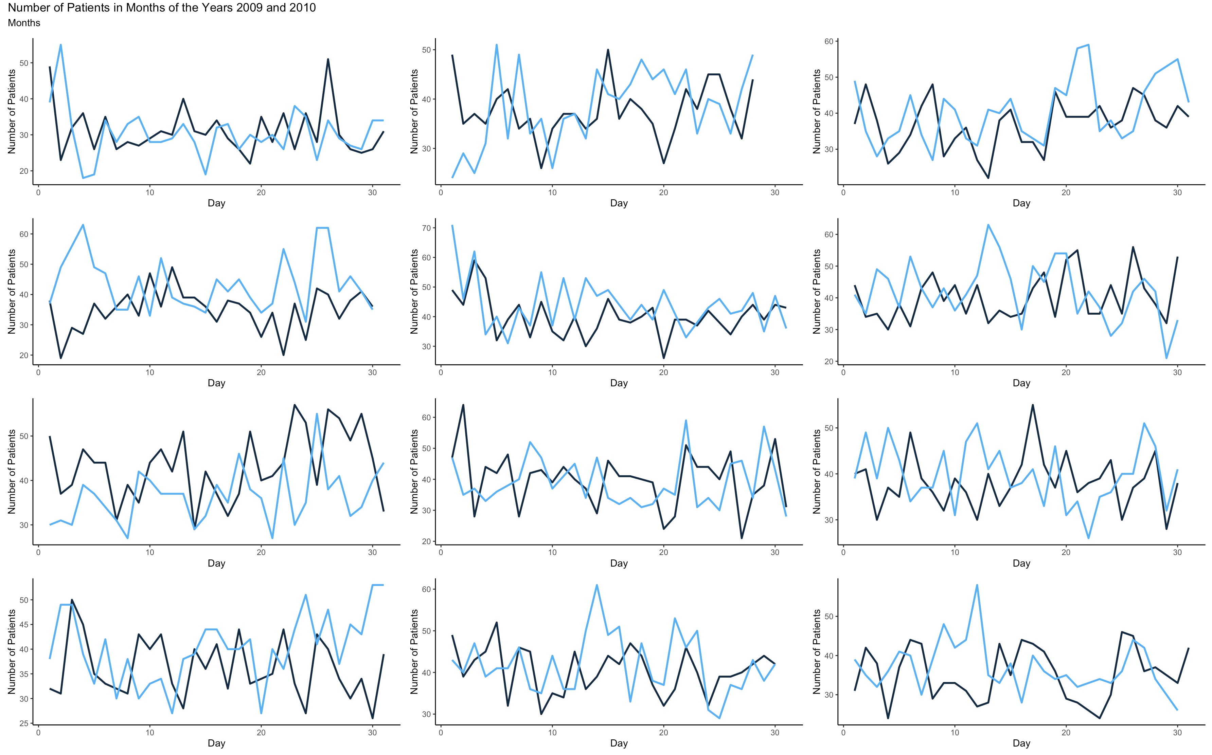
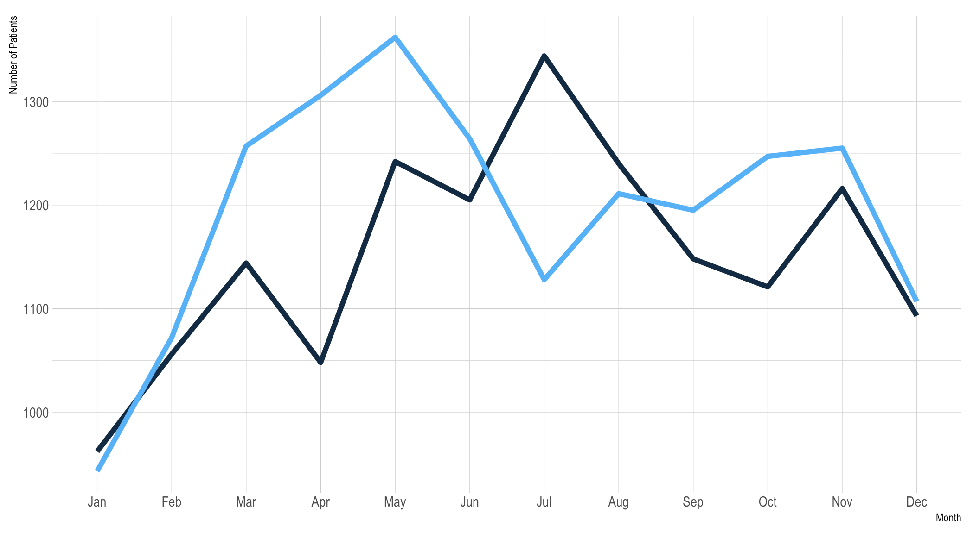
EXPLORATORY DATA ANALYSIS: NUMBER OF PATIENTS
Cumulative number of patients in years 2009 and 2010.
- The overall trend of the data seems similar.
2009
2010

Slide 12
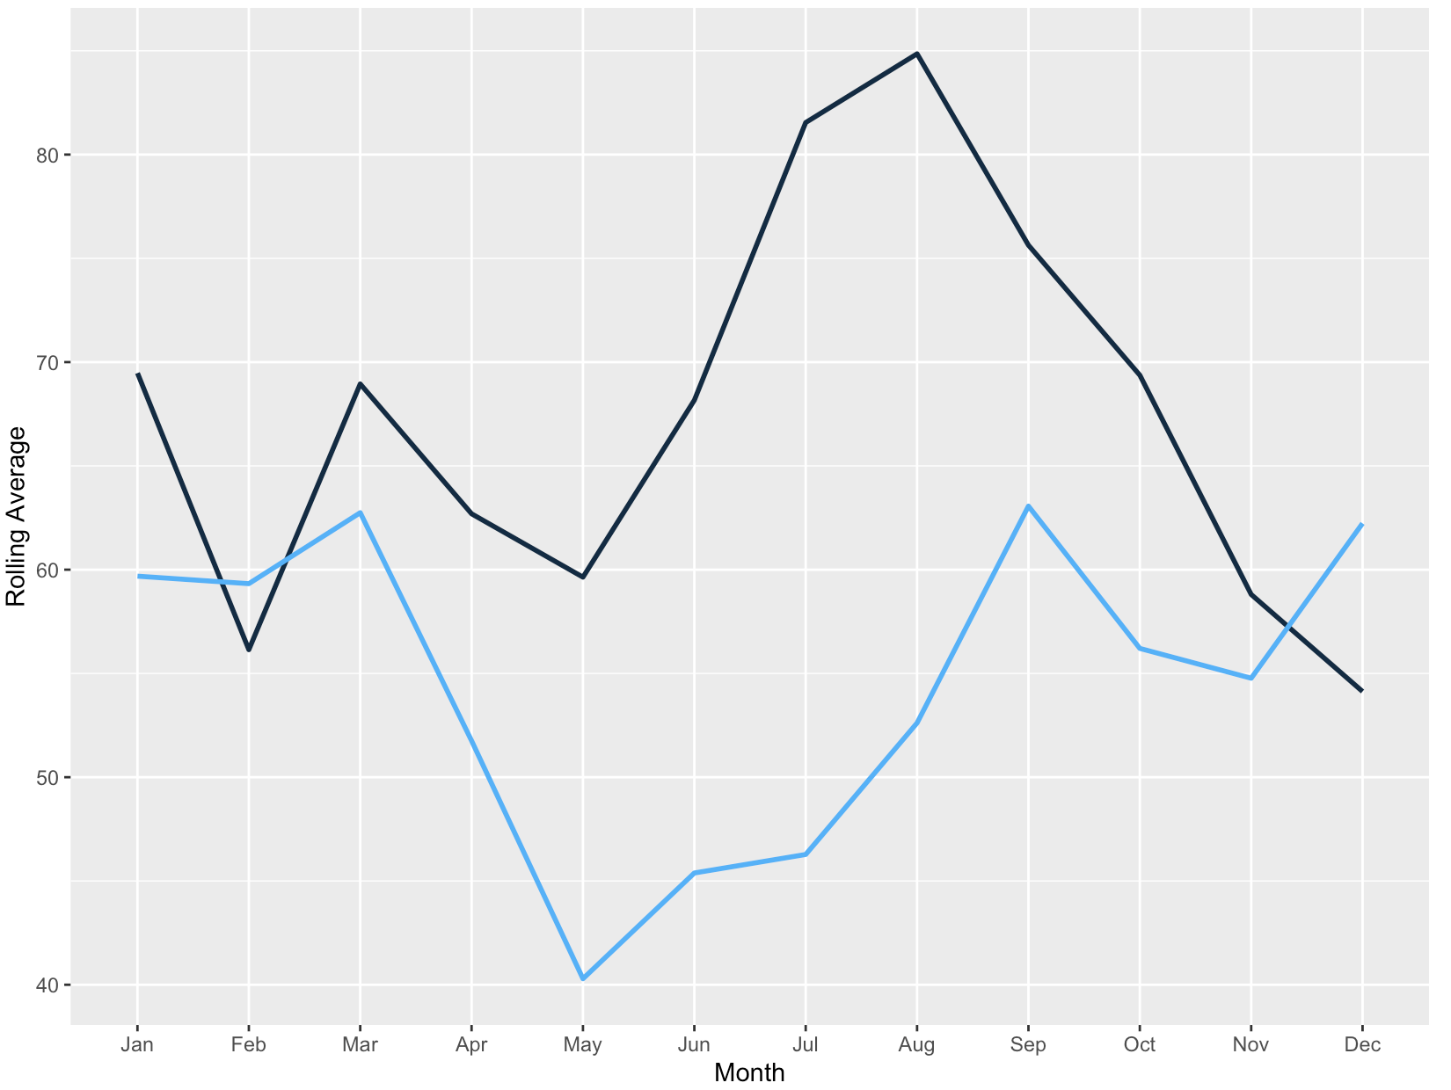
EXPLORATORY DATA ANALYSIS: ROLLING AVERAGE for wait_time
The rolling average of wait_time for both years of 2009 and 2010 seems to be following the same trend.
2009
2010

Slide 13
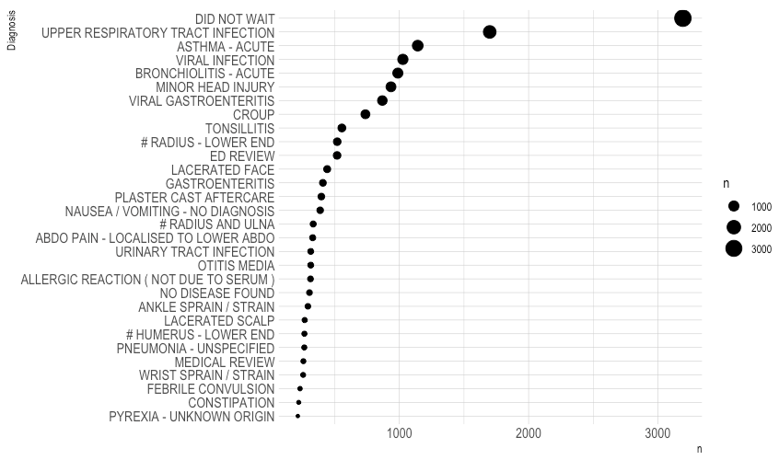
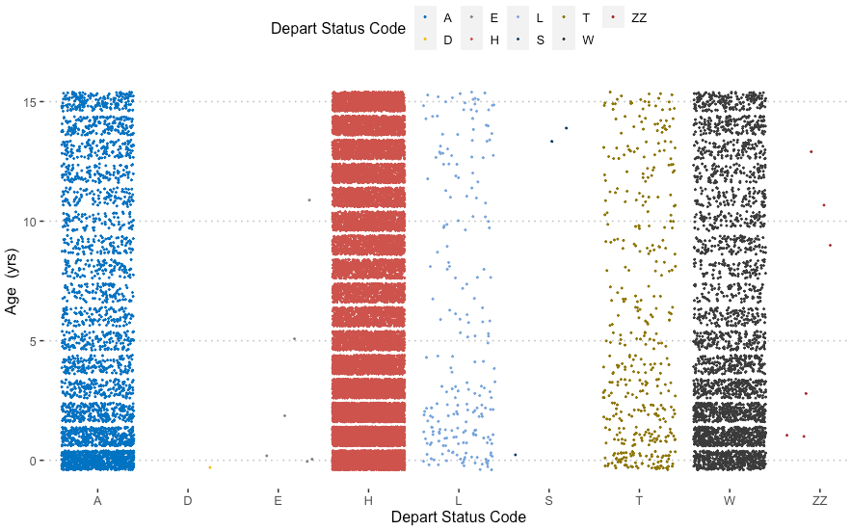
Exploratory Data Analysis: DEPARTURE
Number of patients who did not wait plus the other top 29 descriptions of diagnosis on the left.

Slide 14
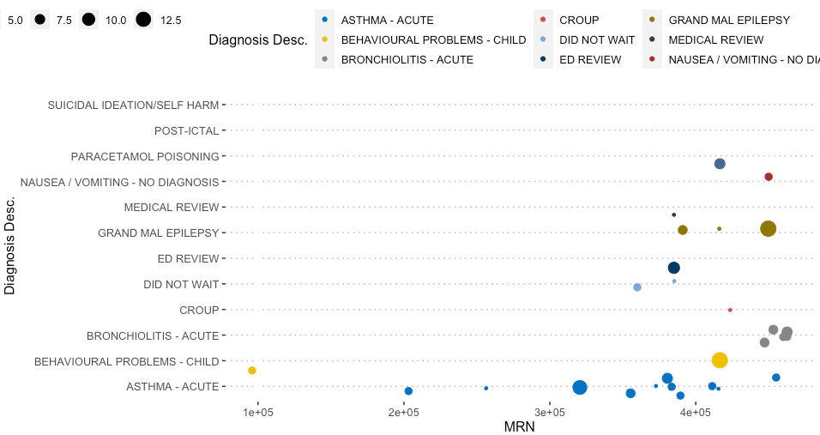
Exploratory Data Analysis: MRN
A random subset of the data, grouped by the diagnosis description, sized to the number of visits for various patients.

Slide 15
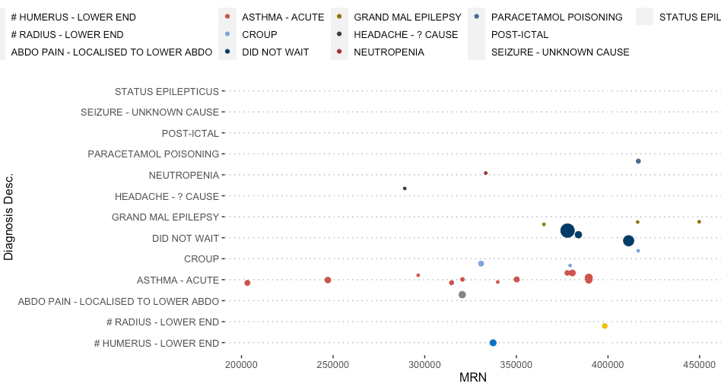
Exploratory Data Analysis: MRN & TIME
A random subset of the data, grouped by the diagnosis description, sized to the number of visits for a specific patient.

Slide 16
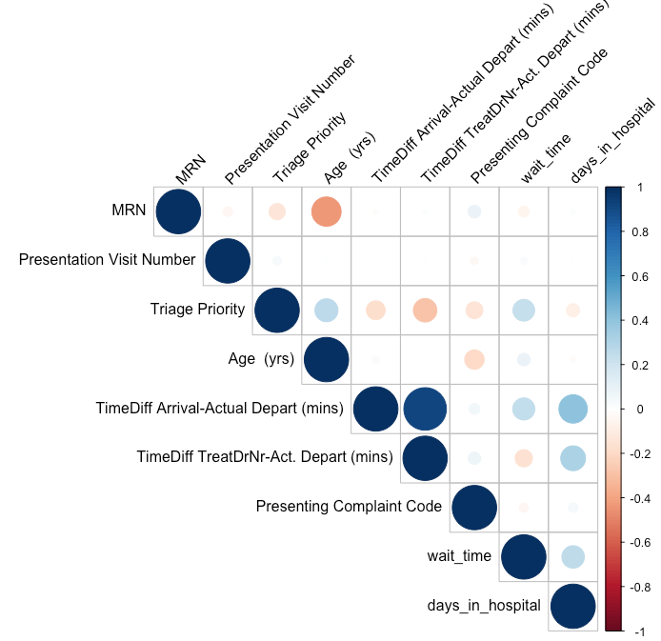
MODEL BUILDING: CORRELATIONS
In modelling endeavors, it is important to identify and, for best practice, avoid high correlations between independent variables. This is in part to avoid biasing the outcome variable predictions.

Slide 17
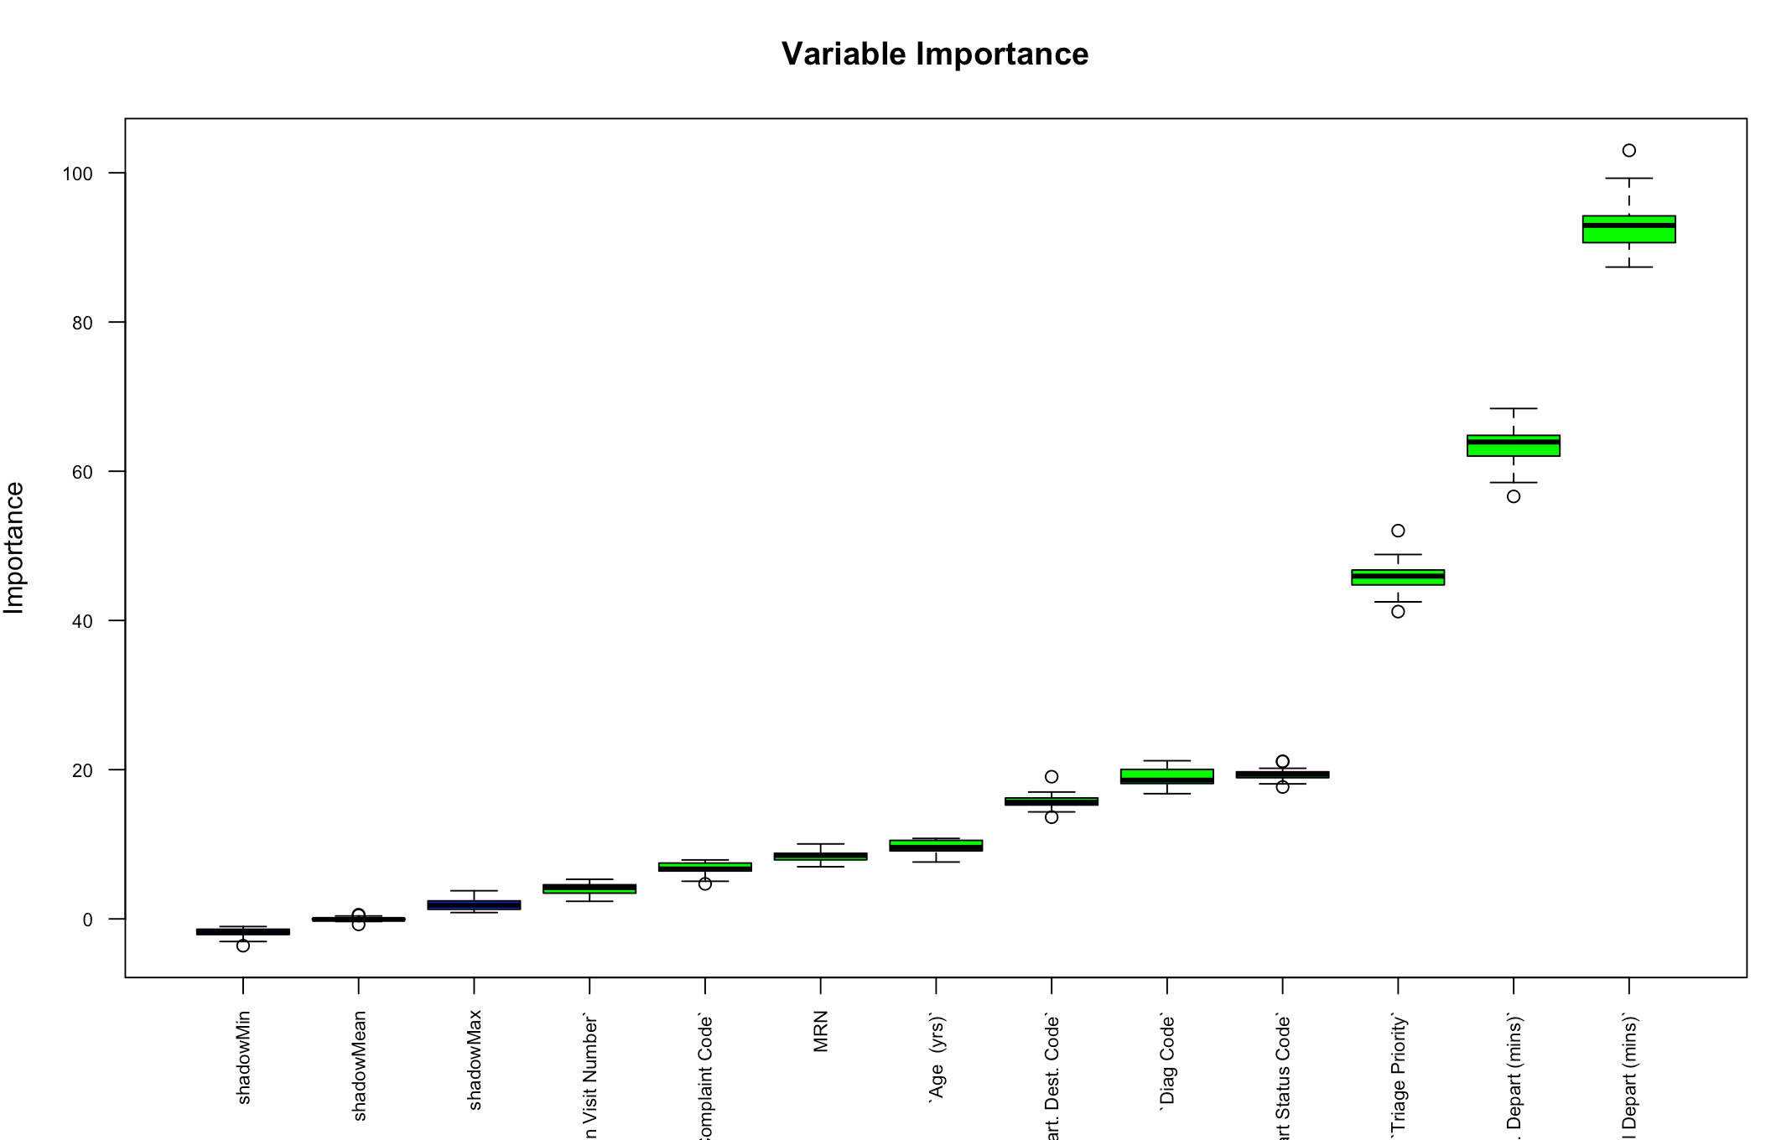
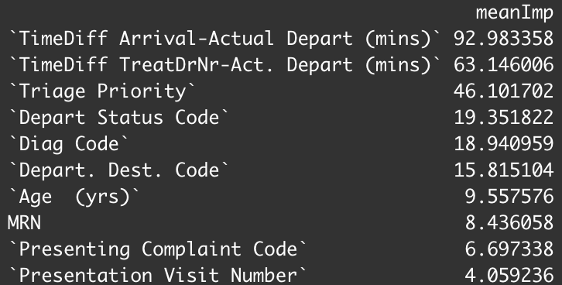
FEATURE IMPORTANCE
Triage priority, the departure status code and the diagnosis code seem to be the most important variables in predicting the wait_time.

Slide 18
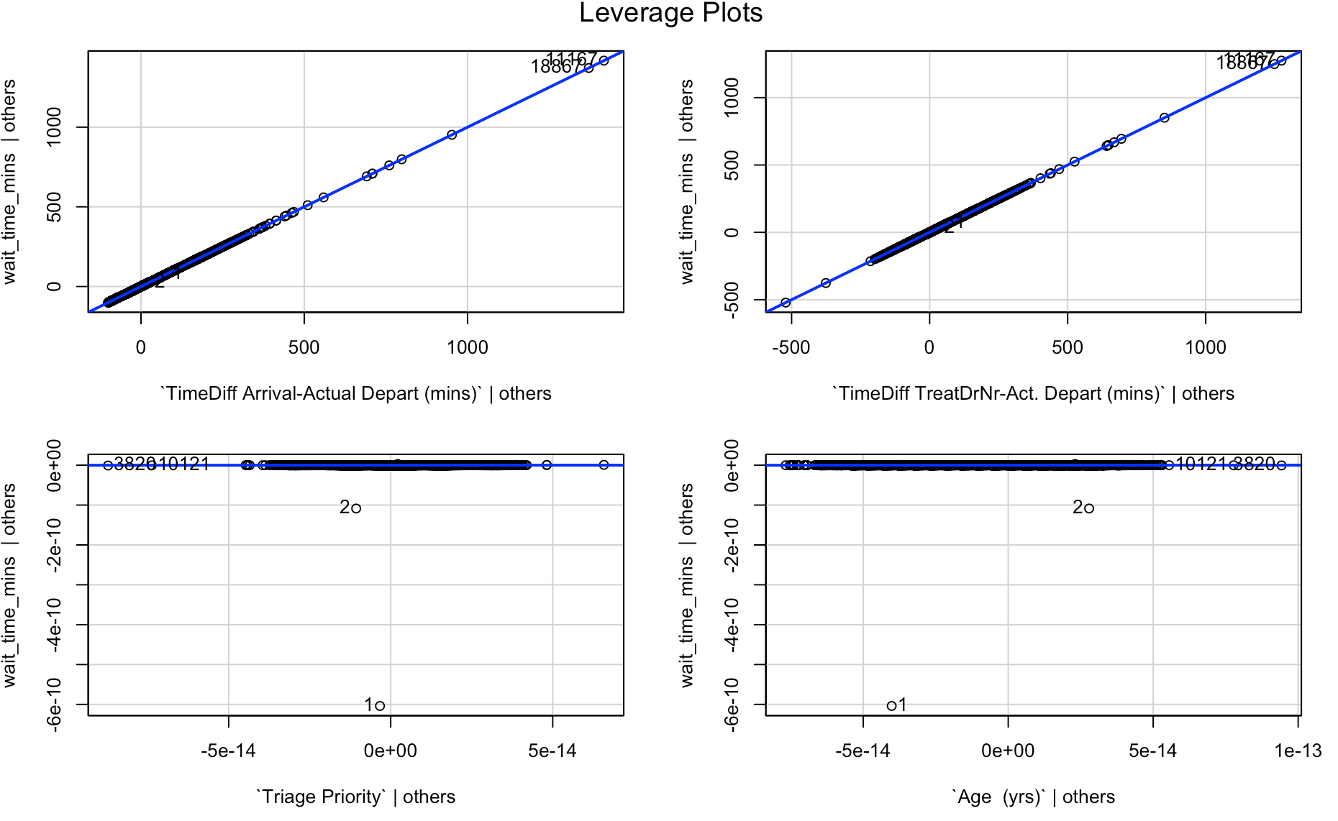
MODEL VALIDATION
The final model will be able to predict wait_time to a high precision point. However, more data outlier and analysis is needed.

Slide 19
BACK-UP

Slide 20
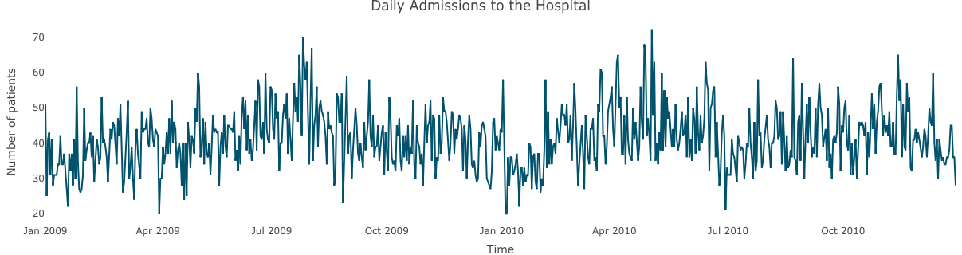
TIMESERIES Data Analysis

