Slide 1



DATATHON 2026
ROUND 1 · IDEA PPT + BASE PROTOTYPE
Team Name: W V P S SRIRAJ
Team Members: W V P S Sriraj (23BCE8414)
Track Chosen: Track 4 - Business
Problem Statement: The Money Leak
Product Name: LeakFinder

Slide 2
PROBLEM & TARGET USER
❖ Problem & Target User
Who and pain: business owners, retail and category managers, and operations teams. Sales, prices, stock and ad spend sit in five separate tables, so nobody can see where profit is lost or which problems are real.
Why it matters: 10.16M was booked but only 7.91M was realized. 17.2% of booked revenue is cancelled or returned. Without proof, managers fix noise and miss the real leak.
Evidence from the dataset:
76 of 250
products priced below unit cost
-1.05M
lost on completed sales because of that
1.75M
revenue cancelled or returned
1.9x
marketing spend vs margin kept
DATATHON 2026 · Round 1 Idea Submission – Template
2

Slide 3
SOLUTION & USP
❖ Proposed Solution
LeakFinder: a decision-support app that finds each money leak (pricing, cancellations and returns, stuck orders, stock, ads), ranks it by money at stake, and shows the evidence.
Manager flow: open Command Center, see ranked leaks, drill into why, run a what-if (for example reprice), download the action plan.
How it fixes the problem: joins 5 tables into one investigation view, with a 'why flagged' panel and a confidence label on every action.
❖ USP
Real leak or noise? tests 10 possible drivers of failed orders and says 'no real signal' when it is chance (0 of 10 are real), instead of showing a made-up risk score.
Beyond the obvious approach: a sales dashboard plus a black-box return model. Ours gives proof, a confidence level and a ranked action, with all ML written from scratch and scored on future data.
DATATHON 2026 · Round 1 Idea Submission – Template
3

Slide 4
DATASET & INSIGHTS
❖ Dataset Usage
Tables used (all 5): transactions joined to customers (customer_id) and products (product_id); inventory joined on product_id; campaigns analysed by date, channel and category.
Cleaning and assumptions: unit_price already includes the discount (checked on all 18,000 rows); Completed = realized, Cancelled/Returned = not realized; Pending over 30 days = stuck; 171 impossible campaign rows excluded; stockout flag not trusted (760 of 760 flagged records still have stock).
Key insights: price below cost is the biggest leak; discounts add only 22K; 0 of 10 failure drivers are real; spend vs conversions r = -0.01; 7 products at high stock risk.
DATATHON 2026 · Round 1 Idea Submission – Template
4

Slide 5
ML MODEL
❖ ML Approach
Built from scratch (NumPy only), no API key: logistic regression, random forest, gradient boosting, KMeans segments, robust z-score alerts, trend regression forecast.
Setup: target = order Cancelled or Returned. Features = quantity, price, discount, below-cost flag, category, region, segment, channel, payment, tenure, hour, weekday, lead days. Baseline = always 'no'. Split = time-aware (train Jan-Sep, test Oct-Dec). Metrics = AUC, accuracy, top-decile lift.
How output is used: best AUC is 0.52 (0.50 = coin flip), so the product does not score customers. It sends managers to the leaks that are real (pricing, stuck orders) and asks for cancel/return reason codes.
Model (from scratch) | AUC | Accuracy | Always-'no' baseline | Top-decile lift
Logistic Regression (scratch) | 0.501 | 0.829 | 0.829 | 1.02
Random Forest (scratch) | 0.503 | 0.829 | 0.829 | 1.00
Gradient Boosting (scratch) | 0.524 | 0.829 | 0.829 | 1.05
DATATHON 2026 · Round 1 Idea Submission – Template
5

Slide 6
BASE PROTOTYPE & MVP
❖ Base Prototype (Round 1)
Working Streamlit app on the provided data, 8 tabs (below). [Add screenshot / public link here]
Command Center
Investigate
Pricing Leak
Stock Risk
Campaigns
Forecast & Alerts
ML Lab
Action Plan
❖ MVP for Round 2
Must-haves: ranked action plan with impact and confidence; pricing what-if with downloadable repricing list; 'why flagged' evidence on every alert; stock-risk monitor; campaign efficiency view.
Demo workflow: input (filters and sliders) -> output (ranked leaks with evidence) -> action (repricing list, stuck-order queue, tracking audit).
DATATHON 2026 · Round 1 Idea Submission – Template
6

Slide 7
TECHNICAL APPROACH
❖ Technical Approach
Technologies: Python, pandas, NumPy (all ML written from scratch), Streamlit, Plotly, GitHub. No external APIs.
Flow: Data -> Analyze -> Model -> Build -> Deploy
Data
Analyze
Model
Build
Deploy
5 CSVs joined; 7 data issues found and documented
leak sizing; scan of 10 drivers with significance tests
from-scratch ML; time-aware split; honest baselines
8-tab Streamlit app; what-ifs; downloads
GitHub repo + public URL; swap CSVs to refresh
DATATHON 2026 · Round 1 Idea Submission – Template
7

Slide 8
FEASIBILITY, IMPACT & NEXT STEPS
❖ Feasibility, Impact & Next Steps
Feasibility and risks: runs on the 5 CSVs in seconds (analysis cached). Risk: cost and price data may be wrong (README warns) -> finance confirms before repricing. Risk: weak signal -> every action carries a High / Medium / Low confidence label.
Impact: repricing up to 1.62M margin gain (20% target margin, 15% volume loss); stuck orders 370K; ad audit up to 1.38M spend above benchmark (low confidence). Impacts overlap, so they are upper bounds.
Limitations: synthetic data, currency not stated, no real-world causes claimed.
Next steps and references: polish and rehearse the 60-second demo; add cancel/return reason capture; A/B test budget moves. Reference: Datathon 2026 Track 4 dataset and README; all code in our repo.
DATATHON 2026 · Round 1 Idea Submission – Template
8

Slide 9
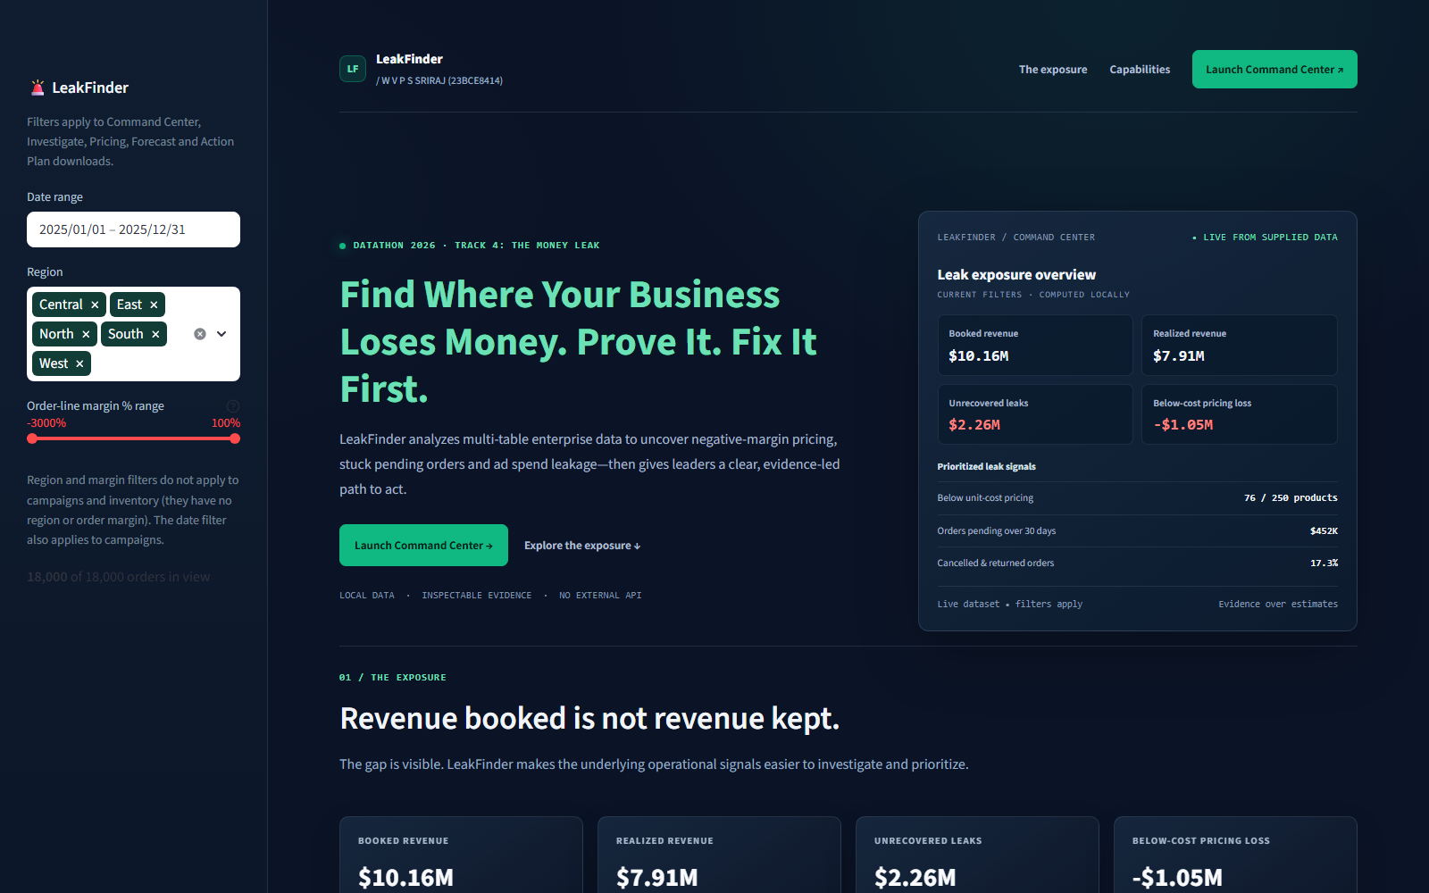
LeakFinder Web Application
W V P S SRIRAJ (23BCE8414)

Slide 10
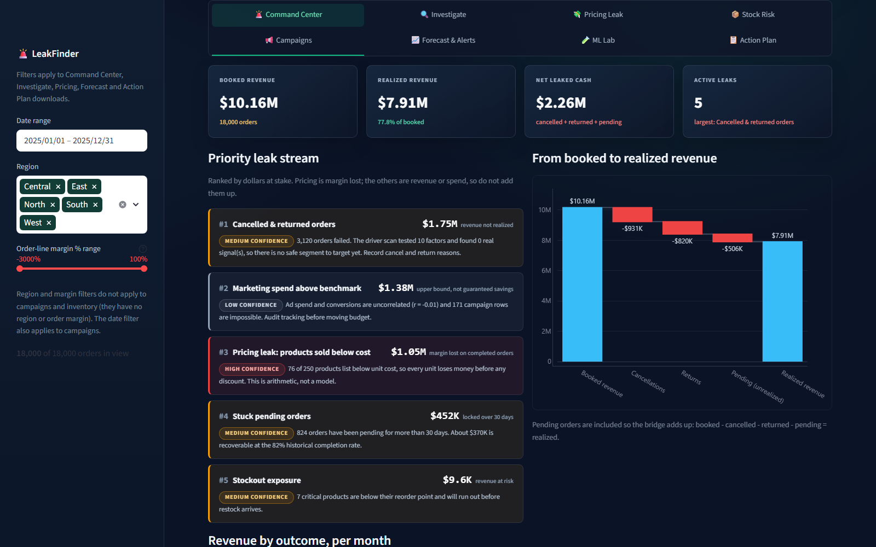
Live Command Center
W V P S SRIRAJ (23BCE8414)

Slide 11

Responsive Mobile View
Designed for a narrow viewport
The filter sidebar collapses, keeping the live exposure preview and key actions readable on mobile.
W V P S SRIRAJ (23BCE8414)

