Slide 1


IICT Faculty
2015

Slide 2
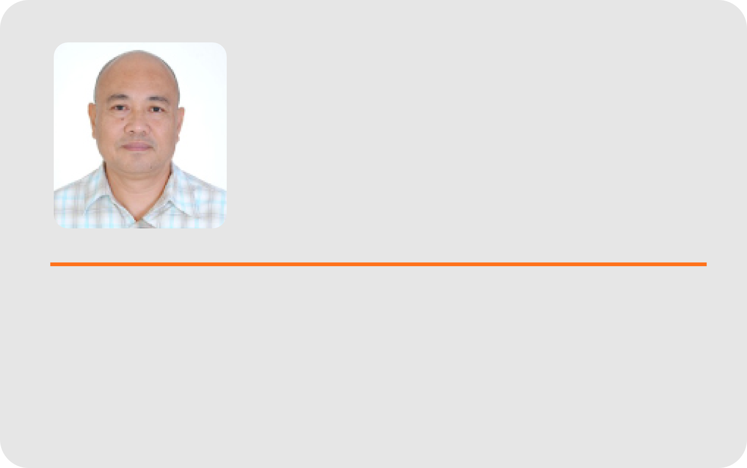
Joel T.
De Castro
B.S. in Biology, M.S. Computer Science, Doctor of Industrial Technology
Director; Prof. II

Slide 3
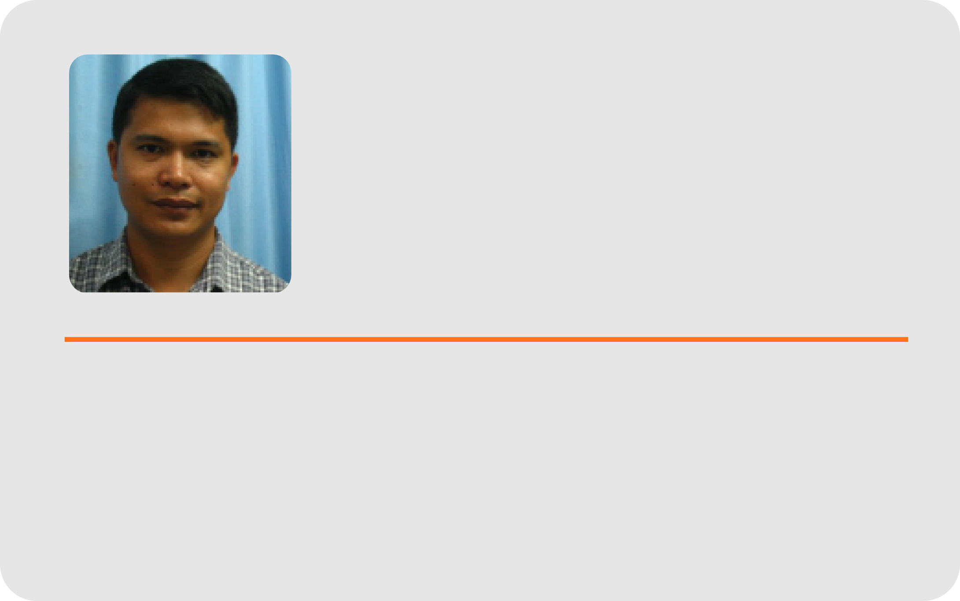
Bobby D. Gerardo
B.S.E.E. , M.A. Ed. (Mathematics), Ph.D. (Information and Knowledge Engineering)
Prof. VI; Vice President for Administration and Finance

Slide 4
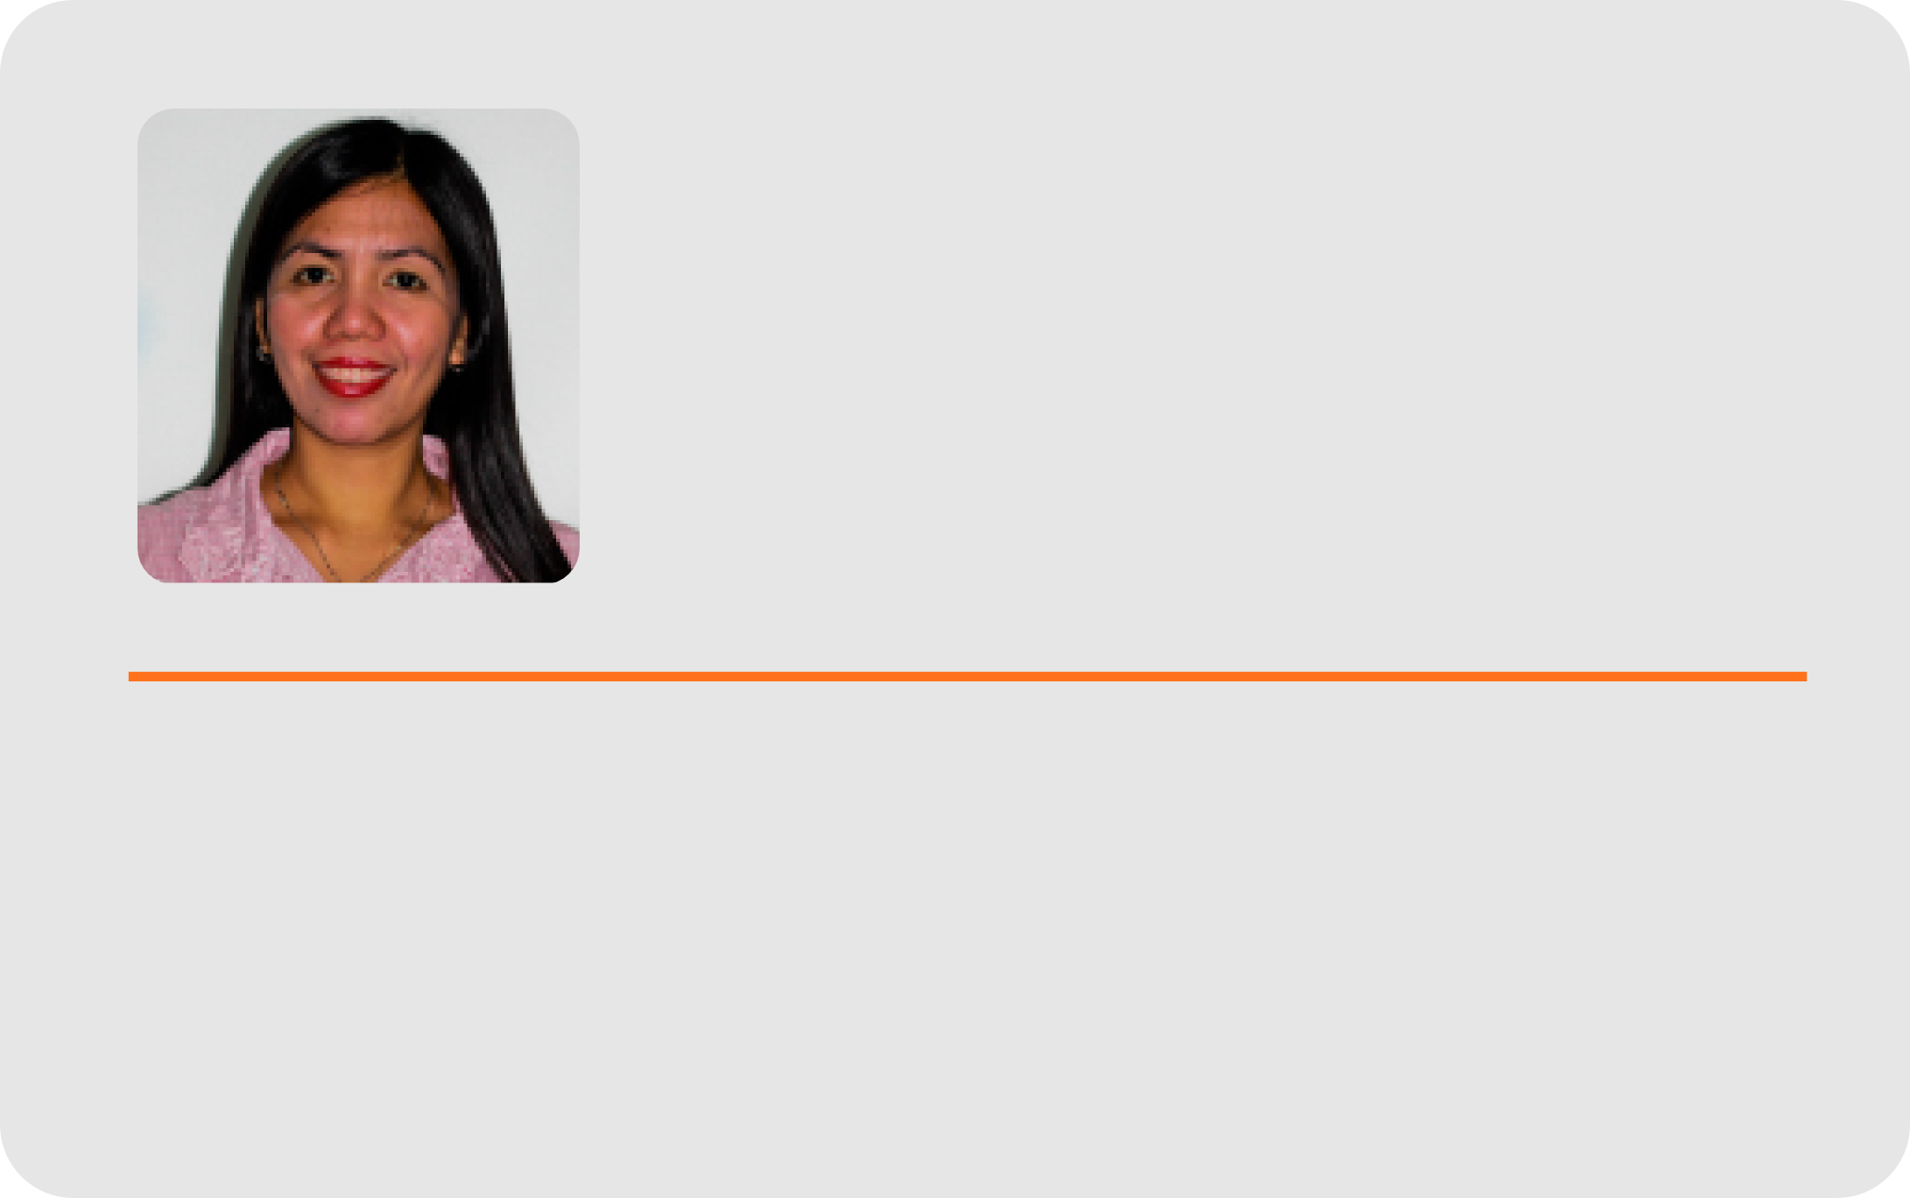
Ma. Beth S. Concepcion
B.S.I.M., Master in Information Management, Doctor of Information Technology (on-going / on study leave);
Asst. Prof. IV

Slide 5
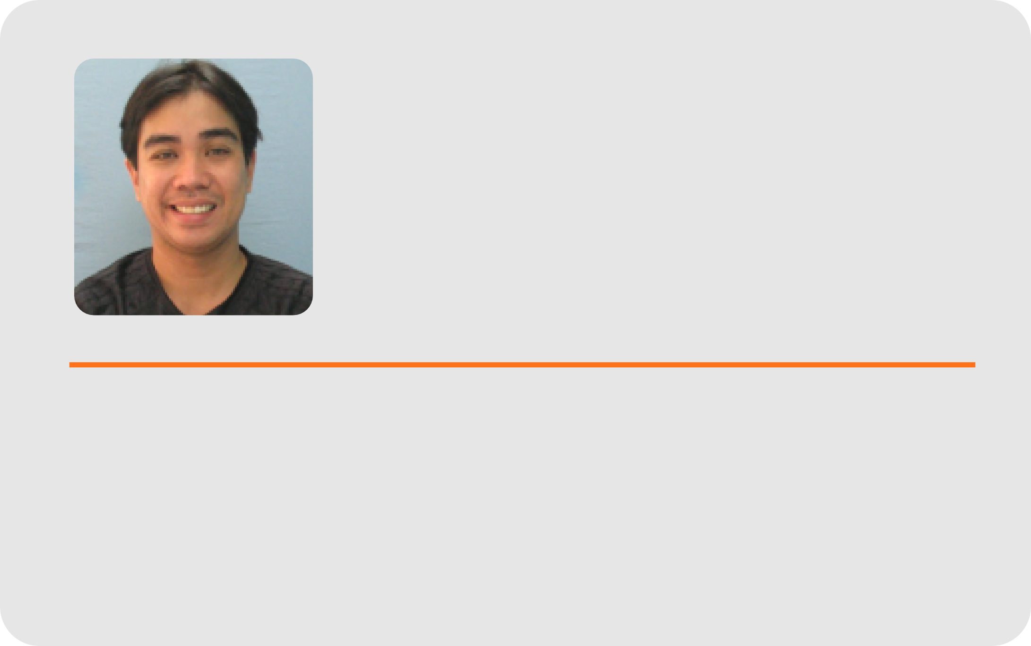
Cyreneo S. Dofitas, Jr.
B.S. Computer Science, M.S. (Computer Science); Asst. Prof. I

Slide 6

Ma. Luche P. Sabayle
B.S.E.D. (Math) , Master of Computer Science
College Secretary; Chair, Division of Computer Science

Slide 7
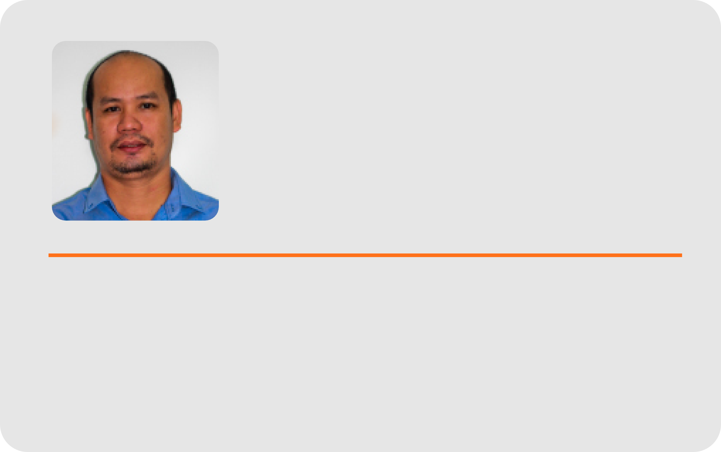
Rodel D. Dosano
BS Electrical Engineering, Masters in Engineering, Ph. D. Information and Knowledge Engineering

Slide 8
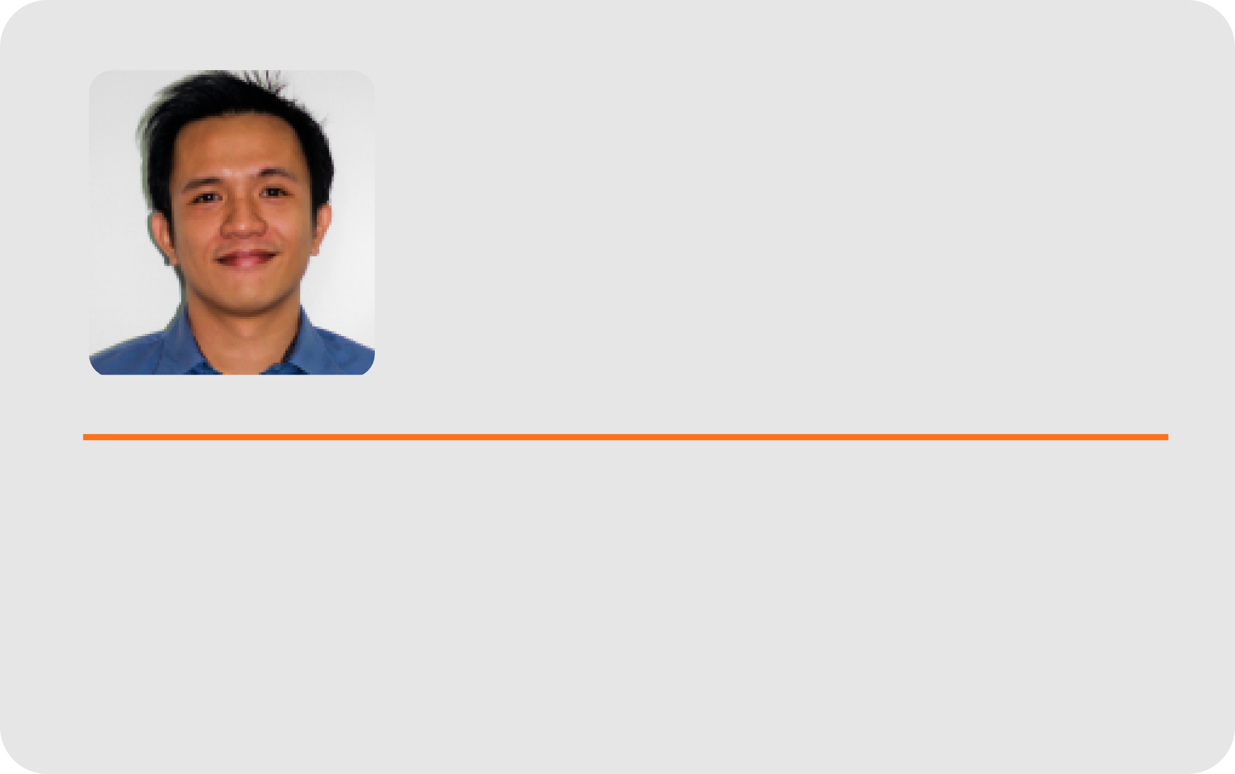
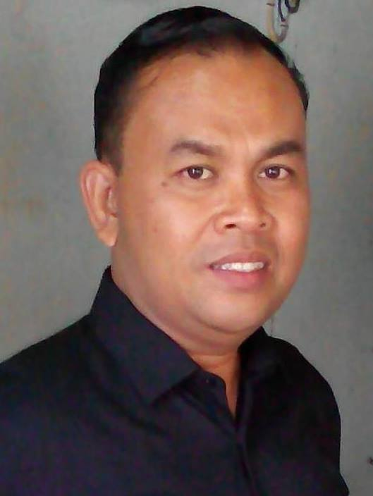
Arnel N. Secondes
B.S.C.S. Master in Computer Science; Chair, Division of Information Systems

Slide 9
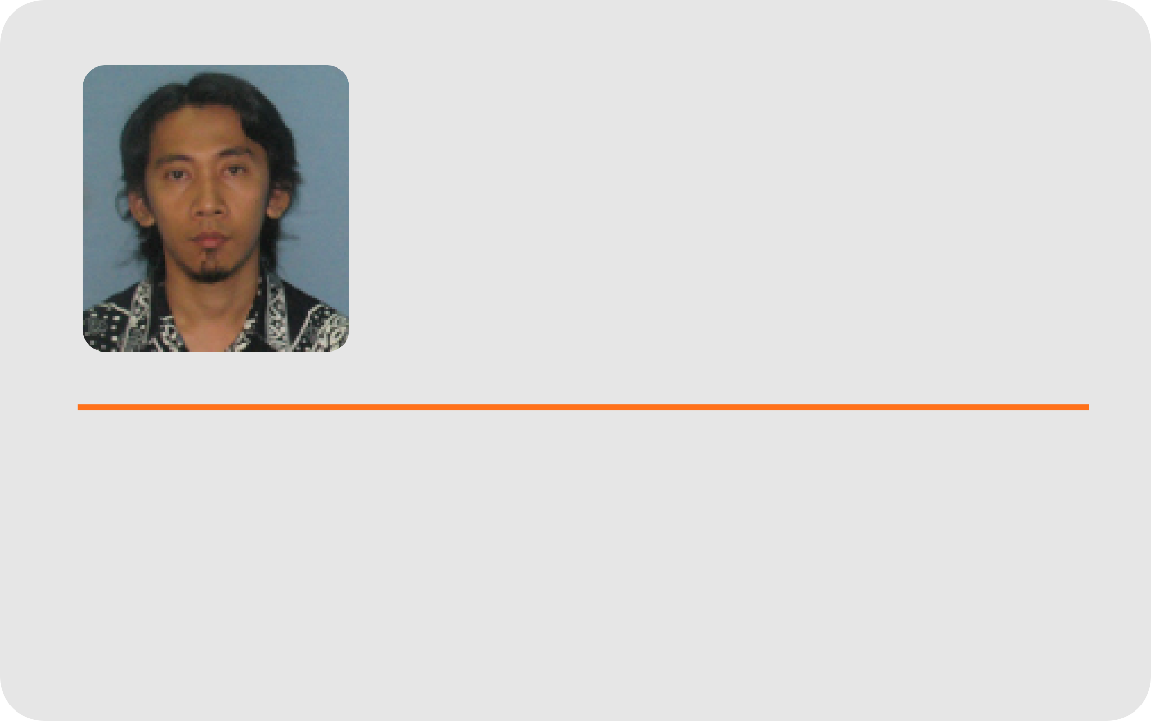
Frank I.
Elijorde
B.S. I.T., M.S. Computer Science), Ph. D. Information and Knowledge Engineering (on-going / on study leave); Asst. Prof. II

Slide 10
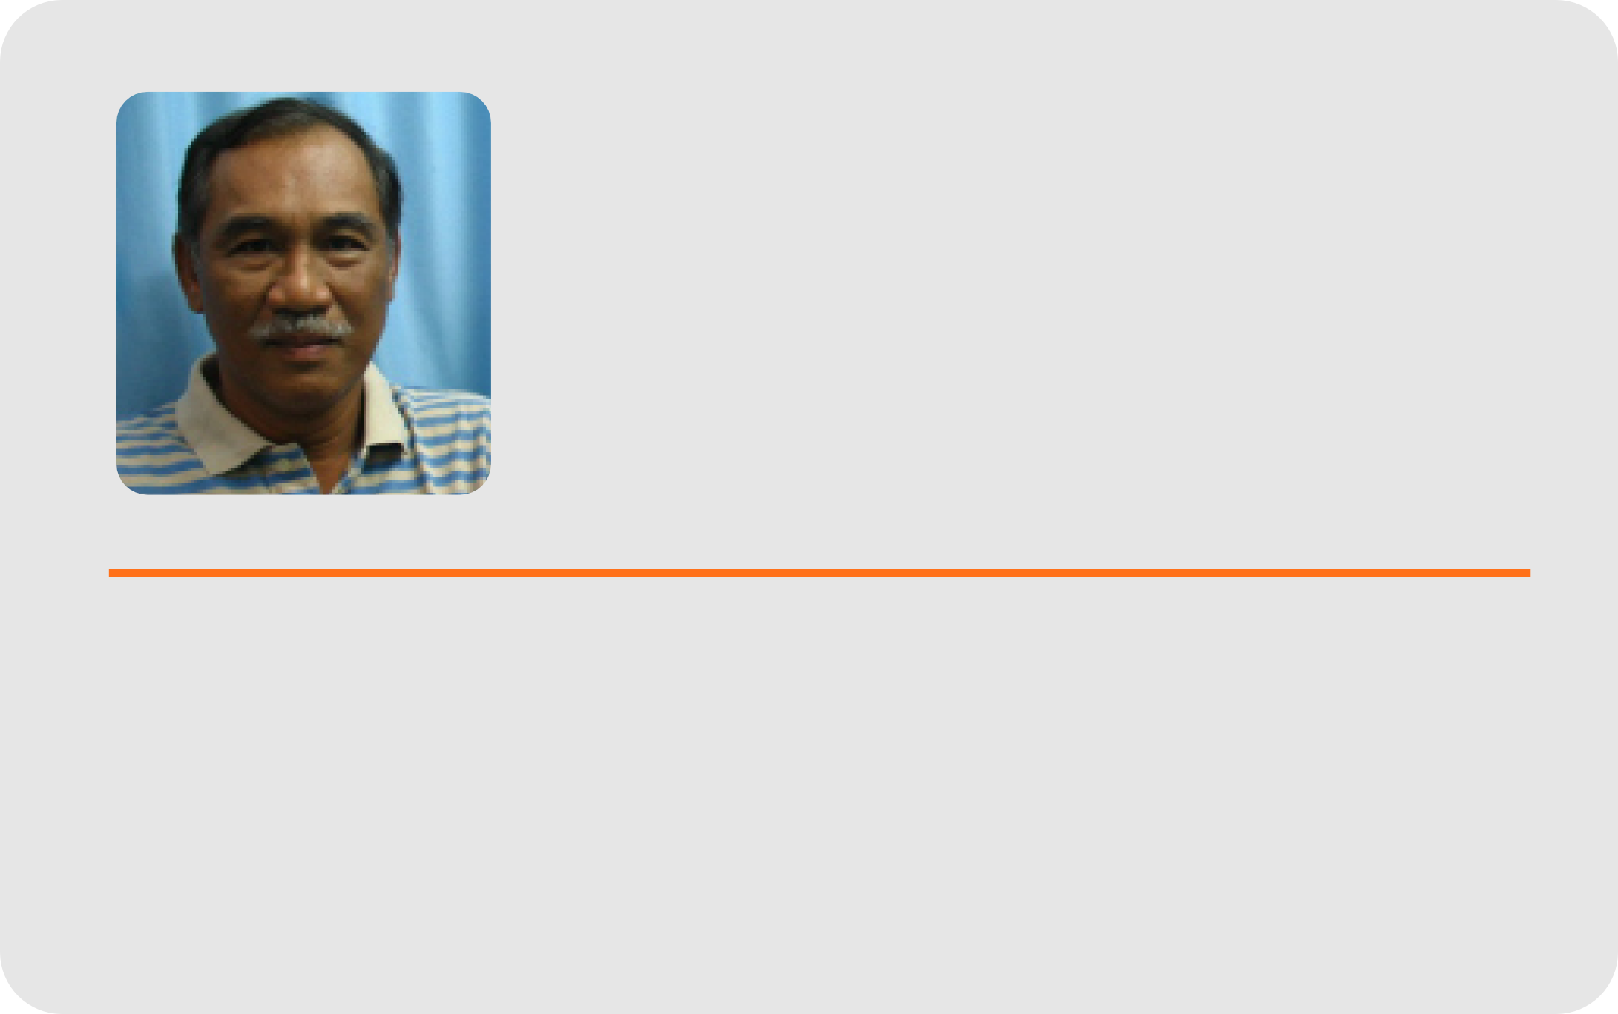
Marino A. Osorio
B.S.C.E., Masters in Engineering, Ed. D. (Educational Management)
Associate Prof. V

Slide 11
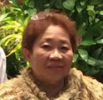
Francisca D. Osorio
B.S.C.E., Masters in Engineering, Ed. D. (Educational Management)

Slide 12
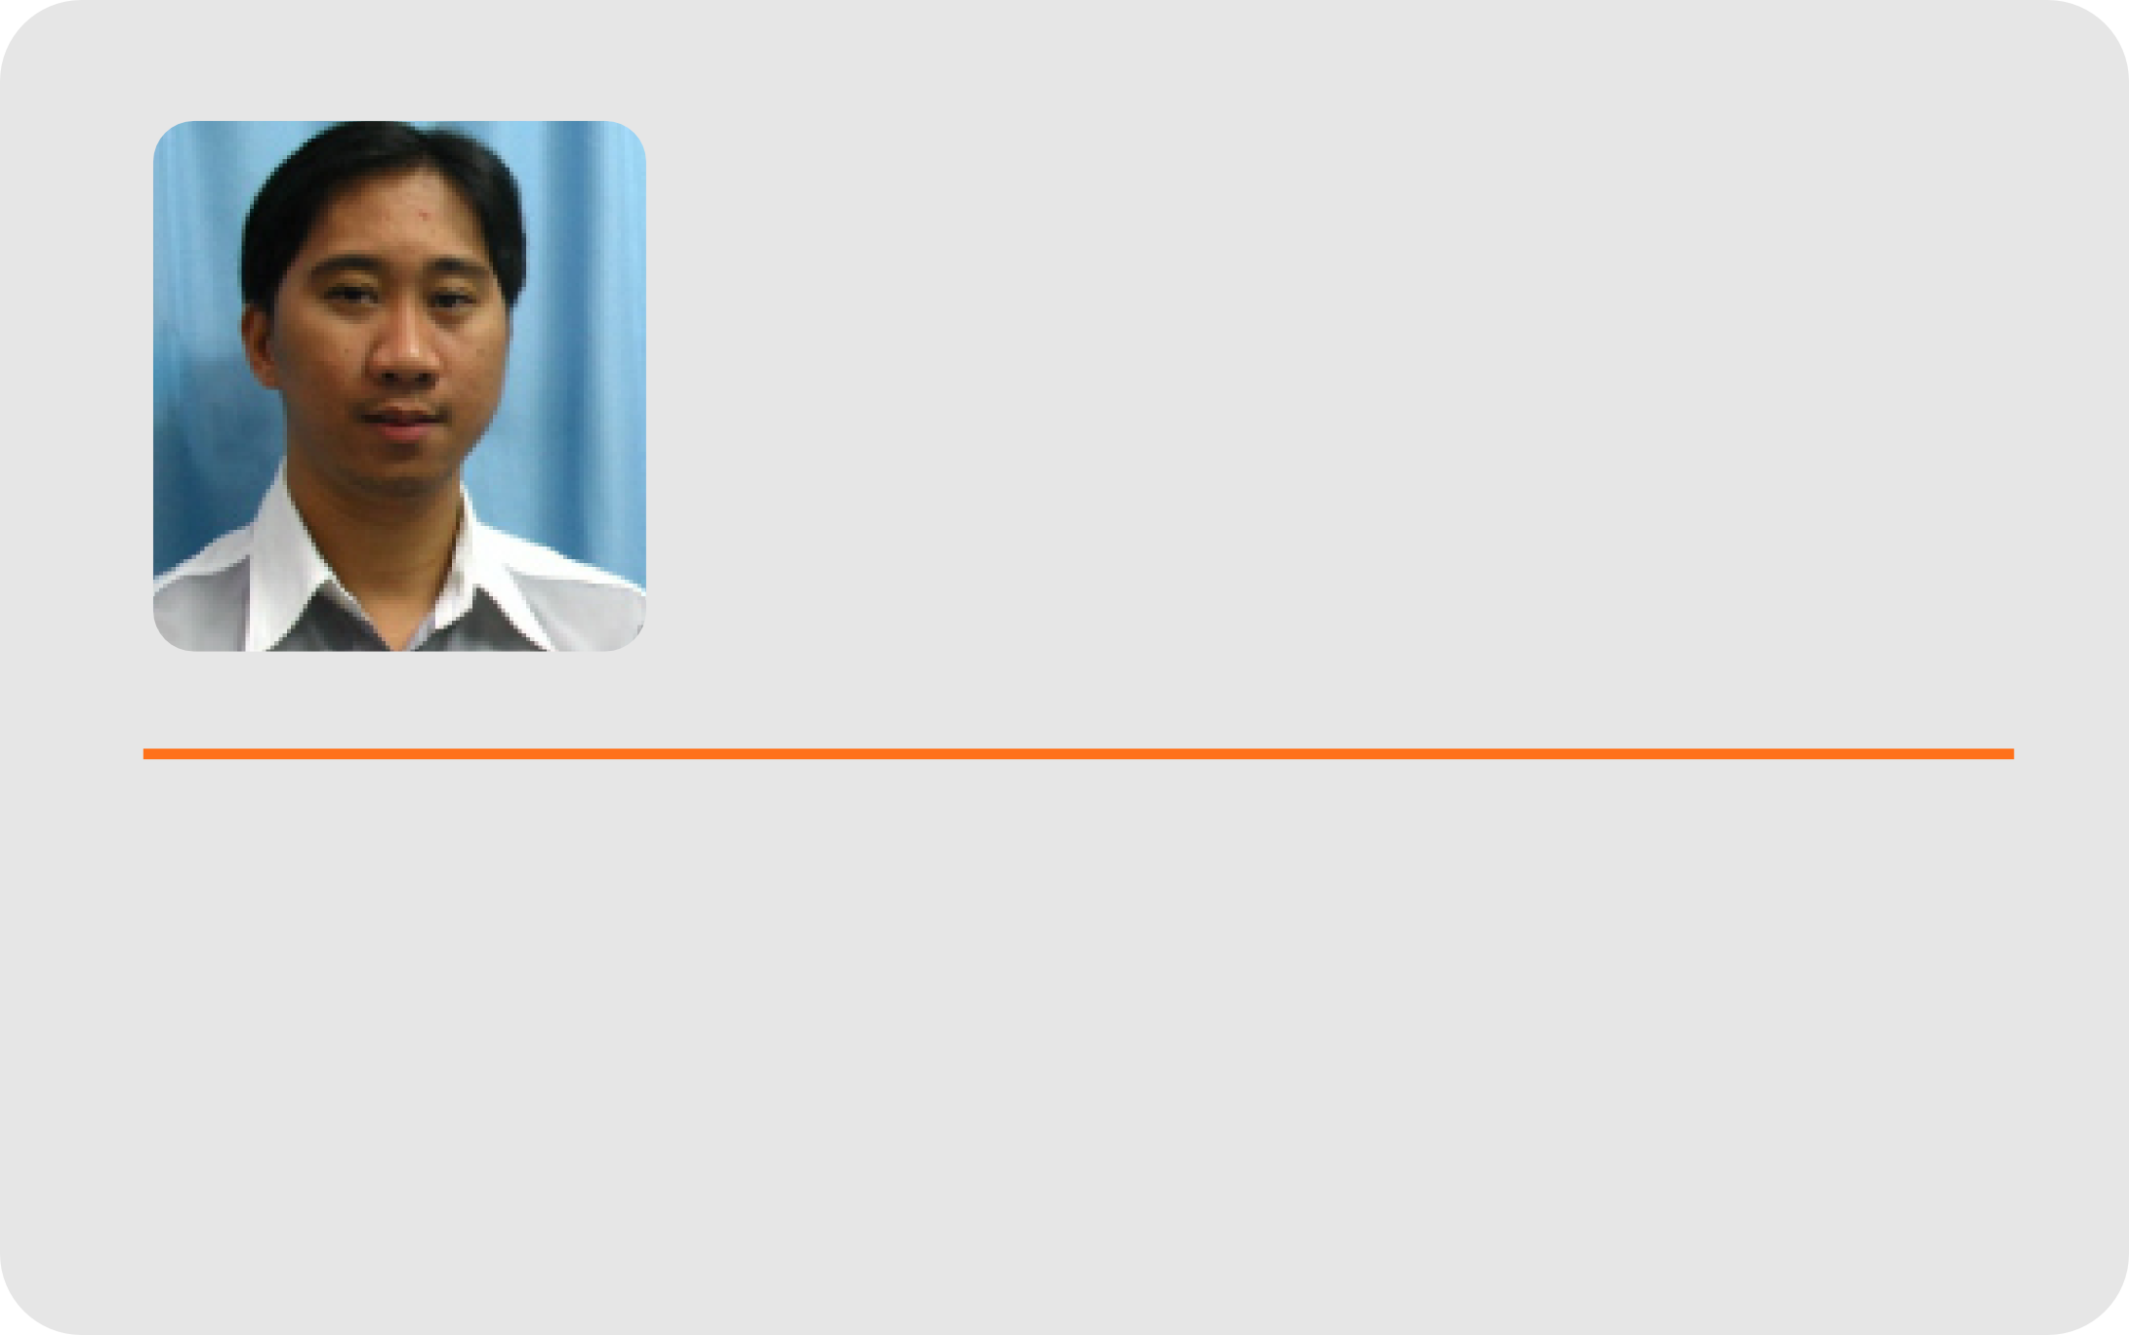
Erwin D.
Osorio
B.S. E.E., Masters in Computer Science Instructor III

Slide 13
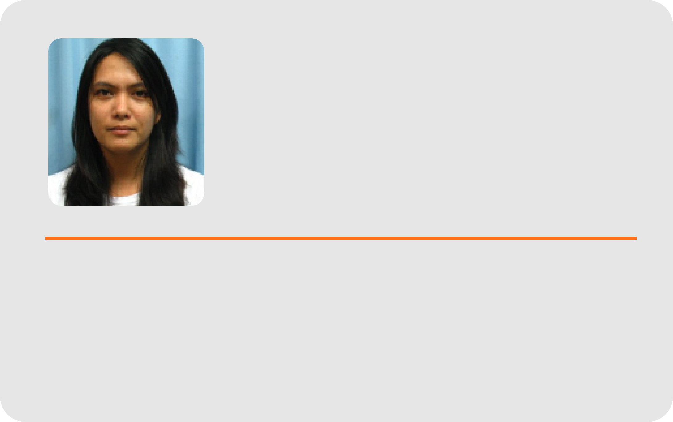
Karen Alinor D. Subong
B.S.E.C.E. , M.A. in Mathematics
Instructor II

Slide 14
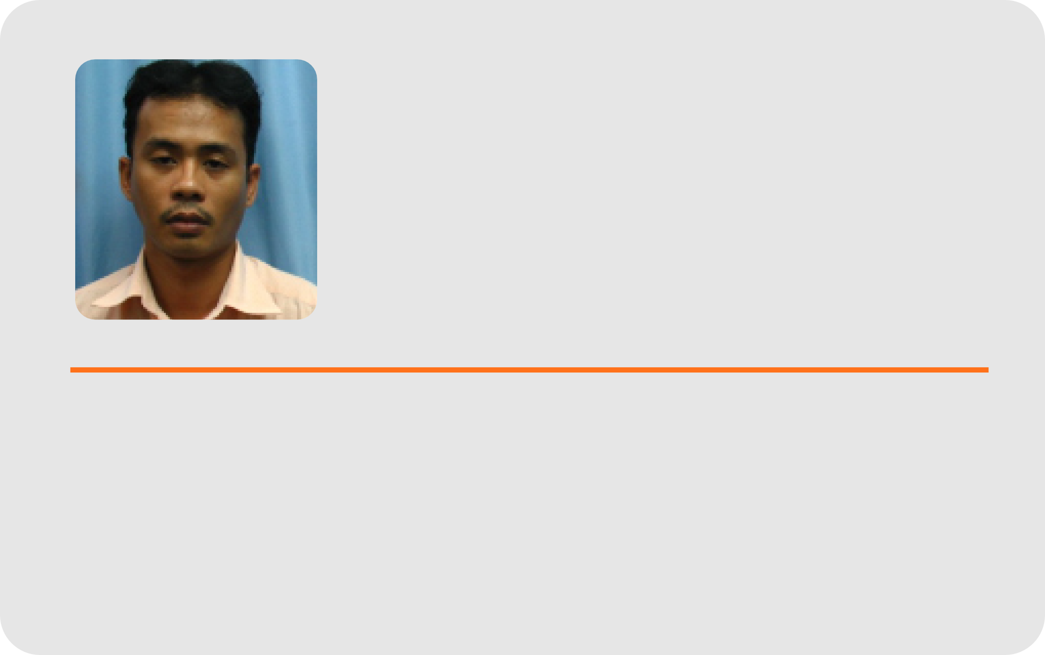
Paul Marlou A. Subong
B.S. I.T.; Instructor I

Slide 15
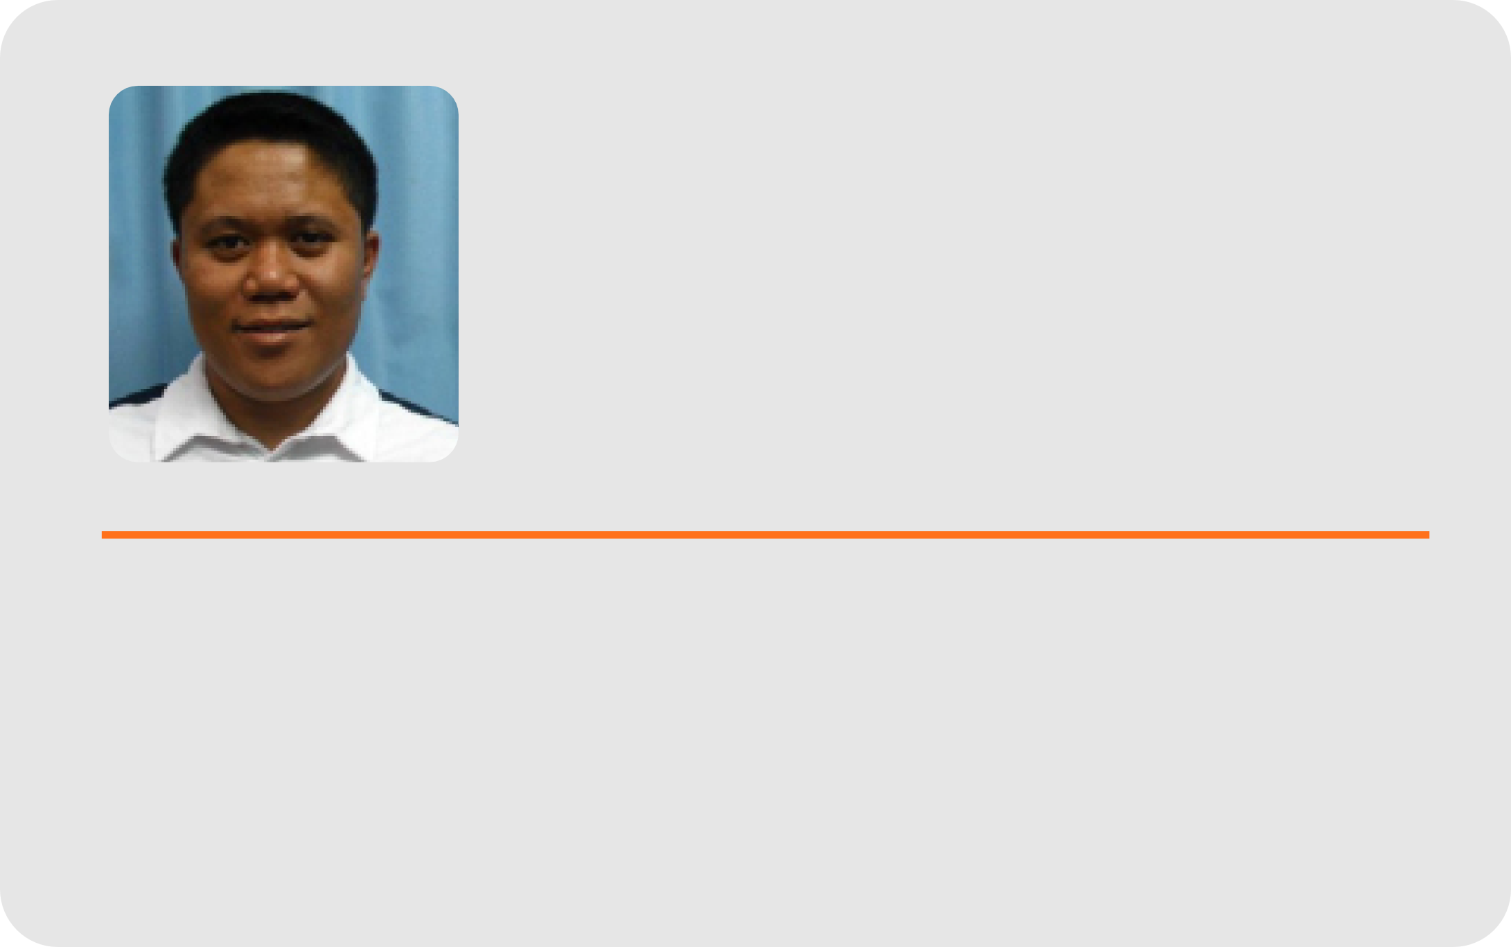
Louie F. Cervantes
B.S.Ed (Physics), Master of Engineering (Information and Knowledge Engineering)

Slide 16
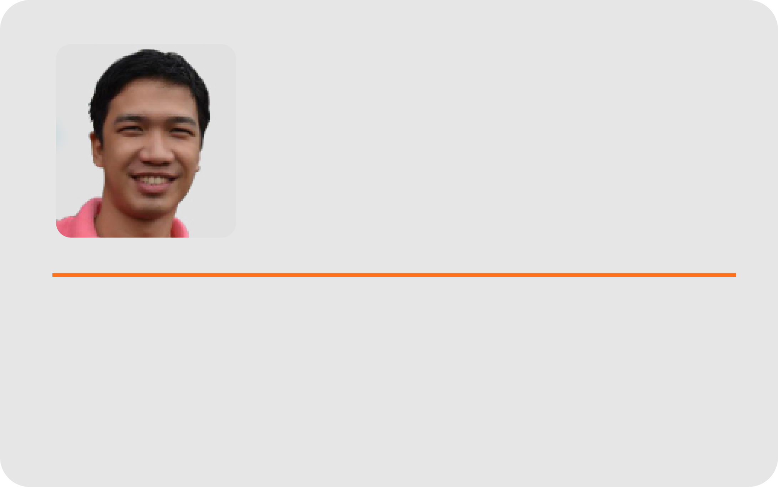
Radly Mar U.
Simpao
B.S. I.T.; Lecturer

Slide 17
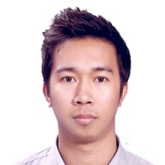
Regin C. Cabacas
B.S. I.T., Master of Engineering (Telecommunications and Radio Communications Engineering)

Slide 18

Raizza Victoria A. Cenaroza
B.S.I.T.,
Masters in Computer Science (on-going)

Slide 19
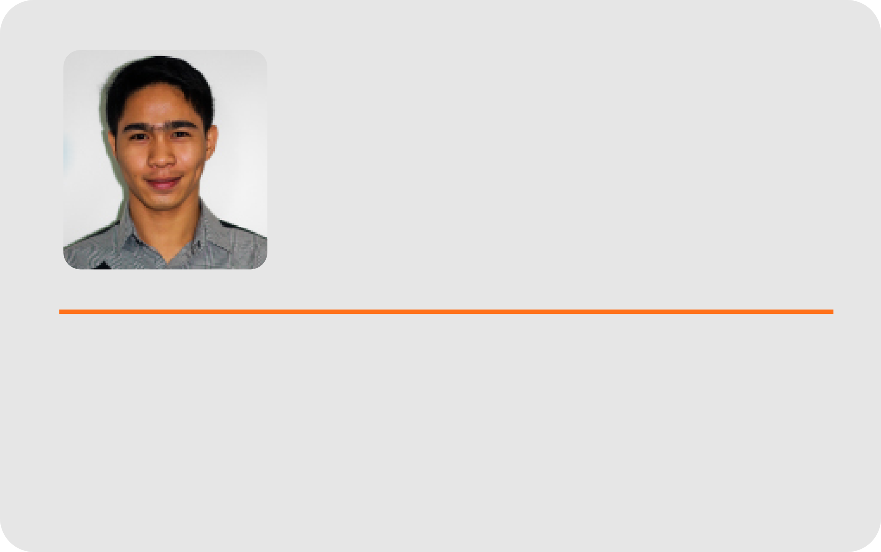
Shem Durst Elijah B. Sandig
B.S.I.M.,
Masters in Computer Science (on-going)

Slide 20
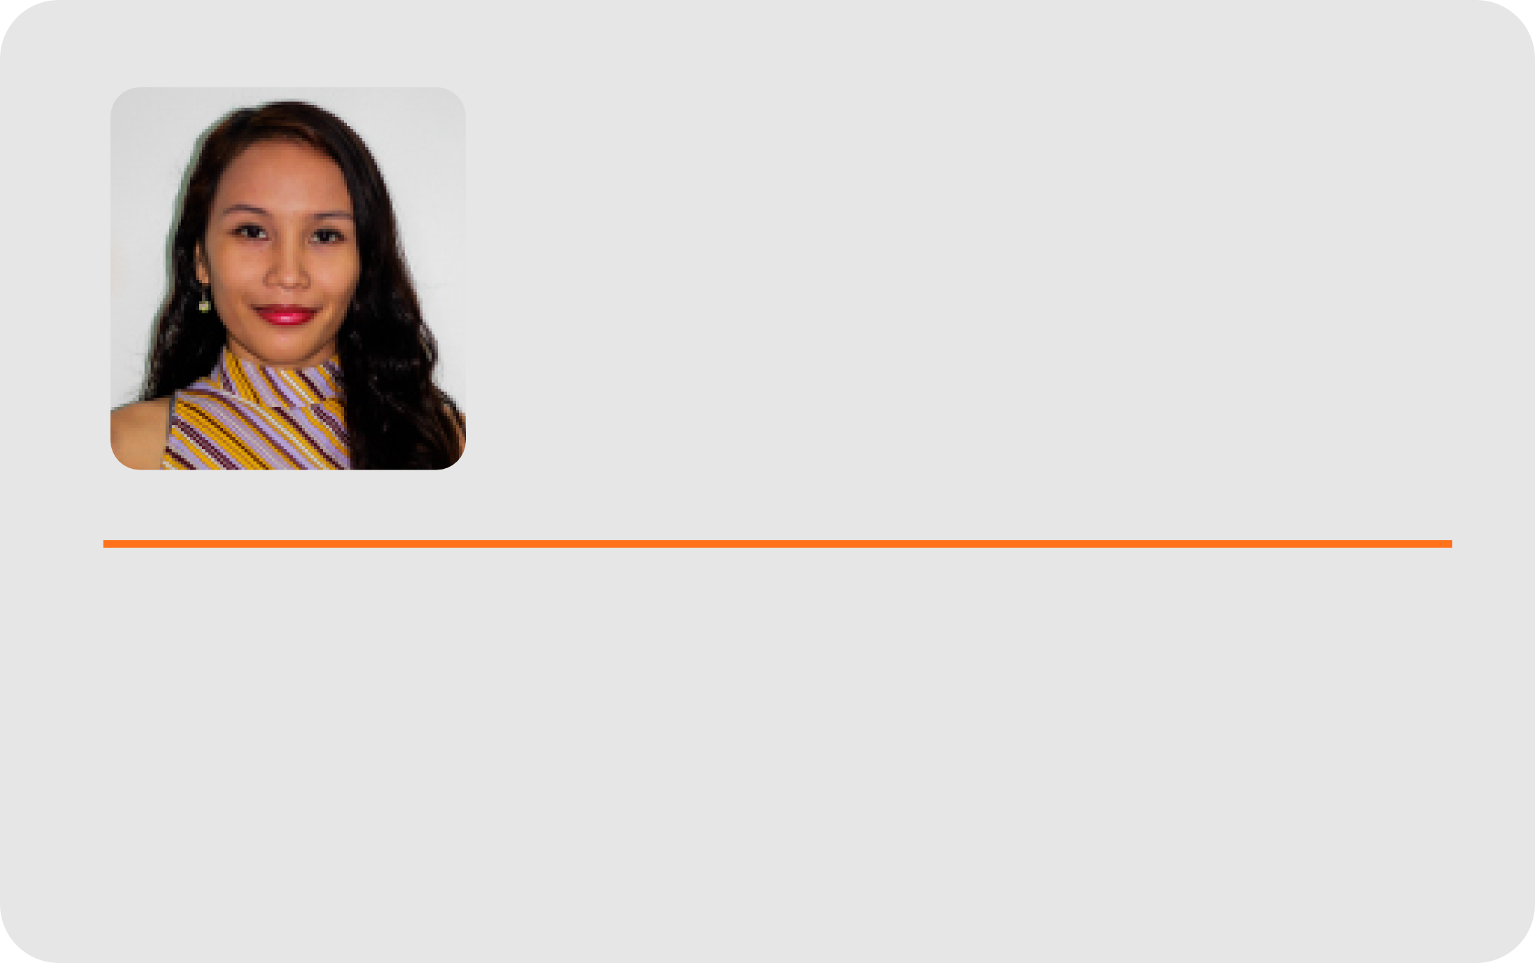
Louise Eve M. Sorolla
B. S. in Computer Science,
Masters in Computer Science (on-going)

Slide 21
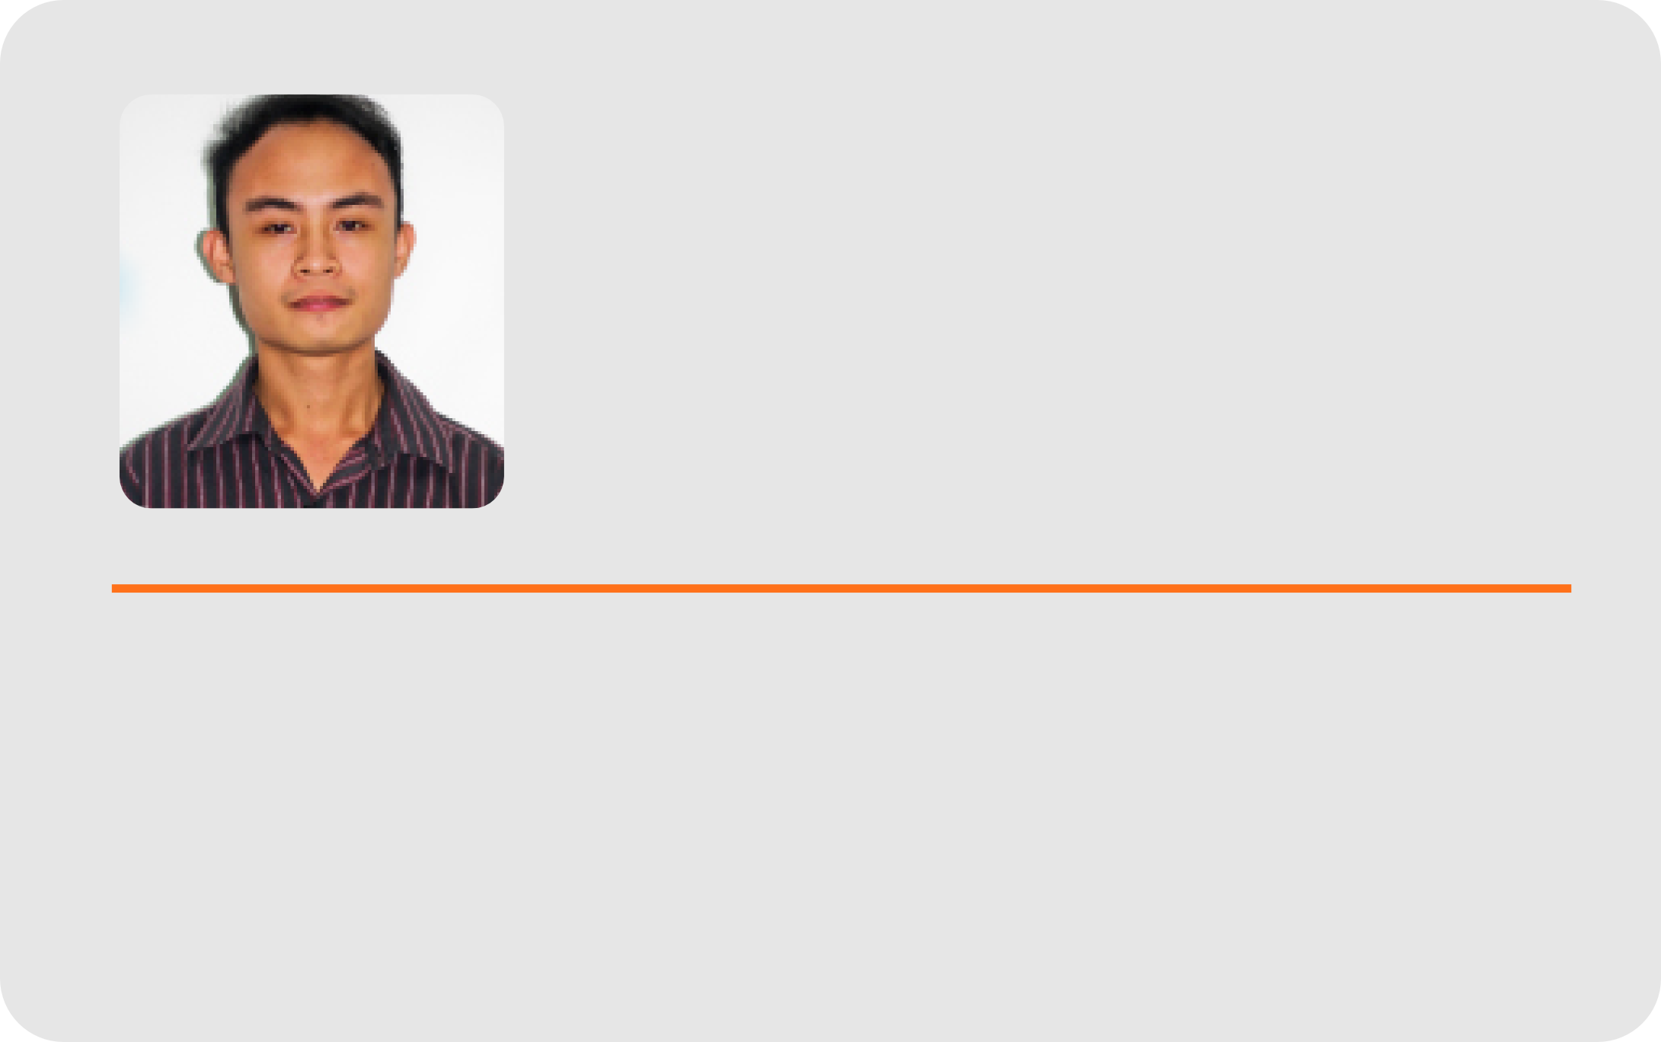
Mark Joseph J. Solidarios
B.S.I.S.,
Masters in Computer Science (on-going)

Slide 22

Janine P. Defante
B.S.I.T.
Masters in Computer Science (on-going)

Slide 23
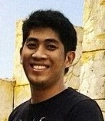
Ralph Voltaire Dayot
B.S. I.T.

Slide 24
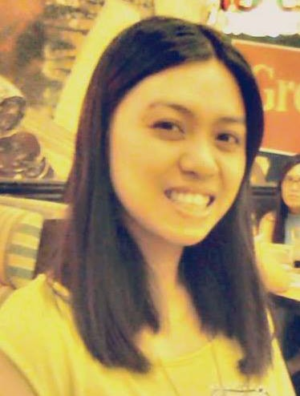
Jemelda Suganob
B.S. I.M., Master in Computer Science (on-going)

Slide 25

Edgar L.
Javison
BS Psychology, MPHIL (Planning)

