Slide 1
A Guided Tour of CML, the Coded Modulation Library
last updated on
**March. 19, 2013
Matthew Valenti **and Terry Ferrett
Iterative Solutions
and West Virginia University
Morgantown, WV 26506-6109
mvalenti@wvu.edu

Slide 2
Outline
CML overview
  What is it? How to set it up and get started?
Uncoded modulation
  Simulate uncoded BPSK and QAM in AWGN and Rayleigh fading
Coded modulation
  Simulate a turbo code from UMTS 25.212
Ergodic (Shannon) capacity analysis
  Determine the modulation constrained capacity of BPSK and QAM
Outage analysis
  Determine the outage probability over block fading channels.
  Determine the outage probability of finite-length codes
The internals of CML
Throughput calculation
  Convert BLER to throughput for hybrid-ARQ

Slide 3

What is CML?
CML is an open source toolbox for simulating capacity approaching codes in Matlab.
Available for free at the Iterative Solutions website:
  www.iterativesolutions.com
Runs in matlab, but uses c-mex for efficiency.
First release was in Oct. 2005.
  Used code that has been developed starting in 1996.

Slide 4
Features
Simulation of BICM (bit interleaved coded modulation)
    Turbo, LDPC, or convolutional codes.
    PSK, QAM, FSK modulation.
    BICM-ID: Iterative demodulation and decoding.
Generation of ergodic capacity curves
  BICM/CM constrained modulation.
Information outage probability
  Block fading channels.
  Blocklength-constrained channels (AWGN or fading)
Calculation of throughput of hybrid-ARQ.

Slide 5
Supported Standards
Binary turbo codes:
  UMTS/3GPP, including HSDPA and LTE.
  cdma2000/3GPP2.
  CCSDS.
Duobinary turbo codes:
  DVB-RCS.
  WiMAX IEEE 802.16.
LDPC codes:
  DVB-S2.
  Mobile WiMAX IEEE 802.16e.

Slide 6
Simulation Data is Valuable
CML saves simulation state frequently
  parameter called “save_rate” can be tuned to desired value.
CML can be stopped at any time.
  Intentionally: Hit CTRL-C within matlab.
  Unintentionally: Power failure, reboot, etc.
CML automatically resumes simulation
  If a simulation is run again, it will pickup where it left off.
  Can reset simulation by setting “reset=1”.
  SNR points can be added or deleted prior to restarting.
Simulations can be made more confident by requesting additional trials prior to restarting.
  The new results will be added to the old ones.

Slide 7
Compiled Mode
A flag called “compiled_mode” can be used to run CML independently of matlab.
CML must first be compiled using the matlab compiler.
Advantages:
  Can run on machines without matlab.
  Can run on a grid computer.

Slide 8
WebCML
WebCML is a new initiative sponsored by NASA and NSF.
Idea is to upload simulation parameters to a website and hit a “simulate” button.
  Simulation begins on the webserver.
  The webserver will divide the simulation into multiple jobs which are sent to a grid computer.
Results can be retrieved while simulation is running and once it has completed.
The grid is comprised of ordinary desktop computers.
  The grid compute engine is a screen saver.
    Kicks in only when computer is idle.
  Users of WebCML are encouraged to donate their organizations computers to the grid.

Slide 9
Getting Started with CML
Download
  www.iterativesolutions.com/download.htm
  Unzip into a directory
    Root directory will be ./cml
About simulation databases
  A large database of previous simulation results can be downloaded.
  Unzip each database and place each extracted directory into the ./cml/output directory
About c-mex files.
  C-mex files are compiled for PC computers.
  For unix and mac computers, must compile.
    Within matlab, cd to ./cml/source and type “make”.

Slide 10
Starting and Interacting with CML
Launch matlab
Cd to the ./cml directory
Type “CmlStartup”
  This sets up paths and determines the version of matlab.
To run CML, only two functions are needed:
  CmlSimulate
    Runs one or more simulations.
    Simulation parameters are stored in text files.
      Currently .m scripts, to be changed to XML files soon.
    The argument tells CML which simulation(s) to run.
  CmlPlot
    Plots the results of one or more simulations.

Slide 11
Scenario Files and the SimParam Structure
The parameters associated with a set of simulations is stored in a scenario file.
  Located in one of two directories
    ./cml/scenarios for publicly available scenarios
    ./cml/localscenarios for personal user scenarios
    Other directories could be used if they are on the matlab path.
  .m extension.
Exercise
  Edit the example scenario file: UncodedScenarios.m
The main content of the scenario file is a structure called sim_param
  Sim_param is an array.
  Each element of the array is called a record and corresponds to a single distinct simulation.

Slide 12
Common Parameters
List of all parameters can be found in:
  ./cml/mat/DefineStructures.m
  ./cml/documentation/readme.pdf
Default values are in the DefineStructures.m file
Some parameters can be changed between runs, others cannot.
  sim_param_changeable
  sim_param_unchangeable

Slide 13
Dissecting the SimParam Structure:
The simulation type
sim_param(record).sim_type =
  ‘uncoded’
    BER and SER of uncoded modulation
  ‘coded’
    BER and FER of coded modulation
  ‘capacity’
    The Shannon capacity under modulation constraints.
  ‘outage’
    The information outage probability of block fading channels
    Assumes codewords are infinite in length
  ‘bloutage’
    Information outage probability in AWGN or ergodic/block fading channels
    Takes into account lenth of the code.
  ‘throughput’
    By using FER curves, determines throughput of hybrid ARQ
    This is an example of an analysis function … no simulation involved.

Slide 14
Lesser Used Simulation Types
sim_param(record).sim_type =
  ‘bwcapacity’
    Shannon capacity of CPFSK under bandwidth constraints.
  ‘minSNRvsB’
    Capacity limit of CPFSK as a function of bandwidth

Slide 15
Parameters Common to All Simulations
Sim_param(record).
  comment = {string}
    Text, can be anything.
  legend = {string}
    What to put in figure caption
  linetype = {string}
    Color, type, and marker of line. Uses syntax from matlab “plot”.
  filename = {string}
    Where to save the results of the simulation
    Once filename is changed, any parameter can be changed.
  reset = {0,1} with default of 0
    Indication to resume “0” or restart “1” simulation when run again.
    If reset = 1, any parameter may be changed.

Slide 16
Specifying the Simulation
sim_param(record).
  SNR = {vector}
    Vector containing SNR points in dB
    Can add or remove SNR points between runs
  SNR_type = {‘Eb/No in dB’ or ‘Es/No in dB’}
    For some simulation types, only one option is supported.
    E.g. for capacity simulations, it must be Es/No
  save_rate = {scalar integer}
    An integer specifying how often the state of the simulation is saved
    Number of trials between saves.
    Simulation echoes a period ‘.’ every time it saves.

Slide 17
Specifying the Simulation (cont’d)
sim_param(record).
  max_trials = {vector}
    A vector of integers, one for each SNR point
    Tells simulation maximum number of trials to run per point.
  max_frame_errors = {vector}
    Also a vector of integers, one for each SNR point.
    Tells simulation maximum number of frame errors to log per point.
    Simulation echoes a ‘x’ every time it logs a frame error.
  minBER = {scalar}
    Simulation halts once this BER is reached
  minFER = {scalar}
    Simulation halts once this FER is reached.

Slide 18
Outline
CML overview
  What is it? How to set it up and get started?
Uncoded modulation
  Simulate uncoded BPSK and QAM in AWGN and Rayleigh fading
Coded modulation
  Simulate a turbo code from UMTS 25.212
Ergodic (Shannon) capacity analysis
  Determine the modulation constrained capacity of BPSK and QAM
Outage analysis
  Determine the outage probability over block fading channels.
  Determine the outage probability of finite-length codes
The internals of CML
Throughput calculation
  Convert BLER to throughput for hybrid-ARQ

Slide 19
Specifying Modulation
sim_param(record).
  modulation = {string}
    Specifies the modulation type
    May be ‘BPSK’, ‘QPSK’, ‘QAM’, ‘PSK’, ‘APSK’, ‘HEX’, or ‘FSK’
    ‘HSDPA’ used to indicate QPSK and QAM used in HSDPA.
    All but FSK are 2 dimensional modulations
      Uses a complex scalar value for each symbol.
    Default is ‘BPSK’
    New (version 1.9 and above): Can also be set to “custom”.
  mod_order = {integer scalar}
    Number of points in the constellation.
    Power of 2.
    Default is 2.
    In some cases, M=0 is used to indicate an unconstrained Gaussian input.
  S_matrix = {complex vector}
    Only used for “custom” modulation type.
    A vector of length “mod_order” containing the values of the symbols in the signal set S.

Slide 20
Specifying Modulation
sim_param(record).
  mapping = {integer vector}
    A vector of length M specifying how data bits are mapped to symbols.
    Vector contains the integers 0 through M-1 exactly once.
    ith element of vector is the set of bits associated with the ith symbol.
    Alternatively, can be a string describing the modulation, like ‘gray’ or ‘sp’
    Default is ‘gray’
  framesize = {integer scalar}
    The number of symbols per Monte Carlo trial
    For coded systems, this is number of bits per codeword
  demod_type = {integer scalar}
    A flag indicating how to implement the demodulator
    0 = log-MAP (approximated linearly)
    1 = max-log-MAP
    2 = constant-log-MAP
    3 and 4 other implementations of log-MAP
    Max-log-MAP is fastest.
    Does not effect the uncoded error rate.
      However, effects coded performance

Slide 21
M-ary Complex Modulation
μ = log₂ M bits are mapped to the symbol x_{k}, which is chosen from the set S = {x₁, x₂, …, x_{M}}
  The symbol is multidimensional.
  2-D Examples: QPSK, M-PSK, QAM, APSK, HEX
    These 2-D signals take on complex values.
  M-D Example: FSK
    FSK signals are represented by the M-dimensional complex vector X.
The signal y = hx_{k} + n is received
  h is a complex fading coefficient (scalar valued).
  n is complex-valued AWGN noise sample
  More generally (FSK), Y = h X + N
    Flat-fading: All FSK tones multiplied by the same fading coefficient h.
Modulation implementation in CML
  The complex signal set S is created with the CreateConstellation function.
  Modulation is performed using the Modulate function.

Slide 22
Log-likelihood of Received Symbols
Let p(x_{k}|y) denote the probability that signal x_{k} ∈S was transmitted given that y was received.
Let f(x_{k}|y) = Κ p(x_{k}|y), where Κ is any multiplicative term that is constant for all x_{k.}
When all symbols are equally likely, f(x_{k}|y) ∝ f(y|x_{k})
For each signal in S, the receiver computes f(y|x_{k})
  This function depends on the modulation, channel, and receiver.
  Implemented by the Demod2D and DemodFSK functions, which actually computes log f(y|x_{k}).
Assuming that all symbols are equally likely, the most likely symbol x_{k} is found by making a hard decision on f(y|x_{k}) or log f(y|x_{k}).

Slide 23
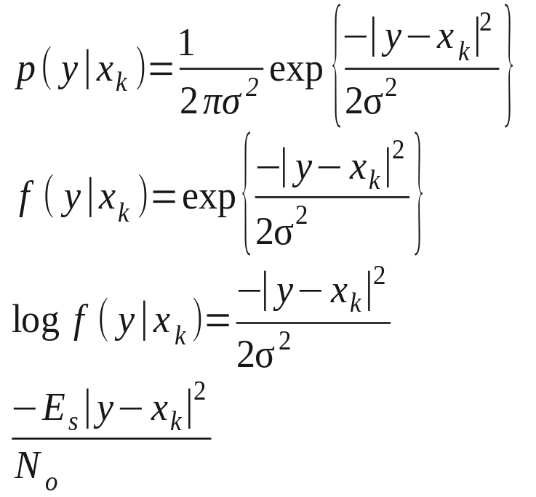
Example: QAM over AWGN.
Let y = x + n, where n is complex i.i.d. N(0,N₀/2 ) and the average energy per symbol is E[|x|²] = E_{s}

Slide 24

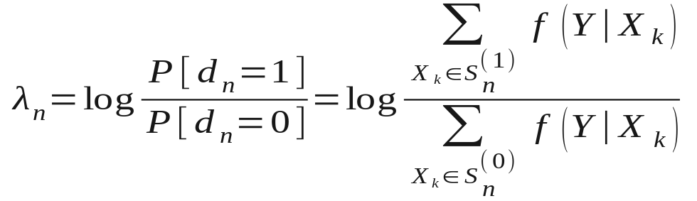

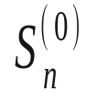
Converting symbol liklihoods to bit LLR
log
f(Y|X_{k})
data
Modulator:
Pick X_{k} ∈ S
X_{k}
Y
Receiver:
Compute
log f(Y|X_{k})for
every X_{k} ∈ S
Demapper:
Compute λ_{n}
from set of
log f(Y|X_{k})
λ_{n}
to
decoder
N_{k}
Demod2D function
SoMAP function
The symbol likelihoods must be transformed into bit log-likelihood ratios (LLRs):
  where represents the set of symbols whose nth bit is a 1.
  and is the set of symbols whose nth bit is a 0.
000
100
001
101
011
111
010
110

Slide 25
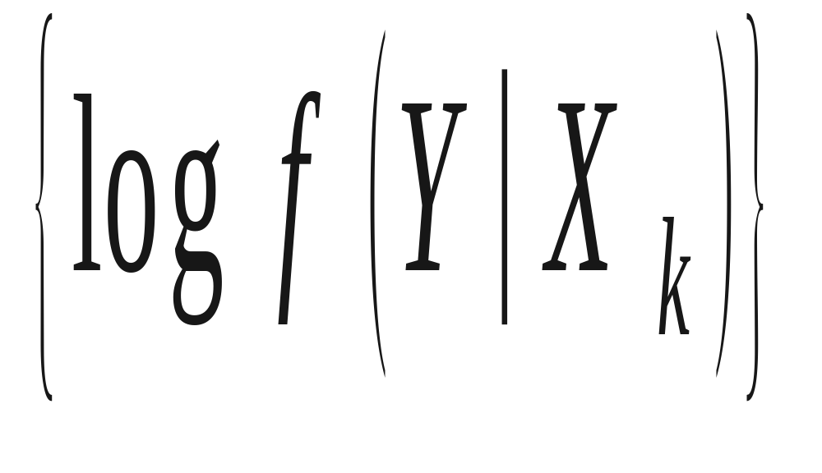
Log-domain Implementation
log-MAP
demod_type = 0
max-log-MAP
demod_type = 1

Slide 26
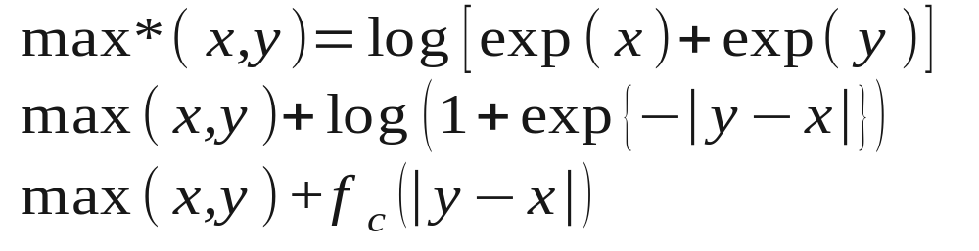

The max* function
0.7
0.6
0.5
0.4
f_{c}(|y-x|)
0.3
0.2
0.1
0
-0.1
0
1
2
3
4
5
6
7
8
9
10
|y-x|

Slide 27
FSK-Specific Parameters
sim_param(record).
  h = {scalar}
    The modulation index
    h=1 is orthogonal
  csi_flag = {integer scalar}
    0 = coherent (only available when h=1)
    1 = noncoherent w/ perfect amplitudes
    2 = noncoherent without amplitude estimates

Slide 28
Specifying the Channel
sim_param(record).
  channel = {‘AWGN’, ‘Rayleigh’, ‘block’}
    ‘Rayleigh’ is “fully-interleaved” Rayleigh fading
    ‘block’ is for coded simulation type only
  blocks_per_frame = {scalar integer}
    For block channel only.
    Number of independent blocks per frame.
    Block length is framesize/blocks_per_frame
  bicm = {integer scalar}
    0 do not interleave bits prior to modulation
    1 interleave bits prior to modulation (default)
    2 interleave and perform iterative demodulation/decoding
    This option is irrelevant unless a channel code is used

Slide 29
Exercises
Create and run the following simulations:
  BPSK in AWGN
  64QAM with gray labeling in AWGN
  64QAM with gray labeling in Rayleigh fading
Choices that need to be made?
  Framesize?
  Save_rate?
  Min_BER?
  Min_frame_errors?
  Demod_type?
Plot all the results on the same figure.

Slide 30
Outline
CML overview
  What is it? How to set it up and get started?
Uncoded modulation
  Simulate uncoded BPSK and QAM in AWGN and Rayleigh fading
Coded modulation
  Simulate a turbo code from UMTS 25.212
Ergodic (Shannon) capacity analysis
  Determine the modulation constrained capacity of BPSK and QAM
Outage analysis
  Determine the outage probability over block fading channels.
  Determine the outage probability of finite-length codes
The internals of CML
Throughput calculation
  Convert BLER to throughput for hybrid-ARQ

Slide 31
Coded Systems:
Code Configuration
Only for sim_param(record).sim_type = ‘coded’
sim_param(record).code_configuration = {scalar int}
  0 = Convolutional
  1 = binary turbo code (PCCC)
  2 = LDPC
  3 = HSDPA turbo code
  4 = UMTS turbo code with rate matching
  5 = WiMAX duobinary tailbiting turbo code (CTC)
  6 = DVB-RCS duobinary tailbiting turbo code

Slide 32
Convolutional Codes
Only rate 1/n mother codes supported.
  Can puncture to higher rate.
Code is always terminated by a tail.
  Can puncture out the tail.
sim_param(record).
  g1 = {binary matrix}
    Example: (133,171) code from Proakis
      g1 = [1 0 1 1 0 1 1
      1 1 1 1 0 0 1];
    Constraint length = number of columns
    Rate 1/n where n is number of rows.
  nsc_flag1 = {scalar integer}
    0 for RSC
    1 for NSC
Can handle cyclic block codes as a rate 1 terminated RSC code

Slide 33
Convolutional Codes:
Decoding Algorithms
sim_param(record).decoder_type = {integer scalar}
  negative value for Viterbi algorithm
    0 = log-MAP (approximated linearly)
    1 = max-log-MAP
    2 = constant-log-MAP
    3 and 4 other implementations of log-MAP
Decodes over entire trellis (no sliding window traceback)

Slide 34
Punctured Convolutional Codes
sim_param(record).
  pun_pattern1 = {binary matrix}
    Puncturing pattern
    n rows
    arbitrary number of columns (depends on puncture period)
    1 means keep bit, 0 puncture it.
    number greater than 1 is number of times to repeat bit.
  tail_pattern1 = {binary matrix}
    tail can have its own puncturing pattern.

Slide 35
Turbo Codes
sim_param(record).
  Parameters for first constituent code
    g1
    nsc_flag1
    pun_pattern1
    tail_pattern1
  Parameters for second constituent code
    g2
    nsc_flag2
    pun_pattern2
    tail_pattern2

Slide 36
Turbo Codes (cont’d)
sim_param(record).
  code_interleaver = {string}
    A string containing the command used to generate the interleaver.
    Examples include:
      “CreateUmtsInterleaver(5114)” % UMTS interleaver.
      “CreateLTEInterleaver(6144)” % LTS interleaver.
      “CreateCCSDSInterleaver(8920)” % CCSDS interleaver.
      “randperm(40)-1” % a random interleaver of length 40.
      Can replace above lengths with other valid lengths.
  decoder_type = {integer scalar}
    Same options as for convolutional codes (except no Viterbi allowed).
  max_iterations = {integer scalar}
    Number of decoder iterations.
    Decoder will automatically halt once codeword is correct.
  plot_iterations = {integer scalar}
    Which iterations to plot, in addition to max_iterations

Slide 37
UMTS Rate Matching
sim_param(record)
  framesize = {integer scalar}
    number of data bits
  code_bits_per_frame = {integer scalar}
    number of code bits
When code_configuration = 4, automatically determines rate matching parameters according to UMTS (25.212)

Slide 38
HSDPA Specific Parameters
sim_param(record).
  N_IR = {integer scalar}
    Size of the virtual IR buffer
  X_set = {integer vector}
    Sequence of redundancy versions (one value per ARQ transmission)
  P = {integer scalar}
    Number of physical channels per turbo codeword
Examples from HSET-6 TS 25.101
  N_IR = 9600
  QPSK
    framesize = 6438
    X_set = [0 2 5 6]
    P = 5 (i.e. 10 physical channels used for 2 turbo codewords)
  16-QAM
    framesze = 9377
    X_set = [6 2 1 5]
    P = 4 (i.e. 8 physical channels used for 2 turbo codewords)

Slide 39
LDPC
sim_parameters(record).
  parity_check_matrix = {string}
    A string used to generate the parity check matrix
  decoder_type
    0 Sum-product (default)
    1 Min-sum
    2 Approximate-min-star
  max_iterations
    Number of decoder iterations.
    Decoder will automatically halt once codeword is correct.
  plot_iterations
    Which iterations to plot, in addition to max_iterations

Slide 40
Block Fading
For coded simulations, block fading is supported.
Sim_param(record).channel = ‘block’
Sim_param(record).blocks_per_frame
  The number of independent blocks per frame
Example, HSDPA with independent retransmissions
  blocks_per_frame = length(X_set );

Slide 41
Exercises
Simulate
  A convolutional code with g=(7,5) over AWGN with BPSK
  The same convolutional code punctured to rate 3/4.
  The UMTS turbo code with 16-QAM
    Unpunctured w/ 640 input bits
    Punctured to force the rate to be 1/2.
    Compare log-MAP and max-log-MAP
  HSDPA
    HSET-6
    Quasi-static block fading

Slide 42
Outline
CML overview
  What is it? How to set it up and get started?
Uncoded modulation
  Simulate uncoded BPSK and QAM in AWGN and Rayleigh fading
Coded modulation
  Simulate a turbo code from UMTS 25.212
Ergodic (Shannon) capacity analysis
  Determine the modulation constrained capacity of BPSK and QAM
Outage analysis
  Determine the outage probability over block fading channels.
  Determine the outage probability of finite-length codes
The internals of CML
Throughput calculation
  Convert BLER to throughput for hybrid-ARQ

Slide 43
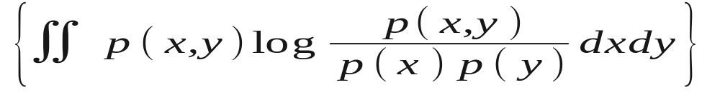
Noisy Channel Coding Theorem
(Shannon 1948)
Consider a memoryless channel with input X and output Y
  The channel is completely characterized by p(x,y)
The capacity C of the channel is
  where I(X,Y) is the (average) mutual information between X and Y.
The channel capacity is an upper bound on information rate r.
  There exists a code of rate r < C that achieves reliable communications.
  “Reliable” means an arbitrarily small error probability.
Source
p(x)
X
Channel
p(y|x)
Y
Receiver

Slide 44
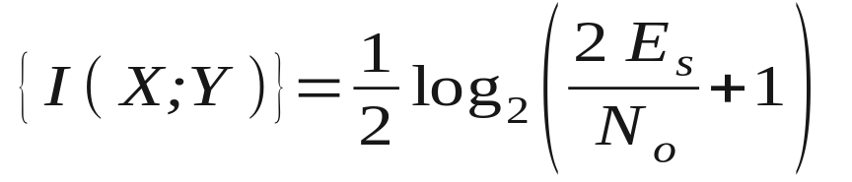
Capacity of the AWGN Channel with Unconstrained Input
Consider the one-dimensional AWGN channel
The capacity is
The X that attains capacity is Gaussian distributed.
  Strictly speaking, Gaussian X is not practical.
  The input X is drawn
  from any distribution
  with average energy
  E[X²] = E_{s}
X
Y = X+N
N~zero-mean white Gaussian
with energy E[N²]= N₀/2
bits per channel use

Slide 45
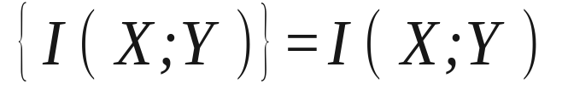
Capacity of the AWGN Channel with a Modulation-Constrained Input
Suppose X is drawn with equal probability from the finite set S = {X₁,X₂, …, X_{M}}
  where f(Y|X_{k}) = κ p(Y|X_{k}) for any κ common to all X_{k}
Since p(x) is now fixed
  i.e. calculating capacity boils down to calculating mutual info.
Modulator:
Pick X_{k} at random from
S= {X₁,X₂, …, X_{M}}
X_{k}
Y
ML Receiver:
Compute f(Y|X_{k})
for every X_{k} ∈ S
N_{k}

Slide 46

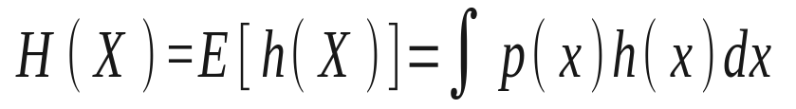
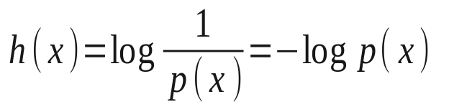

Entropy and Conditional Entropy
Mutual information can be expressed as:
Where the entropy of X is
And the conditional entropy of X given Y is
where
self-information
where

Slide 47
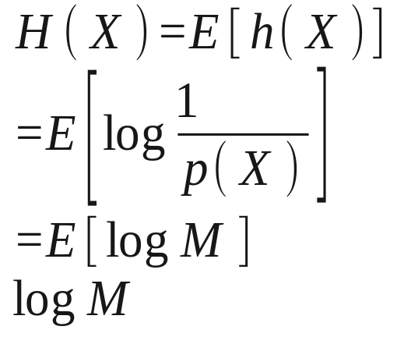
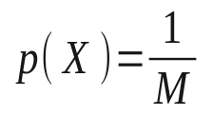
Calculating Modulation-Constrained Capacity
To calculate:
We first need to compute H(X)
Next, we need to compute H(X|Y)=E[h(X|Y)]
  This is the “hard” part.
  In some cases, it can be done through numerical integration.
  Instead, let’s use Monte Carlo simulation to compute it.

Slide 48
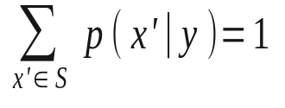
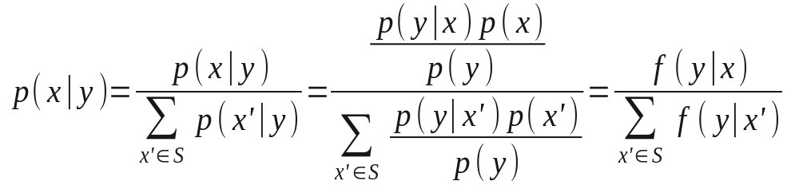
Step 1: Obtain p(x|y) from f(y|x)
Modulator:
Pick X_{k} at random
from S
X_{k}
Y
Receiver:
Compute f(Y|X_{k})
for every X_{k} ∈ S
N_{k}
Noise Generator
Since
We can get p(x|y) from

Slide 49
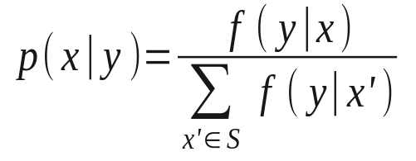
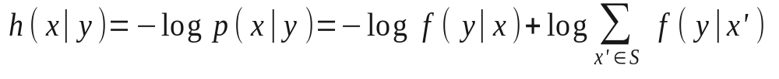
Step 2: Calculate h(x|y)
Modulator:
Pick X_{k} at random
from S
X_{k}
Y
Receiver:
Compute f(Y|X_{k})
for every X_{k} ∈ S
N_{k}
Noise Generator
Given a value of x and y (from the simulation) compute
Then compute

Slide 50
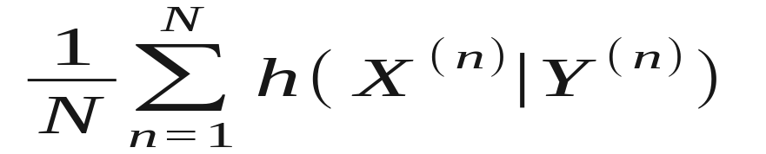
Step 3: Calculating H(X|Y)
Modulator:
Pick X_{k} at random
from S
X_{k}
Y
Receiver:
Compute f(Y|X_{k})
for every X_{k} ∈ S
N_{k}
Noise Generator
Since:
Because the simulation is ergodic, H(X|Y) can be found by taking the sample mean:
where (X^{(n)},Y^{(n)}) is the n^{th} realization of the random pair (X,Y).
  i.e. the result of the n^{th} simulation trial.

Slide 51
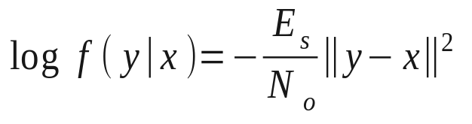
Example: BPSK
Modulator:
Pick X_{k} at random
from S ={+1,-1}
X_{k}
Y
Receiver:
Compute log f(Y|X_{k})
for every X_{k} ∈ S
N_{k}
Noise Generator
Suppose that S ={+1,-1} and N has variance N₀/2E_{s}
Then:

Slide 52
BPSK Capacity as a Function of
Number of Simulation Trials
0.9
E_{b}/N_{o} = 0.2 dB
As N gets large, capacity converges to C=0.5
0.8
0.7
0.6
capacity
0.5
0.4
0.3
0.2
0.1
10
1
10
2
10
3
10
4
10
5
10
6
trials

Slide 53
Unconstrained vs.
BPSK Constrained Capacity
It is theoretically
impossible to operate
in this region.
1.0
BPSK Capacity Bound
Spectral Efficiency
Code Rate r
Shannon Capacity Bound
It is theoretically
possible to operate
in this region.
0.5
-2
-1
0
1
2
3
4
5
6
7
8
9
10
Eb/No in dB

Slide 54

Power Efficiency of Standard
Binary Channel Codes
1.0
BPSK Capacity Bound
Uncoded
BPSK
Spectral Efficiency
Code Rate r
Shannon Capacity Bound
0.5
Turbo Code
1993
LDPC Code
2001
Chung, Forney,
Richardson, Urbanke
IS-95
1991
Odenwalder
Convolutional
Codes 1976
arbitrarily low
BER:
-2
-1
0
1
2
3
4
5
6
7
8
9
10
Eb/No in dB

Slide 55
8
Capacity of PSK and QAM in AWGN
256QAM
7
Capacity (bits per symbol)
6
64QAM
5
2-D Unconstrained Capacity
4
16QAM
16PSK
3
8PSK
2
QPSK
1
BPSK
0
-2
0
2
4
6
8
10
12
14
16
18
20
Eb/No in dB

Slide 56
Capacity of Noncoherent Orthogonal FSK in AWGN
15
W. E. Stark, “Capacity and cutoff rate of noncoherent FSK
with nonselective Rician fading,” IEEE Trans. Commun., Nov. 1985.
M.C. Valenti and S. Cheng, “Iterative demodulation and decoding of turbo coded
M-ary noncoherent orthogonal modulation,” IEEE JSAC, 2005.
10
Noncoherent combining penalty
Minimum Eb/No (in dB)
M=2
min E_{b}/N_{o} = 6.72 dB
at r=0.48
5
M=4
M=16
M=64
0
0
0.1
0.2
0.3
0.4
0.5
0.6
0.7
0.8
0.9
1
Rate R (symbol per channel use)

Slide 57

Capacity of Nonorthogonal CPFSK
40
S. Cheng, R. Iyer Sehshadri, M.C. Valenti, and D. Torrieri,
“The capacity of noncoherent continuous-phase frequency shift keying,”
in Proc. Conf. on Info. Sci. and Sys. (CISS), (Baltimore, MD), Mar. 2007.
35
30
min Eb/No (in dB)
25
20
for h= 1
min E_{b}/N_{o} = 6.72 dB
at r=0.48
15
BW constraint: 2 Hz/bps
10
  Note that these curves are generated
  using sim_type = ‘bwcapacity’
No BW Constraint
5
0
0.1
0.2
0.3
0.4
0.5
0.6
0.7
0.8
0.9
1
(MSK) h
(orthogonal)

Slide 58




BICM
(Caire 1998)
Coded modulation (CM) is required to attain the aforementioned capacity.
  Channel coding and modulation handled jointly.
  Alphabets of code and modulation are matched.
  e.g. trellis coded modulation (Ungerboeck); coset codes (Forney)
Most off-the-shelf capacity approaching codes are binary.
A pragmatic system would use a binary code followed by a bitwise interleaver and an M-ary modulator.
  Bit Interleaved Coded Modulation (BICM).
Binary
to M-ary
mapping
Binary
Encoder
Bitwise
Interleaver

Slide 59
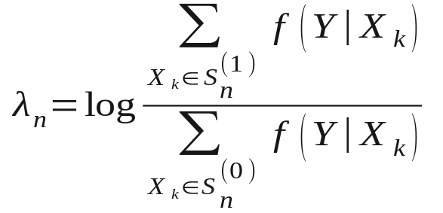
BICM Receiver
c_{n}
Modulator:
Pick X_{k} ∈ S
from (c₁ … c _{μ})
X_{k}
Y
Receiver:
Compute f(Y|X_{k})
for every X_{k} ∈ S
Demapper:
Compute λ_{n}
from set of f(Y|X_{k})
f(Y|X_{k})
λ_{n}
from
encoder
to
decoder
N_{k}
The symbol likelihoods must be transformed into bit log-likelihood ratios (LLRs):
  where represents the set of symbols whose n^{th} bit is a 1.
  and is the set of symbols whose n^{th} bit is a 0.
000
100
001
101
011
111
010
110

Slide 60

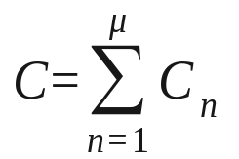
BICM Capacity
c_{n}
Modulator:
Pick X_{k} ∈ S
from (c₁ … c _{μ})
X_{k}
Y
Receiver:
Compute f(Y|X_{k})
for every X_{k} ∈ S
Demapper:
Compute λ_{n}
from set of f(Y|X_{k})
f(Y|X_{k})
λ_{n}
N_{k}
Can be viewed as μ=log₂M binary parallel channels,
each with capacity
Capacity over parallel channels adds:
As with the CM case, Monte Carlo integration may be used.

Slide 61
CM vs. BICM Capacity for 16QAM
4
3.5
3
2.5
Capacity
2
1.5
BICM w/
SP labeling
CM
1
0.5
BICM w/
gray labeling
0
-20
-15
-10
-5
0
5
10
15
20
25
30
Es/No in dB

Slide 62
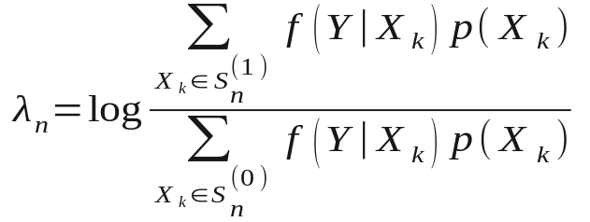
BICM-ID
(Li & Ritcey 1997)
c_{n}
Modulator:
Pick X_{k} ∈ S
from (c₁ … c _{μ})
X_{k}
Y
Receiver:
Compute f(Y|X_{k})
for every X_{k} ∈ S
Demapper:
Compute λ_{n}
from set of f(Y|X_{k})
and p(X_{k})
f(Y|X_{k})
λ_{n}
to decoder
from
encoder
N_{k}
p(X_{k}) from decoder
A SISO decoder can provide side information to the demapper in the form of a priori symbol likelihoods.
  BICM with Iterative Detection The demapper’s output then becomes

Slide 63
Capacity Simulations in CML
sim_param(record).sim_type = ‘capacity’
Exact same parameters as for uncoded simulations
  SNR
  SNR_type = ‘Es/No in dB’
  framesize
  modulation
  mod_order
  channel
  bicm
  demod_type
  max_trials

Slide 64
Exercises
Determine the capacity for
  BPSK in AWGN
  64QAM with gray labeling in AWGN
  64QAM with gray labeling in Rayleigh fading
Setup BICM-ID for
  16-QAM with SP mapping in AWGN and (7,5) CC.

Slide 65
Outline
CML overview
  What is it? How to set it up and get started?
Uncoded modulation
  Simulate uncoded BPSK and QAM in AWGN and Rayleigh fading
Coded modulation
  Simulate a turbo code from UMTS 25.212
Ergodic (Shannon) capacity analysis
  Determine the modulation constrained capacity of BPSK and QAM
Outage analysis
  Determine the outage probability over block fading channels.
  Determine the outage probability of finite-length codes
The internals of CML
Throughput calculation
  Convert BLER to throughput for hybrid-ARQ

Slide 66
Ergodicity vs. Block Fading
Up until now, we have assumed that the channel is ergodic.
  The observation window is large enough that the time-average converges to the statistical average.
Often, the system might be nonergodic.
Example: Block fading
b=1
γ₁
b=2
γ₂
b=3
γ₃
b=4
γ₄
b=5
γ₅
The codeword is broken into B equal length blocks
The SNR changes randomly from block-to-block
The channel is conditionally Gaussian
The instantaneous Es/No for block b is γ_{b}

Slide 67
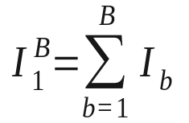
Accumulating Mutual Information
The SNR γ_{b} of block b is a random.
Therefore, the mutual information I_{b} for the block is also random.
  With a complex Gaussian input, I_{b}= log(1+γ_{b})
  Otherwise the modulation constrained capacity can be used for I_{b}
b=1
I₁ = log(1+γ₁)
b=2
I₂
b=3
I₃
b=4
I₄
b=5
I₅
The mutual information of each block is I_{b}= log(1+γ_{b})
Blocks are conditionally Gaussian
The entire codeword’s mutual info is the sum of the blocks’
(Code combining)

Slide 68


Information Outage
An information outage occurs after B blocks if
  where R≤log₂M is the rate of the coded modulation
An outage implies that no code can be reliable for the particular channel instantiation
The information outage probability is
  This is a practical bound on FER for the actual system.

Slide 69
10
0
Modulation Constrained Input
Unconstrained Gaussian Input
10
-1
16-QAM
R=2
Rayleigh Block Fading
Information Outage Probability
10
-2
10
-3
B=1
10
-4
as B →∞,
the curve
becomes
vertical at
the ergodic
Rayleigh fading
capacity bound
10
-5
B=10
B=4
B=3
B=2
Notice the loss of diversity
(see Guillén i Fàbrebas and Caire 2006)
10
-6
0
10
20
30
40
50
Es/No in dB
Notes:
Emphasize diversity → slope

Slide 70
Outage Simulation Type
sim_param(record).
  blocks_per_frame
    Assumes block fading channel
  mod_order
    0 for Gaussian input case
  rate
    Code rate.
    Outage whenever MI < rate
  combining_type = {‘code’, ‘diversity’}
  input_filename
    Required if mod_order > 0
    Contains results of a capacity simulation.
    Used for a table look-up operation

Slide 71
Finite Length Codeword Effects
0.9
0.8
0.7
0.6
capacity
0.5
0.4
Outage Region
0.3
0.2
0.1
10
1
10
2
10
3
10
4
10
5
10
6
Codeword length

Slide 72
10
0
10
-1
10
-2
FER of the (1092,360)
UMTS turbo code
with BPSK
in AWGN
FER
10
-3
information
outage probability
for (1092,360)
code with BPSK
in AWGN
10
-4
10
-5
10
-6
-2
-1.5
-1
-0.5
0
0.5
1
1.5
2
2.5
3
Eb/No in dB

Slide 73
Bloutage Simulation Type
Set up like an uncoded simulation
  framesize
  specify the modulation
    Set mod_order = 0 for unconstrained Gaussian input
  specify the channel (AWGN, Rayleigh, etc.)
Also requires the rate
Saves FER, not BER

Slide 74
Outline
CML overview
  What is it? How to set it up and get started?
Uncoded modulation
  Simulate uncoded BPSK and QAM in AWGN and Rayleigh fading
Coded modulation
  Simulate a turbo code from UMTS 25.212
Ergodic (Shannon) capacity analysis
  Determine the modulation constrained capacity of BPSK and QAM
Outage analysis
  Determine the outage probability over block fading channels.
  Determine the outage probability of finite-length codes
The internals of CML
Throughput calculation
  Convert BLER to throughput for hybrid-ARQ

Slide 75
Main Program Flow
CmlSimulate
  ReadScenario
    Runs SingleRead for each record
    Performs sanity check on sim_param structure
    Initializes or restores the sim_state structure
  For each record~
    SingleSimulate if a simulation
    Otherwise, runs one of the analysis functions:
      CalculateThroughput
      CalculateMinSNR
      CalculateMinSNRvsB

Slide 76
SingleSimulate
Seeds random number generator
Branches into
  SimulateMod
    For uncoded, coded, and bloutage
  SimulateUGI
    For a blocklength-constrained outage simulation with unconstrained Gaussian input.
  SimulateCapacity
    For capacity
  SimulateOutage
    For outage

Slide 77
SimulateMod
Main subfunctions (coded/uncoded cases:
  CmlEncode
  CmlChannel
  CmlDecode
For bloutage, replace CmlDecode with
  Somap
  capacity

Slide 78
SimulateCapacity
Operates like SimulateMod with sim_type = ‘bloutage’
  However, instead of comparing MI of each codeword against the rate, keeps a running average of MI.

Slide 79
SimulateOutage
Randomly generates SNR for each block
Performs table lookup to get MI from SNR
Compares MI against threshold

Slide 80
Outline
CML overview
  What is it? How to set it up and get started?
Uncoded modulation
  Simulate uncoded BPSK and QAM in AWGN and Rayleigh fading
Coded modulation
  Simulate a turbo code from UMTS 25.212
Ergodic (Shannon) capacity analysis
  Determine the modulation constrained capacity of BPSK and QAM
Outage analysis
  Determine the outage probability over block fading channels.
  Determine the outage probability of finite-length codes
The internals of CML
Throughput calculation
  Convert BLER to throughput for hybrid-ARQ

Slide 81

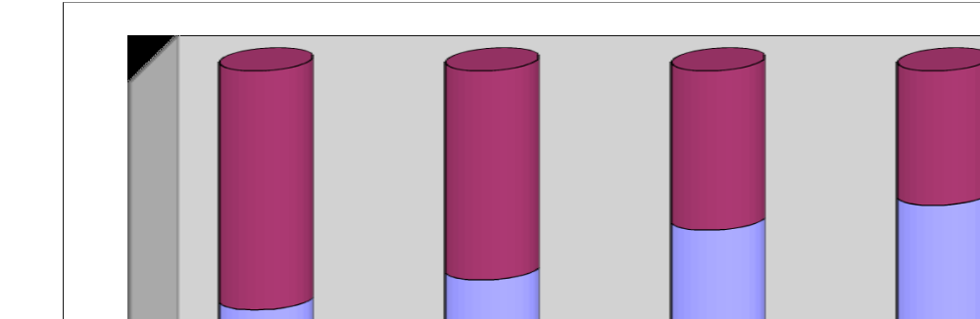
Hybrid-ARQ
(Caire and Tunnineti 2001)
Once the codeword can be decoded with high reliability.
Therefore, why continue to transmit any more blocks?
With hybrid-ARQ, the idea is to request retransmissions until
  With hybrid-ARQ, outages can be avoided.
  The issue then becomes one of latency and throughput.
b=1
I₁ = log(1+γ₁)
b=2
I₂
b=3
I₃
b=4
I₄
b=5
I₅
R
NACK NACK ACK {Wasted transmissions}

Slide 82
Latency and Throughput of Hybrid-ARQ
With hybrid-ARQ B is now a random variable.
  The average latency is proportional to E[B].
  The average throughput is inversely proportional to E[B].
Often, there is a practical upper limit on B
  Rateless coding (e.g. Raptor codes) can allow B_{max} →∞
An example
  HSDPA: High-speed downlink packet access
  16-QAM and QPSK modulation
  UMTS turbo code
  HSET-1/2/3 from TS 25.101
  B_{max} = 4

Slide 83
1
0.9
0.8
Normalized throughput
0.7
0.6
R = 3202/2400 for QPSK
R = 4664/1920 for QAM
B_{max} = 4
0.5
0.4
QPSK
16-QAM
T. Ghanim and M.C. Valenti, “The throughput of
hybrid-ARQ in block fading under modulation constraints,”
in Proc. Conf. on Info. Sci. and Sys. (CISS), Mar. 2006.
0.3
0.2
Unconstrained Gaussian Input
Modulation Constrained Input
0.1
Simulated HSDPA Performance
0
-10
-5
0
5
10
15
20
25
30
Es/No in dB
Notes:
The resukts show how much of the loss id due

Slide 84
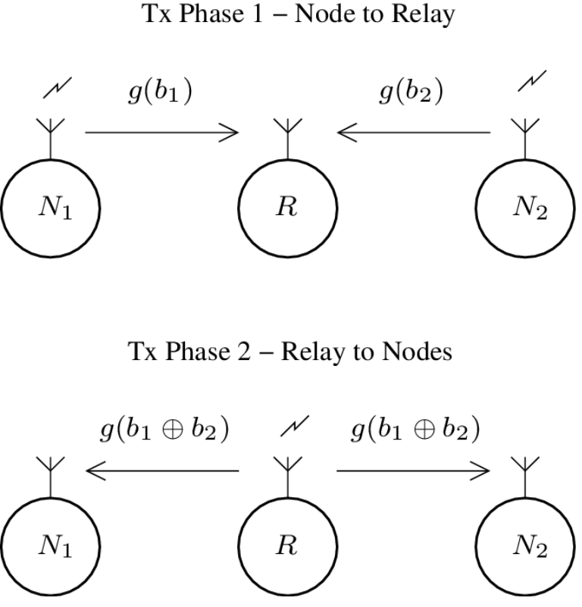
Digital Network Coding
  Digital network coding improves capacity of multiple-access relay channels.
  Two or more nodes exchanging information transmit in the same time and frequency to a relay, deliberately interfering.
  Relay jointly receives and encodes node transmissions such that broadcast may be decoded by all nodes.
DNC Example

Slide 85
Digital Network Coding
  Digital network coding improves capacity of multiple-access relay channels.
  Two or more nodes exchanging information transmit in the same time and frequency to a relay, deliberately interfering.
  Relay jointly receives and encodes node transmissions such that broadcast may be decoded by all nodes.
DNC Example

Slide 86
Digital Network Coding
  Technical Requirements
  Network encoding scheme at relay
  Demodulation scheme to receive and encode interference
  Demodulator producing soft-outputs suitable for capacity-achieving iterative decoding

Slide 87
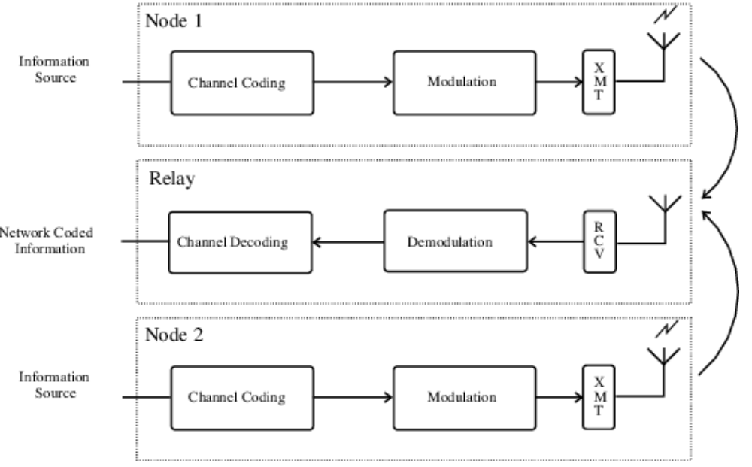
Digital Network Coding
Tx Phase 1 - Block Diagram

Slide 88
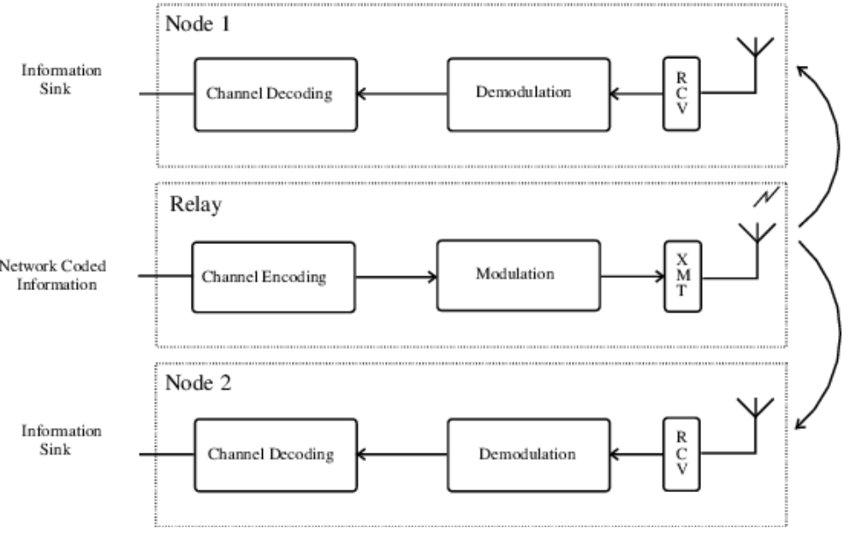
Digital Network Coding
Tx Phase 2 - Block Diagram

Slide 89
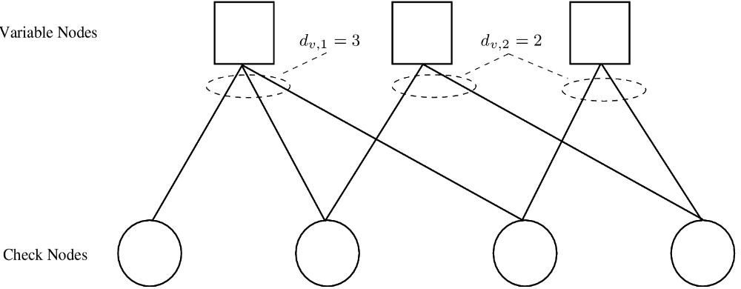
EXIT Analysis - LDPC
  EXIT analysis may be applied to design LDPC code degree distributions which optimize decoding performance

Slide 90
EXIT Analysis - LDPC
  Design goal: match mutual information transfer characteristics of LDPC decoders through selection of variable node degrees
    VND - variable node decoder
    CND - check node decoder
  VND decoder captures characteristic of detector and variable node decoder
  CND curve depends only on channel code parameters

Slide 91


EXIT Analysis - LDPC
  First step of generating VND transfer characteristic is to compute the mutual information at the input and output of the detector
  where
  mutual information of a-prior LLRs at detector input
  Any detector supported by CML may be analyzed.

Slide 92





EXIT Analysis - LDPC
  The extrinsic information at the output of the combined variable node decoder/detector is
  where
  variable node degree
  function computing the mutual information [1]
  and is an AWGN channel where X is drawn from a BPSK constellation, and is the LLR of the channel output.
  [1] S. ten Brink, G. Kramer, and A. Ashikhmin, “Design of low-density parity-check codes for modulation and detection,” IEEE Trans. Commun., vol. 52, pp. 670–678, Apr. 2004.

Slide 93



EXIT Analysis - LDPC
  Considering an LDPC decoder having multiple variable node degrees (irregular)
  where
  number of distinct variable node degrees
  fraction of edges incident on variable nodes of degree
  i-th variable node degree

Slide 94

EXIT Analysis - LDPC
  The extrinsic information at the output of the CND is
  where
  check node degree (check regular)
  Note that the CND transfer characteristic depends only on the code parameters.

Slide 95
EXIT Simulation Example
First step: Specify detector simulation
CML Scenario: ExitP2P
Record: 1
  sim_param(record).sim_type = 'exit'
  sim_param(record).exit_param.exit_phase = 'detector'
  sim_param(record).exit_param.exit_type = 'ldpc'
  sim_param(record).exit_param.requested_IA = 0.1 : 0.1 : 0.9
  sim_param(record).channel = 'awgn'
  sim_param(record).SNR = [ 0 : 0.5: 10 ]
  sim_param(record).modulation = 'psk'
  sim_param(record).mod_order = 4

Slide 96
EXIT Simulation Example
Second step: Simulate decoder simulation
CML Scenario: ExitP2P
Record: 2
  sim_param(record).sim_type = 'exit'
  sim_param(record).exit_param.exit_phase = 'decoder'
  sim_param(record).exit_param.exit_type = 'ldpc'
  sim_param(record).exit_param.requested_IA = 0.1 : 0.1 : 0.9
  sim_param(record).channel = 'awgn'
  sim_param(record).SNR = [ 0 : 0.5: 10 ]
  sim_param(record).modulation = 'psk'
  sim_param(record).mod_order = 4

Slide 97
EXIT Simulation Example
Second step: Specify decoder simulation
CML Scenario: ExitP2P
Record: 2
  sim_param(record).exit_param.rate = 0.6
  sim_param(record).exit_param.dv = [ 2 4 19 ]
  sim_param(record).exit_param.dv_dist = [ 0.4 0.52 0.08 ]
  sim_param(record).exit_param.dc = 11
  sim_param(record).exit_param.det_scenario = 'ExitP2P'
  sim_param(record).exit_param.det_record = 1

Slide 98
EXIT Simulation Example
CML Simulation Steps
- Initialize CML
>> CmlStartup
- Simulate detector characteristic
>> CmlSimulate('ExitP2P', 1)
- Simulate decoder characteristic
>> CmlSimulate('ExitP2P', 2)
- Plot decoder characteristic for SNR = 1 dB
>> CmlPlot('ExitP2P', 2, 1)

Slide 99
EXIT Simulation Example

Slide 100
Digital Network Coding
  Technical Requirements
  Network encoding scheme at relay
  Demodulation scheme to receive and encode interference
  Demodulator producing soft-outputs suitable for capacity-achieving iterative decoding

Slide 101
Conclusions: Design Flow with CML
When designing a system, first determine its capacity.
  Only requires a slight modification of the modulation simulation.
  Does not require the code to be simulated.
  Allows for optimization with respect to free parameters.
After optimizing with respect to capacity, design the code.
  BICM with a good off-the-shelf code.
  Optimize code with respect to the EXIT curve of the modulation.
Information outage analysis can be used to characterize:
  Performance in slow fading channels.
  Delay and throughput of hybrid-ARQ retransmission protocols.
  Finite codeword lengths.

Slide 102
Digital Network Coding
  Technical Requirements
  Network encoding scheme at relay
  Demodulation scheme to receive and encode interference
  Demodulator producing soft-outputs suitable for capacity-achieving iterative decoding

