Slide 1
XRay Financial Early Warning
Exec Logic | Makkah Region Nonprofit Associations
Financial reporting periods: 2023–2025
Reproducible descriptive evidence release
Exec Logic | October 29, 2026 | descriptive, unweighted

Slide 2
The decision question
Which indicators suggest financial pressure worth investigating?
How do signals compare between major cities and other governorates?
Monitoring signals are not proof of insolvency.
Exec Logic | October 29, 2026 | descriptive, unweighted

Slide 3
Dataset and scope
251 association-year joined records → 5 exclusions or evidence holds → 246 candidate records.
199 eligible grouped primary association-years → 92 unique associations by latest available year.
43 rows lost their group/role in a data merge (all exist in the sample file) and 4 reserve-role rows are outside the released primary subset; a robustness scenario restores them.
Exec Logic | October 29, 2026 | descriptive, unweighted

Slide 4
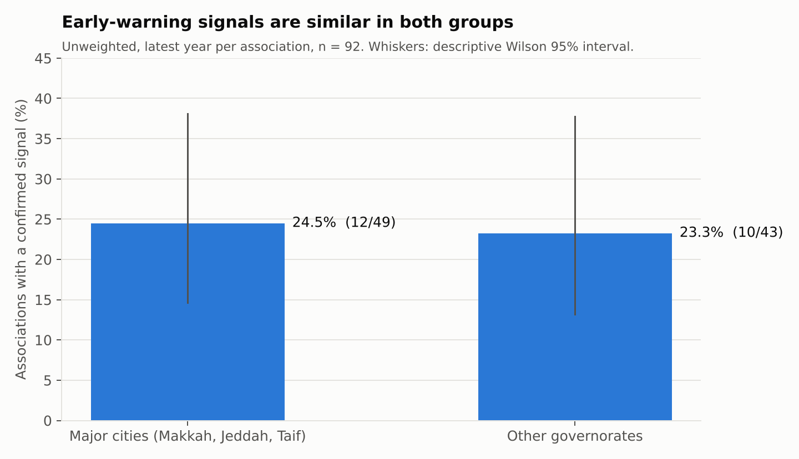
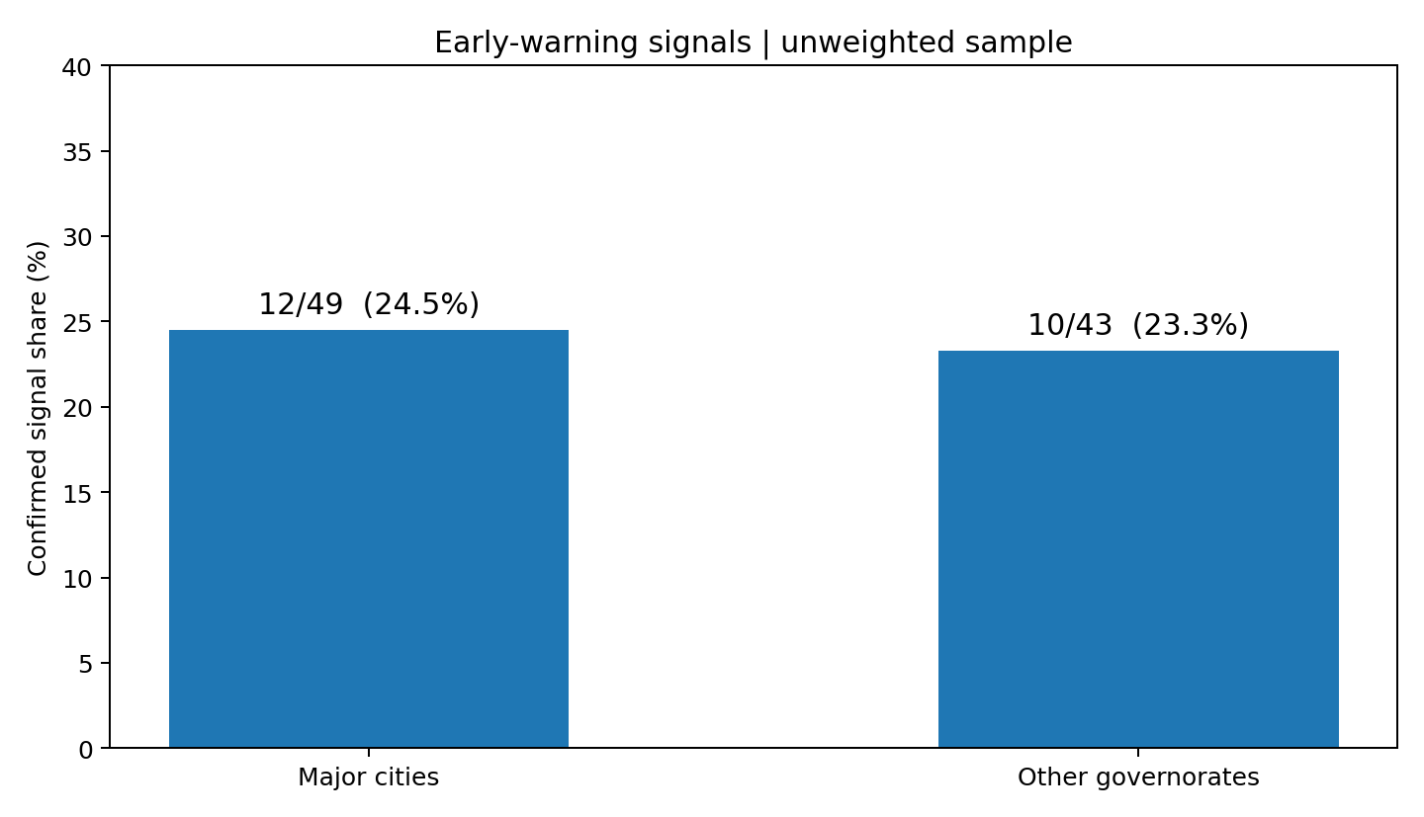
Early-warning signals
Exec Logic | October 29, 2026 | descriptive, unweighted

Slide 5
Five financial indicators
Repeated deficits across consecutive years.
Negative unrestricted net assets.
Cash below one month of expenses.
Revenue decline of at least 25%.
Net-asset decline of at least 25%.
Exec Logic | October 29, 2026 | descriptive, unweighted

Slide 6
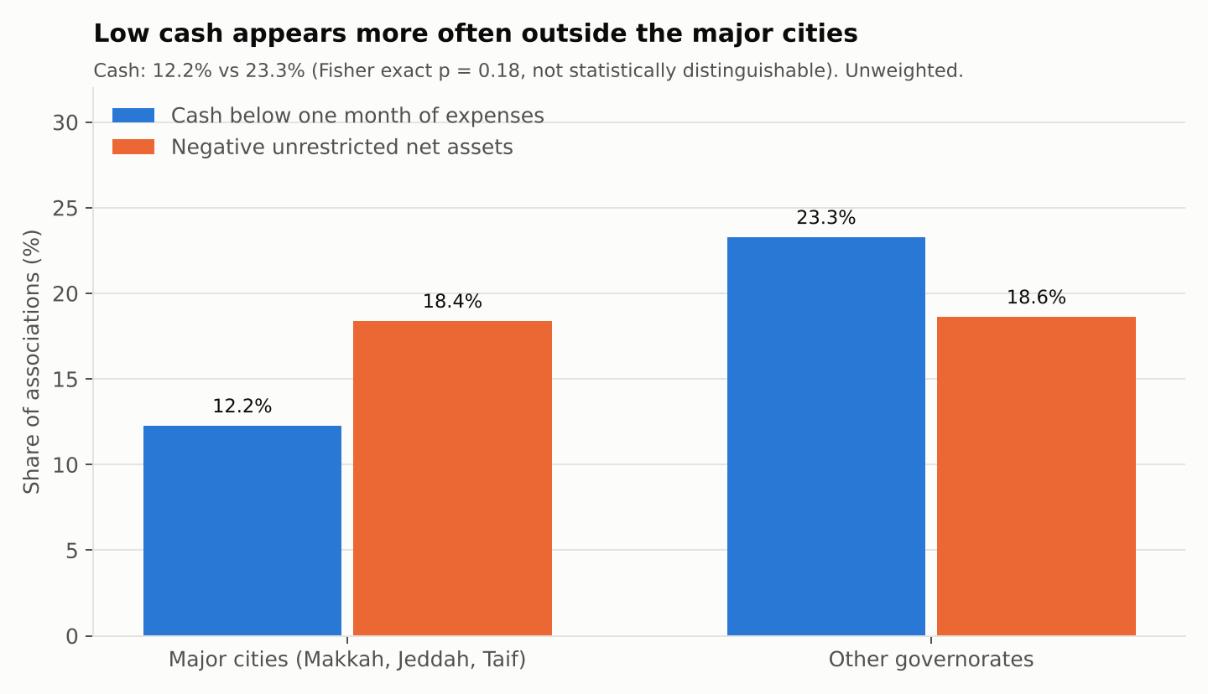
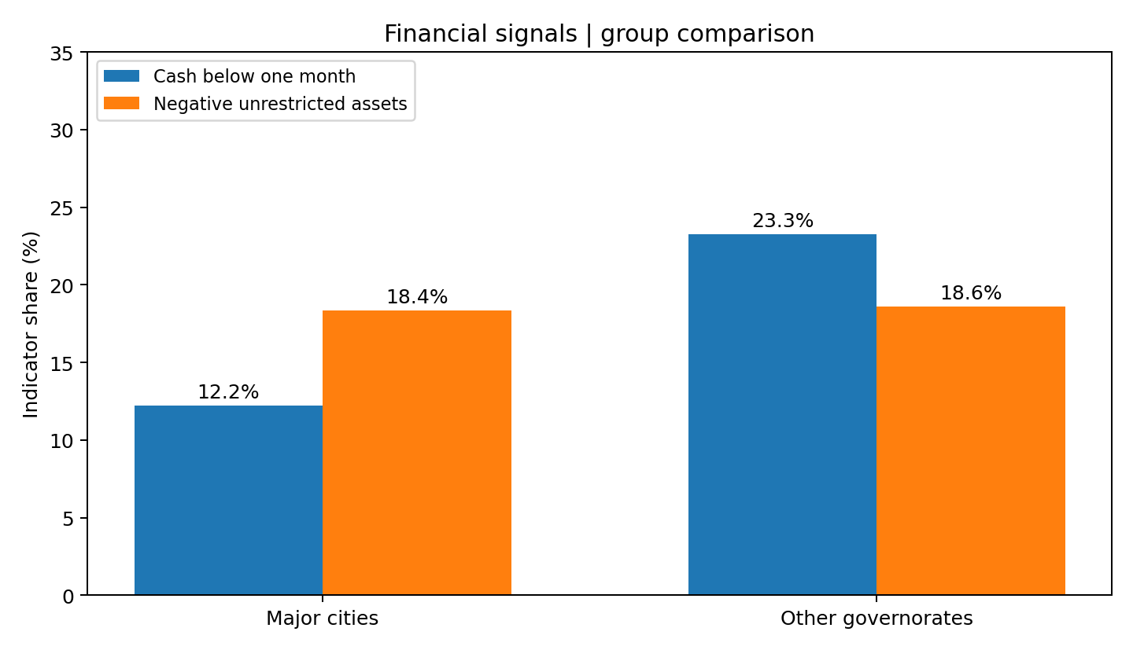
Cash and unrestricted-asset signals
Exec Logic | October 29, 2026 | descriptive, unweighted

Slide 7
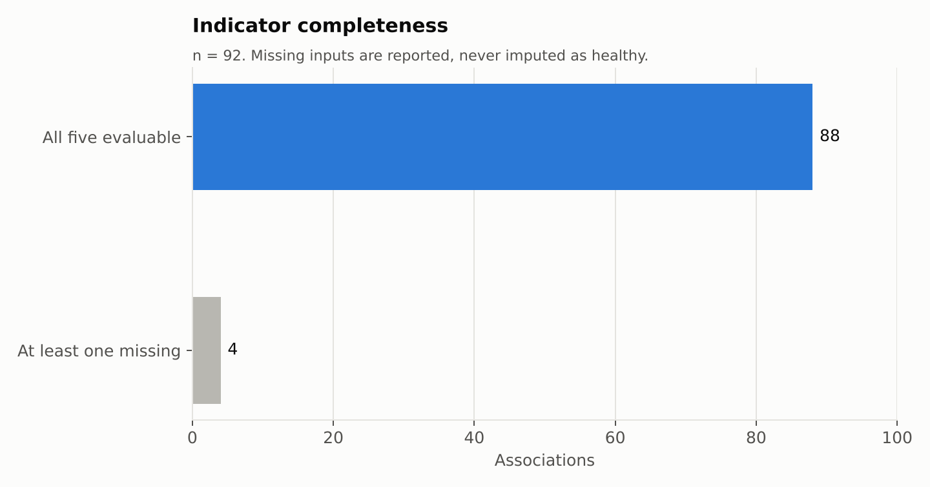
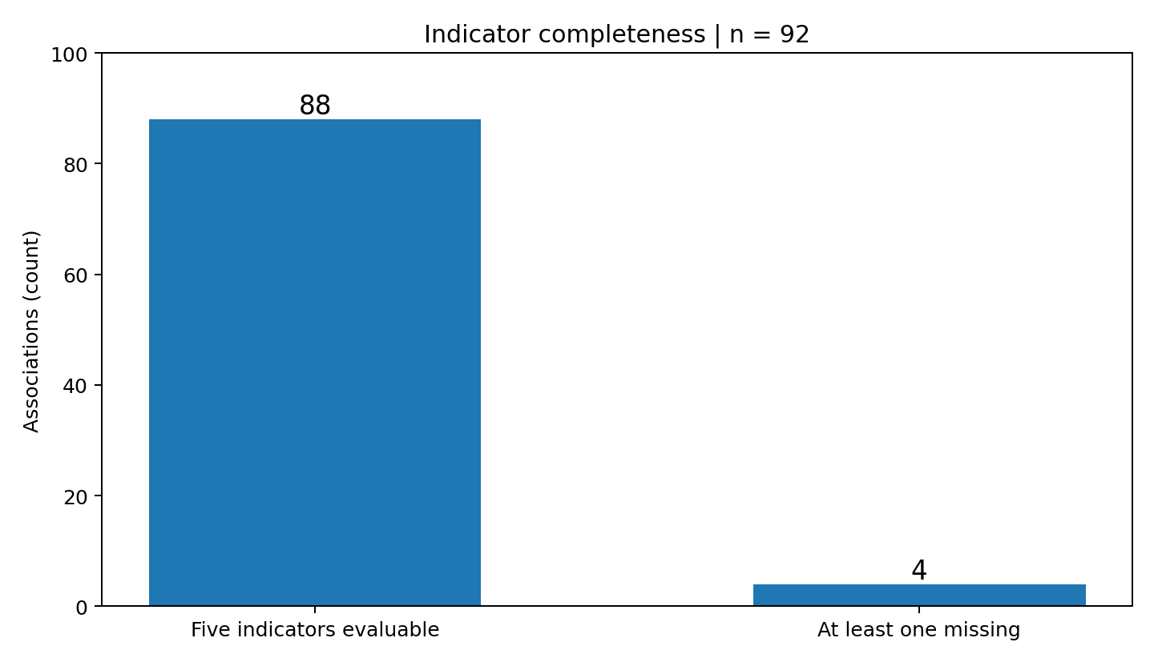
Coverage and missingness
Exec Logic | October 29, 2026 | descriptive, unweighted

Slide 8
Interpretation and uncertainty
22/92 = 23.9% with confirmed signals.
Descriptive 95% Wilson interval: approximately 16.4% to 33.6%.
No validated design-weighted v6 estimates or population extrapolation.
Group difference +1.2 points (Fisher exact p = 1.00); headline stays 23.9–25.6% across four robustness scenarios.
Exec Logic | October 29, 2026 | descriptive, unweighted

Slide 9
Quality and responsible review
Team lead reports members completed human, financial and accounting reviews.
Independent signed per-row approvals were not provided to this release.
Updated contributor workbook: 29 activity and 13 balance-sheet arithmetic flags, independently reproduced.
Cross-version conflicts are review prompts; none of the 92 released units uses those rows; no silent overwrites.
Exec Logic | October 29, 2026 | descriptive, unweighted

Slide 10
Engineering, privacy and reproducibility
Deterministic Python analysis with strict count validation.
Public two-row aggregate release; no financial amount or organization identity.
Unit tests, source lineage, SHA-256 hashes and AI usage disclosure.
Separate private audit and exception register.
Exec Logic | October 29, 2026 | descriptive, unweighted

Slide 11
Action and delivery
Use signals to prioritize evidence-based review, not label organizations.
Code, aggregate data, tests, figures, PDF summary and deck in the public repository.
Contest requires publication on X and official form links; no receipt evidenced.
GitHub: https://github.com/wvwoo/Exec-Logic-xray
Exec Logic | October 29, 2026 | descriptive, unweighted

