Slide 1
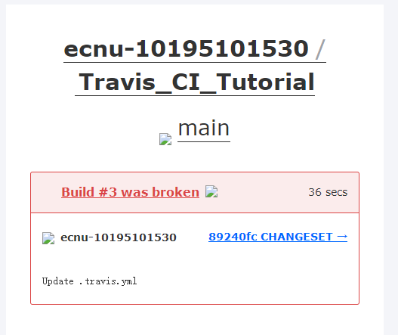
https://github.com/ecnu-10195101530/Travis_CI_Tutorial

