Slide 1
Qwen Office × DingTalk: A Shanqin Case Study
Report date: 14 October 2026
Purpose: internal management discussion and decisions on further validation
Practitioner: Leo Zhang; practice date: 10 October 2026
Notes:
Report date: 14 October 2026
Purpose: internal management discussion and decisions on further validation
Practitioner: Leo Zhang; practice date: 10 October 2026

Slide 2
I. Executive summary
Run a limited, measurable follow-up evaluation. This practice does not yet justify deployment or wider use. With simulated data and preset workflows, Qwen Office called business-system and DingTalk tools to connect document reading, field extraction, tracking registration and briefing distribution. The most useful value to test is reduced repeated preparation and copying as information moves from documents into work records and collaboration channels. [E04, E07, E11, E20]
Notes:
Run a limited, measurable follow-up evaluation. This practice does not yet justify deployment or wider use. With simulated data and preset workflows, Qwen Office called business-system and DingTalk tools to connect document reading, field extraction, tracking registration and briefing distribution. The most useful value to test is reduced repeated preparation and copying as information moves from documents into work records and collaboration channels. [E04, E07, E11, E20]

Slide 3
I. Executive summary (continued)
The evidence also sets clear limits. This was a one-person demonstration. I observed the AI complete contract entry in Qwen Office without clicking the supplementary agreement myself; the specific write call has not been located in the reviewed records. A tracking item was created and read back, but a later inspection returned an empty list. The assistant attributed this to a missed day-seven boundary; the raw records establish neither that cause nor a successful fix. Of four scheduled inspections, two have completion records and two execution errors. This supports the feasibility of selected steps, but does not validate a complete management workflow or sustained reliability. [E01, E05, E07–E10, E15]
Notes:
The evidence also sets clear limits. This was a one-person demonstration. I observed the AI complete contract entry in Qwen Office without clicking the supplementary agreement myself; the specific write call has not been located in the reviewed records. A tracking item was created and read back, but a later inspection returned an empty list. The assistant attributed this to a missed day-seven boundary; the raw records establish neither that cause nor a successful fix. Of four scheduled inspections, two have completion records and two execution errors. This supports the feasibility of selected steps, but does not validate a complete management workflow or sustained reliability. [E01, E05, E07–E10, E15]

Slide 4
I. Executive summary (continued)
Numerical accuracy and sound management judgement need separate acceptance checks. The customer analysis cited ledger figures while also asserting, without independent support, that renewal formalities had not been completed. For project reporting, reviewers must check both the numbers and whether the conclusions go beyond the source material. [E12, E23]
Prioritise document field extraction and draft project-status and decision briefings, compared with manual work using the same standard. If quality is acceptable, test handoffs between two people. Any expansion should depend on net improvement after review, rework and maintenance, together with permitted tools, data and access. The materials contain no measured efficiency gains, cost-benefit results or department-wide rollout outcomes. [E21–E24]
Notes:
Numerical accuracy and sound management judgement need separate acceptance checks. The customer analysis cited ledger figures while also asserting, without independent support, that renewal formalities had not been completed. For project reporting, reviewers must check both the numbers and whether the conclusions go beyond the source material. [E12, E23]
Prioritise document field extraction and draft project-status and decision briefings, compared with manual work using the same standard. If quality is acceptable, test handoffs between two people. Any expansion should depend on net improvement after review, rework and maintenance, together with permitted tools, data and access. The materials contain no measured efficiency gains, cost-benefit results or department-wide rollout outcomes. [E21–E24]

Slide 5
II. Background and scope
On 10 October 2026, I attended a Qwen Office event on behalf of the company and followed the event materials to try office collaboration scenarios based on the Shanqin project. I later demonstrated some results to my manager and was asked to prepare this report. It examines changes to office workflows and the value of further validation, not overall product competitiveness, software development or Agentic SDLC practice. [U1]
Notes:
On 10 October 2026, I attended a Qwen Office event on behalf of the company and followed the event materials to try office collaboration scenarios based on the Shanqin project. I later demonstrated some results to my manager and was asked to prepare this report. It examines changes to office workflows and the value of further validation, not overall product competitiveness, software development or Agentic SDLC practice. [U1]

Slide 6
II. Background and scope (continued)
The practice used a demo tenant, preset contracts and project data. The packages comprised environment preparation and six business skills: contract entry, risk review, risk tracking, business briefings, customer decision support and scheduled inspections. One person exercised these workflows; coverage does not mean every step passed acceptance. The AI entered the contract while I watched in Qwen Office. The collaboration group was not used for real multi-person task handling. [E01–E05; U3]
Notes:
The practice used a demo tenant, preset contracts and project data. The packages comprised environment preparation and six business skills: contract entry, risk review, risk tracking, business briefings, customer decision support and scheduled inspections. One person exercised these workflows; coverage does not mean every step passed acceptance. The AI entered the contract while I watched in Qwen Office. The collaboration group was not used for real multi-person task handling. [E01–E05; U3]

Slide 7
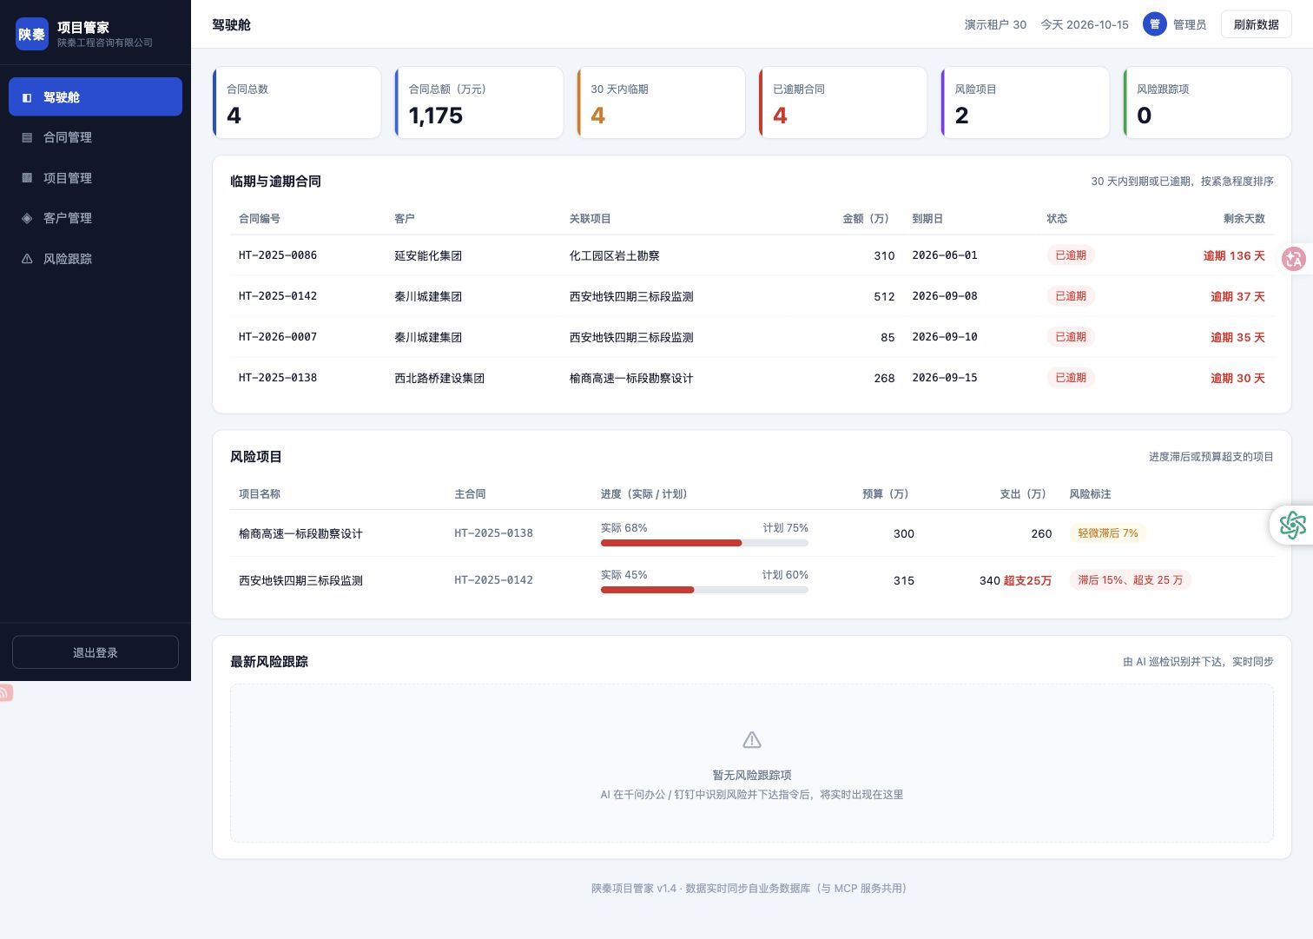
Demo environment: business dashboard
Figure 1. Shanqin Project Manager dashboard
Business demo system /demo30/; read-only capture on 15 October 2026.
The screen shows 4 contracts totalling RMB 11.75 million, 2 at-risk projects, 0 risk-tracking items, and contract and project details.
Values show the demo tenant on 15 October, not business benefits or historical run statistics. The 'due within 30 days' card shows 4 while the contracts below are marked overdue. Its counting definition is unverified; do not interpret it as four future expiries. References: E01, E06, E20.
Notes:
Figure 1. Shanqin Project Manager dashboard
Business demo system /demo30/; read-only capture on 15 October 2026.
The screen shows 4 contracts totalling RMB 11.75 million, 2 at-risk projects, 0 risk-tracking items, and contract and project details.
Values show the demo tenant on 15 October, not business benefits or historical run statistics. The 'due within 30 days' card shows 4 while the contracts below are marked overdue. Its counting definition is unverified; do not interpret it as four future expiries. References: E01, E06, E20.

Slide 8
II. Background and scope (continued)
The analysis reviewed three Qwen drafts and the same-day retrospective, then checked the locally saved main conversation, three inspection execution records, and run logs and group messages retrieved on 14 October. It also read seven skill packages and the actual agreement. Draft claims that conflicted with raw returns or overstated the evidence were corrected. These are local records of historical states; the historical analysis did not query or operate remote systems again. This version adds read-only business-screen captures from 15 October, with scope stated in each caption. [Source index in the appendices]
Notes:
The analysis reviewed three Qwen drafts and the same-day retrospective, then checked the locally saved main conversation, three inspection execution records, and run logs and group messages retrieved on 14 October. It also read seven skill packages and the actual agreement. Draft claims that conflicted with raw returns or overstated the evidence were corrected. These are local records of historical states; the historical analysis did not query or operate remote systems again. This version adds read-only business-screen captures from 15 October, with scope stated in each caption. [Source index in the appendices]

Slide 9
II. Background and scope (continued)
Four categories are distinguished: A, facts directly supported by material; B, observations from limited practice; C, evidence-based analysis; and D, unimplemented proposals or hypotheses. Manual methods described below are proposed comparators, not descriptions of HSBC's current processes. No on-site manual timing data was collected.
Notes:
Four categories are distinguished: A, facts directly supported by material; B, observations from limited practice; C, evidence-based analysis; and D, unimplemented proposals or hypotheses. Manual methods described below are proposed comparators, not descriptions of HSBC's current processes. No on-site manual timing data was collected.

Slide 10
1. Read and enter contract information
The task was to turn contract material in a group into business-ledger fields. A manual comparator would locate and read the document, enter fields and review them. The assistant found the online agreement via group messages, read it, listed the number, customer, project, amount and expiry date, separately explained its status, then requested confirmation. Core values, including RMB 850,000 and expiry on 10 September 2026, matched the input. [A: E04]
Notes:
The task was to turn contract material in a group into business-ledger fields. A manual comparator would locate and read the document, enter fields and review them. The assistant found the online agreement via group messages, read it, listed the number, customer, project, amount and expiry date, separately explained its status, then requested confirmation. Core values, including RMB 850,000 and expiry on 10 September 2026, matched the input. [A: E04]

Slide 11
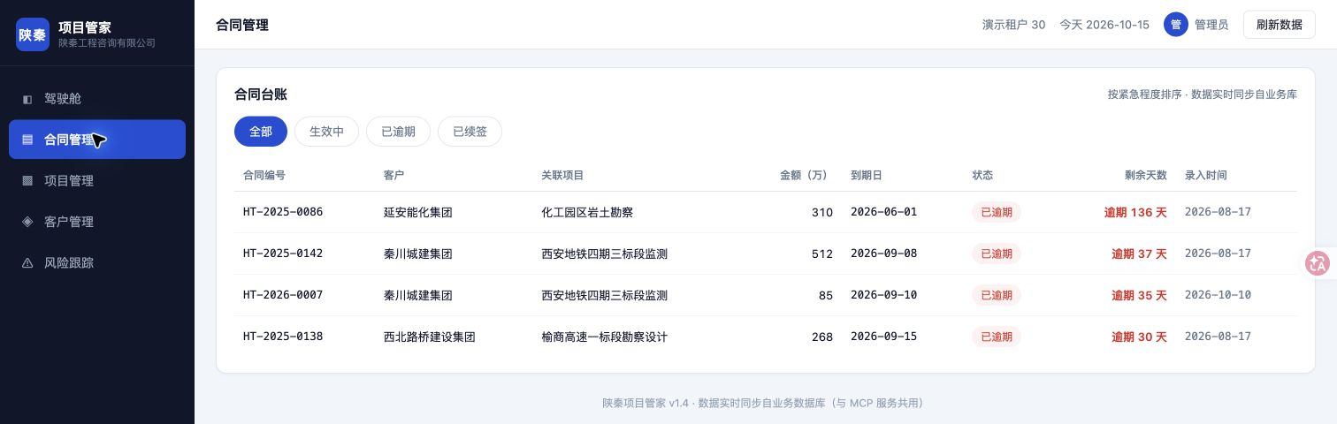
Contract entry: the business ledger
Figure 2. Contract HT-2026-0007 in the ledger
Business demo system /demo30/contracts; captured on 15 October 2026.
Visible fields include the contract number, Qinchuan Urban Construction Group, RMB 850,000, expiry 2026-09-10 and entry date 2026-10-10.
This is the ledger state at the later capture. The screenshot does not show the write process; the account that I watched AI entry throughout and did not click the agreement remains based on my correction U3. References: E04, E05, U3.
Notes:
Figure 2. Contract HT-2026-0007 in the ledger
Business demo system /demo30/contracts; captured on 15 October 2026.
Visible fields include the contract number, Qinchuan Urban Construction Group, RMB 850,000, expiry 2026-09-10 and entry date 2026-10-10.
This is the ledger state at the later capture. The screenshot does not show the write process; the account that I watched AI entry throughout and did not click the agreement remains based on my correction U3. References: E04, E05, U3.

Slide 12
1. Read and enter contract information (cont.)
This connects reading, extraction and a confirmation request. However, the input was a short template embedded in a skill and created during setup; unfamiliar contracts, scans, conflicting versions and missing fields were not tested. I did not click the supplementary agreement and observed the AI complete entry in Qwen Office; the contract also appeared in the later ledger. Retain AI entry as an observed outcome, while noting that its write call has not been located in the reviewed main conversation. Confirmation context and execution receipts are still needed to validate the full write process. [A/B: E04–E05; U3]
For technology projects, the useful idea is to extract verifiable handoff fields from defined materials, attach source references and obtain human confirmation. A further test with new material could measure field accuracy, completeness and review effort. Whether this saves time is unknown.
Notes:
This connects reading, extraction and a confirmation request. However, the input was a short template embedded in a skill and created during setup; unfamiliar contracts, scans, conflicting versions and missing fields were not tested. I did not click the supplementary agreement and observed the AI complete entry in Qwen Office; the contract also appeared in the later ledger. Retain AI entry as an observed outcome, while noting that its write call has not been located in the reviewed main conversation. Confirmation context and execution receipts are still needed to validate the full write process. [A/B: E04–E05; U3]
For technology projects, the useful idea is to extract verifiable handoff fields from defined materials, attach source references and obtain human confirmation. A further test with new material could measure field accuracy, completeness and review effort. Whether this saves time is unknown.

Slide 13
2. Summarise risks and decisions needed
The task was to turn separate ledgers into a status briefing for discussion. The assistant read three data sources—contracts, at-risk projects and tracking items—generated 'new', 'risks', 'handled' and 'decisions needed' content, and posted it to the group. Readback showed three pending decisions and distinguished 'agreement archived' from 'ledger entry awaiting confirmation'. These are recorded outputs. [A: E11]
The useful feature is making status and responsibility explicit. Card colours, @mentions and formatting are ordinary features; no evidence shows improved decision quality or response speed. The risk API already returned days overdue, overspend and progress gaps. The model mainly called tools, aggregated data and expressed results; backend rule calculations cannot all be credited as independent risk detection by the model. [A/C: E06, E11, E13]
Notes:
The task was to turn separate ledgers into a status briefing for discussion. The assistant read three data sources—contracts, at-risk projects and tracking items—generated 'new', 'risks', 'handled' and 'decisions needed' content, and posted it to the group. Readback showed three pending decisions and distinguished 'agreement archived' from 'ledger entry awaiting confirmation'. These are recorded outputs. [A: E11]
The useful feature is making status and responsibility explicit. Card colours, @mentions and formatting are ordinary features; no evidence shows improved decision quality or response speed. The risk API already returned days overdue, overspend and progress gaps. The model mainly called tools, aggregated data and expressed results; backend rule calculations cannot all be credited as independent risk detection by the model. [A/C: E06, E11, E13]

Slide 14
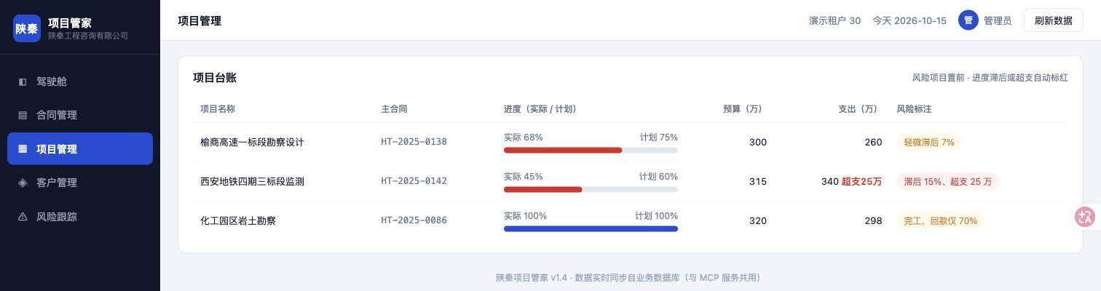
Project ledger: progress and budget risk
Figure 3. Progress, budget and spending in the ledger
Business demo system /demo30/projects; read-only capture on 15 October 2026.
The metro-monitoring project shows 45% actual progress against 60% planned, a budget of RMB 3.15 million and spending of RMB 3.40 million. The screen also shows the Yushang project's progress gap.
This read-only capture from 15 October does not replace the 10 October API return. The screen's '15% behind' means a 15-percentage-point gap. Risk labels come from the business system and cannot all be credited to independent model detection. References: E06, E23.
Notes:
Figure 3. Progress, budget and spending in the ledger
Business demo system /demo30/projects; read-only capture on 15 October 2026.
The metro-monitoring project shows 45% actual progress against 60% planned, a budget of RMB 3.15 million and spending of RMB 3.40 million. The screen also shows the Yushang project's progress gap.
This read-only capture from 15 October does not replace the 10 October API return. The screen's '15% behind' means a 15-percentage-point gap. Risk labels come from the business system and cannot all be credited to independent model detection. References: E06, E23.

Slide 15
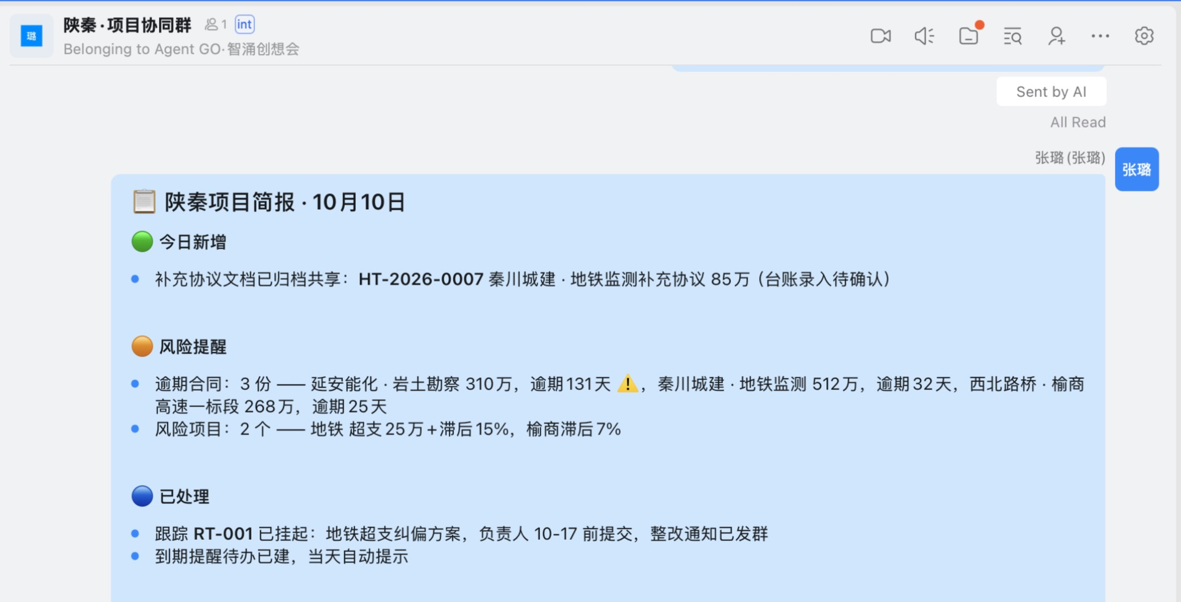
Group briefing: content in DingTalk
Figure 4. DingTalk's 10 October project briefing (excerpt)
Local DingTalk client, 'Shanqin · Project Collaboration' group; captured on 15 October 2026.
Visible sections include 'new today', 'risk alerts' and 'handled'. This briefing still marks the supplementary agreement as 'ledger entry awaiting confirmation'.
This historical message in the current client alone does not establish the initial version or later closure. The group was a one-person demonstration; 'automatic prompt' in the message does not verify reminder delivery. References: E07, E08, E11.
Notes:
Figure 4. DingTalk's 10 October project briefing (excerpt)
Local DingTalk client, 'Shanqin · Project Collaboration' group; captured on 15 October 2026.
Visible sections include 'new today', 'risk alerts' and 'handled'. This briefing still marks the supplementary agreement as 'ledger entry awaiting confirmation'.
This historical message in the current client alone does not establish the initial version or later closure. The group was a one-person demonstration; 'automatic prompt' in the message does not verify reminder delivery. References: E07, E08, E11.

Slide 16
2. Summarise risks and decisions needed (cont.)
This is a suitable first test for draft project briefings, with limits on interpretation. Contract expiry does not establish payment arrears, nor is contract value necessarily an amount to recover. Planned progress of 60% versus actual progress of 45% is a 15-percentage-point gap. Matters needing business judgement should be presented for confirmation. [C: E23]
Notes:
This is a suitable first test for draft project briefings, with limits on interpretation. Contract expiry does not establish payment arrears, nor is contract value necessarily an amount to recover. Planned progress of 60% versus actual progress of 45% is a 15-percentage-point gap. Matters needing business judgement should be presented for confirmation. [C: E23]

Slide 17
3. Register instructions and notify
The task was to turn 'submit a corrective plan within a week' into a trackable item. Records show the assistant created RT-001 with a project, requirement, deadline and 'project owner', then created a personal to-do, sent a correction notice and read the group message back. Compared with the proposed manual workflow, it generated multiple registrations and notification texts. [A/B: E07]
This connects an instruction to work items, but does not demonstrate accountable follow-through. The owner remained a generic role and the to-do was assigned to the demonstrator. There is no record of another person accepting, executing, reporting on or closing it. A to-do with a deadline does not prove notification delivery. [A: E01, E08]
Notes:
The task was to turn 'submit a corrective plan within a week' into a trackable item. Records show the assistant created RT-001 with a project, requirement, deadline and 'project owner', then created a personal to-do, sent a correction notice and read the group message back. Compared with the proposed manual workflow, it generated multiple registrations and notification texts. [A/B: E07]
This connects an instruction to work items, but does not demonstrate accountable follow-through. The owner remained a generic role and the to-do was assigned to the demonstrator. There is no record of another person accepting, executing, reporting on or closing it. A to-do with a deadline does not prove notification delivery. [A: E01, E08]

Slide 18
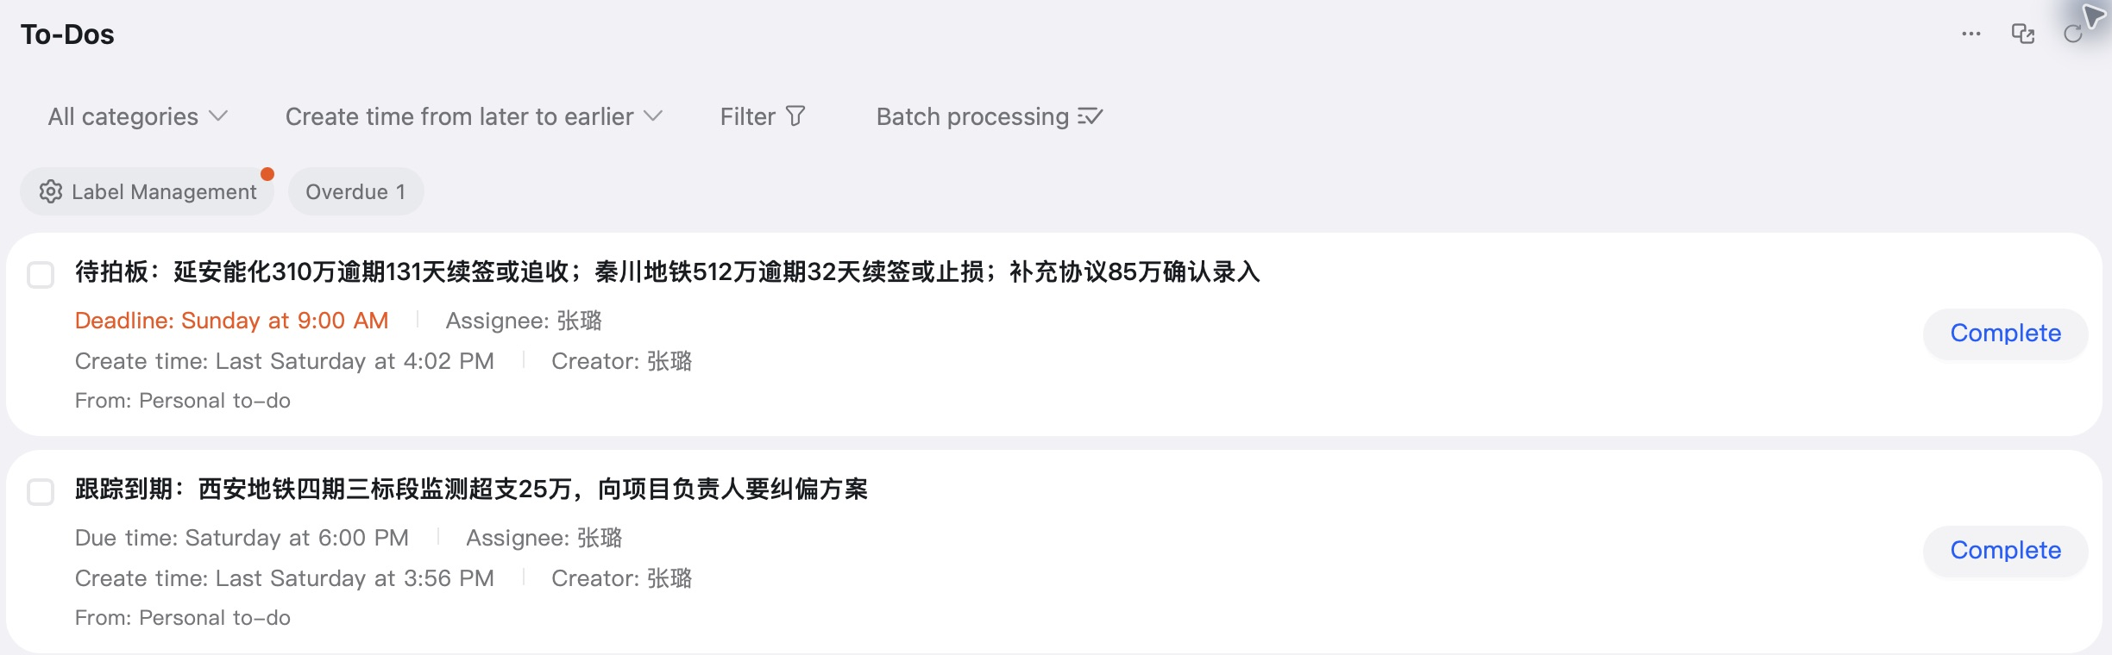
DingTalk to-dos: messages become follow-up items
Figure 5. Decision and corrective-plan follow-up to-dos
Local DingTalk client, To-Dos list; captured on 15 October 2026.
Two practice to-dos, assignees and deadlines are visible. The decision item shows Sunday 9:00 AM and the corrective-plan follow-up Saturday 6:00 PM. Both still have a 'Complete' button.
The screenshot supports the existence of to-dos, not reminder delivery, owner acceptance or business closure. Interpret relative dates with the capture date and original records; this is not a new effectiveness test. References: E07, E08.
Notes:
Figure 5. Decision and corrective-plan follow-up to-dos
Local DingTalk client, To-Dos list; captured on 15 October 2026.
Two practice to-dos, assignees and deadlines are visible. The decision item shows Sunday 9:00 AM and the corrective-plan follow-up Saturday 6:00 PM. Both still have a 'Complete' button.
The screenshot supports the existence of to-dos, not reminder delivery, owner acceptance or business closure. Interpret relative dates with the capture date and original records; this is not a new effectiveness test. References: E07, E08.

Slide 19
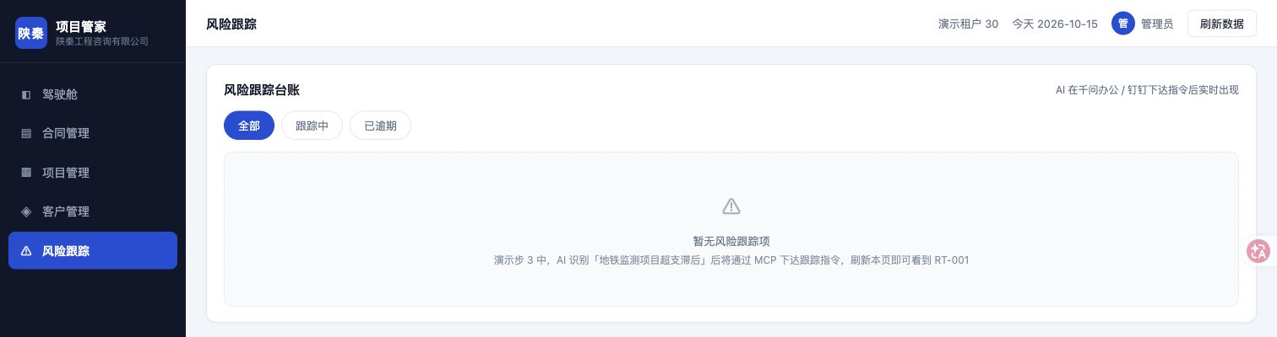
Risk tracking: the current list is empty
Figure 6. Risk-tracking page shows 'No risk-tracking items'
Business demo system /demo30/risks; read-only capture on 15 October 2026.
The 'All' filter is selected. The page says 'No risk-tracking items'; RT-001 is not visible.
This current view on 15 October does not prove RT-001 was deleted or explain the two different reads on 10 October. Alongside the still-existing to-dos, it shows why each work object's status needs separate checks. References: E07, E09, E10.
Notes:
Figure 6. Risk-tracking page shows 'No risk-tracking items'
Business demo system /demo30/risks; read-only capture on 15 October 2026.
The 'All' filter is selected. The page says 'No risk-tracking items'; RT-001 is not visible.
This current view on 15 October does not prove RT-001 was deleted or explain the two different reads on 10 October. Alongside the still-existing to-dos, it shows why each work object's status needs separate checks. References: E07, E09, E10.

Slide 20
3. Register instructions and notify (cont.)
The main conversation read RT-001 at 16:02, but the inspection subtask returned an empty list at 16:11. The records do not establish whether this was caused by a different tenant or connection context, a data reset, persistence or something else. First test how records, to-dos and notifications for one item correspond in an isolated sandbox, then involve a real recipient. Successful sending alone is insufficient for acceptance. [A/C: E09]
Notes:
The main conversation read RT-001 at 16:02, but the inspection subtask returned an empty list at 16:11. The records do not establish whether this was caused by a different tenant or connection context, a data reset, persistence or something else. First test how records, to-dos and notifications for one item correspond in an isolated sandbox, then involve a real recipient. Successful sending alone is insufficient for acceptance. [A/C: E09]

Slide 21
4. Daily inspections and exception handling
The task was to query risks repeatedly and notify only when action was needed. Qwen Office created a daily 09:00 task and immediately triggered one demonstration. Of four subsequent scheduled runs, 11 October logged too_late, 12 October sleep, and 13 and 14 October completion. The latter two group messages appeared at 09:11:57 and 09:11:38. Causes are described only to the extent supported by logs. [A: E15–E16]
The earlier retrospective's failure explanation most needs correction. On 10 October the inspection API had already returned an empty tracking list, yet the assistant attributed this to 'exactly day seven being missed', changed the prompt and confirmed scheduling remained enabled. No successful retest under the same data-present conditions is recorded. An updated configuration and an enabled task do not prove that the business issue was fixed. [A/C: E09–E10]
Notes:
The task was to query risks repeatedly and notify only when action was needed. Qwen Office created a daily 09:00 task and immediately triggered one demonstration. Of four subsequent scheduled runs, 11 October logged too_late, 12 October sleep, and 13 and 14 October completion. The latter two group messages appeared at 09:11:57 and 09:11:38. Causes are described only to the extent supported by logs. [A: E15–E16]
The earlier retrospective's failure explanation most needs correction. On 10 October the inspection API had already returned an empty tracking list, yet the assistant attributed this to 'exactly day seven being missed', changed the prompt and confirmed scheduling remained enabled. No successful retest under the same data-present conditions is recorded. An updated configuration and an enabled task do not prove that the business issue was fixed. [A/C: E09–E10]

Slide 22
4. Daily inspections and exception handling (cont.)
These inspections merit further evaluation, but should not yet be the sole protection for critical deadlines. No group message may mean no risk or no execution. Validate business notifications, operational health, delay, failure alerts and human takeover separately. Only this group and available logs were checked; this does not establish that the platform lacks other alert channels. [C/D: E17]
Notes:
These inspections merit further evaluation, but should not yet be the sole protection for critical deadlines. No group message may mean no risk or no execution. Validate business notifications, operational health, delay, failure alerts and human takeover separately. Only this group and available logs were checked; this does not establish that the platform lacks other alert channels. [C/D: E17]

Slide 23
Actual records of four scheduled inspections
11 October · Execution error
Log: too_late
This does not establish that the device was offline
12 October · Execution error
Log: sleep
Recovery and other alert channels remain to be checked
13 October · Completion recorded
Group message: 09:11:57
Scheduled time: 09:00
14 October · Completion recorded
Group message: 09:11:38
Scheduled time: 09:00
E15–E17; a manual demonstration also ran on 10 October. These four scheduled runs do not estimate overall product reliability.
Notes:
11 October · Execution error
Log: too_late
This does not establish that the device was offline
12 October · Execution error
Log: sleep
Recovery and other alert channels remain to be checked
13 October · Completion recorded
Group message: 09:11:57
Scheduled time: 09:00
14 October · Completion recorded
Group message: 09:11:38
Scheduled time: 09:00
E15–E17; a manual demonstration also ran on 10 October. These four scheduled runs do not estimate overall product reliability.

Slide 24
1. Value at the handoffs between tools
Qwen interprets requests, organises content and calls tools. The business system supplies records and some rule calculations. DingTalk holds online documents, group messages and personal to-dos. Qwen Office creates scheduled tasks. Standalone AI can also summarise manually supplied material; DingTalk adds paths for acquiring inputs and placing outputs into collaboration objects, creating the possibility of less manual copying. [A/C: E20]
No same-task comparison of standalone AI and AI connected to a platform was performed, so this additional value cannot be quantified. Existing templates or ordinary automation should also be compared if they can perform fixed-rule tasks more reliably. [D: E21–E22]
Notes:
Qwen interprets requests, organises content and calls tools. The business system supplies records and some rule calculations. DingTalk holds online documents, group messages and personal to-dos. Qwen Office creates scheduled tasks. Standalone AI can also summarise manually supplied material; DingTalk adds paths for acquiring inputs and placing outputs into collaboration objects, creating the possibility of less manual copying. [A/C: E20]
No same-task comparison of standalone AI and AI connected to a platform was performed, so this additional value cannot be quantified. Existing templates or ordinary automation should also be compared if they can perform fixed-rule tasks more reliably. [D: E21–E22]

Slide 25
How information moves between tools
Inputs and materials
Group documents and business-ledger query results
Material quality and definitions still need checking
Qwen Office
Interpret requests, organise content and call tools
Create scheduled tasks
Business system
Store and query business records
Return some rule-based calculations
DingTalk
Online documents, group messages and personal to-dos
Multi-person acceptance, execution and closure unverified
Roles summarised from E20, E07–E09. Paths differ by scenario; this does not validate a complete workflow through to closure.
Notes:
Inputs and materials
Group documents and business-ledger query results
Material quality and definitions still need checking
Qwen Office
Interpret requests, organise content and call tools
Create scheduled tasks
Business system
Store and query business records
Return some rule-based calculations
DingTalk
Online documents, group messages and personal to-dos
Multi-person acceptance, execution and closure unverified
Roles summarised from E20, E07–E09. Paths differ by scenario; this does not validate a complete workflow through to closure.

Slide 26
2. Validate each control separately
The demonstration contains useful positive observations: confirmation requested after contract extraction, customer analysis kept in the conversation, cross-organisation reading denied, invalid @mention format blocked, and some messages read back. [A/B: E03, E13–E14]
These controls serve different purposes. Format validation is not business approval. A skill's instruction not to post to a group does not prove all conflicting instructions are blocked. One confirmation request does not prove confirmation always matches the eventual write. Not clicking the agreement does not establish that AI acted without authorisation; inspect the specific confirmation and execution sequence. Test refusal, changes, retries, wrong destinations and insufficient permissions separately. [C/D: E14]
Notes:
The demonstration contains useful positive observations: confirmation requested after contract extraction, customer analysis kept in the conversation, cross-organisation reading denied, invalid @mention format blocked, and some messages read back. [A/B: E03, E13–E14]
These controls serve different purposes. Format validation is not business approval. A skill's instruction not to post to a group does not prove all conflicting instructions are blocked. One confirmation request does not prove confirmation always matches the eventual write. Not clicking the agreement does not establish that AI acted without authorisation; inspect the specific confirmation and execution sequence. Test refusal, changes, retries, wrong destinations and insufficient permissions separately. [C/D: E14]

Slide 27
3. Check both fields and interpretation
The customer-analysis API returned business amounts, project counts, expiry dates and status. The assistant further asserted that renewal or extension formalities were incomplete and revenue lacked contractual protection. The input did not establish these conclusions; customer resource priorities also lacked complete payment and return information. Reading material correctly does not guarantee a valid business interpretation. [A/C: E12]
Likewise, an unsupported diagnosis of the inspection problem entered the retrospective and was then described as fixed in a draft. AI summaries should retain raw returns and the basis for human corrections. One AI summary cannot independently substantiate another. [C: E10]
Notes:
The customer-analysis API returned business amounts, project counts, expiry dates and status. The assistant further asserted that renewal or extension formalities were incomplete and revenue lacked contractual protection. The input did not establish these conclusions; customer resource priorities also lacked complete payment and return information. Reading material correctly does not guarantee a valid business interpretation. [A/C: E12]
Likewise, an unsupported diagnosis of the inspection problem entered the retrospective and was then described as fixed in a draft. AI summaries should retain raw returns and the basis for human corrections. One AI summary cannot independently substantiate another. [C: E10]

Slide 28
4. Feasibility is not proof of benefit
Level of judgement | Current basis | Conclusion
Functions work | Records of document reading, tracking writes, to-do creation and message readback | Several functions worked under those conditions
Scenario feasibility | Sequential operations with simulated data, one person and preset skills | Selected paths are feasible; end-to-end gaps remain
Benefits validated | No manual baseline, common quality scoring or handoff-effectiveness measures | Not yet verified
Notes:
Level of judgement | Current basis | Conclusion
Functions work | Records of document reading, tracking writes, to-do creation and message readback | Several functions worked under those conditions
Scenario feasibility | Sequential operations with simulated data, one person and preset skills | Selected paths are feasible; end-to-end gaps remain
Benefits validated | No manual baseline, common quality scoring or handoff-effectiveness measures | Not yet verified

Slide 29
4. Feasibility and benefit (continued)
Level of judgement | Current basis | Conclusion
Readiness for wider use | Bank environment, multi-person use and sustained operations not tested | Not yet verified
Notes:
Level of judgement | Current basis | Conclusion
Readiness for wider use | Bank environment, multi-person use and sustained operations not tested | Not yet verified

Slide 30
4. Feasibility and benefit (continued)
Seven skill packages provide reusable workflows, but contain example dependencies such as demo groups, people and old dates. Rollout also costs parameter migration, permission confirmation, testing and ongoing maintenance; no such cost data was collected. [E19, E21, E24]
Notes:
Seven skill packages provide reusable workflows, but contain example dependencies such as demo groups, people and old dates. Rollout also costs parameter migration, permission confirmation, testing and ongoing maintenance; no such cost data was collected. [E19, E21, E24]

Slide 31
V. Relevance to bank technology work
Candidate uses are extracting project information, summarising status, preparing decisions and handing off tasks. These could use AI's language and information-organisation abilities, while still requiring clear business objects, final judgement, recipients and accountability. They are use-case hypotheses, not evidence of problems at this bank or approval to use the products. [C/D: E22, E24]
Notes:
Candidate uses are extracting project information, summarising status, preparing decisions and handing off tasks. These could use AI's language and information-organisation abilities, while still requiring clear business objects, final judgement, recipients and accountability. They are use-case hypotheses, not evidence of problems at this bank or approval to use the products. [C/D: E22, E24]

Slide 32
V. Relevance to bank technology work (cont.)
Internal usability requires a separate assessment. Business or project owners should define information standards, acceptance criteria and final responsibility. Technology teams should design tests, record failures and human takeover. Security and data owners should confirm permitted tools, data categories, transfer, retention and access. Platform teams should confirm identity, permissions, interfaces, audit, scheduling and support. Applicable internal processes remain to be confirmed; this report does not infer existing architecture or control gaps. [D: E24]
Notes:
Internal usability requires a separate assessment. Business or project owners should define information standards, acceptance criteria and final responsibility. Technology teams should design tests, record failures and human takeover. Security and data owners should confirm permitted tools, data categories, transfer, retention and access. Platform teams should confirm identity, permissions, interfaces, audit, scheduling and support. Applicable internal processes remain to be confirmed; this report does not infer existing architecture or control gaps. [D: E24]

Slide 33
V. Relevance to bank technology work (cont.)
Key limitations are a single preset sample, a one-person demonstration, no benefits baseline and unexplained tracking-state differences. Real material quality, conflicting definitions and exceptions add review cost. Even if generation becomes faster, check whether final delivery still meets requirements and whether data-entry effort has merely become more time-consuming checking.
Notes:
Key limitations are a single preset sample, a one-person demonstration, no benefits baseline and unexplained tracking-state differences. Real material quality, conflicting definitions and exceptions add review cost. Even if generation becomes faster, check whether final delivery still meets requirements and whether data-entry effort has merely become more time-consuming checking.

Slide 34
1. Start with two clearly scoped tasks
A manager should designate a task owner and arrange a validation window of no more than two weeks in a permitted environment, using synthetic material for field extraction and project-briefing drafts. This is a proposed timebox, not an agreed plan or promise of results. Humans review every output first. Any later use of de-identified or real internal material must remain within the actually permitted scope. [D]
Do not initially prioritise customer business decisions, unattended critical reminders or more presentation formatting. Two-person handoffs can be the next stage, testing whether the collaboration platform adds value.
Notes:
A manager should designate a task owner and arrange a validation window of no more than two weeks in a permitted environment, using synthetic material for field extraction and project-briefing drafts. This is a proposed timebox, not an agreed plan or promise of results. Humans review every output first. Any later use of de-identified or real internal material must remain within the actually permitted scope. [D]
Do not initially prioritise customer business decisions, unattended critical reminders or more presentation formatting. Two-person handoffs can be the next stage, testing whether the collaboration platform adds value.

Slide 35
2. Compare complete tasks to one standard
Prepare six pairs of equally difficult but different tasks per scenario: 12 pairs and 24 executions across two scenarios, with 12 manual and 12 AI-assisted runs. Randomly allocate methods and alternate execution order, avoiding the memory advantage of manually completing material before asking AI to repeat it. Use the same input scope and final acceptance criteria; record practice and setup separately from formal timing. This small sample supports initial observation, not department-wide benefit projections. [D]
Notes:
Prepare six pairs of equally difficult but different tasks per scenario: 12 pairs and 24 executions across two scenarios, with 12 manual and 12 AI-assisted runs. Randomly allocate methods and alternate execution order, avoiding the memory advantage of manually completing material before asking AI to repeat it. Use the same input scope and final acceptance criteria; record practice and setup separately from formal timing. This small sample supports initial observation, not department-wide benefit projections. [D]

Slide 36
2. Compare complete tasks to one standard (cont.)
Keep four core measures: active human time, elapsed time to acceptance, output completeness/accuracy and revision rounds. Include prompting, review, confirmation, copying, rework and manual recovery after failure; record learning and maintenance costs separately. Score first drafts and final quality separately, retaining failed and abandoned cases. Do not invent baseline values or target savings before data exists. [D]
If initial results are acceptable, use new tasks to compare AI drafting followed by manual copying with AI connected to the collaboration platform, separating integration benefits from generation benefits. A two-person test should check that owner, deadline, item ID and acceptance information are complete.
Notes:
Keep four core measures: active human time, elapsed time to acceptance, output completeness/accuracy and revision rounds. Include prompting, review, confirmation, copying, rework and manual recovery after failure; record learning and maintenance costs separately. Score first drafts and final quality separately, retaining failed and abandoned cases. Do not invent baseline values or target savings before data exists. [D]
If initial results are acceptable, use new tasks to compare AI drafting followed by manual copying with AI connected to the collaboration platform, separating integration benefits from generation benefits. A two-person test should check that owner, deadline, item ID and acceptance information are complete.

Slide 37
3. Decide whether to expand or stop
Before expanding, require quality against the same standard, net improvement after review and maintenance, traceable error handling and confirmed conditions of use. Critical errors must not escape acceptance, and unauthorised writes or distribution must not occur. The task owner should set time-improvement criteria and tolerances for non-critical errors before seeing results. [D]
If drafts help but integration costs offset the gains, retain drafting assistance alone. If state is inconsistent, critical items are silently missed or responsibility cannot be established, stop the relevant automatic actions and restore manual handling. An inconclusive evaluation may be ended without widening scope just to prolong the trial.
Notes:
Before expanding, require quality against the same standard, net improvement after review and maintenance, traceable error handling and confirmed conditions of use. Critical errors must not escape acceptance, and unauthorised writes or distribution must not occur. The task owner should set time-improvement criteria and tolerances for non-critical errors before seeing results. [D]
If drafts help but integration costs offset the gains, retain drafting assistance alone. If state is inconsistent, critical items are silently missed or responsibility cannot be established, stop the relevant automatic actions and restore manual handling. An inconclusive evaluation may be ended without widening scope just to prolong the trial.

Slide 38
Appendix A. Case evidence
Item | Most direct evidence | Supported conclusion and limits
Contract extraction | R1 lines 320, 325; M5 | Source and core values match; confirmation requested; one preset template
Notes:
Item | Most direct evidence | Supported conclusion and limits
Contract extraction | R1 lines 320, 325; M5 | Source and core values match; confirmation requested; one preset template

Slide 39
Appendix A. Case evidence (continued)
Item | Most direct evidence | Supported conclusion and limits
Subsequent contract entry | User correction U3; R3 line 16, R5 line 73 | I observed AI entry without clicking the agreement; ledger record exists, but the write call and confirmation sequence need checking
Notes:
Item | Most direct evidence | Supported conclusion and limits
Subsequent contract entry | User correction U3; R3 line 16, R5 line 73 | I observed AI entry without clicking the agreement; ledger record exists, but the write call and confirmation sequence need checking

Slide 40
Appendix A. Case evidence (continued)
Item | Most direct evidence | Supported conclusion and limits
Tracking and distribution | R1 lines 380, 387, 395, 438 | Write, to-do creation and group-notice readback recorded; no multi-person acceptance or closure
Tracking-state discrepancy | R1 line 438 versus R2 line 33 | Same-day reads returned one then zero items; cause and connection context unknown
Notes:
Item | Most direct evidence | Supported conclusion and limits
Tracking and distribution | R1 lines 380, 387, 395, 438 | Write, to-do creation and group-notice readback recorded; no multi-person acceptance or closure
Tracking-state discrepancy | R1 line 438 versus R2 line 33 | Same-day reads returned one then zero items; cause and connection context unknown

Slide 41
Appendix A. Case evidence (continued)
Item | Most direct evidence | Supported conclusion and limits
Prompt revision | R1 lines 513–525 | Updated and found enabled; this does not establish the cause or a successful retest
Briefing and interpretation risk | R1 line 459; lines 415, 418 | Briefing readable in the group; some customer-analysis judgements exceed the input
Notes:
Item | Most direct evidence | Supported conclusion and limits
Prompt revision | R1 lines 513–525 | Updated and found enabled; this does not establish the cause or a successful retest
Briefing and interpretation risk | R1 line 459; lines 415, 418 | Briefing readable in the group; some customer-analysis judgements exceed the input

Slide 42
Appendix A. Case evidence (continued)
Item | Most direct evidence | Supported conclusion and limits
Inspection reliability | R5 lines 61, 69; R3, R4 | Two errors and two completions in four scheduled runs; no estimate of overall product reliability
Demo limits | U2; K1–K7; M7 | One person, demo environment, seven skills; M7 shows an entry point to material, not operation results
Notes:
Item | Most direct evidence | Supported conclusion and limits
Inspection reliability | R5 lines 61, 69; R3, R4 | Two errors and two completions in four scheduled runs; no estimate of overall product reliability
Demo limits | U2; K1–K7; M7 | One person, demo environment, seven skills; M7 shows an entry point to material, not operation results

Slide 43
Appendix B. Priority open questions
1. Why did reads of RT-001 differ? Match tenant, connection context and server-side change records; prompt adjustments alone are insufficient.
2. Which call entered the supplementary agreement, with what confirmation and receipt? I have confirmed watching the AI enter it; execution records still need to be matched to the ledger.
3. Were due-date reminders actually delivered, and do missed runs have other alert channels? Neither creation nor silence in the group establishes delivery.
4. Which two actual tasks merit a trial, who accepts the results, and which tools and material are permitted? The manager and relevant owners must decide.
Notes:
1. Why did reads of RT-001 differ? Match tenant, connection context and server-side change records; prompt adjustments alone are insufficient.
2. Which call entered the supplementary agreement, with what confirmation and receipt? I have confirmed watching the AI enter it; execution records still need to be matched to the ledger.
3. Were due-date reminders actually delivered, and do missed runs have other alert channels? Neither creation nor silence in the group establishes delivery.
4. Which two actual tasks merit a trial, who accepts the results, and which tools and material are permitted? The manager and relevant owners must decide.

Slide 44
Appendix B. Priority open questions (cont.)
5. What are the event's exact official name and organiser? The group display name differs from an existing article; this does not affect the scenario analysis.
Notes:
5. What are the event's exact official name and organiser? The group display name differs from an existing article; this does not affect the scenario analysis.

Slide 45
Appendix C. Suggested evaluation records
Measure | What to record | Current status
Human effort | Minutes spent preparing, operating, reviewing, revising, copying and recovering | Not measured
Elapsed time | From complete inputs to final acceptance, identifying system and human waiting separately | No measured comparator
Notes:
Measure | What to record | Current status
Human effort | Minutes spent preparing, operating, reviewing, revising, copying and recovering | Not measured
Elapsed time | From complete inputs to final acceptance, identifying system and human waiting separately | No measured comparator

Slide 46
Appendix C. Evaluation records (continued)
Measure | What to record | Current status
Quality | Field/fact coverage, critical errors and unsupported judgements; draft and final scored separately | No common scoring
Rework | Revision rounds, failures, manual recovery and maintenance effort | Not systematically recorded
Notes:
Measure | What to record | Current status
Quality | Field/fact coverage, critical errors and unsupported judgements; draft and final scored separately | No common scoring
Rework | Revision rounds, failures, manual recovery and maintenance effort | Not systematically recorded

Slide 47
Appendix C. Evaluation records (continued)
Measure | What to record | Current status
Handoff | Item ID, owner, deadline, consistent status and receipt confirmation | One person; multi-person use not tested
Notes:
Measure | What to record | Current status
Handoff | Item ID, owner, deadline, consistent status and receipt confirmation | One person; multi-person use not tested

Slide 48
Appendix C. Evaluation records (continued)
Create separate cases for date boundaries, empty data, read failures, wrong groups, duplicate submissions and changes after confirmation. Report paired task differences, overall median and range, with failure cases. The proposed sample size and timebox are not measured results.
Notes:
Create separate cases for date boundaries, empty data, read failures, wrong groups, duplicate submissions and changes after confirmation. Report paired task differences, overall median and range, with failure cases. The proposed sample size and timebox are not measured results.

Slide 49
Appendix D. Sources and traceability
M1–M3: Qwen-generated report draft, practice-material and fact list, and key findings and management implications dated 2026-10-14. M4: 'Shanqin Three-End Collaboration Demo Retrospective', 2026-10-10. M5: 'Supplementary Agreement' in the demo working directory. M7: screenshot of a handbook card in the group. K1–K7: seven Shanqin skill packages.U1: my requirements for this report; U2: clarification that this was a one-person demonstration; U3: my explicit correction: 'I did not click the supplementary agreement. The AI entered the contract, and I watched Qwen Office throughout.'
Notes:
M1–M3: Qwen-generated report draft, practice-material and fact list, and key findings and management implications dated 2026-10-14. M4: 'Shanqin Three-End Collaboration Demo Retrospective', 2026-10-10. M5: 'Supplementary Agreement' in the demo working directory. M7: screenshot of a handbook card in the group. K1–K7: seven Shanqin skill packages.U1: my requirements for this report; U2: clarification that this was a one-person demonstration; U3: my explicit correction: 'I did not click the supplementary agreement. The AI entered the contract, and I watched Qwen Office throughout.'

Slide 50
Appendix D. Sources (continued)
R1: local main-conversation record, 3348c252-83d0-43c6-a838-030e53705d0c.jsonl; R2: immediate inspection on 10-10, b55b6d62-aae9-4b47-8e0d-7bef9bdc2355.jsonl; R3: inspection on 10-13, 81da9cc9-9185-4183-8d8d-76e720f8802e.jsonl; R4: inspection on 10-14, e22eafc5-9da8-4339-9bcc-2903cbcf2384.jsonl; R5: material review on 10-14, bda09640-0b4e-4605-97e6-208a3b86c468.jsonl.
E numbers refer to the accompanying Evidence Matrix and Key Findings (02_evidence_matrix.md). Full paths, review scope and file fingerprints are in the Material Inventory (01_material_inventory.md) and evidence directory. See 03_management_analysis.md for independent analysis and the measurement proposal, and 05_open_questions.md for the complete open-question list. Original materials are unchanged.
Notes:
R1: local main-conversation record, 3348c252-83d0-43c6-a838-030e53705d0c.jsonl; R2: immediate inspection on 10-10, b55b6d62-aae9-4b47-8e0d-7bef9bdc2355.jsonl; R3: inspection on 10-13, 81da9cc9-9185-4183-8d8d-76e720f8802e.jsonl; R4: inspection on 10-14, e22eafc5-9da8-4339-9bcc-2903cbcf2384.jsonl; R5: material review on 10-14, bda09640-0b4e-4605-97e6-208a3b86c468.jsonl.
E numbers refer to the accompanying Evidence Matrix and Key Findings (02_evidence_matrix.md). Full paths, review scope and file fingerprints are in the Material Inventory (01_material_inventory.md) and evidence directory. See 03_management_analysis.md for independent analysis and the measurement proposal, and 05_open_questions.md for the complete open-question list. Original materials are unchanged.

Slide 51
E01 · Demonstration scope
Key finding: Attended the event on 10-10, later demonstrated results to a manager and was asked to report; a one-person demonstration
Evidence sources: U1, U2; R1 L257: group creation supplied only the current user
Fact or inference: A: personal account; tool calls corroborate the demo setup
Evidence strength: High, limited to personal experience
Open question: Official event name and demonstration scope
Implication for this report: Establishes an internal management purpose, not acceptance of multi-person collaboration
Notes:
Key finding: Attended the event on 10-10, later demonstrated results to a manager and was asked to report; a one-person demonstration
Evidence sources: U1, U2; R1 L257: group creation supplied only the current user
Fact or inference: A: personal account; tool calls corroborate the demo setup
Evidence strength: High, limited to personal experience
Open question: Official event name and demonstration scope
Implication for this report: Establishes an internal management purpose, not acceptance of multi-person collaboration

Slide 52
E02 · Skill packages and preparation
Key finding: Seven skills: environment preparation plus six business skills; original ZIP, extracted and installed copies have identical contents
Evidence sources: M6, M8, K1–K7; R1 L164, 187, 193, 205
Fact or inference: A: files and installation records
Evidence strength: High
Open question: Cost of independent setup by a new user
Implication for this report: Reusable workflow material, not proof that seven business scenarios all passed
Notes:
Key finding: Seven skills: environment preparation plus six business skills; original ZIP, extracted and installed copies have identical contents
Evidence sources: M6, M8, K1–K7; R1 L164, 187, 193, 205
Fact or inference: A: files and installation records
Evidence strength: High
Open question: Cost of independent setup by a new user
Implication for this report: Reusable workflow material, not proof that seven business scenarios all passed

Slide 53
E03 · Organisation access control
Key finding: Organisation access control denied reading the handbook body; the record contains forbidden.accessDenied
Evidence sources: M7; R1 L68, 74
Fact or inference: A; the single blocking observation is B
Evidence strength: High, limited to this request
Open question: Other permission paths and internal identity matching not tested
Implication for this report: Positive observation of an access boundary; not proof that bank access requirements are met
Notes:
Key finding: Organisation access control denied reading the handbook body; the record contains forbidden.accessDenied
Evidence sources: M7; R1 L68, 74
Fact or inference: A; the single blocking observation is B
Evidence strength: High, limited to this request
Open question: Other permission paths and internal identity matching not tested
Implication for this report: Positive observation of an access boundary; not proof that bank access requirements are met

Slide 54
E04 · Contract extraction
Key finding: Input came from a template embedded in the preparation skill. The online document was read, five core values shown, status separately explained and confirmation requested
Evidence sources: M5; K1, K2; R1 L272, 280, 320, 325
Fact or inference: A; extraction feasibility is B
Evidence strength: High, limited to one template document
Open question: Accuracy on new contracts, scans, multiple versions and missing fields
Implication for this report: Limited evidence of extraction feasibility, not an evaluation of real-world contract recognition
Notes:
Key finding: Input came from a template embedded in the preparation skill. The online document was read, five core values shown, status separately explained and confirmation requested
Evidence sources: M5; K1, K2; R1 L272, 280, 320, 325
Fact or inference: A; extraction feasibility is B
Evidence strength: High, limited to one template document
Open question: Accuracy on new contracts, scans, multiple versions and missing fields
Implication for this report: Limited evidence of extraction feasibility, not an evaluation of real-world contract recognition

Slide 55
E05 · AI contract entry and my correction
Key finding: I explicitly did not click the supplementary agreement and watched AI entry throughout in Qwen Office. A later ledger record was created at 16:13:39; the reviewed main conversation has no located contract_write call
Evidence sources: U3 (clarifying U2); R3 L16, R5 L73; R1 call index
Fact or inference: A: personal account and ledger; B: observed AI entry
Evidence strength: Personal observation and ledger existence supported; specific execution chain unresolved
Open question: Which call performed the write, and how do confirmation context and ledger record correspond?
Implication for this report: Withdraw the manual-web-entry explanation and retain the AI-entry observation. A missing call does not prove unauthorised action or full validation of write controls
Notes:
Key finding: I explicitly did not click the supplementary agreement and watched AI entry throughout in Qwen Office. A later ledger record was created at 16:13:39; the reviewed main conversation has no located contract_write call
Evidence sources: U3 (clarifying U2); R3 L16, R5 L73; R1 call index
Fact or inference: A: personal account and ledger; B: observed AI entry
Evidence strength: Personal observation and ledger existence supported; specific execution chain unresolved
Open question: Which call performed the write, and how do confirmation context and ledger record correspond?
Implication for this report: Withdraw the manual-web-entry explanation and retain the AI-entry observation. A missing call does not prove unauthorised action or full validation of write controls

Slide 56
E06 · Risk data and calculation ownership
Key finding: Ledger tools already returned days overdue, overspend and progress gaps; at-risk projects came from rule-based queries
Evidence sources: R1 L341–355; R2 L18–31
Fact or inference: A
Evidence strength: High
Open question: Query completeness, business definitions and data freshness
Implication for this report: Mainly demonstrates information organisation and tool calling, not independent discovery of business risk by the model
Notes:
Key finding: Ledger tools already returned days overdue, overspend and progress gaps; at-risk projects came from rule-based queries
Evidence sources: R1 L341–355; R2 L18–31
Fact or inference: A
Evidence strength: High
Open question: Query completeness, business definitions and data freshness
Implication for this report: Mainly demonstrates information organisation and tool calling, not independent discovery of business risk by the model

Slide 57
E07 · Tracking registration and distribution
Key finding: RT-001 was created and present in the 16:02 read. To-do creation returned success and the group notice was read back
Evidence sources: R1 L367, 378–395, 438
Fact or inference: A; the one-time connection between steps is B
Evidence strength: High
Open question: No evidence of a named accountable owner, acceptance, execution or closure
Implication for this report: Registration, notification and a personal to-do were demonstrated; the management workflow through to closure was not validated
Notes:
Key finding: RT-001 was created and present in the 16:02 read. To-do creation returned success and the group notice was read back
Evidence sources: R1 L367, 378–395, 438
Fact or inference: A; the one-time connection between steps is B
Evidence strength: High
Open question: No evidence of a named accountable owner, acceptance, execution or closure
Implication for this report: Registration, notification and a personal to-do were demonstrated; the management workflow through to closure was not validated

Slide 58
E08 · To-dos and reminder delivery
Key finding: The risk-tracking to-do was assigned to the demonstrator. The materials explicitly distinguish dueTime from a separate reminder rule
Evidence sources: K2 step 5, K4 step 3; R1 L384, 387; U2
Fact or inference: A: configuration instructions and calls; actual reminder delivery is D
Evidence strength: High for to-do creation; delivery unverified
Open question: Final dueTime readback, reminder rules and client notification records
Implication for this report: Replace 'will remind at the due time' with 'a to-do with a deadline was created; delivery needs testing'
Notes:
Key finding: The risk-tracking to-do was assigned to the demonstrator. The materials explicitly distinguish dueTime from a separate reminder rule
Evidence sources: K2 step 5, K4 step 3; R1 L384, 387; U2
Fact or inference: A: configuration instructions and calls; actual reminder delivery is D
Evidence strength: High for to-do creation; delivery unverified
Open question: Final dueTime readback, reminder rules and client notification records
Implication for this report: Replace 'will remind at the due time' with 'a to-do with a deadline was created; delivery needs testing'

Slide 59
E09 · Different results across reads
Key finding: The main conversation returned one RT-001 at 16:02:09; the inspection subtask returned zero at 16:11:36
Evidence sources: R1 L438; R2 L27, 33
Fact or inference: A: discrepancy across reads
Evidence strength: High
Open question: Same tenant/connector scope, concurrent resets and server-side persistence
Implication for this report: The discrepancy already occurred that day; do not describe it only as disappearance on 10-14
Notes:
Key finding: The main conversation returned one RT-001 at 16:02:09; the inspection subtask returned zero at 16:11:36
Evidence sources: R1 L438; R2 L27, 33
Fact or inference: A: discrepancy across reads
Evidence strength: High
Open question: Same tenant/connector scope, concurrent resets and server-side persistence
Implication for this report: The discrepancy already occurred that day; do not describe it only as disappearance on 10-14

Slide 60
E10 · Cause and repair evidence
Key finding: A missed day-seven boundary was the assistant's later explanation. Only the task prompt was changed and enabled status checked; no successful retest under the same data-present conditions was found
Evidence sources: R2 L33; R1 L513–525; R3 L20 and R4 L33 still empty
Fact or inference: A: recorded content; the original cause claim is D
Evidence strength: High, limited to the evidence gap
Open question: If RT-001 is returned, does the rule correctly evaluate the seven-day boundary?
Implication for this report: Withdraw the claim that the boundary defect was fixed and correct behaviour restored
Notes:
Key finding: A missed day-seven boundary was the assistant's later explanation. Only the task prompt was changed and enabled status checked; no successful retest under the same data-present conditions was found
Evidence sources: R2 L33; R1 L513–525; R3 L20 and R4 L33 still empty
Fact or inference: A: recorded content; the original cause claim is D
Evidence strength: High, limited to the evidence gap
Open question: If RT-001 is returned, does the rule correctly evaluate the seven-day boundary?
Implication for this report: Withdraw the claim that the boundary defect was fixed and correct behaviour restored

Slide 61
E11 · Briefing from three data sources
Key finding: The briefing combined three sources, distinguished archived from awaiting entry, and identified three pending decisions. The group message was readable after the sending command was corrected
Evidence sources: R1 L430–459; R5 L69
Fact or inference: A; readability for management is B
Evidence strength: High for content and delivery records
Open question: Contribution to decisions, recipient understanding and subsequent action
Implication for this report: Supports prioritising project-briefing validation; colours and cards have limited value on their own
Notes:
Key finding: The briefing combined three sources, distinguished archived from awaiting entry, and identified three pending decisions. The group message was readable after the sending command was corrected
Evidence sources: R1 L430–459; R5 L69
Fact or inference: A; readability for management is B
Evidence strength: High for content and delivery records
Open question: Contribution to decisions, recipient understanding and subsequent action
Implication for this report: Supports prioritising project-briefing validation; colours and cards have limited value on their own

Slide 62
E12 · Limits of customer interpretation
Key finding: The reply inferred incomplete formalities and revenue without contract protection from expiry dates/active status; the returned data contained no independent supporting evidence
Evidence sources: R1 L415, 418; K6 template
Fact or inference: A: comparison of reply and input; exceeding the evidence is C
Evidence strength: High
Open question: Renewal, payment and contract validity not checked
Implication for this report: Correct numbers do not ensure reliable judgement; do not treat these interpretations as facts
Notes:
Key finding: The reply inferred incomplete formalities and revenue without contract protection from expiry dates/active status; the returned data contained no independent supporting evidence
Evidence sources: R1 L415, 418; K6 template
Fact or inference: A: comparison of reply and input; exceeding the evidence is C
Evidence strength: High
Open question: Renewal, payment and contract validity not checked
Implication for this report: Correct numbers do not ensure reliable judgement; do not treat these interpretations as facts

Slide 63
E13 · @mention format validation
Key finding: An @mention missing a placeholder was rejected by validation, then succeeded after correction. This is a format check
Evidence sources: R1 L445, 451, 453, 459
Fact or inference: A
Evidence strength: High
Open question: Blocking of permission issues, business-content problems and wrong-group posts not tested
Implication for this report: Format validation is not business approval or a general safety gate
Notes:
Key finding: An @mention missing a placeholder was rejected by validation, then succeeded after correction. This is a format check
Evidence sources: R1 L445, 451, 453, 459
Fact or inference: A
Evidence strength: High
Open question: Blocking of permission issues, business-content problems and wrong-group posts not tested
Implication for this report: Format validation is not business approval or a general safety gate

Slide 64
E14 · Confirmation and control validation
Key finding: Confirmation was requested after extraction. I observed later AI entry, but reviewed records do not establish the full confirmation-to-write sequence. Customer analysis stayed in the conversation; the risk skill explicitly posts to the group by default and skips CLI interaction
Evidence sources: R1 L325, 418; U3; K2, K4, K6
Fact or inference: A: request and skill contents; B: entry observation
Evidence strength: High for the existence of a request; enforcement unverified
Open question: Mapping confirmation to writes, refusal, reconfirmation after changes, conflicting instructions and wrong destinations
Implication for this report: A request alone proves neither waiting nor enforcement. Not clicking the agreement also does not establish lack of authorisation
Notes:
Key finding: Confirmation was requested after extraction. I observed later AI entry, but reviewed records do not establish the full confirmation-to-write sequence. Customer analysis stayed in the conversation; the risk skill explicitly posts to the group by default and skips CLI interaction
Evidence sources: R1 L325, 418; U3; K2, K4, K6
Fact or inference: A: request and skill contents; B: entry observation
Evidence strength: High for the existence of a request; enforcement unverified
Open question: Mapping confirmation to writes, refusal, reconfirmation after changes, conflicting instructions and wrong destinations
Implication for this report: A request alone proves neither waiting nor enforcement. Not clicking the agreement also does not establish lack of authorisation

Slide 65
E15 · Scheduled inspection records
Key finding: Qwen scheduled daily runs at 09:00. Two execution errors on 10-11/12 and two scheduled ok records on 10-13/14; also a manual demonstration on 10-10
Evidence sources: R1 L474, 476; R5 L61; R2–R4
Fact or inference: A
Evidence strength: High, limited to these five logs
Open question: Root cause of too_late, recovery from sleep and other notification channels
Implication for this report: Say 'two of four scheduled runs have completion records', not four consecutive successful days or an overall product success rate
Notes:
Key finding: Qwen scheduled daily runs at 09:00. Two execution errors on 10-11/12 and two scheduled ok records on 10-13/14; also a manual demonstration on 10-10
Evidence sources: R1 L474, 476; R5 L61; R2–R4
Fact or inference: A
Evidence strength: High, limited to these five logs
Open question: Root cause of too_late, recovery from sleep and other notification channels
Implication for this report: Say 'two of four scheduled runs have completion records', not four consecutive successful days or an overall product success rate

Slide 66
E16 · Scheduled and delivery times
Key finding: Group messages on 10-13 and 10-14 were at 09:11:57 and 09:11:38, about 12 minutes after 09:00. Possible peak-time queuing was noted when the task was created
Evidence sources: R5 L69; R1 L476
Fact or inference: A; the unproven cause of delay is D
Evidence strength: High, limited to timestamps
Open question: Time attributable to queuing, startup and connection
Implication for this report: Distinguish roughly one minute of runtime from total scheduled-to-delivery delay
Notes:
Key finding: Group messages on 10-13 and 10-14 were at 09:11:57 and 09:11:38, about 12 minutes after 09:00. Possible peak-time queuing was noted when the task was created
Evidence sources: R5 L69; R1 L476
Fact or inference: A; the unproven cause of delay is D
Evidence strength: High, limited to timestamps
Open question: Time attributable to queuing, startup and connection
Implication for this report: Distinguish roughly one minute of runtime from total scheduled-to-delivery delay

Slide 67
E17 · Business silence and run health
Key finding: No daily briefing for 10-11/12 appeared in the queried group page. Logs recorded errors, but not all notification channels were checked
Evidence sources: R5 L61, 69
Fact or inference: A; inability to distinguish no issue from no run by silence alone is C
Evidence strength: High for this group; no basis for asserting the platform has no alerts
Open question: Personal notifications, system reminders and operational monitoring
Implication for this report: Monitor business silence and execution failure separately; do not claim the platform has no alert mechanism
Notes:
Key finding: No daily briefing for 10-11/12 appeared in the queried group page. Logs recorded errors, but not all notification channels were checked
Evidence sources: R5 L61, 69
Fact or inference: A; inability to distinguish no issue from no run by silence alone is C
Evidence strength: High for this group; no basis for asserting the platform has no alerts
Open question: Personal notifications, system reminders and operational monitoring
Implication for this report: Monitor business silence and execution failure separately; do not claim the platform has no alert mechanism

Slide 68
E18 · Sending errors and retries
Key finding: The first sending command in the 10-14 automatic task failed because '+' was missing; it sent after correction
Evidence sources: R4 L37, 39, 42, 44; R5 L69
Fact or inference: A
Evidence strength: High
Open question: Recovery from other exceptions and possible duplicate sending
Implication for this report: One recovery is useful evidence, but troubleshooting and maintenance still cost effort
Notes:
Key finding: The first sending command in the 10-14 automatic task failed because '+' was missing; it sent after correction
Evidence sources: R4 L37, 39, 42, 44; R5 L69
Fact or inference: A
Evidence strength: High
Open question: Recovery from other exceptions and possible duplicate sending
Implication for this report: One recovery is useful evidence, but troubleshooting and maintenance still cost effort

Slide 69
E19 · Skill migration dependencies
Key finding: Skills contain fixed group/person examples, old dates and differing parameter syntax. Actual runs substituted the current group and schema
Evidence sources: K1–K7; R1 L341, 378, 451, 474
Fact or inference: A; configuration review for migration is C
Evidence strength: High
Open question: Subsequent version management and configuration binding
Implication for this report: Do not claim 'install and use without adjustment'; test unfamiliar inputs and destination binding before reuse
Notes:
Key finding: Skills contain fixed group/person examples, old dates and differing parameter syntax. Actual runs substituted the current group and schema
Evidence sources: K1–K7; R1 L341, 378, 451, 474
Fact or inference: A; configuration review for migration is C
Evidence strength: High
Open question: Subsequent version management and configuration binding
Implication for this report: Do not claim 'install and use without adjustment'; test unfamiliar inputs and destination binding before reuse

Slide 70
E20 · Roles of the three tools
Key finding: DingTalk held documents, group messages and personal to-dos. The business ledger handled persistence/queries; Qwen handled understanding, orchestration and scheduling
Evidence sources: Calls and returns in R1 and R2–R5
Fact or inference: A; possible reduction of manual copying is C
Evidence strength: High for roles; benefits not measured
Open question: Same-task comparison with standalone AI/existing automation
Implication for this report: Combined value lies in connecting information to action; do not attribute all backend rules and scheduling to the model or DingTalk
Notes:
Key finding: DingTalk held documents, group messages and personal to-dos. The business ledger handled persistence/queries; Qwen handled understanding, orchestration and scheduling
Evidence sources: Calls and returns in R1 and R2–R5
Fact or inference: A; possible reduction of manual copying is C
Evidence strength: High for roles; benefits not measured
Open question: Same-task comparison with standalone AI/existing automation
Implication for this report: Combined value lies in connecting information to action; do not attribute all backend rules and scheduling to the model or DingTalk

Slide 71
E21 · No benefits baseline
Key finding: No manual baseline, revision effort, quality scoring or real multi-person handoff data in the reviewed material
Evidence sources: M1–M4, R1–R5; U2
Fact or inference: A, within the reviewed scope
Evidence strength: High
Open question: Can comparable tasks be measured later?
Implication for this report: Evidence supports working functions and partial scenario feasibility; benefits and readiness to expand remain unverified
Notes:
Key finding: No manual baseline, revision effort, quality scoring or real multi-person handoff data in the reviewed material
Evidence sources: M1–M4, R1–R5; U2
Fact or inference: A, within the reviewed scope
Evidence strength: High
Open question: Can comparable tasks be measured later?
Implication for this report: Evidence supports working functions and partial scenario feasibility; benefits and readiness to expand remain unverified

Slide 72
E22 · Priorities for limited validation
Key finding: Document extraction and briefing drafts are suitable for limited follow-up tests; test distribution only after people and destinations are clear
Evidence sources: E04, E07–E14, E20–E21
Fact or inference: C: management judgement; D: evaluation proposal
Evidence strength: Medium; testing needed
Open question: Will total review effort offset time savings?
Implication for this report: Recommend a small evaluation, not immediate procurement, deployment or team-wide rollout
Notes:
Key finding: Document extraction and briefing drafts are suitable for limited follow-up tests; test distribution only after people and destinations are clear
Evidence sources: E04, E07–E14, E20–E21
Fact or inference: C: management judgement; D: evaluation proposal
Evidence strength: Medium; testing needed
Open question: Will total review effort offset time savings?
Implication for this report: Recommend a small evaluation, not immediate procurement, deployment or team-wide rollout

Slide 73
E23 · Numbers and business definitions
Key finding: Contract amount and expiry cannot directly establish overdue receivables. Planned 60% versus actual 45% is a 15-percentage-point gap
Evidence sources: R1 L353, 355, 415, 418; M5 payment terms
Fact or inference: A: fields; interpretation correction is C
Evidence strength: High
Open question: Actual payments, renewal and contract terms not validated
Implication for this report: Do not label contract value as loss/debt, or percentage points as efficiency or a relative percentage decline
Notes:
Key finding: Contract amount and expiry cannot directly establish overdue receivables. Planned 60% versus actual 45% is a 15-percentage-point gap
Evidence sources: R1 L353, 355, 415, 418; M5 payment terms
Fact or inference: A: fields; interpretation correction is C
Evidence strength: High
Open question: Actual payments, renewal and contract terms not validated
Implication for this report: Do not label contract value as loss/debt, or percentage points as efficiency or a relative percentage decline

Slide 74
E24 · Conditions for use in a bank
Key finding: No evidence of adaptation to real bank data, systems, permissions or audit. Relevant internal owners must confirm whether use is permitted
Evidence sources: U1, M1–M4, demo call scope
Fact or inference: A within the reviewed scope; implementation conditions are D
Evidence strength: High, limited to the absence of validation
Open question: Company-permitted tools, data, identities and integration methods
Implication for this report: Decide product capability and eligibility for bank use separately; do not infer existing internal problems
Notes:
Key finding: No evidence of adaptation to real bank data, systems, permissions or audit. Relevant internal owners must confirm whether use is permitted
Evidence sources: U1, M1–M4, demo call scope
Fact or inference: A within the reviewed scope; implementation conditions are D
Evidence strength: High, limited to the absence of validation
Open question: Company-permitted tools, data, identities and integration methods
Implication for this report: Decide product capability and eligibility for bank use separately; do not infer existing internal problems

