Slide 1
From business data to next steps
Business system × Qwen Office × DingTalk
A simulated Shanqin project shows how documents and business records can become management briefs, decision items and follow-up tasks.
Practitioner: Leo Zhang · Practice: 10 Oct 2026 · Brief: 15 Oct 2026
Recommendation for management
Test preparation effort and handoff clarity before expanding use.
The practice demonstrates selected operations across systems. Test whether it reduces manual transfer and clarifies handoffs; time savings and benefits at scale have not been measured.
Notes:
From business data to next steps
Business system × Qwen Office × DingTalk
A simulated Shanqin project shows how documents and business records can become management briefs, decision items and follow-up tasks.
Practitioner: Leo Zhang · Practice: 10 Oct 2026 · Brief: 15 Oct 2026
Recommendation for management
Test preparation effort and handoff clarity before expanding use.
The practice demonstrates selected operations across systems. Test whether it reduces manual transfer and clarifies handoffs; time savings and benefits at scale have not been measured.
Leo Zhang · Personal practice study · For management discussion
Not an official institutional assessment, product endorsement or deployment decision.

Slide 2
Three benefits to validate
Three business benefits to validate
01 / Preparation
Less repetitive preparation
Connect document extraction, record queries and brief drafting.
Test: does human effort fall after review and rework?
02 / Management communication
Clearer decision items
Separate what happened from what needs confirmation.
Test: are key facts complete and conclusions supported?
03 / Handoffs
Concrete follow-up records
Turn verbal requests into records, notices and dated tasks.
Test: can actual owners accept, respond and close the work?
Notes:
Three benefits to validate
Three business benefits to validate
01 / Preparation
Less repetitive preparation
Connect document extraction, record queries and brief drafting.
Test: does human effort fall after review and rework?
02 / Management communication
Clearer decision items
Separate what happened from what needs confirmation.
Test: are key facts complete and conclusions supported?
03 / Handoffs
Concrete follow-up records
Turn verbal requests into records, notices and dated tasks.
Test: can actual owners accept, respond and close the work?
The practice demonstrates selected operations across systems. Test whether it reduces manual transfer and clarifies handoffs; time savings and benefits at scale have not been measured.

Slide 3
Three tools, distinct responsibilities
The business system holds records and calculates some rule-based results. Qwen interprets and organises tasks. DingTalk carries documents, messages and to-dos. Each scenario shows the observed direction of handoff.
Business system
Facts & business rules
Returns contract, project-risk and tracking data, including expiry, overspend and progress gaps.
Qwen Office
Interpret & organise
Queries three data sources and organises new items, risks, handled items and decisions needed.
DingTalk
Communicate & confirm
The collaboration group receives the project brief. Three items awaiting decisions can be read back in the records.
Actions summarised from logs; this box is a process illustration.
Notes:
Three tools, distinct responsibilities
The business system holds records and calculates some rule-based results. Qwen interprets and organises tasks. DingTalk carries documents, messages and to-dos. Each scenario shows the observed direction of handoff.
Business system
Facts & business rules
Returns contract, project-risk and tracking data, including expiry, overspend and progress gaps.
Qwen Office
Interpret & organise
Queries three data sources and organises new items, risks, handled items and decisions needed.
DingTalk
Communicate & confirm
The collaboration group receives the project brief. Three items awaiting decisions can be read back in the records.
Actions summarised from logs; this box is a process illustration.
These flows illustrate the records, not a live system demonstration. All screenshots were captured on 15 Oct 2026; Qwen actions are based on logs and practitioner observation. This was a single-person exercise using simulated data and preconfigured skills, not a verified multi-person management cycle.

Slide 4
Risk records → Management brief
Shanqin example: metro monitoring is 45% complete against a 60% plan; budget RMB 3.15m, spending RMB 3.40m.
Shown: compilation, posting and readback
01 / Business system
Facts & business rules
Returns contract, project-risk and tracking data, including expiry, overspend and progress gaps.
Checkable figures: RMB 250,000 overspend; a 15 percentage-point progress gap.
02 / Qwen Office
Interpret & organise
Queries three data sources and organises new items, risks, handled items and decisions needed.
Actions summarised from logs; this box is a process illustration.
03 / DingTalk
Communicate & confirm
The collaboration group receives the project brief. Three items awaiting decisions can be read back in the records.
Management can review facts and questions together before exercising business judgement.
Notes:
Risk records → Management brief
Shanqin example: metro monitoring is 45% complete against a 60% plan; budget RMB 3.15m, spending RMB 3.40m.
Shown: compilation, posting and readback
01 / Business system
Facts & business rules
Returns contract, project-risk and tracking data, including expiry, overspend and progress gaps.
Checkable figures: RMB 250,000 overspend; a 15 percentage-point progress gap.
02 / Qwen Office
Interpret & organise
Queries three data sources and organises new items, risks, handled items and decisions needed.
Actions summarised from logs; this box is a process illustration.
03 / DingTalk
Communicate & confirm
The collaboration group receives the project brief. Three items awaiting decisions can be read back in the records.
Management can review facts and questions together before exercising business judgement.
These flows illustrate the records, not a live system demonstration. All screenshots were captured on 15 Oct 2026; Qwen actions are based on logs and practitioner observation. This was a single-person exercise using simulated data and preconfigured skills, not a verified multi-person management cycle.

Slide 5
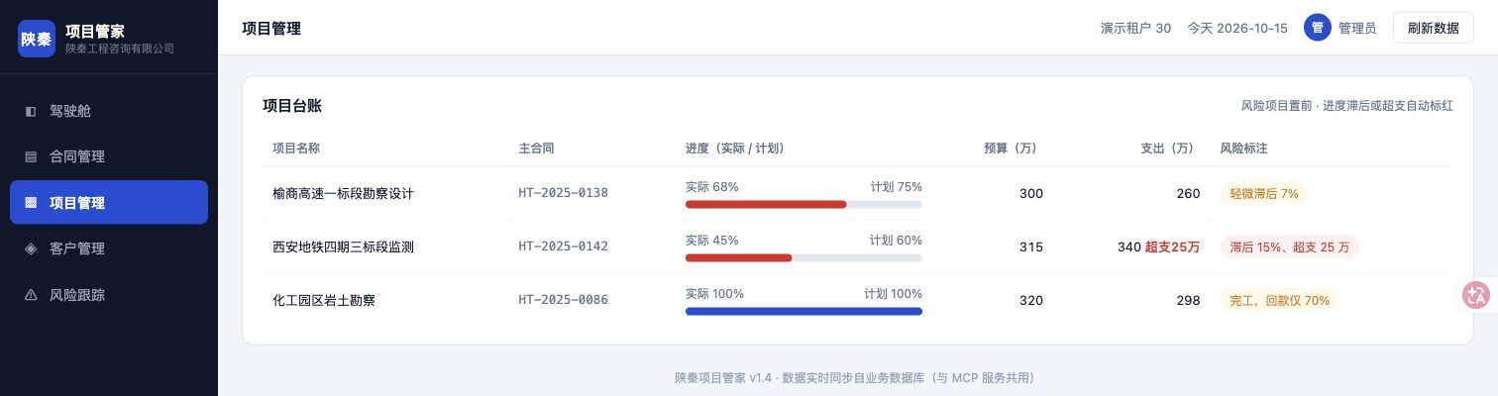
A checkable basis for discussion
Actual interface · Project records · Captured on 15 Oct; shows the state at capture.
Potential value for management
Connect data lookup, summarisation and messaging so discussions can focus sooner on what needs confirmation. Response speed and decision quality have not been measured.
Notes:
A checkable basis for discussion
Project records show 45% actual versus 60% planned progress, a RMB 3.15m budget and RMB 3.40m spending
Actual interface · Project records · Captured on 15 Oct; shows the state at capture.
Potential value for management
Connect data lookup, summarisation and messaging so discussions can focus sooner on what needs confirmation. Response speed and decision quality have not been measured.
Project records: progress and budget risk
Business demo system /demo30/projects; captured read-only on 15 Oct 2026.
This read-only capture from 15 Oct does not replace the 10 Oct API response. The interface's “15% behind” represents a 15 percentage-point gap between the two progress figures. Risk labels are displayed by the business system and cannot all be attributed to independent model detection.
E06、E23

Slide 6
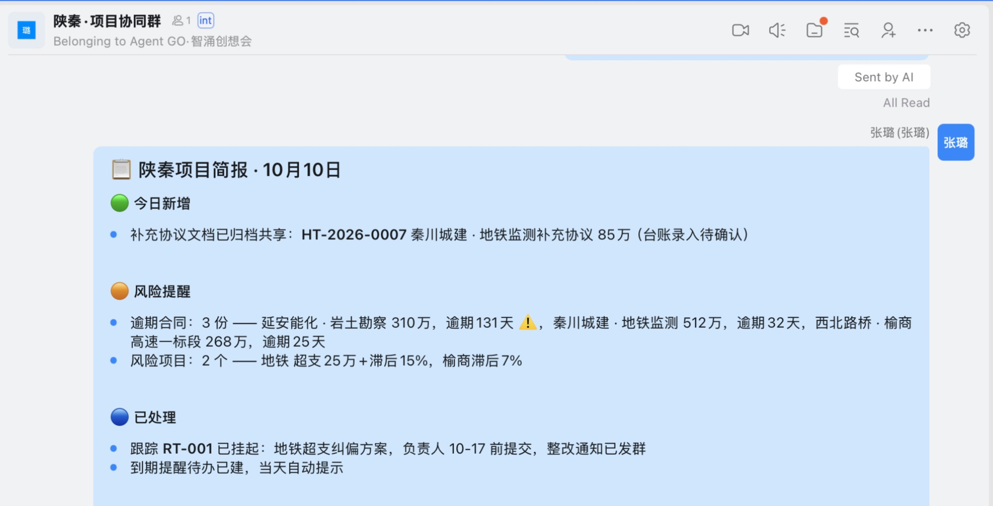
A brief still needs business judgement
Actual interface · Historical group brief · Captured on 15 Oct; the initial message version is unverified.
Human review required
Contract expiry does not establish unpaid debt, and contract value is not the amount recoverable. Suggestions about collection or loss prevention cannot directly justify a decision.
Notes:
A brief still needs business judgement
Excerpt of the 10 Oct project brief retained in the DingTalk group
Actual interface · Historical group brief · Captured on 15 Oct; the initial message version is unverified.
Human review required
Contract expiry does not establish unpaid debt, and contract value is not the amount recoverable. Suggestions about collection or loss prevention cannot directly justify a decision.
Group brief: information in the DingTalk conversation
Local DingTalk client, Shanqin Project Collaboration Group; captured on 15 Oct 2026.
This historical message in the current client does not by itself establish its initial version or later completion status. The group was a single-person demonstration; “automatic reminder” in the message does not establish verified delivery.
E07、E08、E11

Slide 7
Shared agreement → Business record
Shanqin example: supplemental agreement HT-2026-0007, value RMB 850,000, expiry 10 Sep 2026.
Shown: reading and field extraction
01 / DingTalk
Document access
A group message links to the online agreement, providing access to the original terms.
The input was a prepared short template. Unfamiliar contracts and scans were not tested.
02 / Qwen Office
Extract & request confirmation
Extracts the ID, client, project, amount and expiry date, then requests confirmation.
Leo Zhang observed the AI complete the entry throughout the process.
03 / Business system
Business record
The agreement appears in the subsequent records with a RMB 850,000 value and an entry date of 10 Oct.
The specific write call and confirmation context still need to be captured.
Notes:
Shared agreement → Business record
Shanqin example: supplemental agreement HT-2026-0007, value RMB 850,000, expiry 10 Sep 2026.
Shown: reading and field extraction
01 / DingTalk
Document access
A group message links to the online agreement, providing access to the original terms.
The input was a prepared short template. Unfamiliar contracts and scans were not tested.
02 / Qwen Office
Extract & request confirmation
Extracts the ID, client, project, amount and expiry date, then requests confirmation.
Leo Zhang observed the AI complete the entry throughout the process.
03 / Business system
Business record
The agreement appears in the subsequent records with a RMB 850,000 value and an entry date of 10 Oct.
The specific write call and confirmation context still need to be captured.
These flows illustrate the records, not a live system demonstration. All screenshots were captured on 15 Oct 2026; Qwen actions are based on logs and practitioner observation. This was a single-person exercise using simulated data and preconfigured skills, not a verified multi-person management cycle.

Slide 8
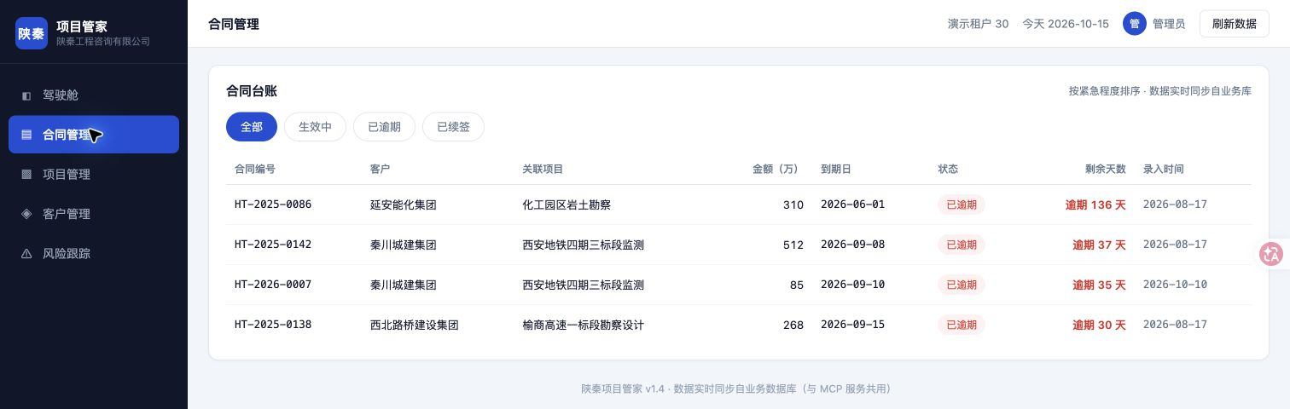
Fields that a person can review
Actual interface · Contract records · Captured on 15 Oct; the entry-process account relies on practitioner correction U3.
Potential value for management
Make finding documents, reading them and filling fields a deliverable that can be reviewed item by item. This may inform extraction from technology handover, requirements and change documents.
Notes:
Fields that a person can review
Contract records show HT-2026-0007, RMB 850,000 and the entry date 2026-10-10
Actual interface · Contract records · Captured on 15 Oct; the entry-process account relies on practitioner correction U3.
Potential value for management
Make finding documents, reading them and filling fields a deliverable that can be reviewed item by item. This may inform extraction from technology handover, requirements and change documents.
Contract entry result: business records
Business demo system /demo30/contracts; captured on 15 Oct 2026.
This is the record state at capture. The screenshot does not show the write process; the account that the practitioner observed the AI entry throughout and did not click the supplemental agreement still relies on practitioner correction U3.
E04、E05、U3

Slide 9
Keep the source and confirmation
Keep source references and human confirmation; verify fields and the target record. This screenshot shows the result but alone cannot establish the full write process or acceptance of the confirmation control.
Leo Zhang observed the AI complete the entry throughout the process.
The specific write call and confirmation context still need to be captured.
E04 · E05 · U3
Notes:
Keep the source and confirmation
Keep source references and human confirmation; verify fields and the target record. This screenshot shows the result but alone cannot establish the full write process or acceptance of the confirmation control.
Leo Zhang observed the AI complete the entry throughout the process.
The specific write call and confirmation context still need to be captured.
E04 · E05 · U3
This is the record state at capture. The screenshot does not show the write process; the account that the practitioner observed the AI entry throughout and did not click the supplemental agreement still relies on practitioner correction U3.

Slide 10
Verbal request → Follow-up records
Shanqin example: a corrective action for metro-project overspend, tracking item RT-001, with a deadline pointing to 17 Oct.
Shown: registration and notification
01 / Qwen Office
Interpret the request
Organises a verbal request into project, action, deadline and owner fields.
Separate calls go to the business system and DingTalk; both destinations are shown here.
A / Business system
Business tracking
Logs recorded RT-001 being created and read back; a later scheduled check returned an empty result.
The discrepancy is unexplained. Connection context and persisted records need investigation.
B / DingTalk
Personal tasks & group notice
Creates dated personal to-dos and sends a corrective-action notice. The to-dos are visible in the screenshot.
Assigned to the demonstrator only; no real multi-person handoff was tested.
Notes:
Verbal request → Follow-up records
Shanqin example: a corrective action for metro-project overspend, tracking item RT-001, with a deadline pointing to 17 Oct.
Shown: registration and notification
01 / Qwen Office
Interpret the request
Organises a verbal request into project, action, deadline and owner fields.
Separate calls go to the business system and DingTalk; both destinations are shown here.
02 / Business system
Business tracking
Logs recorded RT-001 being created and read back; a later scheduled check returned an empty result.
The discrepancy is unexplained. Connection context and persisted records need investigation.
03 / DingTalk
Personal tasks & group notice
Creates dated personal to-dos and sends a corrective-action notice. The to-dos are visible in the screenshot.
Assigned to the demonstrator only; no real multi-person handoff was tested.
These flows illustrate the records, not a live system demonstration. All screenshots were captured on 15 Oct 2026; Qwen actions are based on logs and practitioner observation. This was a single-person exercise using simulated data and preconfigured skills, not a verified multi-person management cycle.

Slide 11
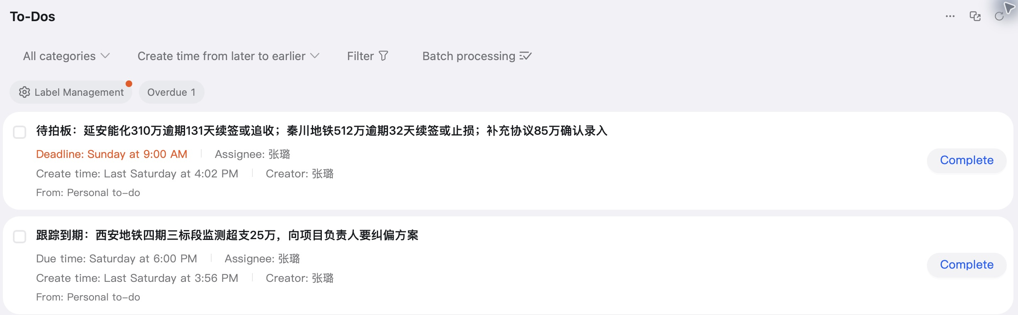
Make actions traceable
Actual interface · To-dos exist · Relative dates and notification delivery require separate checks.
Potential value for management
Give meeting requests a traceable record. In technology projects, the same item could connect its owner, deadline, execution feedback and acceptance record.
Notes:
Make actions traceable
Two practice to-dos remain visible in the DingTalk list
Actual interface · To-dos exist · Relative dates and notification delivery require separate checks.
Potential value for management
Give meeting requests a traceable record. In technology projects, the same item could connect its owner, deadline, execution feedback and acceptance record.
DingTalk to-dos: messages become follow-up items
Local DingTalk client, To-Dos list; captured on 15 Oct 2026.
The screenshot strengthens evidence that the to-dos exist. It does not establish reminder delivery, acceptance by an owner or business completion. Interpret relative dates against the capture date and original records; this is not a new effectiveness test.
E07、E08

Slide 12
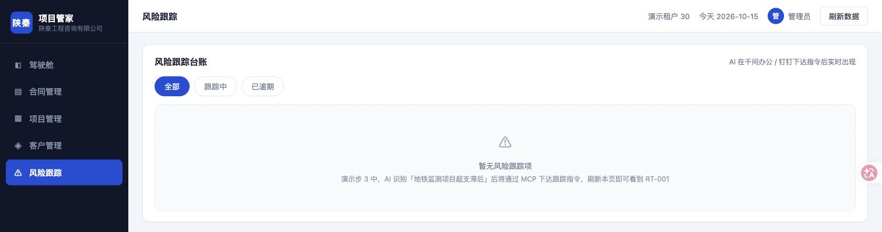
Creation does not prove completion
Actual interface · Empty tracking list · Current state does not establish historical deletion or the root cause.
Human review required
Creation does not establish delivery, acceptance or completion. Consistent cross-system state and acceptance by an actual owner should be priorities in the next validation stage.
Notes:
Creation does not prove completion
The risk-tracking page shows no items with the All filter selected
Actual interface · Empty tracking list · Current state does not establish historical deletion or the root cause.
Human review required
Creation does not establish delivery, acceptance or completion. Consistent cross-system state and acceptance by an actual owner should be priorities in the next validation stage.
Risk tracking: the current list is empty
Business demo system /demo30/risks; captured read-only on 15 Oct 2026.
This interface state on 15 Oct does not prove that RT-001 was deleted or explain the two different reads on 10 Oct. Alongside the screenshot of retained to-dos, it shows that the states of distinct work objects need separate checks.
E07、E09、E10

Slide 13
Two uses to validate first
These are candidate uses. Confirm actual needs and permitted tools, data and access first; the department is not assumed to have the same problems.
Project updates & decision briefs
Approach to adapt
Summarise progress, risks, blockers and questions from approved project materials. Cite sources and distribute after the owner reviews the draft.
What to assess
Total preparation and review time; completeness of key facts; unsupported business judgements.
Requirements, changes & handover extraction
Approach to adapt
Convert unstructured documents into an agreed field list. Flag gaps or conflicts and preserve locations in the source.
What to assess
Field accuracy and omissions; revision rounds; human effort including rework.
Notes:
Two uses to validate first
These are candidate uses. Confirm actual needs and permitted tools, data and access first; the department is not assumed to have the same problems.
Project updates & decision briefs
Approach to adapt
Summarise progress, risks, blockers and questions from approved project materials. Cite sources and distribute after the owner reviews the draft.
What to assess
Total preparation and review time; completeness of key facts; unsupported business judgements.
Requirements, changes & handover extraction
Approach to adapt
Convert unstructured documents into an agreed field list. Flag gaps or conflicts and preserve locations in the source.
What to assess
Field accuracy and omissions; revision rounds; human effort including rework.
Validate first

Slide 14
Build a reliable handoff next
Next stage / Meeting actions & task handoffs
After confirmation, record a named owner, deadline and item ID. Test acceptance, feedback and sign-off with two people.
What to assess
Whether systems refer to the same item; whether the owner receives and accepts it; whether completion is traceable.
What technology teams need to add
Data definitions and interfaces → identity, permissions and write confirmation → item IDs and state mapping → execution logs, failure alerts and human takeover. Compare fixed-rule work with existing templates and conventional automation before choosing the tool.
Notes:
Build a reliable handoff next
Next stage / Meeting actions & task handoffs
After confirmation, record a named owner, deadline and item ID. Test acceptance, feedback and sign-off with two people.
What to assess
Whether systems refer to the same item; whether the owner receives and accepts it; whether completion is traceable.
What technology teams need to add
Data definitions and interfaces → identity, permissions and write confirmation → item IDs and state mapping → execution logs, failure alerts and human takeover. Compare fixed-rule work with existing templates and conventional automation before choosing the tool.
These are candidate uses. Confirm actual needs and permitted tools, data and access first; the department is not assumed to have the same problems.

Slide 15
Run a bounded comparison
Choose two task types. Run a bounded comparison.
Suggested duration: up to two weeks, starting with synthetic materials. Use the results to retain, expand or stop. The current evidence supports a validation exercise.
1. Name a task owner and an assessor
Confirm the need, permitted environment and data scope. Start with field extraction and brief drafting.
2. Compare manual and AI-assisted work against the same quality standard
Example design: six pairs of similar tasks per scenario. Record total time, accuracy, rework and failures. This sample supports only an initial observation.
3. Expand to two-person handoffs only with acceptable quality and a net improvement
Include review and maintenance costs. Agree thresholds first; inconsistent state, critical omissions or unauthorised actions trigger a stop and human takeover.
Notes:
Run a bounded comparison
Choose two task types. Run a bounded comparison.
Suggested duration: up to two weeks, starting with synthetic materials. Use the results to retain, expand or stop. The current evidence supports a validation exercise.
1. Name a task owner and an assessor
Confirm the need, permitted environment and data scope. Start with field extraction and brief drafting.
2. Compare manual and AI-assisted work against the same quality standard
Example design: six pairs of similar tasks per scenario. Record total time, accuracy, rework and failures. This sample supports only an initial observation.
3. Expand to two-person handoffs only with acceptable quality and a net improvement
Include review and maintenance costs. Agree thresholds first; inconsistent state, critical omissions or unauthorised actions trigger a stop and human takeover.
03 / A proposed management decision

Slide 16
What the evidence does and does not show
Capabilities shown
E04–E05 / U3: field extraction, the practitioner's observation of AI entry and subsequent records. E06 / E11: business-data queries, brief distribution and readback. E07–E08: tracking creation, to-dos and notices. E20: the three tools' roles.
Still to validate
E09–E10: unexplained differences between tracking reads. E15–E17: two of four scheduled checks completed; two returned execution errors. E21–E24: no manual-work baseline; real multi-person collaboration, suitability for a banking environment and benefits at scale remain untested.
Derived from the Qwen Office and DingTalk Collaboration Practice Analysis and evidence matrix E01–E24, this page supports management discussion and adds no independent evidence. Business value and technology implications are analyses and proposals to validate. Screenshots retain demonstration business data and are not fully anonymised.
These flows illustrate the records, not a live system demonstration. All screenshots were captured on 15 Oct 2026; Qwen actions are based on logs and practitioner observation. This was a single-person exercise using simulated data and preconfigured skills, not a verified multi-person management cycle.
Notes:
What the evidence does and does not show
Capabilities shown
E04–E05 / U3: field extraction, the practitioner's observation of AI entry and subsequent records. E06 / E11: business-data queries, brief distribution and readback. E07–E08: tracking creation, to-dos and notices. E20: the three tools' roles.
Still to validate
E09–E10: unexplained differences between tracking reads. E15–E17: two of four scheduled checks completed; two returned execution errors. E21–E24: no manual-work baseline; real multi-person collaboration, suitability for a banking environment and benefits at scale remain untested.
Derived from the Qwen Office and DingTalk Collaboration Practice Analysis and evidence matrix E01–E24, this page supports management discussion and adds no independent evidence. Business value and technology implications are analyses and proposals to validate. Screenshots retain demonstration business data and are not fully anonymised.
These flows illustrate the records, not a live system demonstration. All screenshots were captured on 15 Oct 2026; Qwen actions are based on logs and practitioner observation. This was a single-person exercise using simulated data and preconfigured skills, not a verified multi-person management cycle.
Evidence & limits · Why validate before wider use

Slide 17
Thank you
Q&A
Leo Zhang · Personal practice study · For management discussion
Not an official institutional assessment, product endorsement or deployment decision.
Notes:
Thank you
Q&A
Leo Zhang · Personal practice study · For management discussion
Not an official institutional assessment, product endorsement or deployment decision.
Suggested duration: up to two weeks, starting with synthetic materials. Use the results to retain, expand or stop. The current evidence supports a validation exercise.

