Slide 1

Parser Combinators easy to use ???

Slide 2
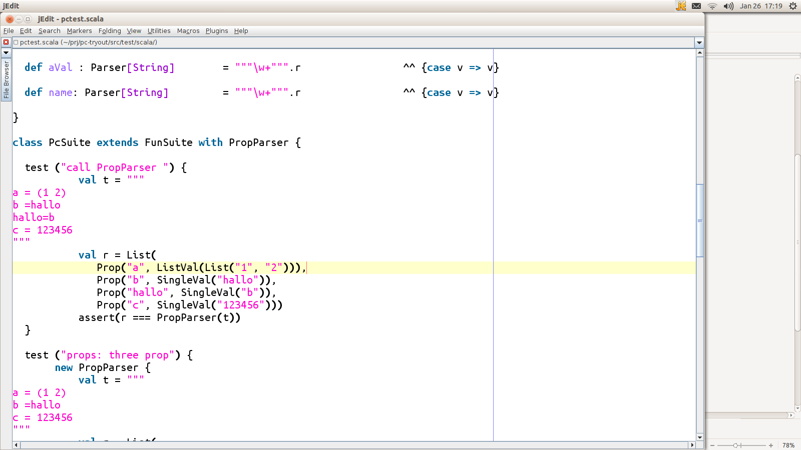
Define what you want to parse

Slide 3
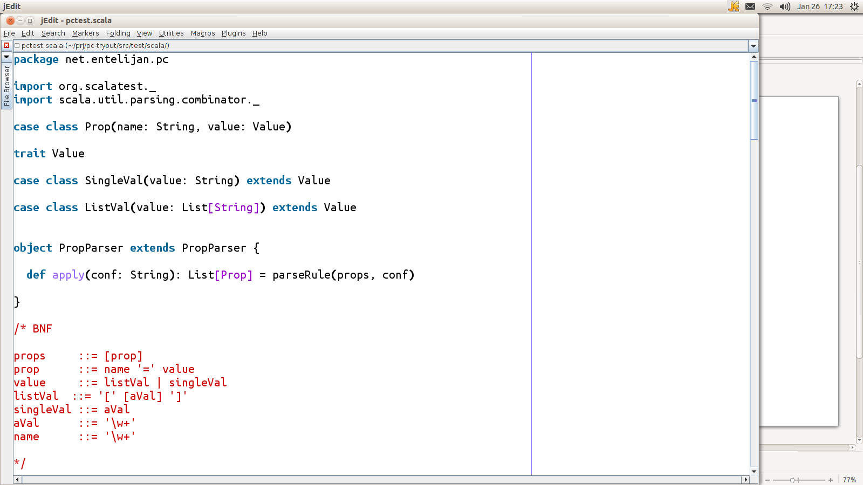
What will be the result of parsing ?

Slide 4
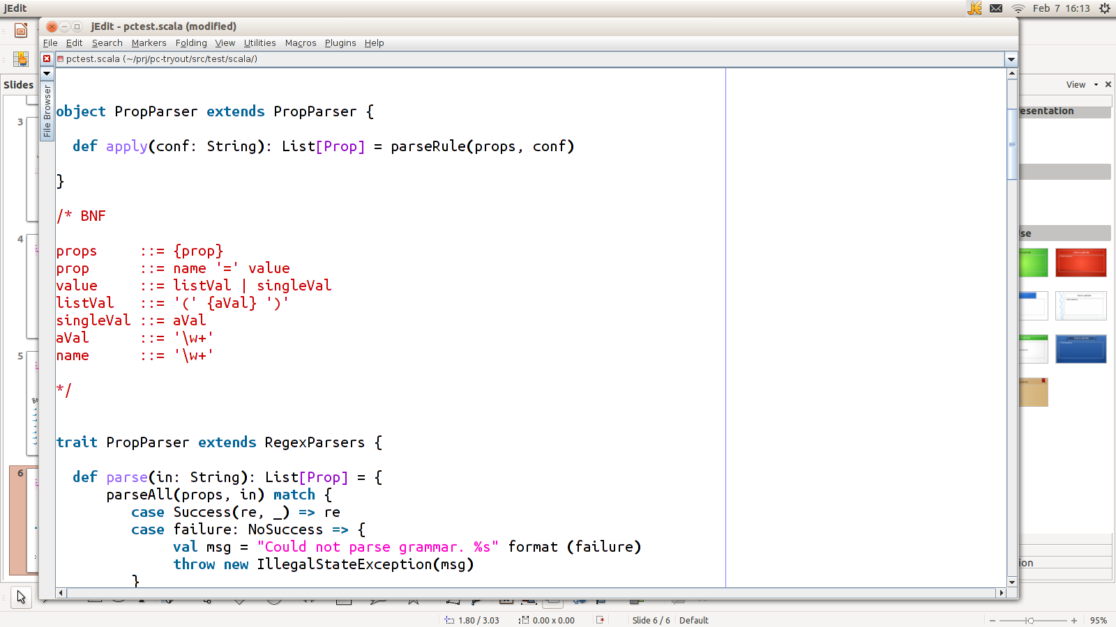
What does the BNF look like
BNF: Backus–Naur Form

Slide 5
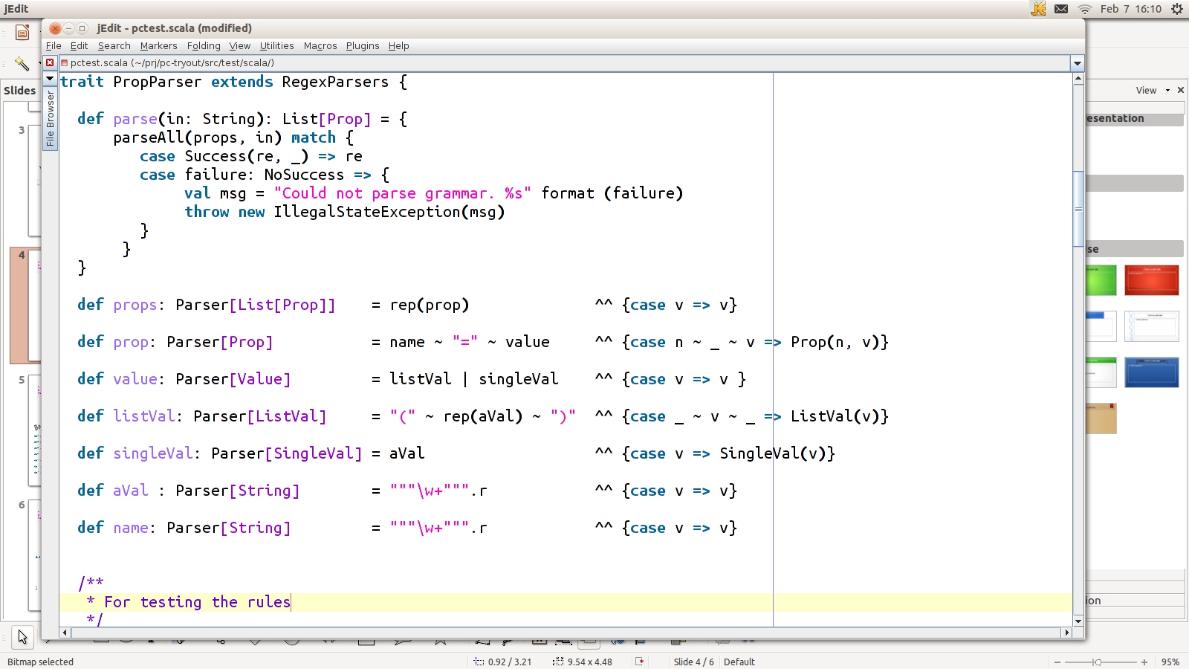
Not to forget: extend
scala.util.parsing.combinator.RegexParsers
BNF-Rules to Parser Combinators

Slide 6
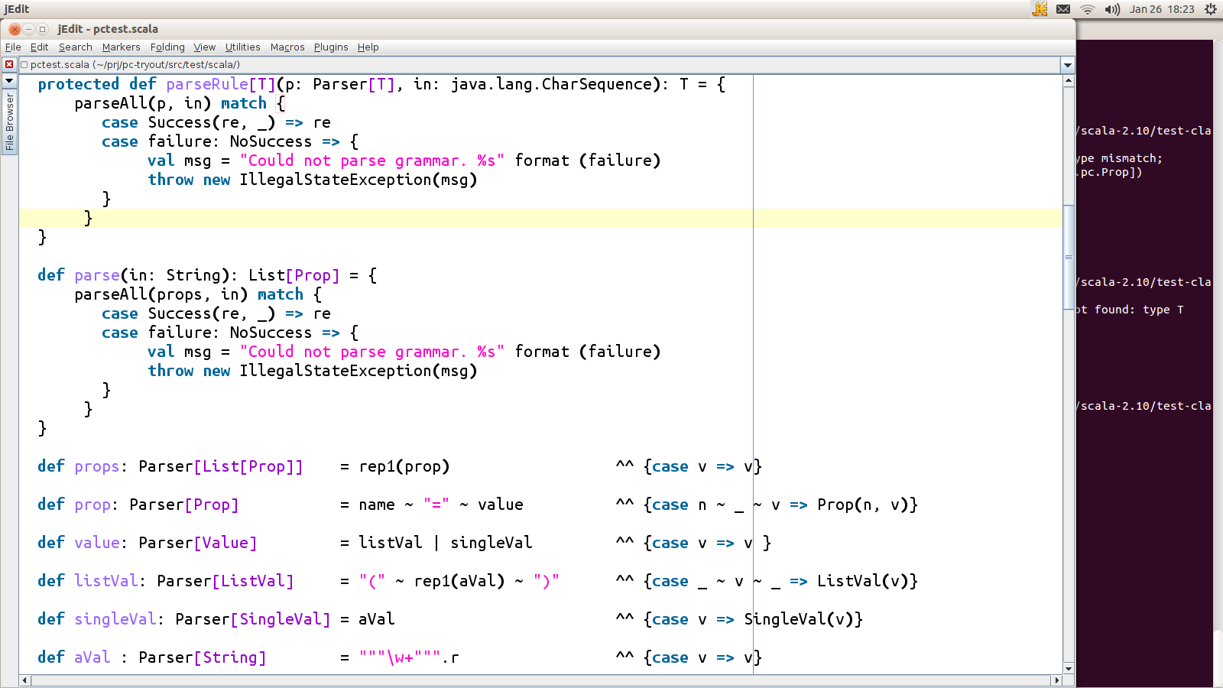
How to call it

