Slide 1
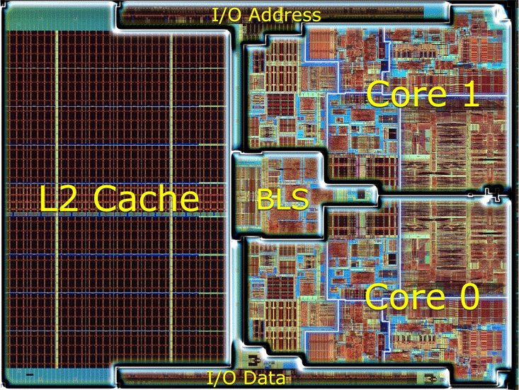
Merom test case

Slide 2

Merom test case
$$ΔT$$
(a)
(b)

Slide 3
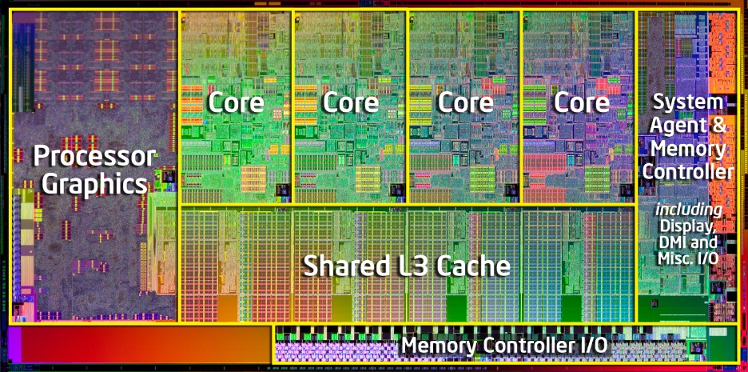
Sandy bridge test case

Slide 4
Power comparison of several Intel processors
Maybe present this as a table instead?
Could also pull in number of metal layers that way

Slide 5
Sandy bridge power reduction through chip folding
Single core folded into increasingly high number of layers

Slide 6
Sandy bridge minimum die thickness required for chip folding with 20:1 AR TSVs

Slide 7
(a)
(b)

Slide 8
2D
50um
150um
1um
300um

Slide 9
50um
300um
2D
2 tier
4 tier
8 tier

Slide 10
Cu (corrected)
GNR (corrected)
Cu (4 conductor)
GNR (4 conductor)

Slide 11
Cu (corrected)
GNR
GNR (corrected)
Cu (4 conductor)
Cu
GNR (4 conductor)
(a)
(b)

Slide 12
GNR
Cu

Slide 13
2D
4 tier
2 tier
8 tier

Slide 14
50um
300um
2D
2 tier
4 tier
8 tier

Slide 15
2D
50um
300um
2 tier
4 tier
8 tier

Slide 16
2D
2 tier
4 tier
8 tier

Slide 17
Inputs
Update system parameters
Determine signal TSV requirements
Rent parameters
Clock frequency
Die thickness
Activity factor
Calculate wire parameters
Die area
Transistor parameters
TSV size
Wire materials
Calculate wiring power
Calculate logic power
Determine power TSV requirements
TSVs OK?
Choose one
Choose one
no
Reduce clock frequency
Reduce die thickness
Reduce logic activity factor
Reduce TSV diameter
Change wire material
Increase die area
yes
Generate thermal map
Max temp OK?
no
yes
Done!

Slide 18
Inputs
Update system parameters
Rent parameters
Clock frequency
Die thickness
Activity factor
Determine signal TSV requirements
Die area
Transistor parameters
TSV size
Wire materials
Calculate wire parameters
Calculate wiring power
Calculate logic power
Determine power TSV requirements
TSVs OK?
Choose one
Choose one
no
Reduce clock frequency
Reduce die thickness
Reduce logic activity factor
Reduce TSV diameter
Change wire material
Increase die area
yes
Generate thermal map
Max temp OK?
no
yes
Done!

Slide 19
Inputs
Update system parameters
Rent parameters
Clock frequency
Die thickness
Activity factor
Determine signal TSV requirements
Die area
Transistor parameters
TSV size
Wire materials
Calculate wire parameters
Calculate wiring power
Calculate logic power
Determine power TSV requirements
Choose one
Choose one
no
Reduce clock frequency
Reduce die thickness
TSVs
OK?
Reduce logic activity factor
Reduce TSV diameter
yes
Outputs
Change wire material
Increase die area
Generate thermal map
Total TSVs
TSV size
Frequency
no
Max
Temp
OK?
yes
Power draw
Max temp
Power noise

Slide 20
(a)
(b)
(c)
(d)
(d)

Slide 22
8 tier
4 tier
2 tier
2D

Slide 23
2D
2 tier
8 tier
4 tier
4 tier
8 tier
2 tier
2D
(a)
(b)

Slide 30



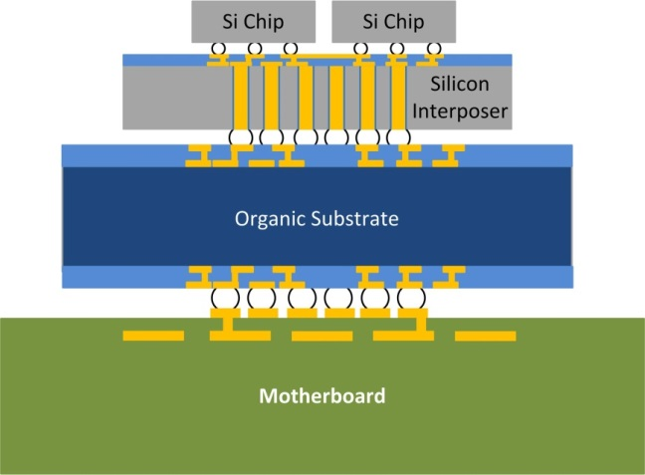
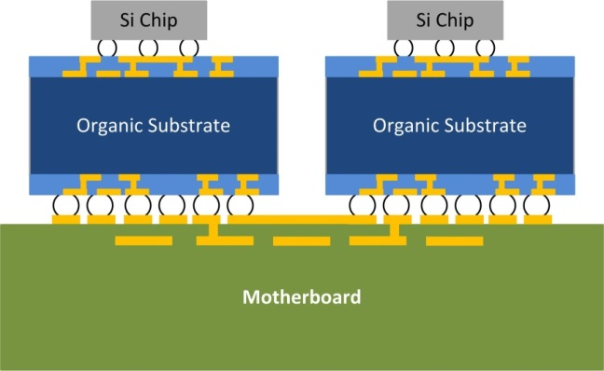
Conventional Packaging
Using Organic Substrate
2.5D (Silicon Interposer)
3DIC + Interposer

Slide 31
Package Substrate
Motherboard

Slide 32
PLACEHOLDER

Slide 33
4 tier
air
2 tier
Temperature
water
Temperature
2d
Die thickness
2D
3D SoC
M3D 2T
M3D 4T

Slide 34
On-chip communication power
2D
2D
2 tier
2 tier
4 tier
4 tier
8 tier
8 tier

Slide 35
Single-sided Air Cooling
Air cooling
8 tier (15.9W)
4 tier (16.8W)
2 tier (19.2W)
2D (26W)

Slide 36
Single-sided Water Cooling
Liquid cooling
8 tier
4 tier
2 tier
2D

Slide 37
Double-sided Water Cooling
Double-sided liquid cooling
Water-cooled heat sink
Water-cooled interposer
8 tier
4 tier
2 tier
2D

Slide 38
Frequency sweeps

Slide 39
The next few slides are 32nm sandy bridge frequency sweeps
All cases assume a 1um layer thickness (i.e. ultimate monolithic integration)

Slide 40
2D
2 tier
4 tier
8 tier

Slide 41
2D
2 tier
4 tier
8 tier

Slide 42
2D
2 tier
4 tier
8 tier

Slide 43
2D
2D
2 tier
2 tier
4 tier
4 tier
8 tier
8 tier

Slide 44
Air cooling
8 tier
4 tier
2 tier
2D

Slide 45
2D
2 tier
4 tier
8 tier

Slide 46
Water-cooled heat sink
8 tier
4 tier
2 tier
2D

Slide 47
Water cooled heat sink + water cooled interposer
8 tier
4 tier
2 tier
2D

Slide 48
Double-sided Water Cooling
Water Cooling
Air cooling

Slide 49
8 tier
4 tier
2 tier
2D

Slide 50
8 tier
4 tier
2 tier
2D

Slide 51
8 tier
8 tier
4 tier
4 tier
2 tier
2 tier
2D
2D

Slide 52






$$ε_{r}=3$$
$ε_{r}=$1
Water-cooled heat sink
$ε_{r}=$1
$$ε_{r}=3$$
Air-cooled heat sink
100$μm$ die
1$μm$ die

Slide 53






100$μm$ die
1$μm$ die
$ε_{r}=$1
$$ε_{r}=3$$
Water-cooled heat sink
$ε_{r}=$1
$$ε_{r}=3$$
Air-cooled heat sink

Slide 54





Power delivery TSVs vs dielectric and die thickness
100 $μm$
10 $μm$
1$μm$
$ε_{r}$=3
100 $μm$
10 $μm$
1$μm$
$ε_{r}$=1

Slide 55


Power delivery TSVs vs dielectric and die thickness
$ε_{r}$=3
$ε_{r}$=1
100 $μm$
10 $μm$
1$μm$
100 $μm$
10 $μm$
1$μm$

Slide 56

Power delivery TSVs vs dielectric and die thickness
100 $μm$
10 $μm$
$ε_{r}$=3.9
1$μm$
100 $μm$
10 $μm$
1$μm$
$ε_{r}$=1

Slide 57








Power delivery TSVs vs dielectric, decap area allocated on interposer, and number of tiers
$$0.01$$
1um substrate
$ε_{r}$=3.9
$$0.01$$
$ε_{r}$=1
$$0.1$$
$$0.1$$
$$1.0$$
$$1.0$$

Slide 58



Power delivery TSVs vs decap area allocated on interposer and number of tiers
$$0.01$$
1um substrate
$$0.1$$
$$1.0$$

Slide 59



Power delivery TSVs vs decap area allocated on interposer and number of tiers
$$0.01$$
10um substrate
$$0.1$$
$$1.0$$

Slide 60



Power delivery TSVs vs decap area allocated on interposer and number of tiers
100um substrate
$$0.01$$
$$0.1$$
$$1.0$$

Slide 61



Power delivery TSVs vs decap area allocated on interposer and number of tiers
100um substrate
$$1\%$$
$$10\%$$
$$100\%$$

Slide 62
50um substrate

Slide 63
10um substrate

Slide 64




$ε_{r}$=3.9
$ε_{r}$=3.0
$ε_{r}$=2.0
$ε_{r}$=1.0

Slide 67
AF = 10%
AF = 1%
AR = 20:1
AR = 10:1
AR = 20:1
AR = 5:1
AR = 10:1
AR = 5:1

Slide 68
AF = 10%
AR = 20:1
AF = 1%
AR = 10:1
AR = 20:1
AR = 5:1
AR = 10:1
AR = 5:1

Slide 69
AF = 10%
AF = 1%
AR = 20
AR = 5
AR = 5
AR = 10
AR = 20
AR = 10

Slide 70
AF = 10%
AF = 1%
AR = 20
AR = 5
AR = 5
AR = 10
AR = 20
AR = 10

Slide 71
AF = 10%
AF = 10%
AF = 1%
AF = 10%
AF = 1%
AF = 1%
AR = 20
AR = 5
AR = 5
AR = 10
AR = 20
AR = 10

Slide 73
AF of 0.01 and 0.1, AR of 5, 10, 20

Slide 74
Aspect ratio of 5, 10, 20

Slide 75
Area fraction of 0.01 and 0.1

Slide 76
10um power TSVs
8 tier
4 tier
2 tier
2D

Slide 77
8 tier
4 tier
2 tier
2D

Slide 78
Total
Wires
Repeaters

Slide 80
Changing ALL levels resistivity

Slide 81
Changing only levels with width < 75nm

Slide 82
SB7nm
Changing levels with width <=35nm

Slide 83
Power tsv area
Vs
Die area allocated for decap
1% on chip
10% extensive on chip
100% interposer-based
Die area used for decap calc is nominal 2D area
1%
10%
100%

Slide 84
SB32nm (with all wires replaced) vs SB7nm with wires <35nm replaced with alt metal. 60% routing eff

Slide 85
SB32nm (with all wires replaced) vs SB7nm with wires <25nm replaced with alt metal. 65% routing efficiency

Slide 86
SB32nm (with all wires replaced) vs SB7nm with wires <25nm replaced with alt metal. 62% routing efficiency

Slide 87
SB32nm (with all wires replaced) vs SB7nm with wires <25nm replaced with alt metal. 62% routing efficiency. 151pts
32nm
7nm A
7nm B

Slide 88
2D
2 tier
4 tier
8 tier

Slide 89
Conventional Packaging
Using Organic Substrate
2.5D (Silicon Interposer)
3DIC + Interposer

Slide 90
Package Substrate
Package Substrate
Motherboard
Motherboard

Slide 91
Package Substrate
Package Substrate
Motherboard
Interposer
Package Substrate
Package Substrate
Package Substrate
Motherboard
Motherboard
Motherboard
2.5D with Silicon Interposer
3DIC with Die Stacking
Monolithic 3DIC

Slide 92
Package Substrate
Package Substrate
Motherboard
Interposer
Package Substrate
Package Substrate
Package Substrate
Motherboard
Motherboard
Motherboard
2.5D with Silicon Interposer
3DIC with Die Stacking
Monolithic 3DIC

Slide 93
Package Substrate
Package Substrate
Motherboard
Interposer
Package Substrate
Package Substrate
Package Substrate
Motherboard
Motherboard
Motherboard
2.5D with Silicon Interposer
3DIC with Die Stacking
Monolithic 3DIC

Slide 94
Optical alignment window

Slide 95
Actual
Simulated

Slide 96
Total
Repeaters
Wires

Slide 97
Repeaters
Wires
Logic

Slide 98
Repeaters
Wires
Logic

Slide 99
2D
2 tier
4 tier
8 tier

Slide 101
2D
2 tier
4 tier
8 tier

Slide 102
2D
2 tier
4 tier
8 tier

Slide 103
Limited
Extensive
Interposer

Slide 104
8 tier
4 tier
2 tier
2D

Slide 105
8 tier
4 tier
2 tier
2D

Slide 106
8 tier
4 tier
2 tier
2D

Slide 107
Power TSVs vs ACTUAL area used for decap
Curves start and end at different points because decap ratio is a ratio of the area PER TIER
Probably need to redo this one with actual area swept the same for all
8 tier
4 tier
2 tier
2D

Slide 108
Max temp limited to 90C
Air cooling
2D
2 tier
4 tier
8 tier

Slide 109
Max temp limited to 90C
Water cooling
2D
2 tier
4 tier
8 tier

Slide 110
Max temp limited to 90C
Air cooling – solid
Water cooling - dashed
2D
Air cooled heat sink
Water cooled heat sink
2 tier
4 tier
8 tier

Slide 111
8 tier
4 tier
2 tier
2D

Slide 112
Power density for PSN purposes fixed at 2D value
Only things changing here are
Total power, since area is changing (this shouldn’t impact things as the PSN stuff all depends on unit cells and power density)
Tier thickness (impacts TSV inductance for top tier power delivery)

Slide 113
This is what happens when the actual power density is used in PSN

Slide 114
Both tier area and power density are fixed at their 2D values
The only thing changing between these cases is the distance between tiers, i.e. the TSV height, i.e. the TSV inductance
This example requires more TSVs than the area free pdens fixed version because the area * pow density = total power
So since the area is fixed at 2D values we’re basically just stacking identical 2D slices on top of each other
By comparing this example to the actual area free pdens free example we can see that the inductance of the TSVs drives
most of the spike for large die thicknesses, but not all of it. Some comes from the increase in power density due to wiring
inefficiency in the thick-tier cases

Slide 115
100 $μm$
10 $μm$
1$μm$
$ε_{r}$=3
100 $μm$
10 $μm$
1$μm$
$ε_{r}$=1

Slide 116


100 $μm$
10 $μm$
1$μm$
$ε_{r}$=3.9
100 $μm$
10 $μm$
1$μm$
$ε_{r}$=1

Slide 117

100 $μm$
1$μm$
$ε_{r}$=3.9
100 $μm$
1$μm$
$ε_{r}$=1

Slide 118
100 $μm$
1$μm$
$ε_{r}$=3.9
100 $μm$
1$μm$
$ε_{r}$=1

Slide 123
8 tier
4 tier
2 tier
2D

Slide 124
8 tier
4 tier
2 tier
2D

Slide 125
2D
2 tier
4 tier
8 tier

Slide 126
2D
2 tier
4 tier
8 tier

Slide 127
Air cooled heat sink
Water cooled heat sink
2D
2 tier
4 tier
8 tier

Slide 128
Air cooling
Water cooling

Slide 129
Water cooling
Air cooling

Slide 130
Water cooling
Air cooling

Slide 131
Air cooled heat sink
Water cooled heat sink
2D
2 tier
4 tier
8 tier

Slide 132
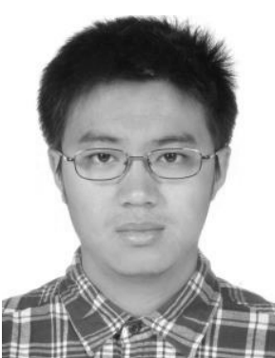
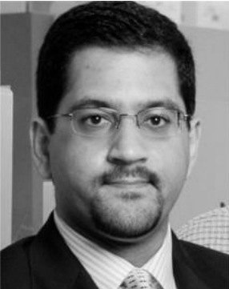




Slide 133
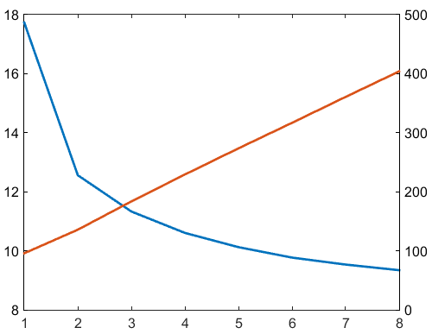
Power (W)
Power Density (W/cm²)
Tiers

Slide 134
2D
2 tier
4 tier
8 tier

Slide 135
2D
2 tier
4 tier
8 tier

Slide 136
Our compact model accurately predicts overall 3DIC wire length
Compact Simulation
cf_fft_256_8 test case
Fully Routed
Routed WL data from S. Panth, DAC 2013

Slide 137
2D

Slide 138
2D

Slide 139
2D
2 tier

Slide 140
2D
2 tier
3 tier

Slide 141
Cf_fft_256_8 test case
2D
2 tier
3 tier
4 tier
34% Reduction in length of longest wire!

Slide 142
Heat sink HTC required to keep SB3D temp under 90C with f=3.5GHz
Microfluidic cooling
Air Cooling

Slide 143
Power consumption (excluding any heat sink power) for SB3D with f =3.5GHz and HTC from previous page

