Slide 1
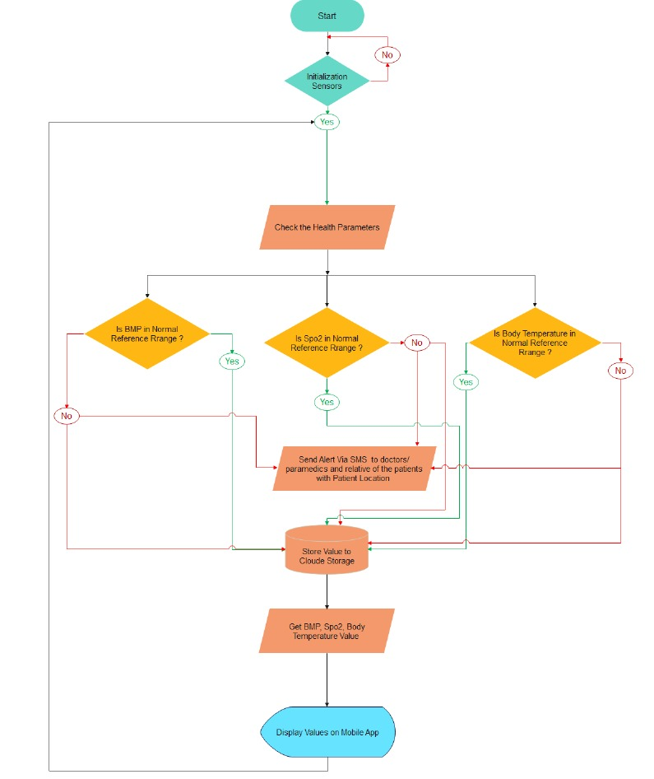
System Description

Slide 2


Application
This is a sample representation of the application using Flutter and Dart

Slide 3
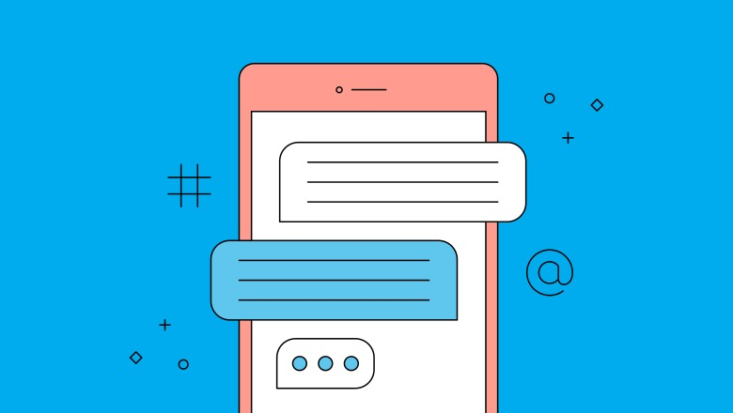
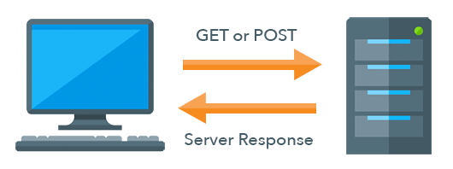

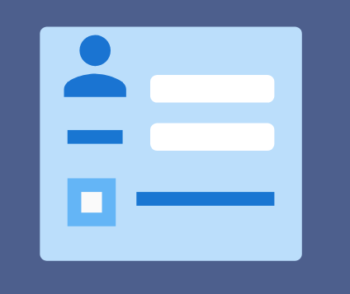
System Requirements
Functional Requirements:
User Authentication Communication
User Registration Real-time Monitoring

Slide 4
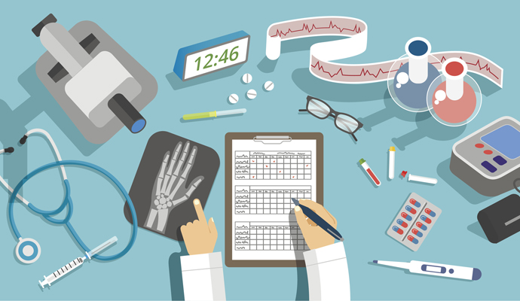
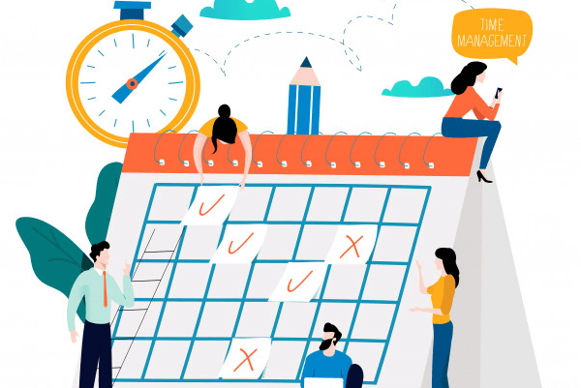

Patient Management
Schedule Management Reminder Management

Slide 5


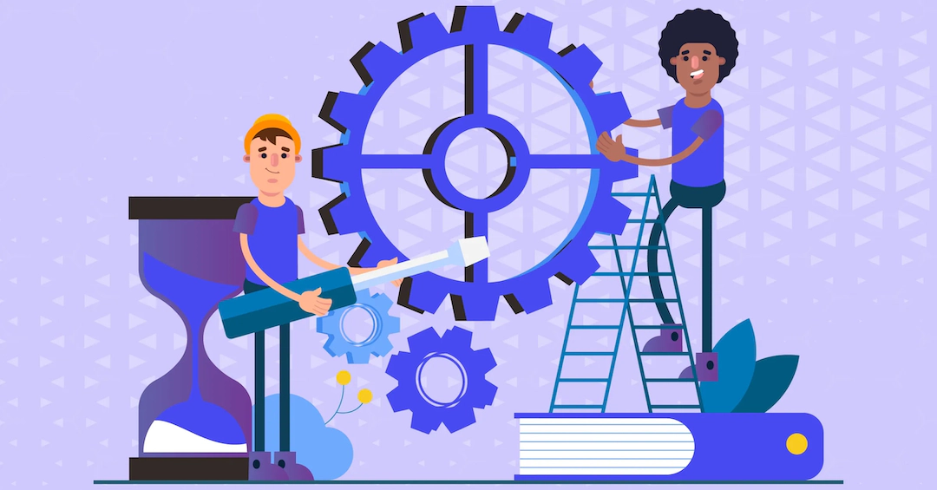

Non-Functional Requirements:
Performance
Security
Scalability
Reliability

Slide 6
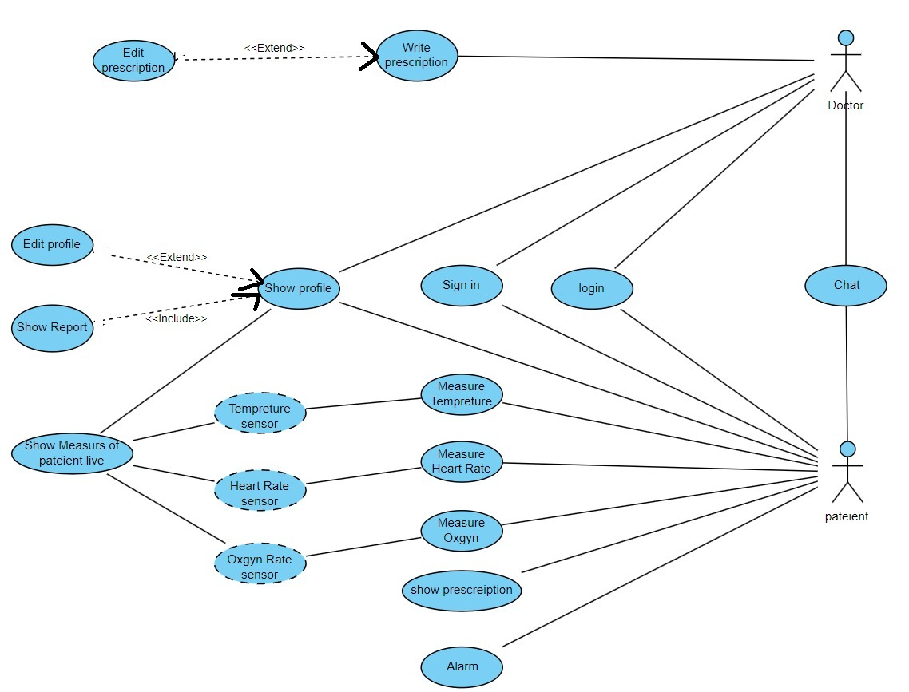
Use-case

Slide 7
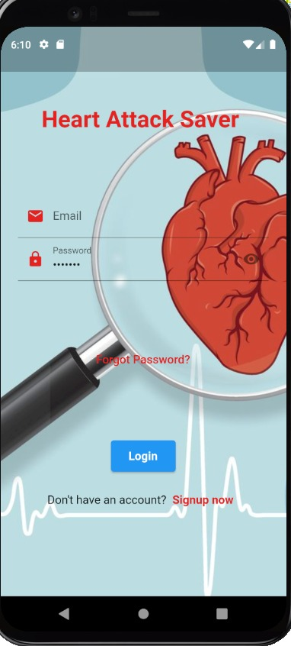
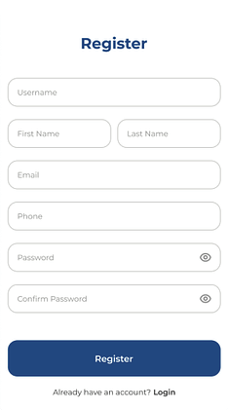
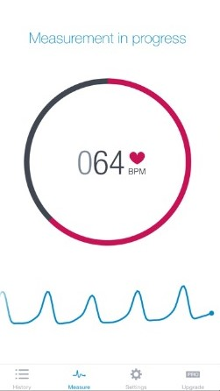
User-Interface

Slide 8
