Slide 1
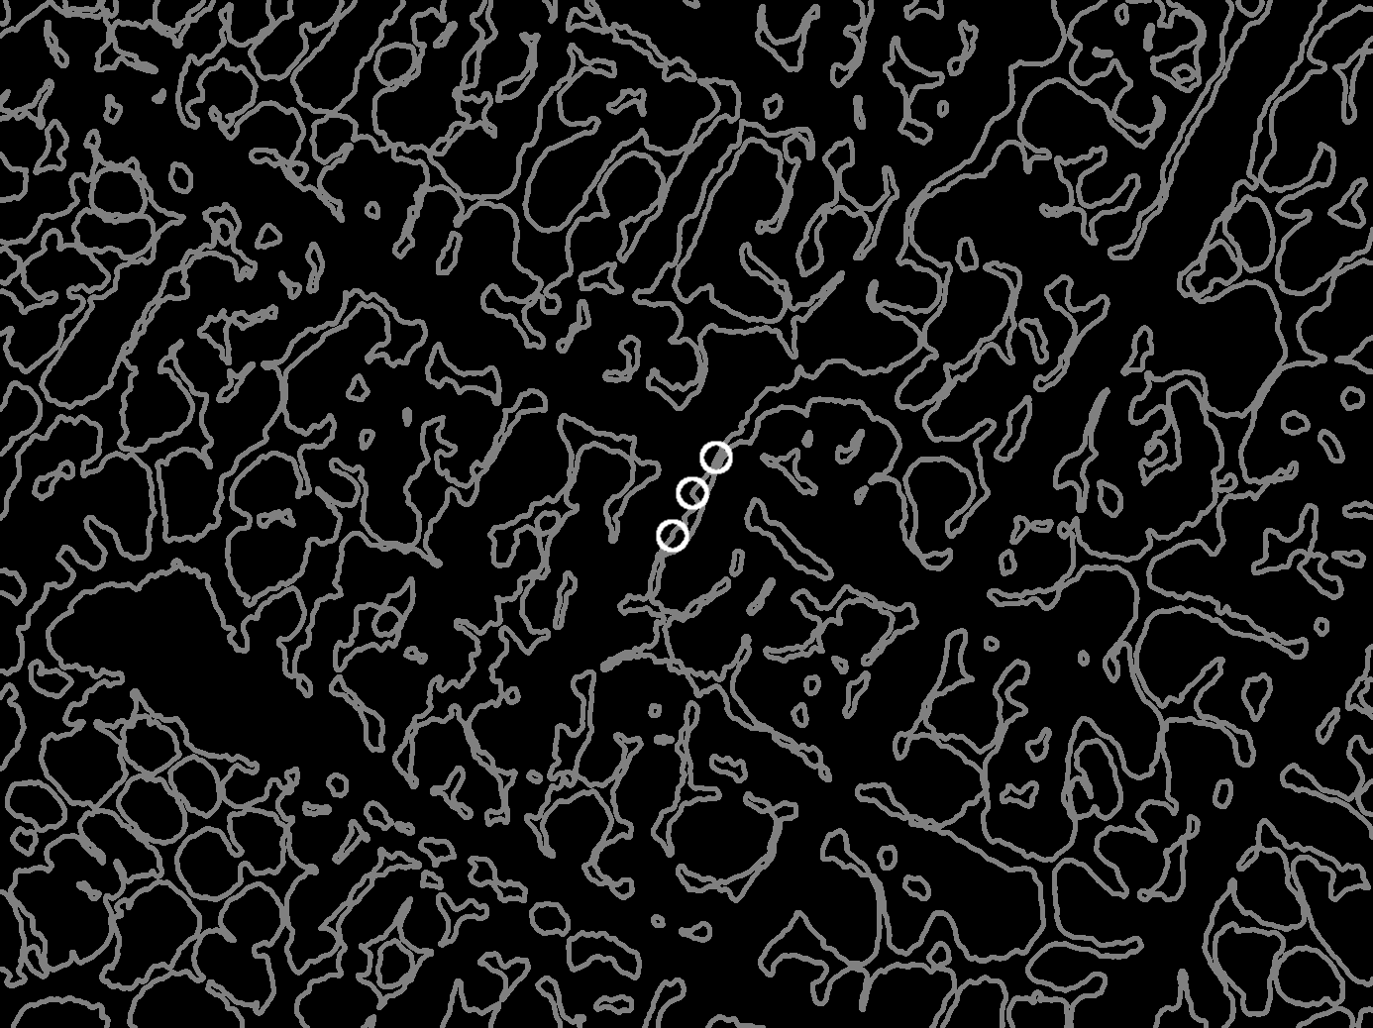
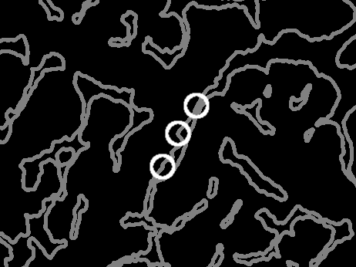
Image showing radius of low fd (Field 000)

Slide 2
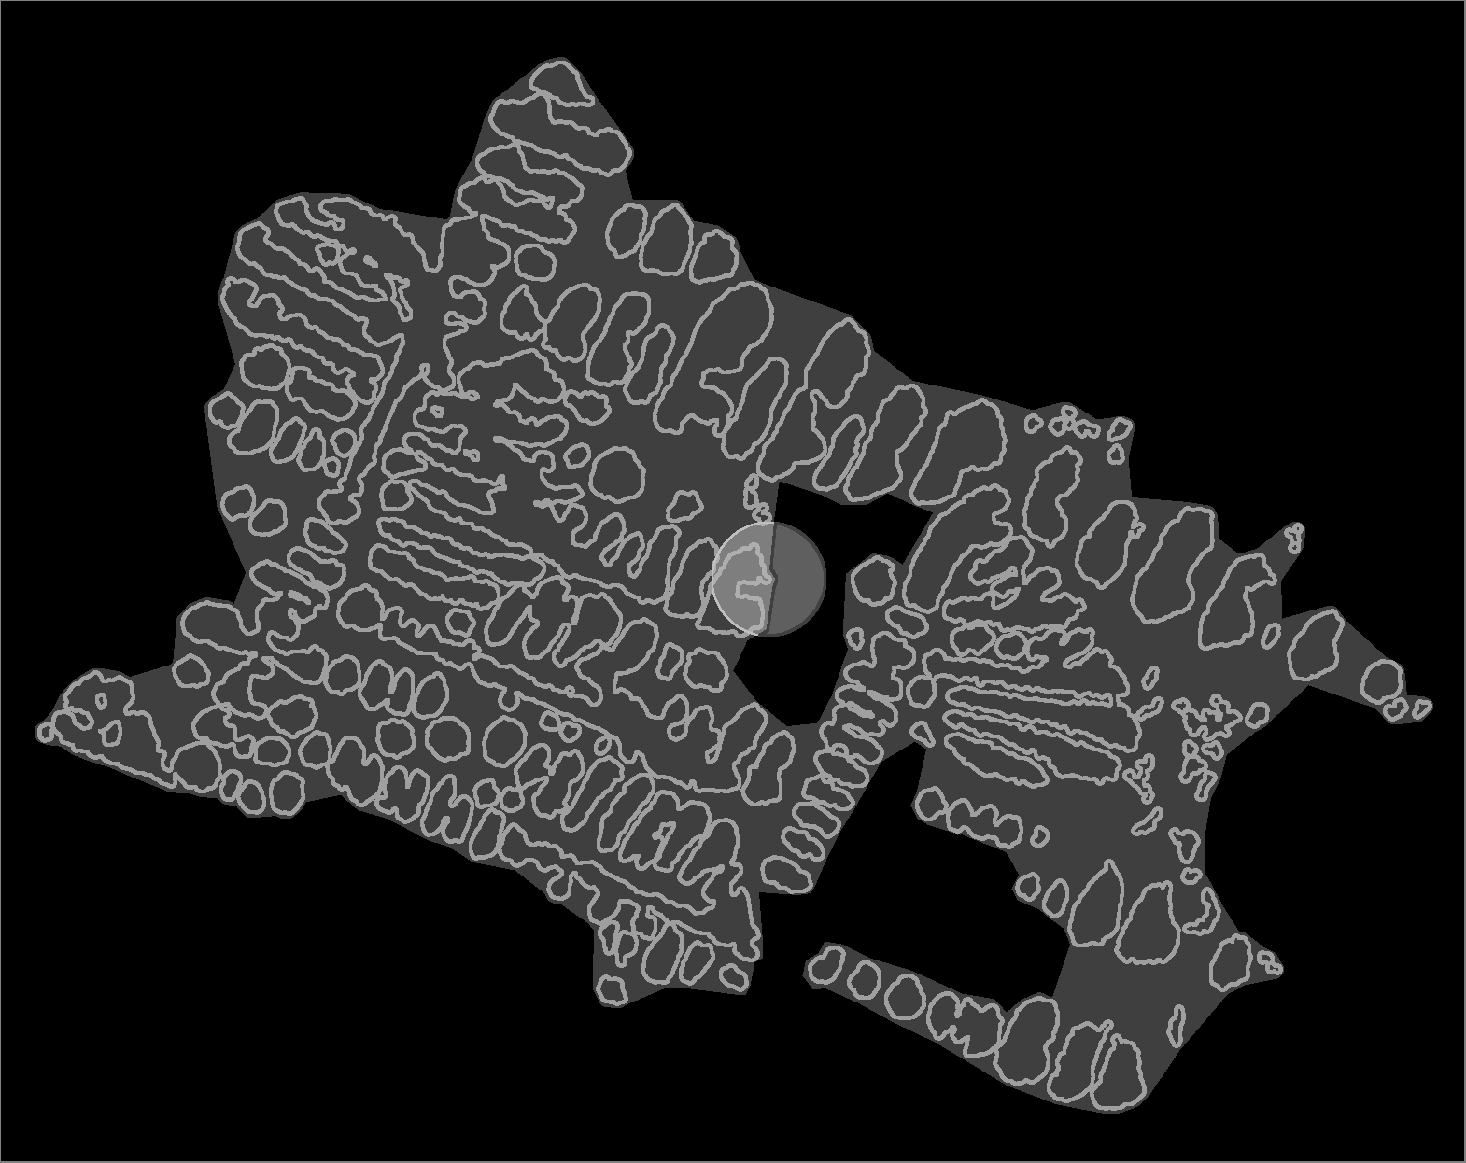
Image showing radius of high fd (Indv 100) (vol frac as % of dendrite over convex hull dilated by high fd radius circle)

Slide 3
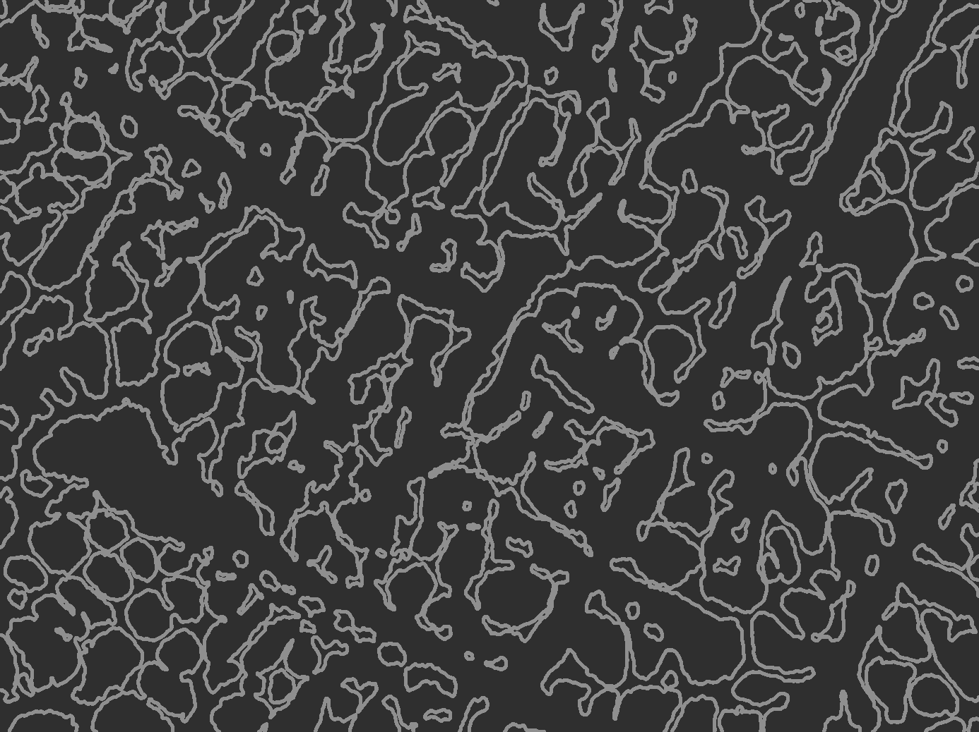
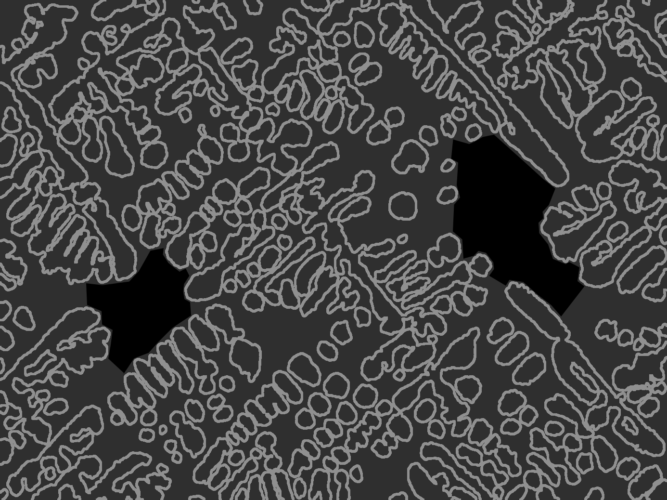
Image showing gaps in Field 100 compared to 000 (vol frac as % of dendrite over image)

Slide 5
compare data sets against volume fraction per Dr. Monroe

Slide 6
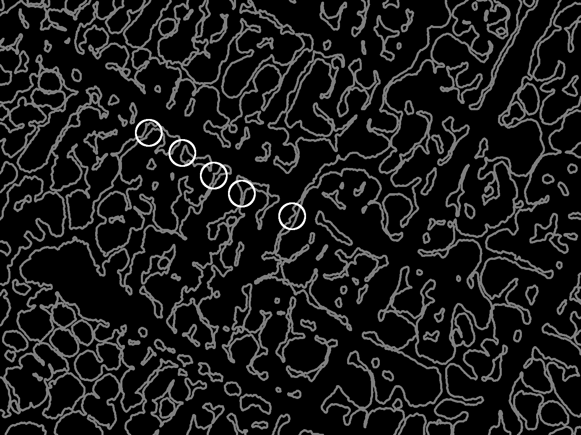
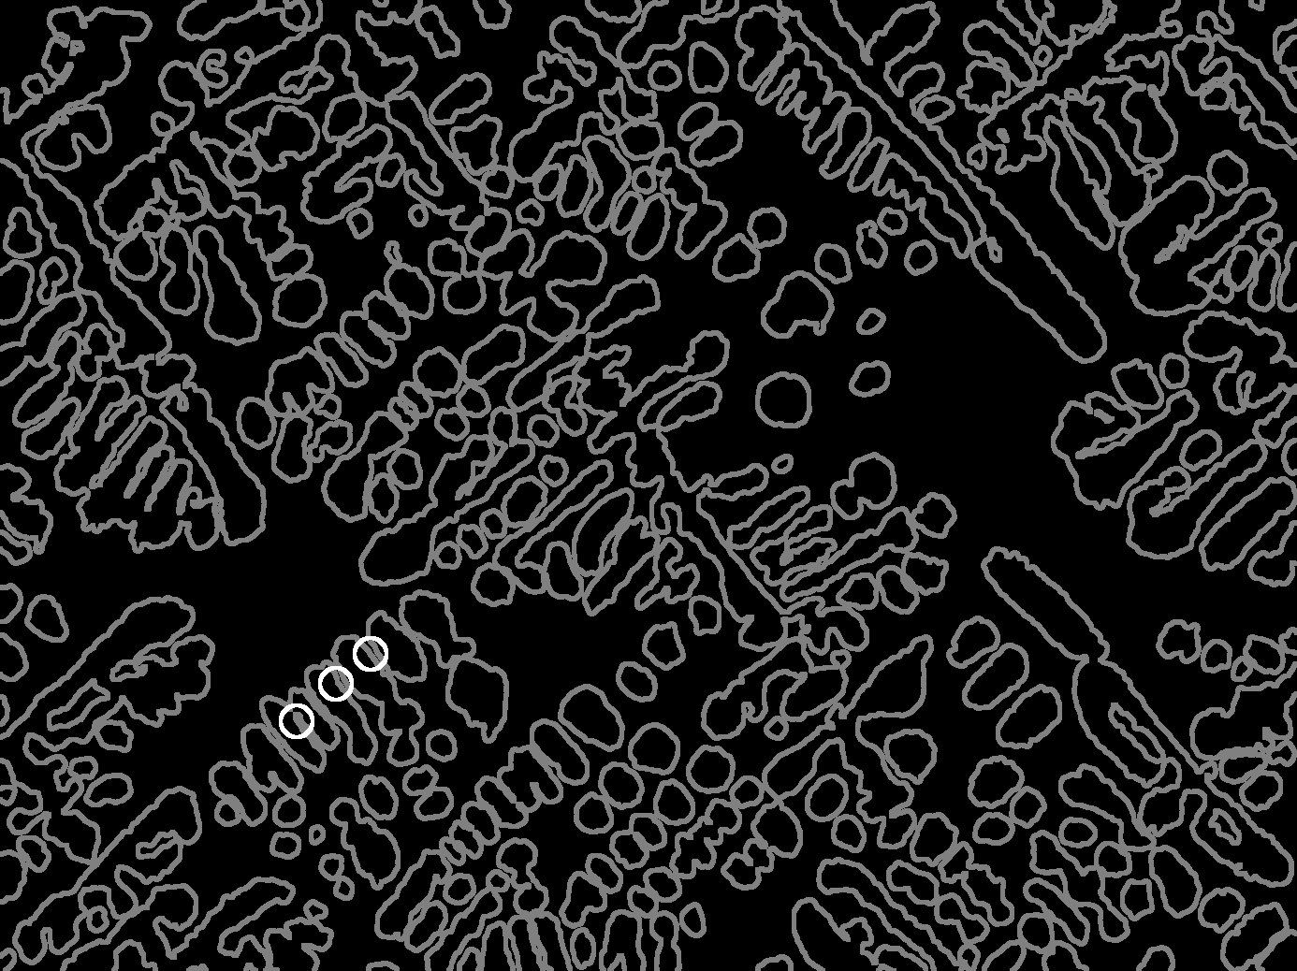
Image showing crossover radius (Field 000 and 100) same mag

Slide 7
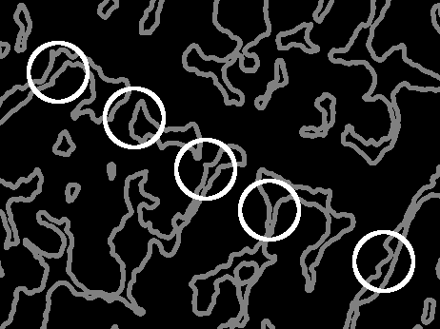
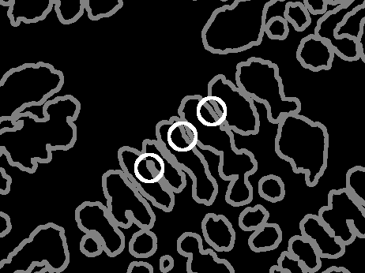
Image showing crossover radius (Field 000 and 100) same mag

Slide 9

Models
AI
$s={10}^{2.004−7.913(C−0.05)−1.283(V−0.03)+21.79(C−0.05)(V−0.03)} um$
AF
$s={10}^{2.047−8.068(C−0.05)−1.474(V−0.03)+25.28(C−0.05)(V−0.03)} um$

Slide 10
Model Corners Comparison
AI | 0.05 | 0.09
0.03 | 2.004746 | 1.68821
0.12 | 1.889305 | 1.651211
AF | 0.05 | 0.09
0.03 | 2.047402 | 1.724689
0.12 | 1.914727 | 1.683019
Absolute % Difference | 0.05 | 0.09
0.03 | 2.11% | 2.14%
0.12 | 1.34% | 1.91%

Slide 11
Model Parameters Comparison
Intercept | 2.004746
C | -0.31654
V | -0.11544
CV | 0.078442
Intercept | 2.047402
C | -0.32271
V | -0.13268
CV | 0.091005
Intercept | 2.11%
C | 1.93%
V | 13.89%
CV | 14.83%

