Slide 1
Pokemon Battle Analysis
Original dataset from:
ttps://www.kaggle.com/terminus7/pokemon-challenge

Slide 2


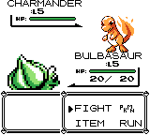
Background
Pokemon is a series of games created by Creatures and Game Freak, and published by Nintendo
Main sequence games:
Play as pokemon trainer
Fight and catch critters called pokemon
Train them up, battle other trainers
Eventually complete some overarching goal to win
First game released in 1996
28 games released, new pair of games in development now (2018)
Sold ~280M units, ~$8.5B gross revenue est, ~$380M per year avg
https://en.wikipedia.org/wiki/Pok%C3%A9mon
https://en.wikipedia.org/wiki/Pok%C3%A9mon_(video_game_series)
https://commons.wikimedia.org/wiki/File:International_Pok%C3%A9mon_logo.svg TM Nintendo
https://en.wikipedia.org/wiki/File:Pok%C3%A9mon_box_art_-_Red_Version.png ©/TM Nintendo
https://en.wikipedia.org/wiki/File:Bulbasaur_pokemon_red.png ©Nintendo

Slide 3



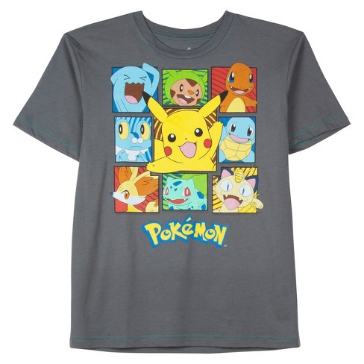
Background
Other games:
a few spinoffs
trading card game (25.7B cards sold, ~$5B est total)
mobile augmented reality game ($900M/yr avg est)
anime series with >900 episodes
20 feature length films
Cultural impact
Merchandise/apparel
Catchphrases/Memes
Conventions
Player vs Player (PVP)
https://en.wikipedia.org/wiki/Pok%C3%A9mon
https://en.wikipedia.org/wiki/Pok%C3%A9mon_Trading_Card_Game
https://variety.com/2018/gaming/news/pokemon-go-2-years-1-billion-1202867409/
https://en.wikipedia.org/wiki/File:Pokemon_Trading_Card_Game_cardback.jpg TM Nintendo
https://commons.wikimedia.org/wiki/File:Pok%C3%A9mon_GO_logo.svg TM Nintendo
https://pokemonblog.com/2018/03/08/first-official-english-dub-trailer-for-pokemon-the-series-sun-moon-ultra-adventures/ ©/TM Nintendo
https://www.target.com ©Nintendo

Slide 4
The Game
Central game mechanic: pokemon v pokemon battles
A battle is won by one side when the opposing side has no usable pokemon
Achieved by reducing all opposing pokemon to 0 HP by attacking

Slide 5
The Game
Battles are turn-based
At the start of each turn, both sides choose an action
Action can be one of
Fight – select one of four moves the pokemon will attempt to use when its turn comes
Bag – use an item from the trainers bag
Pokemon – select a different pokemon to switch to
Run – run away from the fight
Most interested in the fight action, since most damage is dealt that way

Slide 6
The Game
Types affect damage dealth
There are 18 types, shown at right
Pokemon have 1 or 2 types
Attacks have 1 type
An attack may be (damage mult.):
super effective (2x),
normal (1x)
not-very effective (0.5x),
ineffective (0x),
If a pokemon has 2 types, the overall effectiveness is the product of each individual effectiveness rating
Bug
Dark
Dragon
Electric
Fairy
Fighting
Fire
Flying
Ghost
Grass
Ground
Ice
Normal
Poison
Psychic
Rock
Steel
Water

Slide 7
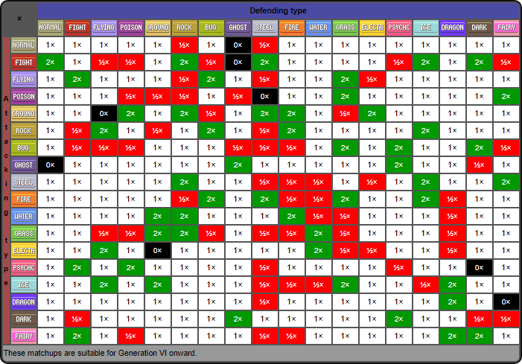
The Game
c/o https://bulbapedia.bulbagarden.net/wiki/Type

Slide 8
Stat information
Statistics also affect damage
Pokemon have 6 statistics (stats):
HP – how much damage can be taken before fainting
Attack – proportional to outgoing damage with non-special attacks
Defense – inversely proportional to incoming damage with non-special attacks
Sp Attack v. Sp Defense – same as attack/defense, but for special attacks
Speed – proportional to likelihood of acting first in combat

Slide 9
The Game
Fight moves may cause only damage, may cause only a status effect, or both, depending on the move selected
Assume both sides choose fight, and select a damage-only move
The pokemon with higher speed goes first
If equal, order is decided randomly (50/50)

Slide 10
The Dataset
Two files
A table of pokemon, including unique ID, name, whether the pokemon is legendary, their two types (null for type 2 if pokemon has one type) and 6 base stats
800 pokemon table records
A list of battles by unique ID of the two pokemon involved, and the ID of the winner
50000 battle table records
To fully explore the dataset, the tables will have to be joined on ID
The battle data was generated using a secret simulation algorithm which has not been released by the originator of the dataset

Slide 11
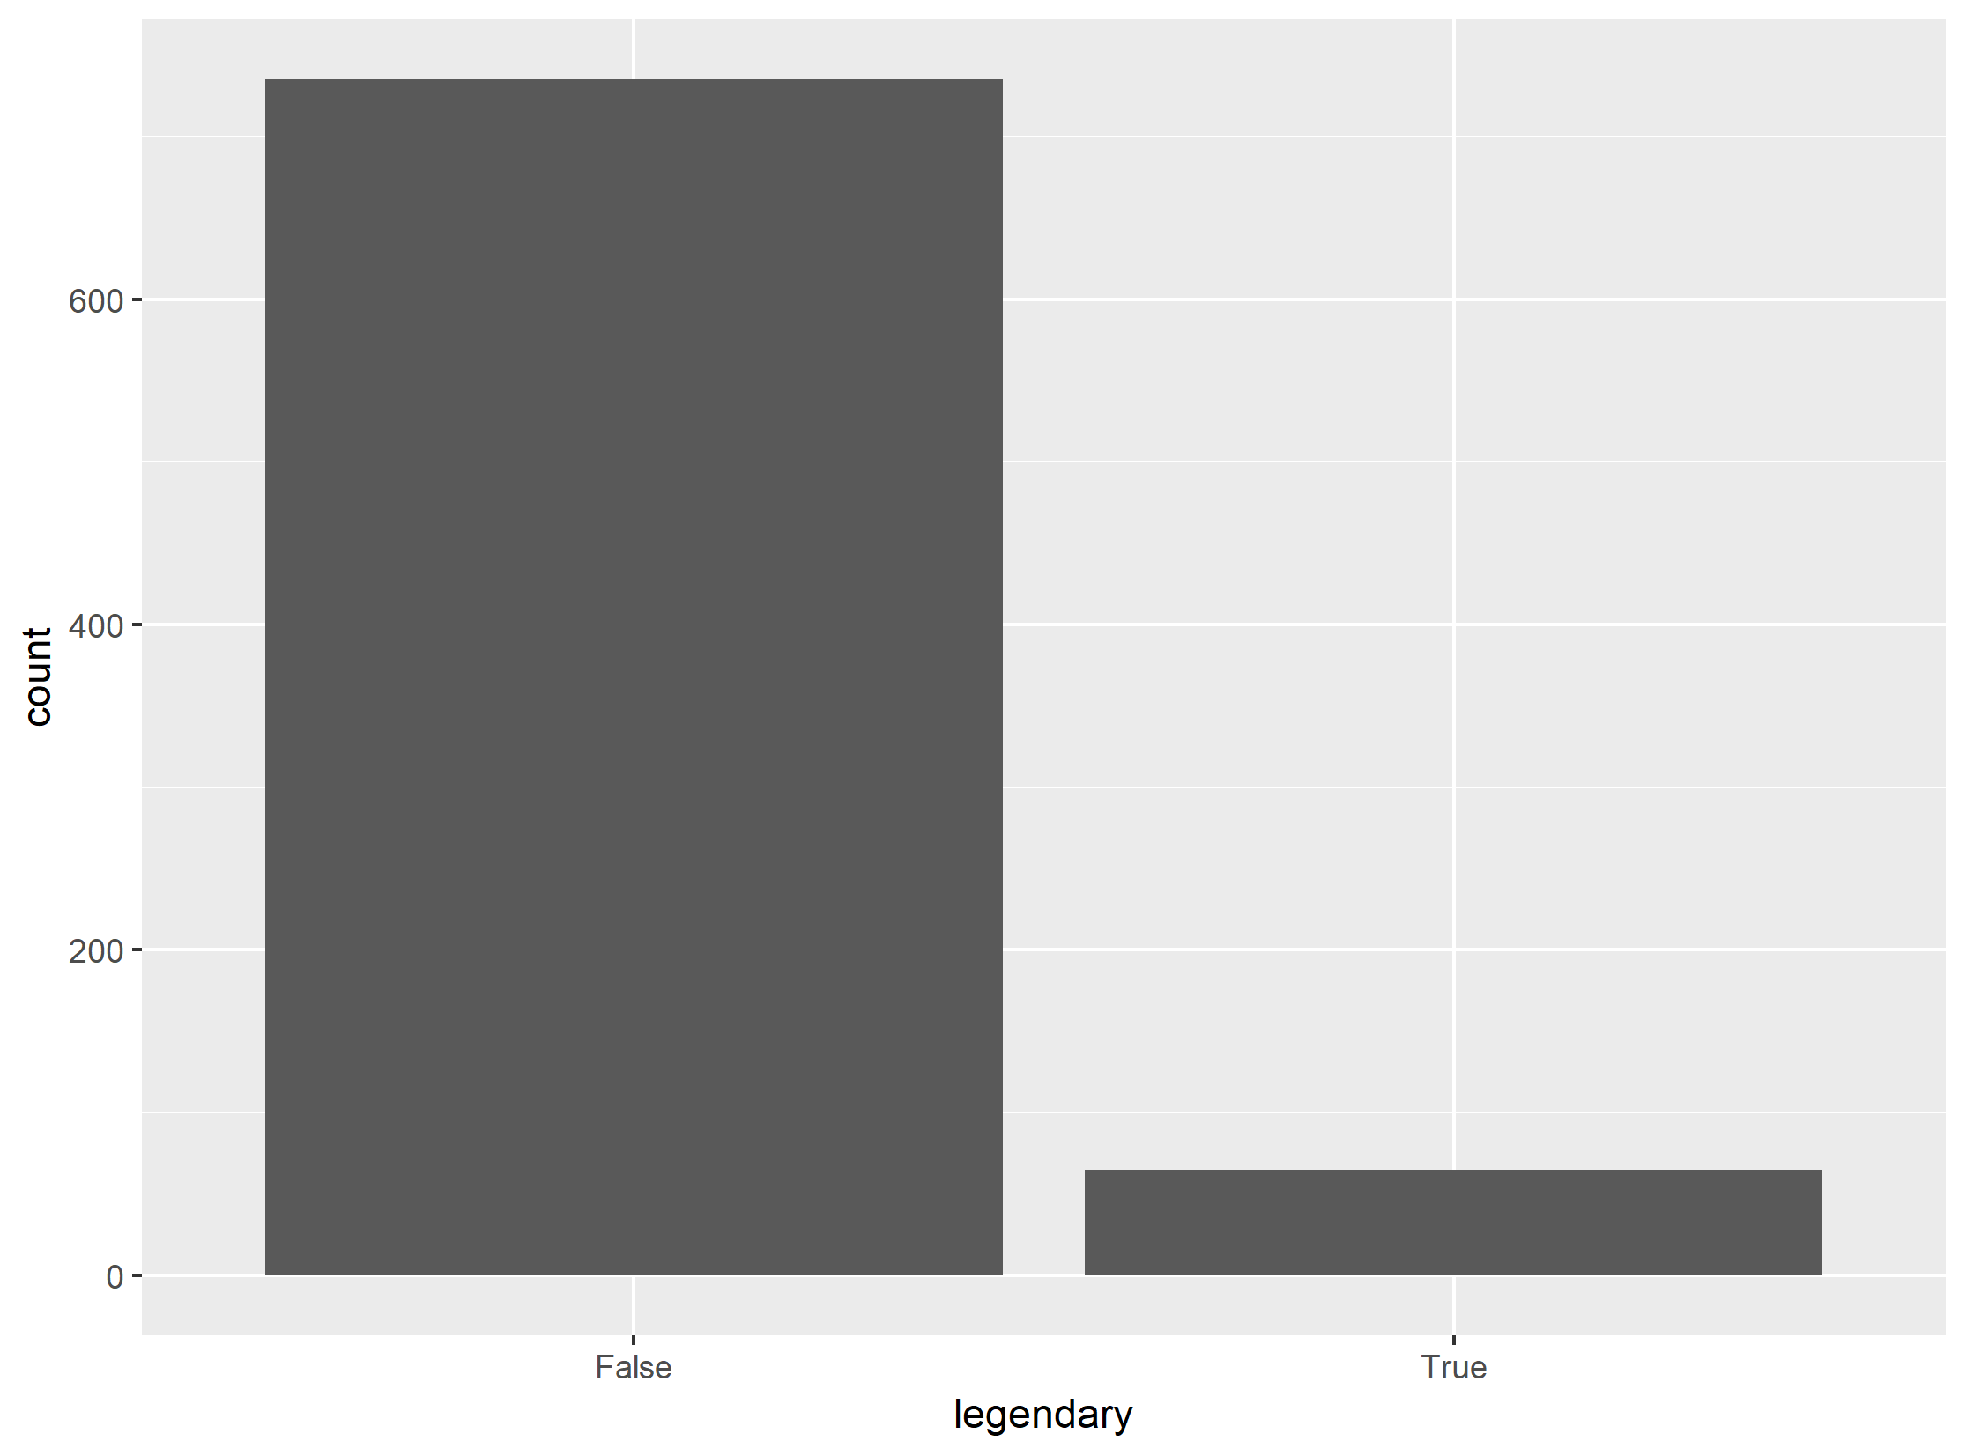
Legendary-ness
In the game, legendary-ness only indicates the following:
pokemon is unique (per game instance)
challenging to obtain
has high base stats
has access to stronger fight moves
Legendary-ness does not explicitly mean the pokemon is stronger than others
No direct relationship with combat ability
Of 800 pokemon, 8.1% are legendary

Slide 12
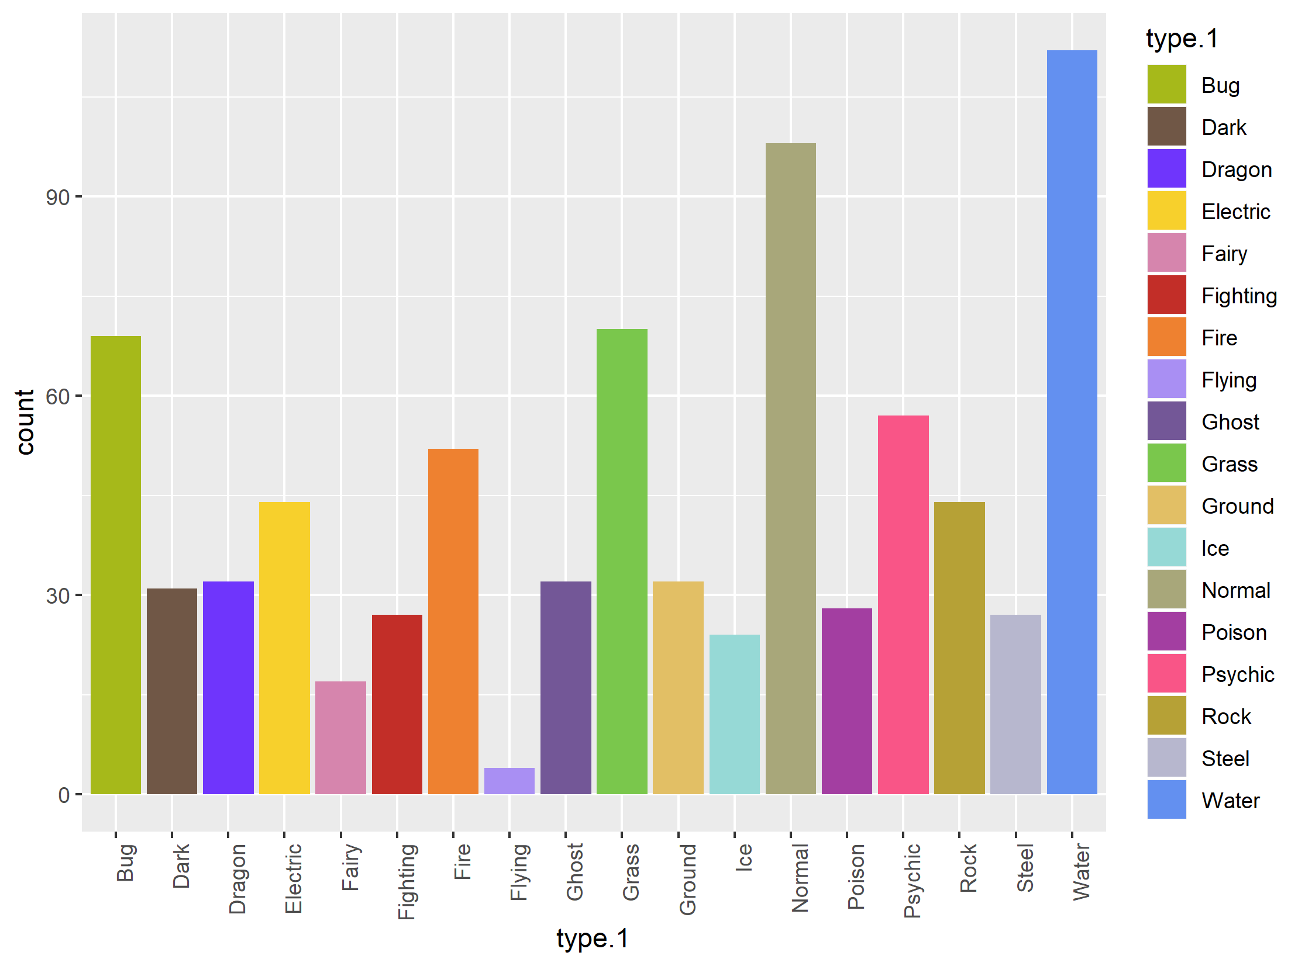
Distribution of first type
type.1 | count
Bug | 69
Dark | 31
Dragon | 32
Electric | 44
Fairy | 17
Fighting | 27
Fire | 52
Flying | 4
Ghost | 32
Grass | 70
Ground | 32
Ice | 24
Normal | 98
Poison | 28
Psychic | 57
Rock | 44
Steel | 27
Water | 112

Slide 13
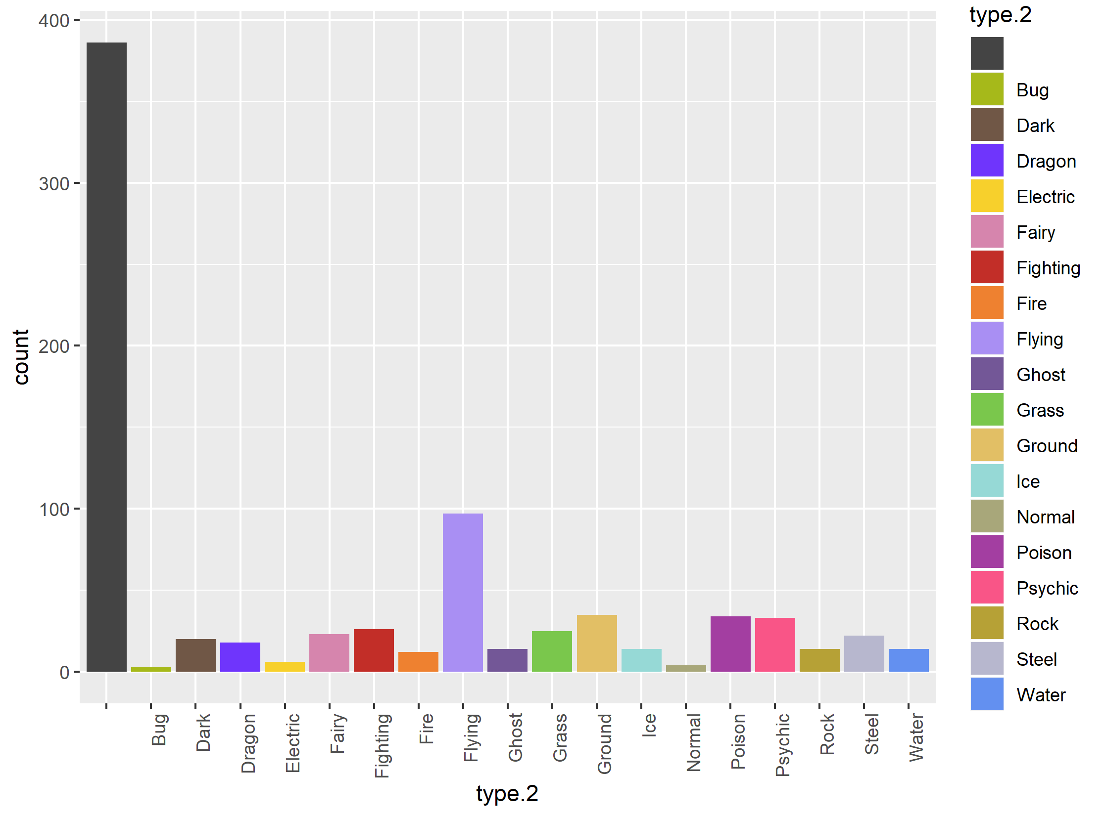
Distribution of second type
48% have no second type
type.2 | count
<null> | 386
Bug | 3
Dark | 20
Dragon | 18
Electric | 6
Fairy | 23
Fighting | 26
Fire | 12
Flying | 97
Ghost | 14
Grass | 25
Ground | 35
Ice | 14
Normal | 4
Poison | 34
Psychic | 33
Rock | 14
Steel | 22
Water | 14

Slide 14
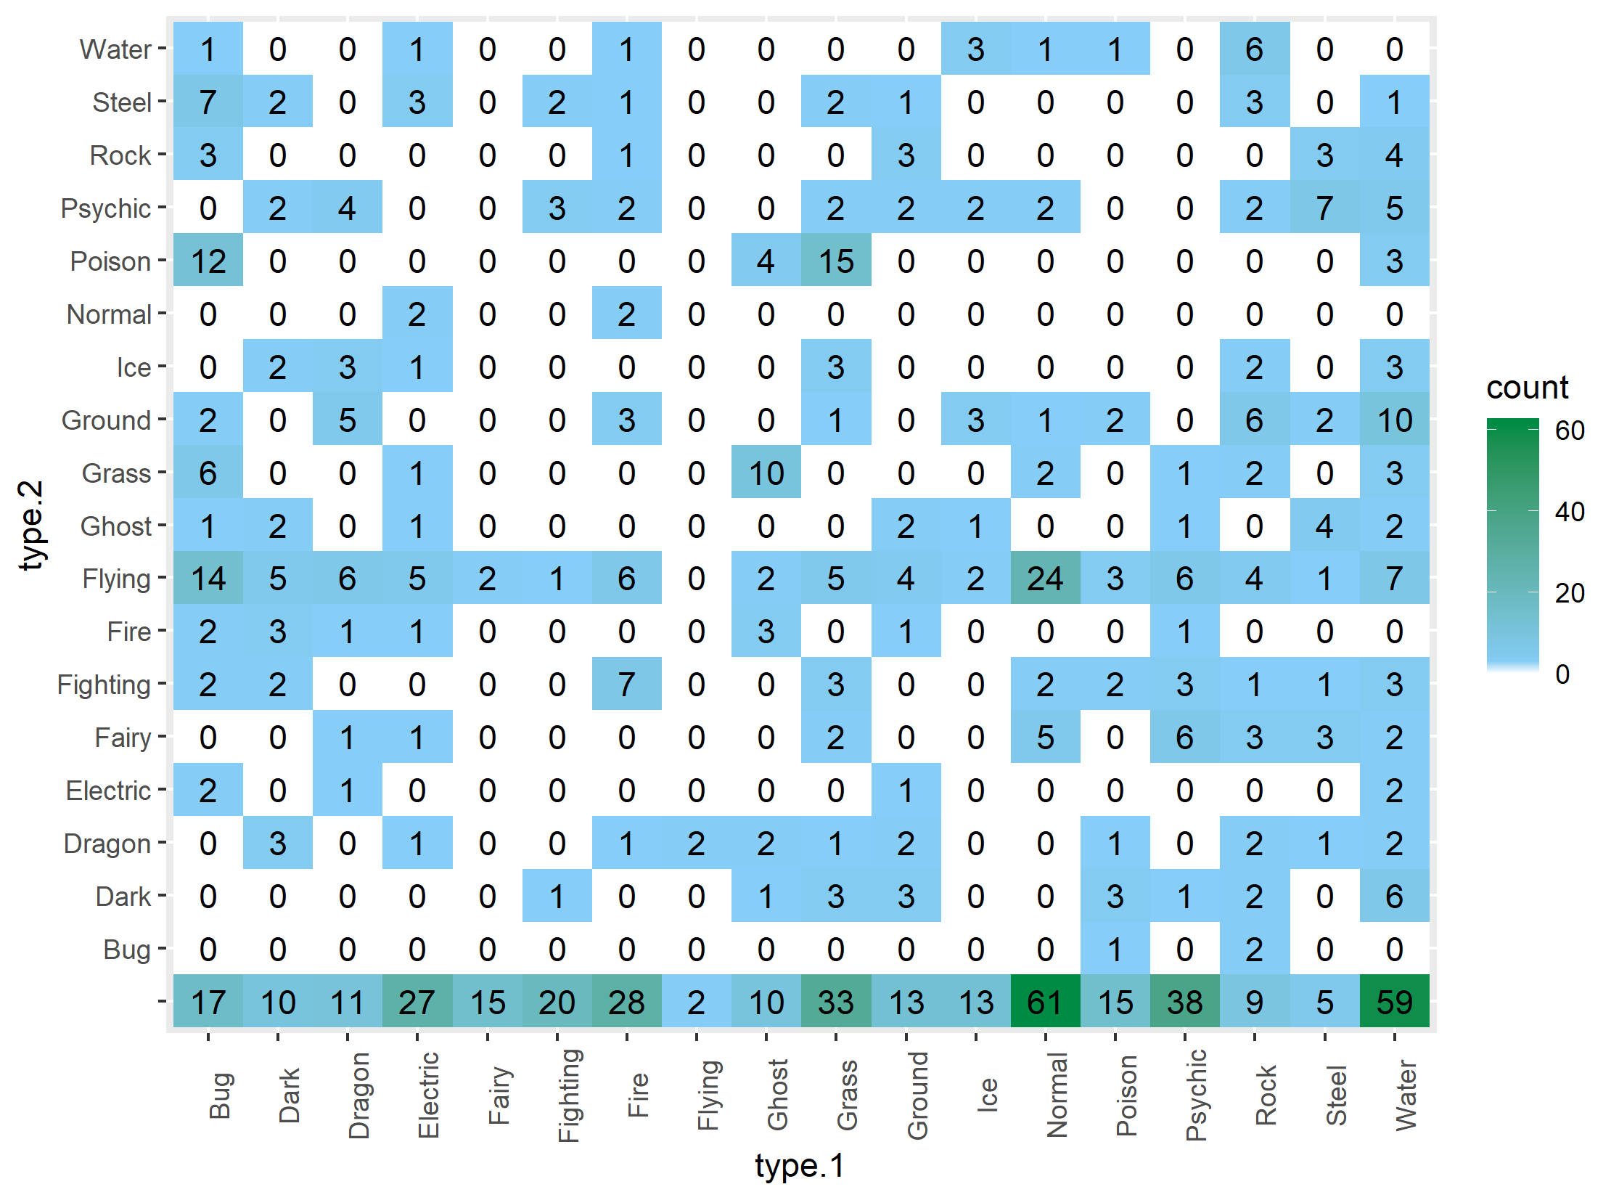
Overall distribution of types
Bottom row is single-typed pokemon
Flying is a common secondary type, rarely a first type
No pokemon has the same type twice (NE/SW diag)

Slide 15
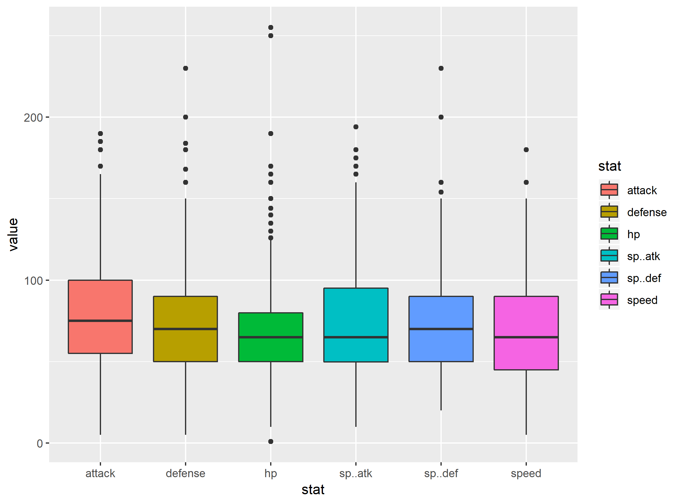
Stat distribution

Slide 16
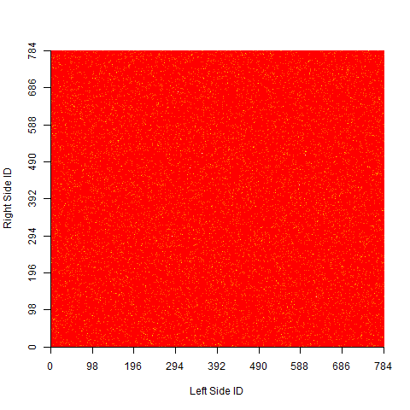
Battle-space coverage by IDs
Red indicates no matchup, yellow indicates a matchup, between indicated IDs
7.8% of the space is covered, with 7.3% of those duplicated (3650/50000)

Slide 17
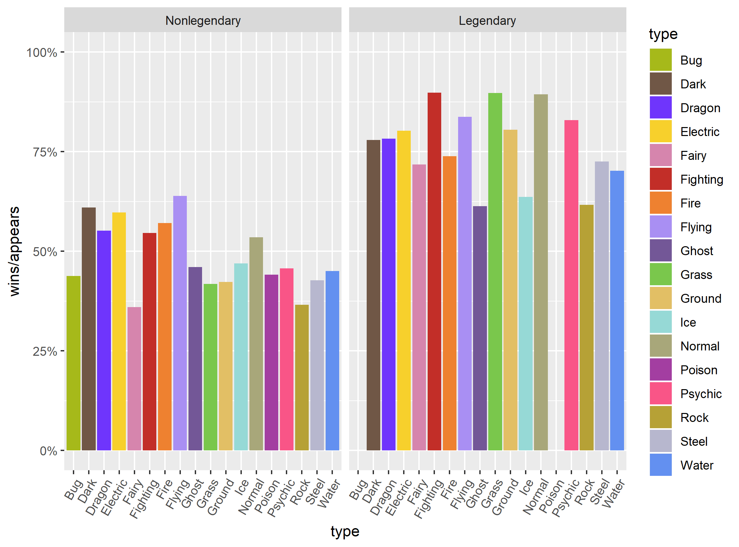
Win Ratio by Type
Type does not seem to have much effect on win ratio
Legendary-ness does, but is that an artifact of stat distributions?

Slide 18
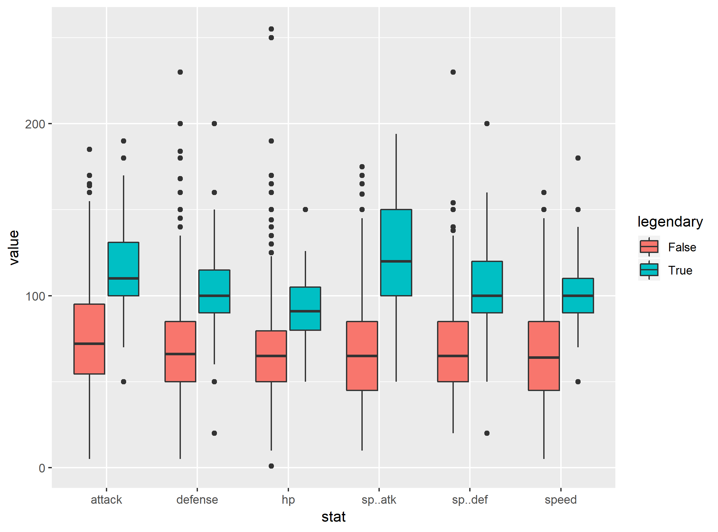
Stat Distribution (Legendary)
Legendary pokemon just so happen to have higher stats
Stats appear to correlate with win rate, which is expected

Slide 19
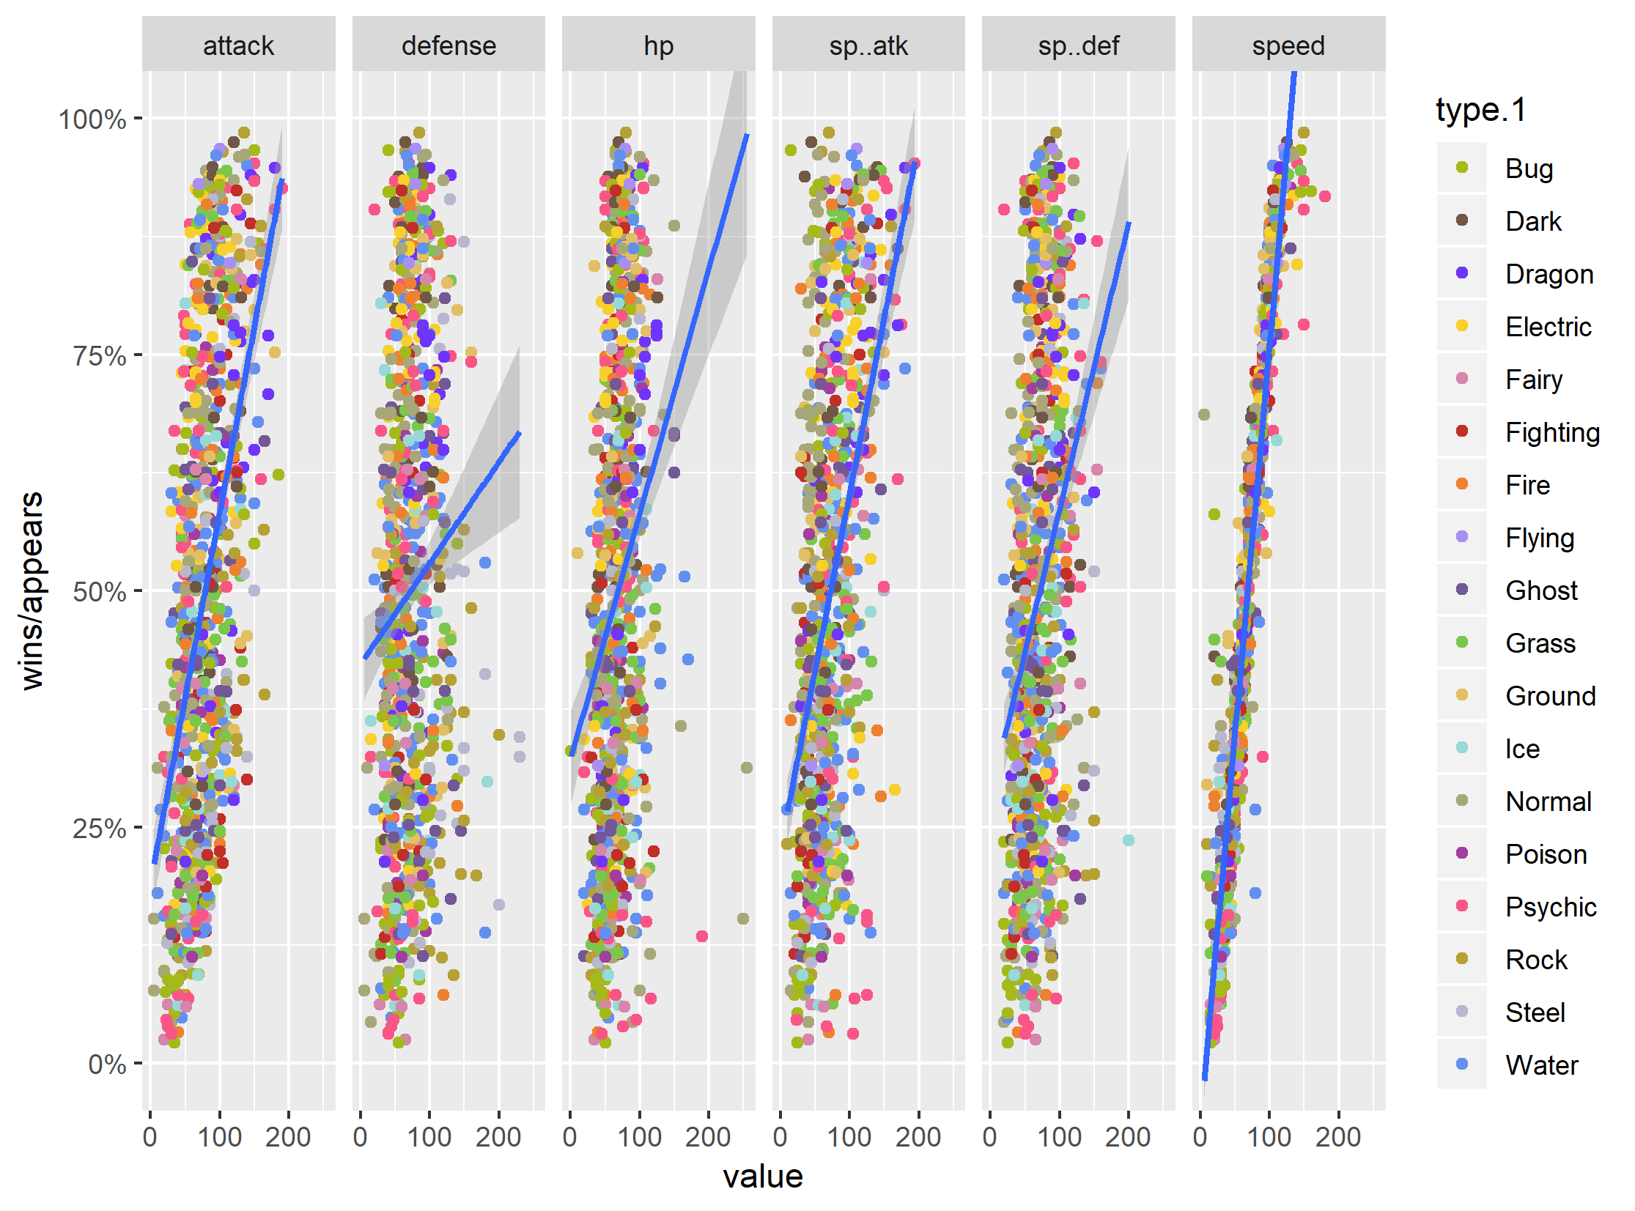
Win Ratio by Stat
Scatterplot of win ratio vs. stat, broken out by stat, with first type colored
Speed correlates most strongly with win ratio

Slide 20
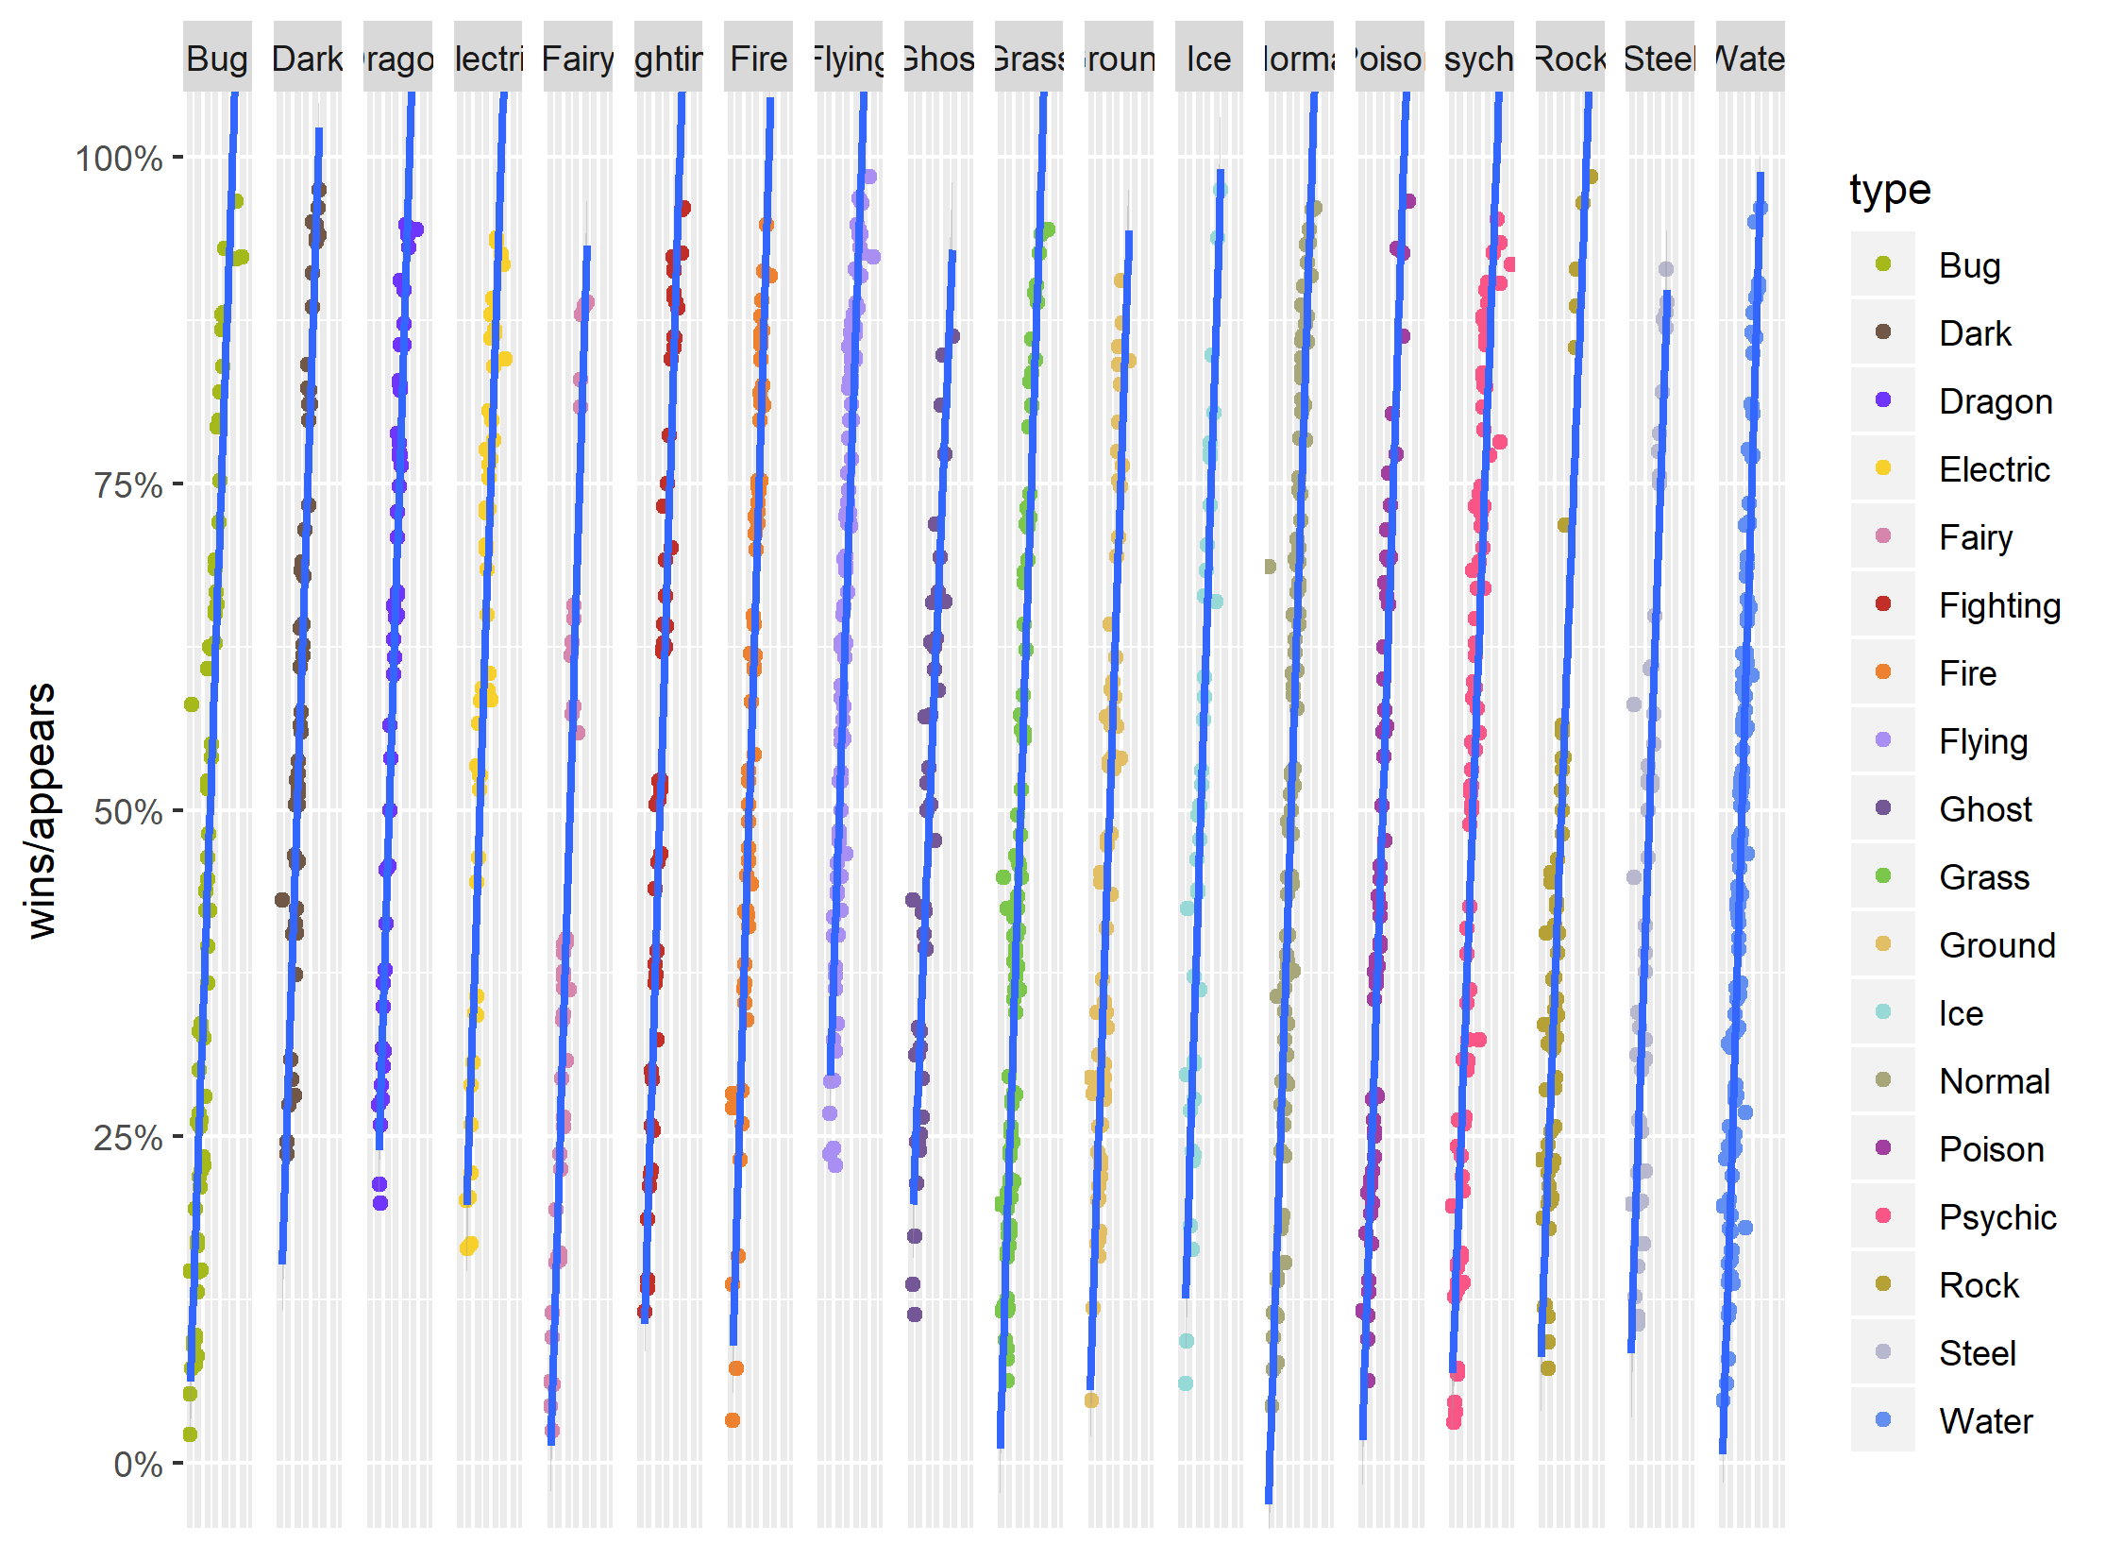
Simpson’s Paradox?
Scatterplot of win ratio vs. speed, broken out by first type
First type does not appear to have an effect on overall correlation

Slide 21
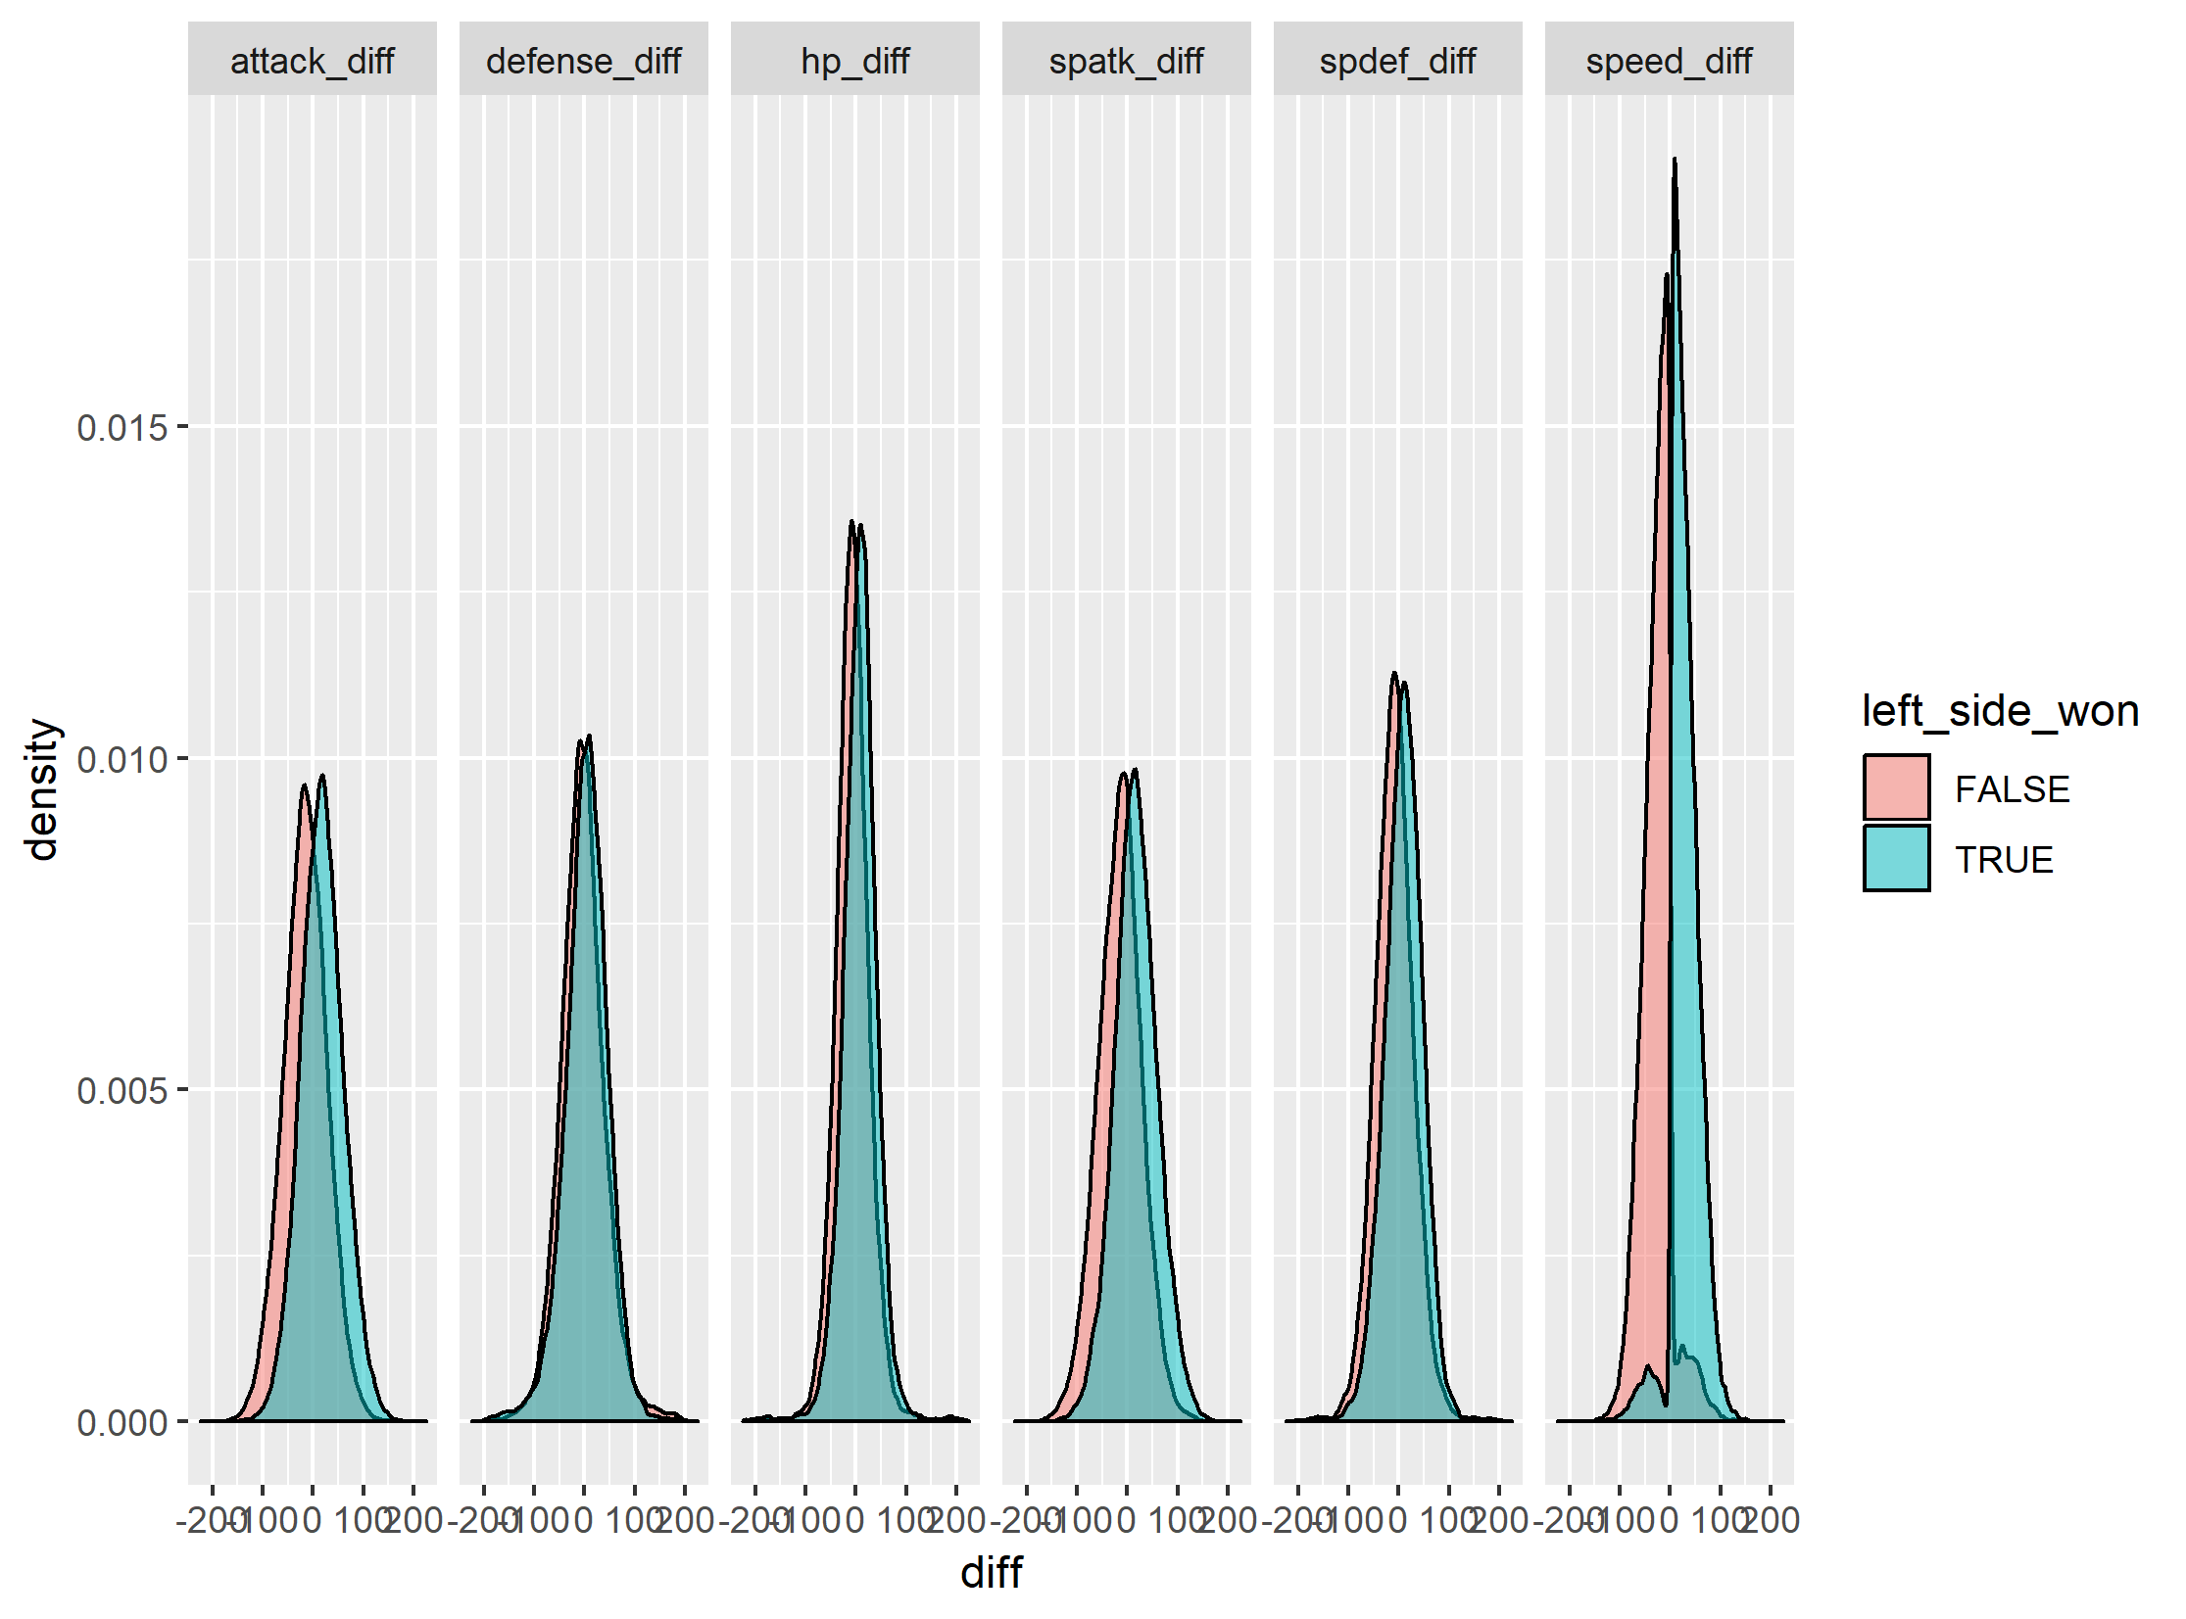
Stat Differences by Stat
Distribution plots of winner, broken out by stat difference
Large overlap for each difference, except speed

Slide 22
Attempting to model combat
Based on domain knowledge model combat as:
atk_advantage = my_attack / op_defense
Same with sp atk
Find max of atk/sp_atk advantage for left and right
Find difference between left and right
Treat as new stat

Slide 23
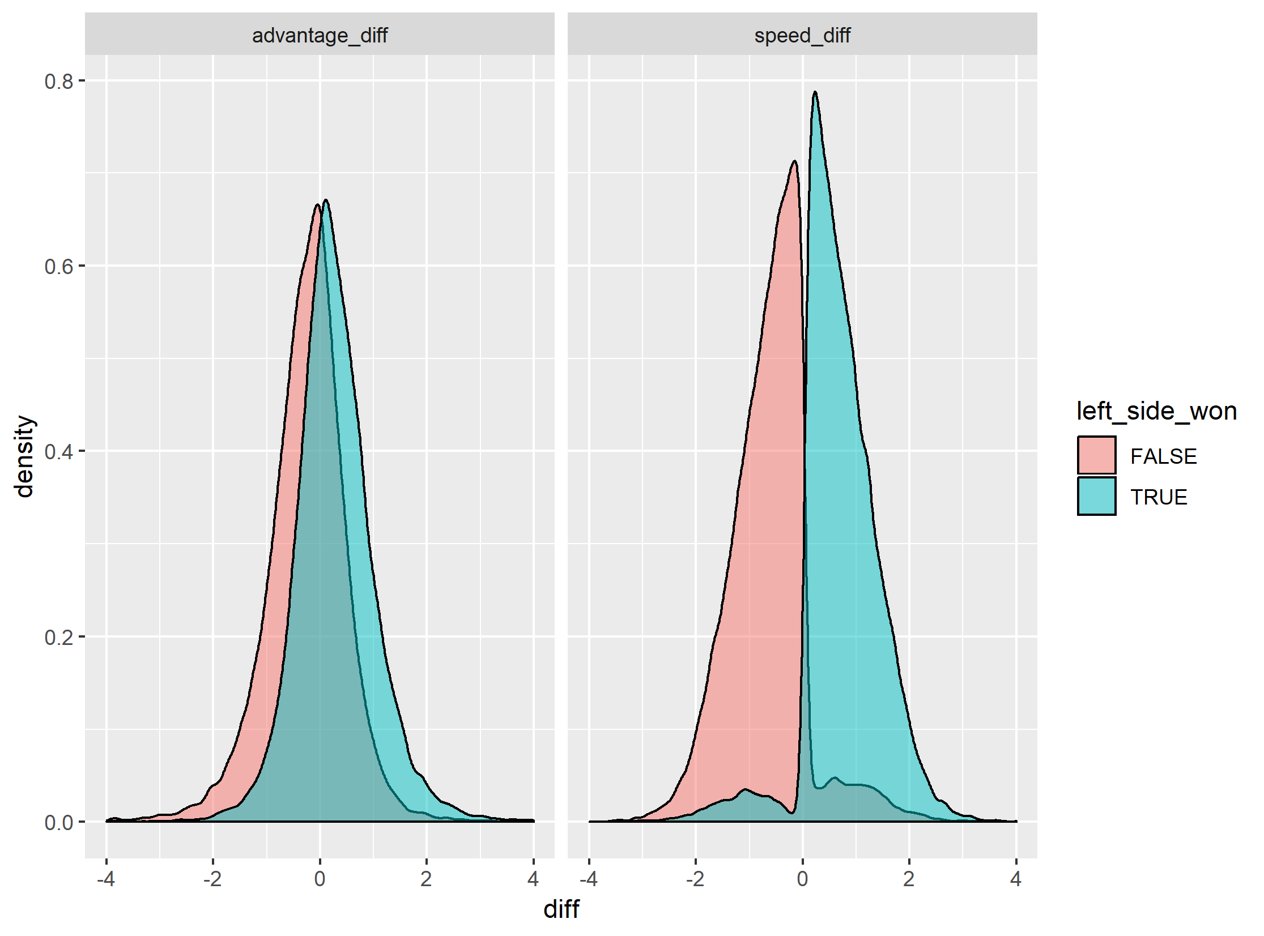
Attempting to model combat
Distribution plots of winner, broken out by advantage or speed
This model still has significant overlap, speed is dominant

Slide 24
Predicting winners
Because speed has a sharp division, expect tree-based ML to perform well
First perform initial using bagged trees with MATLAB defaults
maxnumsplits = #obs – 1
numlearningcycles = 30
Use 10-fold cross-validation
MATLAB R2018a
Seed = 314159

Slide 25
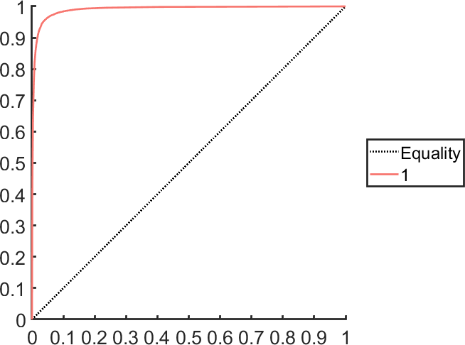
Prediction model
MATLAB R2018a, seed = 314159
 | Predicted Class
True Class |  | Loss | Win
 | Loss | 25208 | 1191
 | Win | 943 | 22658
AUROC = 0.990,
Optimal Threshold = 0.600,
Accuracy = 0.957
Prediction is reasonably good. What can hyperparameter optimization do?

Slide 26
Hyperparameter Optimization
Optimize on MATLAB defaults for ensemble models
Ensemble method
Number of Learning Cycles
Learn Rate
Min Leaf Size
Use 10-fold cross-validation
MATLAB R2018a
Seed = 314159

Slide 27

Hyperparameter Optimization
MATLAB R2018a, seed = 314159
 | Predicted Class
True Class |  | Loss | Win
 | Loss | 25146 | 1253
 | Win | 913 | 22688
AUROC = 0.992,
Optimal Threshold = 0.605,
Accuracy = 0.957
No particular improvement over initial trial

Slide 28
Future Directions
Try additional combat models as pseudo-stats using domain-specific research
Try other ML models (SVM in particular)
Enhance data by incorporating actual battles between pokemon in practice, instead of simulated battles
Develop data product from model

Slide 29
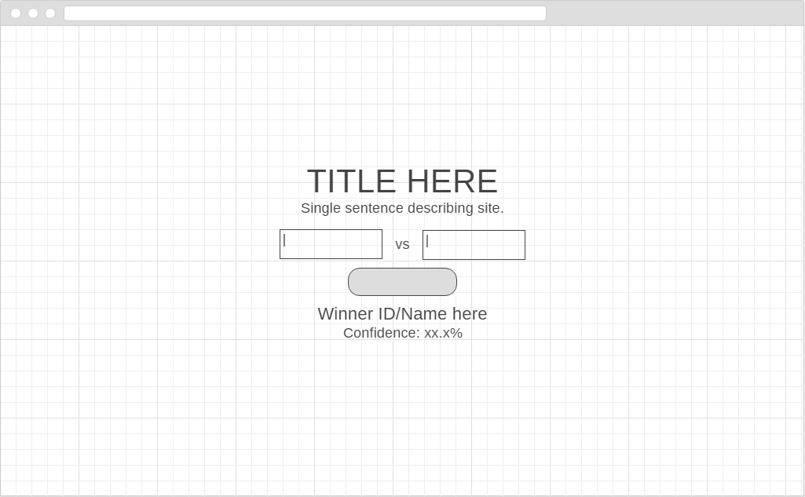
Data product idea
https://wireframe.cc/uMlSu5

Slide 30
Data product idea
Set up website with simple interface
Title
Short description
Two search-based drop-downs to find pokemon
Can search by ID or by name
Button to predict results
Backend is model stored on AWS/Azure as backend (or private server)
Use case:
User navigates to site
User enters two pokemon, presses button
Predicted winner is shown, along with win confidence

