Slide 2
Background

Slide 3
Type information
There are 18 types, shown at right
Pokemon have 1 or 2 types
Attacks have 1 type
An attack may be (damage mult.):
super effective (2x),
not-very effective (0.5x),
ineffective (0x),
normal (1x)
If a pokemon has 2 types, the effectiveness of the attack is multiplied across both
Bug
Dark
Dragon
Electric
Fairy
Fighting
Fire
Flying
Ghost
Grass
Ground
Ice
Normal
Poison
Psychic
Rock
Steel
Water

Slide 4
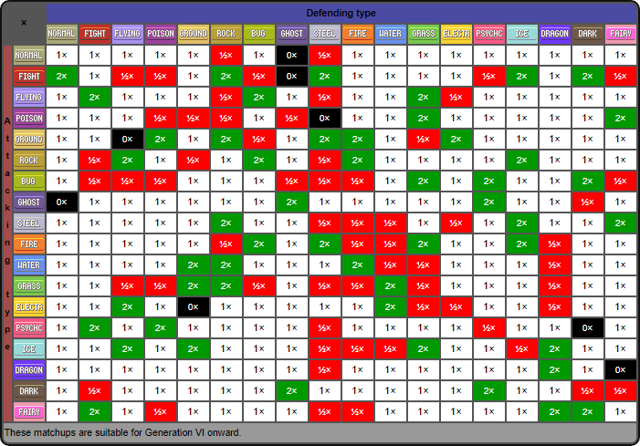
Type information
c/o https://bulbapedia.bulbagarden.net/wiki/Type

Slide 5
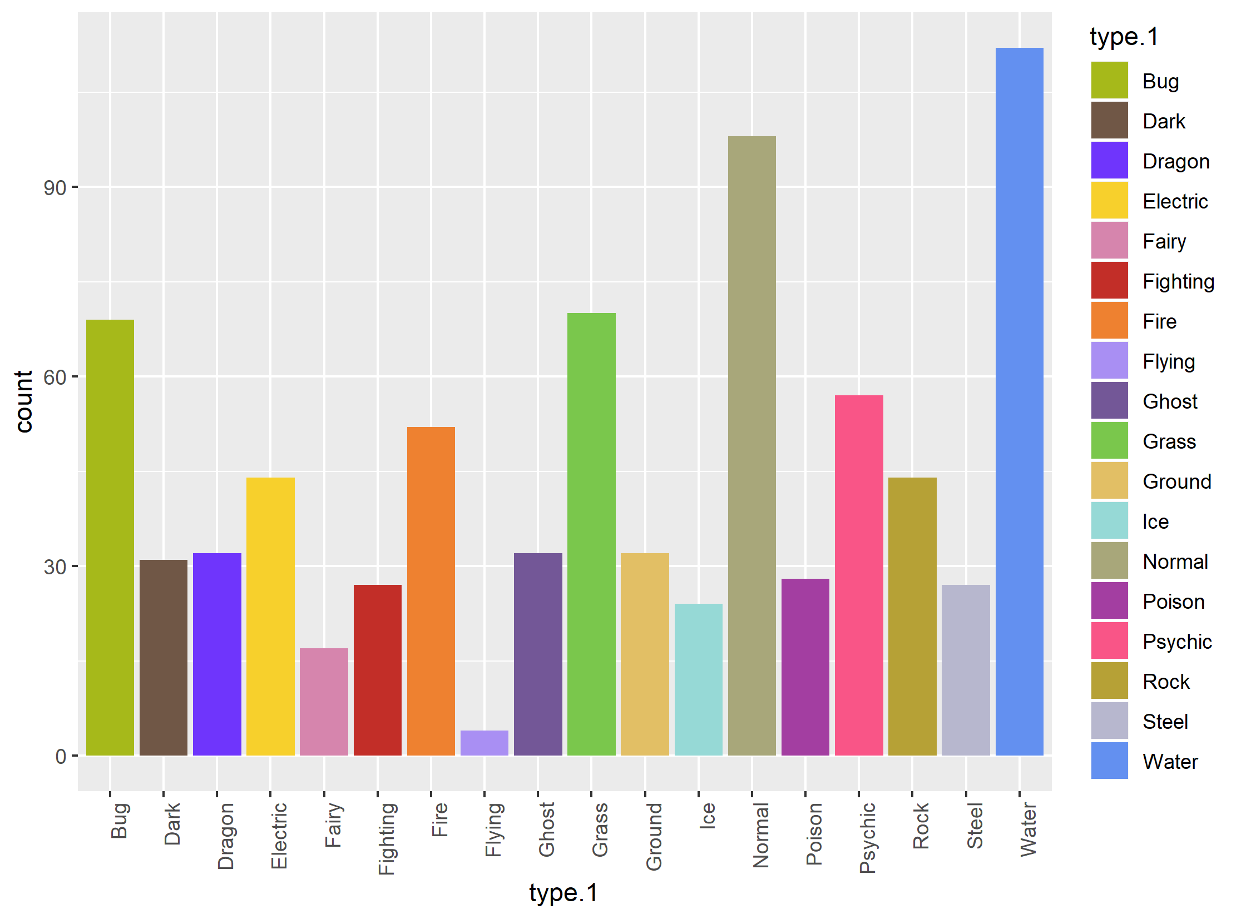
Type information
type.1 | count
Bug | 69
Dark | 31
Dragon | 32
Electric | 44
Fairy | 17
Fighting | 27
Fire | 52
Flying | 4
Ghost | 32
Grass | 70
Ground | 32
Ice | 24
Normal | 98
Poison | 28
Psychic | 57
Rock | 44
Steel | 27
Water | 112

Slide 6
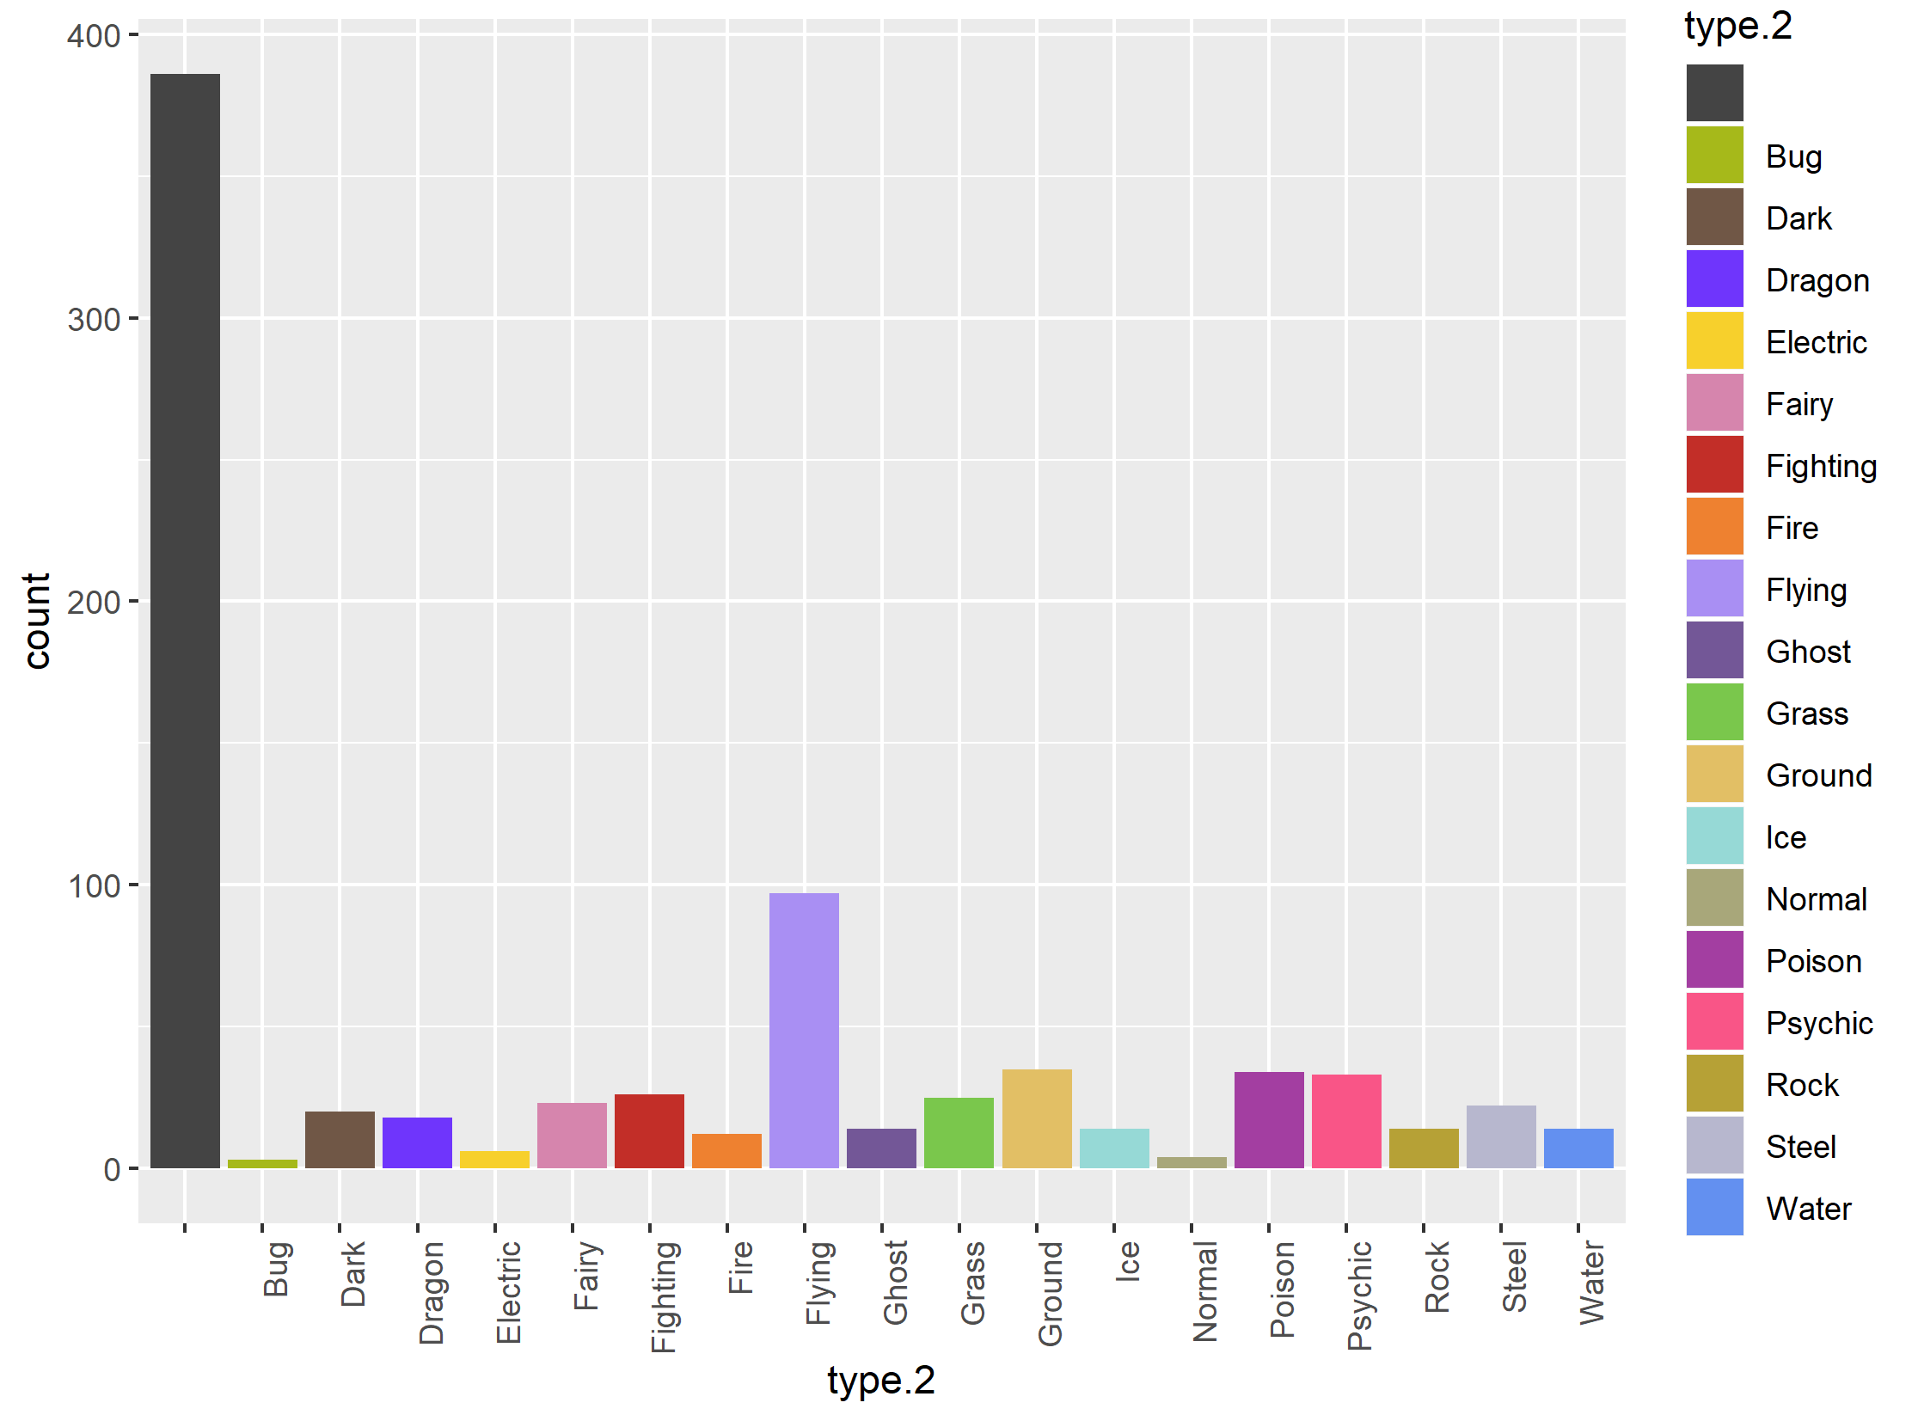
Type information
48% have no second type
type.2 | count
 | 386
Bug | 3
Dark | 20
Dragon | 18
Electric | 6
Fairy | 23
Fighting | 26
Fire | 12
Flying | 97
Ghost | 14
Grass | 25
Ground | 35
Ice | 14
Normal | 4
Poison | 34
Psychic | 33
Rock | 14
Steel | 22
Water | 14

Slide 7
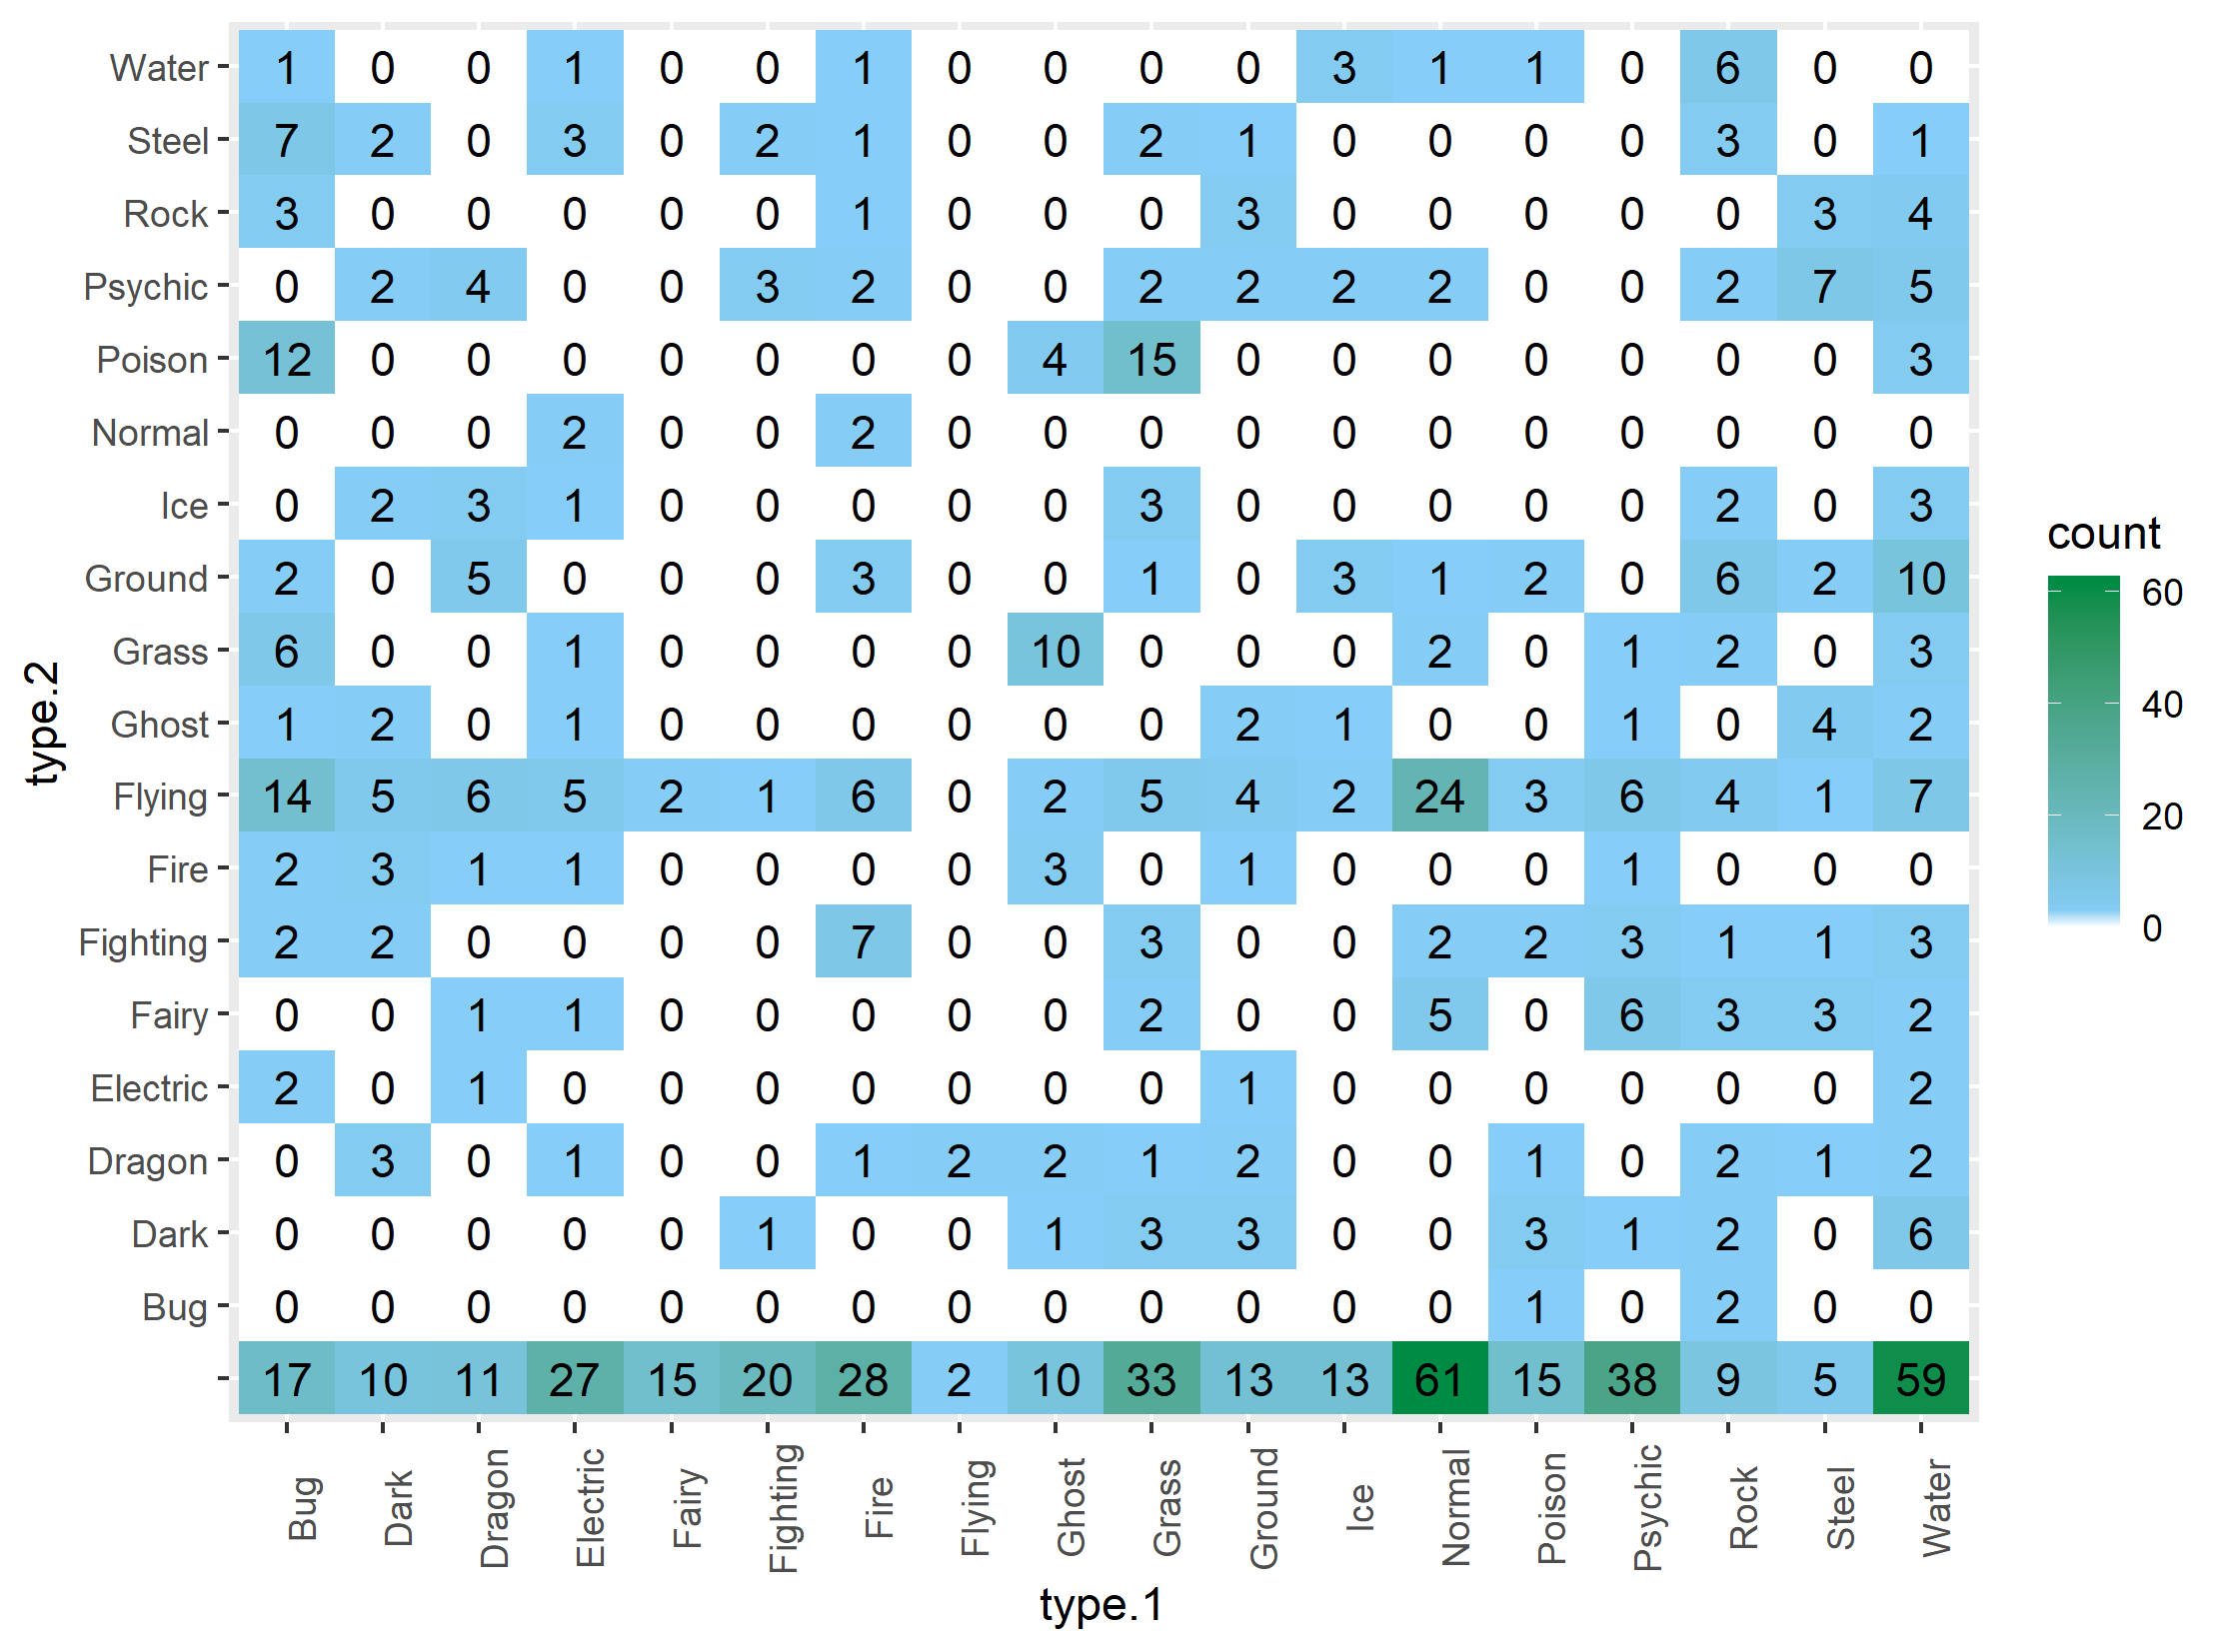
Type information
Distribution of types, bottom row is single-typed pokemon

Slide 8
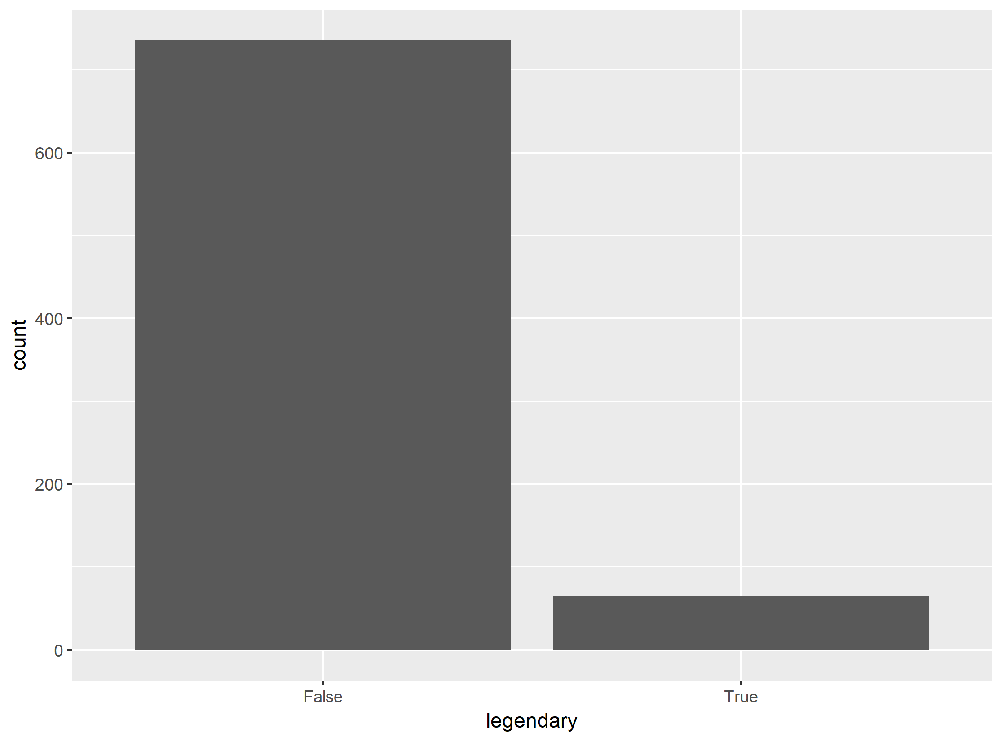
Type information
8.1% are legendary

Slide 9
Stat information
There are 6 statistics:
HP – how much damage before fainting
Attack – proportional to outgoing damage with non-special attacks
Defense – inversely proportional to incoming damage with non-special attacks
Sp Attack v. Sp Defense – same as attack/defense, but for special attacks
Speed – proportional to likelihood of acting first in combat

Slide 10
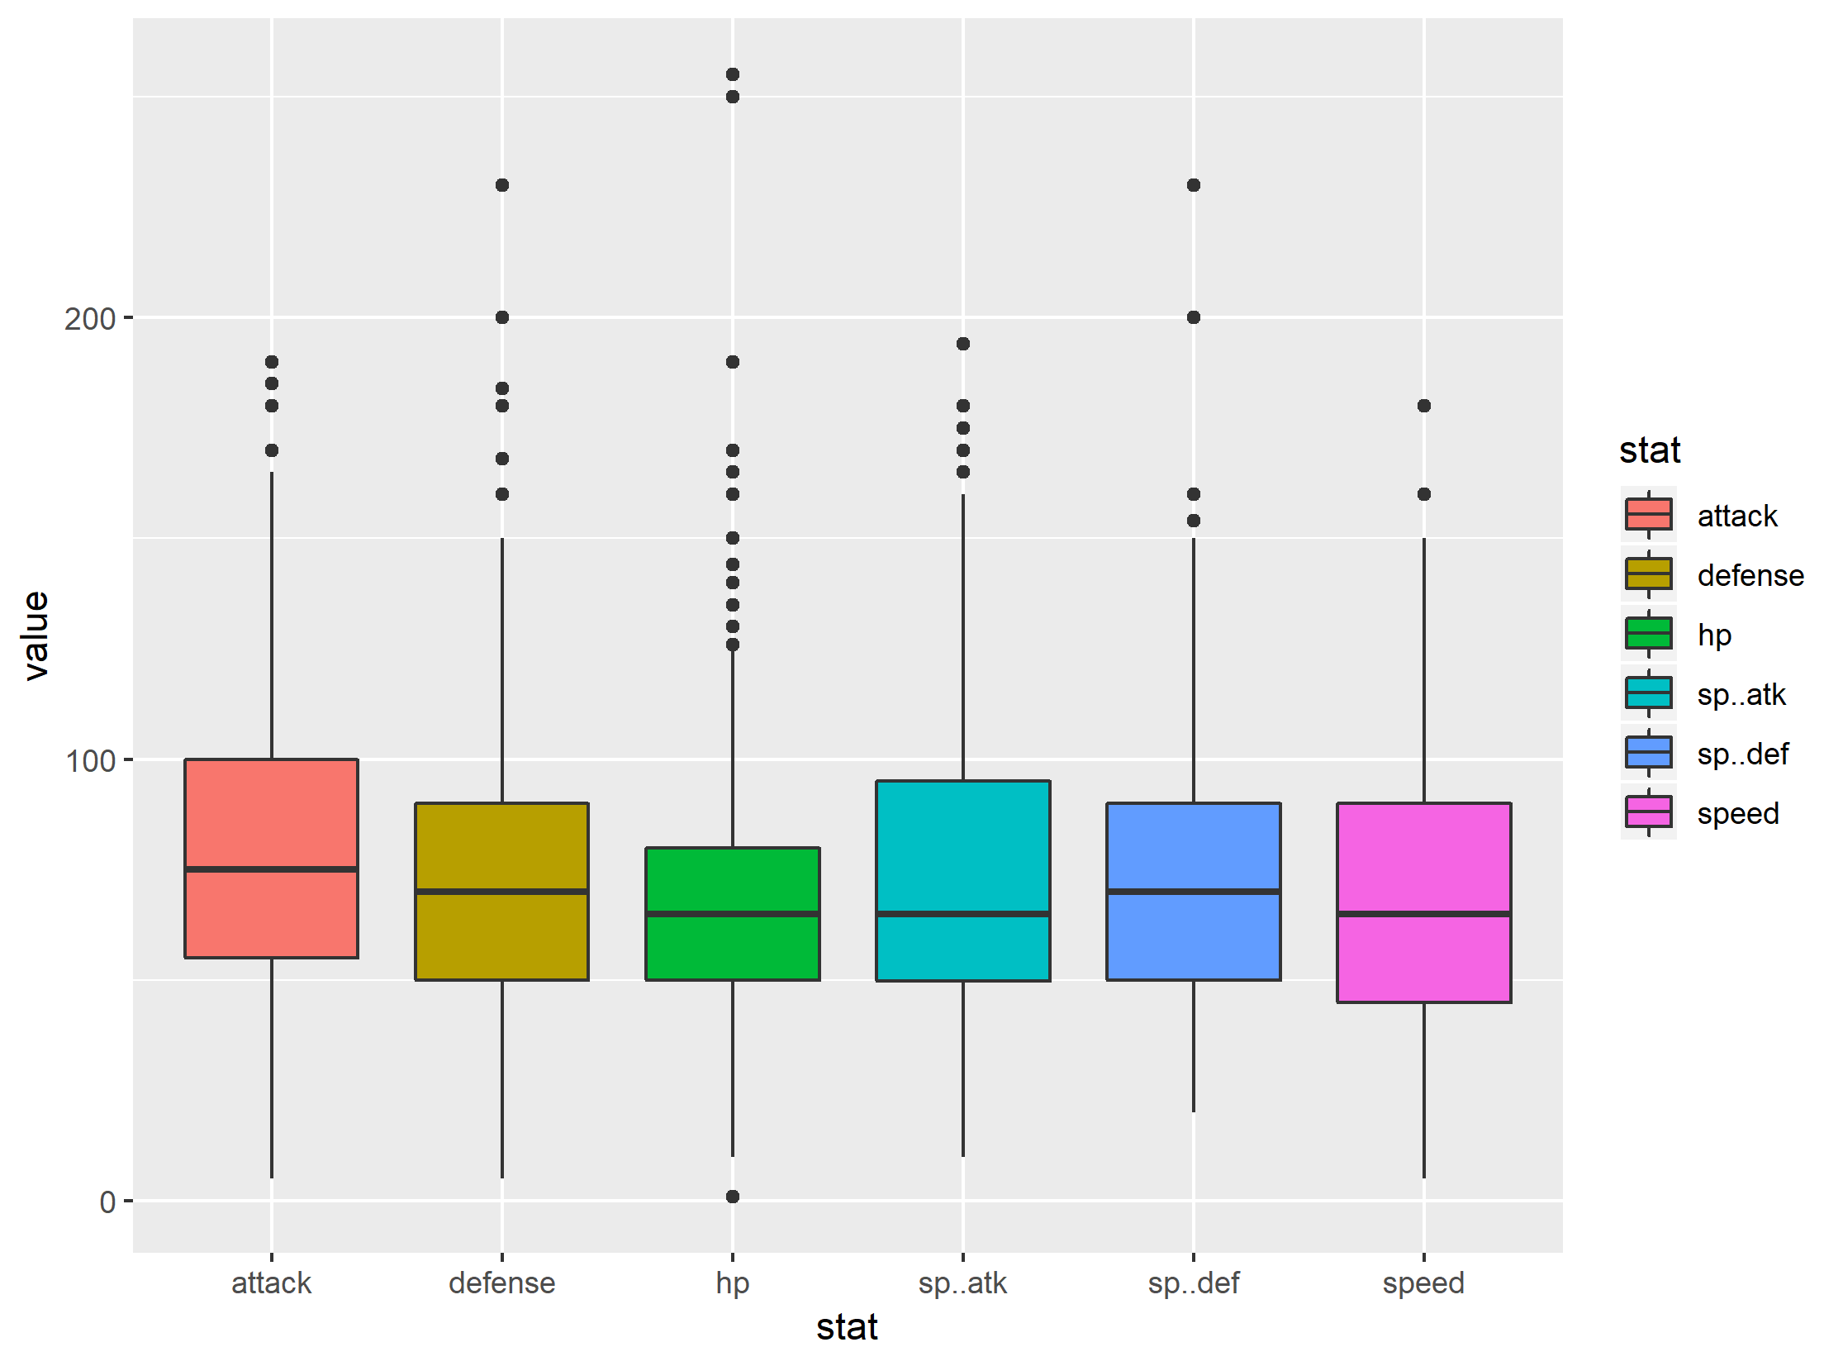
Stat information

Slide 11
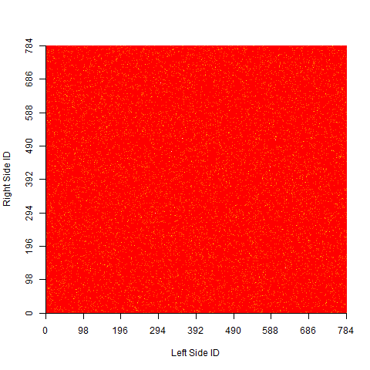
Combat information
Red indicates no matchup, yellow indicates a matchup, between indicated IDs
7.8% of the space is covered, with 7.3% of those duplicated (3650/50000)

Slide 12
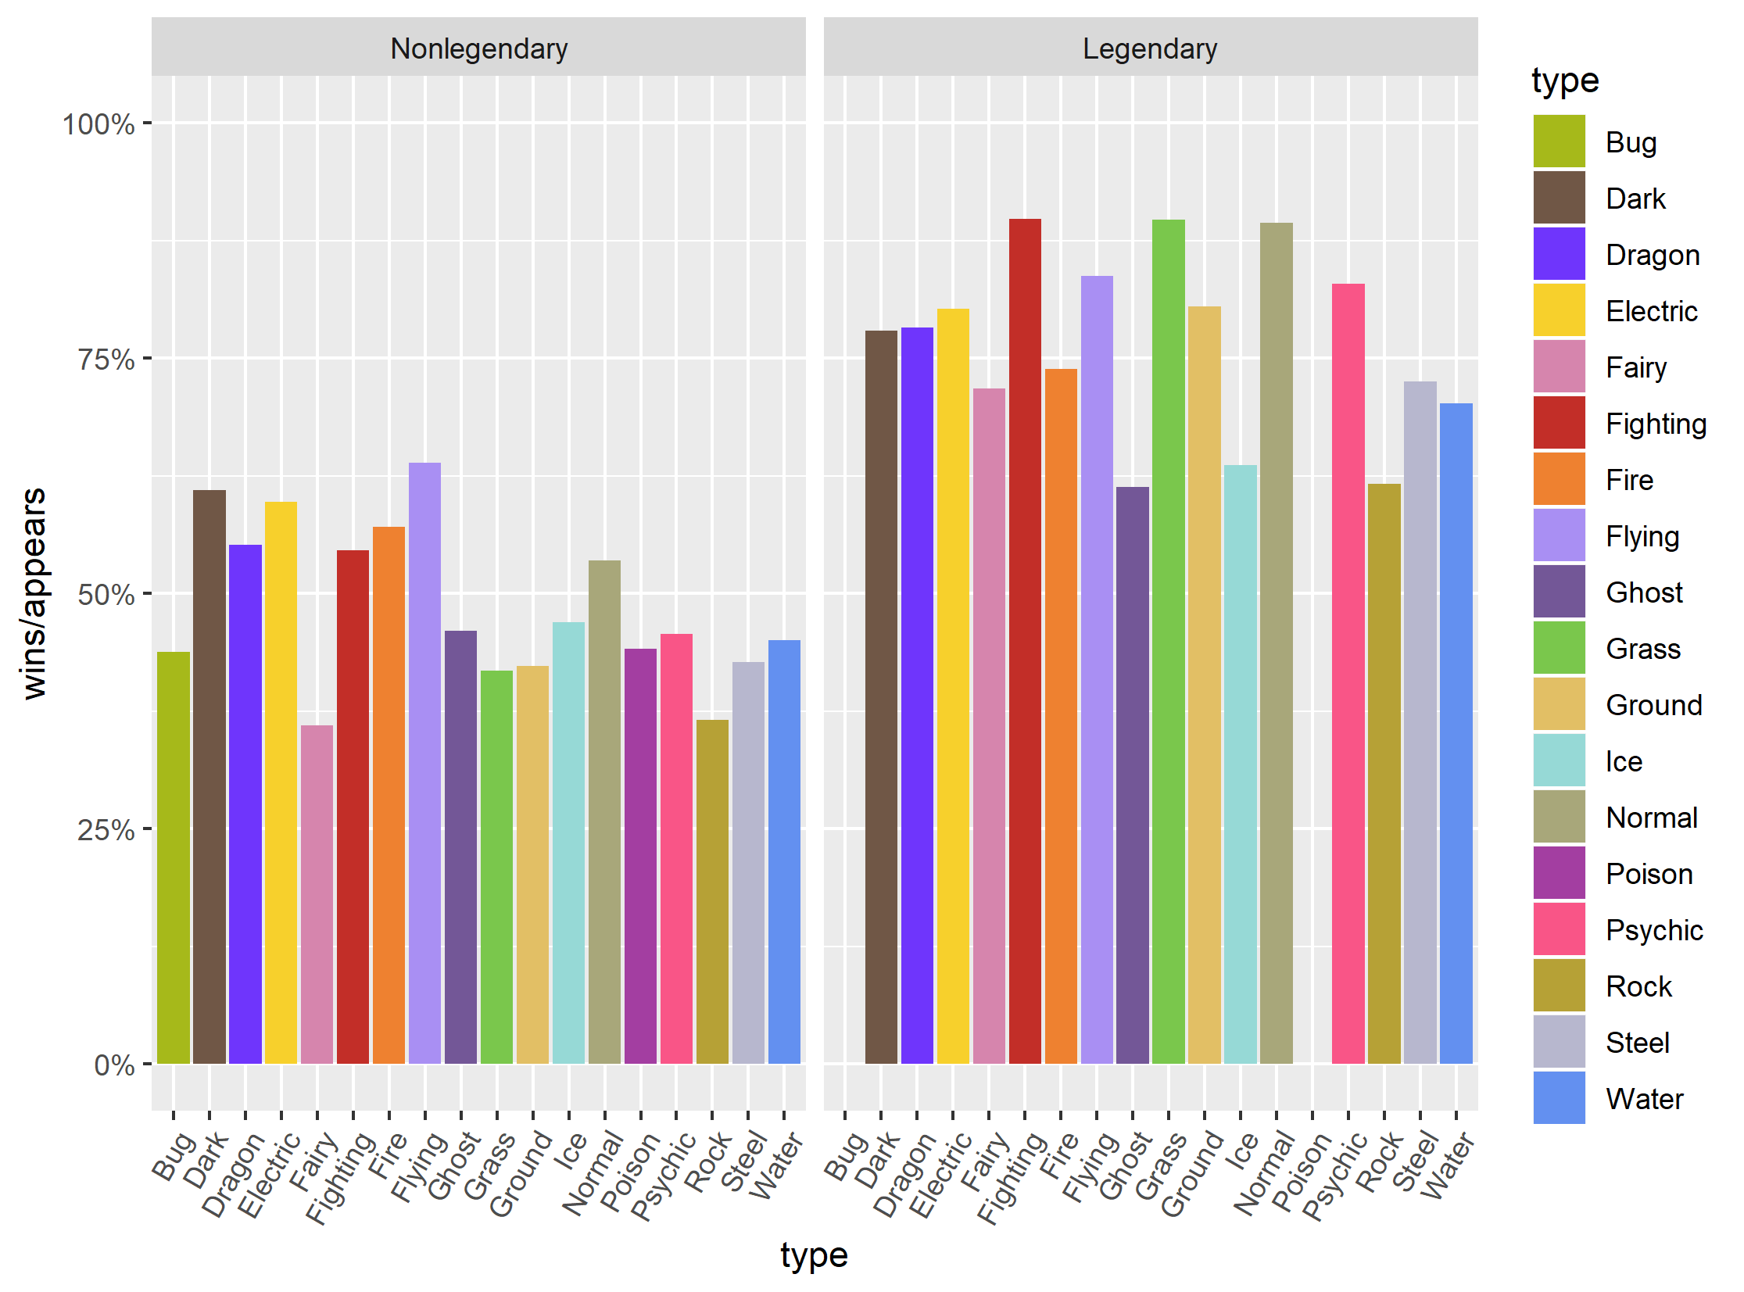
Combat information
Win ratio by type
Type does not seem to have much effect on win ratio
Legendary-ness does, but that is an artifact of stat distributions…

Slide 13
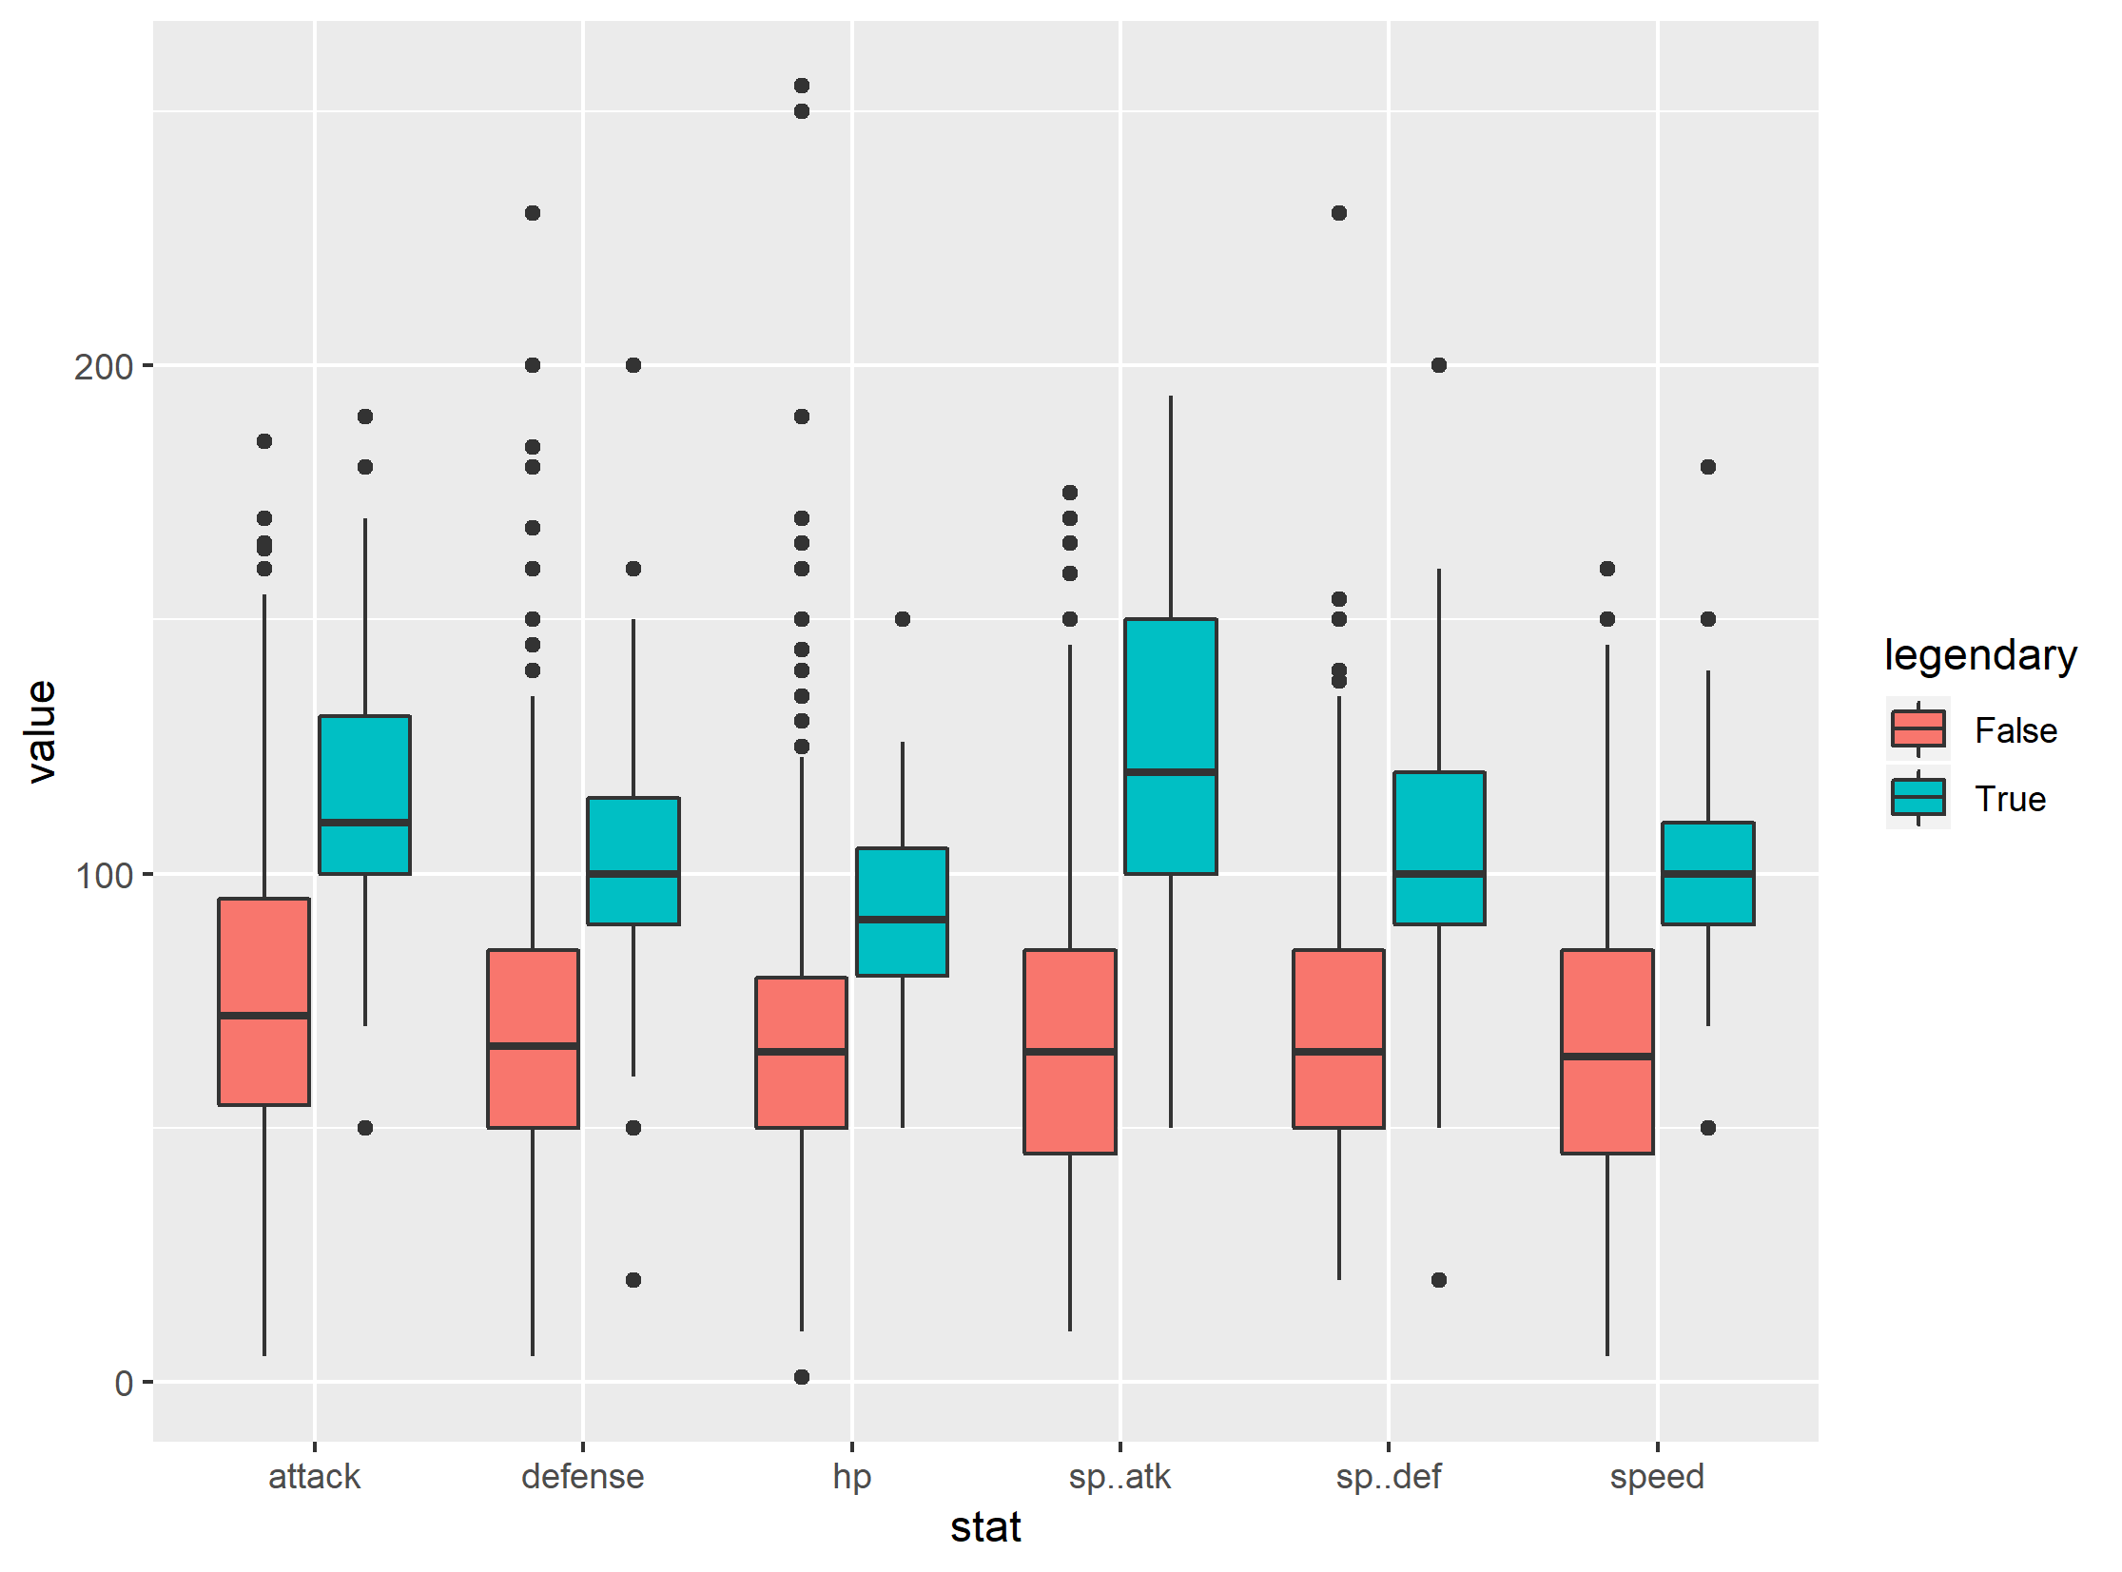
Effect of legendary-ness
Legendary pokemon happen to have higher stats
Stats appear to correlate with win rate, which is expected

Slide 14
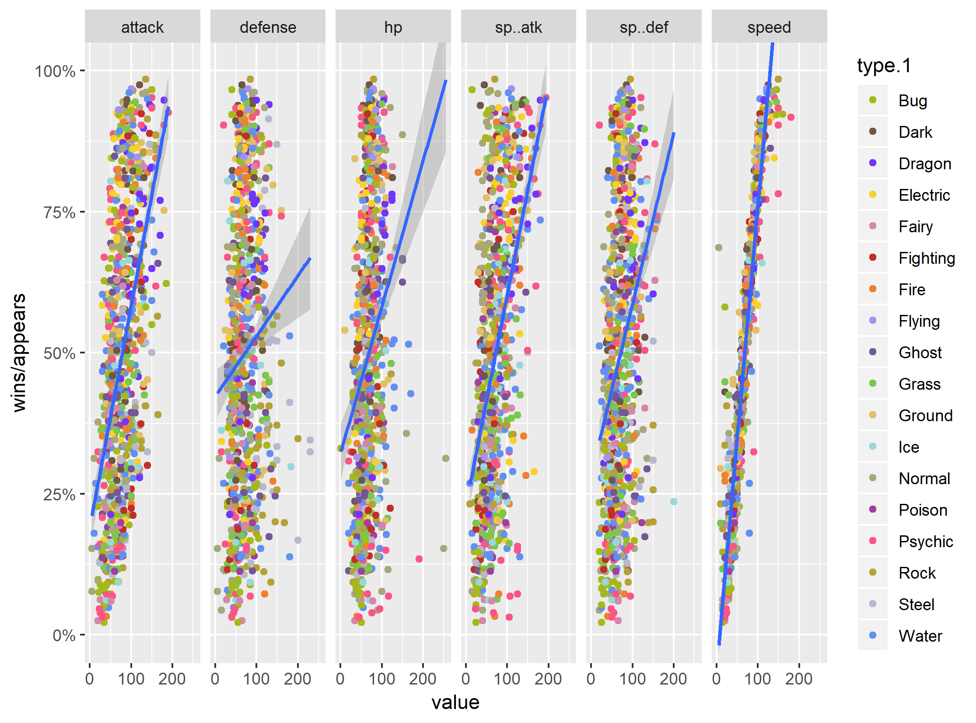
Win ratio vs stat
Scatterplot of win ratio vs. stat, broken out by stat, with first type colored
Speed correlates most strongly with win ratio

Slide 15
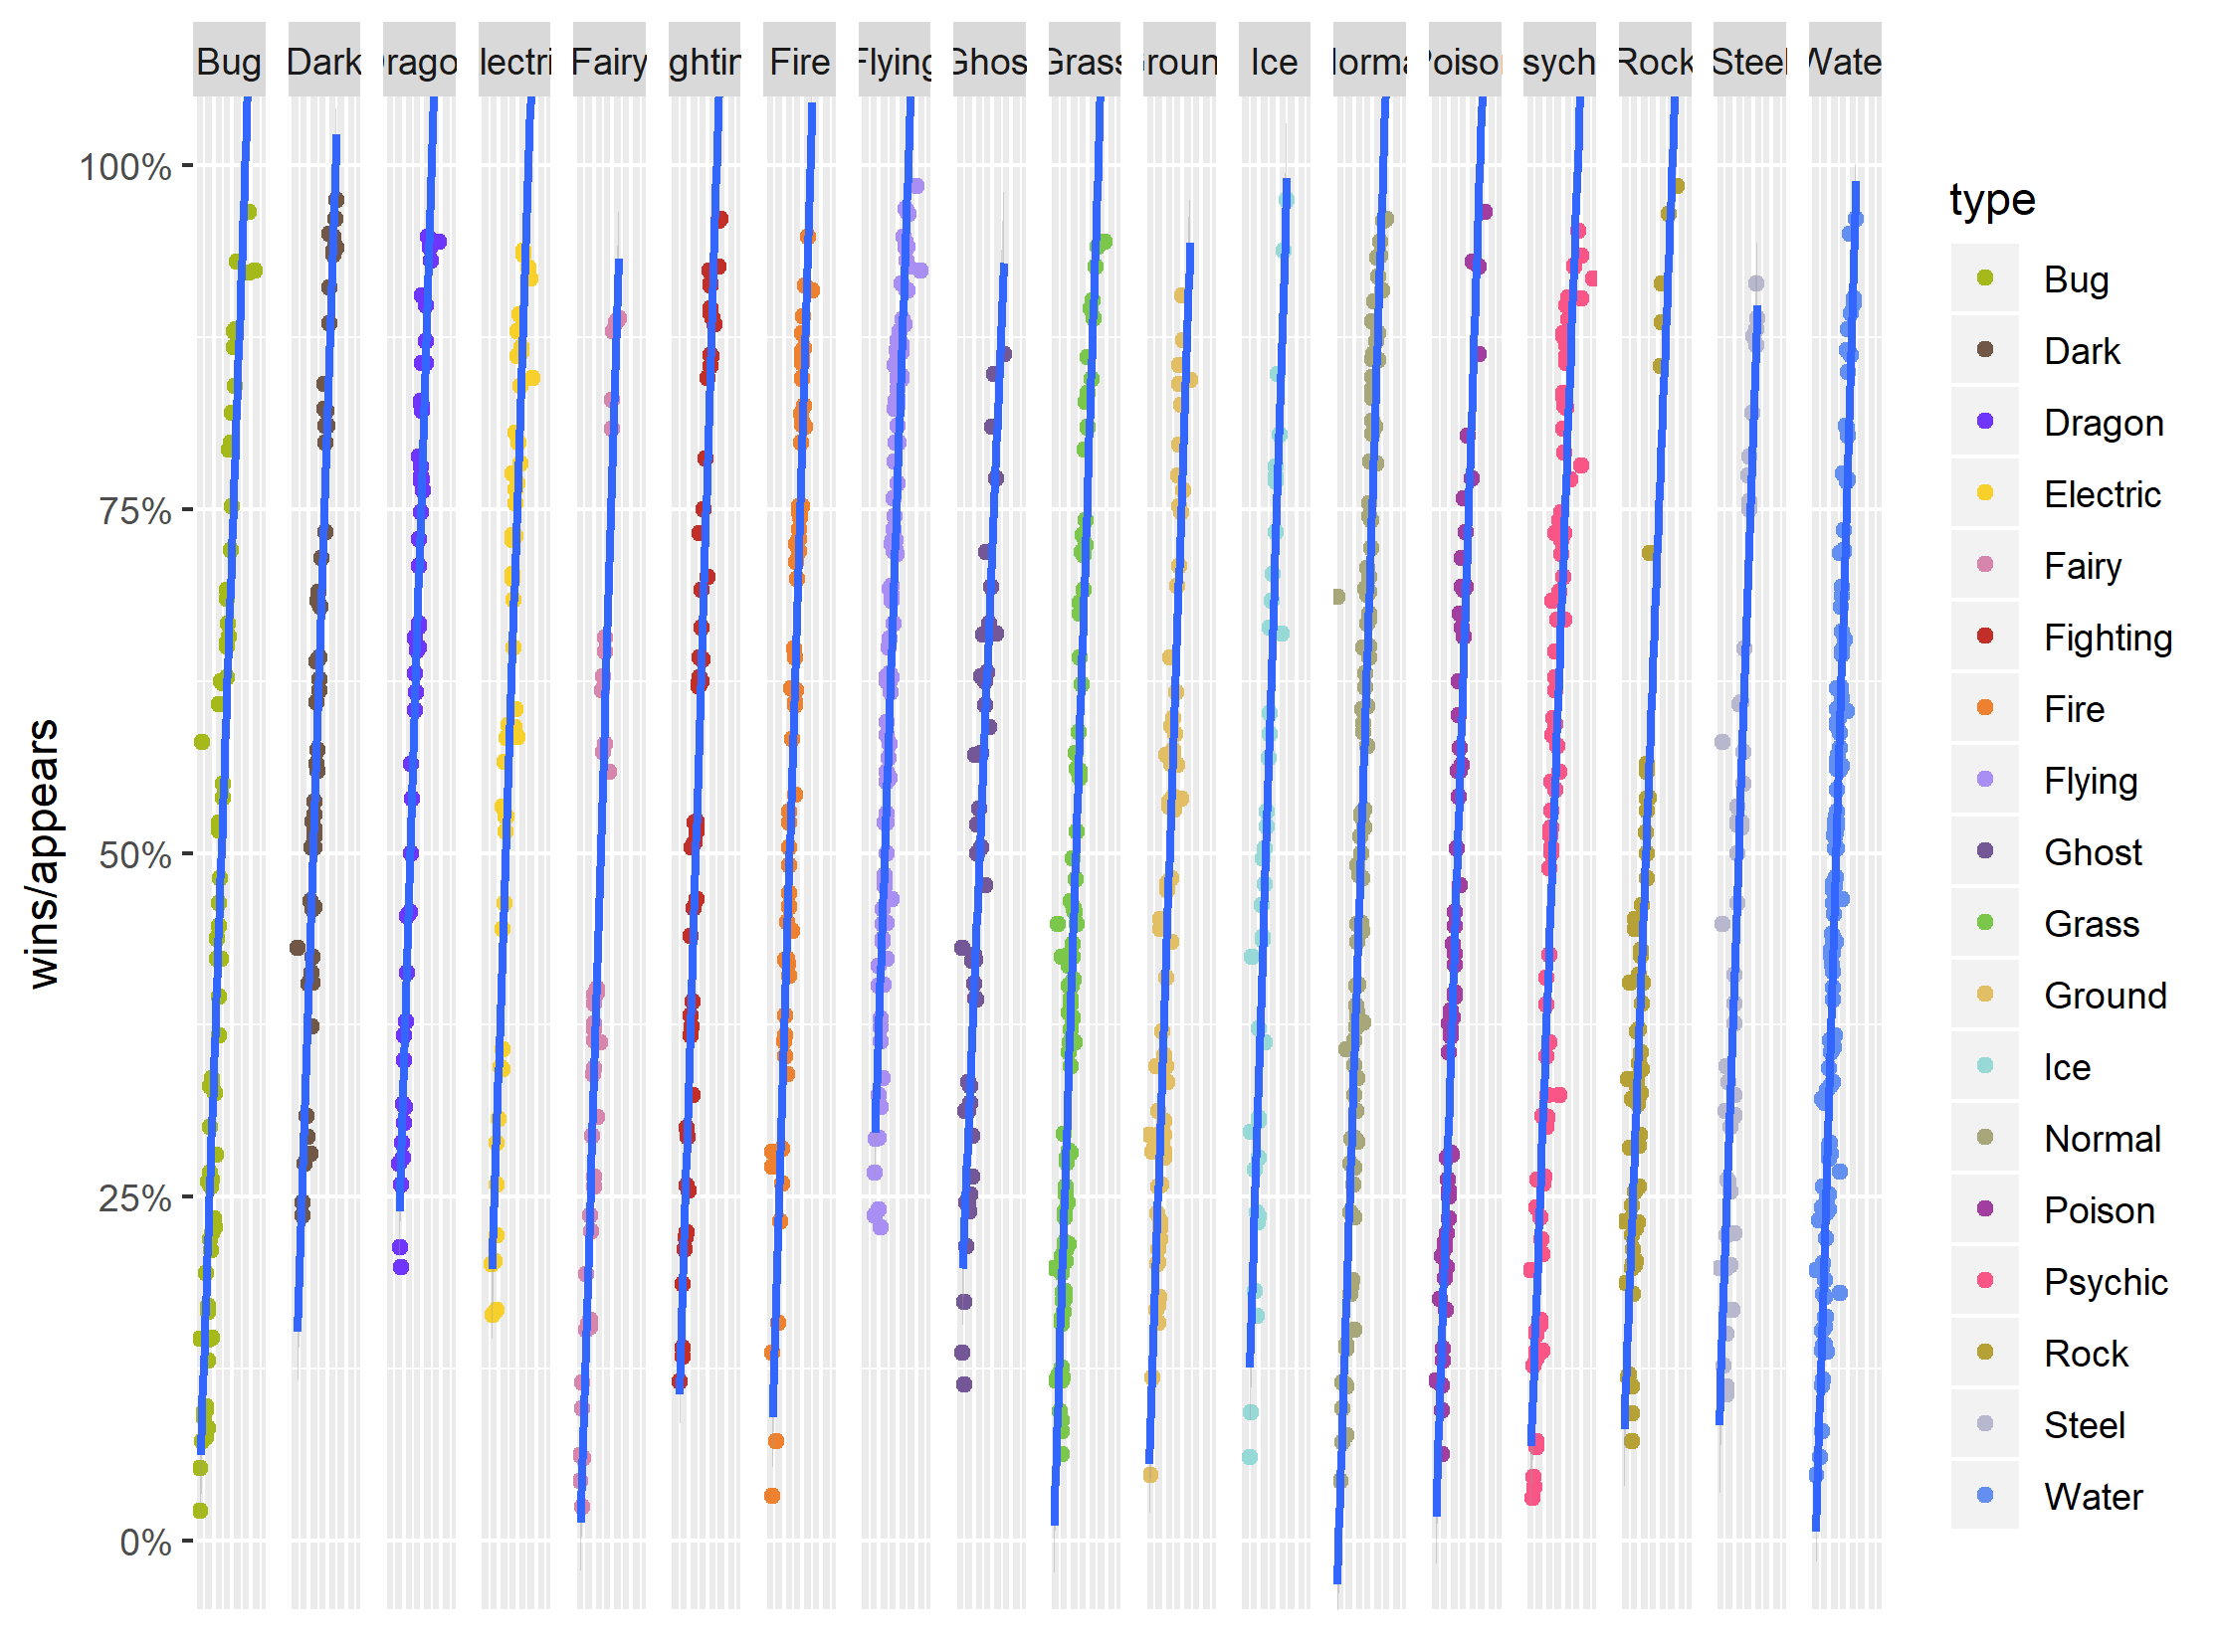
Simpson’s paradox?
Scatterplot of win ratio vs. speed, broken out by first type
First type does not appear to have an effect on overall correlation

Slide 16
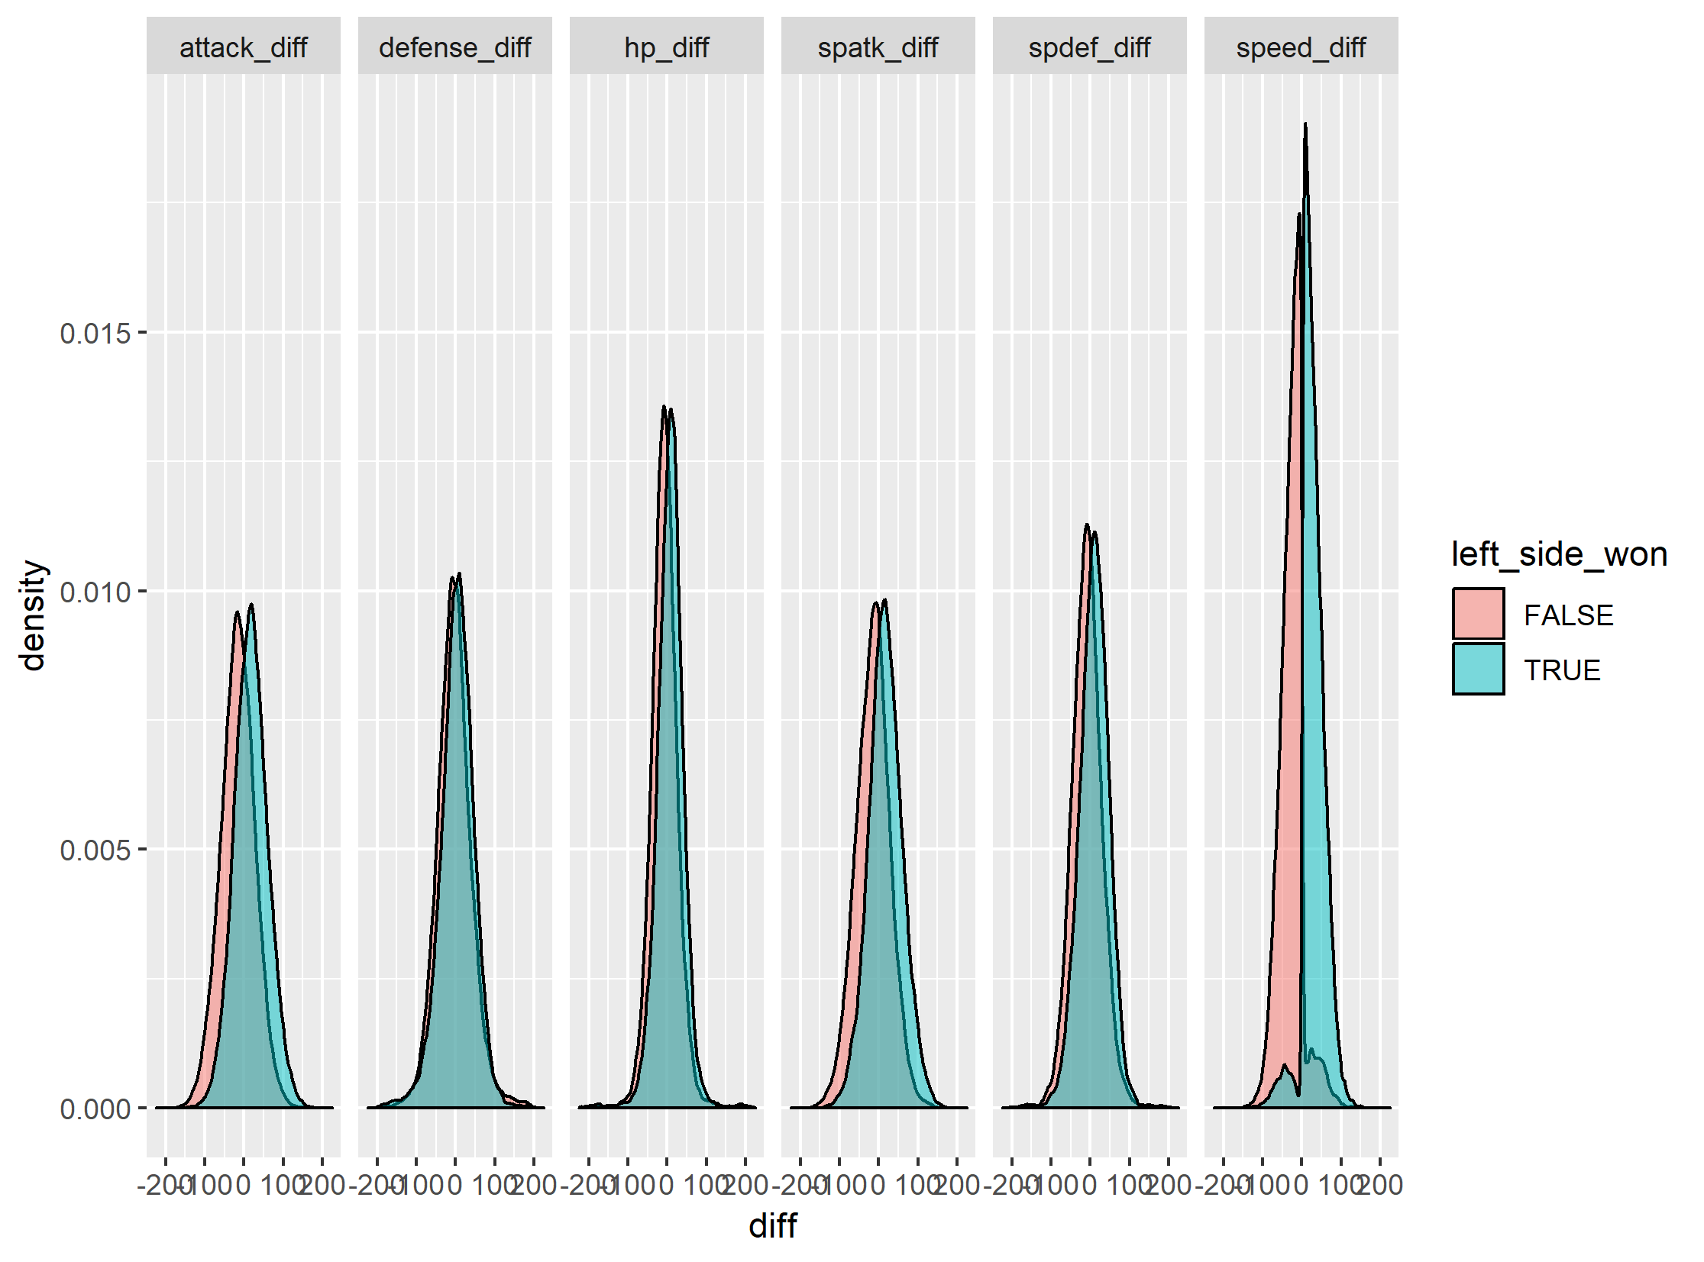
What about stat differences?
Distribution plots of winner, broken out by stat difference
Large overlap for each difference, except speed

Slide 17
Attempting to model combat
Based on domain knowledge model combat as:
atk_advantage = my_attack / op_defense
Same with sp atk
Find max of atk/sp_atk advantage for left and right
Find difference between left and right
Treat as new stat

Slide 18
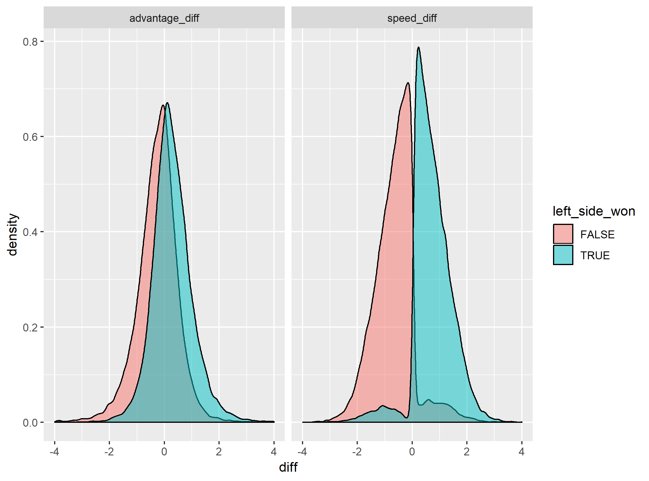
Attempting to model combat
Distribution plots of winner, broken out by advantage or speed
This model still has significant overlap, speed is dominant

Slide 19
Predicting winners
Because speed has a sharp division, expect tree-based ML to perform well
First perform initial using bagged trees with MATLAB defaults
maxnumsplits = #obs – 1
numlearningcycles = 30
Use 10-fold cross-validation
MATLAB R2018a
Seed = 314159

Slide 20
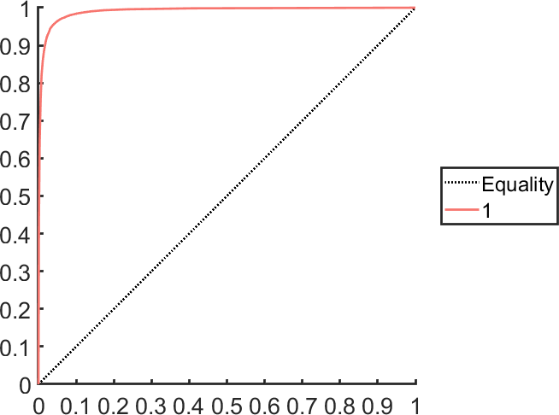
Prediction model
MATLAB R2018a, seed = 314159
 | Predicted Class
True Class |  | Loss | Win
 | Loss | 25208 | 1191
 | Win | 943 | 22658
AUROC = 0.990,
Optimal Threshold = 0.600,
Accuracy = 0.957
Prediction is reasonably good. What can hyperparameter optimization do?

Slide 21
Hyperparameter Optimization
Optimize on MATLAB defaults for ensemble models
Ensemble method
Number of Learning Cycles
Learn Rate
Min Leaf Size
Use 10-fold cross-validation
MATLAB R2018a
Seed = 314159

Slide 22

Hyperparameter Optimization
MATLAB R2018a, seed = 314159
 | Predicted Class
True Class |  | Loss | Win
 | Loss | 25146 | 1253
 | Win | 913 | 22688
AUROC = 0.992,
Optimal Threshold = 0.605,
Accuracy = 0.957
No particular improvement over initial trial

Slide 23
Future Directions
Try additional combat models as pseudo-stats using domain-specific research
Try other ML models (SVM in particular)
Enhance data by incorporating actual battles between pokemon in practice, instead of simulated battles
Develop data product from model

Slide 24
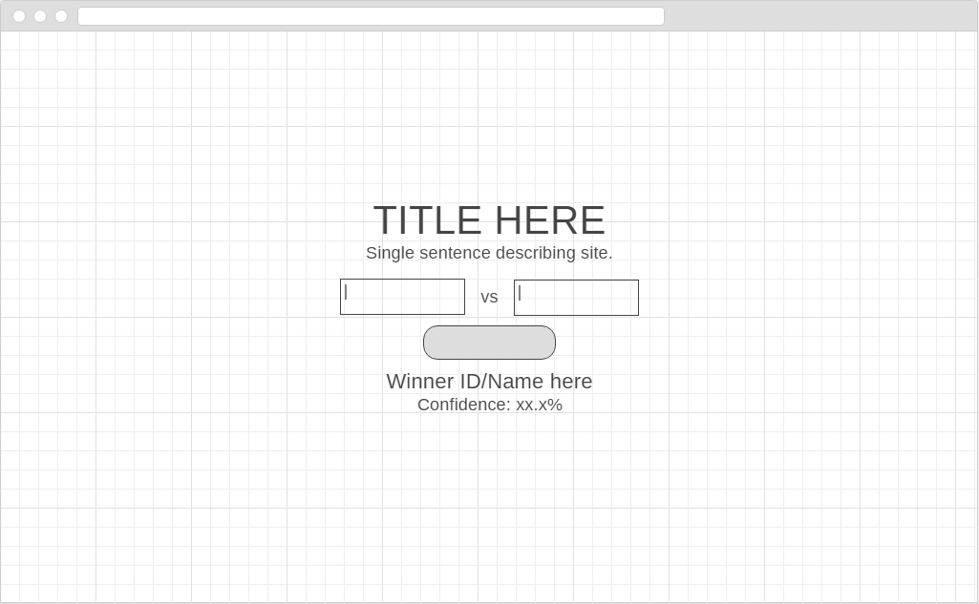
Data product idea
https://wireframe.cc/uMlSu5

Slide 25
Data product idea
Set up website with simple interface
Title
Short description
Two search-based drop-downs to find pokemon
Can search by ID or by name
Button to predict results
Backend is model stored on AWS/Azure as backend (or private server)
Use case:
User navigates to site
User enters two pokemon, presses button
Predicted winner is shown, along with win confidence

