Slide 1





Go up stairs
for x₀∈[0,14]
if x_{n+1}＜0, x_{n+1}∈[0,7]
if x_{n+1}＞14, x_{n+1}∈[8,14]
Randomly Select x₀∈[0,30]
Ncs(H) =ψ(x)=f(x+8)
for x₀∈[18,30]
Ncs(C)=g(x)=f(x-18)
(x≥18)
if x_{n+1}＜18,则x_{n+1}∈[18,24]
if x_{n+1}＞30,则x_{n+1}∈[25,30]
Record where x=x
Go Downstairs
Ncs(M) =f(x)
if x_{n+1}＜4,则x_{n+1}∈[4,9]
Ncs(H) =ψ(x)=f(x-8)
Randomly select x₀∈[4,14]
if x_{n+1}＞14,则x_{n+1}∈[10,14]
Ncs(C)=g(x)=f(x+18)
Notes:
if x_{n+1}＞14, x_{n+1}∈[8,14]

Slide 2
Ncs表示落点的个数
N_{UP} : 待定人次 M:The pressure centers of Metatarsals Two and Three Metatarsals Four and Five
H: The pressure centers of Hallux C: The pressure centers of Medial Calcaneus Lateral Calcaneus

Slide 3
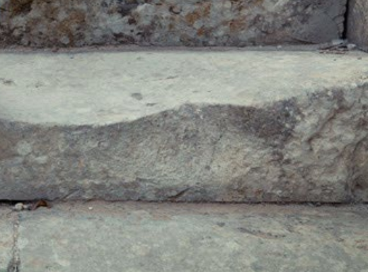


y
③
x
④
②
①
y
x

