Slide 1
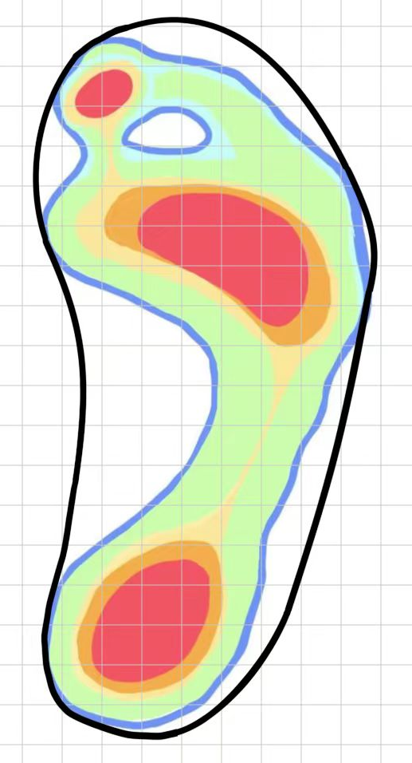
A Total of 118 Squares
19 Squares
13 Squares

Slide 2
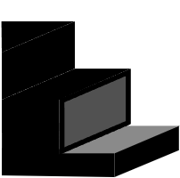

Weathering
A countertop
The actual footprint section

Slide 3
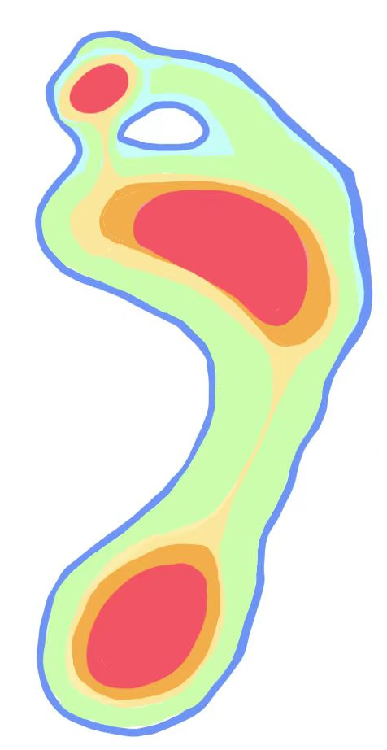
Hallux
Metatarsals two and three Metatarsals four and five
Medial Calcaneus
Lateral Calcaneus

