Slide 1
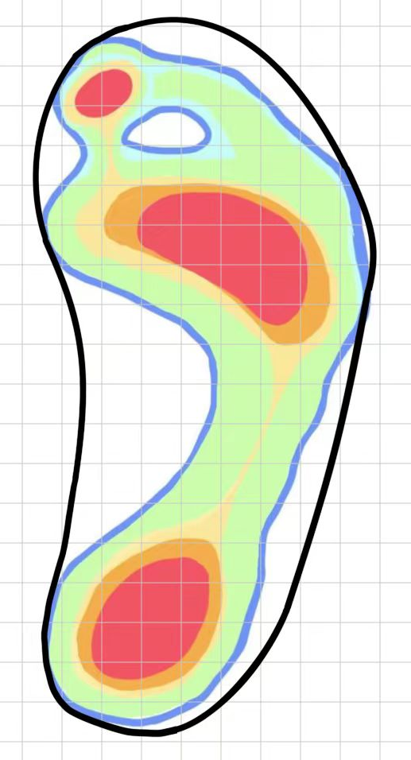
a total of 118 grids
19 grids
13 grids

Slide 2
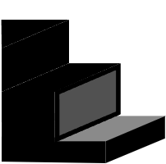

weathering section
a countertop
the actual footprint section

Slide 3
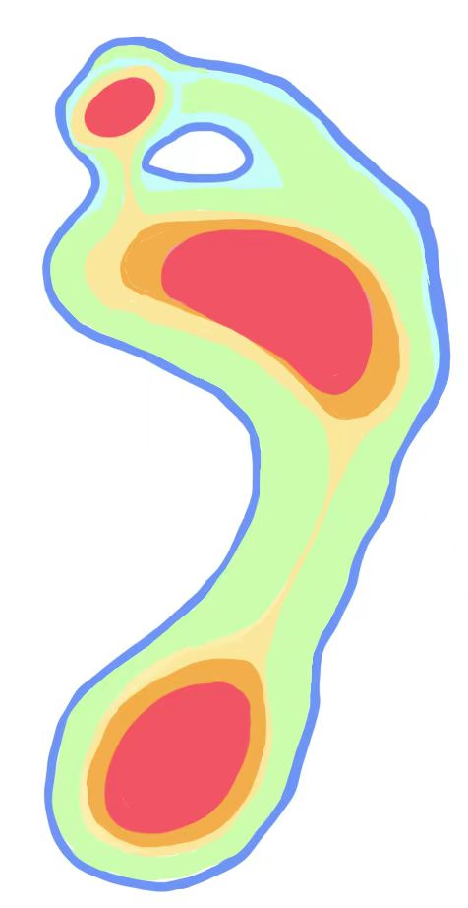
Hallux
Metatarsals two and three Metatarsals four and five
Medial Calcaneus
Lateral Calcaneus

