Slide 1
Probabilistic Record Linkage:
A Short Tutorial
William W. Cohen
CALD

Slide 2

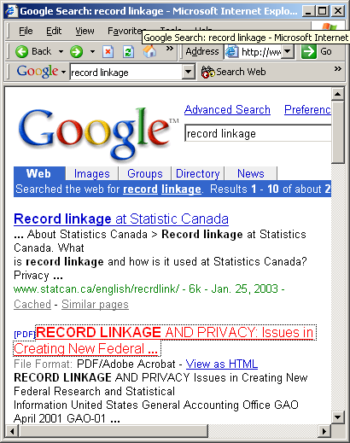

Slide 3
Record linkage: definition
Record linkage: determine if pairs of data records describe the same entity
  I.e., find record pairs that are co-referent
  Entities: usually people (or organizations or…)
  Data records: names, addresses, job titles, birth dates, …
Main applications:
  Joining two heterogeneous relations
  Removing duplicates from a single relation

Slide 4
Record linkage: terminology
The term “record linkage” is possibly co-referent with:
  For DB people: data matching, merge/purge, duplicate detection, data cleansing, ETL (extraction, transfer, and loading), de-duping
  For AI/ML people: reference matching, database hardening
  In NLP: co-reference/anaphora resolution
  Statistical matching, clustering, language modeling, …

Slide 5
Record linkage: approaches
Probabilistic linkage
  This tutorial
Deterministic linkage
  Test equality of normalized version of record
    Normalization loses information
    Very fast when it works!
  Hand-coded rules for an “acceptable match”
    e.g. “same SSNs, or same zipcode, birthdate, and Soundex code for last name”
    difficult to tune, can be expensive to test

Slide 6
Record linkage: goals/directions
Toolboxes vs. black boxes:
  To what extent is record linkage an interactive, exploratory, data-driven process? To what extent is it done by a hands-off, turn-key, autonomous system?
General-purpose vs. domain-specific:
  To what extent is the method specific to a particular domain? (e.g., Australian mailing addresses, scientific bibliography entries, …)

Slide 7
Record linkage tutorial: outline
Introduction: definition and terms, etc
Overview of the Fellegi-Sunter model
  Classify pairs as link/nonlink
Main issues in Felligi-Sunter model
Some design decisions
  from original Felligi-Sunter paper
  other possibilities

Slide 8
Felligini-Sunter: notation
Two sets to link: A and B
A x B = {(a,b) : a2A, b2B} = M [ U
  M = matched pairs, U= unmatched pairs
Record for a2 A is α(a), for b2 B is β(b)
Comparison vector, written γ(a,b), contains “comparison features” (e.g., “last names are same”, “birthdates are same year”, …)
  γ(a,b)=h γ¹(α(a),β(b)),…, γ^{K}(α(a),β(b))i
Comparison space Γ = range of γ(a,b)

Slide 9
Felligini-Sunter: notation
Three actions on (a,b):
  A₁: treat (a,b) as a match
  A₂: treat (a,b) as uncertain
  A₃: treat (a,b) as a non-match
A linkage rule is a function
  L: Γ ! {A₁,A₂,A₃}
Assume a distribution D over A x B:
  m(γ) = Pr_{D}( γ(a,b) | (a,b)2 M )
  u(γ) = Pr_{D}( γ(a,b) | (a,b)2 U )

Slide 10
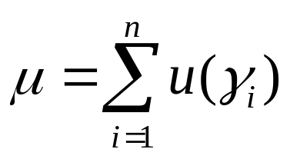
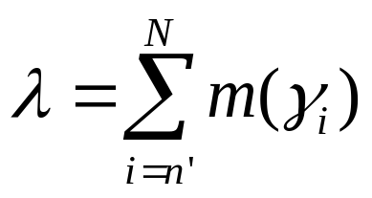
Felligini-Sunter: main result
Suppose we sort all γ’s by m(γ)/u(γ), and pick n< n’ so
Then the best* linkage rule with Pr(A₁|U)=μ and Pr(A₃|M)=λ is:
  γ₁…,γ_{n}, γ_{n+1},…,γ_{n’-1},γ_{n’},…,γ_{N}
m(γ)/u(γ) large
m(γ)/u(γ) small
A₁
A₂
A₃
*Best = minimal Pr(A₂)

Slide 11
Felligini-Sunter: main result
Intuition: consider changing the action for some γ_{i} in the list, e.g. from A₁ to A₂.
  To keep μ constant, swap some γ_{j} from A₂ to A₁.
  …but if u(γ_{j})=u(γ_{i}) then m(γ_{j})<m(γ_{i})…
  …so after the swap, P(A₂) is increased by m(γ_{i})-m(γ_{j})
m_{i}/u_{i}
m_{j}/u_{j}
γ₁,…,γ_{i},…,γ_{n},γ_{n+1},…,γ_{j},…,γ_{n’-1},γ_{n’},…,γ_{N}
m(γ)/u(γ) large
A₁
A₂
A₃
m(γ)/u(γ) small

Slide 12
Felligini-Sunter: main result
Allowing ranking rules to be probabilistic means that one can achieve any Pareto-optimal combination of μ,λ with this sort of threshold rule
Essentially the same result is known as the probability ranking principle in information retrieval (Robertson ’77)
  PRP is not always the “right thing” to do: e.g., suppose the user just wants a few relevant documents
  Similar cases may occur in record linkage: e.g., we just want to find matches that lead to re-identification

Slide 13
Main issues in F-S model
Modeling and training:
  How do we estimate m(γ), u(γ) ?
Making decisions with the model:
  How do we set the thresholds μ and λ?
Feature engineering:
  What should the comparison space Γ be?
    Distance metrics for text fields
    Normalizing/parsing text fields
Efficiency issues:
  How do we avoid looking at |A| * |B| pairs?

Slide 14
Issues for F-S: modeling and training
How do we estimate m(γ), u(γ) ?
  Independence assumptions on γ=hγ¹,…,γ^{K}i
    Specifically, assume γ^{i}, γ^{j} are independent given the class (M or U) - the naïve Bayes assumption
  Don’t assume training data (!)
    Instead look at chance of agreement on “random pairings”

Slide 15
Issues for F-S: modeling and training
Notation for “Method 1”:
  p_{S}(j) = empirical probability estimate for name j in set S (where S=A, B, AÅB)
  e_{S} = error rate for names in S
Consider drawing (a,b) from A x B and measuring γ^{j}= “names in a and b are both name j” and γ^{neq} = “names in a and b don’t match”

Slide 16
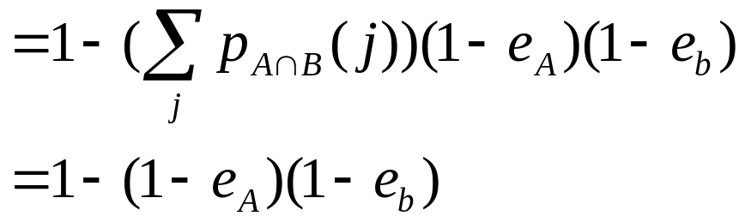
Issues for F-S: modeling and training
Notation:
  p_{S}(j) = empirical probability estimate for name j in set S (where S=A, B, AÅB)
  e_{S} = error rate for names in S
m(γ^{joe}) = Pr( γ^{joe}| M) = p_{AÅB}(joe)(1-e_{A})(1-e_{B})
m(γ^{neq})

Slide 17
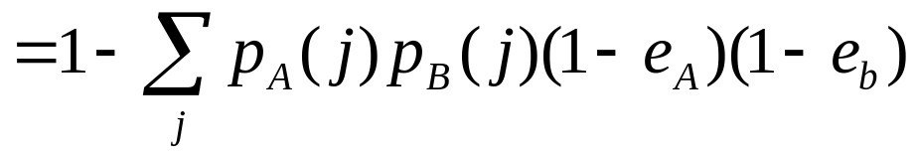
Issues for F-S: modeling and training
Notation:
  p_{S}(j) = empirical probability estimate for name j in set S (where S=A, B, AÅB)
  e_{S} = error rate for names in S
u(γ^{joe}) = Pr( γ^{joe}| U) = p_{A}(joe) p_{B}(joe)(1-e_{A})(1-e_{B})
u(γ^{neq})

Slide 18
Issues for F-S: modeling and training
Proposal: assume p_{A}(j)=p_{B}(j)=p_{AÅ B}(j) and estimate from A[B (since we don’t have AÅB)
Note: this gives more weight to agreement on rare names and less weight to common names.

Slide 19
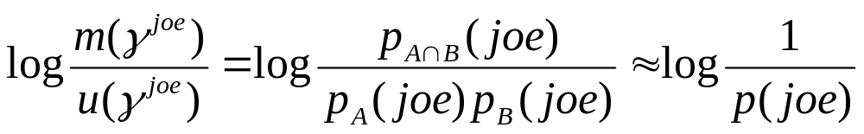
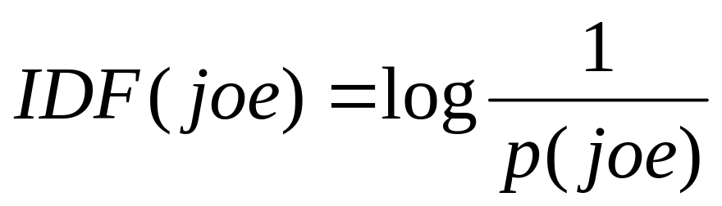
Issues for F-S: modeling and training
Aside: log of this weight is same as the inverse document frequency measure widely used in IR:
Lots of recent/current work on similar IR weighting schemes that are statistically motivated…

Slide 20
Issues for F-S: modeling and training
Alternative approach (Method 2):
  Basic idea is to use estimates for some γ^{i}’s to estimate others
  Broadly similar to E/M training (but less experimental evidence that it works)
  To estimate m(γ^{h}), use counts of
    Agreement of all components γ^{i}
    Agreement of γ^{h}
    Agreement of all components but γ^{h}, i.e. γ¹,…,γ^{h-1},γ^{h+1},γ^{K}

Slide 21
Main issues in F-S: modeling
Modeling and training: How do we estimate m(γ), u(γ) ?
  F-S: Assume independence, and a simple relationship between p_{A}(j), p_{B}(j) and p_{AÅ B}(j)
    Connections to language modeling/IR approach?
  Or: use training data (of M and U)
    Use active learning to collect labels M and U
  Or: use semi- or un-supervised clustering to find M and U clusters (Winkler)
  Or: assume a generative model of records a or pairs (a,b) and find a distance metric based on this
    Do you model the non-matches U ?

Slide 22
Main issues in F-S model
Modeling and training:
  How do we estimate m(γ), u(γ) ?
Making decisions with the model:
  How do we set the thresholds μ and λ?
Feature engineering:
  What should the comparison space Γ be?
    Distance metrics for text fields
    Normalizing/parsing text fields
Efficiency issues:
  How do we avoid looking at |A| * |B| pairs?

Slide 23
Main issues in F-S: efficiency
Efficiency issues: how do we avoid looking at |A| * |B| pairs?
Blocking: choose a smaller set of pairs that will contain all or most matches.
  Simple blocking: compare all pairs that “hash” to the same value (e.g., same Soundex code for last name, same birth year)
  Extensions (to increase recall of set of pairs):
    Block on multiple attributes (soundex, zip code) and take union of all pairs found.
    Windowing: Pick (numerically or lexically) ordered attributes and sort (e.g., sort on last name). The pick all pairs that appear “near” each other in the sorted order.

Slide 24
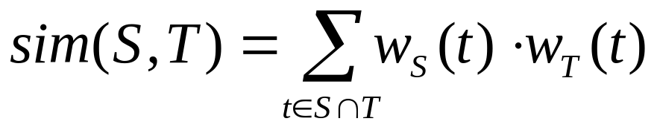
Main issues in F-S : efficiency
Efficiency issues: how do we avoid looking at |A| * |B| pairs?
Use a sublinear time distance metric like TF-IDF.
  The trick: similarity between sets S and T is
  So, to find things like S you only need to look sets T with overlapping terms, which can be found with an index mapping S to {terms t in S}
  Further trick: to get most similar sets T, need only look at terms t with large weight w_{S}(t) or w_{T}(t)

Slide 25
The “canopy” algorithm (NMU, KDD2000)
Input: set S, thresholds BIG, SMALL
Let PAIRS be the empty set.
Let CENTERS = S
While (CENTERS is not empty)
  Pick some a in CENTERS (at random)
  Add to PAIRS all pairs (a,b) such that SIM(a,b)<SMALL
  Remove from CENTERS all points b’ such that SIM(a,b)<BIG
Output: the set PAIRS

Slide 26
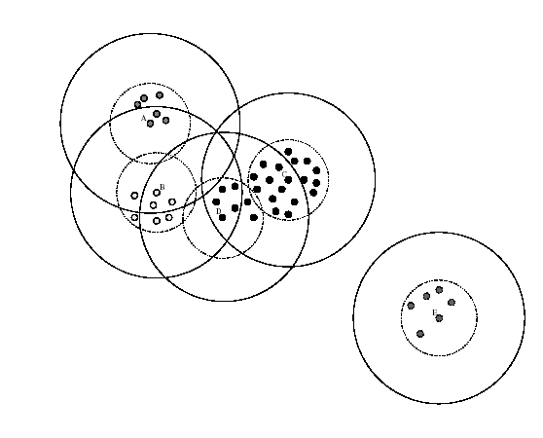
The “canopy” algorithm (NMU, KDD2000)

Slide 27
Main issues in F-S model
Making decisions with the model -?
Feature engineering: What should the comparison space Γ be?
  F-S: Up to the user (toolbox approach)
  Or: Generic distance metrics for text fields
    Cohen, IDF based distances
    Elkan/Monge, affine string edit distance
    Ristad/Yianolos, Bilenko/Mooney, learned edit distances

Slide 28
Main issues in F-S: comparison space
Feature engineering: What should the comparison space Γ be?
  Or: Generic distance metrics for text fields
    Cohen, Elkan/Monge, Ristad/Yianolos, Bilenko/Mooney
  HMM methods for normalizing text fields
    Example: replacing “St.” with “Street” in addresses, without screwing up “St. James Ave”
    Seymour, McCallum, Rosenfield
    Christen, Churches, Zhu
    Charniak

Slide 29
Record linkage tutorial summary
Introduction: definition and terms, etc
Overview of Fellegi-Sunter
Main issues in Felligi-Sunter model
  Modeling, efficiency, decision-making, string distance metrics and normalization
Outside the F-S model?
  Form constraints/preferences on match set
  Search for good sets of matches
    Database hardening (Cohen et al KDD2000), citation matching (Pasula et al NIPS 2002)

