Slide 1
Processing Strings with HMMs:
Structuring text and computing distances
William W. Cohen
CALD

Slide 2
Outline
Motivation: adding structure to unstructured text
Mathematics:
  Unigram language models (& smoothing)
  HMM language models
  Reasoning: Viterbi, Forward-Backward
  Learning: Baum-Welsh
Modeling:
  Normalizing addresses
  Trainable string edit distance metrics

Slide 3
Finding structure in addresses
William Cohen, 6941 Biddle St
Mr. & Mrs. Steve Zubinsky, 5641 Darlington Ave
Dr. Allan Hunter, Jr. 121 W. 7th St, NW.
Ava May Brown, Apt #3B, 14 S. Hunter St.
George St. George Biddle Duke III, 640 Wyman Ln.

Slide 4
Finding structure in addresses
Name | Number | Street
William Cohen, | 6941 | Biddle St
Mr. & Mrs. Steve Zubinsky, | 5641 | Darlington Ave
Dr. Allan Hunter, Jr. | 121 | W. 7th St, NW.
Ava May Brown, | Apt #3B, 14 | S. Hunter St.
George St. George Biddle Duke III, | 640 | Wyman Ln.
Knowing the structure may lead to better matching.
But, how do you determine which characters go where?

Slide 5
Finding structure in addresses
Name | Number | Street
William Cohen, | 6941 | Biddle St
Mr. & Mrs. Steve Zubinsky, | 5641 | Darlington Ave
Dr. Allan Hunter, Jr. | 121 | W. 7th St, NW.
Ava May Brown, | Apt #3B, 14 | S. Hunter St.
George St. George Biddle Duke III, | 640 | Wyman Ln.
Step 1: decide how to score an assignment of words to fields
Good!

Slide 6
Finding structure in addresses
Name | Number | Street
William Cohen, 6941 | Biddle | St
Mr. & Mrs. Steve Zubinsky, | 5641 Darlington | Ave
Dr. Allan Hunter | , Jr. 121 W. 7th St, | NW.
Ava May | Brown, Apt #3B, | 14 S. Hunter St.
George St. George Biddle | Duke III, 640 | Wyman Ln.
Not so good!

Slide 7
Finding structure in addresses
One way to score a structure:
  Use a language model to model the tokens that are likely to occur in each field
  Unigram model:
    Tokens are drawn with replacement with probability P(token=t| field=f) = p_{t,f}
    Vocabulary of N tokens has F*(N-1) parameters
    Can estimate p_{t,f} from a sample. Generally need to use smoothing (e.g. Dirichlet, Good-Turing)
    Might use special tokens, e.g. #### vs 6941
  Bigram model, trigram model: probably not useful here

Slide 8
Finding structure in addresses
Name | Number | Street
William Cohen, 6941 | Biddle | St
Mr. & Mrs. Steve Zubinsky, | 5641 Darlington | Ave
Examples:
P(william|Name) = pretty high
P(6941|Name) = pretty low
P(Zubinsky|Name) = low, but so is P(Zubinsky|Number)
compared to P(6941|Number)

Slide 9
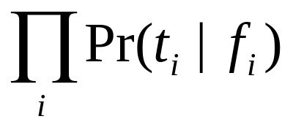
Finding structure in addresses
Name | Name | Number | Street | Street
William | Cohen | 6941 | Rosewood | St
Each token has a field variable - what model it was drawn from.
Structure-finding is inferring the hidden field-variable value.
Prob(string|structure) =
Prob(structure) = Prob( f₁, f₂, … f_{K} ) = ????

Slide 10
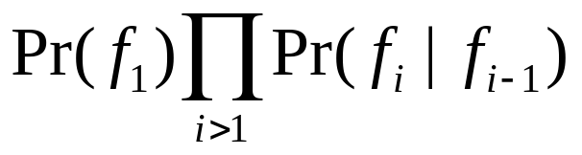
Finding structure in addresses
Name | Name | Number | Street | Street
William | Cohen | 6941 | Rosewood | St
Pr(f_{i}=Num|f_{i-1}=Num)
Name
Num
Street
Each token has a field variable - what model it was drawn from.
Structure-finding is inferring the hidden field-variable value.
Pr(f_{i}=Street|f_{i-1}=Num)
Prob(string|structure) =
Prob(structure) = Prob( f₁, f₂, … f_{K} ) =

Slide 11
Hidden Markov Models
Hidden Markov model:
  Set of states, each with a emission distribution P(t|f) and a next-state transition distribution P(g|f)
  Designated final state, and a start distribution.
Pr(f_{i}=Num|f_{i-1}=Num)
Kumar | 0.0013
Dave | 0.0015
Steve | 0.2013
… | …
Name
Num
Street
### | 0.345
Apt | 0.123
… | …
$ | 1.0

Slide 12
Hidden Markov Models
Hidden Markov model:
  Set of states, each with a emission distribution P(t|f) and a next-state transition distribution P(g|f)
  Designated final state, and a start distribution P(f1).
Generate a string by
Pick f1 from P(f1)
Pick t1 by Pr(t|f1).
Pick f2 by Pr(f2|f1).
Repeat…
Pr(f_{i}=Num|f_{i-1}=Num)
Name
Num
Street

Slide 13
Hidden Markov Models
Name
Name
Num
Street
Street
William
Cohen
6941
Rosewood
St
Generate a string by
Pick f1 from P(f1)
Pick t1 by Pr(t|f1).
Pick f2 by Pr(f2|f1).
Repeat…
Name
Num
Street

Slide 14
Bayes rule for HMMs
Question: given t1,…,tK, what is the most likely sequence of hidden states f1,…,fK ?
Name |  | Name |  | Name |  | Name |  | Name
Num |  | Num |  | Num |  | Num |  | Num
Str |  | Str |  | Str |  | Str |  | Str
William |  | Cohen |  | 6941 |  | Rosewd |  | St

Slide 15
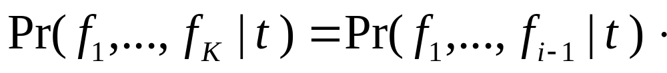
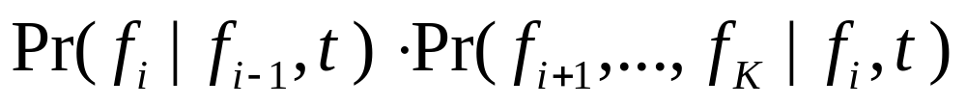
Bayes rule for HMMs
Key observation:
Name |  | Name |  | Name |  | Name |  | Name
Num |  | Num |  | Num |  | Num |  | Num
Str |  | Str |  | Str |  | Str |  | Str
William |  | Cohen |  | 6941 |  | Rosewd |  | St

Slide 16
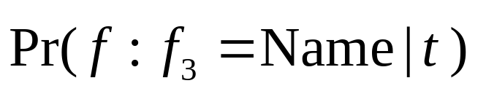
Bayes rule for HMMs
Look at one hidden state:
Name |  | Name |  | Name |  | Name |  | Name
Num |  | Num |  | Num |  | Num |  | Num
Str |  | Str |  | Str |  | Str |  | Str
William |  | Cohen |  | 6941 |  | Rosewd |  | St

Slide 17
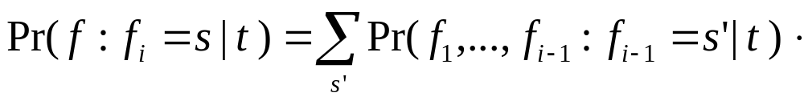
Bayes rule for HMMs
Easy to calculate!
Compute with dynamic programming…

Slide 18
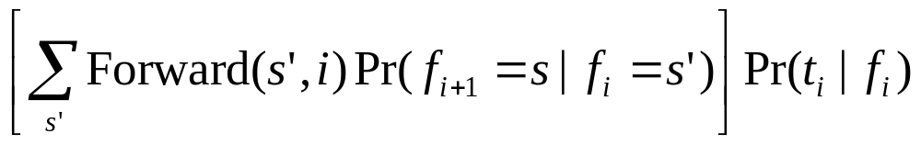
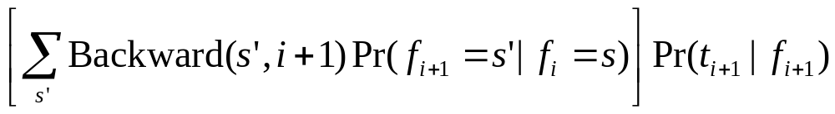
Forward-Backward
Forward(s,1) = Pr(f₁=s)
Forward(s,i+1) =
Backward(s,K) = 1 for the final state s
Backward(s,i) =

Slide 19
Forward-Backward
Name |  | Name |  | Name |  | Name |  | Name
Num |  | Num |  | Num |  | Num |  | Num
Str |  | Str |  | Str |  | Str |  | Str
William |  | Cohen |  | 6941 |  | Rosewd |  | St

Slide 20
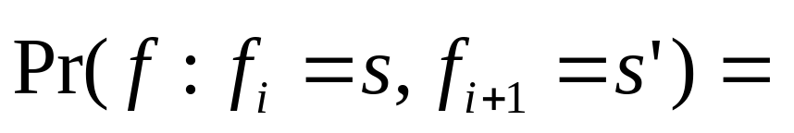
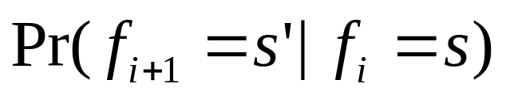
Forward-Backward
Name |  | Name |  | Name |  | Name |  | Name
Num |  | Num |  | Num |  | Num |  | Num
Str |  | Str |  | Str |  | Str |  | Str
William |  | Cohen |  | 6941 |  | Rosewd |  | St

Slide 21
Viterbi
The sequence of ML hidden states might not be the ML sequence of hidden states.
The Viterbi algorithm finds most likely state sequence
  Iterative algorithm, similar to Forward computation
  Uses a max instead of a summation

Slide 22
Parameter learning with E/M
Expectation-Maximization: for Model M for data D with hidden variables H
  Initialize: pick values for M and H
  E step: compute E[H=h|D,M]
    Here: compute Pr( f_{i}=s)
  M step: pick M to maximize Pr(D,H|M)
    Here: re-estimate transition probabilities and language models given estimated probabilities of hidden state variables
For HMMs this is called Baum-Welsch

Slide 23
Finding structure in addresses
Name | Name | Number | Street | Street
William | Cohen | 6941 | Rosewood | St
Infer structure with Viterbi (or Forward-Backward)
Train with
  Labeled data (where f1,..,fK is known)
  Unlabeled data (with Baum-Welsh)
  Partly-labeled data (e.g. lists of known names from a related source to estimate Name state emission probabilities)

Slide 24
Experiments: Seymour et al
Adding structure to research-paper title pages.
Data: 1000 labeled title pages, 2.4M words of BibTex data
Estimate LM parameters with labeled data only, uniform probability of transitions: 64.5% of hidden variables are correct.
Estimate transition probabilities as well: 85.9%.
Estimate everything using all data: 90.5%
Use mixture model to interpolate BibTex unigram model and labeled-data model: 92.4%.

Slide 25
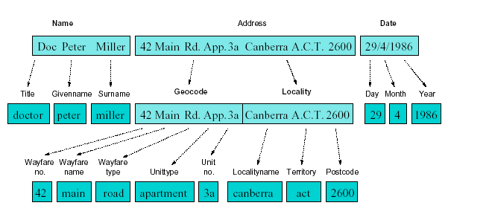
Experiments: Christen & Churches
Structuring problem: Australian addresses

Slide 26
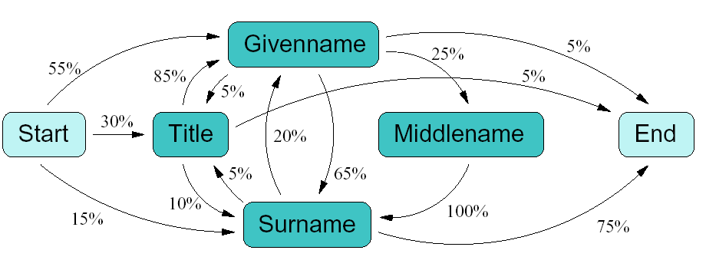
Experiments: Christen & Churches
Using same HMM technique for structuring, and using labeled data only for training.

Slide 27
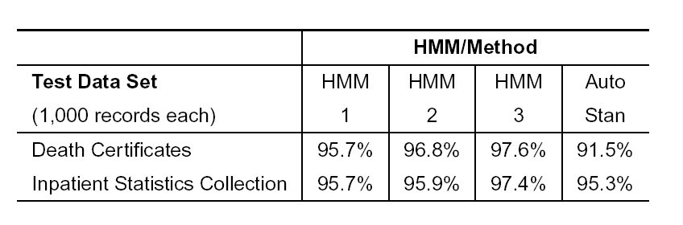
Experiments: Christen & Churches
HMM1 = 1,450 training records
HMM2 = 1 + 1000 additional records from another source
HMM3 = 1+2+ 60 “unusual records”
AutoStan = rule-based approach “developed over years”

Slide 28
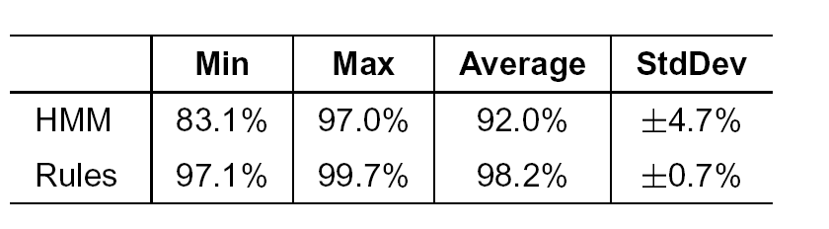
Experiments: Christen & Churches
Second (more regular) dataset: less impressive results, relative to rules.
Figures are min/max average on 10-CV

