Slide 1
SimStudent
Noboru Matsuda, Gustavo Lacerda, Ken Koedinger, William Cohen
Based on CTAT
Uses machine learning to generalize from example problems solved
Target applications:
  Engineering: With examples from a human expert, SimStudent learns a correct model, which lets a non-programmer author a cognitive tutor.
    Effort comparable to building an example-tracing tutor
  Student modeling: When examples are from an individual student, SimStudent learns a model predicting that student’s behavior.
cognitive
an existing example-tracing tutor
identical

Slide 2
SimStudent Demo

Slide 3
SimStudent demo: summary
sub-lhs
x+3=6
x = _
sub-rhs
x+3 = 6
x = 3
done
x+3=6
x = 3
x+3 = 6
done!
copy-term
Sub-lhs
2x+1 = 7
2x = _
sub-rhs
2x+1=7
2x = 1
2x+1=7

Slide 4
What affects learning in SimStudent?
Learning strategy
  How to collect machine-learning data (observation, experimentation)
  How to generalize/specialize examples
  What kinds of rules to consider or prefer
Domain knowledge
  feature predicates (hasCoefficient,isConstantTerm,…)
  operators (addTerm,copyTerm,…)

Slide 5
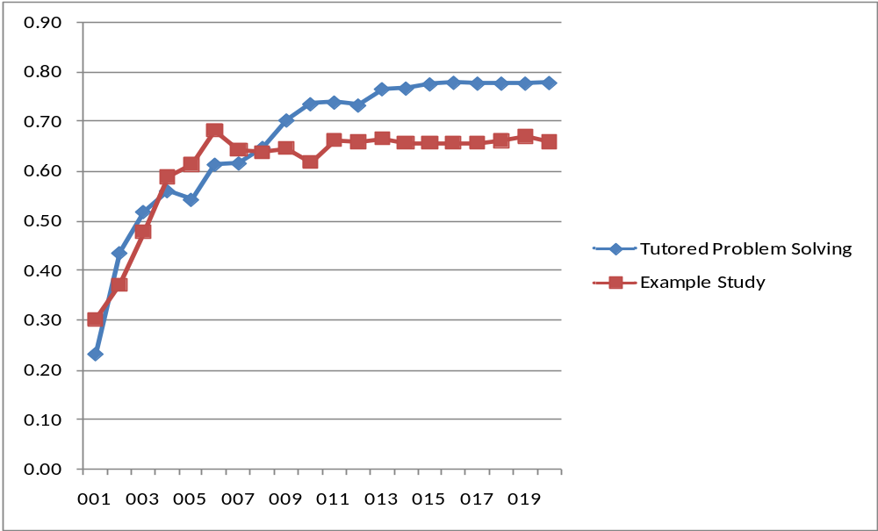
Learning Strategy Study
Training: SimStudent solves problems, gets help on errors or impasses
Testing: work a test problem. For each step score 0 there is no rule that fires; otherwise score p, the probability that a randomly chosen rule will give a correct output.
Training: SimStudent model-traces (explains) solved problems, gets help when model-tracing fails
Notes:
Comparison of two learning strategies:
Tutored Problem Solving: SimSt was given problems and asked to solve them with feedback from a tutor. Learning happened when (1) SimStudent made an error and got a negative feedback, and (2) SimStudent hit an impasse and get a step demonstrated by the tutor.
Example Study: The tutor solved problems correctly, and for each step, SimStudent attempted to “explain” how the step was performed. If it failed to explain then learning happened to learn a new rule.
Human learning log data were collected from a PSLC in-vivo study on Algebra I.
20 training problems and 10 test problems were used for the SimSt study.
The graph shows average “Step Score” on the 10 training problems (total 48 steps) after a certain number of training problems were taken. X-axis shows the number of training problems.
StepScore = 0 if a step can not performed correctly at all.
StepScore = TP/(TP+FP) if there were TP number of correct rule application and FP (possibly zero) number of incorrect rule applications.
IL outperformed other two learning conditions, because only IL has a chance to revise incorrect rules when flagged by the tutor. (We have a controlled study about this – when we disabled generating negative examples for IL, IL started to show same errors that other conditions made).

Slide 6
SimStudent: working problems vs explaining worked problems
sub
sub-lhs
x+4=7
x = _
x+4 = 7
x = 3
x+4 = 7
copy-term
→ copy-odd-term

Slide 7
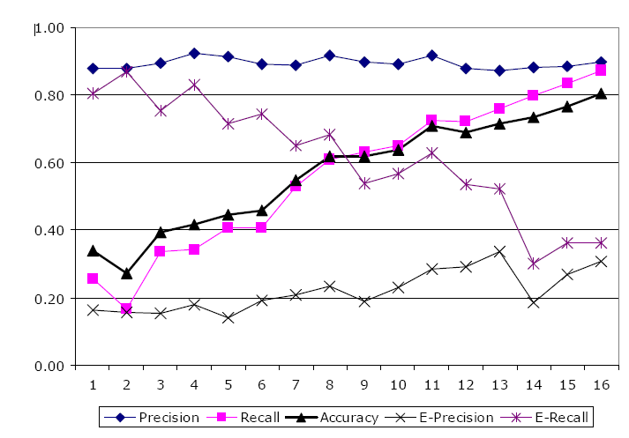
Student modeling:
Log data from 59 students, ~= 6900 training steps, ~= 3300 test steps, nine algebra skills.
Task: model-trace student actions on test steps.
Precision is high and recall steadily rises for steps where students were correct.
Precision is low and recall steadily drops for steps where students were wrong.
Prior knowledge study
Booth study suggests that features predicates and operators should include plausible conceptual errors

Slide 8
What prior knowledge affects learning in SimStudent?
Learning strategy
  How to collect machine-learning examples (observation, experimentation)
  How to generalize/specialize examples
  What kinds of rules to consider or prefer
Domain knowledge
  feature predicates (hasCoefficient,isConstantTerm,…)
  operators (addTerm,copyTerm,…)
we control this
?
rich theory of how to do this, e.g. grammatic bias [Cohen, AIJ 94]
we control

