Slide 1





Reasoning With Data Extracted From the Biomedical Literature
William W. Cohen
with Ni Lao (Google), Ramnath Balasubramanyan,
Dana Moshovitz-Attias
School of Computer Science,
Carnegie Mellon University,
John Woolford, Jelena Jakovljevic
Biology Dept,
Carnegie Mellon University

Slide 2
Outline
The scientific literature as something scientists interact with:
  recommending papers (to read, cite, …)
  recommending new entities (genes, algorithms, …) of interest
The scientific literature as a source of data
  extracting entities, relations, …. (e.g., protein-protein interactions)
The scientific literature as a tool for interpreting data
  and vice versa

Slide 3
Part 1. Recommendations for Scientists

Slide 4
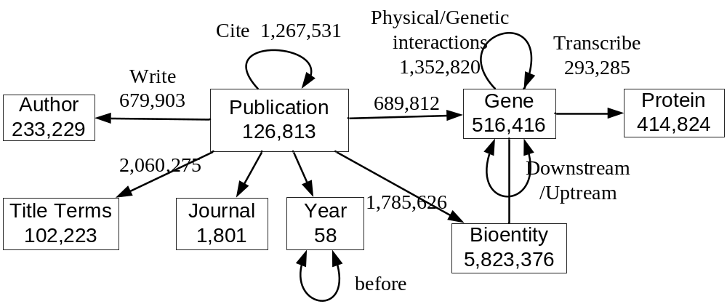

A Graph View of the Literature
Data used in this study
  Yeast: 0.2M nodes, 5.5M links
  Fly: 0.8M nodes, 3.5M links
  E.g. the fly graph

Slide 5
Defining Similarity on Graphs: PPR/RWR
  Given type t* and node x, find y:T(y)=t* and y~x.
Similarity defined by “damped” version of PageRank
Similarity between nodes x and y:
  “Random surfer model”: from a node z,
    with probability α, teleport back to x (“restart”)
    Else pick a y uniformly from { y’ : z → y’ }
    repeat from node y ....
  Similarity x~y = Pr( surfer is at y | restart is always to x )
Intuitively, x~y is sum of weight of all paths from x to y, where weight of path decreases with length (and also fanout)
Can easily extend to a “query” set X={x₁,…,x_{k}}
Disadvantages: [more later]

Slide 6
Learning How to Perform
BioLiterature Retrieval Tasks
Tasks:
  Gene recommendation: author, year→gene studied
  Citation recommendation: words,year→paper cited/read
  Expert-finding: words, genes→(possible) author
  Literature-recommendation: author, [papers read in past]
Baseline method:
  Typed RWR proximity methods
Baseline learning method:
  parameterize Prob(walk edge|edge label=L) and tune the parameters for each label L (somehow…)
P(L=cite) = a
P(bindTo) = d
P(express) = d
P(write)=b
P(NE) = c

Slide 7
Similarity Queries on Graphs
  1) Given type t* and node x in G, find y:T(y)=t* and y~x.
  2) Given type t* and node set X, find y:T(y)=t* and y~X.
Evaluation: specific families of tasks for scientific publications:
  “Entity recommendation”: (given title, author, year, … predict entities mentioned in a paper, e.g. gene-protein entities) – can improve NER
  Citation recommendation for a paper: (given title, year, …, of paper p, what papers should be cited by p?)
  Expert-finding: (given keywords, genes, … suggest a possible author)
  Literature recommendation: given researcher and year, suggest papers to read that year
Why is RWR/PPR the right similarity metric?
  it’s not – we should use learning to refine it

Slide 8
Learning Similarity Queries on Graphs
For each task:
query 1, ans 1
query 2, ans 2
….
LEARNER
Sim(s,p) = mapping
from query ➔ ans
may use RWR
variant of RWR
Evaluation: specific families of tasks for scientific publications:
  Citation recommendation for a paper: (given title, year, …, of paper p, what papers should be cited by p?)
  Expert-finding: (given keywords, genes, … suggest a possible author)
  “Entity recommendation”: (given title, author, year, … predict entities mentioned in a paper, e.g. gene-protein entities)
  Literature recommendation: given researcher and year, suggest papers to read that year

Slide 9
Learning Proximity Measures for
BioLiterature Retrieval Tasks
Tasks:
  Gene recommendation: author, year→gene
  Reference recommendation: words,year→paper
  Expert-finding: words, genes→author
  Literature-recommendation: author, [papers read in past]
Baseline method:
  Typed RWR proximity methods
Baseline learning method:
  parameterize Prob(walk edge|edge label=L) and tune the parameters for each label L (somehow…)
P(L=cite) = a
P(bindTo) = d
P(express) = d
P(write)=b
P(NE) = c

Slide 10
Path-based vs Edge-label based learning
Learning one-parameter-per-edge label is limited because the context in which an edge label appears is ignored
  E.g. (observed from real data – task, find papers to read)
Instead, we will learn path-specific parameters
Path | Comments
 | Don't read about genes I’ve already read about
 | Do read papers from my favorite authors
author –[read]→ paper –[contain]→gene-[contain-¹]→paper
author –[read]→ paper –[write-¹]→author-[write]→paper
Paths will be interpreted as constrained random walks that give a similarity-like weight to every reachable node
  Step 0: D₀ = {a} Start at author a
  Step 1: D₁: Uniform over all papers p read by a
  Step 2: D₂: Author a’ of papers in D₁ weighted by number of papers in D1 published by a’
  Step 3: D₃ Papers p’ written by a’ weighted by ....
  …

Slide 11
A Limitation of RWR Learning Methods
Learning one-parameter-per-edge label is limited because the context in which an edge label appears is ignored
  E.g. (observed from real data – task, find papers to read)
Instead, we will learn path-specific parameters
Path | Comments
 | Don't read about genes I’ve already read about
 | Do read papers from my favorite authors
author –[read]→ paper –[contain]→gene-[contain-¹]→paper
author –[read]→ paper –[write-¹]→author-[write]→paper
Path | Comments
 | Do read about the genes I’m working on
 | Don't read papers from my own lab
author –[write]→ paper –[contain]→gene-[contain-¹]→paper
author –[write]→ paper –[publish⁻¹]→institute-[publlish]→paper

Slide 12
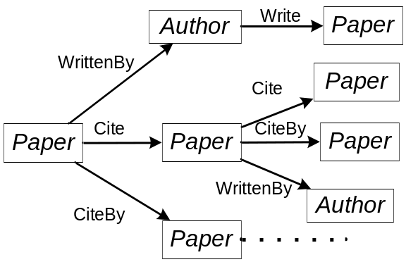
Definitions
An graph G=(T,R,X,E), is
  a set of entity types T={T} and a set of relations R={R}
  a set of entities (nodes) X={x}, where each node x has a type from T
  a set of edges e=(x,y), where each edge has a relation label from R
A path P=(R₁, …,R_{n}) is a sequence of relations
Path Constrained Random Walk
  Given a query set S of “source” nodes
  Distribution D₀ at time 0 is uniform over s in S
  Distribution D_{t} at time t>0 is formed by
    Pick x from D_{t-1}
    Pick y uniformly from all things related to x
      by an edge labeled R_{t}
  Notation: f_{P}(s,t) = Prob(s→t; P)
  In our examples type of t will be determined by R_{n}
Notes:
The instantiation of type T is I_{E}(T)={e| e.T =T}
Each relation is a pair of entity types R.T₁, R.T₂
R(e1,e2)=1/0 to denote e1,e2 having relation R or not
R(e,•)={e’| R(e,e')=1} to denote the set of entities that have relation R with e

Slide 13
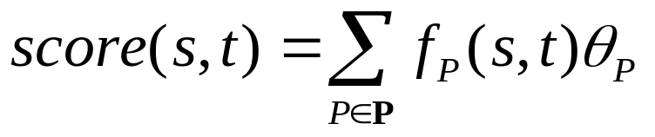
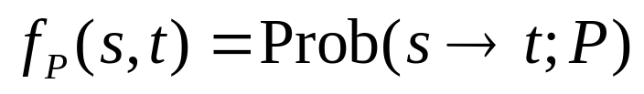
Path Ranking Algorithm (PRA)
[Lao & Cohen, ECML 2010]
A PRA model scores a source-target node pair by a linear function of their path features
  where P is a path (sequence of link types/relation names) with length ≤ L
For a relation R and a set of node pairs {(s_{i}, t_{i})}, we construct a training dataset D ={(x_{i}, y_{i})}, where x_{i} is a vector of all the path features for (s_{i}, t_{i}), and y_{i} indicates whether R(s_{i}, t_{i}) is true or not
θ is estimated using L1,L2-regularized logistic regression
Notes:
Given a set of seed nodes E_{q}, and a target type T_{q}

Slide 14
Experimental Setup for BioLiterature
Data sources for bio-informatics
  PubMed on-line archive of over 18 million biological abstracts
  PubMed Central (PMC) full-text copies of over 1 million of these papers
  Saccharomyces Genome Database (SGD) a database for yeast
  Flymine a database for fruit flies
Tasks
  Gene recommendation: author, year→gene
  Venue recommendation: genes, title words→journal
  Reference recommendation: title words,year→paper
  Expert-finding: title words, genes→author
Data split
  2000 training, 2000 tuning, 2000 test
Time variant graph
  each edge is tagged with a time stamp (year)
  only consider edges that are earlier than the query, during random walk

Slide 15
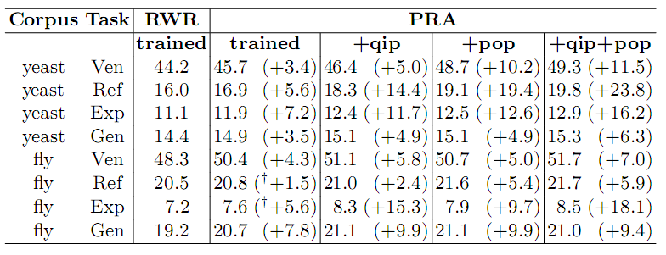
BioLiterature: Some Results
Compare the mean average precision (MAP) of PRA to
  RWR model
  RWR trained with one-parameter per link
Except these† , all improvements are statistically signiﬁcant at p<0.05 using paired t-test

Slide 16
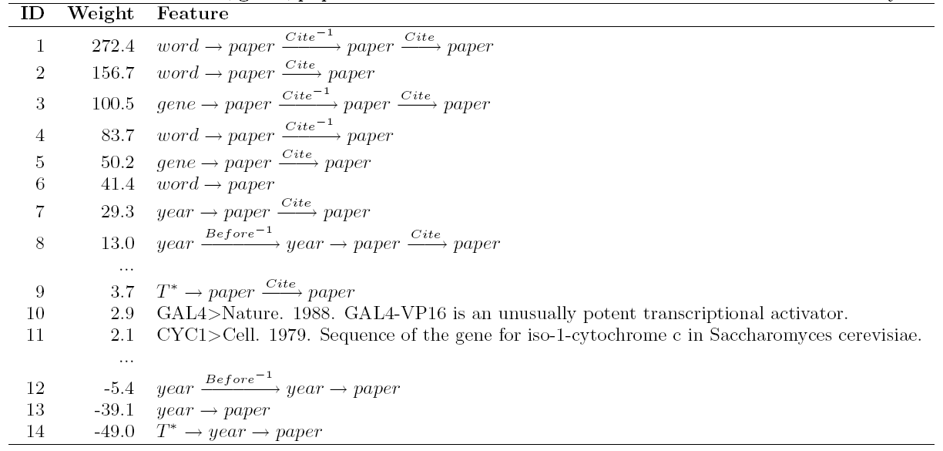
Example Path Features and their Weights
A PRA+qip+pop model trained for the citation recommendation task on the yeast data
1) papers co-cited with on-topic papers
6) approx. standard IR retrieval
7,8) papers cited during the past two years
12,13) papers published during the past two years

Slide 17
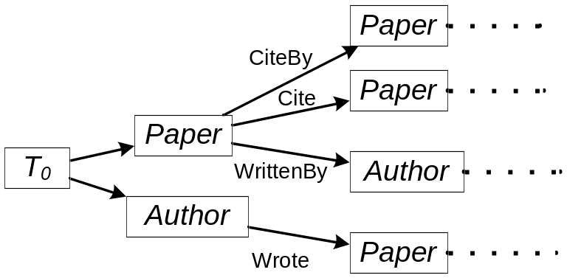
Extension 1: Query Independent Paths
PageRank (and other query-independent rankings):
  assign an importance score (query independent) to each web page
  later combined with relevance score (query dependent)
We generalize pagerank to heterogeneous graphs:
  We include to each query a special entity e₀ of special type T₀
  T₀ is related to all other entity types, and each type is related to all instances of that type
  This defines a set of PageRank-like query independent relation paths
  Compute f(*→t;P) offline for efficiency
Example
well cited papers
all papers
productive authors
all authors

Slide 18
Extension 2: Entity-specific rankings
There are entity-specific characteristics which cannot be captured by a general model
  Some items are interesting to the users because of features not captured in the data
  To model this, assume the identity of the entity matters
  Introduce new features f(s→t; P_{s,t}) to account for jumping from s to t and new features f(*→t; P_{*,t})
  At each gradient step, add a few new features of this sort with highest gradient, count on regularization to avoid overfitting

Slide 19
BioLiterature: Some Results
Compare the MAP of PRA to
  RWR model
  query independent paths (qip)
  popular entity biases (pop)
Except these† , all improvements are statistically signiﬁcant at p<0.05 using paired t-test

Slide 20
Example Path Features and their Weights
A PRA+qip+pop model trained for the citation recommendation task on the yeast data
9) well cited papers
10,11) key early papers about specific genes
14) old papers

Slide 21
Outline
The scientific literature as something scientists interact with:
  recommending papers (to read, cite, …)
  recommending new entities (genes, algorithms, …) of interest
The scientific literature as a source of data
  extracting entities, relations, …. (e.g., protein-protein interactions)
The scientific literature as a tool for interpreting data
  and vice versa

Slide 22
Part 2. Extraction from the Scientific Literature: BioNELL
Builds on NELL (Never Ending Language Learner), a web-based information extraction system:
  a semi-supervised, coupled, multi-view system that learns concepts and relations from a fixed ontology

Slide 23
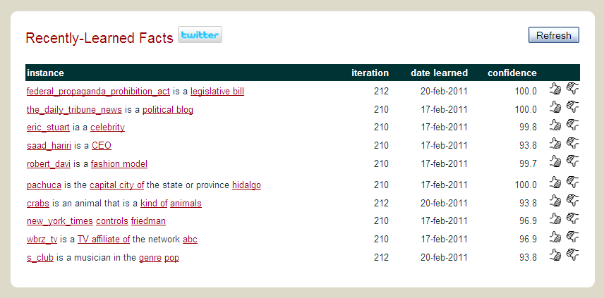
Examples of what NELL knows

Slide 24
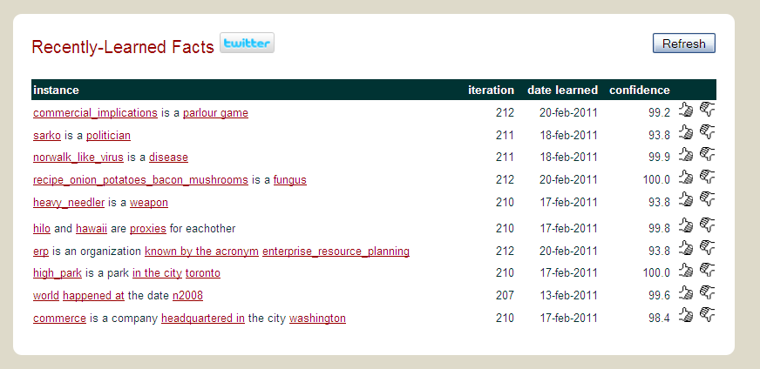
Examples of what NELL knows

Slide 25
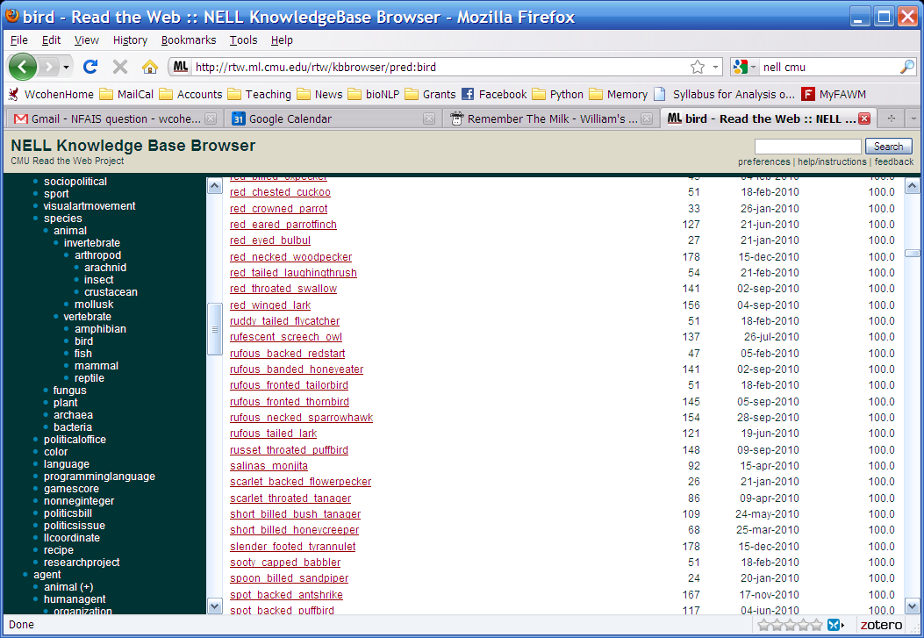
Examples of what NELL knows

Slide 26
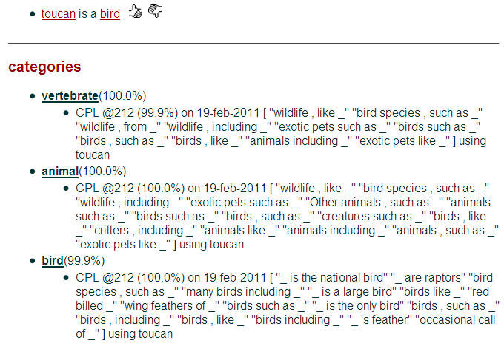

Slide 27
Semi-Supervised (Bootstrapped) Learning
it’s underconstrained!!
Extract cities:
Paris
Pittsburgh
Seattle
Cupertino
San Francisco
Austin
denial
anxiety
selfishness
Berlin
mayor of arg1
live in arg1
arg1 is home of
traits such as arg1
Given: four seed examples of the class “city”

Slide 28
One Key to Accurate Semi-Supervised Learning
teamPlaysSport(t,s)
playsForTeam(a,t)
person
sport
playsSport(a,s)
team
coach(NP)
athlete
coach
coachesTeam(c,t)
NP
NP1
NP2
Krzyzewski coaches the Blue Devils.
Krzyzewski coaches the Blue Devils.
hard (underconstrained)
semi-supervised learning problem
much easier (more constrained)
semi-supervised learning problem
Easier to learn many interrelated tasks than one isolated task
Also easier to learn using many different types of information

Slide 29
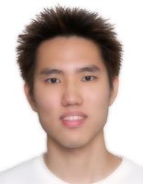
SEAL: Set Expander for Any Language
Another key: use lists and tables as well as text
Seeds
Extractions
Single-page Patterns
…
…
ford, toyota, nissan
…
honda
…
…
*Richard C. Wang and William W. Cohen: Language-Independent Set Expansion of Named Entities using the Web. In Proceedings of IEEE International Conference on Data Mining (ICDM 2007), Omaha, NE, USA. 2007.

Slide 30
NELL
evidence integration
CPL
text extraction patterns
SEAL
HTML extraction patterns
Morph
Morphologybased extractor
RL
learned inference rules
Ontology and populated KB
the Web

Slide 31
BioNELL
evidence integration++
CPL
text extraction patterns
SEAL
HTML extraction patterns
Morph
Morphologybased extractor
RL
learned inference rules
Ontology and populated KB
the Web
bioText
corpus

Slide 32
Part 2. Extraction from the Scientific Literature: BioNELL
BioNELL vs NELL:
  automatically constructed ontology
    GO, ChemBio, …. plus small number of facts about mutual exclusion
  automatically chosen seeds
  conservative bootstrapping
    only use some learned facts in bootstrapping (based on PMI with concept name)

Slide 33
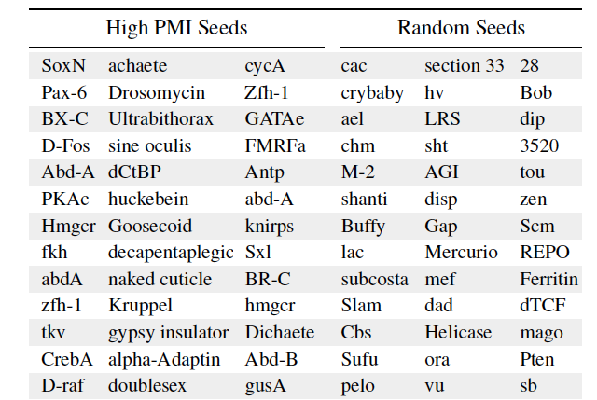
Part 2. Extraction from the Scientific Literature: BioNELL

Slide 34
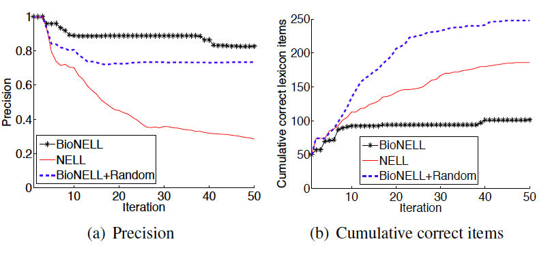
Part 2. Extraction from the Scientific Literature: BioNELL

Slide 35
Summary of BioNELL
Advantages over traditional IE for BioText
  Exploits existing ontologies
  Scaling up vs “scaling out”: coupled semi-supervised learning is easier than uncoupled SSL
  Trivial to introduce a new concept/relation (just add to ontology and give 10-20 seed instances)
    Easy to customize BioNELL for a task
Disadvantages
  Evaluation is difficult
  Limited recall
Still early work in many ways

Slide 36
Outline
The scientific literature as something scientists interact with:
  recommending papers (to read, cite, …)
  recommending new entities (genes, algorithms, …) of interest
The scientific literature as a source of data
  extracting entities, relations, …. (e.g., protein-protein interactions)
The scientific literature as a tool for interpreting data
  and vice versa

Slide 37


Part 3. Interpreting Data With Literature

Slide 38
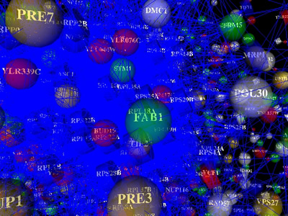
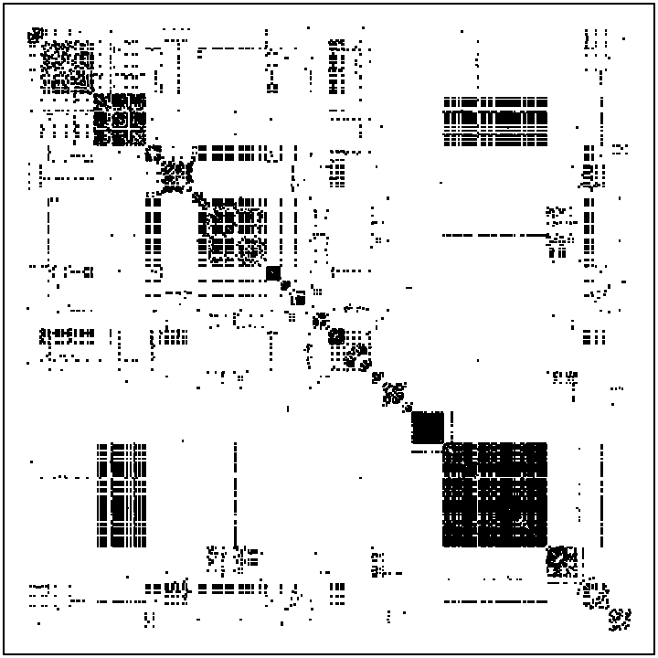
Case Study:
Protein-protein interactions in yeast
p1, p2 do interact
Index of protein 2
Using known interactions between 844 proteins, curated by Munich Info Center for Protein Sequences (MIPS).
Studied by Airoldi et al in 2008 JMLR paper (on mixed membership stochastic block models)
Index of protein 1
(sorted after clustering)

Slide 39
Case Study:
Protein-protein interactions in yeast
English text
Vac1p coordinates Rab and phosphatidylinositol 3-kinase signaling in Vps45p-dependent vesicle docking/fusion at the endosome. The vacuolar protein sorting (VPS) pathway of Saccharomyces cerevisiae mediates transport of vacuolar protein precursors from the late Golgi to the lysosome-like vacuole. Sorting of some vacuolar proteins occurs via a prevacuolar endosomal compartment and mutations in a subset of VPS genes (the class D VPS genes) interfere with the Golgi-to-endosome transport step. Several of the encoded proteins, including Pep12p/Vps6p (an endosomal target (t) SNARE) and Vps45p (a Sec1p homologue), bind each other directly [1]. Another of these proteins, Vac1p/Pep7p/Vps19p, associates with Pep12p and binds phosphatidylinositol 3-phosphate (PI(3)P), the product of the Vps34 phosphatidylinositol 3-kinase (PI 3-kinase) ......
EP7, VPS45, VPS34, PEP12, VPS21,…
Using known interactions between 844 proteins from MIPS.
… and 16k paper abstracts from SGD, annotated with the proteins that the papers refer to (all papers about these 844 proteins).
Protein annotations

Slide 40
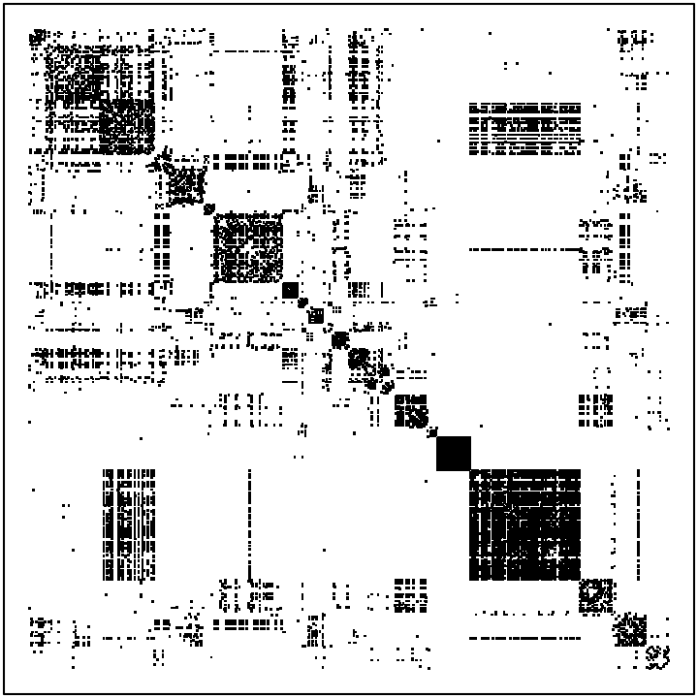
Question: Is there information about protein interactions in the text?
Thresholded text
co-occurrence counts
MIPS interactions

Slide 41
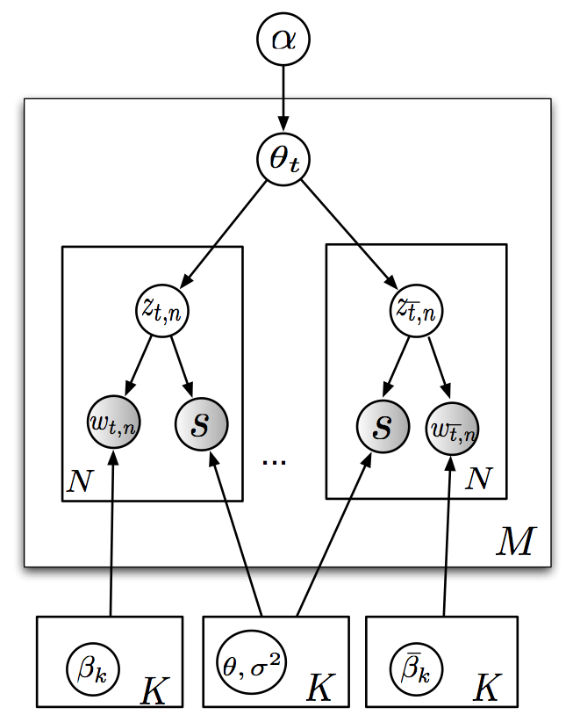
Question: How to model this?
LinkLDA
English text
Vac1p coordinates Rab and phosphatidylinositol 3-kinase signaling in Vps45p-dependent vesicle docking/fusion at the endosome. The vacuolar protein sorting (VPS) pathway of Saccharomyces cerevisiae mediates transport of vacuolar protein precursors from the late Golgi to the lysosome-like vacuole. Sorting of some vacuolar proteins occurs via a prevacuolar endosomal compartment and mutations in a subset of VPS genes (the class D VPS genes) interfere with the Golgi-to-endosome transport step. Several of the encoded proteins, including Pep12p/Vps6p (an endosomal target (t) SNARE) and Vps45p (a Sec1p homologue), bind each other directly [1]. Another of these proteins, Vac1p/Pep7p/Vps19p, associates with Pep12p and binds phosphatidylinositol 3-phosphate (PI(3)P), the product of the Vps34 phosphatidylinositol 3-kinase (PI 3-kinase) ......
EP7, VPS45, VPS34, PEP12, VPS21
Protein annotations

Slide 42
Question: How to model this?
α
English text
LinkLDA
Vac1p coordinates Rab and phosphatidylinositol 3-kinase signaling in Vps45p-dependent vesicle docking/fusion at the endosome. The vacuolar protein sorting (VPS) pathway of Saccharomyces cerevisiae mediates transport of vacuolar protein precursors from the late Golgi to the lysosome-like vacuole. Sorting of some vacuolar proteins occurs via a prevacuolar endosomal compartment and mutations in a subset of VPS genes (the class D VPS genes) interfere with the Golgi-to-endosome transport step. Several of the encoded proteins, including Pep12p/Vps6p (an endosomal target (t) SNARE) and Vps45p (a Sec1p homologue), bind each other directly [1]. Another of these proteins, Vac1p/Pep7p/Vps19p, associates with Pep12p and binds phosphatidylinositol 3-phosphate (PI(3)P), the product of the Vps34 phosphatidylinositol 3-kinase (PI 3-kinase) ......
EP7, VPS45, VPS34, PEP12, VPS21
θ
z
z
word
prot
N
L
M
Protein annotations
β
γ

Slide 43
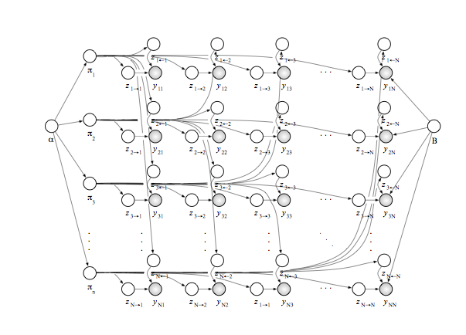
Question: How to model this?
p1, p2 do interact
MMSBM of Airoldi et al
Index of protein 2
Draw K² Bernoulli distributions
Draw a θ_{i} for each protein
For each entry i,j, in matrix
  Draw z_{i*} from θ_{i}
  Draw z_{*j} from θ_{j}
  Draw m_{ij} from a Bernoulli associated with the pair of z’s.
Index of protein 1

Slide 44
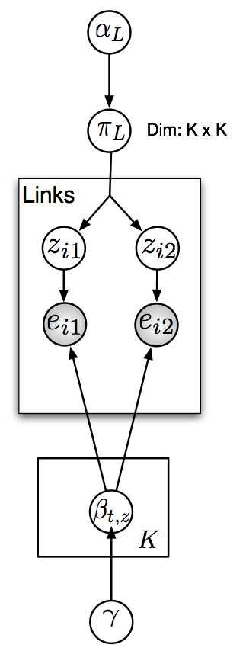
Question: How to model this?
p1, p2 do interact
Sparse block model of Parkinnen et al, 2007
Draw topics over proteins β
For each row in the link relation:
  Draw (z_{L*},z_{*R}) from π
  Draw a protein i from left multinomial associated with pair
  Draw a protein j from right multinomial associated with pair
  Add i,j to the link relation
Index of protein 2
These define the “blocks”
Index of protein 1

Slide 45
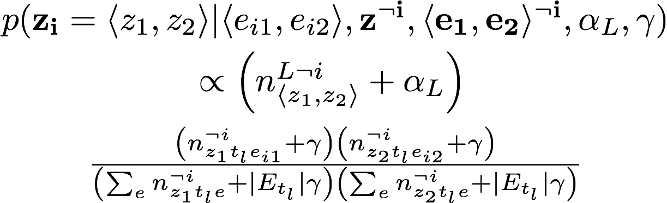
Gibbs sampler for sparse block model
Sampling the class pair for a link
probability of class pair in the link corpus
probability of the two entities in their respective classes

Slide 46
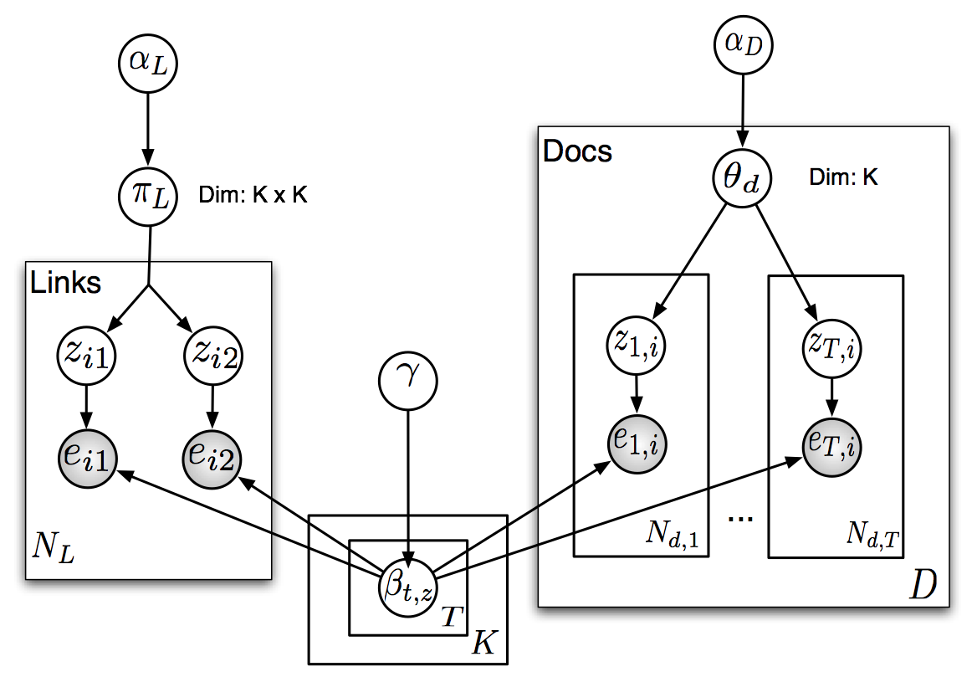
BlockLDA: jointly modeling blocks and text
Entity distributions shared between “blocks” and “topics”

Slide 47
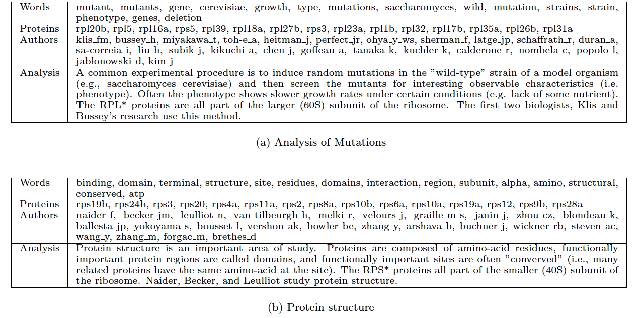
Sample topics

Slide 48
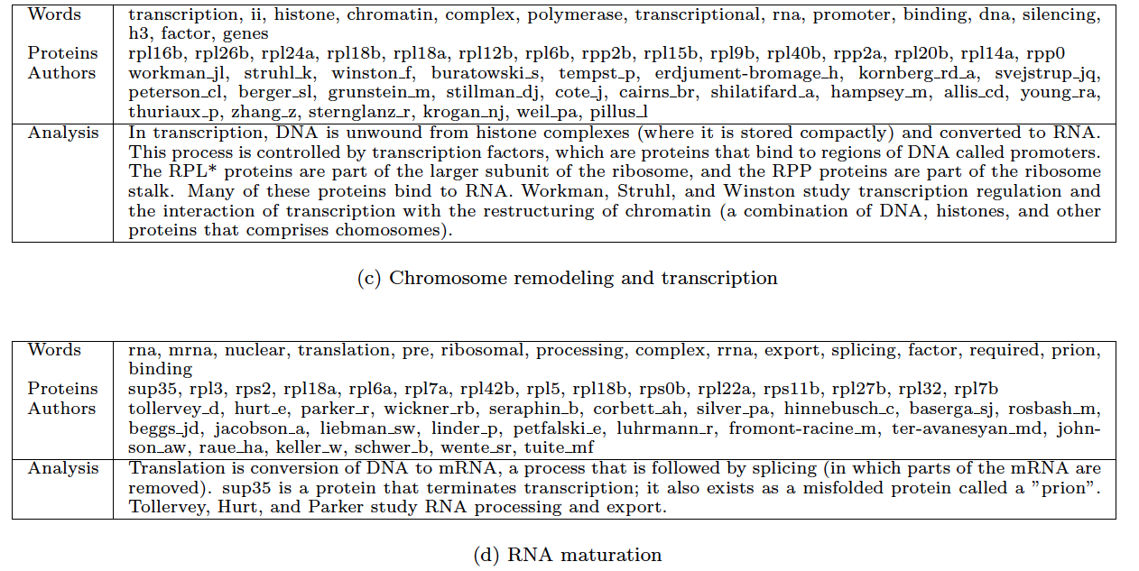
Sample topics

Slide 49
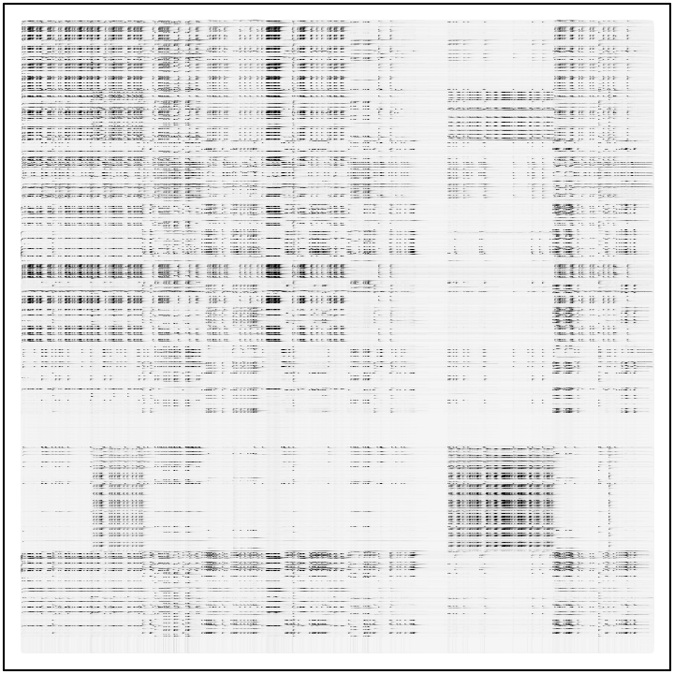
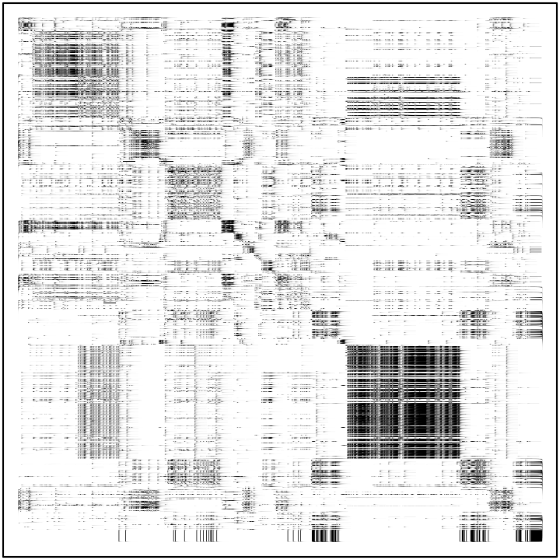
Recovering the interaction matrix
MIPS interactions
Sparse Block model
Block-LDA

Slide 50
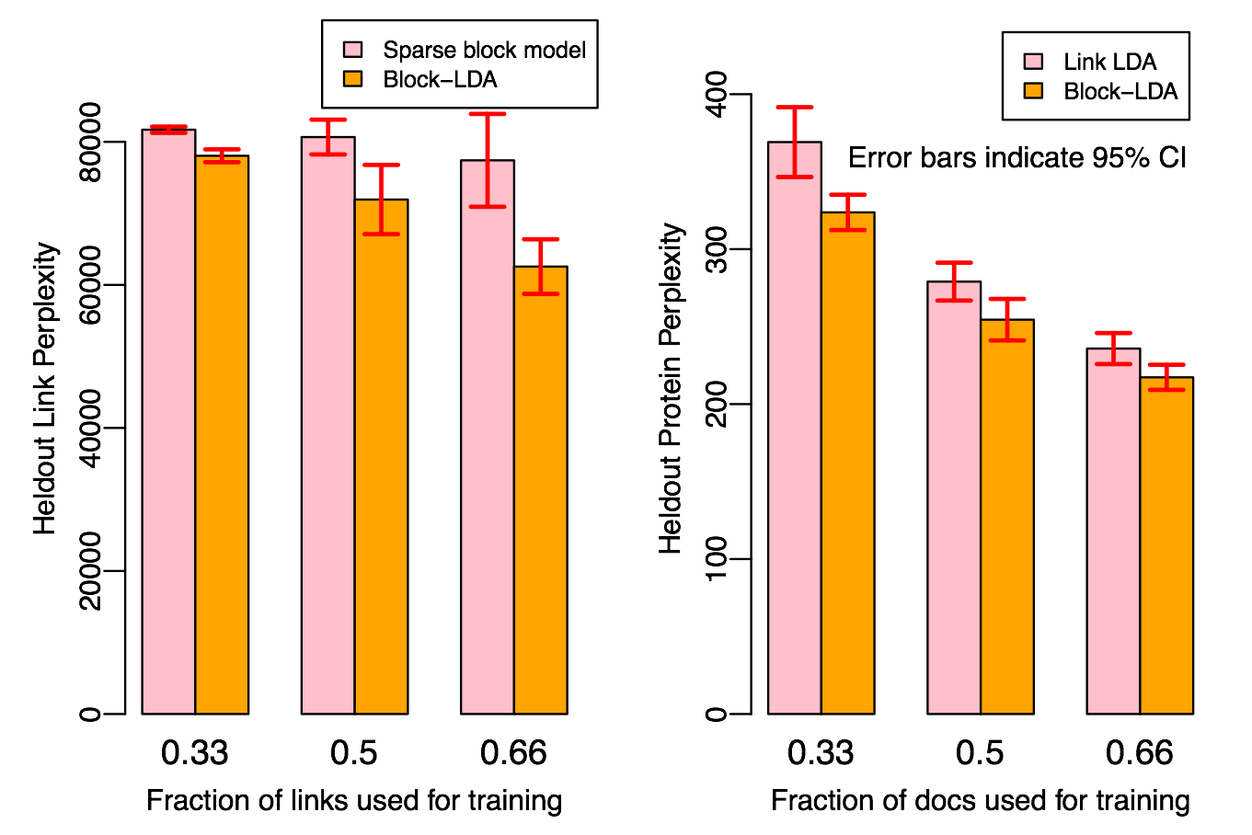
Varying The Amount of Training Data

Slide 51
Another Performance Test
Goal: predict “functional categories” of proteins
  15 categories at top-level (e.g., metabolism, cellular communication, cell fate, …)
  Proteins have 2.1 categories on average
  Method for predicting categories:
    Run with 15 topics
    Using held-out labeled data, associate topics with closest category
    If category has n true members, pick top n proteins by probability of membership in associated topic.
  Metric: F1, Precision, Recall

Slide 52
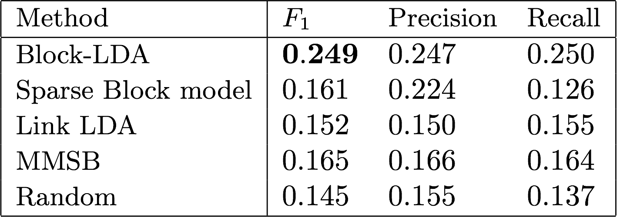
Performance: prediction functional categories of yeast

Slide 53
Varying The Amount of Training Data

Slide 54
Sample topics – do they explain the blocks?

Slide 55
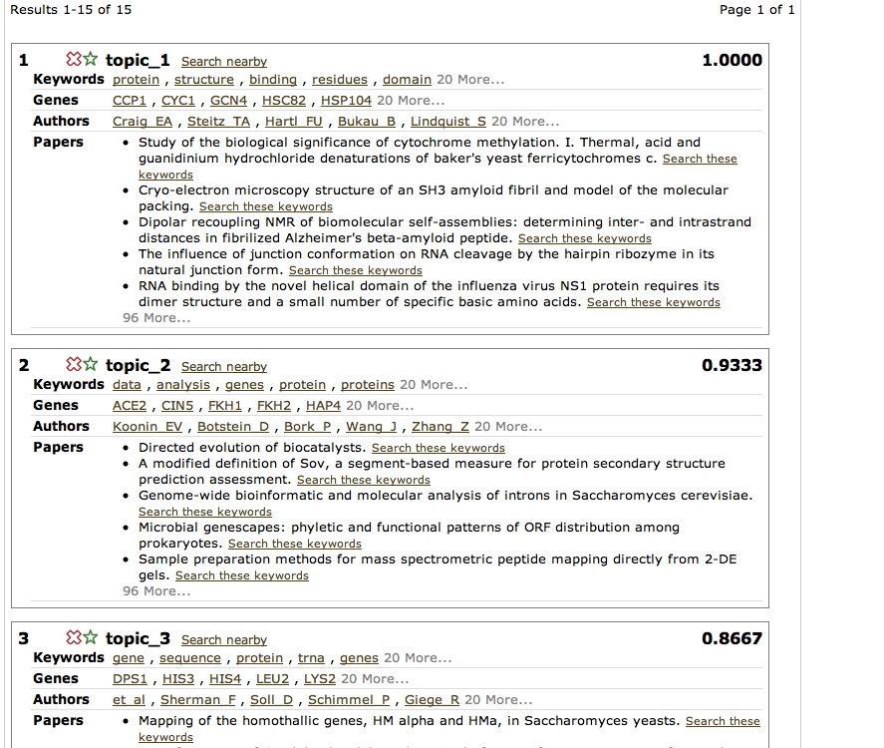
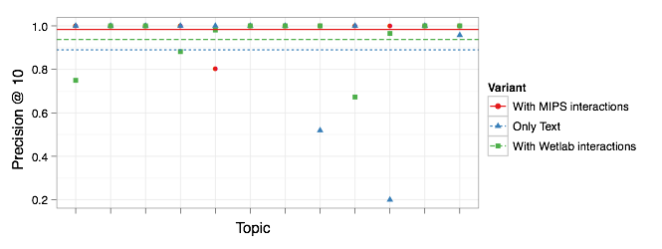
Another test: vetting interaction predictions and/or topics
Procedure:
  hand-labeling by one expert (so far)
  double-blind
    text only
    MIPS interactions
    smaller set of pull-downs done in Woolford’s wet-lab
  Y/N: is topic a meaningful category?
  Y/N: if so, how many of the top 10 paper (proteins) in that category?

Slide 56
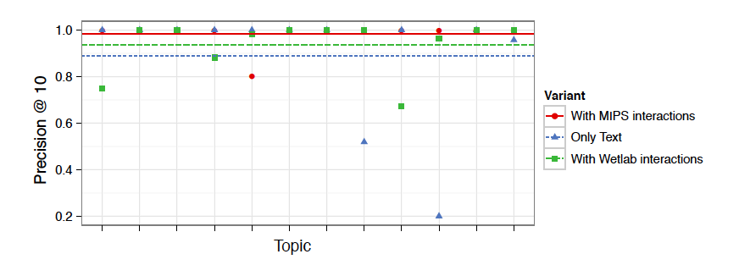
Another test: vetting interaction predictions and/or topics
Articles

Slide 57
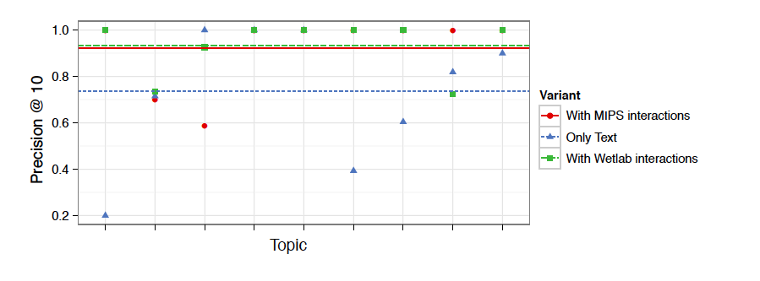
Another test: vetting interaction predictions and/or topics
Proteins

Slide 58
Summary
Big question:
  can using text lead to more accurate models of data?
  can you do this systematically for many modeling tasks?
  can the literature give us a lens for interpreting the results of statistical modeling?
Advantages:
  Huge potential payoff
But
  Hard to evaluate!
Still early work in many ways

Slide 59
Conclusions/summary
The scientific literature as something scientists interact with:
  recommending papers (to read, cite, …)
  recommending new entities (genes, algorithms, …) of interest
The scientific literature as a source of data
  extracting entities, relations, …. (e.g., protein-protein interactions): GOFIE
The scientific literature as a tool for interpreting data
  and vice versa
  … all we’ve evaluated to date
Past usage of literature is data – so this is possibly the most general setting

Slide 60
Thanks to…
Ni, Ramnath, Dana and others…
NIH, NSF, Google
AAAI Fall Symposium organizers
you all for listening!

