Slide 1

Joint Modeling of
Entity-Entity Links and Entity-Annotated Text
Ramnath Balasubramanyan, William W. Cohen
Language Technologies Institute and Machine Learning Department,
School of Computer Science,
Carnegie Mellon University,

Slide 2
Motivation: Toward Re-usable “Topic Models”
LDA inspired many similar “topic models”
  “Topic models” = generative models of selected properties of data (e.g., LDA: word co-occurance in a corpus, sLDA: word co-occurance and document labels, ..., RelLDA, Pairwise LinkLDA: words and links in hypertext, …)
LDA-like models are surprisingly hard to build
  Conceptually modular, but nontrivial to implement
  High-level toolkits like HBC, BLOG, … have had limited success
  An alternative: general-purpose families of models than can be reconfigured and re-tasked for different purposes
    Somewhere between a modeling language (like HBC) and a task-specific LDA-like topic model

Slide 3
Motivation: Toward Re-usable “Topic” Models
α
Examples of re-use of LDA-like topic models:
  LinkLDA model
    Proposed to model text and citations in publications (Eroshova et al, 2004)
θ
z
z
word
cite
N
L
M
β
γ

Slide 4
Motivation: Toward Re-usable “Topic” Models
α
Examples of re-use of LDA-like topic models:
  LinkLDA model
    Proposed to model text and citations in publications
    Re-used to model commenting behavior on blogs (Yano et al, NAACL 2009)
θ
z
z
word
userId
N
L
M
β
γ

Slide 5
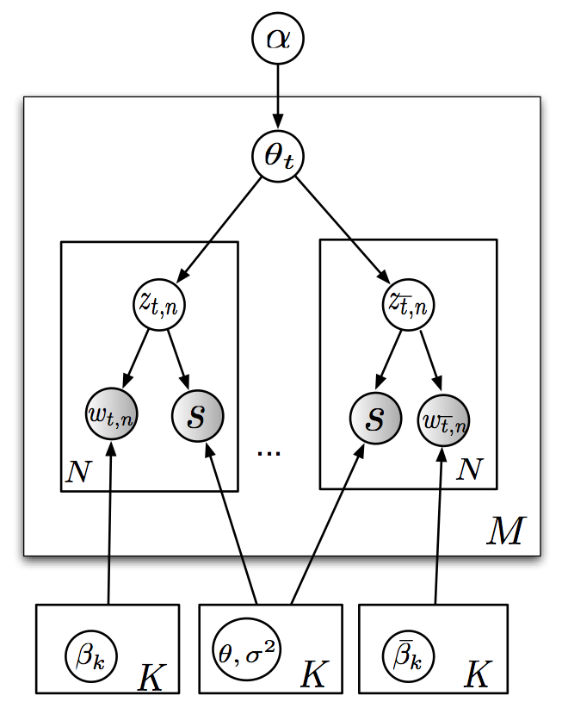
Motivation: Toward Re-usable “Topic” Models
α
Examples of re-use of LDA-like topic models:
  LinkLDA model
    Proposed to model text and citations in publications
    Re-used to model commenting behavior on blogs
    Re-used to model selectional restrictions for information extraction (Ritter et al, ACL 2010)
θ
z
z
subj
obj
N
L
M
β
γ

Slide 6
Motivation: Toward Re-usable “Topic” Models
α
Examples of re-use of LDA-like topic models:
  LinkLDA model
    Proposed to model text and citations in publications
    Re-used to model commenting behavior on blogs
    Re-used to model selectional restrictions for IE
    Extended and re-used to model multiple types of annotations (e.g., authors, algorithms) and numeric annotations (e.g., timestamps, as in TOT)
θ
z
z
subj
obj
N
L
[Our current work]
M
β
γ

Slide 7
Motivation: Toward Re-usable “Topic” Models
Examples of re-use of LDA-like topic models:
  LinkLDA model
    Proposed to model text and citations in publications
    Re-used to model commenting behavior on blogs
    Re-used to model selectional restrictions for information extraction
What kinds of models are easy to re-use?

Slide 8
Motivation: Toward Re-usable “Topic” Models
What kinds of models are easy to reuse? What makes re-use possible?
What syntactic shape does information often take?
  (Annotated) text: i.e., collections of documents, each containing a bag of words, and (one or more) bags of typed entities
    Simplest case: one type ➔ entity-annotated text
    Complex case: many entity types, time-stamps, …
  Relations: i.e., k-tuples of typed entities
    Simplest case: k=2 ➔ entity-entity links
    Complex case: relational DB
  Combinations of relations and annotated text are also common
  Research goal: jointly model information in annotated text + set of relations
This talk:
  one binary relation and one corpus of text annotated with one entity type
  joint model of both

Slide 9
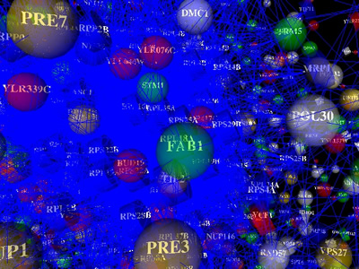
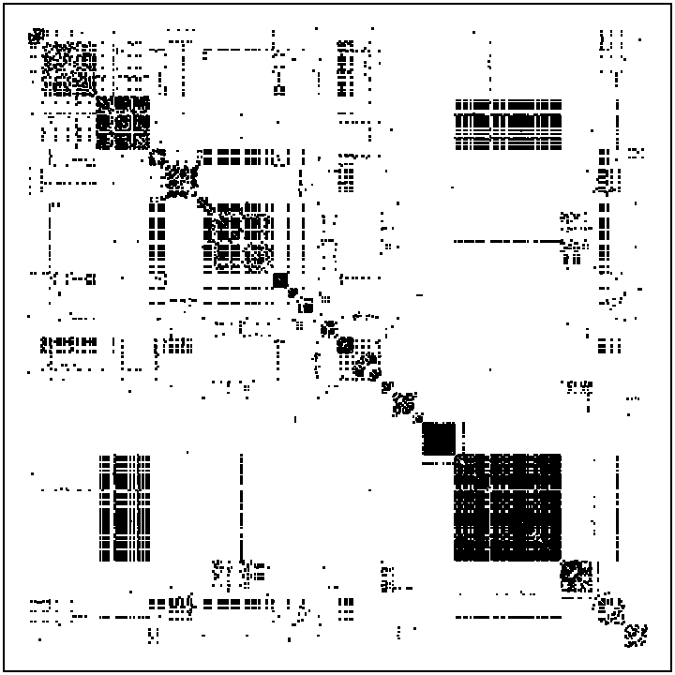
Test problem:
Protein-protein interactions in yeast
p1, p2 do interact
Index of protein 2
Using known interactions between 844 proteins, curated by Munich Info Center for Protein Sequences (MIPS).
Studied by Airoldi et al in 2008 JMLR paper (on mixed membership stochastic block models)
Index of protein 1
(sorted after clustering)

Slide 10
Test problem:
Protein-protein interactions in yeast
English text
Vac1p coordinates Rab and phosphatidylinositol 3-kinase signaling in Vps45p-dependent vesicle docking/fusion at the endosome. The vacuolar protein sorting (VPS) pathway of Saccharomyces cerevisiae mediates transport of vacuolar protein precursors from the late Golgi to the lysosome-like vacuole. Sorting of some vacuolar proteins occurs via a prevacuolar endosomal compartment and mutations in a subset of VPS genes (the class D VPS genes) interfere with the Golgi-to-endosome transport step. Several of the encoded proteins, including Pep12p/Vps6p (an endosomal target (t) SNARE) and Vps45p (a Sec1p homologue), bind each other directly [1]. Another of these proteins, Vac1p/Pep7p/Vps19p, associates with Pep12p and binds phosphatidylinositol 3-phosphate (PI(3)P), the product of the Vps34 phosphatidylinositol 3-kinase (PI 3-kinase) ......
EP7, VPS45, VPS34, PEP12, VPS21,…
Using known interactions between 844 proteins from MIPS.
… and 16k paper abstracts from SGD, annotated with the proteins that the papers refer to (all papers about these 844 proteins).
Protein annotations

Slide 11
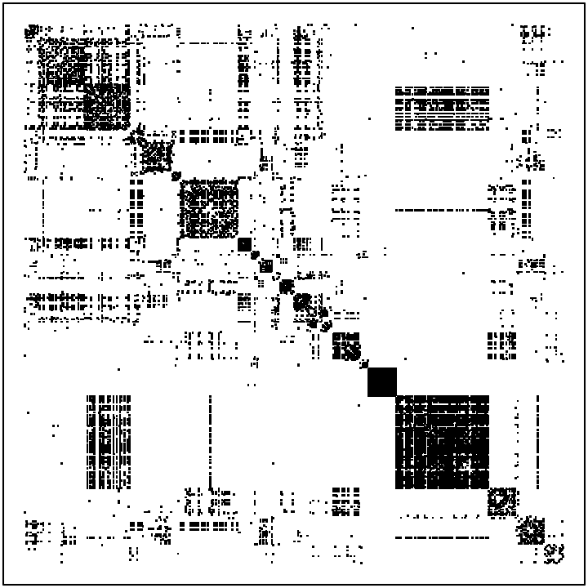
Aside: Is there information about protein interactions in the text?
Thresholded text
co-occurrence counts
MIPS interactions

Slide 12
Question: How to model this?
Generic, configurable version of LinkLDA
English text
Vac1p coordinates Rab and phosphatidylinositol 3-kinase signaling in Vps45p-dependent vesicle docking/fusion at the endosome. The vacuolar protein sorting (VPS) pathway of Saccharomyces cerevisiae mediates transport of vacuolar protein precursors from the late Golgi to the lysosome-like vacuole. Sorting of some vacuolar proteins occurs via a prevacuolar endosomal compartment and mutations in a subset of VPS genes (the class D VPS genes) interfere with the Golgi-to-endosome transport step. Several of the encoded proteins, including Pep12p/Vps6p (an endosomal target (t) SNARE) and Vps45p (a Sec1p homologue), bind each other directly [1]. Another of these proteins, Vac1p/Pep7p/Vps19p, associates with Pep12p and binds phosphatidylinositol 3-phosphate (PI(3)P), the product of the Vps34 phosphatidylinositol 3-kinase (PI 3-kinase) ......
EP7, VPS45, VPS34, PEP12, VPS21
Protein annotations

Slide 13
Question: How to model this?
α
English text
Instantiation
Vac1p coordinates Rab and phosphatidylinositol 3-kinase signaling in Vps45p-dependent vesicle docking/fusion at the endosome. The vacuolar protein sorting (VPS) pathway of Saccharomyces cerevisiae mediates transport of vacuolar protein precursors from the late Golgi to the lysosome-like vacuole. Sorting of some vacuolar proteins occurs via a prevacuolar endosomal compartment and mutations in a subset of VPS genes (the class D VPS genes) interfere with the Golgi-to-endosome transport step. Several of the encoded proteins, including Pep12p/Vps6p (an endosomal target (t) SNARE) and Vps45p (a Sec1p homologue), bind each other directly [1]. Another of these proteins, Vac1p/Pep7p/Vps19p, associates with Pep12p and binds phosphatidylinositol 3-phosphate (PI(3)P), the product of the Vps34 phosphatidylinositol 3-kinase (PI 3-kinase) ......
EP7, VPS45, VPS34, PEP12, VPS21
θ
z
z
word
prot
N
L
M
Protein annotations
β
γ

Slide 14
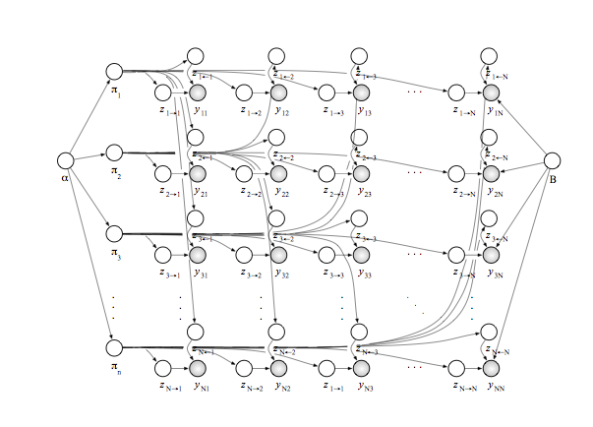
Question: How to model this?
p1, p2 do interact
MMSBM of Airoldi et al
Index of protein 2
Draw K² Bernoulli distributions
Draw a θ_{i} for each protein
For each entry i,j, in matrix
  Draw z_{i*} from θ_{i}
  Draw z_{*j} from θ_{j}
  Draw m_{ij} from a Bernoulli associated with the pair of z’s.
Index of protein 1

Slide 15
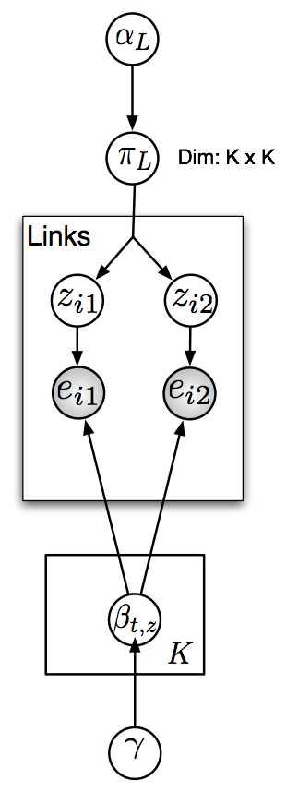
Question: How to model this?
p1, p2 do interact
we prefer…
Sparse block model of Parkinnen et al, 2007
Draw K² multinomial distributions β
For each row in the link relation:
  Draw (z_{L*},z_{*R}) from π
  Draw a protein i from left multinomial associated with pair
  Draw a protein j from right multinomial associated with pair
  Add i,j to the link relation
Index of protein 2
These define the “blocks”
Index of protein 1

Slide 16
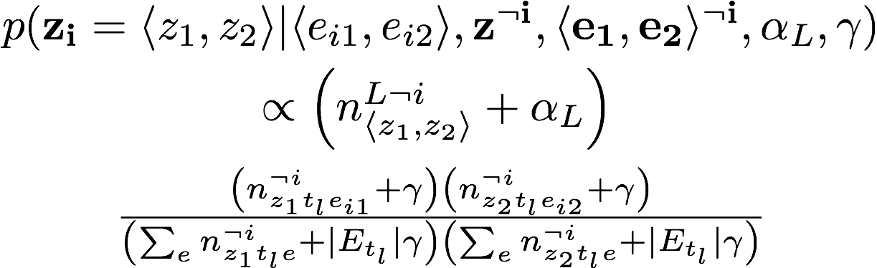
Gibbs sampler for sparse block model
Sampling the class pair for a link
probability of class pair in the link corpus
probability of the two entities in their respective classes

Slide 17
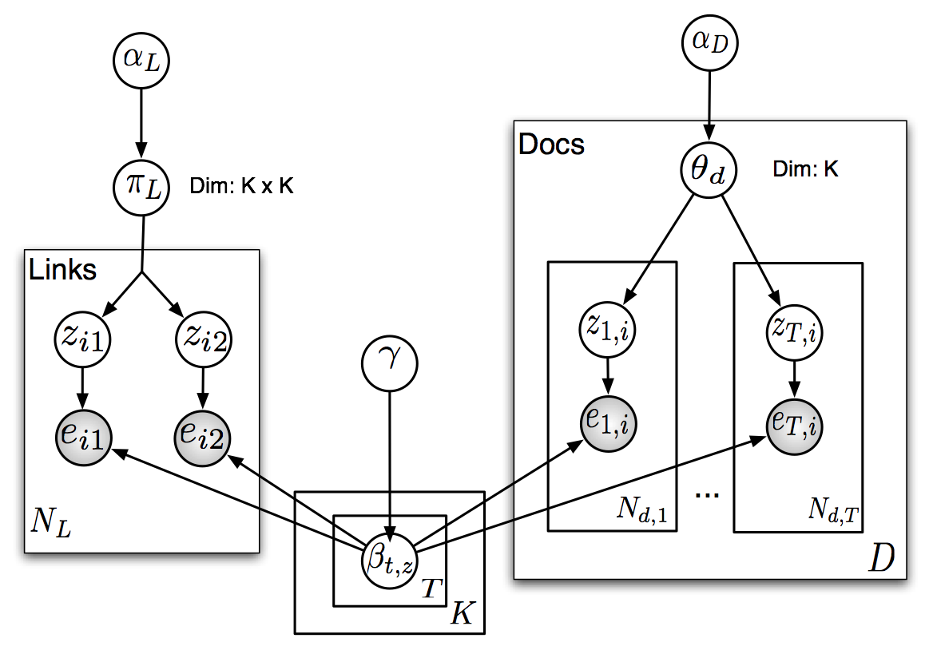
BlockLDA: jointly modeling blocks and text
Entity distributions shared between “blocks” and “topics”

Slide 18
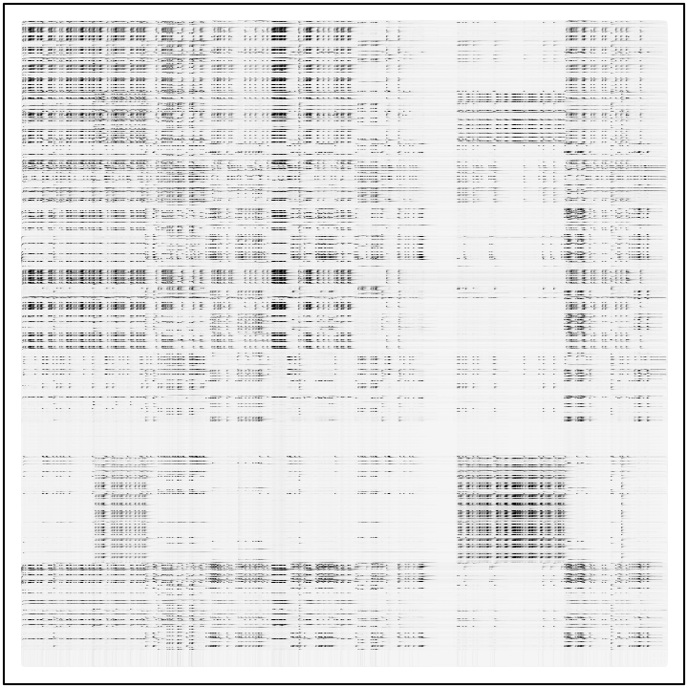
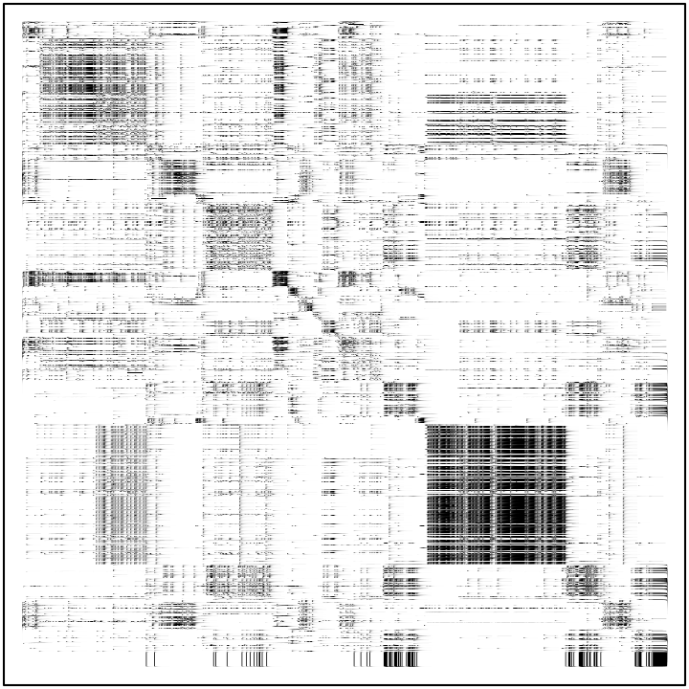
Recovering the interaction matrix
MIPS interactions
Sparse Block model
Block-LDA

Slide 19
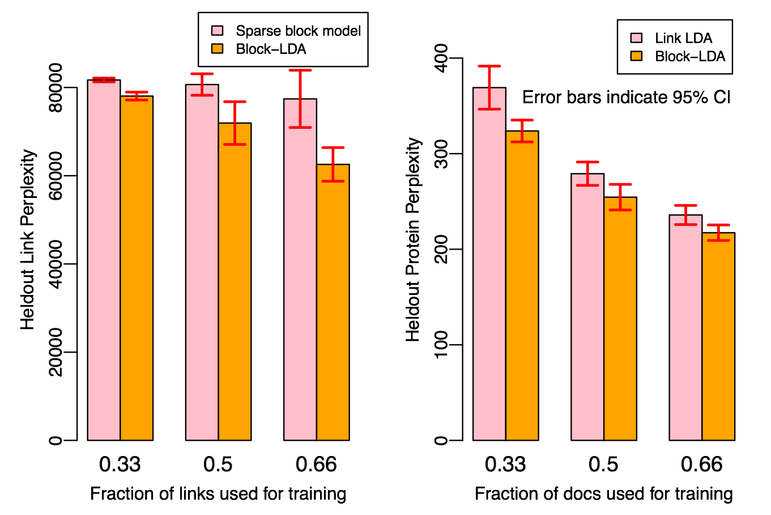
Varying The Amount of Training Data

Slide 20
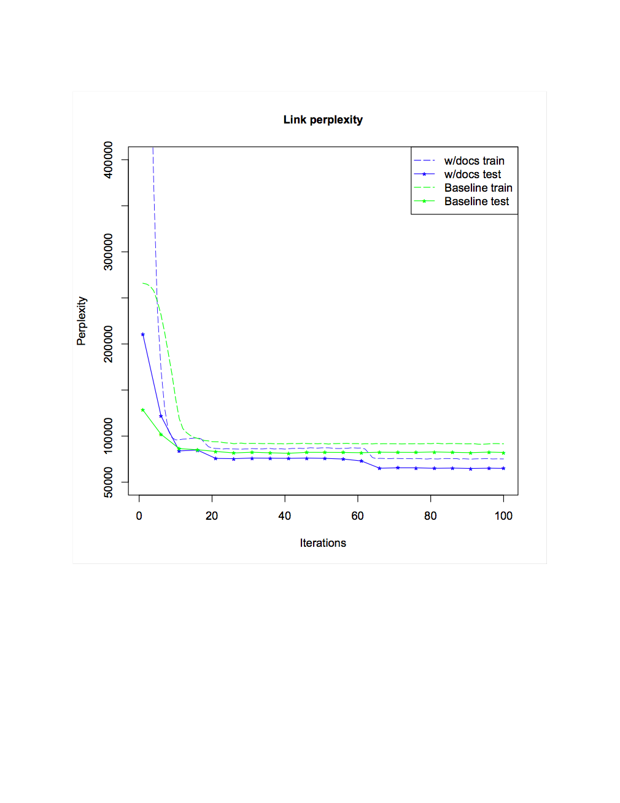
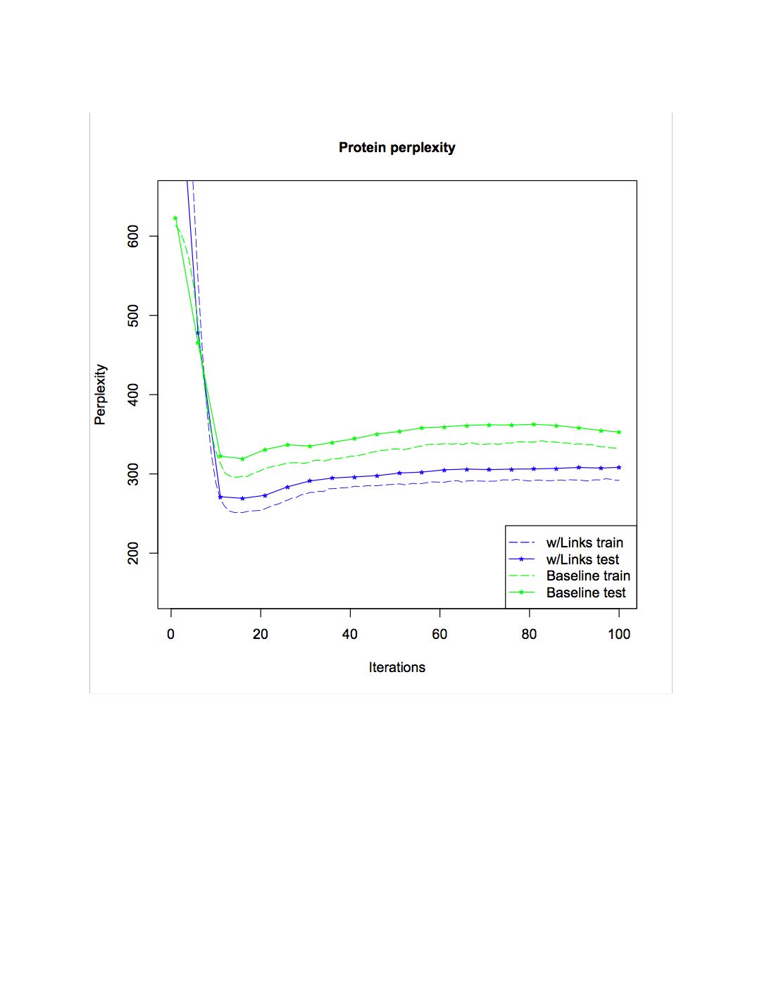
1/3 of links + all text for training; 2/3 of links for testing
1/3 of text + all links for training; 2/3 of docs for testing

Slide 21
Another Performance Test
Goal: predict “functional categories” of proteins
  15 categories at top-level (e.g., metabolism, cellular communication, cell fate, …)
  Proteins have 2.1 categories on average
  Method for predicting categories:
    Run with 15 topics
    Using held-out labeled data, associate topics with closest category
    If category has n true members, pick top n proteins by probability of membership in associated topic.
  Metric: F1, Precision, Recall

Slide 22
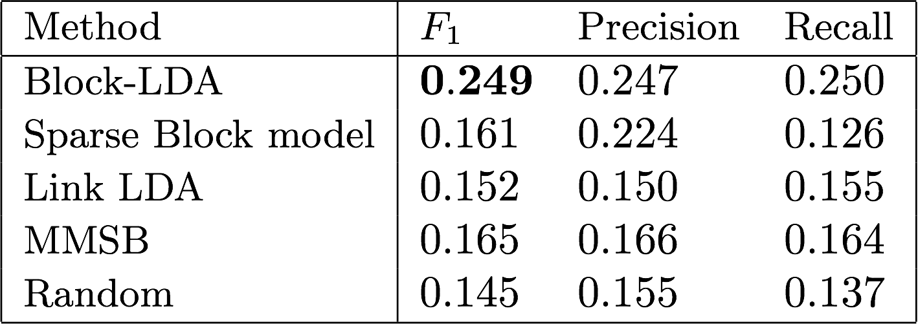
Performance

Slide 23
Other Related Work
Link PLSA LDA: Nallapati et al., 2008 - Models linked documents
Nubbi: Chang et al., 2009, - Discovers relations between entities in text
Topic Link LDA: Liu et al, 2009 - Discovers communities of authors from text corpora

Slide 24
Conclusions
Hypothesis:
  relations + annotated text are a common syntactic representation of data, so joint models for this data should be useful
  BlockLDA is an effective model for this sort of data
Result: for yeast protein-protein interaction data
  improvements in block modeling when entity-annotated text about the entities involved is added
  improvements in entity perplexity given text when relational data about the entities involved is added

Slide 25
Thanks to…
NIH/NIGMS
NSF
Google
Microsoft LiveLabs
Notes:
Ando & Lee – rescuing LSA ? SIGIR from 2005? Dealing with skew of sizes
Yoram and Deutche – Matt Streeter?
Method as a stochastic gradient?
Lanzos – from Shi – fast vision ncut methods
Negative starting values

