Slide 1
Working with MinorThird:
Lesson 3:
Advanced Topics
William W. Cohen
CALD

Slide 2
Outline
  using or adding to the “repository”
  non-text applications of Minorthird
  levels of the Java API
  immediate & medium-term plans
  questions/answers

Slide 3
The Minorthird Repository
Goals of the repository:
  a fixed collection of labeled datasets
    reproducible experiments
    good data hygiene
    encourage data sharing
  each dataset has short “key”
  documents can be shared in multiple datasets
    reutersModAptTrain, reutersModLewisTrain
  labels and documents can be stored separately
    e.g., labels under CVS control, documents elsewhere
  data can be in any supported format

Slide 4
The Minorthird Repository
Implementation of the repository:
  minorthird/config/data.properties defines
    edu.cmu.minorthird.repository=DIR
    edu.cmu.minorthird.dataDir [DIR/data]
    edu.cmu.minorthird.labelDir [DIR/labels]
    edu.cmu.minorthird.scriptDir [DIR/loaders]
The key for a dataset is the file name of a beanShell (interpreted Java) script in DIR/loaders.
  Minorthird checks for DIR/loaders/key before checking for a directory of documents in key
The beanShell script in DIR/loaders/key evaluates with variables dataDir and labelDir bound appropriately, and should return a TextLabels object (labeled dataset).

Slide 5
The Minorthird Repository
Using the repository:
  unpack the sample one http://www.cs.cmu.edu/~wcohen/repository.tgz
  set data.properties appropriately
  add to it using scripts in repository/loaders as examples
Not using the repository:
  in data.properties: edu.cmu.minorthird.scriptDir=.
  one new feature: you can also load data in an odd format by writing a bean shell script to load it, and giving minorthird the name of that script.
  second new feature: some built-in “toy” datasets

Slide 6
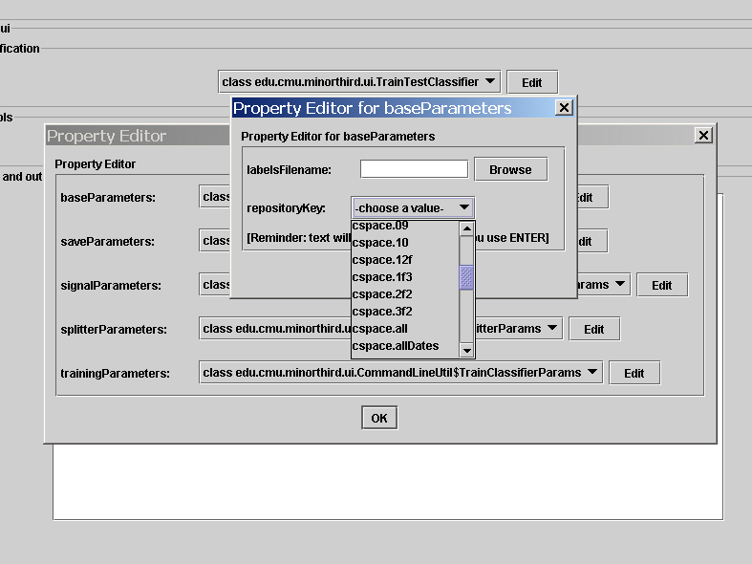

Slide 7
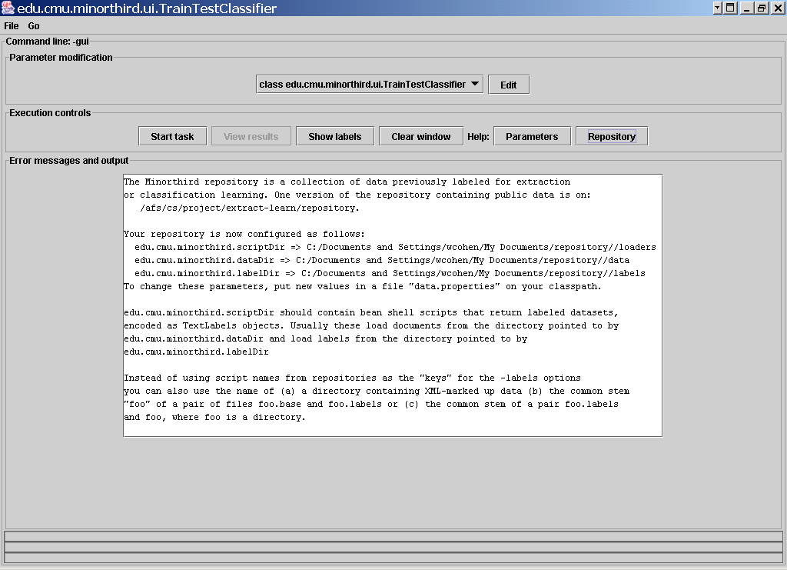

Slide 8
Using Minorthird without Text
Data format for “normal” learning:
class: POS,
NEG are special
groupId
ignored
list of featureName=value
default value=1.0
value!=0.0
b week1 NEG sunny humid temp=85
b week1 POS sunny dry temp=76
b week2 POS cloudy dry temp=72
...

Slide 9
Using Minorthird without Text
Data format for “normal” learning:
“default” assignment: all groupIds are unique
groupId: examples in same group are never split across a training/testing partition.
b week1 NEG sunny humid temp=85
b week1 POS sunny dry temp=76
b week2 POS cloudy dry temp=72
...
Example: web site from which a document was taken – want to test on docs from “new” sites

Slide 10
Using Minorthird without Text
Data format for sequential learning:
b week1 NEG sunny humid temp=85
b week1 POS sunny dry temp=76
b week1 POS cloudy dry temp=72
*
b week1 POS sunny humid temp=80
b week1 POS sunny dry temp=76
*
...
stars end a sequence of examples

Slide 11
Using Minorthird without Text
Analog of UI methods:
  java edu.cmu.minorthird.classify.UI –gui
  java edu.cmu.minorthird.class.UI -help

Slide 12
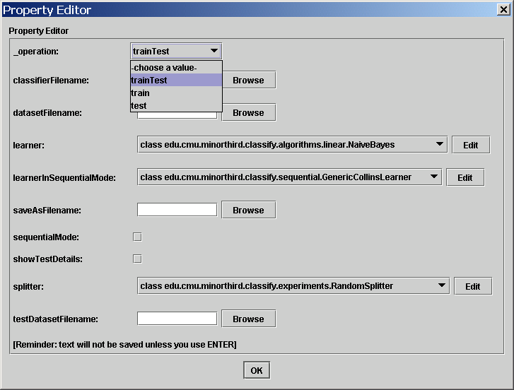

Slide 13
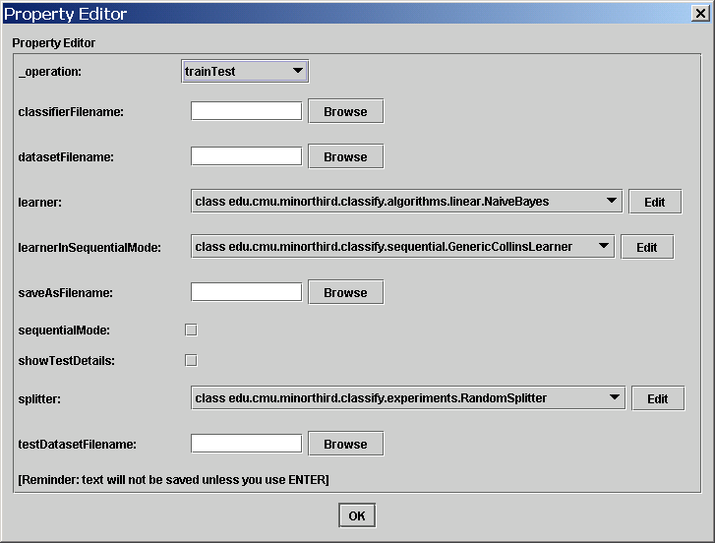
only used for test
always needed
determines which learner is used
only used for test

Slide 14
Java API
Goals:
  as simple as possible, but no simpler
  wanted support for: interactive training, active learning, unsupervised learning, and embedding learning into an adaptive system
Extraction Learning, Text Classif
Representing and changing text
Mapping text to instances
Batch learning
Online learning
Learner-teacher protocols
Data structured for learning
GUI utilities
other utilities

Slide 15
Java API overview: classify
Instance: weighted set of Features
Example
  Instance +ClassLabel
  ClassLabel is weighted set of Strings
Dataset
  iterator-style access to examples
Classifier
  Instance -> ClassLabel
  Instance -> String “explanation”
ClassifierLearner
ClassifierTeacher
  DatasetClassifierTeacher

Slide 16
Java API overview: classify
ClassifierLearner
  BatchClassifierLearner
    BatchBinaryClassifierLearner
  OnlineClassifierLearner
    OnlineBinaryClassifierLearner
BinaryClassifier:
  predicts real number ~= log Prob(POS)
BatchClassifierLearner
  Dataset -> [Binary]Classifier
OnlineClassifierLearner
  learner.reset(), learner.addExample(..), learner.getClassifier(...)

Slide 17
Java API: classify.experiments
Evaluation: description of experimental results, produced by Tester
CrossValidatedDataset: detailed description of experimental results (-showTestDetails output)
Splitters: groupId-sensitive
  s.split(iterator); then s.getTrain(i), s.getTest(i), s.getNumPartitions()
  CrossValSplitter, RandomSplitter, StratifiedCrossValSplitter, SubsamplingCrossValSplitter, ...

Slide 18
Java API overview: classify.sequential
Instance:
Example
  Instance +ClassLabel
Dataset
Classifier
  Instance -> ClassLabel
ClassifierLearner
ClassifierTeacher
  DsetClsTeacher
Instance[] (sequence)
Example[] (labeled seq)
SequenceDataset
SequenceClassifier
  Instance[] -> ClassLabel[]
SequenceClass..Learner
SequenceCl...Teacher
  DsetSeqClsTeacher

Slide 19
Java API overview: text.learn
Instance:
Example
  Instance +ClassLabel
Dataset
Classifier
  Instance -> ClassLabel
ClassifierLearner
ClassifierTeacher
  DsetClsTeacher
Span (usually a document)
AnnotationExample
  Doc+TextLabels+“signal”
TextLabels+TextBase
Annotator
  ann.annotate(textLabels)
  ann.annotatedCopy(...)
AnnotatorLearner
AnnotatorTeacher
  TextLabsAnnTeacher

Slide 20
Java API: util, util.gui
util.ProgressCounter:
  progress status within long iterations
  lightweight, text or UI
util.gui.Visible, util.gui.Viewer
  Visible objects can be shown in a Viewer
  Viewers can be easily glued together to build integrated browsers for structured objects
  util.gui has a number of Viewer-building tools
  Most natively-implemented classifiers are Visible, as are Datasets, Examples, TextLabels, ....

Slide 21
Java API: util, util.gui
Why mess with GUIs?
  Hard to debug ML methods without support
  Minorthird should be a tool for learning about machine learning
Gui-ify your classifiers if you possibly can

Slide 22
Where I hope Minorthird Goes
Free IE!
Better support for experiments
  Tools for managing a series of experiments
  Statistical significance tests
Better explanation facilities
  Strings are too shallow
More learning methods
  “Big tent”: Minorthird is for comparing and evaluating methods, not a specific method on its own
  Gateways to WEKA, MALLET, GATE, ... ?
Free Minorthird-created text processing tools
  names, dates, body parsing for email
  pos tagger, shallow parser for newswire text
  gene/protein, cell names for bio text

Slide 23
Q & A
?

