Slide 1
Information Extraction from the
World Wide Web
William W. Cohen
Carnegie Mellon University
for Factiva, Feb 2006
Notes:
Welcome to the NIPS Tutorial on "IE from the WWW". I'm Andrew McCallum. William Cohen and I are happy to giving this tutorial, and happy to see all of you. Please ask questions during tutorial---no sense in waiting to the end of a multi-hour tutorial... You have a copy of some slides in your tutorial proceedings, but the slides we'll present today are different enough that you may find it less confusing to put your proceedings aside.
William and I have been working in machine learning approaches to information extraction for many years. Initially separately: myself at CMU/JustResearch and William at AT&T Research. We came together at WhizBang Labs, an Internet start-up solely devoted to IE from the Web. The company Whiz'ed with the Internet boom---growing rapidly; (in our hayday there were more members of the editorial board of the MLJ working at WhizBang than at any other single institution;) and we Bang'ed with the dot-com crash. We learned a tremendous amount about business and real-world IE. So we bring a mixture of academic and industrial perspective to the problem.
Let's start with a few motivational problem: Let's say you are looking for a job as a bread baker.

Slide 2
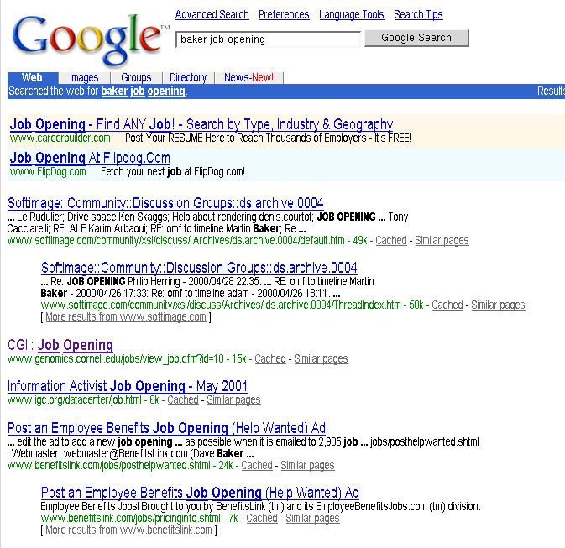
Example: The Problem
Martin Baker, a person
Genomics job
Employers job posting form

Slide 3
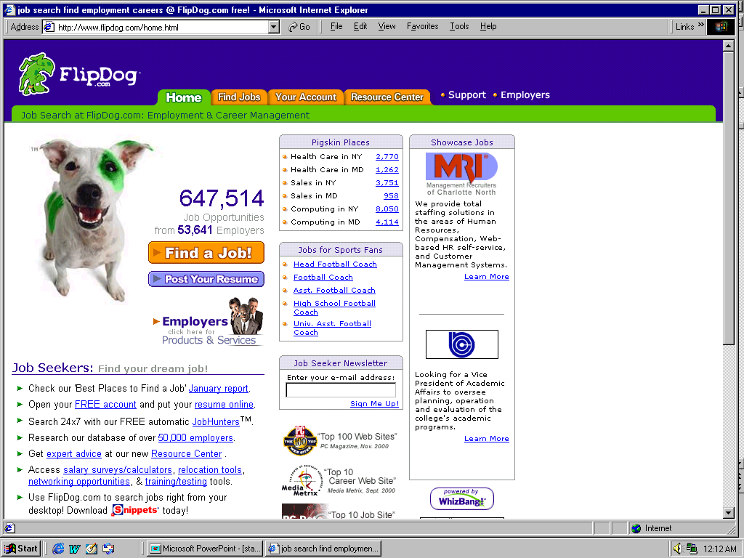
Example: A Solution

Slide 4

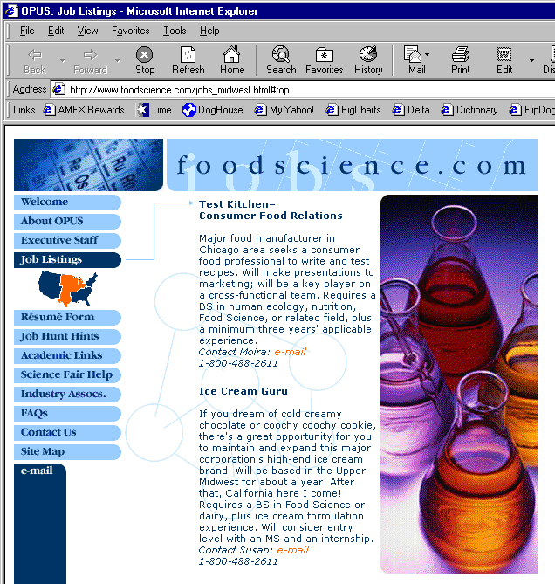
Extracting Job Openings from the Web
foodscience.com-Job2
JobTitle: Ice Cream Guru
Employer: foodscience.com
JobCategory: Travel/Hospitality
JobFunction: Food Services
JobLocation: Upper Midwest
Contact Phone: 800-488-2611
DateExtracted: January 8, 2001
Source: www.foodscience.com/jobs_midwest.html
OtherCompanyJobs: foodscience.com-Job1
Notes:
WB’s first application area is extracting job openings from the web.
Start at company home page, automatically follow links to find the job openings section, segment job openings from each other, and extract job title, location, description, and all of these fields.
(Notice that capitalization, position on page, bold face are just as much indicators of this being a job title as the words themselves.
Notice also that part of the IE task is figuring out which links to follow. And often data for a relation came from multiple different pages.)

Slide 5
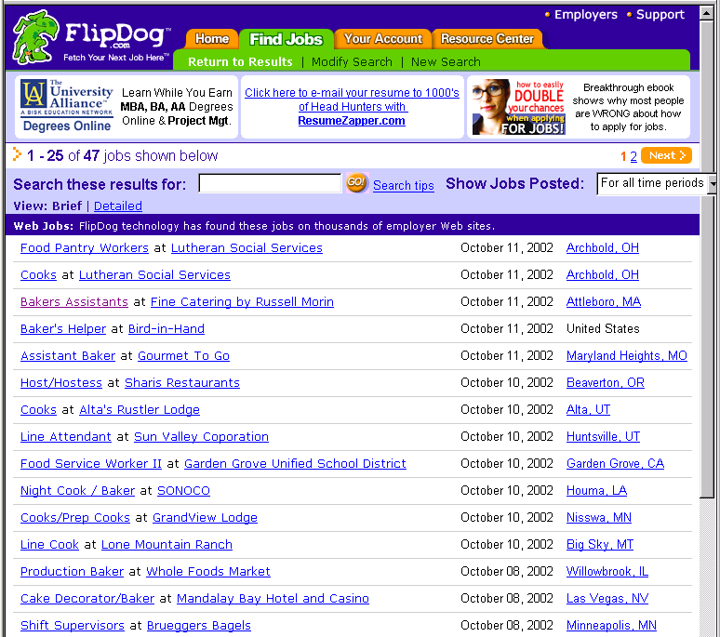
Job Openings:
Category = Food Services
Keyword = Baker
Location = Continental U.S.
Notes:
Not only did this support extremely useful and targeted search and data navigation, with highly summarized display

Slide 6
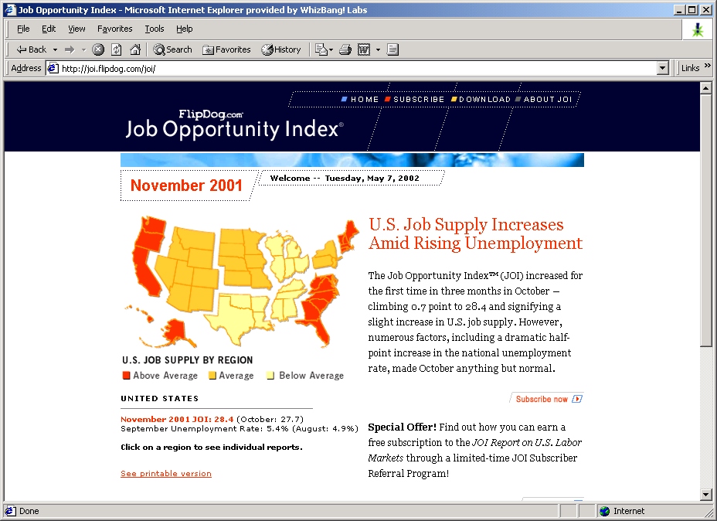
Data Mining the Extracted Job Information
Notes:
It also supported something that a web page search engine could never do: data mine the extracted information.
Once a month, we data-mined our database of jobs and the changes in them to produce a Job Opportunity Index report …
used by several state and local governments to help set policy.

Slide 7
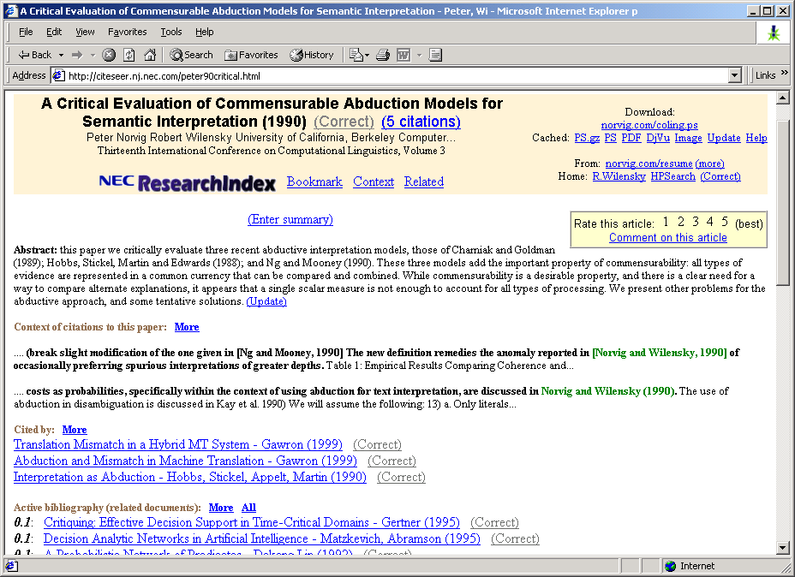
IE from Research Papers
Notes:
CiteSeer, which we all know and love, is made possible by the automatic extraction of title and author information from research paper headers and references in order to build the reference graph that we use to find related work.

Slide 8
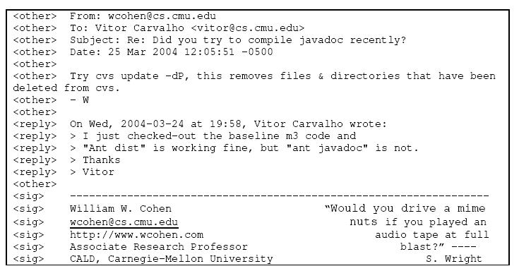
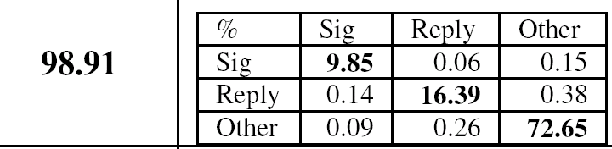
Document Analysis for Email
% accurate

Slide 9



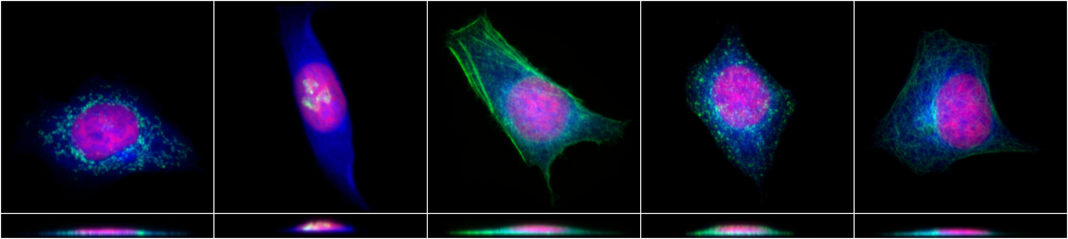

SLIF: Large-scale acquisition of FMI’s by mining on-line publications
SLIF
Online
papers
Annotated
FMI’s
DB
Feature | Value
NumObjects: | 125.0
EulerNumber: | -43.0
objectSizeRatio: | 3.1
CenterOfFluor: | 34.6
... | ...
Feature | Value
NumObjects: | 125.0
EulerNumber: | -43.0
objectSizeRatio: | 3.1
CenterOfFluor: | 34.6
... | ...
Feature | Value
NumObjects: | 125.0
EulerNumber: | -43.0
objectSizeRatio: | 3.1
CenterOfFluor: | 34.6
... | ...
Murphy lab
image analysis
...
Journals on WWW
Notes:
goal is building DB of assertions about SL

Slide 10
Overview of SLIF2
Control and communication
External
DBs (GO,)
[Cohen, 2003]
Entity matching
& extraction
proteins,
cells, ...
Caption
Scope
Annotated
Scopes
[Cohen & Sarawigi,
2004; Ravikumar &
Cohen, 2004; Cohen et al
2003; current work]
Caption
understanding
ImagePtr
Figure-
Caption
pair
SLIF DB
[Cohen et al, 2003]
Label
Matching
Label
finding
[Kou et al, 2003]
Panel
labels
Panel
splitting
[Kou et al, 2003]
image type, image scale, subcellular location features, ...
[Murphy et
al, 2001]
Panels
Annotated
Panels
Panel classification,
Micrograph analysis,
[Murphy et al, 2001;
current work]
Notes:
mention that we starting in middle – at hard part: XML and smart spiders

Slide 11
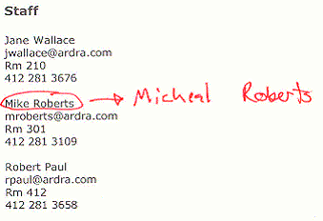
Webmaster Overview
Details:
  Assume DB-backed website, where schema changes over time
    No other changes allowed (yet)
  Interaction:
    User requests (via NL email) changes in factual content of website (assume update of one tuple)
    System analyzes request
    System presents preview page and editable form version of request
Key points:
  partial correctness is useful
  user can verify correctness (vs case for DB queries, q/a,...) => source of training data
Mike Roborts should be Micheal Roberts in the staff listing, pls fix it. Thanks - W

Slide 12

Shallow NLP
Feature Building
Classification
LEARNER
offline
training
data
POS tags
C
requestType
email msg
NP chunks
C
targetRelation
words, ...
C
targetAttrib
Information
Extraction
features
newEntity1,...
entity1, entity2, ....
oldEntity1,...
C
keyEntity1,...
otherEntity1,...
preview page
user-editable form
version of request
Update Request Construction
User
confirm?
web page
templates
database

Slide 13
What is “Information Extraction”
As a task:
Filling slots in a database from sub-segments of text.
October 14, 2002, 4:00 a.m. PT
For years, Microsoft Corporation CEO Bill Gates railed against the economic philosophy of open-source software with Orwellian fervor, denouncing its communal licensing as a "cancer" that stifled technological innovation.
Today, Microsoft claims to "love" the open-source concept, by which software code is made public to encourage improvement and development by outside programmers. Gates himself says Microsoft will gladly disclose its crown jewels--the coveted code behind the Windows operating system--to select customers.
"We can be open source. We love the concept of shared source," said Bill Veghte, a Microsoft VP. "That's a super-important shift for us in terms of code access.“
Richard Stallman, founder of the Free Software Foundation, countered saying…
NAME TITLE ORGANIZATION
Notes:
What is IE. As a task it is…
Starting with some text… and a empty data base with a defined ontology of fields and records,
Use the information in the text to fill the database.

Slide 14
What is “Information Extraction”
As a task:
Filling slots in a database from sub-segments of text.
October 14, 2002, 4:00 a.m. PT
For years, Microsoft Corporation CEO Bill Gates railed against the economic philosophy of open-source software with Orwellian fervor, denouncing its communal licensing as a "cancer" that stifled technological innovation.
Today, Microsoft claims to "love" the open-source concept, by which software code is made public to encourage improvement and development by outside programmers. Gates himself says Microsoft will gladly disclose its crown jewels--the coveted code behind the Windows operating system--to select customers.
"We can be open source. We love the concept of shared source," said Bill Veghte, a Microsoft VP. "That's a super-important shift for us in terms of code access.“
Richard Stallman, founder of the Free Software Foundation, countered saying…
IE
NAME TITLE ORGANIZATION
Bill Gates CEO Microsoft
Bill Veghte VP Microsoft
Richard Stallman founder Free Soft..

Slide 15
What is “Information Extraction”
As a family
of techniques:
Information Extraction =
segmentation + classification + clustering + association
October 14, 2002, 4:00 a.m. PT
For years, Microsoft Corporation CEO Bill Gates railed against the economic philosophy of open-source software with Orwellian fervor, denouncing its communal licensing as a "cancer" that stifled technological innovation.
Today, Microsoft claims to "love" the open-source concept, by which software code is made public to encourage improvement and development by outside programmers. Gates himself says Microsoft will gladly disclose its crown jewels--the coveted code behind the Windows operating system--to select customers.
"We can be open source. We love the concept of shared source," said Bill Veghte, a Microsoft VP. "That's a super-important shift for us in terms of code access.“
Richard Stallman, founder of the Free Software Foundation, countered saying…
Microsoft Corporation
CEO
Bill Gates
Microsoft
Gates
Microsoft
Bill Veghte
Microsoft
VP
Richard Stallman
founder
Free Software Foundation
Notes:
As a family of techniques, is consists of
Segmentation to find the beginning and ending boundaries of the text snippets that will go in the DB.
Classification…

Slide 16
What is “Information Extraction”
As a family
of techniques:
Information Extraction =
segmentation + classification + association + clustering
October 14, 2002, 4:00 a.m. PT
For years, Microsoft Corporation CEO Bill Gates railed against the economic philosophy of open-source software with Orwellian fervor, denouncing its communal licensing as a "cancer" that stifled technological innovation.
Today, Microsoft claims to "love" the open-source concept, by which software code is made public to encourage improvement and development by outside programmers. Gates himself says Microsoft will gladly disclose its crown jewels--the coveted code behind the Windows operating system--to select customers.
"We can be open source. We love the concept of shared source," said Bill Veghte, a Microsoft VP. "That's a super-important shift for us in terms of code access.“
Richard Stallman, founder of the Free Software Foundation, countered saying…
Microsoft Corporation
CEO
Bill Gates
Microsoft
Gates
Microsoft
Bill Veghte
Microsoft
VP
Richard Stallman
founder
Free Software Foundation

Slide 17
What is “Information Extraction”
As a family
of techniques:
Information Extraction =
segmentation + classification + association + clustering
October 14, 2002, 4:00 a.m. PT
For years, Microsoft Corporation CEO Bill Gates railed against the economic philosophy of open-source software with Orwellian fervor, denouncing its communal licensing as a "cancer" that stifled technological innovation.
Today, Microsoft claims to "love" the open-source concept, by which software code is made public to encourage improvement and development by outside programmers. Gates himself says Microsoft will gladly disclose its crown jewels--the coveted code behind the Windows operating system--to select customers.
"We can be open source. We love the concept of shared source," said Bill Veghte, a Microsoft VP. "That's a super-important shift for us in terms of code access.“
Richard Stallman, founder of the Free Software Foundation, countered saying…
Microsoft Corporation
CEO
Bill Gates
Microsoft
Gates
Microsoft
Bill Veghte
Microsoft
VP
Richard Stallman
founder
Free Software Foundation

Slide 18
What is “Information Extraction”
As a family
of techniques:
Information Extraction =
segmentation + classification + association + clustering
October 14, 2002, 4:00 a.m. PT
For years, Microsoft Corporation CEO Bill Gates railed against the economic philosophy of open-source software with Orwellian fervor, denouncing its communal licensing as a "cancer" that stifled technological innovation.
Today, Microsoft claims to "love" the open-source concept, by which software code is made public to encourage improvement and development by outside programmers. Gates himself says Microsoft will gladly disclose its crown jewels--the coveted code behind the Windows operating system--to select customers.
"We can be open source. We love the concept of shared source," said Bill Veghte, a Microsoft VP. "That's a super-important shift for us in terms of code access.“
Richard Stallman, founder of the Free Software Foundation, countered saying…
*
Microsoft Corporation
CEO
Bill Gates
Microsoft
Gates
Microsoft
Bill Veghte
Microsoft
VP
Richard Stallman
founder
Free Software Foundation
Free Soft..
Microsoft
Microsoft
TITLE ORGANIZATION
*
*
founder
CEO
VP
*
Stallman
Veghte
NAME
Bill Gates
Richard
Bill

Slide 19
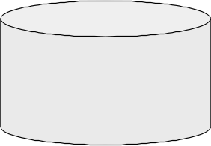
IE in Context
Create ontology
Spider
Filter by relevance
IE
Segment
Classify
Associate
Cluster
Database
Load DB
Document
collection
Train extraction models
Query,
Search
Label training data
Data mine

Slide 20
Why IE from the Web?
Science
  Grand old dream of AI: Build large KB* and reason with it.
  IE from the Web enables the creation of this KB.
  IE from the Web is a complex problem that inspires new advances in machine learning.
Profit
  Many companies interested in leveraging data currently “locked in unstructured text on the Web”.
  Not yet a monopolistic winner in this space.
Fun!
  Build tools that we researchers like to use ourselves:
  Cora & CiteSeer, MRQE.com, FAQFinder,…
  See our work get used by the general public.
* KB = “Knowledge Base”
Notes:
Poor Doug Lenat, creating Cyc. I was there at ICML in 1991… Now 11 years later.

Slide 21
Tutorial Outline
IE History
Landscape of problems and solutions
Parade of models for segmenting/classifying:
  Sliding window
  Boundary finding
  Finite state machines
  Trees
Overview of related problems and solutions
  Association, Clustering
  Integration with Data Mining
Where to go from here
optimistic me we’ll get here today?
Notes:
In the rest of the tutorial, we will
Touch briefly on the history of IE
Survey the dimensions of the landscape of the problems and solutions
Get into the technique meat by explaining a parade of models falling in different modeling families.
Briefly describe several other concepts you should know about
And end by looking forward.

Slide 22
IE History
Pre-Web
Mostly news articles
  De Jong’s FRUMP [1982]
    Hand-built system to fill Schank-style “scripts” from news wire
  Message Understanding Conference (MUC) DARPA [’87-’95], TIPSTER [’92-’96]
Most early work dominated by hand-built models
  E.g. SRI’s FASTUS, hand-built FSMs.
  But by 1990’s, some machine learning: Lehnert, Cardie, Grishman and then HMMs: Elkan [Leek ’97], BBN [Bikel et al ’98]
Web
AAAI ’94 Spring Symposium on “Software Agents”
  Much discussion of ML applied to Web. Maes, Mitchell, Etzioni.
Tom Mitchell’s WebKB, ‘96
  Build KB’s from the Web.
Wrapper Induction
  Initially hand-build, then ML: [Soderland ’96], [Kushmeric ’97],…
Notes:
ML… although this is an area where ML has not yet trounced the hand-built systems. In some of the latest evaluations, hand-built shared 1st place with a ML.
Now many companies making a business from IE (from the Web): WasBang, Inxight, Intelliseek, ClearForest.

Slide 23
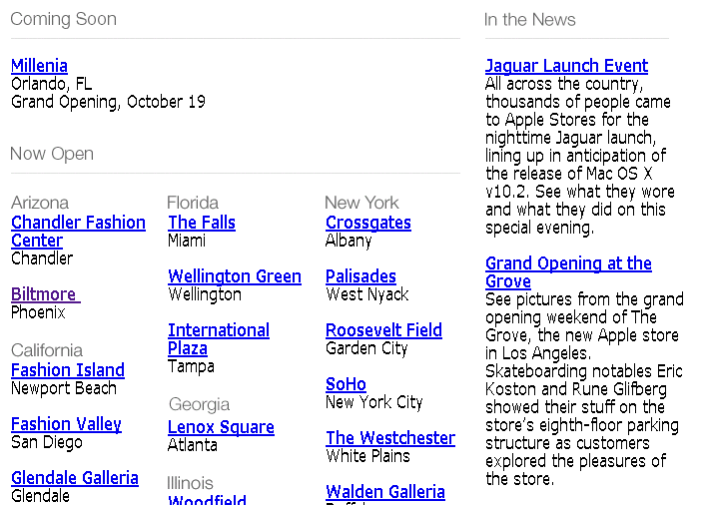
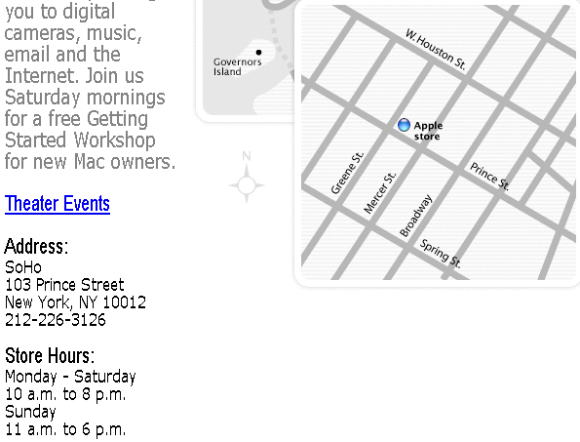
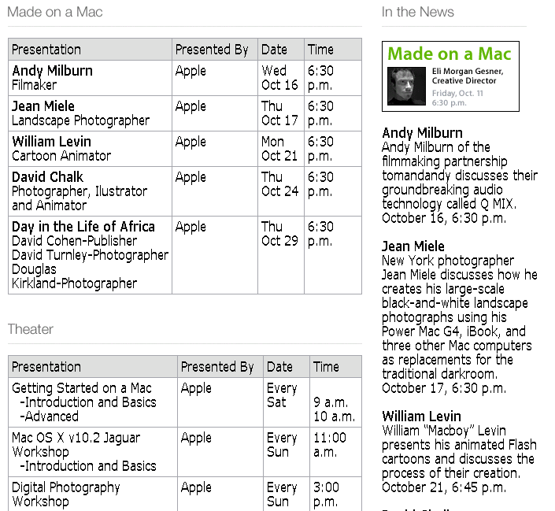
What makes IE from the Web Different?
Less grammar, but more formatting & linking
Newswire
Web
www.apple.com/retail
Apple to Open Its First Retail Store
in New York City
MACWORLD EXPO, NEW YORK--July 17, 2002--Apple's first retail store in New York City will open in Manhattan's SoHo district on Thursday, July 18 at 8:00 a.m. EDT. The SoHo store will be Apple's largest retail store to date and is a stunning example of Apple's commitment to offering customers the world's best computer shopping experience.
"Fourteen months after opening our first retail store, our 31 stores are attracting over 100,000 visitors each week," said Steve Jobs, Apple's CEO. "We hope our SoHo store will surprise and delight both Mac and PC users who want to see everything the Mac can do to enhance their digital lifestyles."
www.apple.com/retail/soho
www.apple.com/retail/soho/theatre.html
The directory structure, link structure, formatting & layout of the Web is its own new grammar.
Notes:
Traditionally, IE was done mostly on newswire: flowing, grammatical sentences with little or no formatting information.
The Web is different: less grammar, more ungrammatical little snippets, but rich formatting and layout information.
This directory structure…
So lets consider the dimensions of the IE landscape.
First some ways in which the problem space varies:

Slide 24
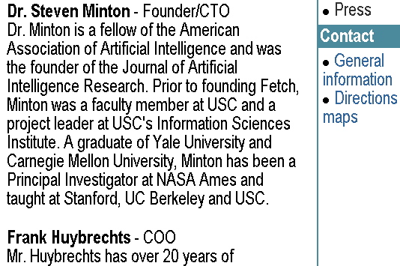
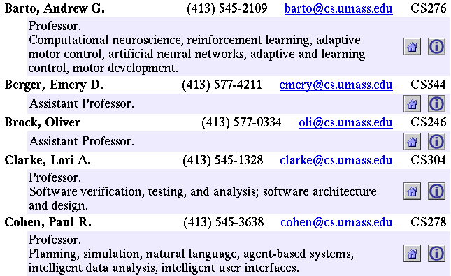
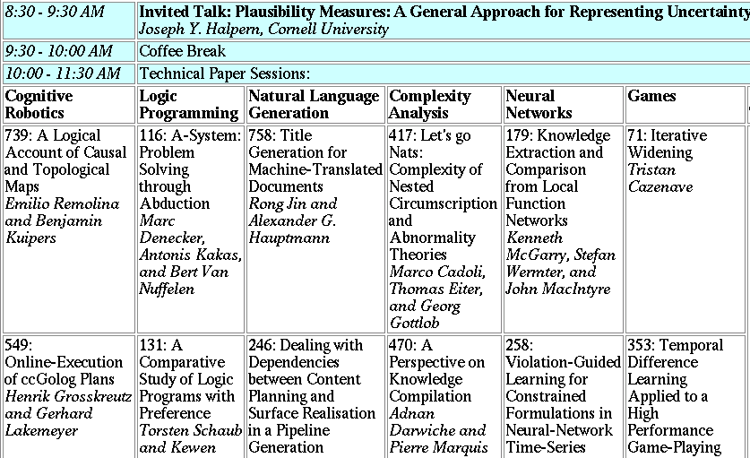
Landscape of IE Tasks (1/4):
Pattern Feature Domain
Text paragraphs
without formatting
Grammatical sentences
and some formatting & links
Astro Teller is the CEO and co-founder of BodyMedia. Astro holds a Ph.D. in Artificial Intelligence from Carnegie Mellon University, where he was inducted as a national Hertz fellow. His M.S. in symbolic and heuristic computation and B.S. in computer science are from Stanford University. His work in science, literature and business has appeared in international media from the New York Times to CNN to NPR.
Non-grammatical snippets,
rich formatting & links
Tables
Notes:
Different families of features may be more or less useful in different data sets.

Slide 25
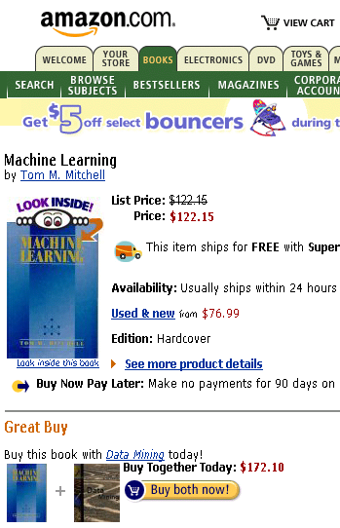
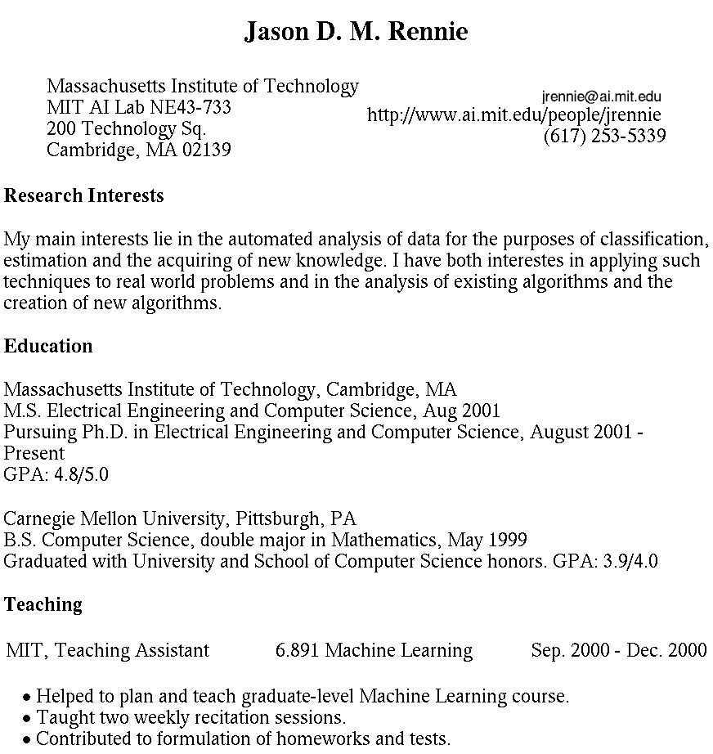

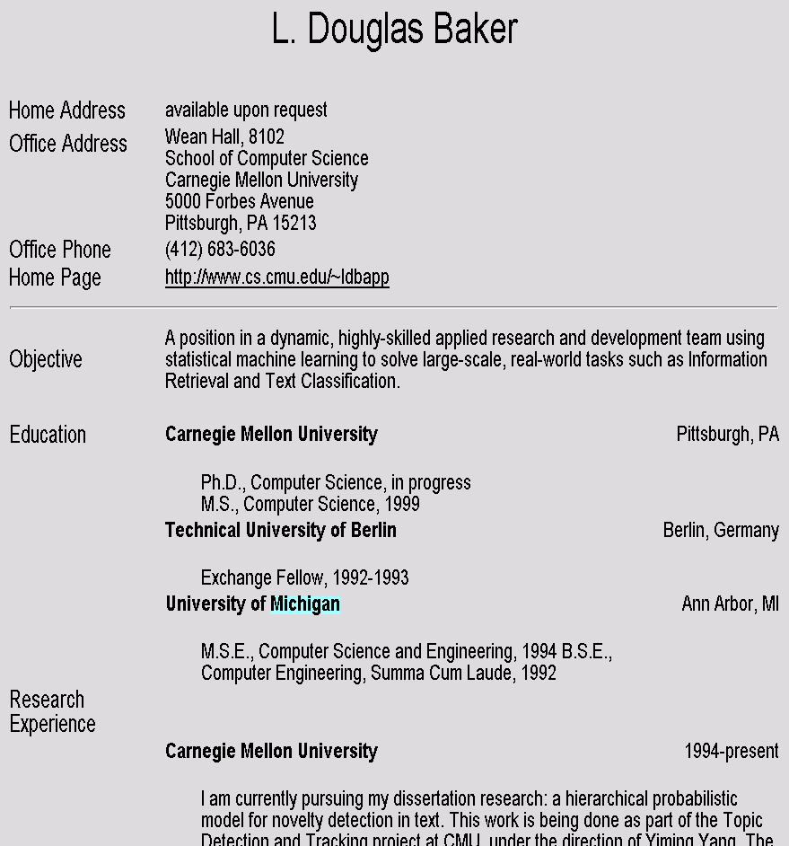
Landscape of IE Tasks (2/4):
Pattern Scope
Web site specific
Genre specific
Wide, non-specific
Formatting
Layout
Language
Amazon.com Book Pages
Resumes
University Names
Notes:
If you were going to use formatting to do extraction, how often (with what granularity) would you have to re-train your models?

Slide 26
Landscape of IE Tasks (3/4):
Pattern Complexity
E.g. word patterns:
Closed set
Regular set
U.S. states
U.S. phone numbers
He was born in Alabama…
Phone: (413) 545-1323
The big Wyoming sky…
The CALD main office can be
reached at 412-268-1299
Complex pattern
Ambiguous patterns,
needing context and
many sources of evidence
U.S. postal addresses
University of Arkansas
P.O. Box 140
Hope, AR 71802
Person names
…was among the six houses sold by Hope Feldman that year.
Headquarters:
1128 Main Street, 4th Floor
Cincinnati, Ohio 45210
Pawel Opalinski, Software
Engineer at WhizBang Labs.
Notes:
How complicated a modeling technique will you have to use?

Slide 27
Landscape of IE Tasks (4/4):
Pattern Combinations
Jack Welch will retire as CEO of General Electric tomorrow. The top role
at the Connecticut company will be filled by Jeffrey Immelt.
Single entity
Binary relationship
N-ary record
Person: Jack Welch
Relation: Person-Title
Person: Jack Welch
Title: CEO
Relation: Succession
Company: General Electric
Title: CEO
Out: Jack Welsh
In: Jeffrey Immelt
Person: Jeffrey Immelt
Location: Connecticut
Relation: Company-Location
Company: General Electric
Location: Connecticut
“Named entity” extraction
Notes:
How many components of the output of your system? Single entity…
It is more difficult to get high accuracy on the right than on the left, because each consituent has to be right, and errors compound. 90%^5=60%

Slide 28
Evaluation of Single Entity Extraction
TRUTH:
Michael Kearns and Sebastian Seung will start Monday’s tutorial, followed by Richard M. Karpe and Martin Cooke.
PRED:
Michael Kearns and Sebastian Seung will start Monday’s tutorial, followed by Richard M. Karpe and Martin Cooke.
# correctly predicted segments 2
Precision = =
# predicted segments 6
# correctly predicted segments 2
Recall = =
# true segments 4
1
F1 = Harmonic mean of Precision & Recall =
((1/P) + (1/R)) / 2

Slide 29
State of the Art Performance
Named entity recognition
  Person, Location, Organization, …
  F1 in high 80’s or low- to mid-90’s
Binary relation extraction
  Contained-in (Location1, Location2)
  Member-of (Person1, Organization1)
  F1 in 60’s or 70’s or 80’s
Wrapper induction
  Extremely accurate performance obtainable
  Human effort (~30min) required on each site

Slide 30
Landscape of IE Techniques (1/1):
Models
Classify Pre-segmented
Candidates
Lexicons
Sliding Window
Abraham Lincoln was born in Kentucky.
Abraham Lincoln was born in Kentucky.
Abraham Lincoln was born in Kentucky.
member?
Classifier
Alabama
Alaska
…
Wisconsin
Wyoming
Classifier
which class?
which class?
Try alternate
window sizes:
Boundary Models
Finite State Machines
Context Free Grammars
Abraham Lincoln was born in Kentucky.
Abraham Lincoln was born in Kentucky.
Abraham Lincoln was born in Kentucky.
BEGIN
Most likely state sequence?
NNP
NNP
V
V
P
NP
Classifier
Most likely parse?
PP
which class?
VP
NP
VP
BEGIN
END
BEGIN
END
S
…and beyond
Any of these models can be used to capture words, formatting or both.

Slide 31
Landscape:
Focus of this Tutorial
Pattern complexity
closed set
regular
complex
ambiguous
Pattern feature domain
words
words + formatting
formatting
Pattern scope
site-specific
genre-specific
general
Pattern combinations
entity
binary
n-ary
Models
lexicon
regex
window
boundary
FSM
CFG
Notes:
Organized according to the last row.

Slide 32
Sliding Windows

Slide 33
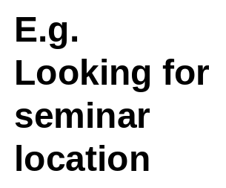
Extraction by Sliding Window
GRAND CHALLENGES FOR MACHINE LEARNING
Jaime Carbonell
School of Computer Science
Carnegie Mellon University
3:30 pm
7500 Wean Hall
Machine learning has evolved from obscurity in the 1970s into a vibrant and popular discipline in artificial intelligence during the 1980s and 1990s. As a result of its success and growth, machine learning is evolving into a collection of related disciplines: inductive concept acquisition, analytic learning in problem solving (e.g. analogy, explanation-based learning), learning theory (e.g. PAC learning), genetic algorithms, connectionist learning, hybrid systems, and so on.
CMU UseNet Seminar Announcement

Slide 34
Extraction by Sliding Window
GRAND CHALLENGES FOR MACHINE LEARNING
Jaime Carbonell
School of Computer Science
Carnegie Mellon University
3:30 pm
7500 Wean Hall
Machine learning has evolved from obscurity in the 1970s into a vibrant and popular discipline in artificial intelligence during the 1980s and 1990s. As a result of its success and growth, machine learning is evolving into a collection of related disciplines: inductive concept acquisition, analytic learning in problem solving (e.g. analogy, explanation-based learning), learning theory (e.g. PAC learning), genetic algorithms, connectionist learning, hybrid systems, and so on.
CMU UseNet Seminar Announcement

Slide 35
Extraction by Sliding Window
GRAND CHALLENGES FOR MACHINE LEARNING
Jaime Carbonell
School of Computer Science
Carnegie Mellon University
3:30 pm
7500 Wean Hall
Machine learning has evolved from obscurity in the 1970s into a vibrant and popular discipline in artificial intelligence during the 1980s and 1990s. As a result of its success and growth, machine learning is evolving into a collection of related disciplines: inductive concept acquisition, analytic learning in problem solving (e.g. analogy, explanation-based learning), learning theory (e.g. PAC learning), genetic algorithms, connectionist learning, hybrid systems, and so on.
CMU UseNet Seminar Announcement

Slide 36
Extraction by Sliding Window
GRAND CHALLENGES FOR MACHINE LEARNING
Jaime Carbonell
School of Computer Science
Carnegie Mellon University
3:30 pm
7500 Wean Hall
Machine learning has evolved from obscurity in the 1970s into a vibrant and popular discipline in artificial intelligence during the 1980s and 1990s. As a result of its success and growth, machine learning is evolving into a collection of related disciplines: inductive concept acquisition, analytic learning in problem solving (e.g. analogy, explanation-based learning), learning theory (e.g. PAC learning), genetic algorithms, connectionist learning, hybrid systems, and so on.
CMU UseNet Seminar Announcement

Slide 37
A “Naïve Bayes” Sliding Window Model
[Freitag 1997]
…
00 : pm Place : Wean Hall Rm 5409 Speaker : Sebastian Thrun
…
w _{t-m}
w _{t-1}
w _{t}
w _{t+n}
w _{t+n+1}
w _{t+n+m}
prefix
contents
suffix
Estimate Pr(LOCATION|window) using Bayes rule
Try all “reasonable” windows (vary length, position)
Assume independence for length, prefix words, suffix words, content words
Estimate from data quantities like: Pr(“Place” in prefix|LOCATION)
If P(“Wean Hall Rm 5409” = LOCATION) is above some threshold, extract it.
Other examples of sliding window: [Baluja et al 2000]
(decision tree over individual words & their context)

Slide 38
“Naïve Bayes” Sliding Window Results
Domain: CMU UseNet Seminar Announcements
GRAND CHALLENGES FOR MACHINE LEARNING
Jaime Carbonell
School of Computer Science
Carnegie Mellon University
3:30 pm
7500 Wean Hall
Machine learning has evolved from obscurity in the 1970s into a vibrant and popular discipline in artificial intelligence during the 1980s and 1990s. As a result of its success and growth, machine learning is evolving into a collection of related disciplines: inductive concept acquisition, analytic learning in problem solving (e.g. analogy, explanation-based learning), learning theory (e.g. PAC learning), genetic algorithms, connectionist learning, hybrid systems, and so on.
Field F1
Person Name: 30%
Location: 61%
Start Time: 98%

Slide 39
SRV: a realistic sliding-window-classifier IE system
[Frietag AAAI ‘98]
What windows to consider?
  all windows containing as many tokens as the shortest example, but no more tokens than the longest example
How to represent a classifier? It might:
  Restrict the length of window;
  Restrict the vocabulary or formatting used before/after/inside window;
  Restrict the relative order of tokens;
  Etc…
<title>Course Information for CS213</title>
<h1>CS 213 C++ Programming</h1>
Notes:
Insert propositional version basic SRV algorithm here

Slide 40
SRV: a rule-learner for sliding-window classification
Top-down rule learning:
let RULES = ;;
while (there are uncovered positive examples) {
// construct a rule R to add to RULES
  let R be a rule covering all examples;
  while (R covers too many negative examples) {
  let C = argmax_{C} VALUE( R, R&C, uncoveredExamples)
  over some set of candidate conditions C
  let R = R - C;
  }
  let RULES = RULES + {R};
  }
Notes:
Insert propositional version basic SRV algorithm here

Slide 41
SRV: a rule-learner for sliding-window classification
  Rule learning: greedily add conditions to rules, rules to rule set
  Search metric: SRV algorithm greedily adds conditions to maximize “information gain”
  To prevent overfitting:
  rules are built on 2/3 of data, then their false positive rate is estimated on the 1/3 holdout set.
  Candidate conditions: …
“Two tokens, one a 3-char token, starting just after the title”
<title>Course Information for CS213</title>
<h1>CS 213 C++ Programming</h1>
courseNumber(X) :-
tokenLength(X,=,2),
every(X, inTitle, false),
some(X, A, <previousToken>, inTitle, true),
some(X, B, <>, tripleton, true)
Notes:
Insert propositional version basic SRV algorithm here

Slide 42
Learning “first-order” rules
A sample “zero-th” order rule set:
  (tok1InTitle & tok1StartsPara & tok2triple)
  or (prevtok2EqCourse & prevtok1EqNumber) or …
First-order “rules” can be learned the same way—with additional search to find best “condition”
  phrase(X) :- firstToken(X,A), not startPara(A),
  nextToken(A,B), triple(B)
  phrase(X) :- firstToken(X,A), prevToken(A,C), eq(C,’number’),
  prevToken(C,D), eq(D,’course’)
Semantics:
“p(X) :- q(X),r(X,Y),s(Y)” = “{X : exists Y : q(X) and r(X,Y) and s(Y)}”
Notes:
Semantics of first-order rules
Define “Background knowledge” predicates
Modifications to algorithm

Slide 43
SRV: a rule-learner for sliding-window classification
Primitive predicates used by SRV:
  token(X,W), allLowerCase(W), numerical(W), …
  nextToken(W,U), previousToken(W,V)
HTML-specific predicates:
  inTitleTag(W), inH1Tag(W), inEmTag(W),…
  emphasized(W) = “inEmTag(W) or inBTag(W) or …”
  tableNextCol(W,U) = “U is some token in the column after the column W is in”
  tablePreviousCol(W,V), tableRowHeader(W,T),…
Notes:
SRV’s predicates – core features, HTML-specific ones

Slide 44
SRV: a rule-learner for sliding-window classification
Non-primitive “conditions” used by SRV:
  every(+X, f, c) = for all W in X : f(W)=c
  some(+X, W, <f₁,…,f_{k}>, g, c)= exists W: g(f_{k}(…(f₁(W)…))=c
  tokenLength(+X, relop, c):
  position(+W,direction,relop, c):
    e.g., tokenLength(X,>,4), position(W,fromEnd,<,2)
courseNumber(X) :-
tokenLength(X,=,2),
every(X, inTitle, false),
some(X, A, <previousToken>, inTitle, true),
some(X, B, <>. tripleton, true)
Non-primitive conditions make greedy search easier
Notes:
Semantics of first-order rules
Define “Background knowledge” predicates
Modifications to algorithm

Slide 45
Utility of non-primitive conditions in greedy rule search
Greedy search for first-order rules is hard because useful conditions can give no immediate benefit:
phrase(X) :- token(X,A), prevToken(A,B),inTitle(B),
  nextToken(A,C), tripleton(C)
“A token followed by a 3-char numeric token just after the title”
<title>Course Information for CS213</title>
<h1>CS 213 C++ Programming</h1>
courseNumber(X) :-
tokenLength(X,=,2),
every(X, inTitle, false),
some(X, A, <previousToken>, inTitle, true),
some(X, B, <>. tripleton, true)
Non-primitive conditions make greedy search easier
Notes:
Semantics of first-order rules
Define “Background knowledge” predicates
Modifications to algorithm

Slide 46
Rapier: an alternative approach
[Califf & Mooney, AAAI ‘99]
A bottom-up rule learner:
initialize RULES to be one rule per example;
repeat {
randomly pick N pairs of rules (R_{i},R_{j});
let {G_{1…},G_{N}} be the consistent pairwise generalizations;
let G* = G_{i} that optimizes “compression”
let RULES = RULES + {G*} – {R’: covers(G*,R’)}
}
where compression(G,RULES) = size of RULES- {R’: covers(G,R’)} and “covers(G,R)” means every example matching G matches R

Slide 47
<title>Course Information for CS213</title>
<h1>CS 213 C++ Programming</h1> …
Differences dropped
courseNum(window1) :- token(window1,’CS’), doubleton(‘CS’), prevToken(‘CS’,’CS213’), inTitle(‘CS213’), nextTok(‘CS’,’213’), numeric(‘213’), tripleton(‘213’), nextTok(‘213’,’C++’), tripleton(‘C++’), ….
<title>Syllabus and meeting times for Eng 214</title>
<h1>Eng 214 Software Engineering for Non-programmers </h1>…
courseNum(window2) :- token(window2,’Eng’), tripleton(‘Eng’), prevToken(‘Eng’,’214’), inTitle(‘214’), nextTok(‘Eng’,’214’), numeric(‘214’), tripleton(‘214’), nextTok(‘214’,’Software’), …
courseNum(X) :- token(X,A),
prevToken(A, B), inTitle(B), nextTok(A,C)),
numeric(C), tripleton(C), nextTok(C,D), …
Common conditions carried over to generalization

Slide 48
Rapier: an alternative approach
Combines top-down and bottom-up learning
  Bottom-up to find common restrictions on content
  Top-down greedy addition of restrictions on context
Use of part-of-speech and semantic features (from WORDNET).
Special “pattern-language” based on sequences of tokens, each of which satisfies one of a set of given constraints
  < <tok2{‘ate’,’hit’},POS2{‘vb’}>, <tok2{‘the’}>, <POS2{‘nn’>>

Slide 49
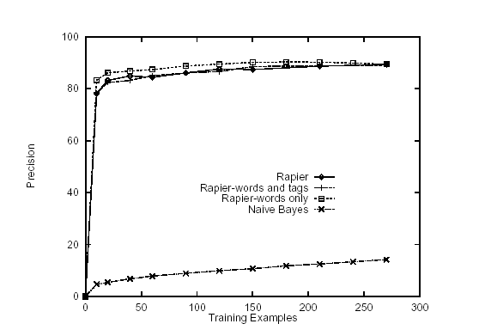
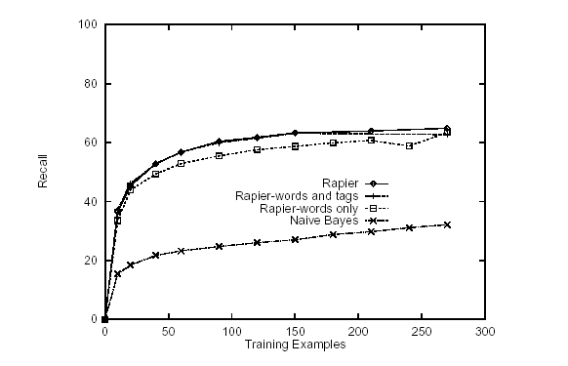
Rapier: results – precision/recall

Slide 50
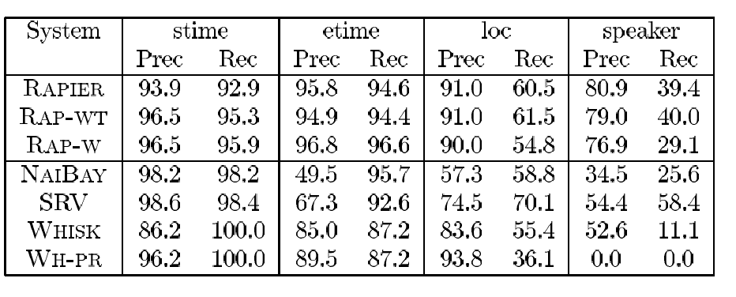
Rapier – results vs. SRV

Slide 51
Rule-learning approaches to sliding-window classification: Summary
SRV, Rapier, and WHISK [Soderland KDD ‘97]
  Representations for classifiers allow restriction of the relationships between tokens, etc
  Representations are carefully chosen subsets of even more powerful representations based on logic programming (ILP and Prolog)
  Use of these “heavyweight” representations is complicated, but seems to pay off in results
Can simpler representations for classifiers work?

Slide 52
BWI: Learning to detect boundaries
[Freitag & Kushmerick, AAAI 2000]
Another formulation: learn three probabilistic classifiers:
  START(i) = Prob( position i starts a field)
  END(j) = Prob( position j ends a field)
  LEN(k) = Prob( an extracted field has length k)
Then score a possible extraction (i,j) by
  START(i) * END(j) * LEN(j-i)
LEN(k) is estimated from a histogram

Slide 53
BWI: Learning to detect boundaries
BWI uses boosting to find “detectors” for START and END
Each weak detector has a BEFORE and AFTER pattern (on tokens before/after position i).
Each “pattern” is a sequence of tokens and/or wildcards like: anyAlphabeticToken, anyToken, anyUpperCaseLetter, anyNumber, …
Weak learner for “patterns” uses greedy search (+ lookahead) to repeatedly extend a pair of empty BEFORE,AFTER patterns

Slide 54
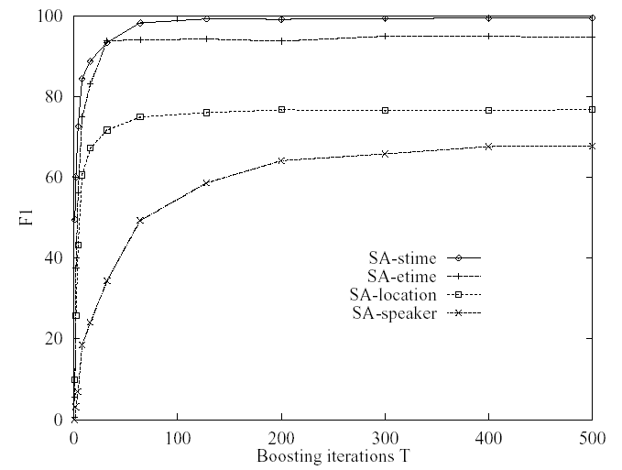
BWI: Learning to detect boundaries
Field F1
Person Name: 30%
Location: 61%
Start Time: 98%

Slide 55
Problems with Sliding Windows and Boundary Finders
Decisions in neighboring parts of the input are made independently from each other.
  Naïve Bayes Sliding Window may predict a “seminar end time” before the “seminar start time”.
  It is possible for two overlapping windows to both be above threshold.
  In a Boundary-Finding system, left boundaries are laid down independently from right boundaries, and their pairing happens as a separate step.

Slide 56
Finite State Machines

