Slide 1
Information Extraction from the
World Wide Web
William W. Cohen
Carnegie Mellon University
for Factiva, Feb 2006
Session 3 of 3
Notes:
Welcome to the NIPS Tutorial on "IE from the WWW". I'm Andrew McCallum. William Cohen and I are happy to giving this tutorial, and happy to see all of you. Please ask questions during tutorial---no sense in waiting to the end of a multi-hour tutorial... You have a copy of some slides in your tutorial proceedings, but the slides we'll present today are different enough that you may find it less confusing to put your proceedings aside.
William and I have been working in machine learning approaches to information extraction for many years. Initially separately: myself at CMU/JustResearch and William at AT&T Research. We came together at WhizBang Labs, an Internet start-up solely devoted to IE from the Web. The company Whiz'ed with the Internet boom---growing rapidly; (in our hayday there were more members of the editorial board of the MLJ working at WhizBang than at any other single institution;) and we Bang'ed with the dot-com crash. We learned a tremendous amount about business and real-world IE. So we bring a mixture of academic and industrial perspective to the problem.
Let's start with a few motivational problem: Let's say you are looking for a job as a bread baker.

Slide 2
Tutorial Outline
IE History
Landscape of problems and solutions
Parade of models for segmenting/classifying:
  Sliding window
  Boundary finding
  Finite state machines
  Trees
Overview of related problems and solutions
  Association, Clustering
  Integration with Data Mining
Where to go from here
last week
yesterday
Notes:
In the rest of the tutorial, we will
Touch briefly on the history of IE
Survey the dimensions of the landscape of the problems and solutions
Get into the technique meat by explaining a parade of models falling in different modeling families.
Briefly describe several other concepts you should know about
And end by looking forward.

Slide 3
Finite State Machines

Slide 4
NER by Segmenting and Classifying Tokens
  Prototypical cases for token classification: address parsing, bibliography parsing, ...
House number
Building
Road
City
State
Zip
4089 Whispering Pines Nobel Drive San Diego CA 92122
Author
Year
Title
Journal
Volume
Page
P.P.Wangikar, T.P. Graycar, D.A. Estell, D.S. Clark, J.S. Dordick (1993) Protein and Solvent Engineering of Subtilising BPN' in Nearly Anhydrous Organic Media J.Amer. Chem. Soc. 115, 12231-12237.

Slide 5
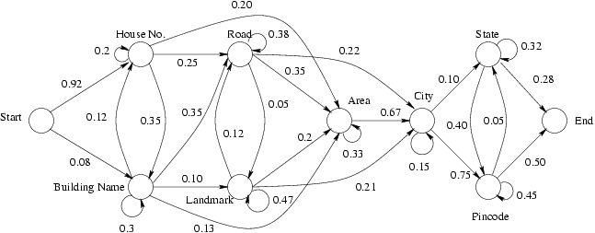
HMM Structure for Indian Street Addresses
hall | 0.11
center | 0.06
bldg | 0.02
... | ...

Slide 6
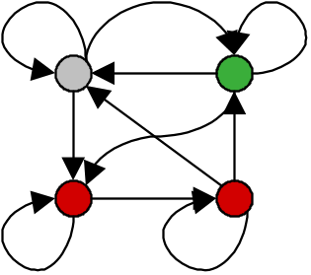

NER with Hidden Markov Models
Given a sequence of observations:
Yesterday Pedro Domingos spoke this example sentence.
and a trained HMM:
person name
location name
background
Find the most likely state sequence: (Viterbi)
Yesterday Pedro Domingos spoke this example sentence.
Any words said to be generated by the designated “person name”
state extract as a person name:
Person name: Pedro Domingos

Slide 7
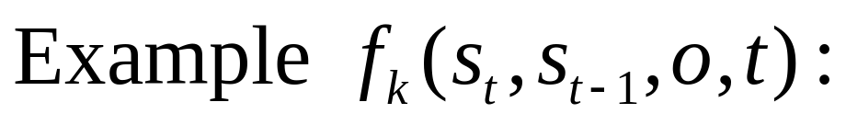
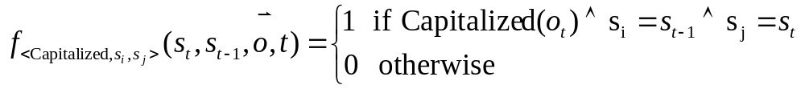
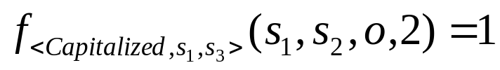
Feature Functions
o =
Yesterday Pedro Domingos spoke this example sentence.
o₁ o₂ o₃ o₄ o₅ o₆ o₇
s₁
s₂
s₃
s₄

Slide 8
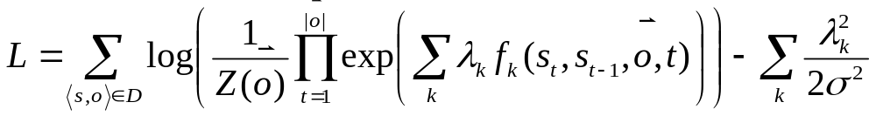
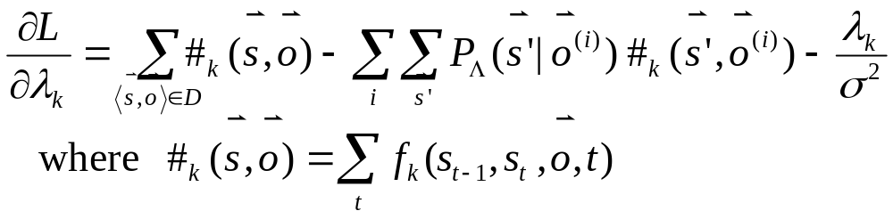

Learning Parameters of CRFs
Maximize log-likelihood of parameters Λ = {λ_{k}} given training data D
Log-likelihood gradient:
Methods:
iterative scaling (quite slow)
conjugate gradient (much faster)
limited-memory quasi-Newton methods, BFGS (super fast)
[Sha & Pereira 2002] & [Malouf 2002]

Slide 9
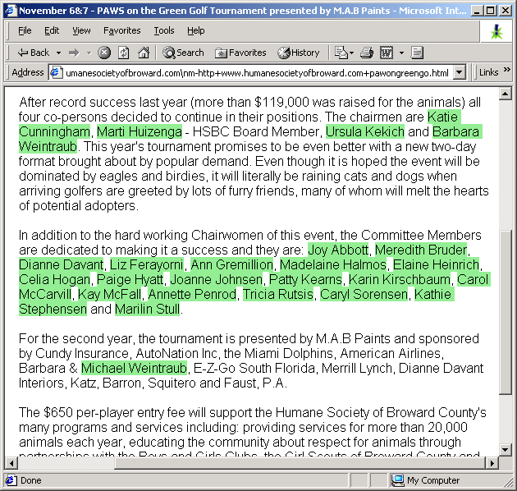
Person name Extraction

Slide 10
Features in Experiment
Capitalized Xxxxx
Mixed Caps XxXxxx
All Caps XXXXX
Initial Cap X….
Contains Digit xxx5
All lowercase xxxx
Initial X
Punctuation .,:;!(), etc
Period .
Comma ,
Apostrophe ‘
Dash -
Preceded by HTML tag
Character n-gram classifier
says string is a person
name (80% accurate)
In stopword list
(the, of, their, etc)
In honorific list
(Mr, Mrs, Dr, Sen, etc)
In person suffix list
(Jr, Sr, PhD, etc)
In name particle list
(de, la, van, der, etc)
In Census lastname list;
segmented by P(name)
In Census firstname list;
segmented by P(name)
In locations lists
(states, cities, countries)
In company name list
(“J. C. Penny”)
In list of company suffixes
(Inc, & Associates, Foundation)
Hand-built FSM person-name extractor says yes, (prec/recall ~ 30/95)
Conjunctions of all previous feature pairs, evaluated at the current time step.
Conjunctions of all previous feature pairs, evaluated at current step and one step ahead.
All previous features, evaluated two steps ahead.
All previous features, evaluated one step behind.
Total number of features = ~500k

Slide 11
Tree-based Models

Slide 12
STALKER: Hierarchical boundary finding
[Muslea,Minton & Knoblock 99]
Main idea:
  To train a hierarchical extractor, pose a series of learning problems, one for each node in the hierarchy
  At each stage, extraction is simplified by knowing about the “context.”

Slide 13
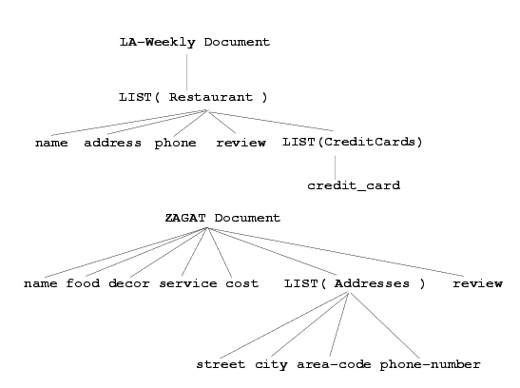
Stalker: hierarchical decomposition of two web sites

Slide 14
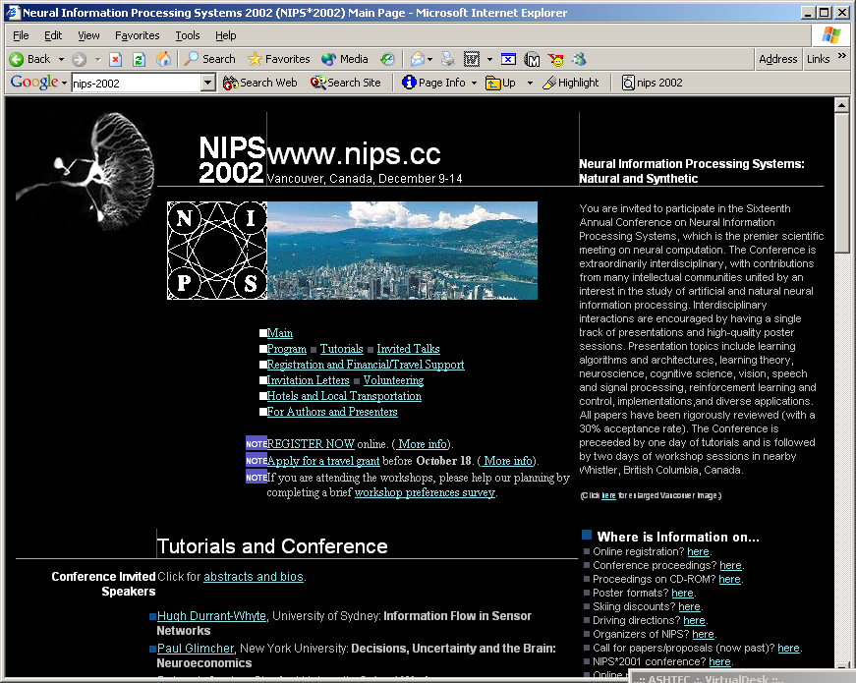

Slide 15

(BEFORE=null, AFTER=(Tutorial,Topics))
(BEFORE=null, AFTER=(Tutorials,and))
Notes:
First train system to find an enclosing part of a page…by training it to find, say before/after boundaries

Slide 16
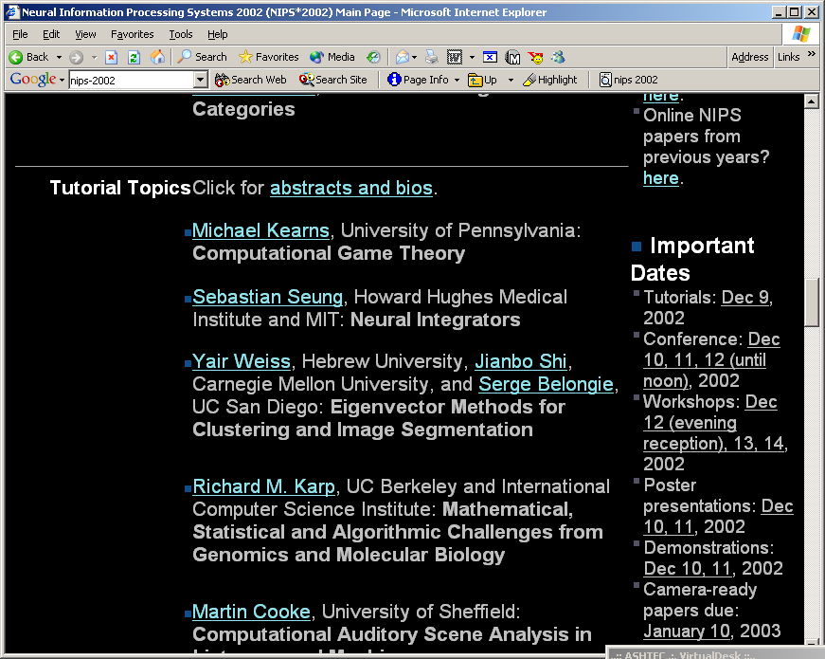
(BEFORE=null, AFTER=(<,li,>,))
Notes:
Next train to recognize begin/end of list items, in the selected context

Slide 17
(BEFORE=(:), AFTER=null)
Notes:
Finally train to extract title from list item

Slide 18
(BEFORE=(:), AFTER=null)
Notes:
Finally train to extract title from list item

Slide 19
(BEFORE=(:), AFTER=null)
Notes:
Finally train to extract title from list item

Slide 20
Example Wrapster predicate
html
head
http://wasBang.org/aboutus.html
WasBang.com contact info:
Currently we have offices in two locations:
  Pittsburgh, PA
  Provo, UT
body
Example:
p(s1,s2) iff s2 are the tokens below an li node inside a ul node inside s1: //ul//li
EXECUTE(p,s1) extracts
– “Pittsburgh, PA”
– “Provo, UT”
…
p
p
“WasBang.com .. info:”
ul
“Currently..”
li
li
a
a
“Pittsburgh, PA”
“Provo, UT”

Slide 21
Example Wrapster predicate
html
head
http://wasBang.org/aboutus.html
WasBang.com contact info:
Currently we have offices in two locations:
  Pittsburgh, PA
  Provo, UT
body
…
p
p
“WasBang.com .. info:”
ul
“Currently..”
li
li
Extract word between “in” and “locations”:
/in (\w+) locations/
extracts ‘two’
a
a
“Pittsburgh, PA”
“Provo, UT”
“WasBang.com .. info:”
“Currently..”
“Pittsburgh, PA”
“Provo, UT”

Slide 22
Composing builders
Composing builders for L_{xpath} and L_{bracket.}
LGG of the locations would be
(p_{tags} composeWith p_{L,R} )
where
  tags = ul,li
  L = “(“
  R = “)”
Jobs at WasBang.com:
  Call (888)-555-1212 now to apply!
Webmaster (New York). Perl, servlets essential.
Librarian (Pittsburgh). MLS required.
Ski Instructor (Vancouver). Snowboarding skills also useful.

Slide 23
Composing builders – structural/global
Composing builders for L_{tagpath} and L_{city}
L_{city} = {p_{city}} where p_{city}(s₁,s₂) iff s₂ is a city name inside of s₂.
LGG of the locations would be
p_{tags} composeWith p_{city}
Jobs at WasBang.com:
  Call Alberta Hill at 1-888-555-1212 now to apply!
Webmaster (New York). Perl, servlets essential.
Librarian (Pittsburgh). MLS required.
Ski Instructor (Vancouver). Snowboarding skills also useful.

Slide 24
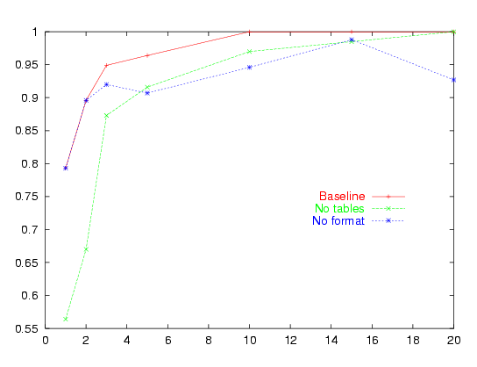
Wrapster results
F1
#examples

Slide 25
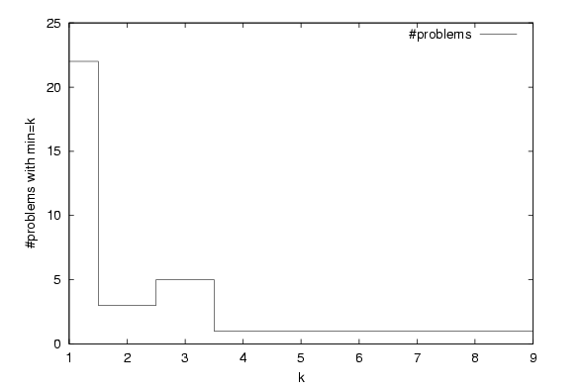
Wrapster results
Examples needed for 100% accuracy

Slide 26
How to torture a wrapper salesman
How is the wrapper constructed: by programming, or by learning?
If it’s programming, what’s the language?
  regular expressions, xpath, xslt, ...
If it’s learning:
  how does the method work (rule learning, state machine, boosting, ...) ?
  how does it compare to published methods, like WIEN, BWI, Stalker, Wrapster, on published benchmark problems?
  what if you run into a site that you can’t learn?
How are extracted items grouped into records?
  hierarchically, like Stalker?
  can you group together items on different pages? (does Factiva need to?)
What about frames, forms, and Javascript?

Slide 27
How to torture a wrapper salesman
How is a broken wrapper detected? which kinds of errors can be automatically be repaired?
How does the user check the quality of a wrapped site?
Some hard test cases:
  items-to-extract that are not completely isolated by markup (e.g., “Job title: AI Consultant”)
  items that look the same but have different HTML
    <B><I>foo</I></B> and <I><B>foo</B></I>
  complex tables

Slide 28
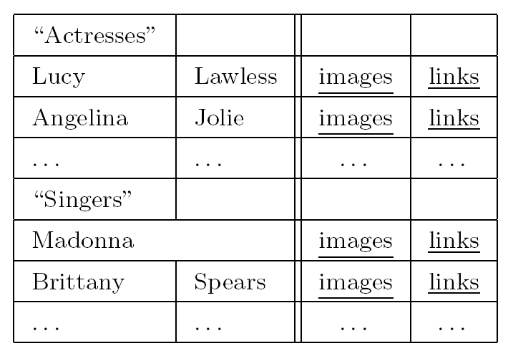
A simple torture test for wrappers
How to represent “links to pages about singers”?
Need a geometric view of a page.

Slide 29
Broader Issues in IE

Slide 30
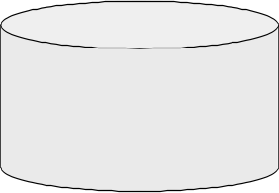
Broader View
Up to now we have been focused on segmentation and classification
Create ontology
Spider
Filter by relevance
IE
Segment
Classify
Associate
Cluster
Database
Load DB
Document
collection
Train extraction models
Query,
Search
Label training data
Data mine

Slide 31
Broader View
Now touch on some other issues
3
Create ontology
Spider
Filter by relevance
IE
Tokenize
Segment
Classify
Associate
Cluster
1
2
Database
Load DB
Document
collection
4
Train extraction models
Query,
Search
Label training data
5
Data mine

Slide 32
(1) Association as Binary Classification
Christos Faloutsos conferred with Ted Senator, the KDD 2003 General Chair.
Person
Person
Role
Person-Role (Christos Faloutsos, KDD 2003 General Chair) → NO
Person-Role ( Ted Senator, KDD 2003 General Chair) → YES
For instance: learn a classifier based on the interfiller (words between the entities):
PERSON , the ROLE (positive example)
PERSON conferred with PERSON , the ROLE (negative example)

Slide 33
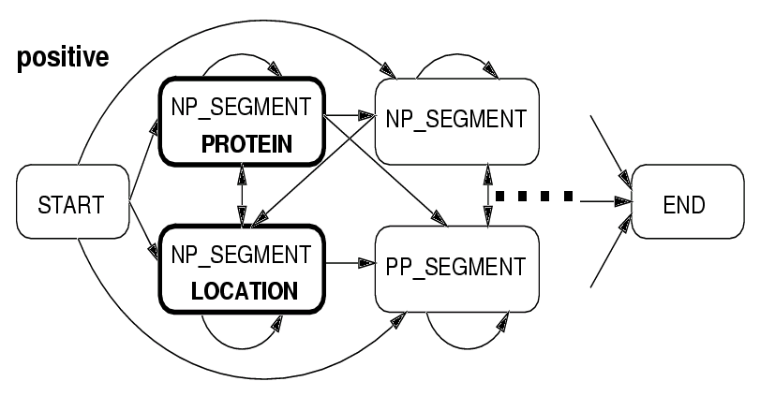
(1) Association with Finite State Machines
[Ray & Craven, 2001]
… This enzyme, UBC6, localizes to the endoplasmic reticulum, with the catalytic domain facing the cytosol. …
Classify tokens (or in this case tokens and/or “chunks” of text) according to column in a relation, instead of entity type.
DET this
N enzyme
N ubc6
V localizes
PREP to
ART the
ADJ endoplasmic
N reticulum
PREP with
ART the
ADJ catalytic
N domain
V facing
ART the
N cytosol
Subcellular-localization (UBC6, endoplasmic reticulum)

Slide 34
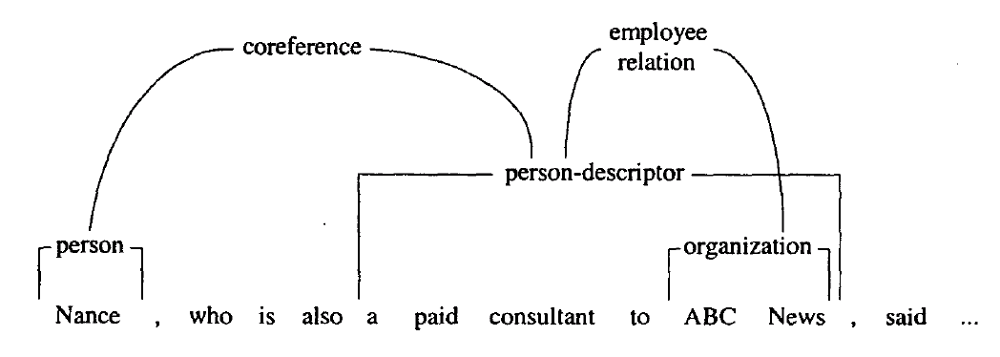
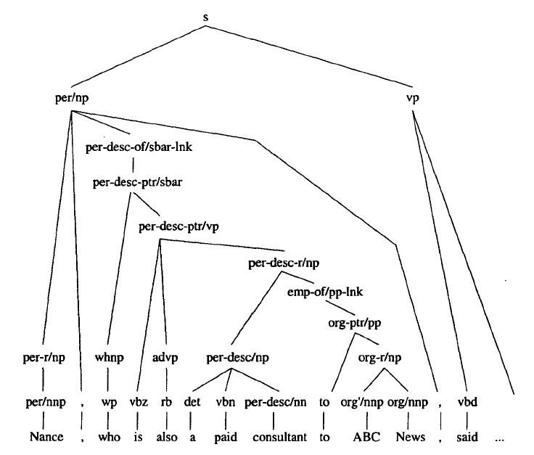
(1) Association using Parse Tree
Simultaneously POS tag, parse, extract & associate!
[Miller et al 2000]
Increase space of parse constituents to include
entity and relation tags
Notation Description .
c_{h} head constituent category
c_{m} modifier constituent category
X_{p} X of parent node
t POS tag
w word
Parameters e.g. .
P(c_{h}|c_{p}) P(vp|s)
P(c_{m}|c_{p},c_{hp},c_{m-1},w_{p}) P(per/np|s,vp,null,said)
P(t_{m}|c_{m},t_{h},w_{h}) P(per/nnp|per/np,vbd,said)
P(w_{m}|c_{m},t_{m},t_{h},w_{h}) P(nance|per/np,per/nnp,vbd,said)
(This is also a great example
of extraction using a tree model.)

Slide 35
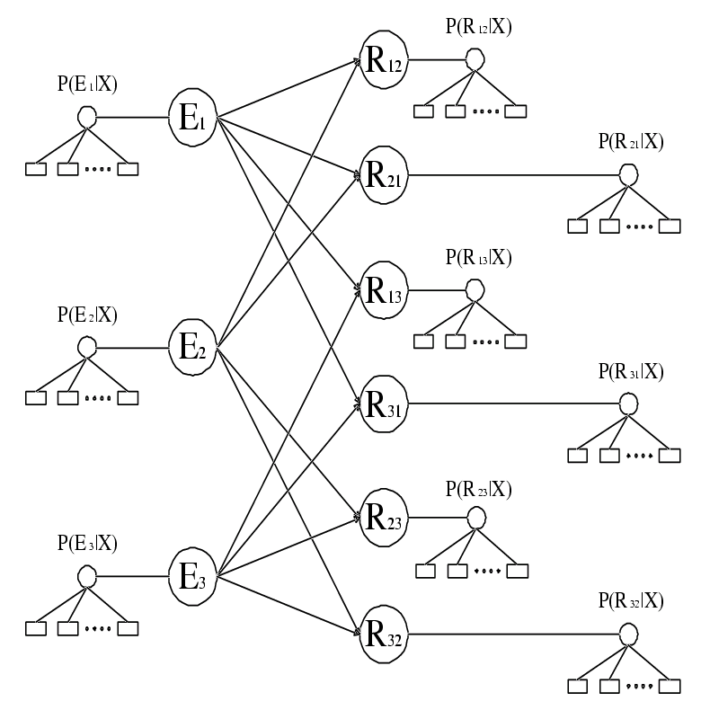
(1) Association with Graphical Models
Capture arbitrary-distance dependencies among predictions.
[Roth & Yih 2002]
Random variable
over the class of
relation between
entity #2 and #1,
e.g. over {lives-in,
is-boss-of,…}
Random variable
over the class of
entity #2, e.g. over
{person, location,…}
Local language
models contribute
evidence to relation
classification.
Local language
models contribute
evidence to entity
classification.
Dependencies between classes
of entities and relations!
Inference with loopy belief propagation.

Slide 36
(1) Association with Graphical Models
Also capture long-distance dependencies among predictions.
[Roth & Yih 2002]
Random variable
over the class of
relation between
entity #2 and #1,
e.g. over {lives-in,
is-boss-of,…}
Random variable
over the class of
entity #1, e.g. over
{person, location,…}
person
lives-in
Local language
models contribute
evidence to relation
classification.
person?
Local language
models contribute
evidence to entity
classification.
Dependencies between classes
of entities and relations!
Inference with loopy belief propagation.

Slide 37
(1) Association with Graphical Models
Also capture long-distance dependencies among predictions.
[Roth & Yih 2002]
Random variable
over the class of
relation between
entity #2 and #1,
e.g. over {lives-in,
is-boss-of,…}
Random variable
over the class of
entity #1, e.g. over
{person, location,…}
person
lives-in
Local language
models contribute
evidence to relation
classification.
location
Local language
models contribute
evidence to entity
classification.
Dependencies between classes
of entities and relations!
Inference with loopy belief propagation.

Slide 38
(1) Association with “Grouping Labels”
[Jensen & Cohen, 2001]
Create a simple language that reflects a field’s relation to other fields
Language represents ability to define:
  Disjoint fields
  Shared fields
  Scope
Create rules that use field labels

Slide 39
(1) Grouping labels: A simple example
Next:Name:recordstart
Name: Box Kite
Company: -
Location: -
Order: -
Cost: $100
Description: -
Color: -
Size: -
Kites
Buy a kite
Box Kite $100
Stunt Kite $300

Slide 40
(2) Grouping labels: A messy example
next:Name:recordstart
prevlink:Cost
Kites
Buy a kite
Box Kite $100
Stunt Kite $300
Name: Box Kite
Company: -
Location: -
Order: -
Cost: $100
Description: Great for kids
Color: blue
Size: small
Box Kite
Great for kids
Detailed specs
Specs
Color: blue
Size: small
pagetype:Product

Slide 41
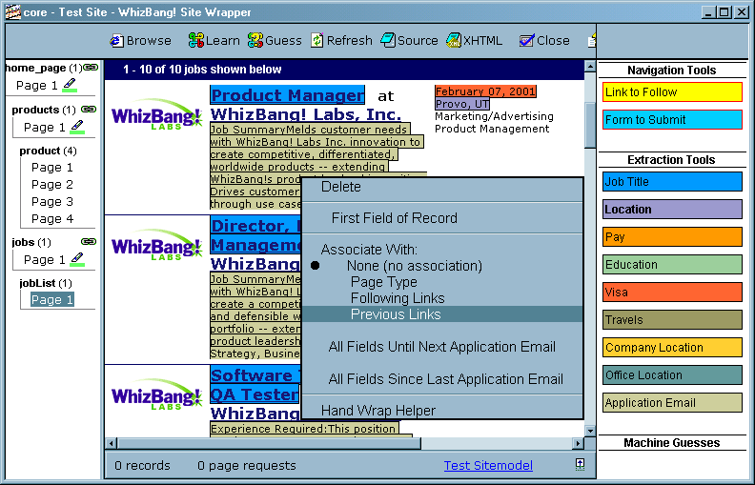
(2) User interface: adding labels to extracted fields

Slide 42
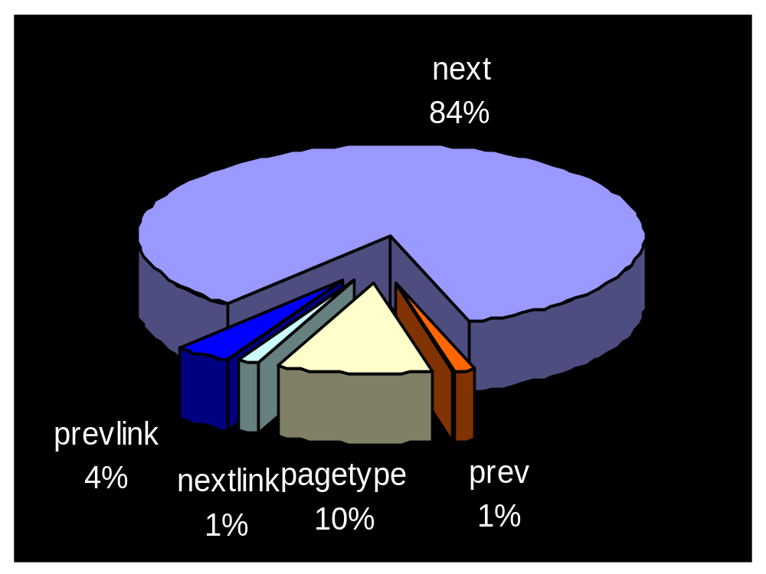
(1) Experimental Evaluation of Grouping Labels
Fixed language, then wrapped 499 new sites—all of which could be handled.

Slide 43
Broader View
Now touch on some other issues
3
Create ontology
Spider
Filter by relevance
IE
Tokenize
Segment
Classify
Associate
Cluster
1
2
Database
Load DB
Document
collection
4
Train extraction models
Query,
Search
Label training data
5
Data mine
Record linkage

Slide 44
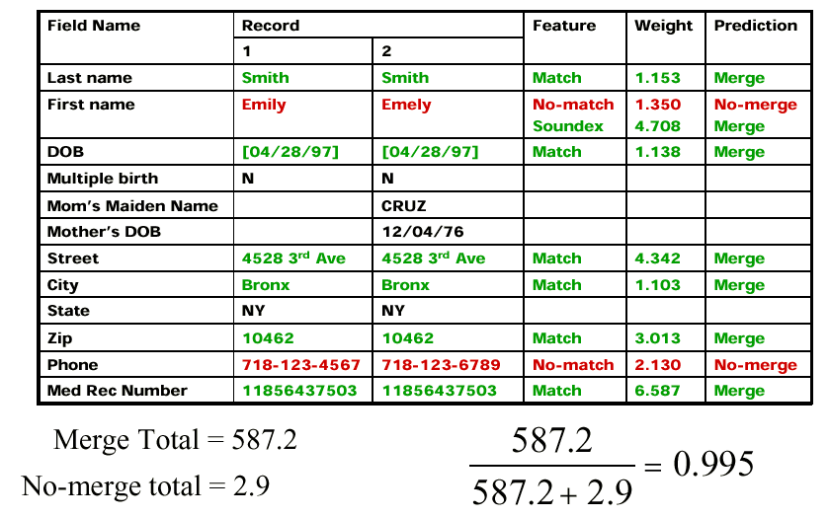
(2) Learning a Distance Metric Between Records
[Borthwick, 2000; Cohen & Richman, 2001; Bilenko & Mooney, 2002, 2003]
Learn Pr ({duplicate, not-duplicate} | record1, record2)
with a Maximum Entropy classifier.
Do greedy agglomerative clustering using this Probability as a distance metric.

Slide 45
(2) String Edit Distance
distance(“William Cohen”, “Willliam Cohon”)
s
W | I | L | L | I | A | M | _ | C | O | H | E | N
W | I | L | L | L | I | A | M | _ | C | O | H | O | N
C | C | C | C | I | C | C | C | C | C | C | C | S | C
0 | 0 | 0 | 0 | 1 | 1 | 1 | 1 | 1 | 1 | 1 | 1 | 2 | 2
alignment
t
op
cost

Slide 46
(2) Computing String Edit Distance
D(i-1,j-1) + d(si,tj) //subst/copy
D(i-1,j)+1 //insert
D(i,j-1)+1 //delete
learn
these
parameters
D(i,j) = min
 |  | C | O |  | H | E | N
M |  | 1 | 2 |  | 3 | 4 | 5
C |  | 1 | 2 |  | 3 | 4 | 5
C |  | 2 | 3 |  | 3 | 4 | 5
O |  | 3 | 2 |  | 3 | 4 | 5
H |  | 4 | 3 |  | 2 | 3 | 4
N |  | 5 | 4 |  | 3 | 3 | 3
A trace indicates where the min value came from, and can be used to find edit operations and/or a best alignment (may be more than 1)

Slide 47
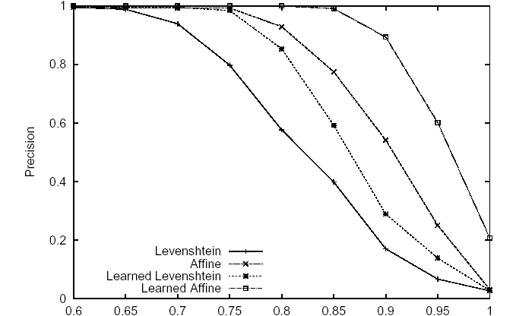
(2) String Edit Distance Learning
[Bilenko & Mooney, 2002, 2003]
Precision/recall for MAILING dataset duplicate detection

Slide 48
(2) Information Integration
[Minton, Knoblock, et al 2001], [Doan, Domingos, Halevy 2001],
[Richardson & Domingos 2003]
Goal might be to merge results of two IE systems:
Name: | Introduction to Computer Science
Number: | CS 101
Teacher: | M. A. Kludge
Time: | 9-11am
Name: | Data Structures in Java
Room: | 5032 Wean Hall
Title: | Intro. to Comp. Sci.
Num: | 101
Dept: | Computer Science
Teacher: | Dr. Klüdge
TA: | John Smith
Topic: | Java Programming
Start time: | 9:10 AM
Soft joins: WHIRL (Cohen, 2000), Koudas, Srinivasan, Gravano, ...

Slide 49
(2) Two further Integration Issues Issues
Efficiently clustering large data sets by pre-clustering with a cheap distance metric (hybrid of string-edit distance and term-based distances)
  [McCallum, Nigam & Ungar, 2000]
Don’t simply merge greedily: capture dependencies among multiple merges.
  [Cohen, MacAllister, Kautz KDD 2000; Pasula, Marthi, Milch, Russell, Shpitser, NIPS 2002; McCallum and Wellner, KDD WS 2003]

Slide 50
Broader View
Now touch on some other issues
3
Create ontology
Spider
Filter by relevance
IE
Tokenize
Segment
Classify
Associate
Cluster
1
2
Database
Load DB
Document
collection
4
Train extraction models
Query,
Search
Label training data
5
Data mine
1

Slide 51
(5) Data Mining: Working with IE Data
Some special properties of IE data:
  It is based on extracted text
  It is “dirty”, (missing extraneous facts, improperly normalized entity names, etc.)
  May need cleaning before use
What operations can be done on dirty, unnormalized databases?
  Datamine it directly.
  Query it directly with a language that has “soft joins” across similar, but not identical keys. [Cohen 1998]
  Use it to construct features for learners [Cohen 2000]
  Infer a “best” underlying clean database
  [Cohen, Kautz, MacAllester, KDD2000]

Slide 52
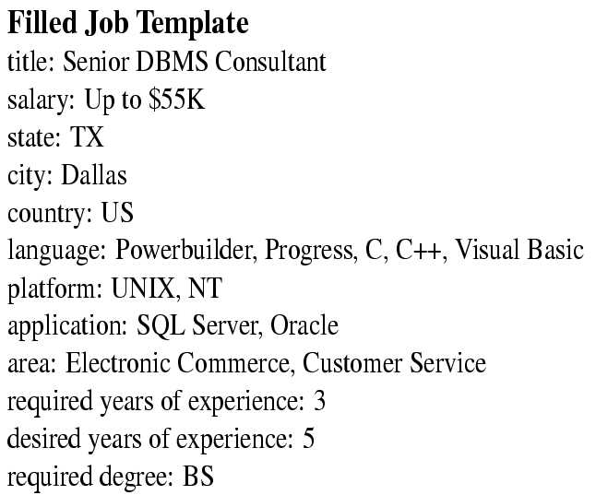
(5) Data Mining: Mutually supportive
IE and Data Mining
[Nahm & Mooney, 2000]
Extract a large database
Learn rules to predict the value of each field from the other fields.
Use these rules to increase the accuracy of IE.
Example DB record
Sample Learned Rules
platform:AIX & !application:Sybase & application:DB2
application:Lotus Notes
language:C++ & language:C & application:Corba & title=SoftwareEngineer
➔ platform:Windows
language:HTML & platform:WindowsNT & application:ActiveServerPages
➔ area:Database
Language:Java & area:ActiveX & area:Graphics
➔ area:Web

Slide 53
(5) Working with IE Data
Association rule mining using IE data
Classification using IE data

Slide 54
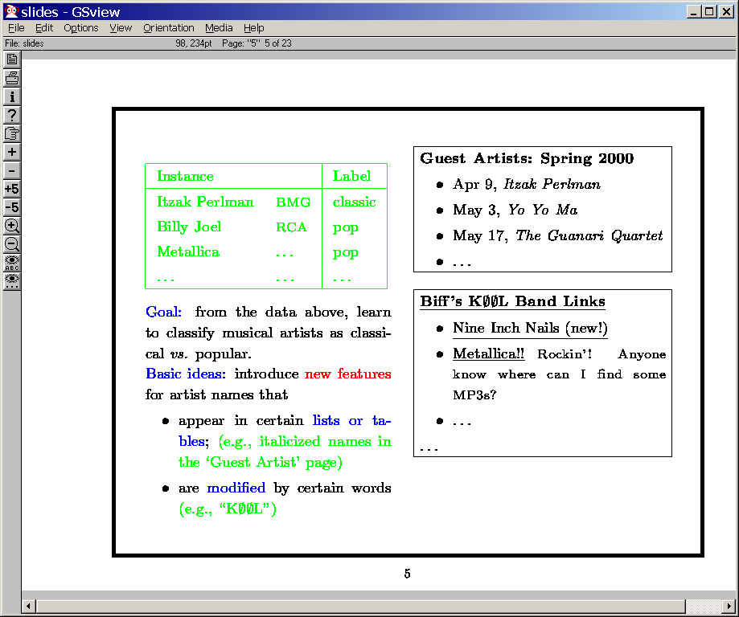
[Cohen, ICML2000]
Idea: do very lightweight “site wrapping” of relevant pages
Make use of (partial, noisy) wrappers

Slide 55
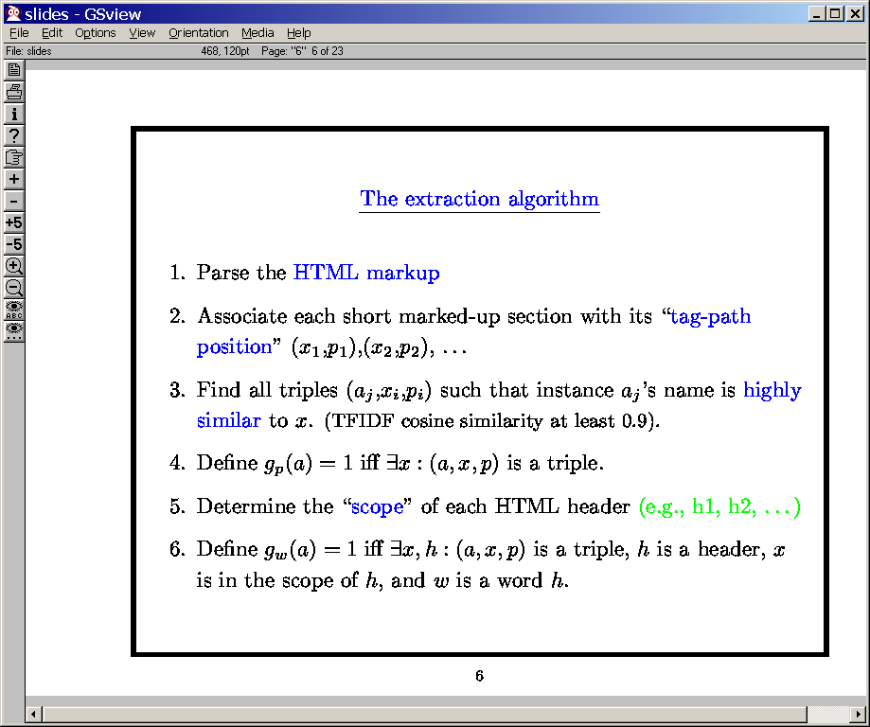

Slide 56
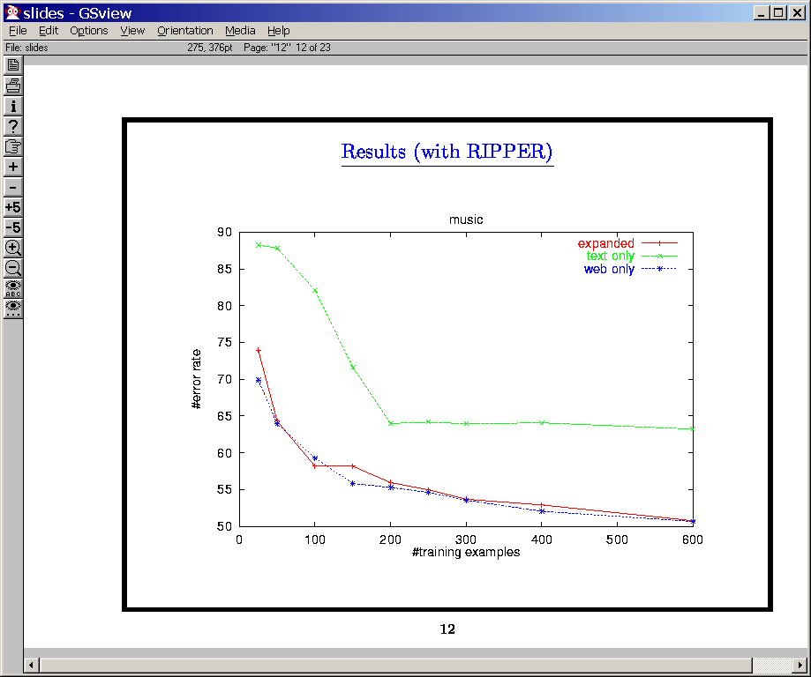

Slide 57
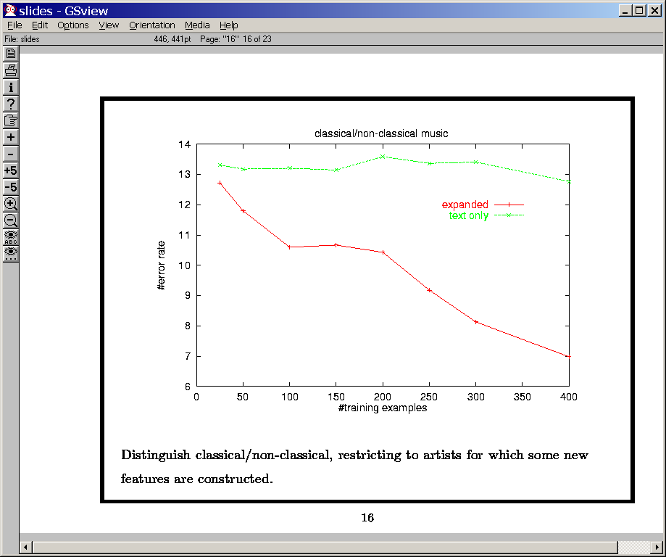

Slide 58
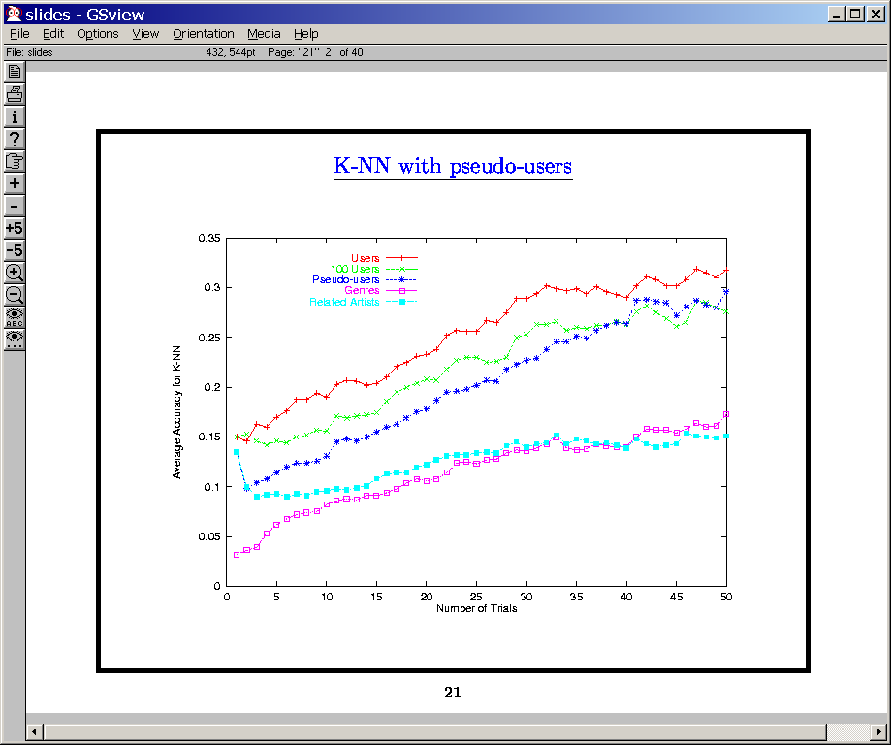

Slide 59
(5) Working with IE Data
Association rule mining using IE data
Classification using IE data
  Many features based on lists, tables, etc are proposed
  The learner filters these features and decides which to use in a classifier
  How else can proposed structures be filtered?

Slide 60
(5) Finding “pretty good” wrappers without site-specific training data
Local structure in extraction
  Assume a set of “seed examples” similar to field to be extracted.
  Identify small possible wrappers (e.g., simple tagpaths)
  Use semantic information to evaluate, for each wrapper
    Average minimum TFIDF distance to a known positive “seed example” over all extracted strings
  Adopt best single tagpath
Results on 84 pre-wrapped page types (Cohen, AAAI-99)
  100% equivalent to target wrapper 80% of time
  More conventional learning approach: 100% equivalent to target wrapper 50% of the time (Cohen & Fan, WWW-99)

Slide 61
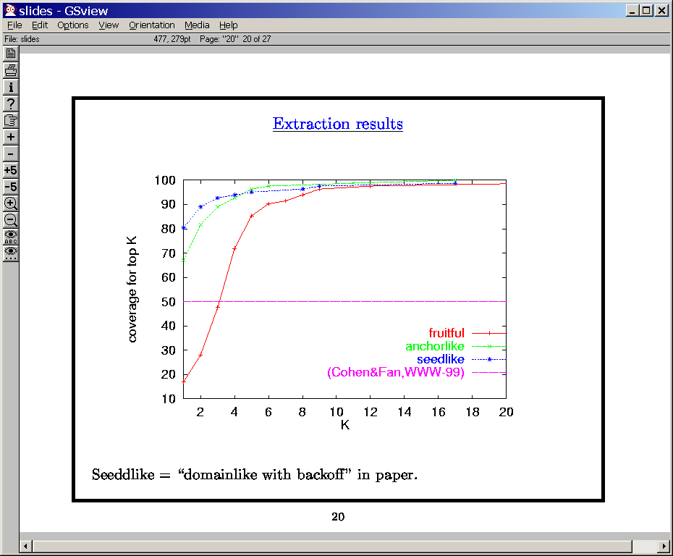

Slide 62
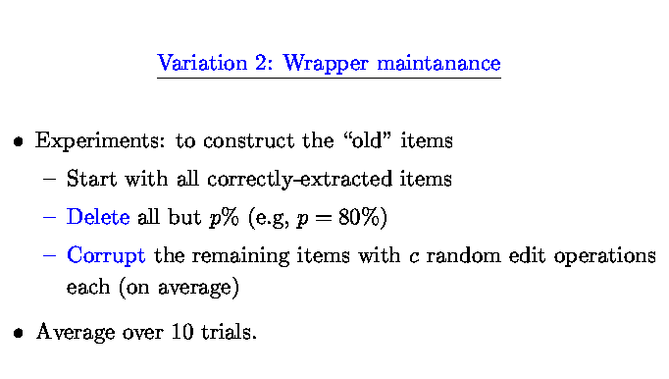

Slide 63
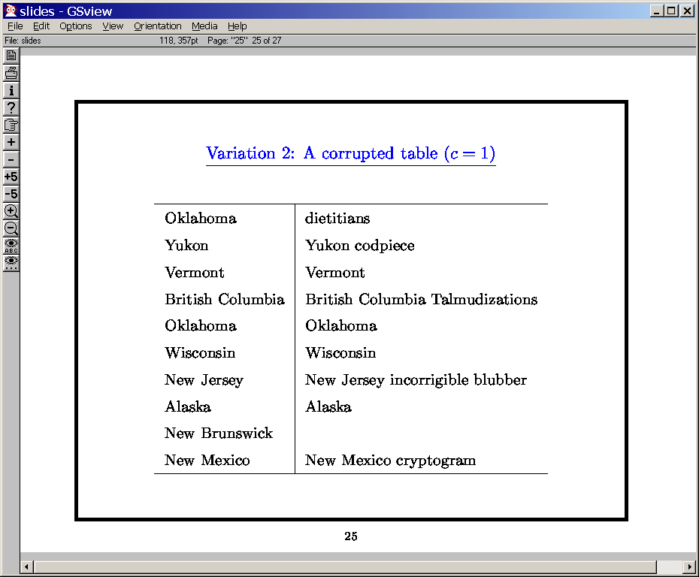

Slide 64
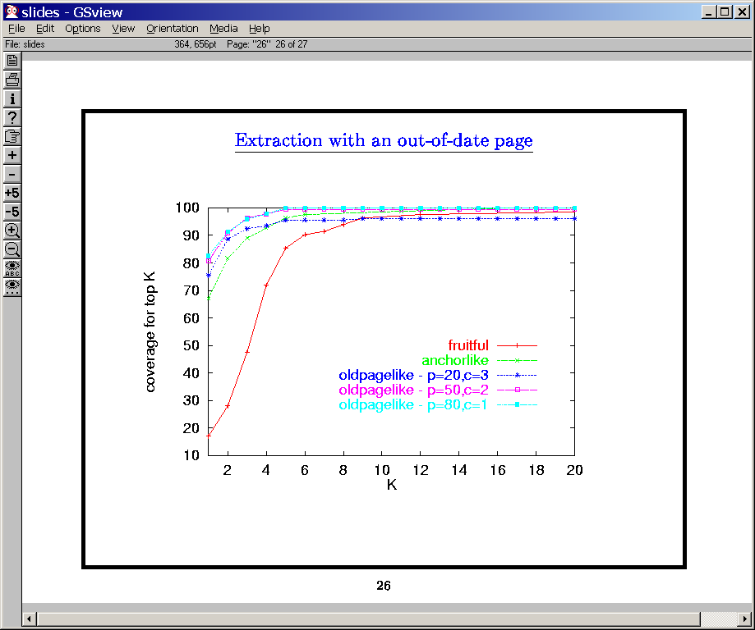

Slide 65
(5) Working with IE Data
Association rule mining using IE data
Classification using IE data
  Many features based on lists, tables, etc are proposed
  The learner filters these features and decides which to use in a classifier
  How else can proposed structures be filtered?
  How else can structures be proposed?

Slide 66








Learning Formatting Patterns “On the Fly”:
“Scoped Learning” for IE
[Blei, Bagnell, McCallum, 2002]
[Taskar, Wong, Koller 2003]
Formatting is regular on each site, but there are too many different sites to wrap.
Can we get the best of both worlds?

Slide 67
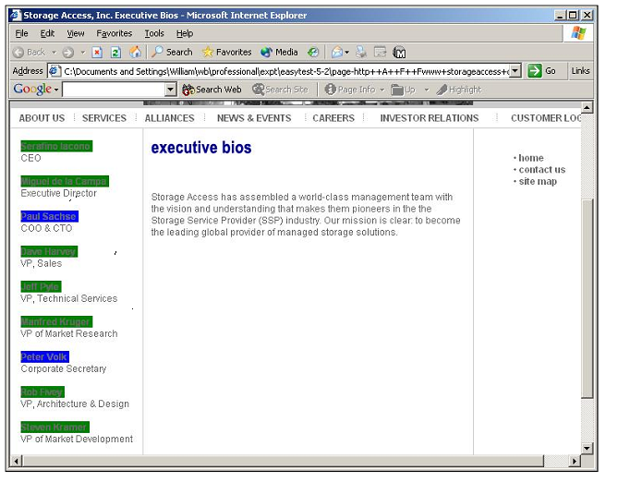
List1
builder
predicate
Task: classify links as to whether they point to an “executive biography” page

Slide 68
List2
builder
predicate

Slide 69
List3
builder
predicate

Slide 70
Features extracted:
{ List1, List3,…},
{ List1, List2, List3,…},
{ List2, List 3,…},
{ List2, List3,…},
…

Slide 71
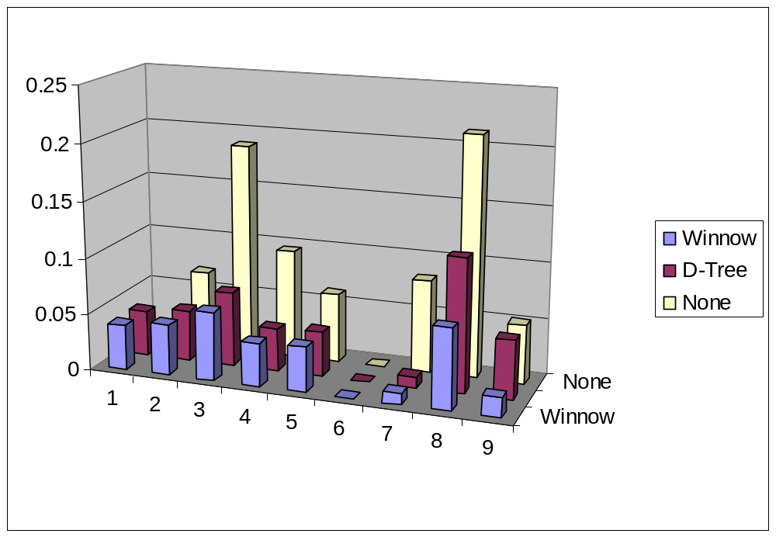
Experimental results
Error reduced by almost half on average
Builder features hurt
No improvement

Slide 72
Wrap-up

Slide 73
Where from Here?
Science
  Higher accuracy, integration with data mining.
  Relational Learning, Minimizing labeled data needs, unified models of all four of IE’s components.
  Multi-modal IE: text, images, video, audio. Multi-lingual.
Profit
  SRA, Inxight, Fetch, Mohomine/Kofax, Cymfony, Semantic Discovery, Clearforest, Eliyon/Zoominfo...
  Bio-informatics, Intelligent Tutors, Information Overload, Anti-terrorism
Fun
  Search engines that return “things” instead of “pages” (people, companies, products, universities, courses…)
  New insights by mining previously untapped knowledge.

Slide 74
References
[Bikel et al 1997] Bikel, D.; Miller, S.; Schwartz, R.; and Weischedel, R. Nymble: a high-performance learning name-finder. In Proceedings of ANLP’97, p194-201.
[Califf & Mooney 1999], Califf, M.E.; Mooney, R.: Relational Learning of Pattern-Match Rules for Information Extraction, in Proceedings of the Sixteenth National Conference on Artificial Intelligence (AAAI-99).
[Cohen, Hurst, Jensen, 2002] Cohen, W.; Hurst, M.; Jensen, L.: A flexible learning system for wrapping tables and lists in HTML documents. Proceedings of The Eleventh International World Wide Web Conference (WWW-2002)
[Cohen, Kautz, McAllester 2000] Cohen, W; Kautz, H.; McAllester, D.: Hardening soft information sources. Proceedings of the Sixth International Conference on Knowledge Discovery and Data Mining (KDD-2000).
[Cohen, 1998] Cohen, W.: Integration of Heterogeneous Databases Without Common Domains Using Queries Based on Textual Similarity, in Proceedings of ACM SIGMOD-98.
[Cohen, 2000a] Cohen, W.: Data Integration using Similarity Joins and a Word-based Information Representation Language, ACM Transactions on Information Systems, 18(3).
[Cohen, 2000b] Cohen, W. Automatically Extracting Features for Concept Learning from the Web, Machine Learning: Proceedings of the Seventeeth International Conference (ML-2000).
[Collins & Singer 1999] Collins, M.; and Singer, Y. Unsupervised models for named entity classification. In Proceedings of the Joint SIGDAT Conference on Empirical Methods in Natural Language Processing and Very Large Corpora, 1999.
[De Jong 1982] De Jong, G. An Overview of the FRUMP System. In: Lehnert, W. & Ringle, M. H. (eds), Strategies for Natural Language Processing. Larence Erlbaum, 1982, 149-176.
[Freitag 98] Freitag, D: Information extraction from HTML: application of a general machine learning approach, Proceedings of the Fifteenth National Conference on Artificial Intelligence (AAAI-98).
[Freitag, 1999], Freitag, D. Machine Learning for Information Extraction in Informal Domains. Ph.D. dissertation, Carnegie Mellon University.
[Freitag 2000], Freitag, D: Machine Learning for Information Extraction in Informal Domains, Machine Learning 39(2/3): 99-101 (2000).
Freitag & Kushmerick, 1999] Freitag, D; Kushmerick, D.: Boosted Wrapper Induction. Proceedings of the Sixteenth National Conference on Artificial Intelligence (AAAI-99)
[Freitag & McCallum 1999] Freitag, D. and McCallum, A. Information extraction using HMMs and shrinakge. In Proceedings AAAI-99 Workshop on Machine Learning for Information Extraction. AAAI Technical Report WS-99-11.
[Kushmerick, 2000] Kushmerick, N: Wrapper Induction: efficiency and expressiveness, Artificial Intelligence, 118(pp 15-68).
[Lafferty, McCallum & Pereira 2001] Lafferty, J.; McCallum, A.; and Pereira, F., Conditional Random Fields: Probabilistic Models for Segmenting and Labeling Sequence Data, In Proceedings of ICML-2001.
[Leek 1997] Leek, T. R. Information extraction using hidden Markov models. Master’s thesis. UC San Diego.
[McCallum, Freitag & Pereira 2000] McCallum, A.; Freitag, D.; and Pereira. F., Maximum entropy Markov models for information extraction and segmentation, In Proceedings of ICML-2000
[Miller et al 2000] Miller, S.; Fox, H.; Ramshaw, L.; Weischedel, R. A Novel Use of Statistical Parsing to Extract Information from Text. Proceedings of the 1st Annual Meeting of the North American Chapter of the ACL (NAACL), p. 226 - 233.

Slide 75
References
[Muslea et al, 1999] Muslea, I.; Minton, S.; Knoblock, C. A.: A Hierarchical Approach to Wrapper Induction. Proceedings of Autonomous Agents-99.
[Muslea et al, 2000] Musclea, I.; Minton, S.; and Knoblock, C. Hierarhical wrapper induction for semistructured information sources. Journal of Autonomous Agents and Multi-Agent Systems.
[Nahm & Mooney, 2000] Nahm, Y.; and Mooney, R. A mutually beneficial integration of data mining and information extraction. In Proceedings of the Seventeenth National Conference on Artificial Intelligence, pages 627--632, Austin, TX.
[Punyakanok & Roth 2001] Punyakanok, V.; and Roth, D. The use of classifiers in sequential inference. Advances in Neural Information Processing Systems 13.
[Ratnaparkhi 1996] Ratnaparkhi, A., A maximum entropy part-of-speech tagger, in Proc. Empirical Methods in Natural Language Processing Conference, p133-141.
[Ray & Craven 2001] Ray, S.; and Craven, Ml. Representing Sentence Structure in Hidden Markov Models for Information Extraction. Proceedings of the 17th International Joint Conference on Artificial Intelligence, Seattle, WA. Morgan Kaufmann.
[Soderland 1997]: Soderland, S.: Learning to Extract Text-Based Information from the World Wide Web. Proceedings of the Third International Conference on Knowledge Discovery and Data Mining (KDD-97).
[Soderland 1999] Soderland, S. Learning information extraction rules for semi-structured and free text. Machine Learning, 34(1/3):233-277.

