Slide 1
Planning RADAR’s Legacy
William W. Cohen
Machine Learning Department and Language Technologies Institute
School of Computer Science
Carnegie Mellon University

Slide 2
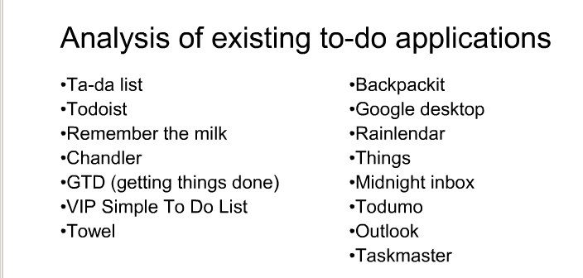
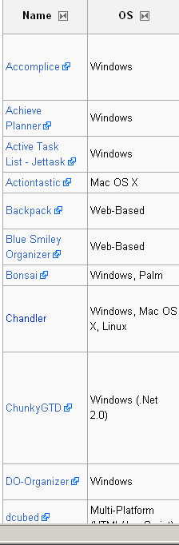
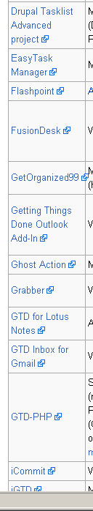
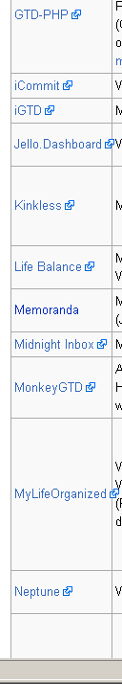
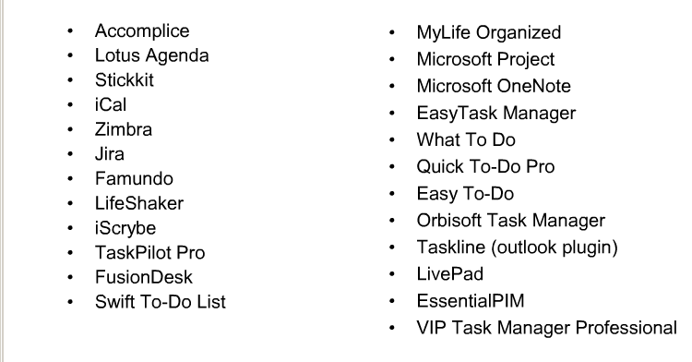

Slide 3
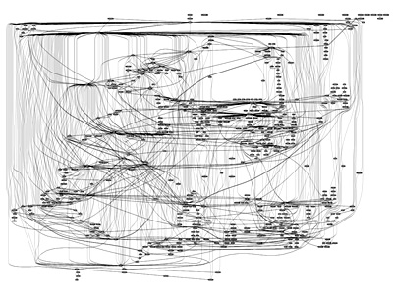

Slide 4
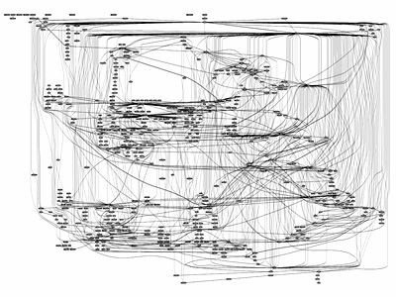
???

Slide 5
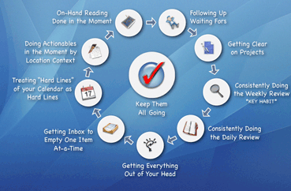

Slide 6
PIM Tools and Email and Impact
How can RADAR have an impact in the future?
  How can we get market share in the space of PIM tools?
  Exploit regular, repeating behavior – produced by a system.
  Space of GTD™ tools has exploded since last 2-3 years.
GTD Principles:
  It’s a system not a tool (e.g. Hipster PDAs)
  Planning: Keep track of goals (projects) – desired outcomes – and for every goal, keep track of next actions: “physical actions that advance the project”
    Lightweight planning and tagging actions with preconditions
  Collection: Empty your inboxes completely(!) and record all the resulting goals or next-actions
  Execution: Don’t multitask planning and executing.

Slide 7
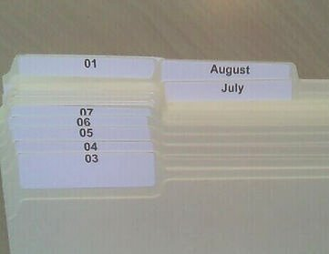
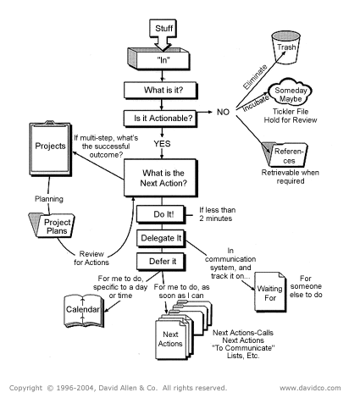
Every goal/ project has a next action associated with it and can thus be moved forward.
Lightweight tagging for projects and next-actions: eg
context (work vs home)
blocked (waiting for)
time allocated
“43 folders”

Slide 8
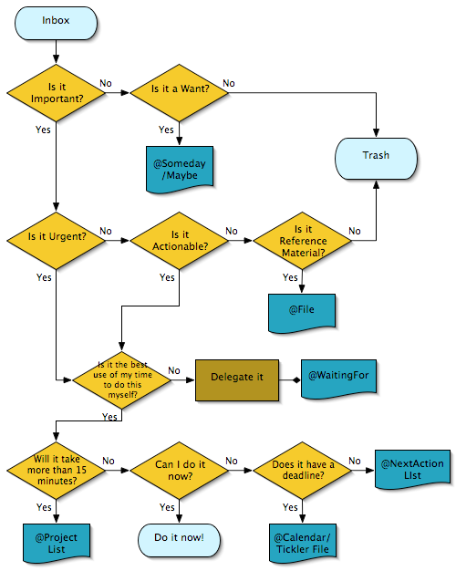
Three phases: Collection, …
Clear garage
  Sell old snowblower
    Post to CraigsList
Graduate Zhenzhen
  Thesis comments
  …
Eight possible outcomes
Some have associated fields

Slide 9
Three phases: Collection, Execution…
Clear garage
  Sell old snowblower
    Post to CraigsList
Graduate Zhenzhen
  Thesis comments
  …
search for
Related:
messages,
people,
…

Slide 10
Three phases: Planning, Collection, Execution, Planning
Subplan reuse?
Graduate:
Do preliminary research
Choose committee
Propose
  Write proposal
  …
Write thesis draft
Get advisor’s comments
Schedule defense
Revise thesis
Prepare thesis talk
…
Clear garage
  Sell old snowblower
    Post to CraigsList
Graduate Zhenzhen
  Thesis comments
  …
WbyE
Webmaster Msgs
Workflow-By-Example

