Slide 1
Stacked Sequential Learning
William W. Cohen
Center for Automated Learning and Discovery
Carnegie Mellon University
Vitor Carvalho
Language Technology Institute
Carnegie Mellon University

Slide 2
Outline
Motivation:
  MEMMs don’t work on segmentation tasks
New method:
  Stacked sequential MaxEnt
  Stacked sequential Anything
Results
More results...
Conclusions

Slide 3
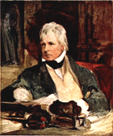
However, in celebration of the locale, I will present this results in the style of Sir Walter Scott (1771-1832), author of “Ivanhoe” and other classics.
In that pleasant district of merry Pennsylvania which is watered by
the river Mon, there extended since ancient times a large computer science department. Such being our chief scene, the date of our story refers to a period towards the middle of the year 2003 ....

Slide 4
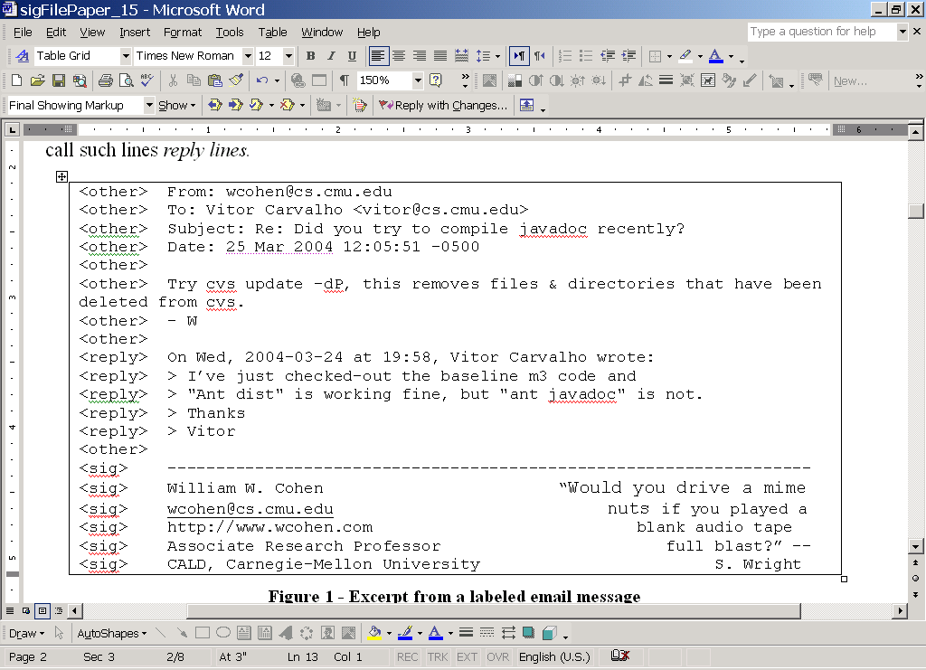
Chapter 1, in which a graduate student (Vitor) discovers a bug in his advisor’s code that he cannot fix
The problem: identifying reply and signature sections of email messages.
The method: classify each line as reply, signature, or other.

Slide 5
Chapter 1, in which a graduate student discovers a bug in his advisor’s code that he cannot fix
The problem: identifying reply and signature sections of email messages.
The method: classify each line as reply, signature, or other.
The warmup: classify each line is signature or nonsignature, using learning methods from Minorthird, and dataset of 600+ messages
The results: from [CEAS-2004, Carvalho & Cohen]....

Slide 6
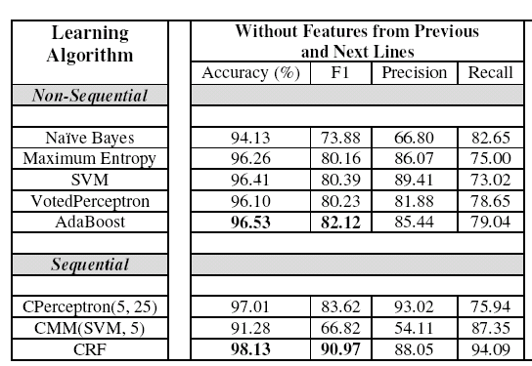
Chapter 1, in which a graduate student discovers a bug in his advisor’s code that he cannot fix
But... Minorthird’s version of MEMMs has an accuracy of less than 70%
(guessing majority class gives accuracy around 10%!)

Slide 7
Flashback: In which we recall the invention and re-invention of sequential classification with recurrent sliding windows, ..., MaxEnt Markov Models (MEMM)
From data, learn Pr(y_{i}|y_{i-1},x_{i})
  MaxEnt model
To classify a sequence x₁,x₂,... search for the best y₁,y₂,...
  Viterbi
  beam search
probabilistic classifier using previous label Y_{i-1} as a feature (or conditioned on Yi-1)
reply
reply
sig
Y_{i-1}
Y_{i}
Y_{i+1}
Pr(Y_{i} | Y_{i-1}, f₁(X_{i}), f₂(X_{i}),...)=...
features of X_{i}
X_{i-1}
X_{i}
X_{i+1}

Slide 8
Flashback: In which we recall the invention and re-invention of sequential classification with recurrent sliding windows, ..., MaxEnt Markov Models (MEMM) ... and also praise their many virtues relative to CRFs
MEMMs are easy to implement
MEMMs train quickly
  no probabilistic inference in the inner loop of learning
You can use any old classifier (even if it’s not probabilistic)
MEMMs scale well with number of classes and length of history
Pr(Y_{i} | Y_{i-1},Y_{i-2},...,f₁(X_{i}),f₂(X_{i}),...)=...
Y_{i-1}
Y_{i}
Y_{i+1}
X_{i-1}
X_{i}
X_{i+1}

Slide 9
The flashback ends and we return again to our document analysis task , on which the elegant MEMM method fails miserably for reasons unknown
MEMMs have an accuracy of less than 70% on this problem – but why ?

Slide 10
Chapter 2, in which, in the fullness of time, the mystery is investigated...
predicted
true
...and it transpires that often the classifier predicts a signature block that is much longer than is correct
false positive predictions
...as if the MEMM “gets stuck” predicting the sig label.

Slide 11
Chapter 2, in which, in the fullness of time, the mystery is investigated...
...and it transpires that
Pr(Y_{i}=sig|Y_{i-1}=sig) = 1-ε
as estimated from the data, giving the previous label a very high weight.
Y_{i-1}
reply
Y_{i}
reply
Y_{i+1}
sig
X_{i-1}
X_{i}
X_{i+1}

Slide 12
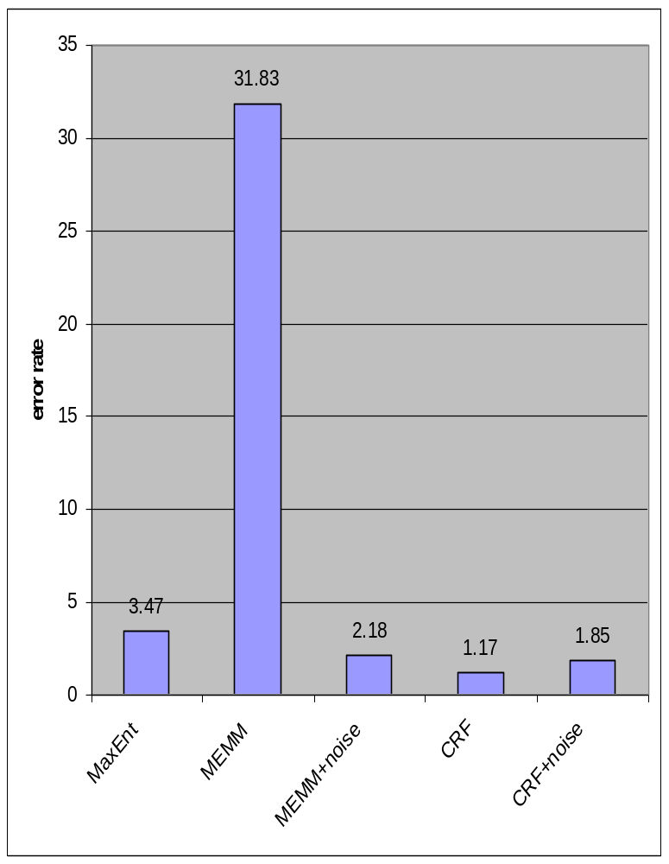
Chapter 2, in which, in the fullness of time, the mystery is investigated...
We added “sequence noise” by randomly switching around 10% of the lines: this
  lowers the weight for the previous-label feature
  improves performance for MEMMs
  degrades performance for CRFs
Adding noise in this case however is a loathsome bit of hackery.

Slide 13
Chapter 2, in which, in the fullness of time, the mystery is investigated...
Label bias problem CRFs can represent some distributions that MEMMs cannot [Lafferty et al 2000]:
  e.g., the “rib-rob” problem
  this doesn’t explain why MaxEnt >> MEMMs
Observation bias problem: MEMMs can overweight “observation” features [Klein and Manning 2002] :
  here we observe the opposite: the history features are overweighted
MaxEnt
rib-rob
CRFs
MEMMs

Slide 14
Chapter 2, in which, in the fullness of time, the mystery is investigated...and an explanation is proposed.
From data, learn Pr(y_{i}|y_{i-1},x_{i})
  MaxEnt model
To classify a sequence x₁,x₂,... search for the best y₁,y₂,...
  Viterbi
  beam search
probabilistic classifier using previous label Y_{i-1} as a feature (or conditioned on Yi-1)
reply
reply
sig
Y_{i-1}
Y_{i}
Y_{i+1}
X_{i-1}
X_{i}
X_{i+1}

Slide 15
Chapter 2, in which, in the fullness of time, the mystery is investigated...and an explanation is proposed.
From data, learn Pr(y_{i}|y_{i-1},x_{i})
  MaxEnt model
To classify a sequence x₁,x₂,... search for the best y₁,y₂,...
  Viterbi
  beam search
Learning data is noise-free, including values for Y_{i-1}
Classification data values for Y_{i-1} are noisy since they come from predictions
i.e., the history values used at learning time are a poor approximation of the values seen in classification

Slide 16
Chapter 3, in which a novel extension to MEMMs is proposed that will correct the performance problem
From data, learn Pr(y_{i}|y_{i-1},x_{i})
  MaxEnt model
To classify a sequence x₁,x₂,... search for the best y₁,y₂,...
  Viterbi
  beam search
While learning, replace the true value for Y_{i-1} with an approximation of the predicted value of Y_{i-1}
To approximate the value predicted by MEMMs, use the value predicted by non-sequential MaxEnt in a cross-validation experiment.
After Wolpert [1992] we call this stacked MaxEnt.
find approximate Y’s with a MaxEnt-learned hypothesis, and then apply the sequential model to that

Slide 17
Chapter 3, in which a novel extension to MEMMs is proposed that will correct the performance problem
Learn Pr(y_{i}|x_{i}) with MaxEnt and save the model as f(x)
Do k-fold cross-validation with MaxEnt, saving the cross-validated predictions the cross-validated predictions y’_{i}=f_{k}(x_{i})
Augment the original examples with the y’’s and compute history features: g(x,y’) → x’
Learn Pr(y_{i}|x’_{i}) with MaxEnt and save the model as f’(x’)
To classify: augment x with y’=f(x), and apply f to the resulting x’: i.e., return f’(g(x,f(x))
Y_{i-1}
f’
Y_{i}
Y_{i+1}
Y’_{i-1}
Y’_{i}
Y’_{i+1}
f
X_{i-1}
X_{i}
X_{i+1}

Slide 18
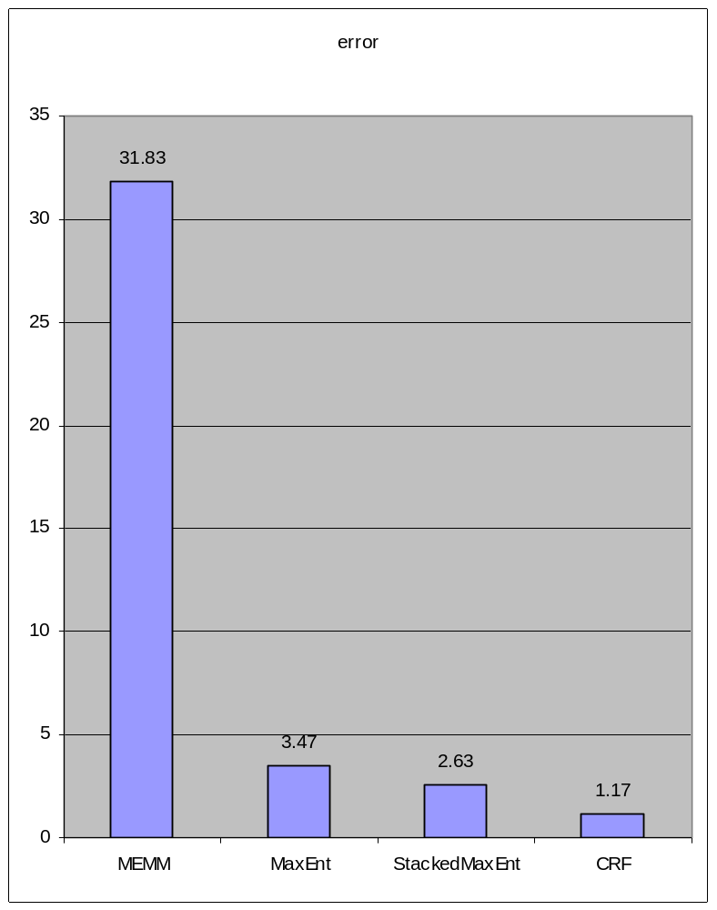
Chapter 3, in which a novel extension to MEMMs is proposed that will correct the performance problem
StackedMaxEnt (k=5) outperforms MEMMs and non-sequential MaxEnt, but not CRFs
StackedMaxEnt can also be easily extended....
  It’s easy (but expensive) to increase the depth of stacking
  It’s easy to increase the history size
  It’s easy to build features for “future” estimated Yi’s as well as “past” Yi’s.
  stacking can be applied to any other sequential learner

Slide 19
Chapter 3, in which a novel extension to MEMMs is proposed that will correct the performance problem
StackedMaxEnt can also be easily extended....
  It’s easy (but expensive) to increase the depth of stacking
  It’s cheap to increase the history size
  It’s easy to build features for “future” estimated Yi’s as well as “past” Yi’s.
  stacking can be applied to any other sequential learner
. . .
Y_{i-1}
Y_{i}
Y_{i+1}
. . .
^
^
^
Y_{i-1}
Y_{i}
Y_{i+1}
. . .
^
^
^
. . .
Y_{i-1}
^
Y_{i}
Y_{i+1}
. . .
^
^
. . .
. . .
X_{i-1}
X_{i}
X_{i+1}
. . .

Slide 20
Chapter 3, in which a novel extension to MEMMs is proposed that will correct the performance problem
StackedMaxEnt can also be easily extended....
  It’s easy (but expensive) to increase the depth of stacking
  It’s cheap to increase the history size
  It’s easy to build features for “future” estimated Yi’s as well as “past” Yi’s.
  stacking can be applied to any other sequential learner
Y_{i+1}
^
^
Y_{i}
Y_{i+1}
^
^
Y_{i-1}
^
Y_{i}
Y_{i+1}
. . .
^
^
. . .
. . .
X_{i-1}
X_{i}
X_{i+1}
. . .

Slide 21
Chapter 3, in which a novel extension to MEMMs is proposed that will correct the performance problem
StackedMaxEnt can also be easily extended....
  It’s cheap to increase the history size, and build features for “future” estimated Yi’s as well as “past” Yi’s.
Y_{i-2}
Y_{i-1}
Y_{i}
Y_{i+1}
Y_{i+1}
Y_{i-1}
Y_{i-2}
^
Y_{i}
Y_{i+1}
^
^
^
Y_{i+1}
^
X_{i-2}
X_{i-1}
X_{i}
X_{i+1}
X_{i+1}

Slide 22
Chapter 3, in which a novel extension to MEMMs is proposed that will correct the performance problem
StackedMaxEnt can also be easily extended....
  It’s easy (but expensive) to increase the depth of stacking
  It’s cheap to increase the history size
  It’s easy to build features for “future” estimated Yi’s as well as “past” Yi’s.
  stacking can be applied to any other sequential learner
CRF
Learn Pr(y_{i}|x_{i}) with MaxEnt and save the model as f(x)
Do k-fold cross-validation with MaxEnt, saving the cross-validated predictions the cross-validated predictions y’_{i}=f_{k}(x_{i})
Augment the original examples with the y’’s and compute history features: g(x,y’) → x’
Learn Pr(y_{i}|x’_{i}) with MaxEnt and save the model as f’(x’)
To classify: augment x with y’=f(x), and apply f to the resulting x’: i.e., return f’(g(x,f(x))
CRF
CRF

Slide 23
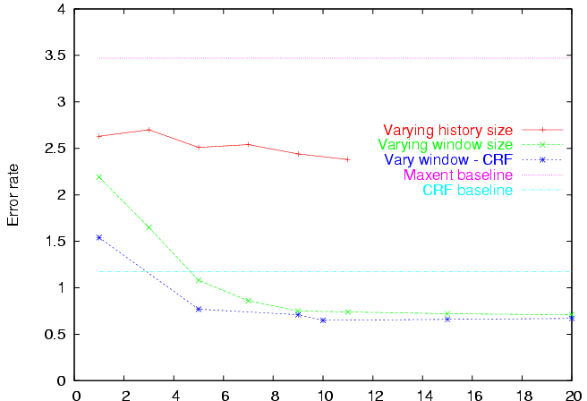
Chapter 3, in which a novel extension to MEMMs is proposed and several diverse variants of the extension are evaluated on signature-block finding....
non-sequential MaxEnt
baseline
Reduction in error rate for stacked-MaxEnt (s-ME) vs CRFs is 46%, which is statistically significant
stacked MaxEnt,
no “future”
With large windows stackedME is better than CRF baseline
CRF baseline
stacked MaxEnt,
stackedCRFs with
large history+future
window/history size

Slide 24
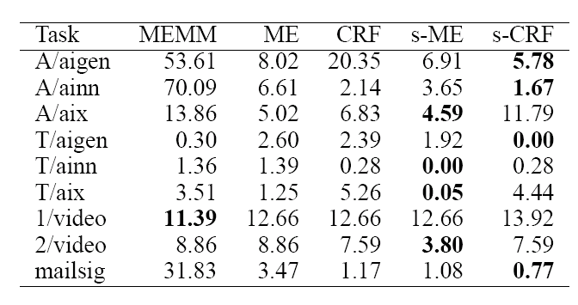
Chapter 4, in which the experiment above is repeated on a new domain, and then repeated again on yet another new domain.
+stacking
(w=k=5)
-stacking
newsgroup FAQ segmentation (2 labels x three newsgroups)
video segmentation

Slide 25
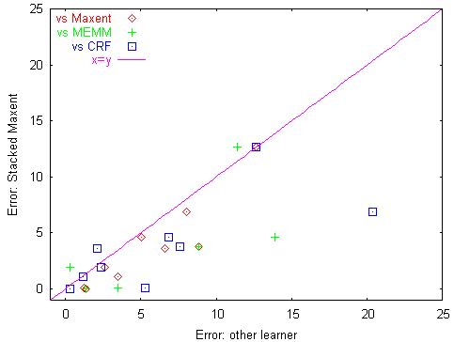
Chapter 4, in which the experiment above is repeated on a new domain, and then repeated again on yet another new domain.

Slide 26
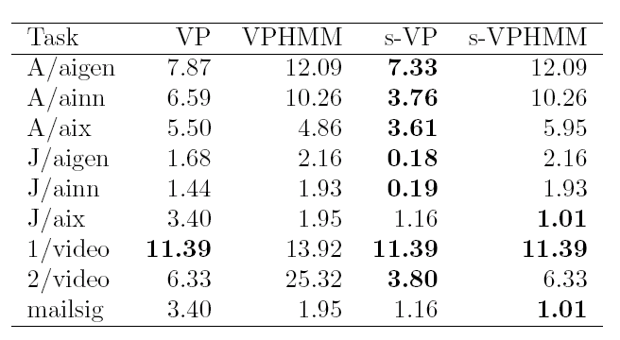
Chapter 5, in which all the experiments above were repeated for a second set of learners: the voted perceptron (VP), the voted-perceptron-trained HMM (VP-HMM), and their stacked versions.

Slide 27
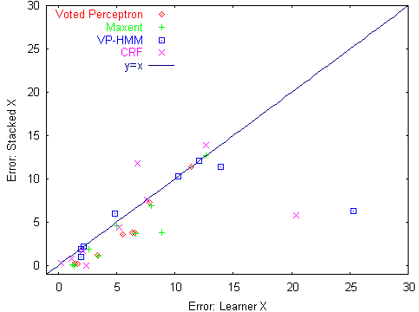
Chapter 5, in which all the experiments above were repeated for a second set of learners: the voted perceptron (VP), the voted-perceptron-trained HMM (VP-HMM), and their stacked versions.
Stacking usually* improves or leaves unchanged
MaxEnt (p>0.98)
VotedPerc (p>0.98)
VPHMM (p>0.98)
CRFs (p>0.92)
*on a randomly chosen problem using a 1-tailed sign test

Slide 28
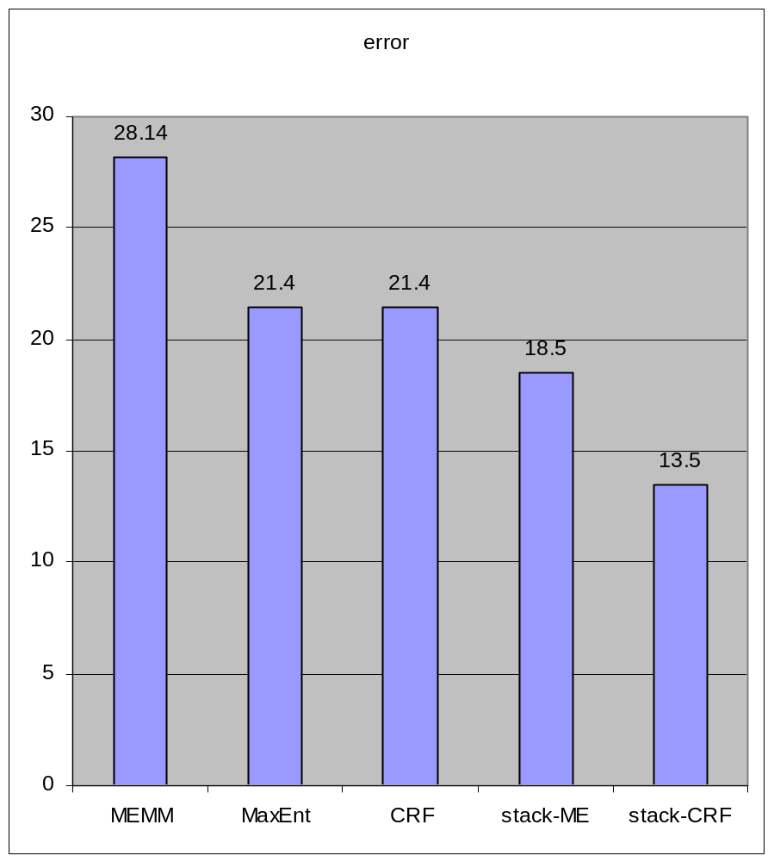
Chapter 4b, in which the experiment above is repeated again for yet one more new domain....
Classify pop songs as “happy” or “sad”
1-second long song “frames” inherit the mood of their containing song
Song frames are classified with a sequential classifier
Song mood is majority class of all its frames
52,188 frames from 201 songs, 130 features per frame, used k=5, w=25

Slide 29
Epilog: in which the speaker discusses certain issues of possible interest to the listener, who is now fully informed of the technical issues (or it may be, only better rested) and thus receptive to such commentary
Scope:
  we considered only segmentation tasks—sequences with long runs of identical labels—and 2-class problems.
  MEMM fails here.
Issue:
  learner is brittle w.r.t. assumptions
  training data for local model is assumed to be error-free, which is systematically wrong
Solution: sequential stacking
  model-free way to improve robustness
  stacked MaxEnt outperforms or ties CRFs on 8/10 tasks; stacked VP outperforms CRFs on 8/9 tasks.
  a meta-learning method applies to any base learner, and can also reduce error of CRF substantially
  experiments with non-segmentation problems (NER) had no large gains

Slide 30
Epilog: in which the speaker discusses certain issues of possible interest to the listener, who is now fully informed of the technical issues (or it may be, only better rested) and thus receptive to such commentary
... and in which finally, the speaker realizes that the structure of the epic romantic knowledge is ill-suited to talks of this ilk, and perhaps even the very medium of PowerPoint itself, but none-the-less persists with a final animation...
Sir W. Scott
R.I.P.

