Slide 1
MLD Journal Club
William Cohen
Roy Maxion

Slide 2
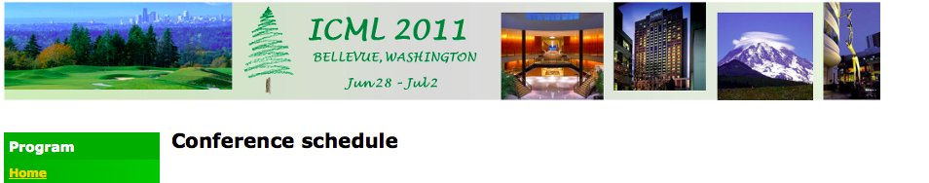

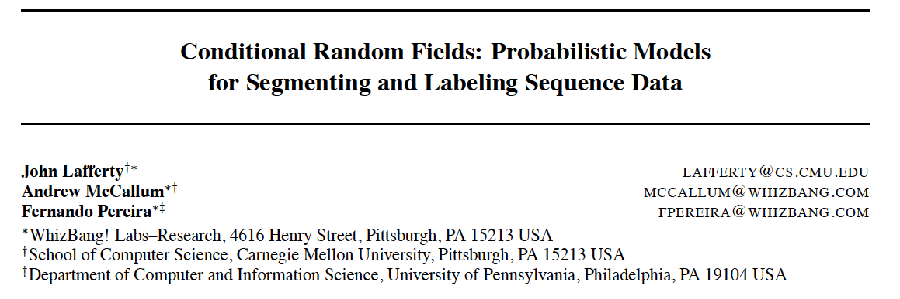
ICML 2001

Slide 3
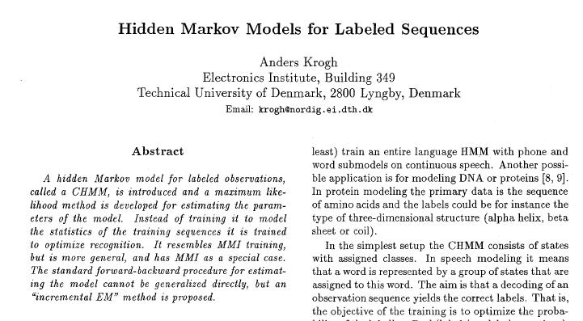
IEEE Pattern Recognition, 1994

Slide 4
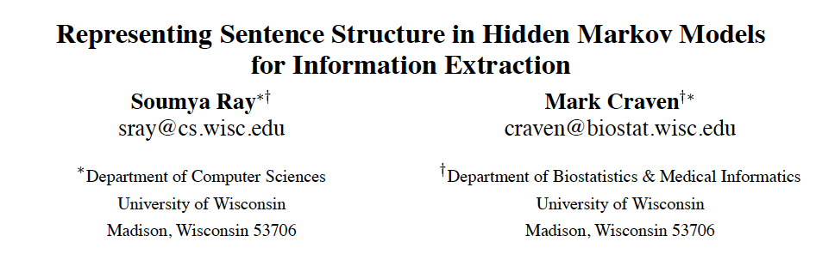
IJCAI 2001

Slide 5
Goals for the Journal Club
Scientists need to do much more than just “do science”
  Monitor progress in related research areas
  Critical thinking about other research
  Persuasively and clearly present their work and explain their ideas
    Publication
    Funding
    Students & teaching
    Scientific influence
You need these skills to succeed in science

Slide 6
Advice for Speakers
Be reflective:
  what makes a talk work/not work?
  speakers: number slides; listeners: take notes!
Be relaxed:
  don’t rush, don’t cram, don’t overwhelm
  take the time to make the visuals informative, attractive and easy to grasp
  deciding what not to say is important
Be concrete:
  examples are better than abstractions

Slide 7
Advice for Speakers
Be reasonable
  Don’t expect too much of the audience
  Think about what who you’re speaking to
  Ask yourself: how can I make this easier for the audience
Be honest
  About limitations of the work and/or your grasp of it
Practice!

Slide 8
Practice!
1st-time MLD PhDs:
  5min and 30min talk and (speaking skills)?
other MLD PhDs:
  5min talk and (speaking skills|30min|DAP)
MLD MS students: DAP
  (5min or 30min)?
Anyone else enrolled
  5min and 30min

