Slide 1
Scalable Statistical Relational Learning for NLP
William Wang
CMU → UCSB
William Cohen
CMU

Slide 2
Outline
Motivation/Background
  Logic
  Probability
  Combining logic and probabilities:
    Inference and semantics: MLNs
    Probabilistic DBs and the independent-tuple mechanism
Recent research
  ProPPR – a scalable probabilistic logic
  Structure learning
  Applications: knowledge-base completion
  Joint learning
Cutting-edge research
  ….

Slide 3
Motivation - 1
Surprisingly many tasks in NLP can be mostly solved with data, learning, and not much else:
  E.g., document classification, document retrieval
Some can’t
  e.g., semantic parse of sentences like “What professors from UCSD have founded startups that were sold to a big tech company based in the Bay Area?”
  We seem to need logic:
  { X : founded(X,Y), startupCompany(Y), acquiredBy(Y,Z), company(Z), big(Z), headquarters(Z,W), city(W), bayArea(W) }

Slide 4
Motivation
Surprisingly many tasks in NLP can be mostly solved with data, learning, and not much else:
  E.g., document classification, document retrieval
Some can’t
  e.g., semantic parse of sentences like “What professors from UCSD have founded startups that were sold to a big tech company based in the Bay Area?”
  We seem to need logic as well as uncertainty:
  { X : founded(X,Y), startupCompany(Y), acquiredBy(Y,Z), company(Z), big(Z), headquarters(Z,W), city(W), bayArea(W) }
Logic and uncertainty have long histories and mostly don’t play well together

Slide 5
Motivation – 2
The results of NLP are often expressible in logic
The results of NLP are often uncertain
Logic and uncertainty have long histories and mostly don’t play well together

Slide 6
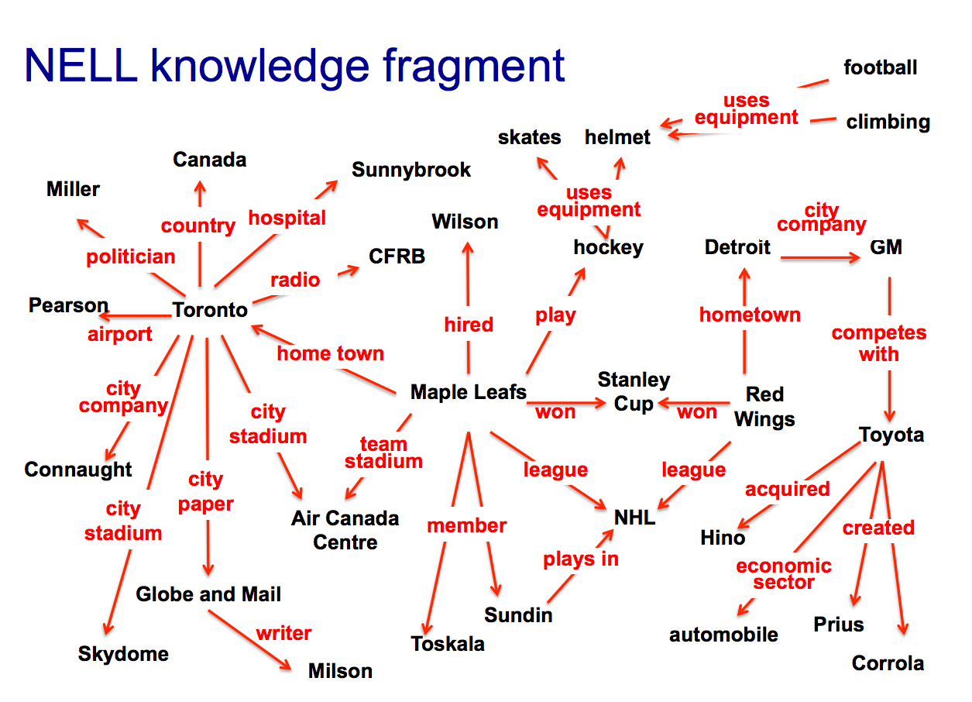

Slide 7
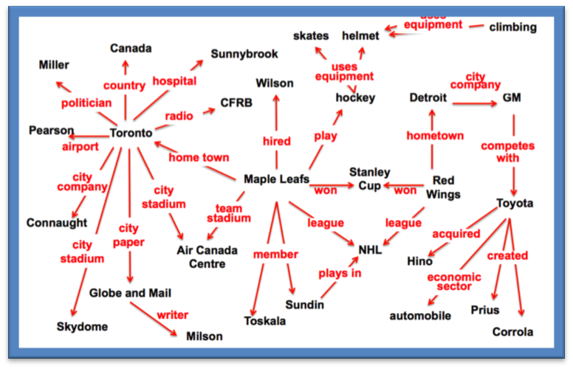
KR & Reasoning
What if the DB/KB or inference rules are imperfect?
Inference Methods, Inference Rules
Queries
…
Answers
Challenges for KR:
Robustness: noise, incompleteness, ambiguity (“Sunnybrook”), statistical information (“foundInRoom(bathtub, bathroom)”), …
Complex queries: “which Canadian hockey teams have won the Stanley Cup?”
Learning: how to acquire and maintain knowledge and inference rules as well as how to use it
Current state of the art
“Expressive, probabilistic, efficient: pick any two”

Slide 8
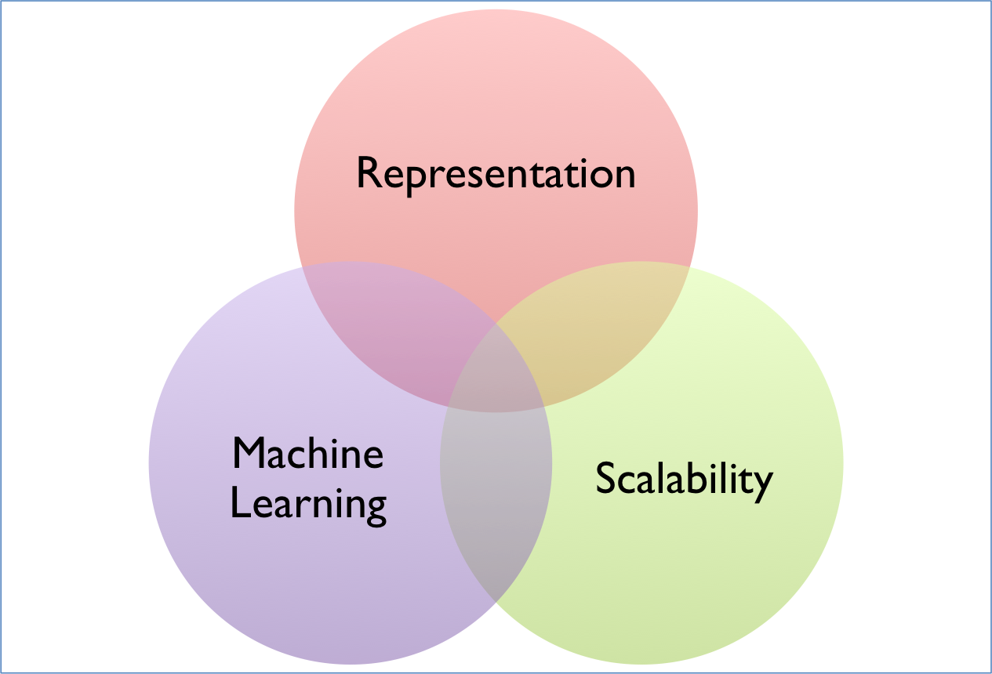
Three Areas of Data Science
Probabilistic logics,
Representation learning
Abstract Machines, Binarization
Scalable Statistical Relational Learning
Scalable Learning

Slide 9
Outline
Motivation/Background
  Logic
  Probability
  Combining logic and probabilities:
    Inference and semantics: MLNs
    Probabilistic DBs and the independent-tuple mechanism
Recent research
  ProPPR – a scalable probabilistic logic
  Structure learning
  Applications: knowledge-base completion
  Joint learning
Cutting-edge research
  ….

Slide 10
Background: Logic Programs
A program with one definite clause (Horn clauses):
  grandparent(X,Y) :- parent(X,Z),parent(Z,Y)
Logical variables: X,Y,Z
Constant symbols: bob, alice, …
We’ll consider two types of clauses:
  Horn clauses A:-B1,…,Bk with no constants
  Unit clauses A:- with no variables (facts):
    parent(alice,bob):- or parent(alice,bob)
head
“neck”
body
Intensional definition,
rules
Extensional definition, database
H/T: “Probabilistic Logic Programming, De Raedt and Kersting

Slide 11
Background: Logic Programs
A program with one definite clause:
  grandparent(X,Y) :- parent(X,Z),parent(Z,Y)
Logical variables: X,Y,Z
Constant symbols: bob, alice, …
Predicates: grandparent, parent
Alphabet: set of possible predicates and constants
Atomic formulae: parent(X,Y), parent(alice,bob)
Ground atomic formulae: parent(alice,bob), …
H/T: “Probabilistic Logic Programming, De Raedt and Kersting

Slide 12
Background: Logic Programs
The set of all ground atomic formulae (consistent with a fixed alphabet) is the Herbrand base of a program: {parent(alice,alice),parent(alice,bob),…,parent(zeke,zeke),grandparent(alice,alice),…}
The interpretation of a program is a subset of the Herbrand base.
An interpretation M is a model of a program if
  For any A:-B1,…,Bk in the program and any mapping Theta from the variables in A,B1,..,Bk to constants:
    If Theta(B1) in M and … and Theta(Bk) in M then Theta(A) in M (i.e., M deductively closed)
A program defines a unique least Herbrand model
H/T: “Probabilistic Logic Programming, De Raedt and Kersting

Slide 13
Background: Logic Programs
A program defines a unique least Herbrand model
Example program:
  grandparent(X,Y):-parent(X,Z),parent(Z,Y).
  parent(alice,bob). parent(bob,chip). parent(bob,dana).
The least Herbrand model also includes grandparent(alice,dana) and grandparent(alice,chip).
Finding the least Herbrand model: theorem proving…
Usually we case about answering queries: What are values of W: grandparent(alice,W) ?
H/T: “Probabilistic Logic Programming, De Raedt and Kersting

Slide 14
Motivation
Inference Methods, Inference Rules
Queries
{T : query(T) } ?
Answers
Challenges for KR:
Robustness: noise, incompleteness, ambiguity (“Sunnybrook”), statistical information (“foundInRoom(bathtub, bathroom)”), …
Complex queries: “which Canadian hockey teams have won the Stanley Cup?”
Learning: how to acquire and maintain knowledge and inference rules as well as how to use it
query(T):- play(T,hockey), hometown(T,C), country(C,canada)

Slide 15
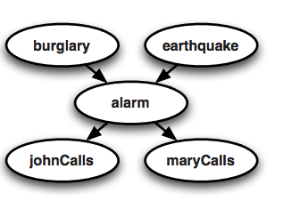
Background: Probabilistic Inference
Random variable: burglary, earthquake, …
Usually denote with upper-case letters: B,E,A,J,M
Joint distribution: Pr(B,E,A,J,M)
B | E | A | J | M | prob
T | T | T | T | T | 0.00001
F | T | T | T | T | 0.03723
…
H/T: “Probabilistic Logic Programming, De Raedt and Kersting

Slide 16
Background: Bayes networks
Random variable: B,E,A,J,M
Joint distribution: Pr(B,E,A,J,M)
Directed graphical models give one way of defining a compact model of the joint distribution:
Queries: Pr(A=t|J=t,M=f) ?
A | J | Prob(J|A)
F | F | 0.95
F | T | 0.05
T | F | 0.25
T | T | 0.75
A | M | Prob(J|A)
F | F | 0.80
…
H/T: “Probabilistic Logic Programming, De Raedt and Kersting

Slide 17
Background
Random variable: B,E,A,J,M
Joint distribution: Pr(B,E,A,J,M)
Directed graphical models give one way of defining a compact model of the joint distribution:
Queries: Pr(A=t|J=t,M=f) ?
A | J | Prob(J|A)
F | F | 0.95
F | T | 0.05
T | F | 0.25
T | T | 0.75
H/T: “Probabilistic Logic Programming, De Raedt and Kersting

Slide 18
Background: Markov networks
Random variable: B,E,A,J,M
Joint distribution: Pr(B,E,A,J,M)
Undirected graphical models give another way of defining a compact model of the joint distribution…via potential functions.
ϕ(A=a,J=j) is a scalar measuring the “compatibility” of A=a J=j
x
x
x
x
A | J | ϕ(a,j)
F | F | 20
F | T | 1
T | F | 0.1
T | T | 0.4

Slide 19
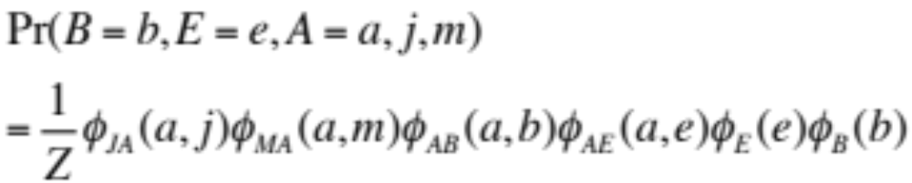
Background
x
x
x
x
…
…
clique potential
A | J | ϕ(a,j)
F | F | 20
F | T | 1
T | F | 0.1
T | T | 0.4
ϕ(A=a,J=j) is a scalar measuring the “compatibility” of A=a J=j

Slide 20
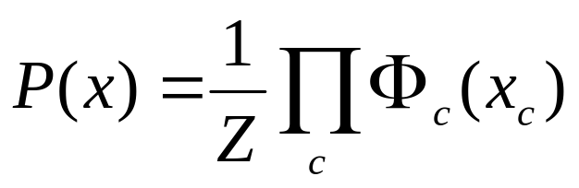
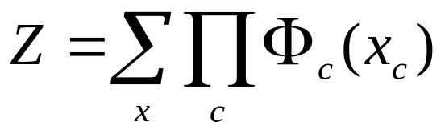
Another example
Undirected graphical models
[h/t Pedro Domingos]
Smoking
Cancer
Asthma
Cough
x = vector
Smoking | Cancer | Ф(S,C)
False | False | 4.5
False | True | 4.5
True | False | 2.7
True | True | 4.5
x_{c} = short vector
H/T: Pedro Domingos

Slide 21
Motivation
In space of “flat” propositions corresponding random variables
Inference Methods, Inference Rules
Queries
Answers
Challenges for KR:
Robustness: noise, incompleteness, ambiguity (“Sunnybrook”), statistical information (“foundInRoom(bathtub, bathroom)”), …
Complex queries: “which Canadian hockey teams have won the Stanley Cup?”
Learning: how to acquire and maintain knowledge and inference rules as well as how to use it

Slide 22
Outline
Motivation/Background
  Logic
  Probability
  Combining logic and probabilities:
    Inference and semantics: MLNs
    Probabilistic DBs and the independent-tuple mechanism
Recent research
  ProPPR – a scalable probabilistic logic
  Structure learning
  Applications: knowledge-base completion
  Joint learning
Cutting-edge research

Slide 23
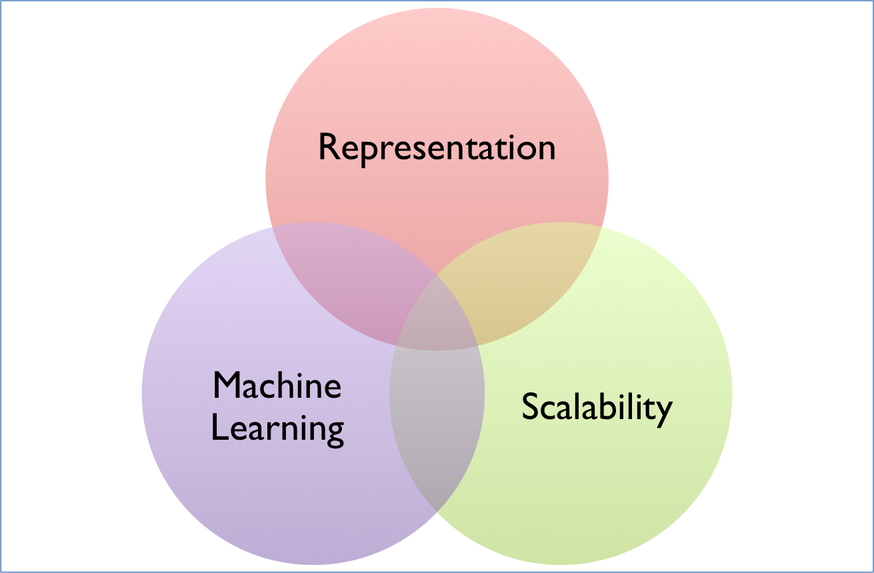
Three Areas of Data Science
Probabilistic logics,
Representation learning
Abstract Machines, Binarization
MLNs
Scalable Learning

Slide 24
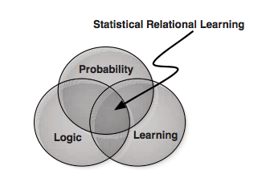
Background
???
H/T: “Probabilistic Logic Programming, De Raedt and Kersting

Slide 25
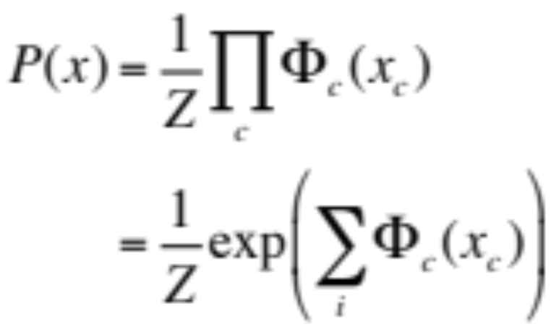
Another example
Undirected graphical models
[h/t Pedro Domingos]
Smoking
Cancer
Asthma
Cough
x = vector
Smoking | Cancer | Ф(S,C)
False | False | 4.5
False | True | 4.5
True | False | 2.7
True | True | 4.5

Slide 26
Another example
Undirected graphical models
[h/t Pedro Domingos]
Smoking
Cancer
Asthma
Cough
x = vector
Smoking | Cancer | Ф(S,C)
False | False | 1.0
False | True | 1.0
True | False | 0.1
True | True | 1.0
A soft constraint that smoking ➔ cancer

Slide 27
Markov Logic: Intuition
[Domingos et al]
A logical KB is a set of hard constraints
on the set of possible worlds constrained to be deductively closed
Let’s make closure a soft constraints:
When a world is not deductively closed,
It becomes less probable
Give each rule a weight which is a reward for satisfying it: (Higher weight ⇒ Stronger constraint)

Slide 28
Markov Logic: Definition
A Markov Logic Network (MLN) is a set of pairs (F, w) where
  F is a formula in first-order logic
  w is a real number
Together with a set of constants,
it defines a Markov network with
  One node for each grounding of each predicate in the MLN – each element of the Herbrand base
  One feature for each grounding of each formula F in the MLN, with the corresponding weight w
H/T: Pedro Domingos

Slide 29
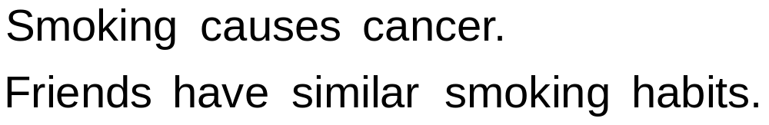
Example: Friends & Smokers
H/T: Pedro Domingos

Slide 30
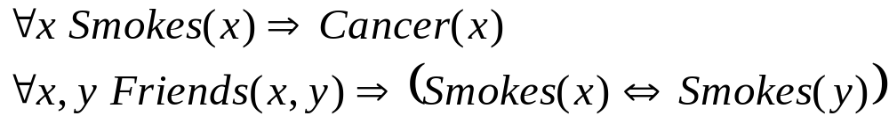
Example: Friends & Smokers
H/T: Pedro Domingos

Slide 31

Example: Friends & Smokers
H/T: Pedro Domingos

Slide 32
Example: Friends & Smokers
Two constants: Anna (A) and Bob (B)
H/T: Pedro Domingos

Slide 33
Example: Friends & Smokers
Two constants: Anna (A) and Bob (B)
Smokes(A)
Smokes(B)
Cancer(A)
Cancer(B)
H/T: Pedro Domingos

Slide 34
Example: Friends & Smokers
Two constants: Anna (A) and Bob (B)
Friends(A,B)
Friends(A,A)
Smokes(A)
Smokes(B)
Friends(B,B)
Cancer(A)
Cancer(B)
Friends(B,A)
H/T: Pedro Domingos

Slide 35
Example: Friends & Smokers
Two constants: Anna (A) and Bob (B)
Friends(A,B)
Friends(A,A)
Smokes(A)
Smokes(B)
Friends(B,B)
Cancer(A)
Cancer(B)
Friends(B,A)
H/T: Pedro Domingos

Slide 36
Example: Friends & Smokers
Two constants: Anna (A) and Bob (B)
Friends(A,B)
Friends(A,A)
Smokes(A)
Smokes(B)
Friends(B,B)
Cancer(A)
Cancer(B)
Friends(B,A)
H/T: Pedro Domingos

Slide 37
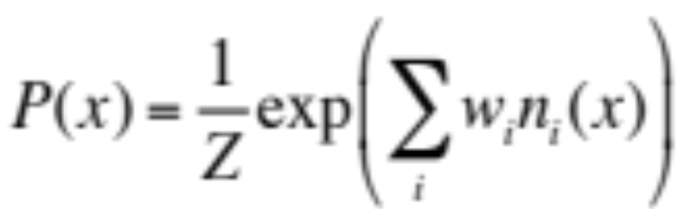

Markov Logic Networks
MLN is template for ground Markov nets
Probability of a world x:
Weight of formula i
No. of true groundings of formula i in x
Recall for ordinary Markov net
H/T: Pedro Domingos

Slide 38
MLNs generalize many statistical models ☺
Special cases:
  Markov networks
  Bayesian networks
  Log-linear models
  Exponential models
  Max. entropy models
  Gibbs distributions
  Boltzmann machines
  Logistic regression
  Hidden Markov models
  Conditional random fields
Obtained by making all predicates zero-arity
Markov logic allows objects to be interdependent
(non-i.i.d.)
H/T: Pedro Domingos

Slide 39
MLNs generalize logic programs ☺
Subsets of Herbrand base ~ domain of joint distribution
Interpretation ~ element of the joint
Consistency with all clauses A:-B1,…,Bk , i.e. “model of program” ~ compatibility with program as determined by clique potentials
Reaches logic in the limit when potentials are infinite (sort of)
H/T: Pedro Domingos

Slide 40
MLNs are expensive ☹
Inference done by explicitly building a ground MLN
  Herbrand base is huge for reasonable programs: It grows faster than the size of the DB of facts
  You’d like to able to use a huge DB—NELL is O(10M)
After that inference on an arbitrary MLN is expensive: #P-complete
  It’s not obvious how to restrict the template so the MLNs will be tractable
  Possible solution: PSL (Getoor et al), which uses hinge-loss leading to a convex optimization task

Slide 41
What are the alternatives?
There are many probabilistic LPs:
  Compile to other 0th-order formats: (Bayesian LPs – replace undirected model with directed one),
  Impose a distribution over proofs, not interpretations (Probabilistic Constraint LPs, Stochastic LPs, …): requires generating all proofs to answer queries, also a large space
Limited relational extensions to 0th-order models (PRMs, RDTs,,…)
Probabilistic programming languages (Church, …)
  Imperative languages for defining complex probabilistic models (Related LP work: PRISM)
Probabilistic Deductive Databases

Slide 42
Recap: Logic Programs
A program with one definite clause (Horn clauses):
  grandparent(X,Y) :- parent(X,Z),parent(Z,Y)
Logical variables: X,Y,Z
Constant symbols: bob, alice, …
We’ll consider two types of clauses:
  Horn clauses A:-B1,…,Bk with no constants
  Unit clauses A:- with no variables (facts):
    parent(alice,bob):- or parent(alice,bob)
head
“neck”
body
Intensional definition,
rules
Extensional definition, database
H/T: “Probabilistic Logic Programming, De Raedt and Kersting

Slide 43
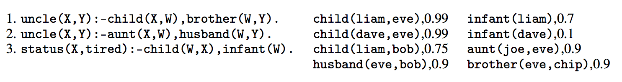
A PrDDB
Actually all constants are only in the database
Confidences/numbers are associated with DB facts, not rules

Slide 44
A PrDDB
Old trick: (David Poole?) If you want to weight a rule you can introduce a rule-specific fact….
r3. status(X,tired) :- child(W,X), infant(W), weighted(r3).
r3. status(X,tired) :- child(W,X), infant(W) {r3}.
weighted(r3),0.88
So learning rule weights is a special case of learning weights for selected DB facts (and vice-versa)

Slide 45
Simplest Semantics for a PrDDB
Pick a hard database I from some distribution D over databases. The tuple-independence models says: just toss a biased coin for each “soft” fact.
Compute the ordinary deductive closure (the least model) of I .
Define Pr( fact f ) = Pr( closure(I ) contains fact f ) Pr(I | D)

Slide 46
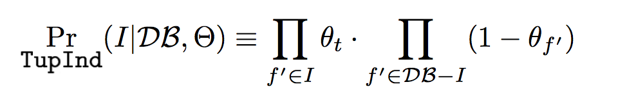

Simplest Semantics for a PrDDB
the weight associated with fact f’

Slide 47
Implementing the independent tuple model
An explanation of a fact f is some minimal subset of the DB facts which allows you to conclude f using the theory.
You can generate all possible explanations Ex(f) of fact f using a theorem prover
Ex(status(eve,tired)) = { { child(liam,eve),infant(liam) } ,
{ child(dave,eve),infant(dave) } }

Slide 48
Implementing the independent tuple model
An explanation of a fact f is some minimal subset of the DB facts which allows you to conclude f using the theory.
You can generate all possible explanations Ex(f) of fact f using a theorem prover
Ex (status(bob,tired)) = { { child(liam,bob),infant(liam) } }

Slide 49

Implementing the independent tuple model
An explanation of a fact f is some minimal subset of the DB facts which allows you to conclude f using the theory.
You can generate all possible explanations using a theorem prover
The tuple-independence score for a fact, Pr(f), depends only on the explanations!
Key step:

Slide 50
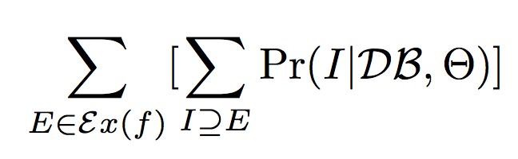
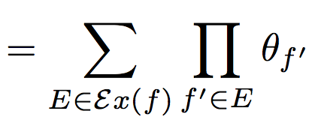
Implementing the independent tuple model
If there’s just one explanation we’re home free….
If there are many explanations we can compute
by adding up this quantity for each explanation E…
…except, of course that this double-counts interpretations that are supersets of two or more explanations ….
Notes:
TO DO: insert the l_x0013_atex..

Slide 51
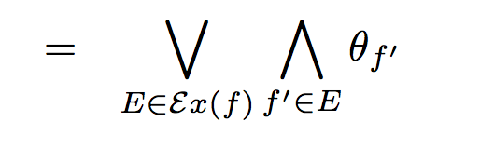
Implementing the independent tuple model
If there’s just one explanation we’re home free….
If there are many explanations we can compute
I
This is not easy: Basically the counting gets hard (#P-hard) when explanations overlap.
This makes sense: we’re looking at overlapping conjunctions of independent events.
Notes:
TO DO: insert the l_x0013_atex..

Slide 52
Implementing the independent tuple model
An explanation of a fact f is some minimal subset of the DB facts which allows you to conclude f using the theory.
You can generate all possible explanations using a theorem prover
Ex (status(bob,tired)) = { { child(liam,bob),infant(liam) } }

Slide 53
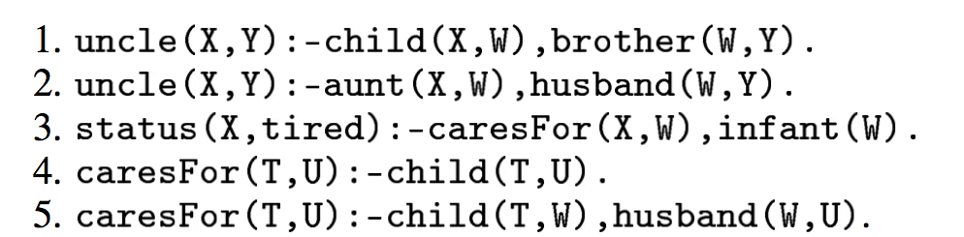
Implementing the independent tuple model
Ex (status(bob,tired)) = {
{ child(dave,eve), husband(eve,bob), infant(dave) },
{ child(liam,bob), infant(liam) },
{ child(liam,eve), husband(eve,bob), infant(liam) } }

Slide 54
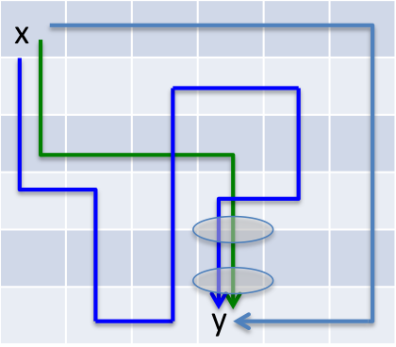
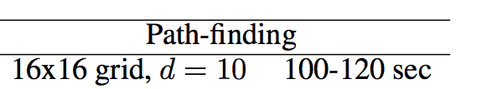
A torture test for the independent tuple model
[de Raedt et al]
Each edge is a DB fact e(cell1,cell2)
Prove: pathBetween(x,y)
Proofs reuse the same DB tuples
Keeping track of all the proofs and tuple-reuse is expensive….
ProbLog2

Slide 55
Beyond the tuple-independence model?
There are smart ways to speed up the weighted-proof counting you need to do…
But it’s still hard…and the input can be huge
There’s a lot of work on extending the independent tuple mode
  E.g., introducing multinomial random variables to chose between related facts like: age(dave,infant), age(dave,toddler), … age(dave,adult),
  E.g., using MLNs to characterize the dependencies between facts in the DB
There’s not much work on cheaper models…

Slide 56
What are the alternatives?
There are many probabilistic LPs:
  Compile to other 0th-order formats: (Bayesian LPs – replace undirected model with directed one),
  Impose a distribution over proofs, not interpretations (Probabilistic Constraint LPs, Stochastic LPs, …):
    requires generating all proofs to answer queries, also a large space
    …but at least scoring in that space is efficient

Slide 57
Outline
Motivation/Background
  Logic
  Probability
  Combining logic and probabilities:
    Inference and semantics: MLNs
    Probabilistic DBs and the independent-tuple mechanism
Recent research
  ProPPR – a scalable probabilistic logic
  Structure learning
  Applications: knowledge-base completion
  Joint learning
Cutting-edge research
  ….

Slide 58
Key References for Part 1
Probabilistic logics that are converted to 0-th order models:
  u et al, Probabilistic Databases, Morgan Claypool 2011
  Fierens, … de Raedt, Inference and Learning in Probabilistic Logic Programs using Weighted Boolean Formulas, to appear (ProbLog2 paper)
  Sen, …Getoor, PrDB: Managing and Exploiting Rich Correlations in Probabilistic DBs, VLDB 18(6) 2006
Stochastic Logic Programs: Cussens, Parameter Estimation in SLPs, MLJ 44(3), 2001
  Kimmig,…,Getoor: Lifted graphical models: a survey, MLJ 99(1), 1999
  MLNs: Markov logic networks, MLJ 62(1-2), 2006. Also a book in the Morgan Claypool Synthesis series.
  PSL: Probabilistic similarity logic, Brocheler, …,Getoor, UAI 2010
Independent tuple model and extensions:
  Poole, The independent choice logic for modelling multiple agents under uncertainty, AIJ 94(1), 1997

